Slide 1
Fracture energy variations of rocks: a mechanical investigation
Antoine Guggisberg¹,
Mathias Lebihain²,
Marie Violay¹
¹École polytechnique fédérale de Lausanne, LEMR, Lausanne, Switzerland
²École des Ponts ParisTech, Laboratoire Navier, Paris, France
antoine.guggisberg@epfl.ch

Slide 2
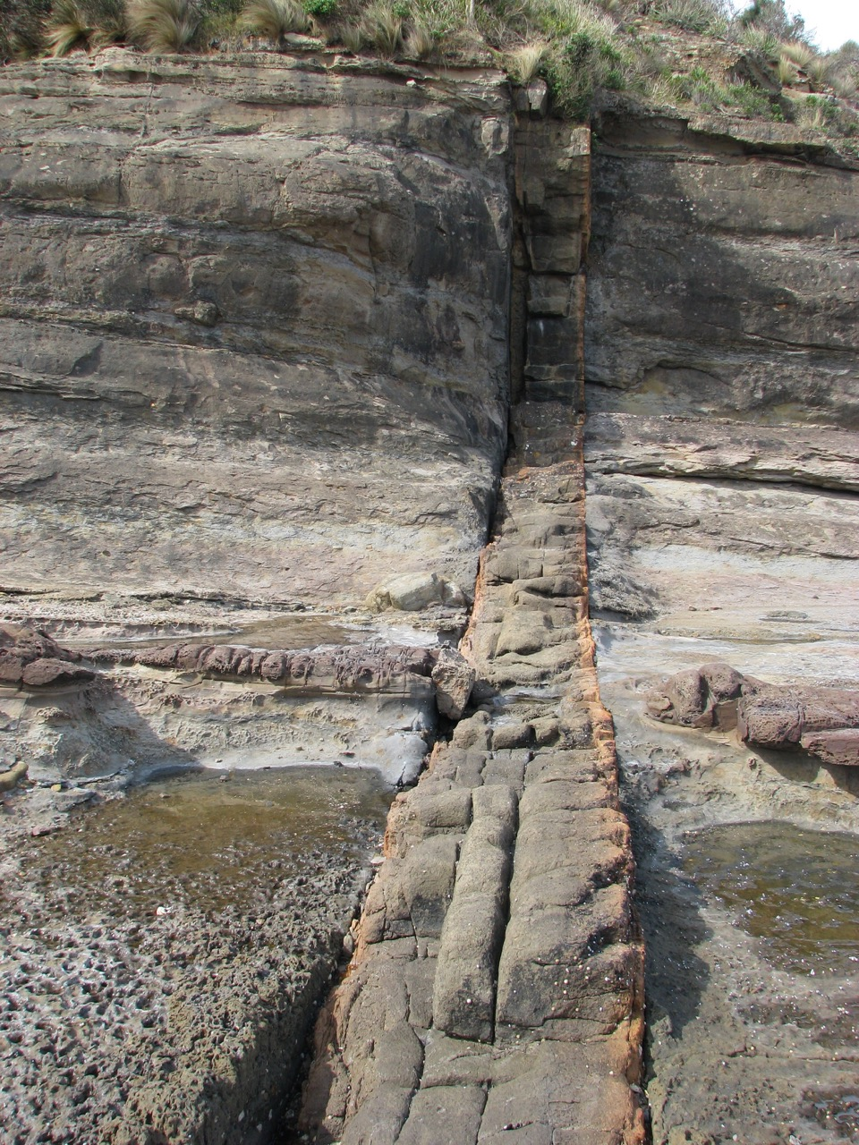
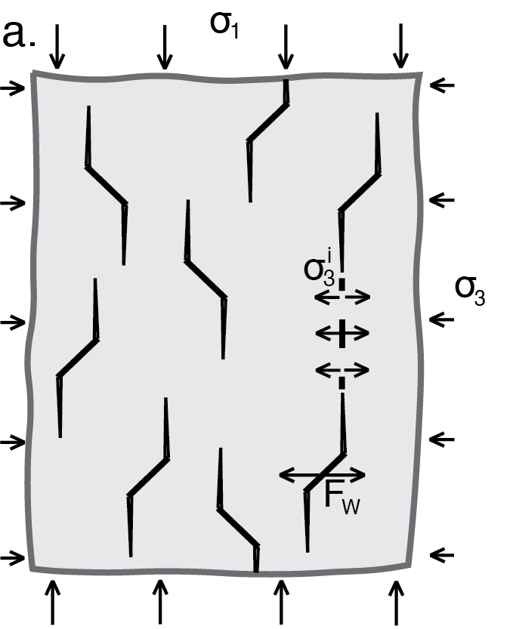
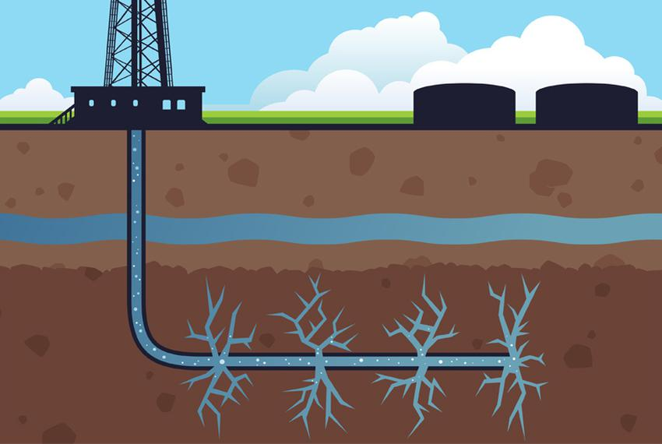
Introduction – Importance of fracture energy
(Wing crack) models
Hydraulic fracturing (Texas Tribune)
Dike propagation (geoetc.com)
All controlled by the fracture energy!
Notes:
My presentation is about fracture energy variation of rocks
Before you fall asleep, let me introduce why it’s absolutely relevant to our field:
Rocks mechanics are controlled by faults and cracks, and fracture mechanics only has 1 parameter: the fracture toughness
It controls wing crack models, hydraulic fracturing, dike propagation, etc.

Slide 3

Introduction – Fracture energy variations
Fracture energy: $G_{C}=K_{IC}^{2}/E′$
  "The material property describing the energy required to open new cracks"
Dissipative micro-mechanisms vary with environmental parameters
  Inducing fracture energy variations
Necessity of controlled experiments in the simplest set-up
  Mode I
  Observing micro-mechanisms + fracture energy variations
Notes:
However, it has one issue: it has important variations
But first, the definition. The fracture energy is the amount of energy required to open crack. It’s directly linked to the fracture toughness
At a macroscopic scale, it works great. But at a microscopic scale on the crack tip, there is not a single straight crack, there is a myriad of dissipative micro-mechanisms
For rocks, we observe, micro-cracking in a diffuse area, a plastic zone, and briding.
The problem is that they can vary with environmental parameters, which induce fracture energy variations
Our goal is study experimentally how they influence rupture in the simplest set-up: tensile crack and by observing variations and micro-mechanisms

Slide 4
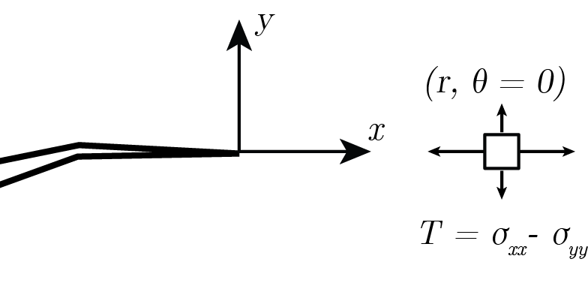
Introduction – Effect of T-stress (mode I)
T-stress is a proxy of confining pressure
T-stress constrains the crack tip
  crack path stabilization, less crack branching, more localization
  Increases fracture energy
Notes:
Among the environmental parameters, we study T-stress.
In short, it’s a proxy of pressure that constrains the crack tip
It stabilizes crack path, increases localization and reduces crack branching, so it increases fracture energy
As observed by Aliha, fracture toughness is directly correlated with T-stress
However, these tests are unreliable because they do not dissociate environmental effects
FIELD STRESS ORIENTATON, more about geometrz

Slide 5
Introduction – Effect of T-stress (mode I)
T-stress is a proxy of confining pressure
T-stress constrains the crack tip
  crack path stabilization, less crack branching, more localization
  Increases fracture energy
Modified from Aliha et al. 2017
Notes:
Among the environmental parameters, we study T-stress.
In short, it’s a proxy of pressure that constrains the crack tip
It stabilizes crack path, increases localization and reduces crack branching, so it increases fracture energy
As observed by Aliha, fracture toughness is directly correlated with T-stress
However, these tests are unreliable because they do not dissociate environmental effects
FIELD STRESS ORIENTATON, more about geometrz

Slide 6
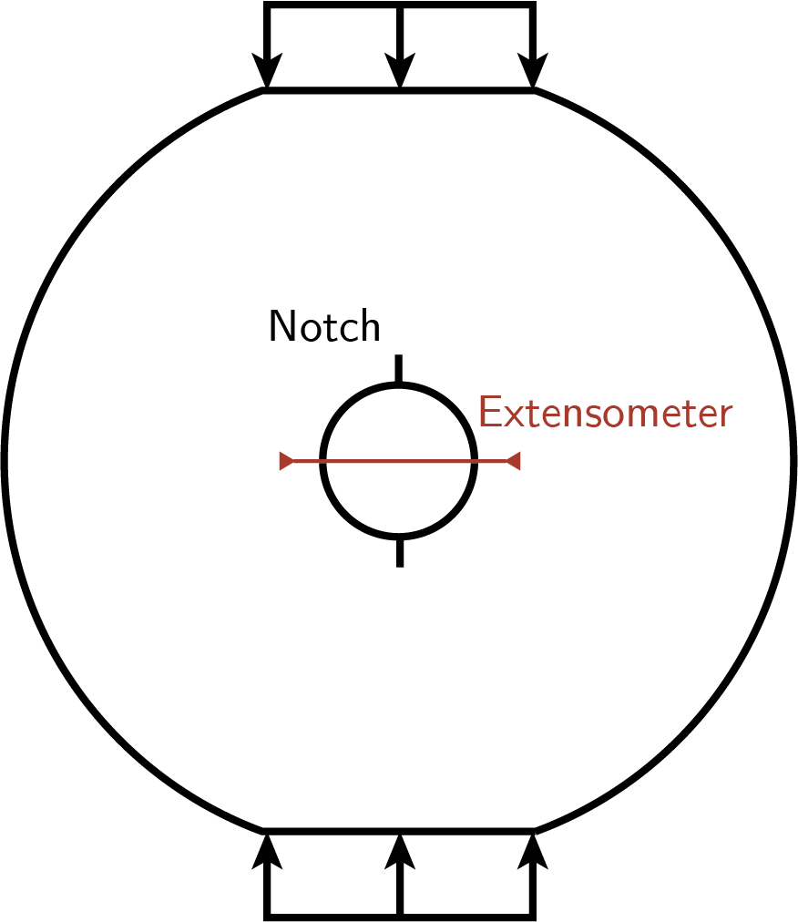
Experiments –
Modified Ring Test
Stable test, independent of size effects
Notes:
That’s why we came out with a modified ring test
That is stable, size independent, and coupled with a compliance method, we can monitor continuously the crack length, the fracture toughness and the T-stress

Slide 7
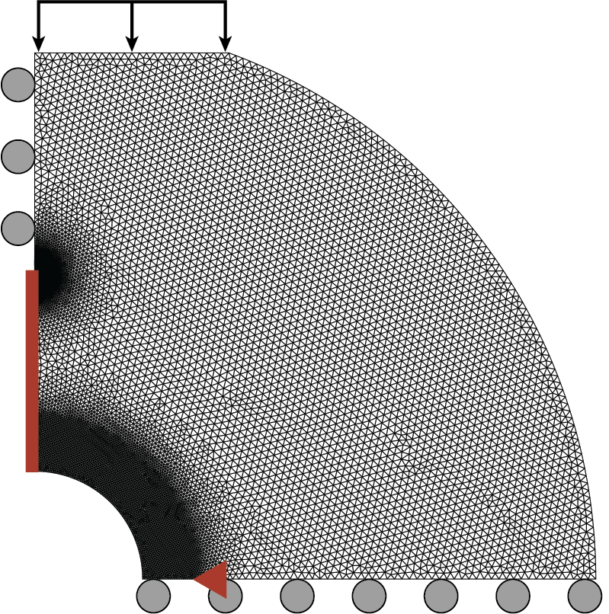



Experiments –
Modified Ring Test
Stable test, independent of size effects
compliance-based method for continuous monitoring of:
  crack length $ℓ$
  $G_{C}$
  $T$
$$u$$
$$ℓ$$
Notes:
That’s why we came out with a modified ring test
That is stable, size independent, and coupled with a compliance method obtained in FEM, we can monitor continuously the crack length, the fracture energy and the T-stress

Slide 8
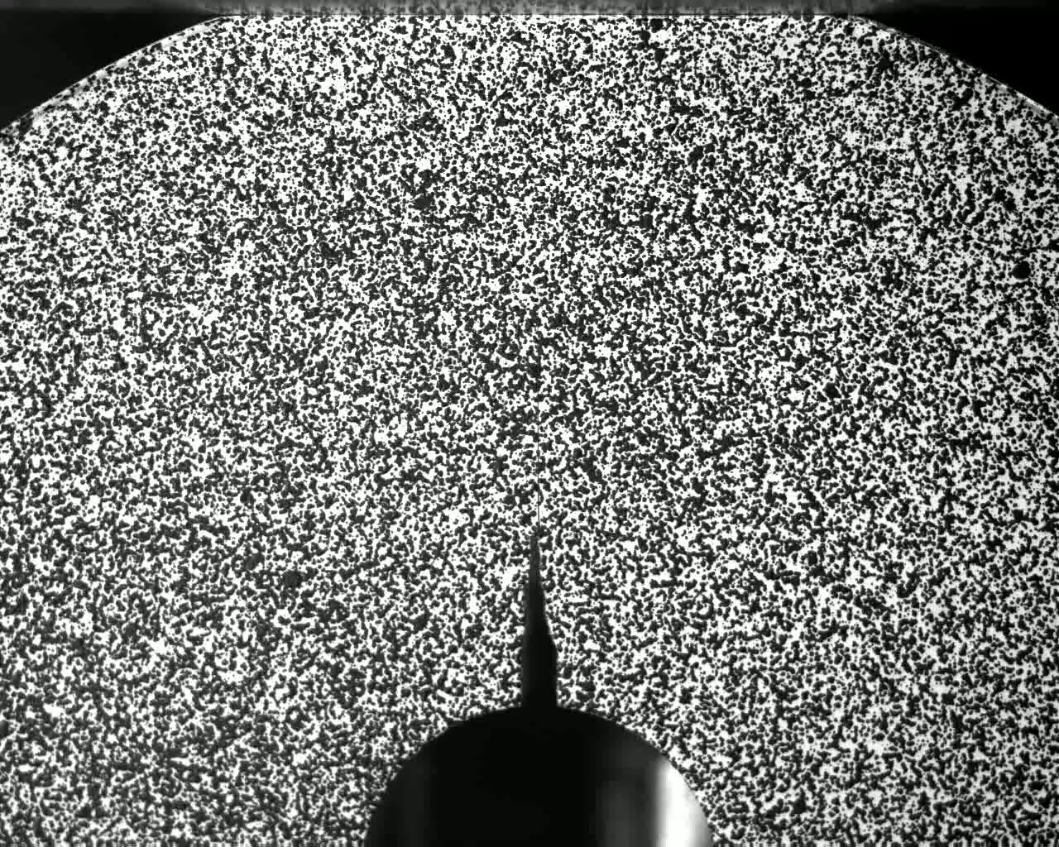

Experiments –
Modified Ring Test
Stable test, independent of size effects
compliance-based method for continuous monitoring of:
  crack length $ℓ$
  $G_{C}$
  $T$
Notes:
That’s why we came out with a modified ring test
That is stable, size independent, and coupled with a compliance method, we can monitor continuously the crack length, the fracture toughness and the T-stress

Slide 9
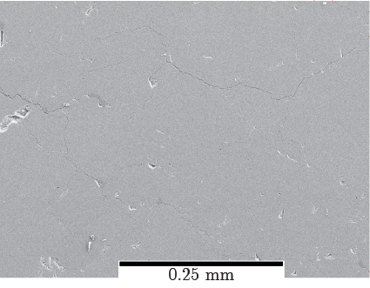
Carrara marble –
SEM microstructure investigation
Presumed crack tip
Notes:
To look at micromechanisms, we realized thin sections on the broken sample - as a first step
On this SEM image, the crack tip, where it’s supposed to end.

Slide 10
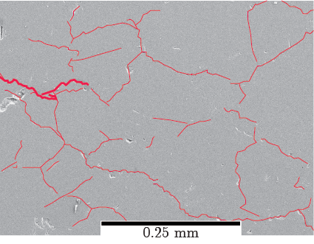
Carrara marble –
SEM microstructure investigation
Presumed crack tip
Diffuse micro-cracking zone
Interpreted as a millimetric ‘process zone’
Notes:
I identified the microcracks
And here, you can clearly distinguish a diffuse micro-cracking zone at the tip. These open microcracks are only present at the tip
Its size is difficult to clearly delimit as there is no clear boundary. but it is definitely millimetric

Slide 11
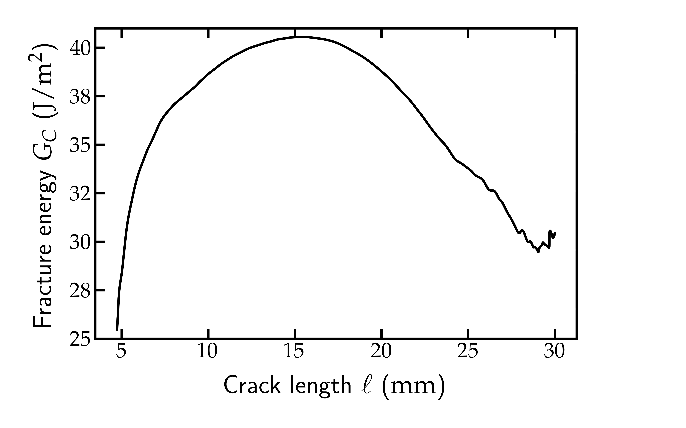
Carrara marble – effect of T-stress
Notes:
On carrara marble, we could obtain these curves
It shows that fracture energy varies of factor 2 during one experiment
Because T-stress varies accordingly
There is a shift between fracture energy and T-stress, it can be understood as a rough estimation of a process zone of 3-4 mm

Slide 12
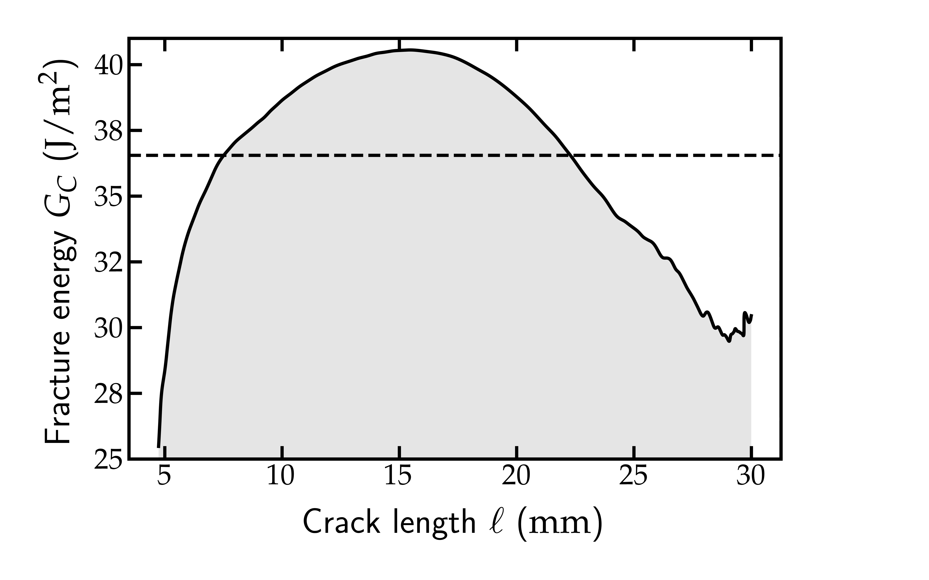

Carrara marble – effect of T-stress
Normal evaluation of fracture energy: $G_{C}=37 (J/m^{2}$)
$$G_{C}$$
Notes:
On carrara marble, we could obtain these curves
It shows that fracture energy varies of factor 2 during one experiment
Because T-stress varies accordingly
There is a shift between fracture energy and T-stress, it can be understood as a rough estimation of a process zone of 3-4 mm

Slide 13
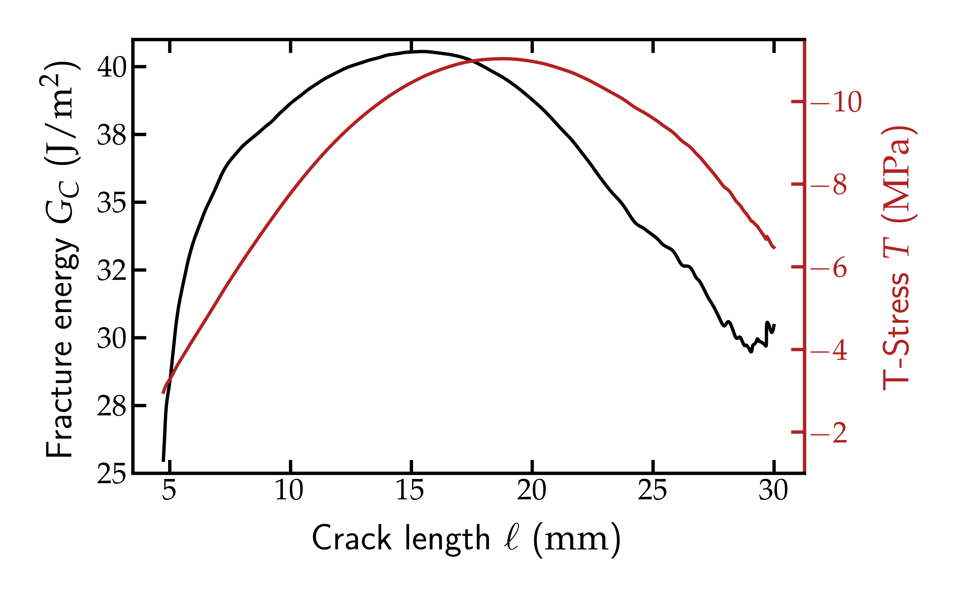
Carrara marble – effect of T-stress
3-4 mm, ‘process zone’ size?
Notes:
On carrara marble, we could obtain these curves
It shows that fracture energy varies of factor 2 during one experiment
Because T-stress varies accordingly
There is a shift between fracture energy and T-stress, it can be understood as a rough estimation of a process zone of 3-4 mm
This proves the process zone existence from a microstructural and mechanical approaches

Slide 14
Conclusions
Fracture energy varies by a factor of 2 within a single experiment because of crack tip constraint (= T-stress)
Necessity to consider environmental parameters and its effects on the ‘process zone’
Continuous monitoring of this ‘process zone’?
Thank you
Contact: antoine.guggisberg@epfl.ch
Notes:
Plus, we saw that fracture energy varies of factors 2 within a single experiment. So how are we supposed to use this parameter in our models? We don’t know, there is work to do
That’s why I will work on improving micro-mechanisms monitoring techniques to better adjust fracture mechanics to rocks.

