Slide 1



Surface change analysis of small scaled martian valley System based on an erosion-accumulation model
Vilmos Steinmann^{1,2,3}
Ákos Kereszturi²
¹Department of physical geography, faculty of science , eötvös loránd university, Budapest, Hungary
²konkoly thege miklós astronomical institute, reserach centre for astronomy and earth sciences, budapest, hungary
³doctoral school of earth sciences, eötvös loránd university, budapest, hungary

Slide 2
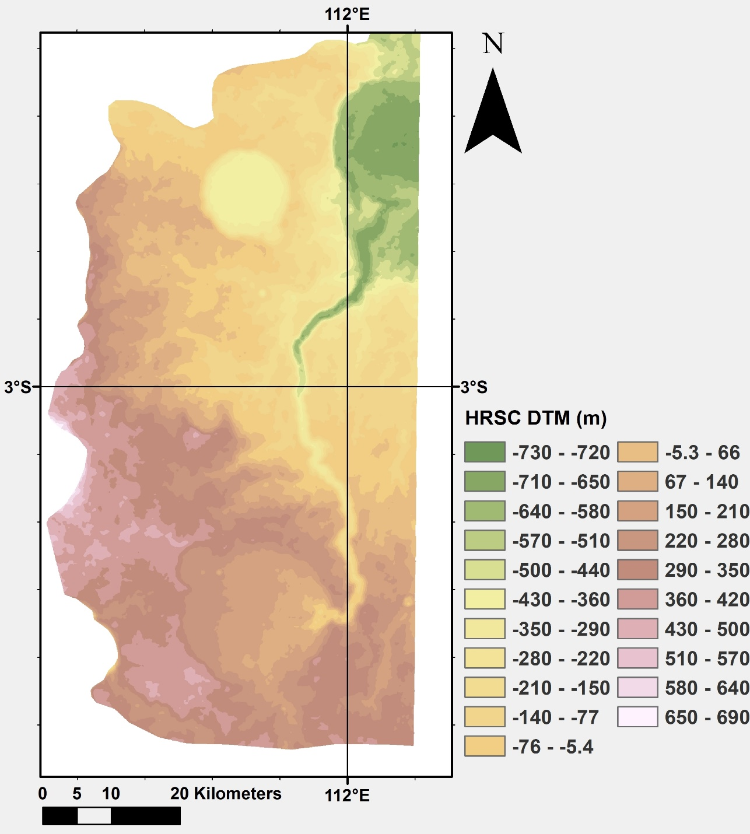
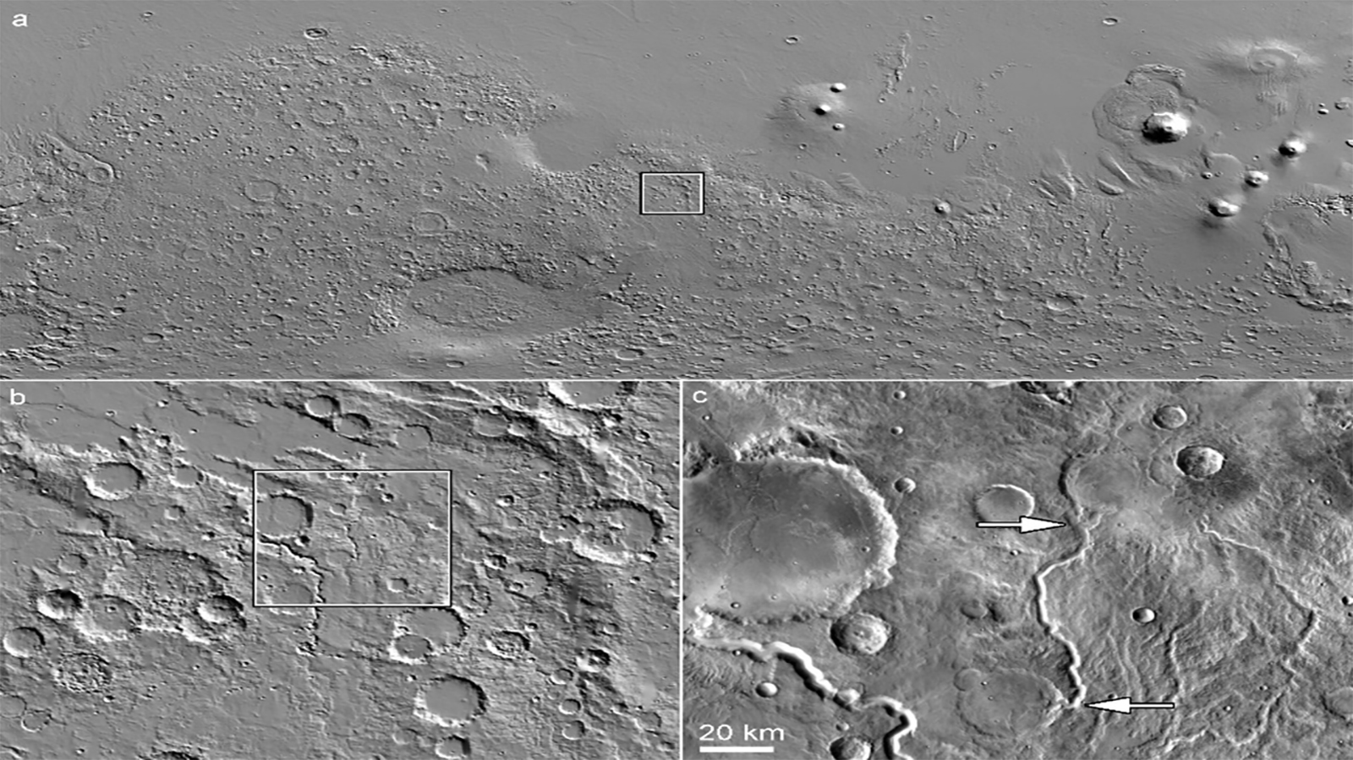

Slide 3
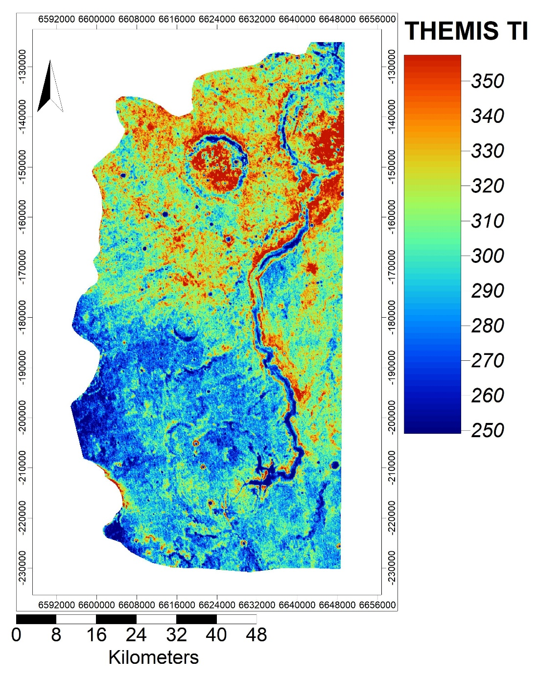
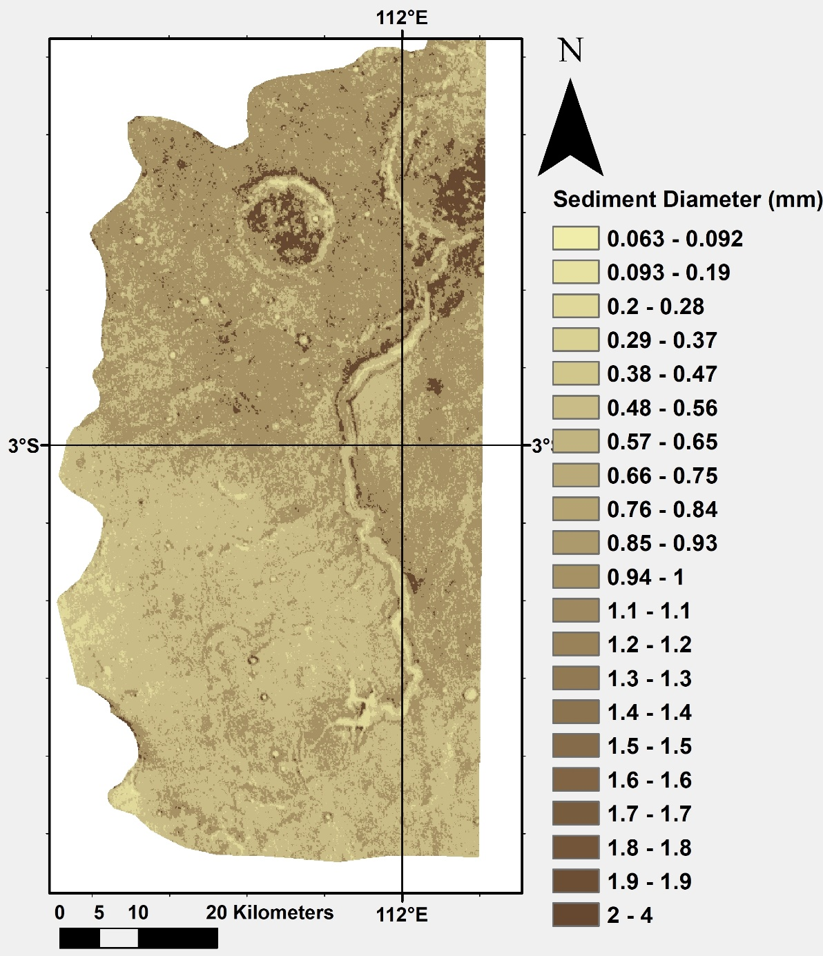

Slide 4
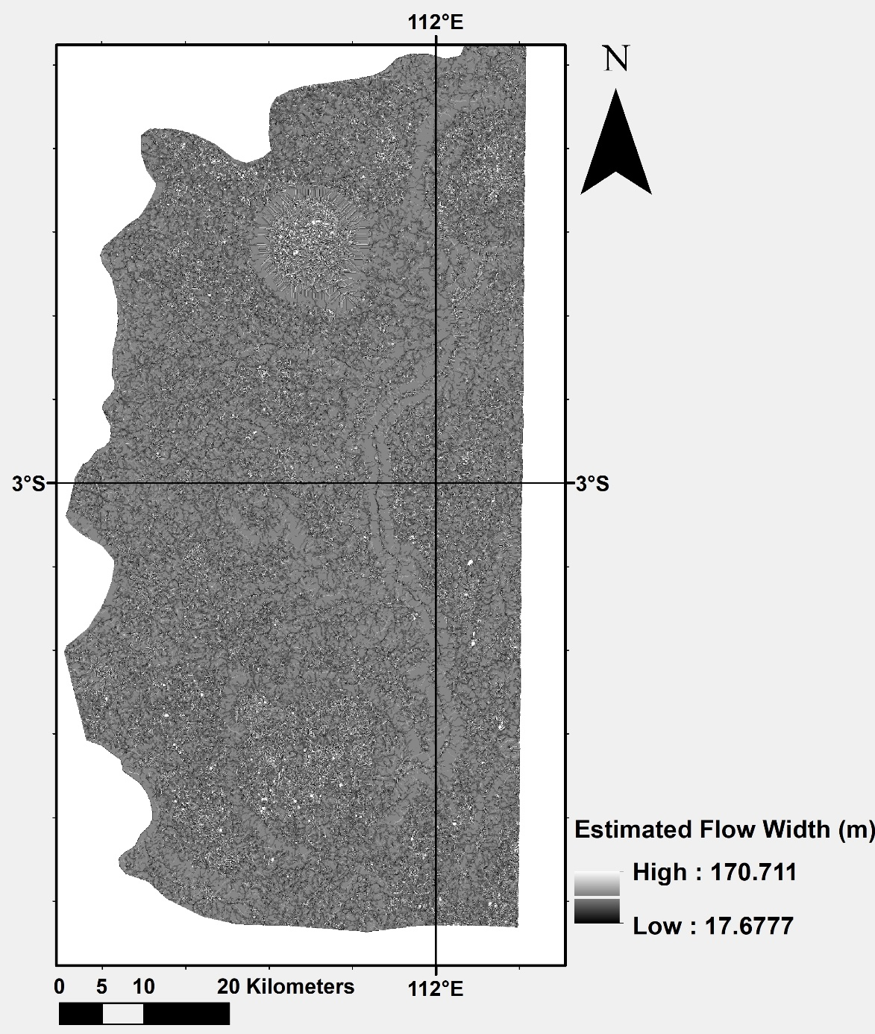
Used images
  HRSC DTM (50 m/px)
  THEMIS TI (100 m/px)
Final resolution of the results: 100 m/px
Used software
  SAGA GIS
  GRASS GIS
Flow width and Valley depth calculation in SAGA GIS
Erosion-Accumulation simulation and other calculations in GRASS GIS
Analysed area
  Small valley system
  East from Palos Crater and Tinto Vallis

Slide 5
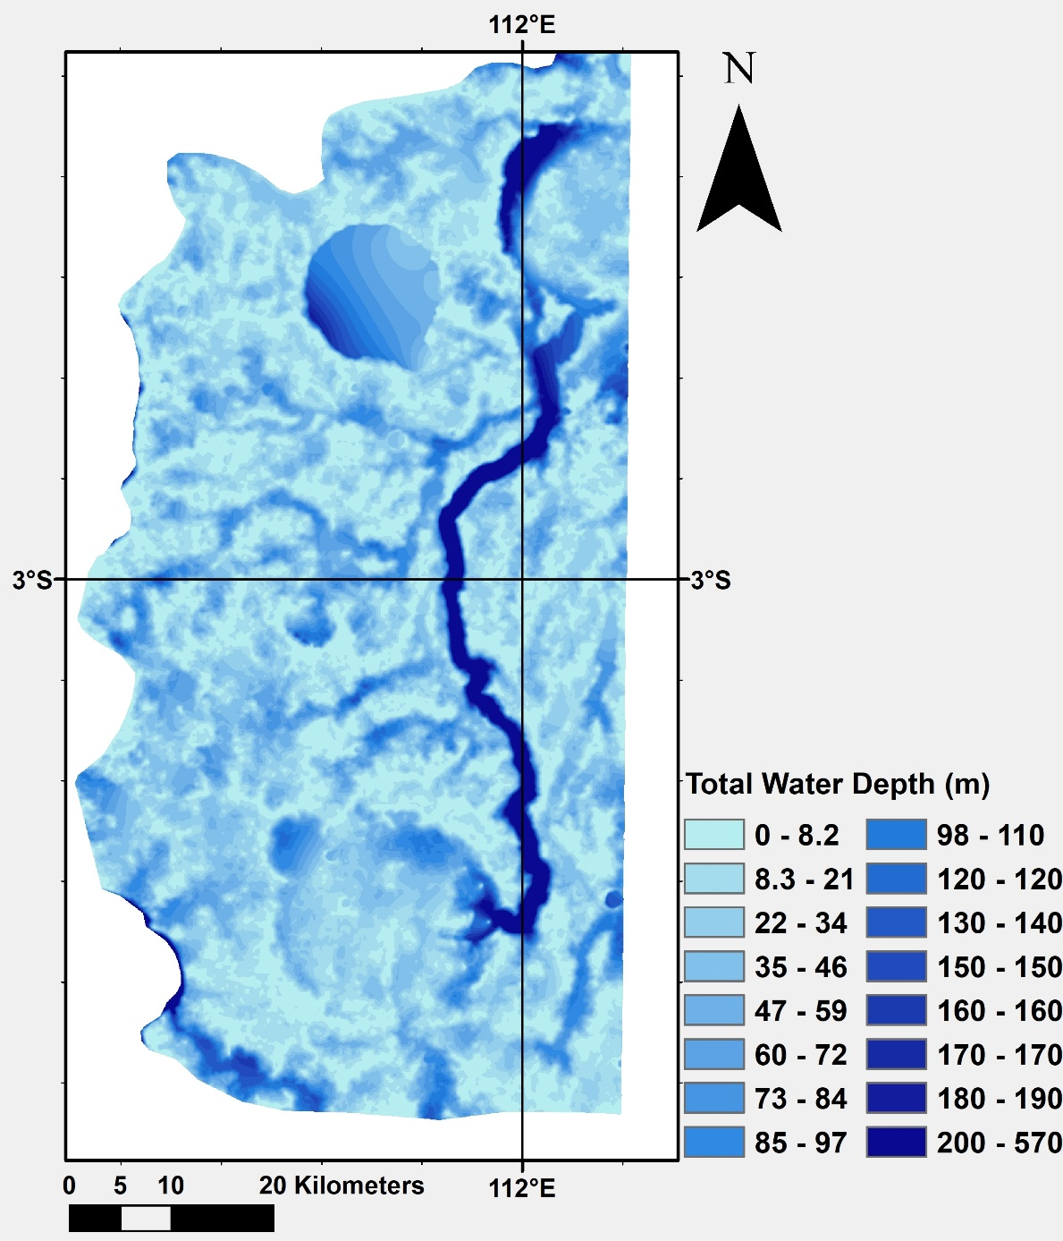
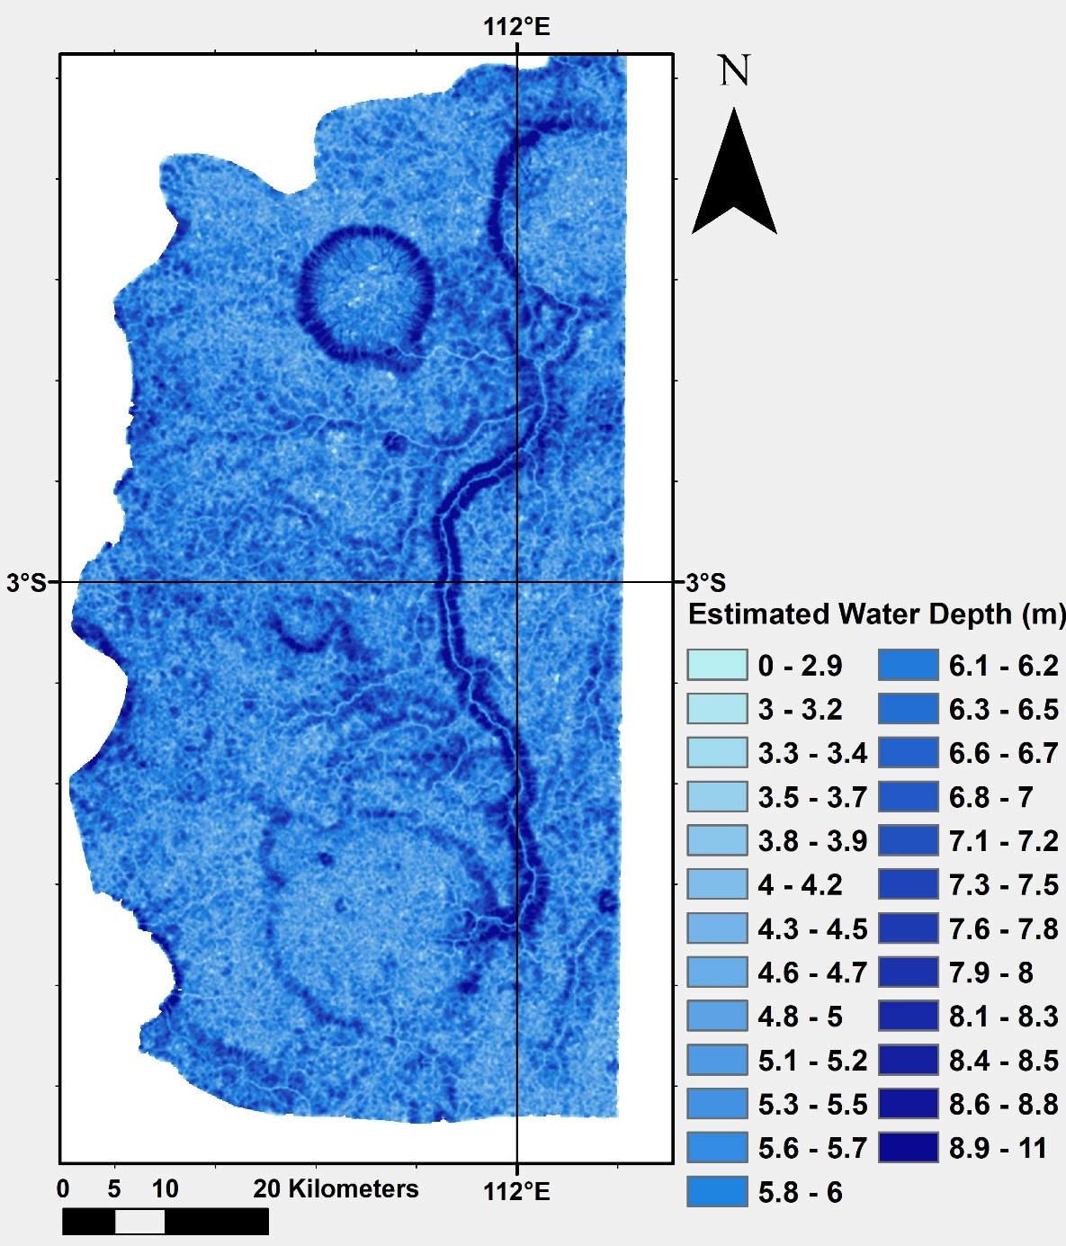

Slide 6
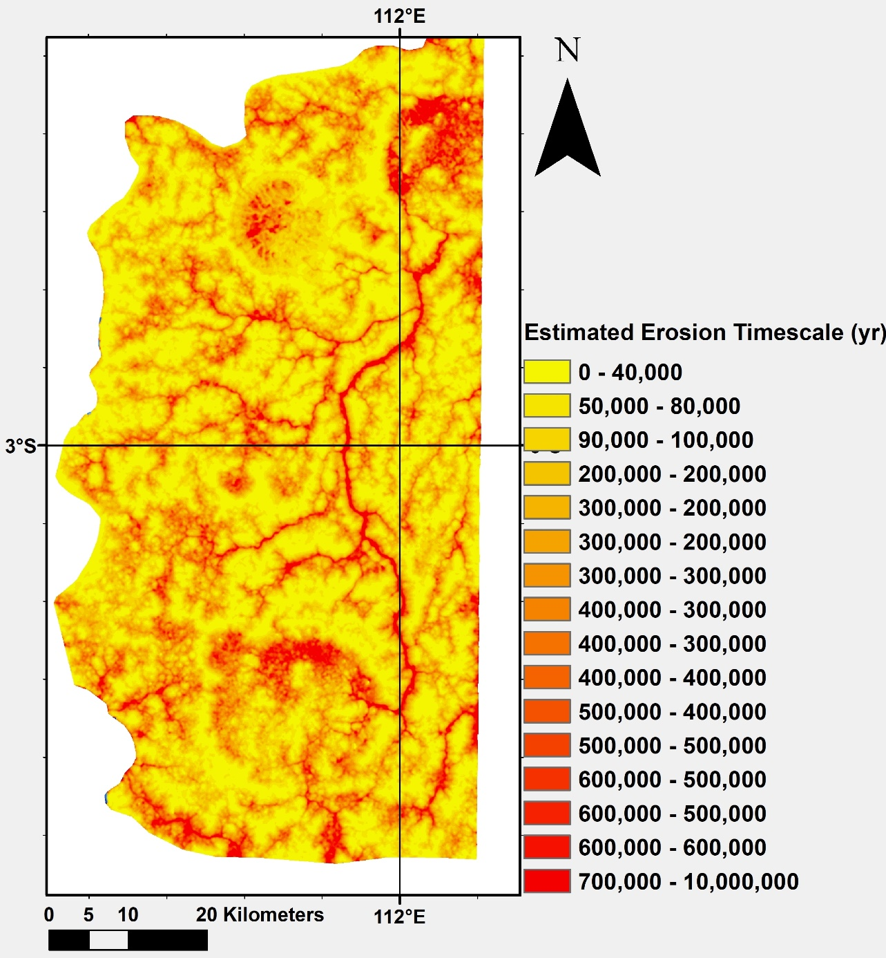
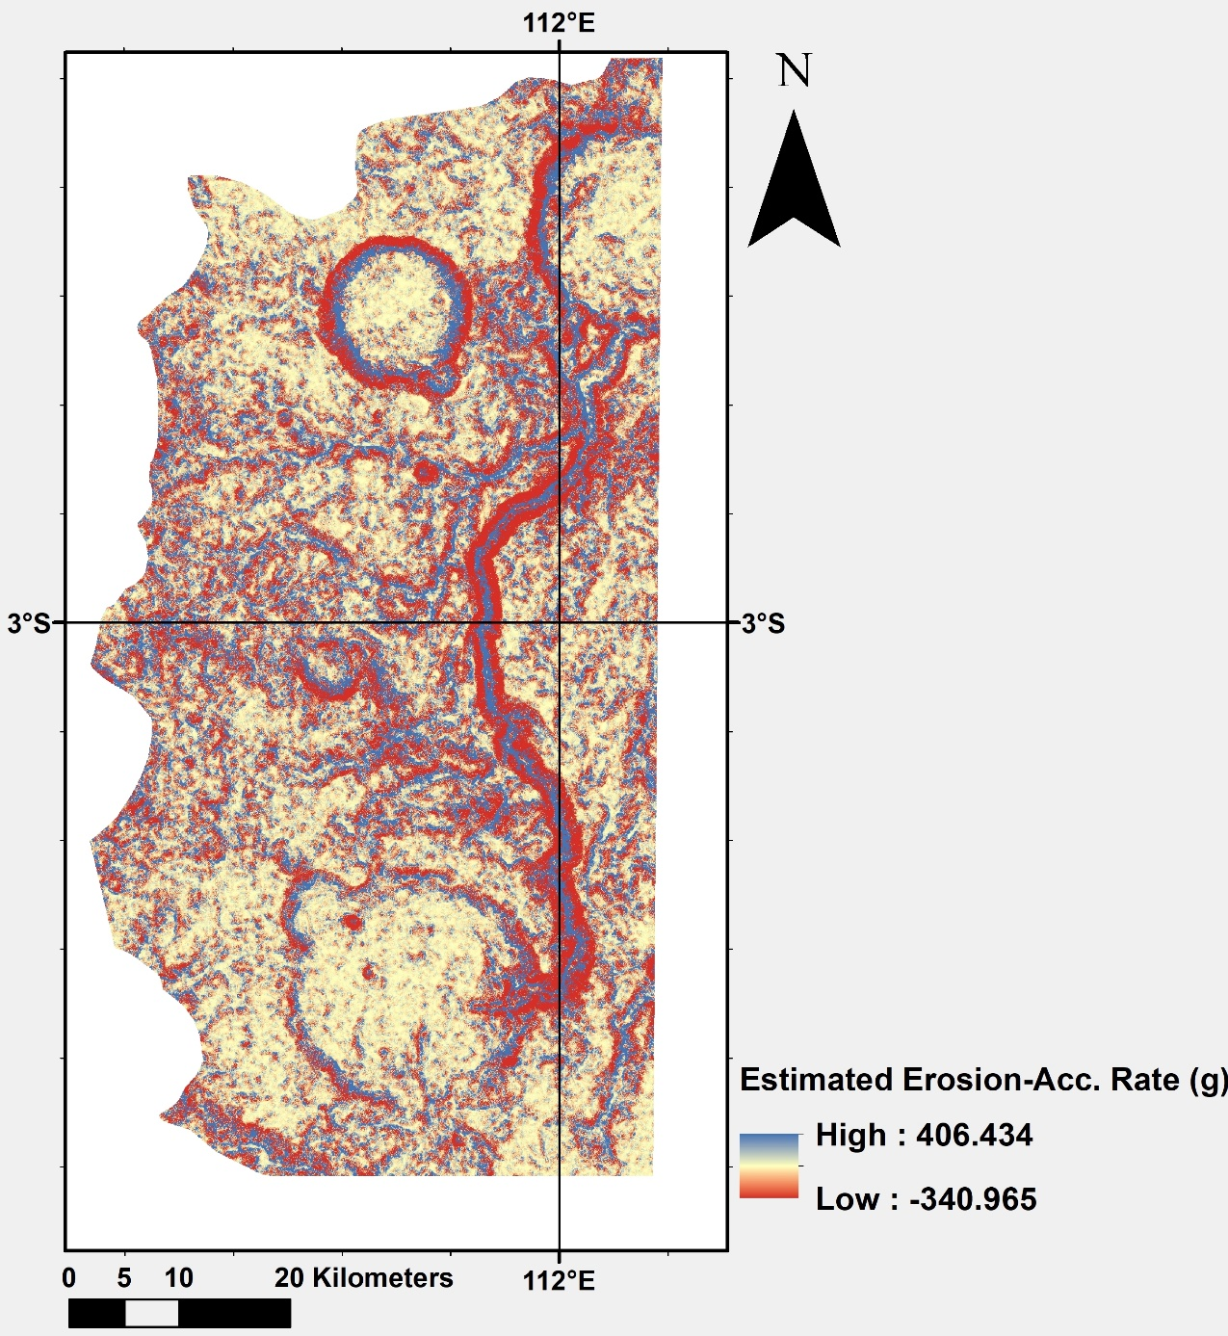

Slide 7
Thank you for your attention!
Contact: steinmann.vilmos@csfk.org

