Slide 1




Appraising Crowd Sourced Rain Data from the Met Office WOW Platform
Weather Observation Website (WOW)
Tess O’Hara, Newcastle University
Newcastle Supervisors; Hayley Fowler, Elizabeth Lewis
Contact: t.ohara@ncl.ac.uk

Slide 2
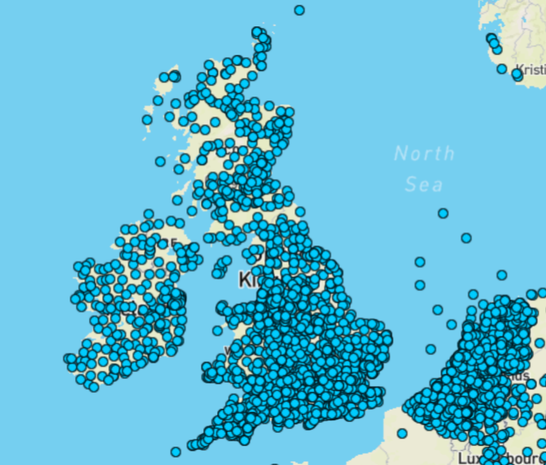
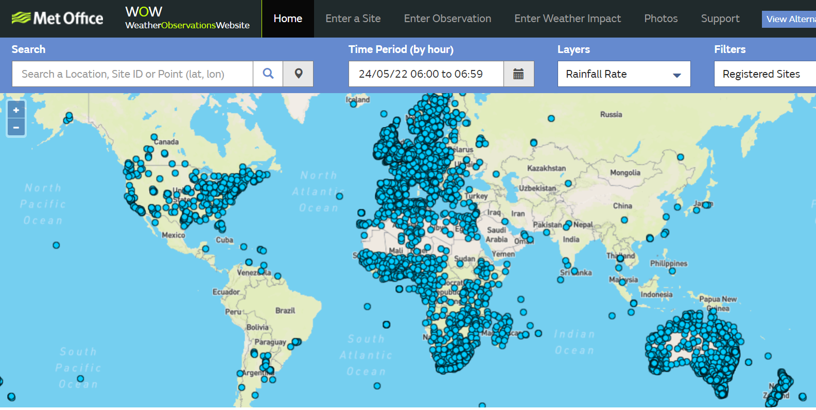
What is WOW?
F1. WOW Worldwide and Ireland/UK/NL inset
https://wow.metoffice.gov.uk

Slide 3
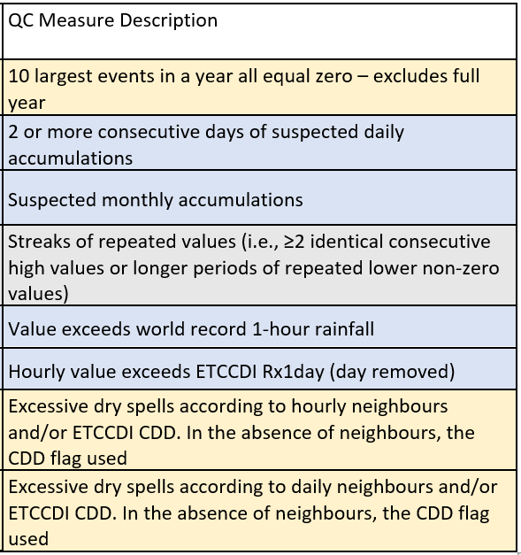
What statistical quality control was used? Quality control of a global hourly rainfall dataset, Lewis et al., 2021

Slide 4
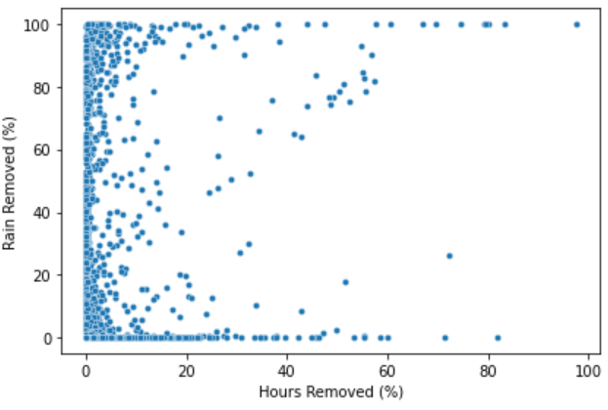
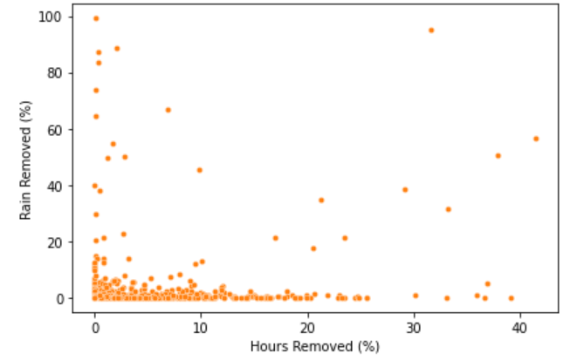
How much data was removed by statistical QC?
WOW - 2,706 gauges
40% of gauges had zero observations removed
Official - 1,240 gauges
20% of gauges had zero observations removed
F2. QC performance comparison
Notes:
The majority of gauges (WOW: 2512 or 93%, Official:1141 or 92% ) had less than 10% of their observations removed by the SQC. 1,062 WOW (39.25%) and 249 official gauges (20.1%) had no hours removed by SQC

Slide 5
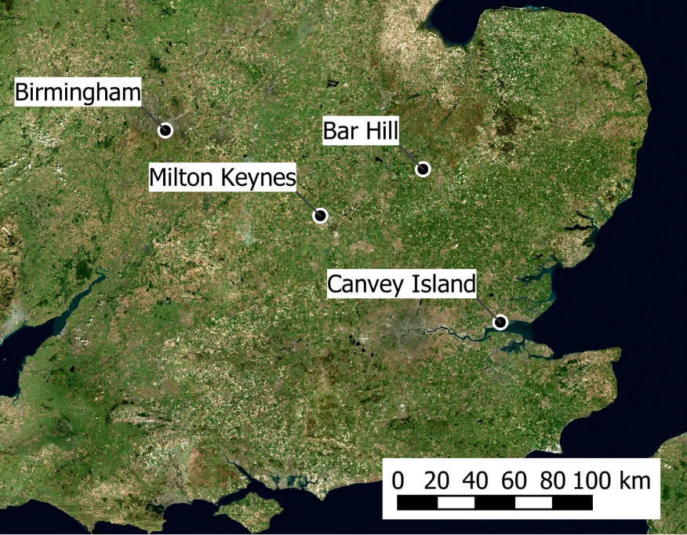
A closer look – convective storms that caused urban pluvial flooding.
F3. Event locations

Slide 6
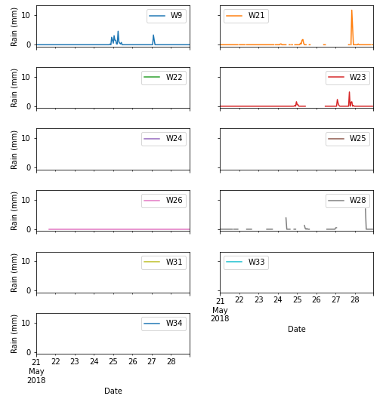
What manual statistical quality control was used?
Event Time Series Review
Are there any data missing in 24 hours prior to flooding?
Is there potential for accumulation after any gaps in the record?
Is there a gap due to QC?
Are there event pattern anomalies (erratic/low/high)?
Are there extreme highs during the event that are anomalous from other gauges?
Full Time Series
Are there anomalies in the extended gauge (repeated values)?
Are there pre-qc extremes (>100mm)?
Are there post-qc extremes (>45mm)?
Annual Daily Time Series – From start of year to event occurrence
Is the daily Pearson correlation with nearest official neighbour high (>0.7), medium (0.5 – 0.7), low (0.3 – 0.5) or very low (<.3)?
F4. Gauges removed based on manual QC

Slide 7
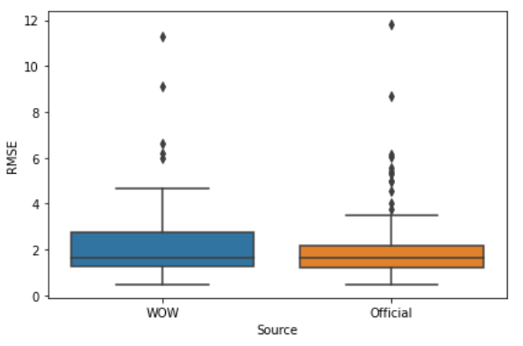
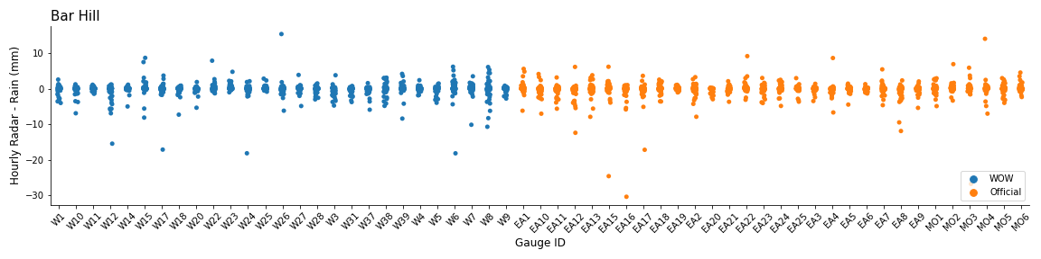
How do WOW and Official data compare to radar?
F5. Boxplot of RMSE between hourly rain gauge and co-located radar rain depth (multiple events)
F6. Strip plot Single event: radar – rain gauge
Notes:
T-test p-value 0.43 confirming minimal variation between the cohorts

Slide 8
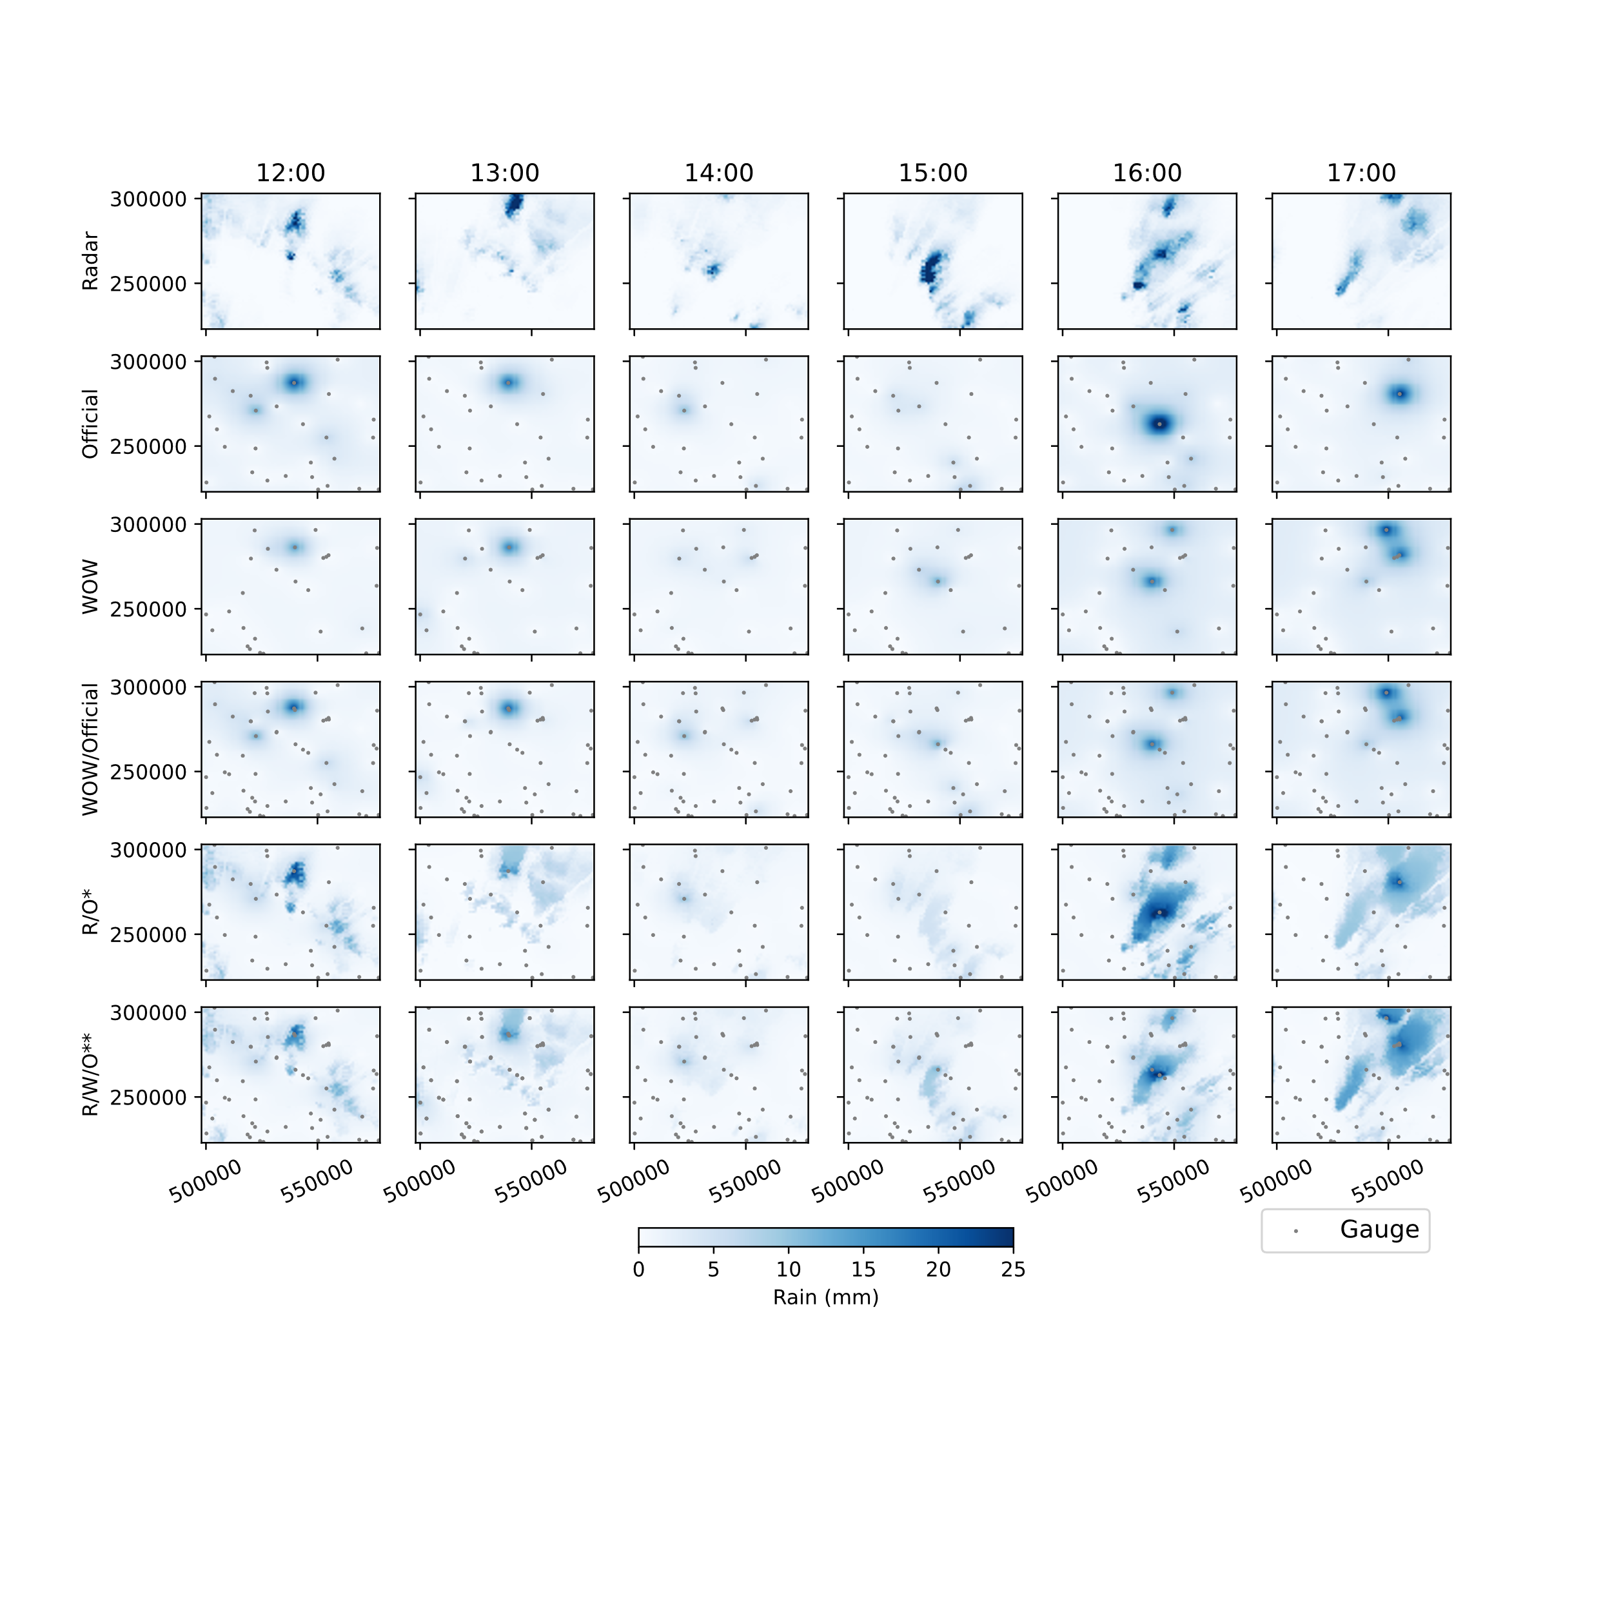
What a difference a gauge makes?!
http://www.rainplusplus.com
Radar
Radar/Official
Radar/Official /WOW
F7. Block Kriging with External Drift of Radar/Official and Radar/Official/WOW
Notes:
Met office gauge approximately 5km from flooded area, overestimating rain spatial extent (MO3 in interpolation)

Slide 9
WOW!
https://wow.metoffice.gov.uk
See my explainer: https://arcg.is/1zmui5
Contact: t.ohara@ncl.ac.uk

