Slide 1
Citizen science – an invaluable tool for obtaining high-resolution spatial and temporal meteorological data
Jadranka Šepić, Jure Vranić, Ivica Aviani, Drago Milanović, and Miro Burazer
University of Split

Slide 2
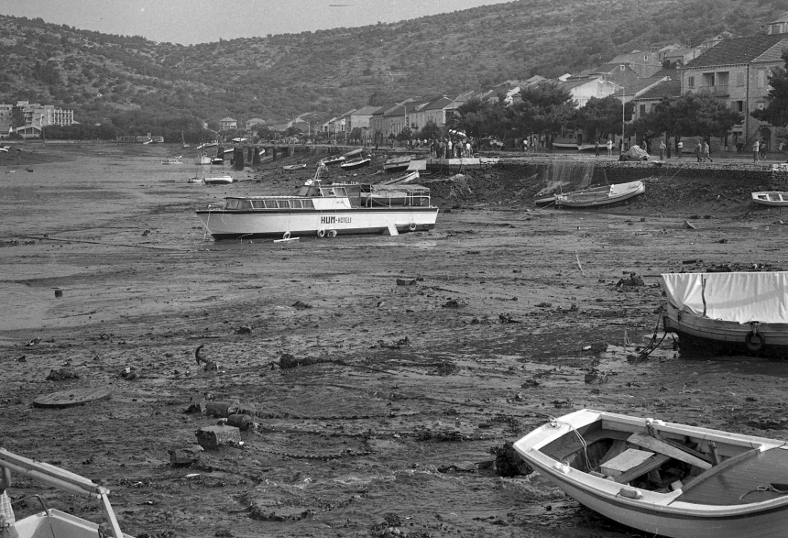
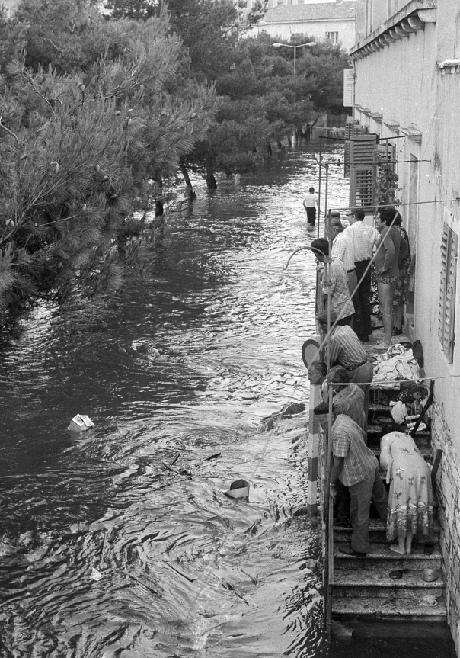
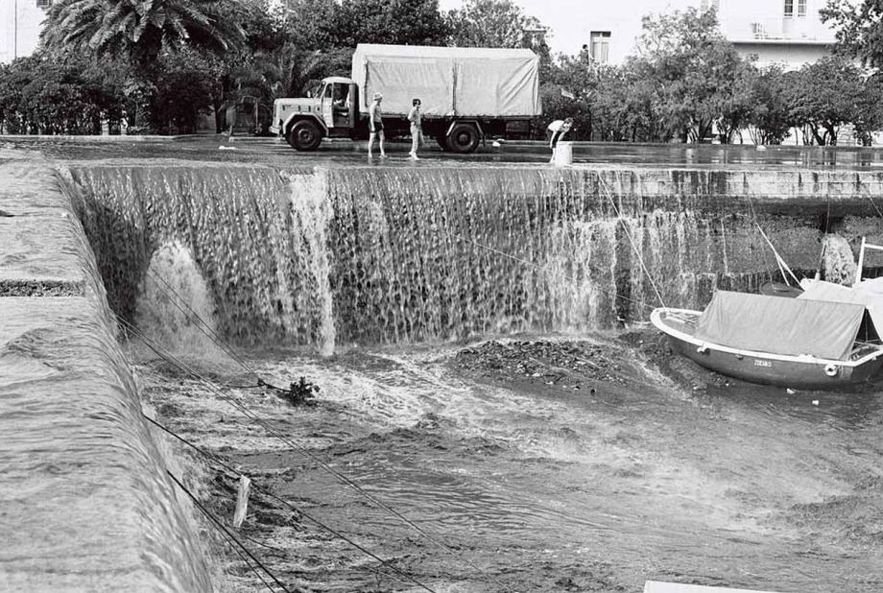
Motivation
Vela Luka, Adriatic Sea, Croatia, 21 June 1978
8-9 min
Research of meteorological tsunamis – tsunami-like sea level oscillations generated by small-scale, short-lasting atmospheric processes.
8-9 min

Slide 3
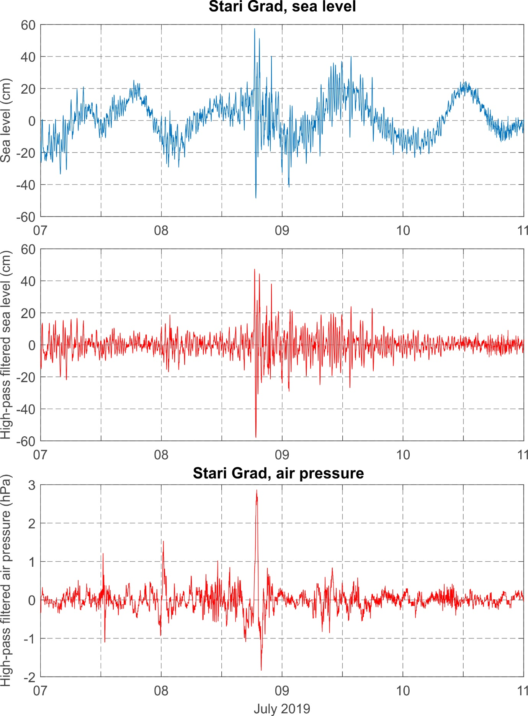
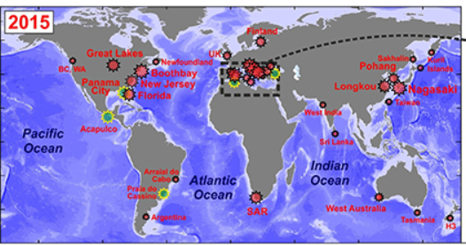
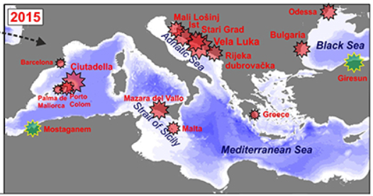
Meteotsunamis occur throughout the World, often at locations at which there are no easy-accessible atmospheric measurements, or there are only sparse measurements.
(Orlić and Šepić)
Atmospheric processes of interest are short-lasting, spatially limited (10-100 km) and of quickly changing properties – spatially dense network needed for analysis.
(Vilibić et al., 2016)

Slide 4
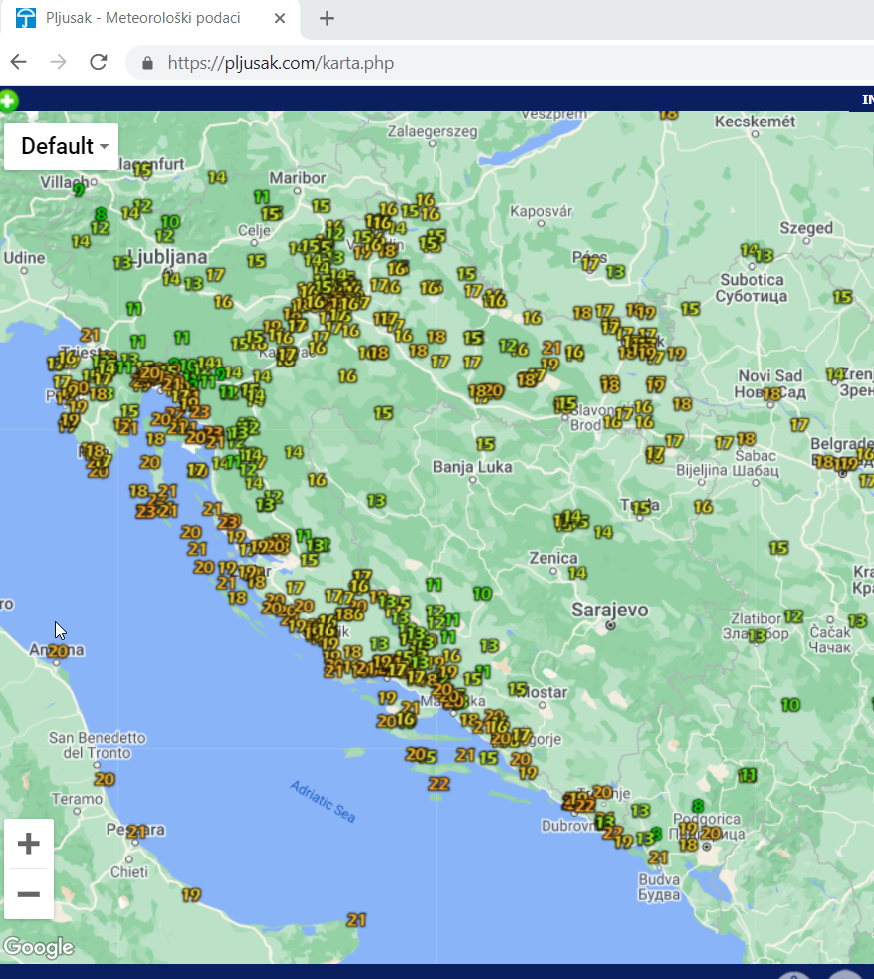
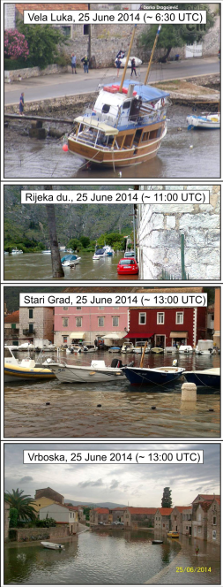
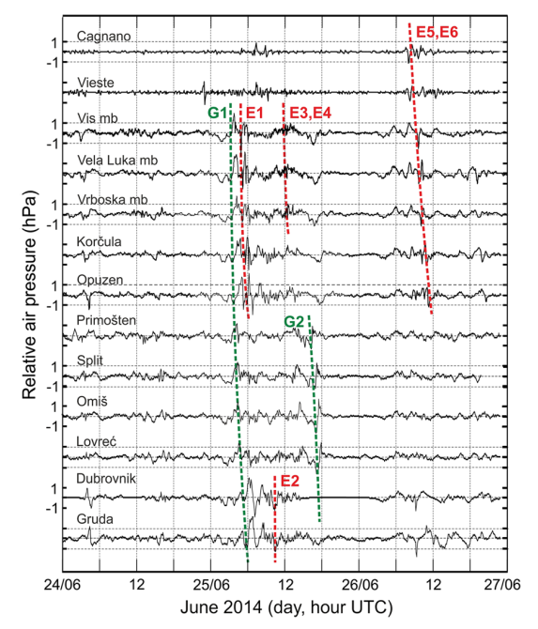
Using citizen data to overcome problems and publish high-quality research papers
The Adriatic Sea 2014 meteotsunami
Croatian amateur meteorological network pljusak.com
(Šepić et al., 2016)

Slide 5
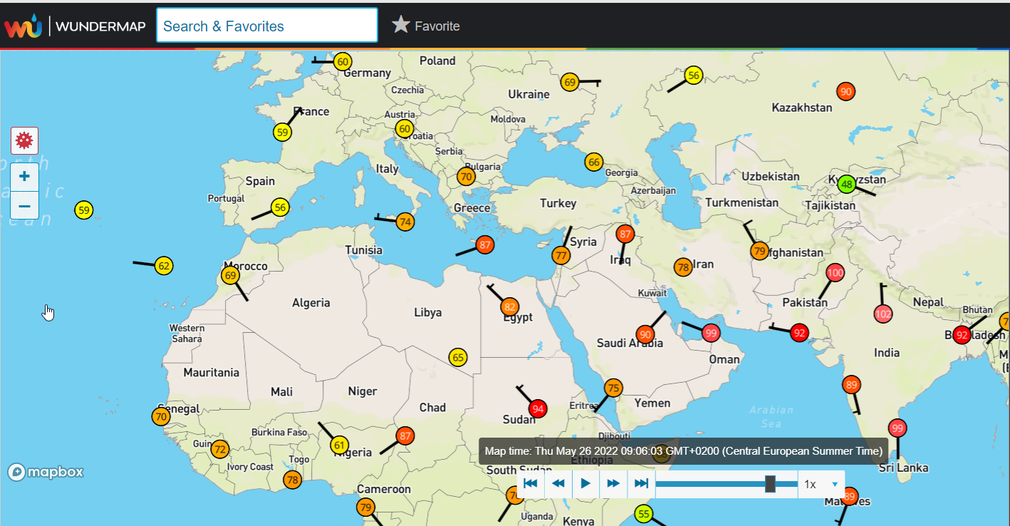
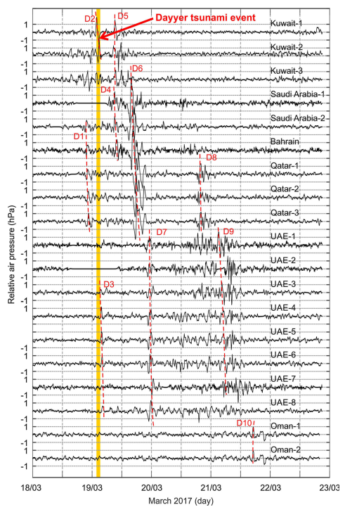
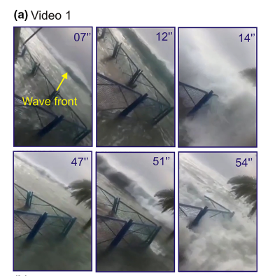
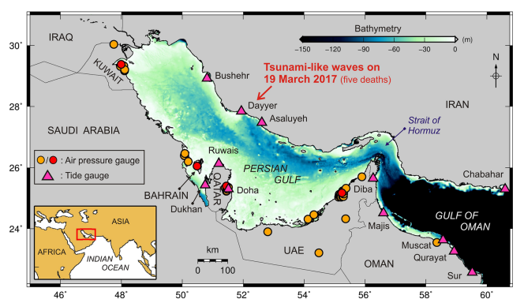
The Iranian 2019 meteotsunami
World amateur meteorological network Wunderground Wundermap
(Heidarzadeh et al., 2019)

Slide 6
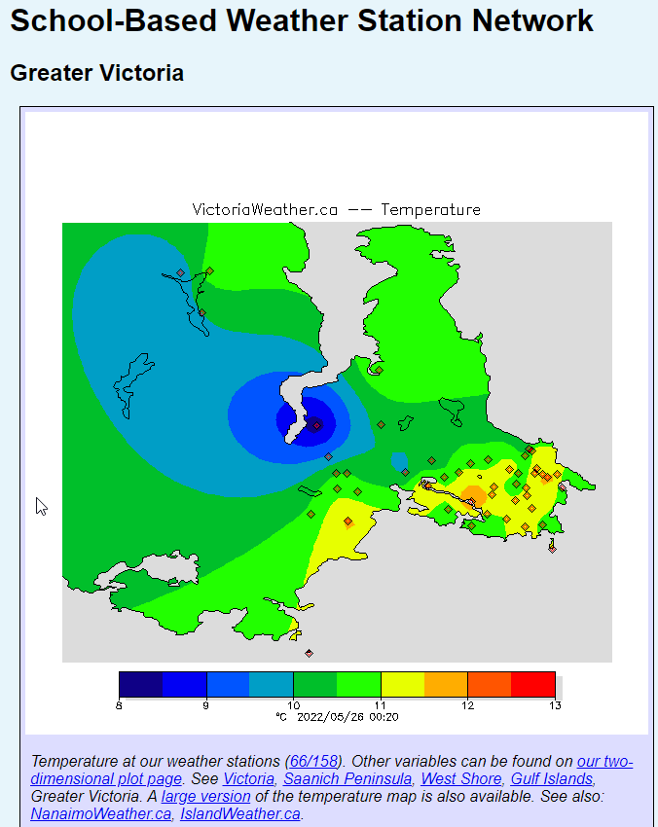
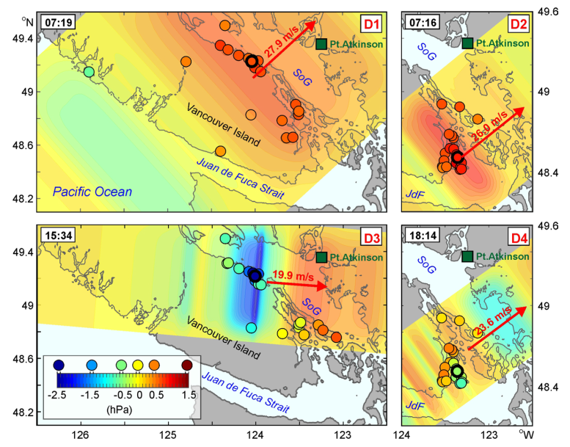
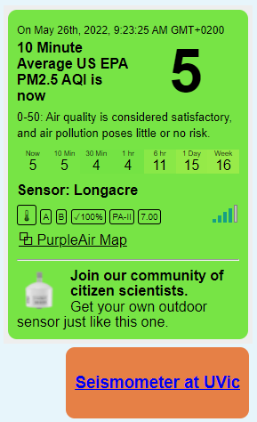
The British Columbia 2010 meteotsunami
(Rabonivich et al., 2021)

Slide 7
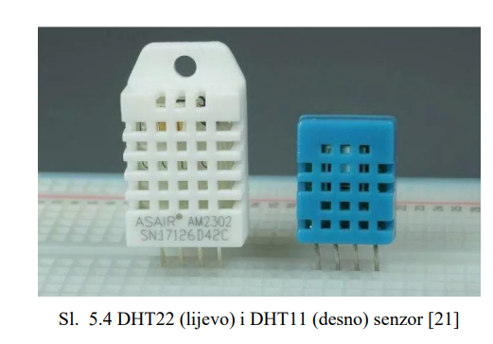
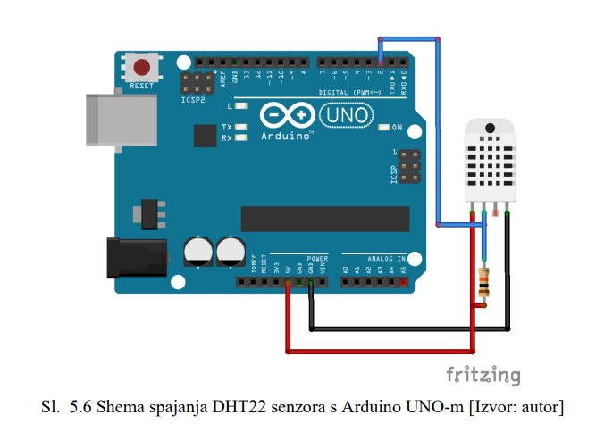
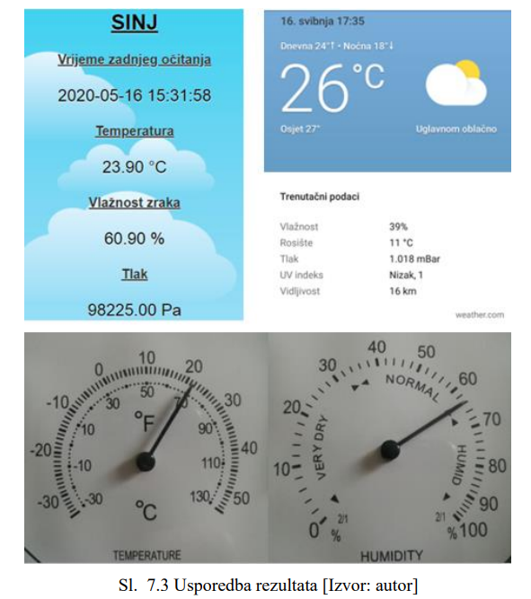
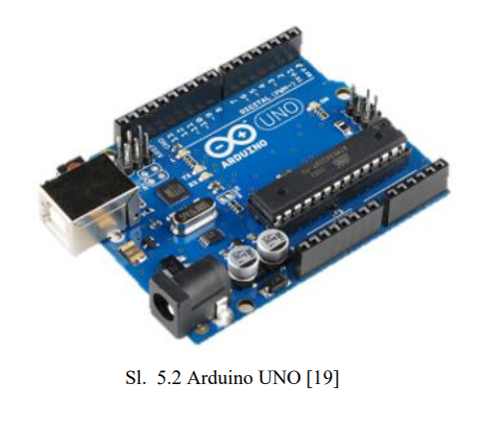
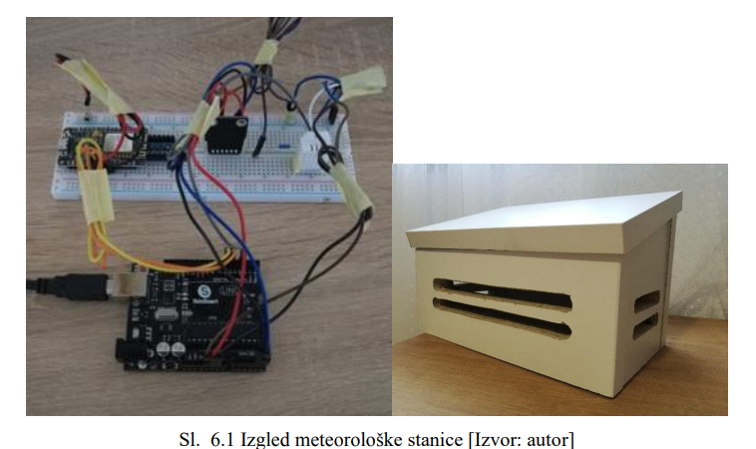
Perspectives
(Orlić and Šepić)
(Poljak, 2020)

