Slide 1

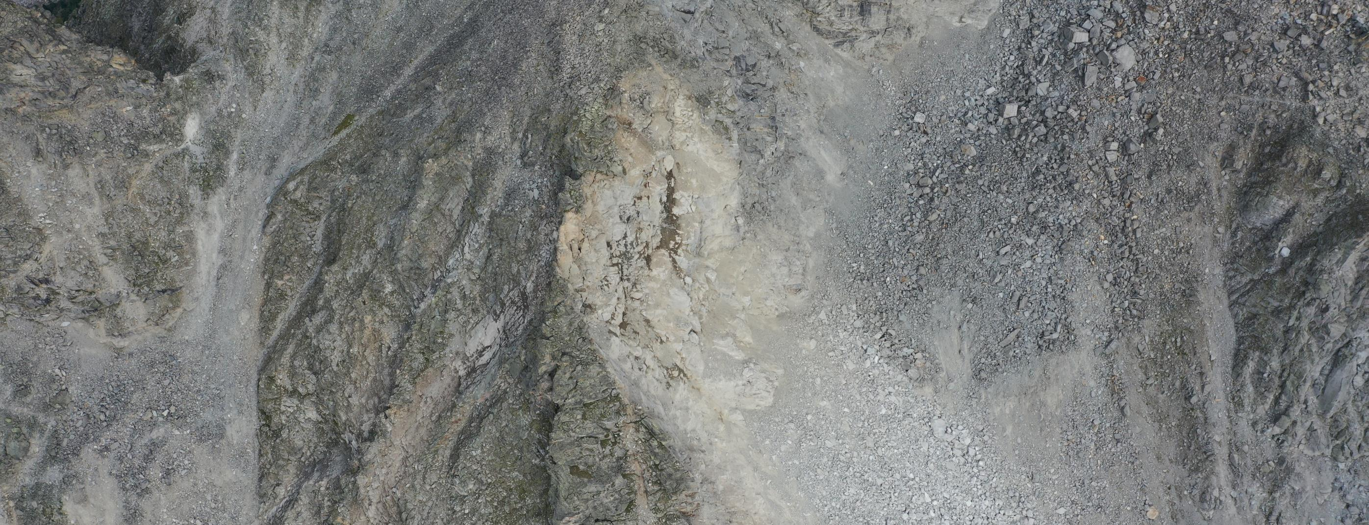

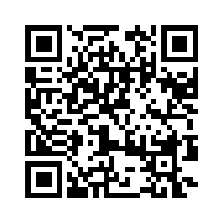




Geomorphic responses at the permafrost margins: observations from the swiss alps
department of Geography
  research group Physical Geography
Hanne Hendrickx, Jan Nyssen, Reynald Delaloye, Amaury Frankl
https://meetingorganizer.copernicus.org/EGU22/EGU22-7928.html

Slide 2
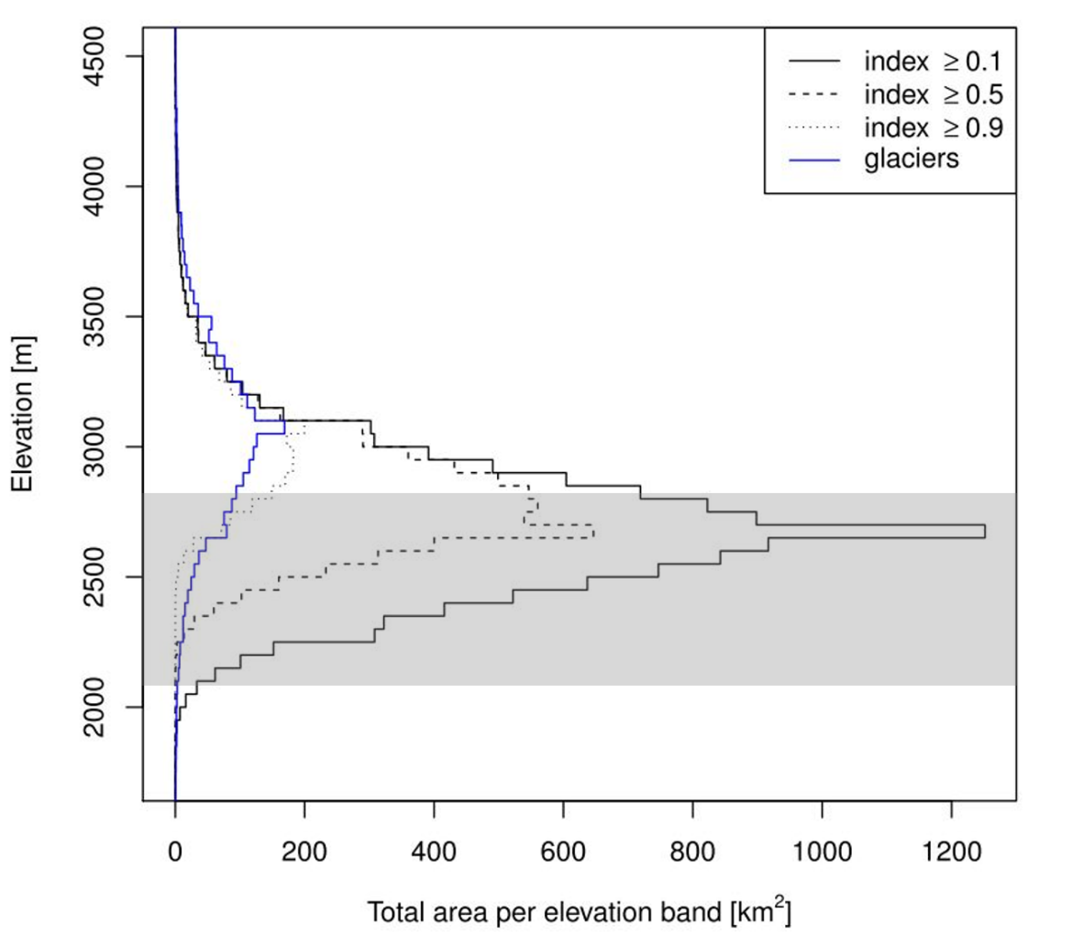
What happens at the permafrost margins?
Warm permafrost (-2 to 0° C, 2000-2700 m a.s.l.)
Geomorphic responses expected since frozen ground limits erosion processes
Critical to monitor these areas:
cascading systems can develop
processes could accelerate & shift upwards as climate changes
Modified from Boeckli et al. 2012

Slide 3
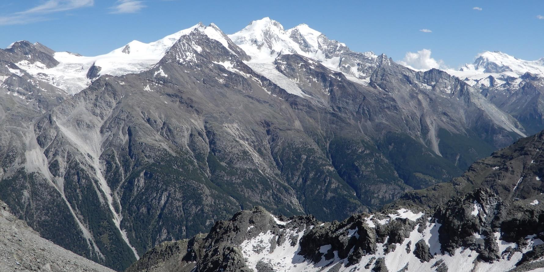
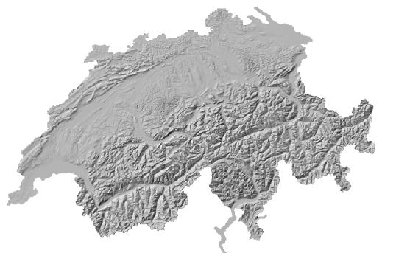


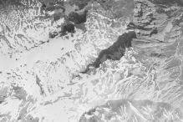
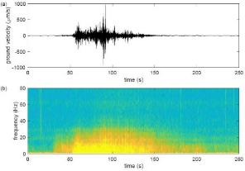


Case study 1: Grosse grabe rockface
Hendrickx et al. 2022
TLS
UAV
Webcam
Aerial photos
Seismics

Slide 4
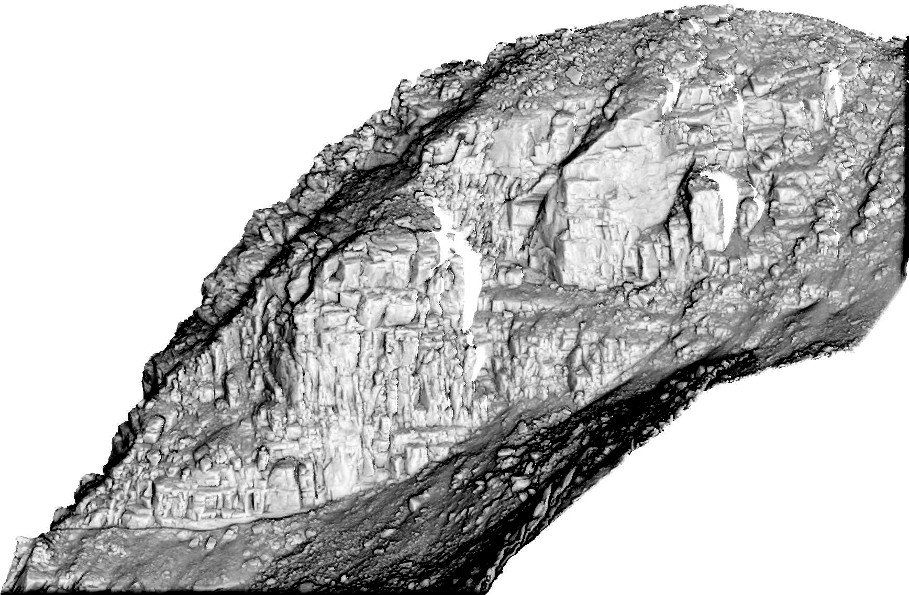

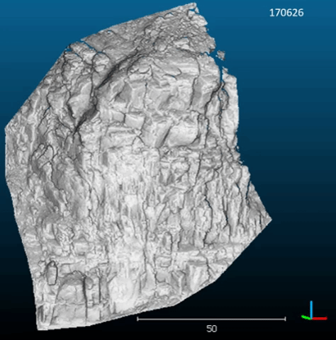
Case study 1: Grosse grabe rockface
03/07/2019 – 19/10/2020
Hendrickx et al. 2022
4

Slide 5
Case study 1: Grosse grabe rockface
Hendrickx et al. 2022

Slide 6
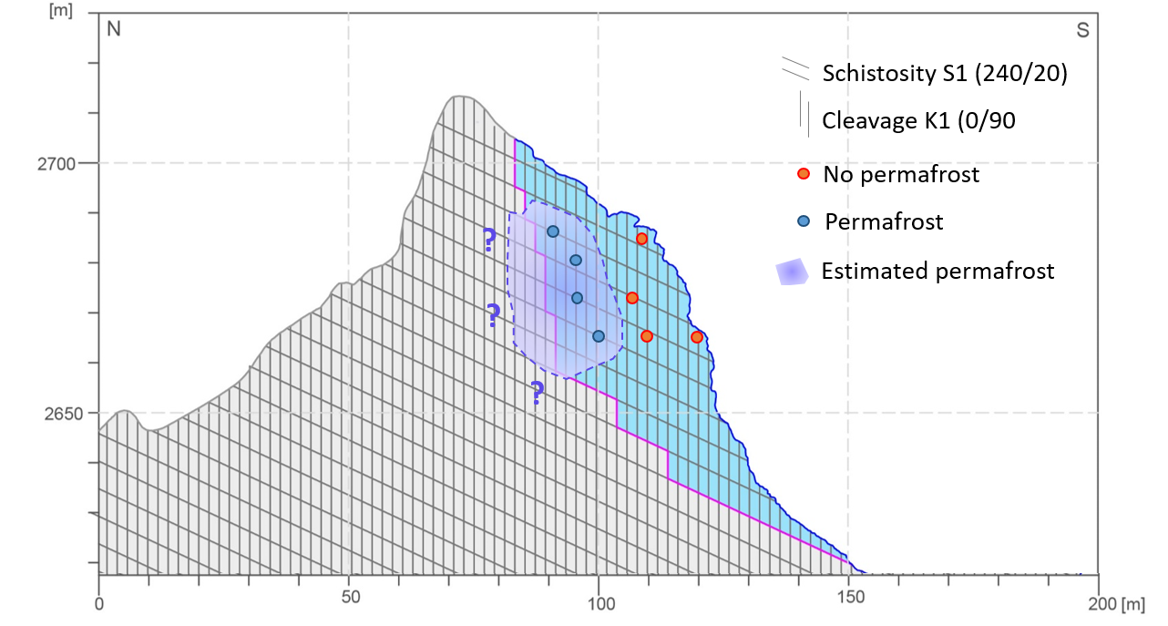
Case study 1: Grosse grabe rockface
Hendrickx et al. 2022

Slide 7
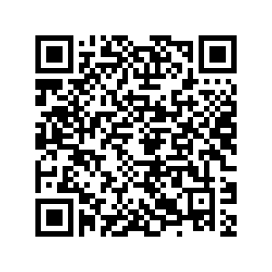

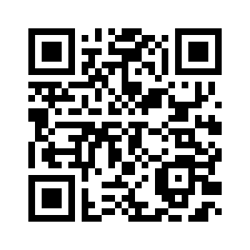
Case study 2: Grabengufer rockslide
Permanent
GNSS
dGNSS
Webcam

Slide 8
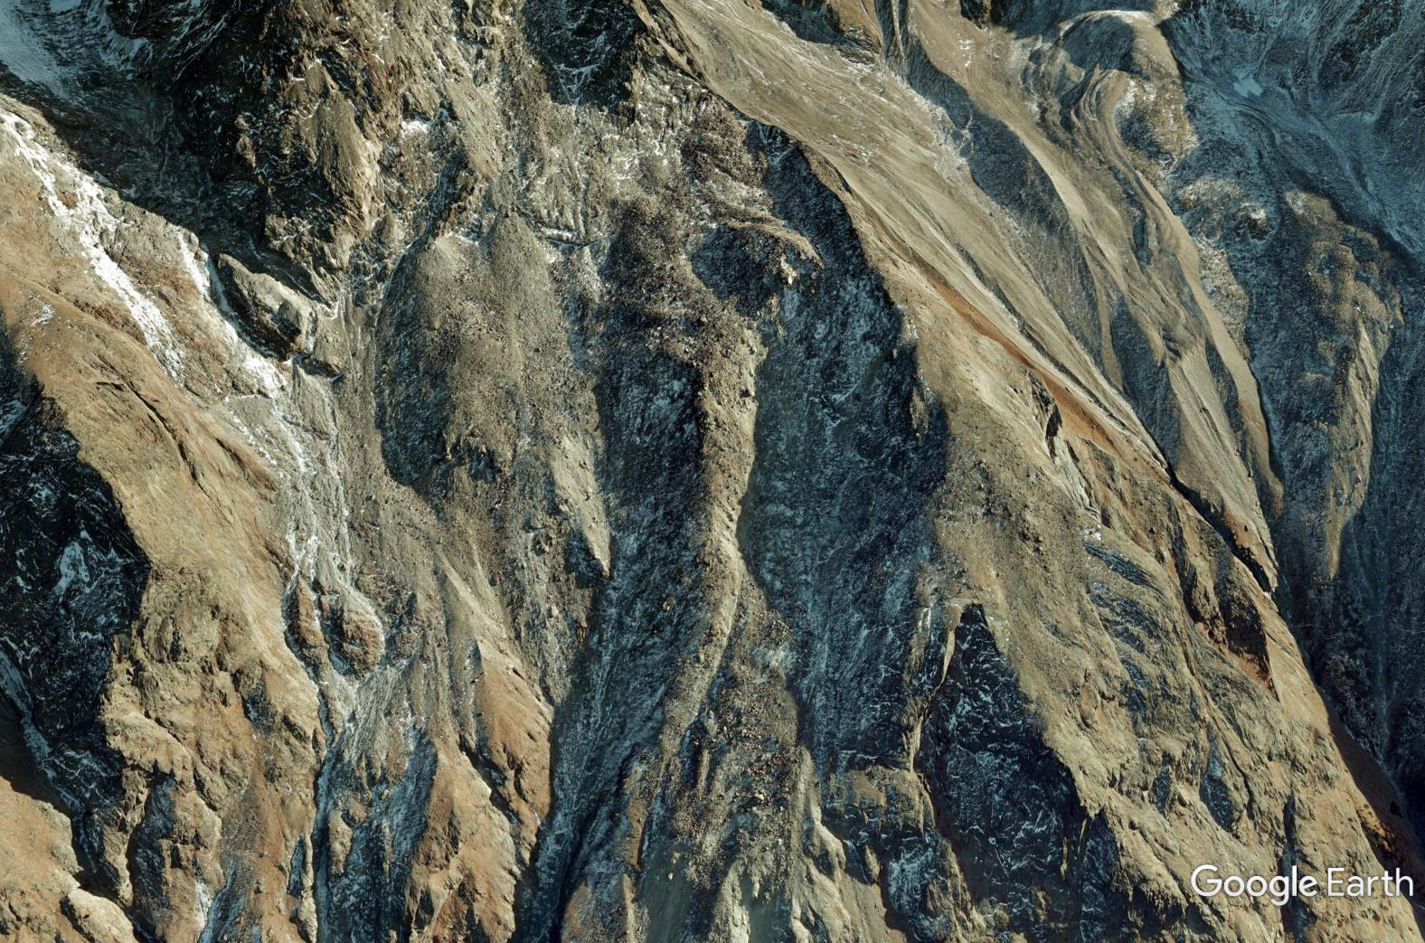
Case study 2: Grabengufer rockslide
550 m

Slide 9
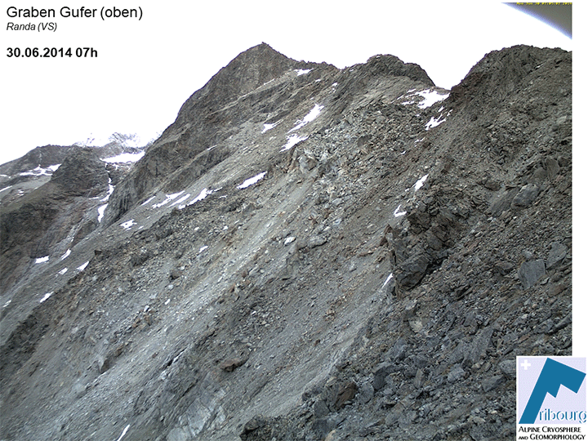
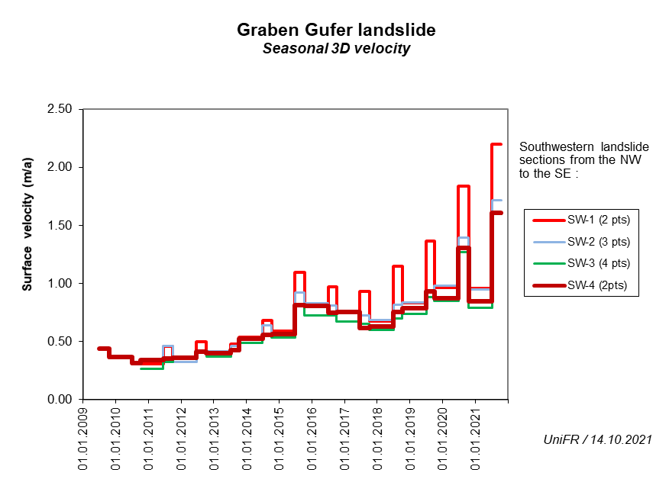
Case study 2: Grabengufer rockslide

Slide 10
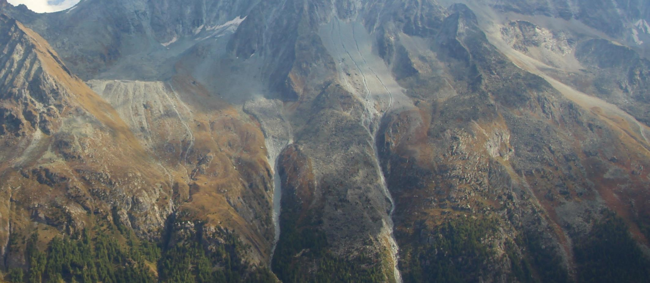

Case study 3: Tsarmine rock glacier
Permanent
GNSS
TLS
UAV
dGNSS
Webcam

Slide 11
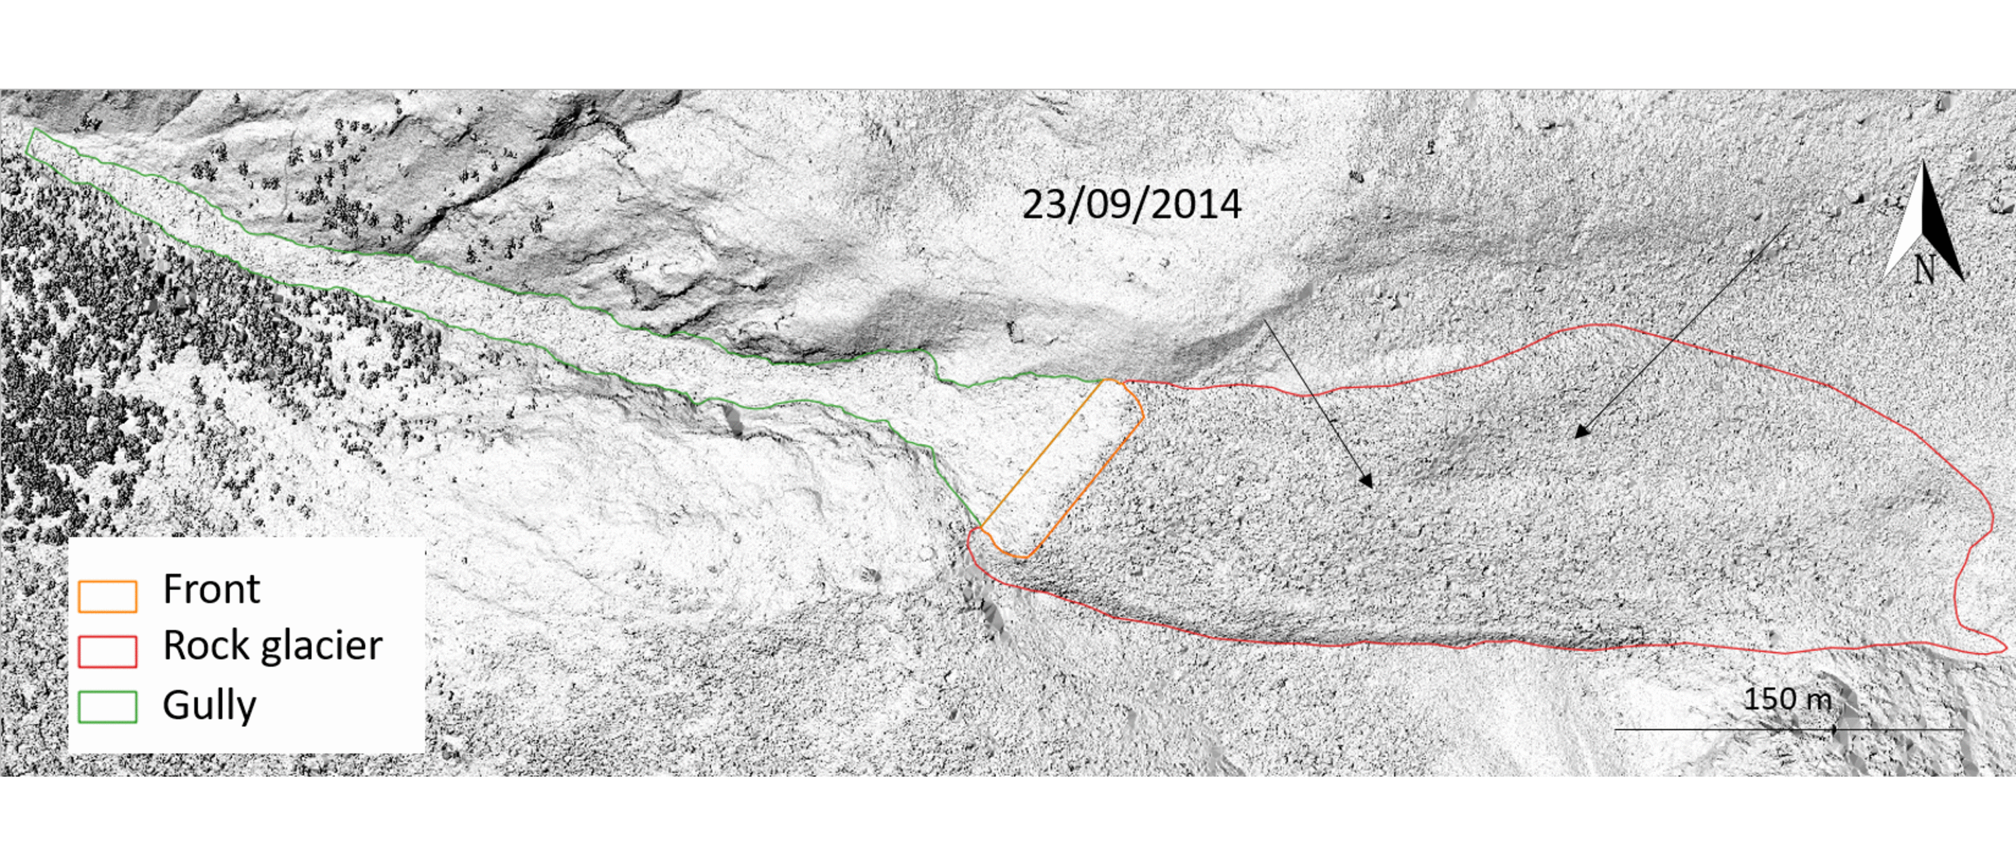
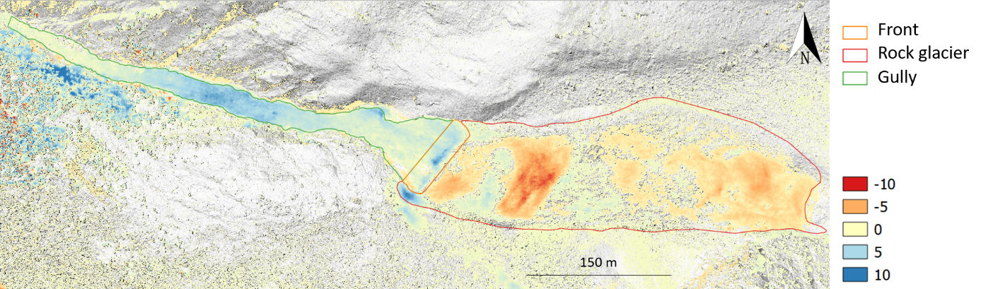
Case study 3: Tsarmine rock glacier
m

Slide 12
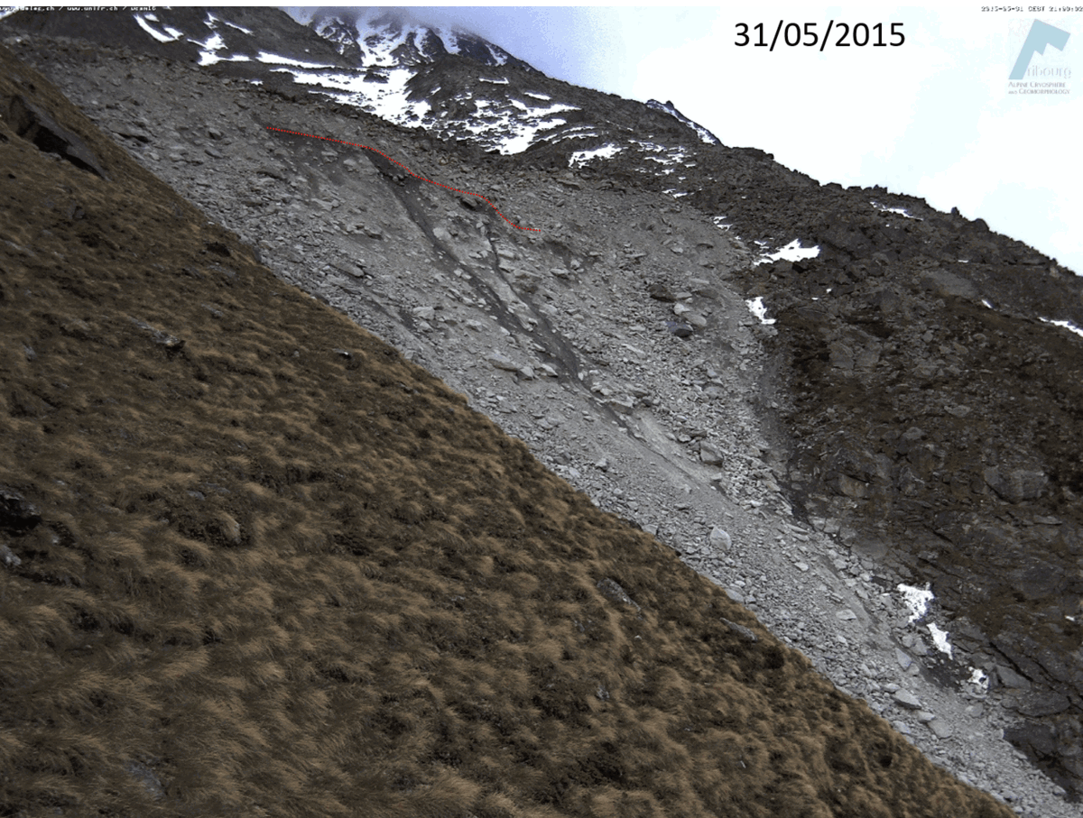
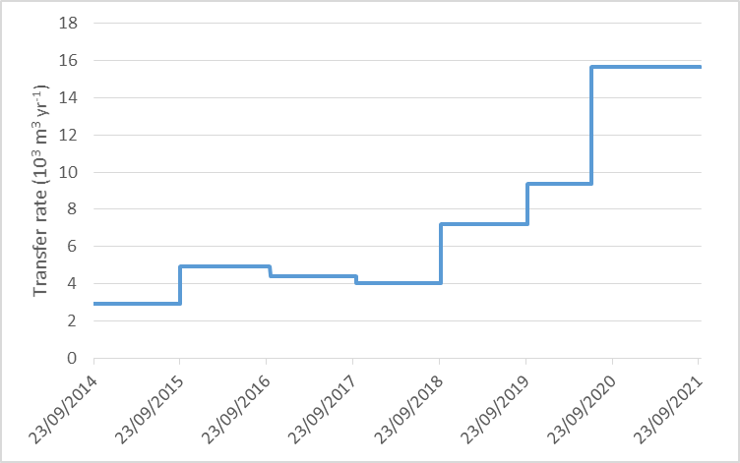

Case study 3: Tsarmine rock glacier
Kummert et al. 2018
m

Slide 13
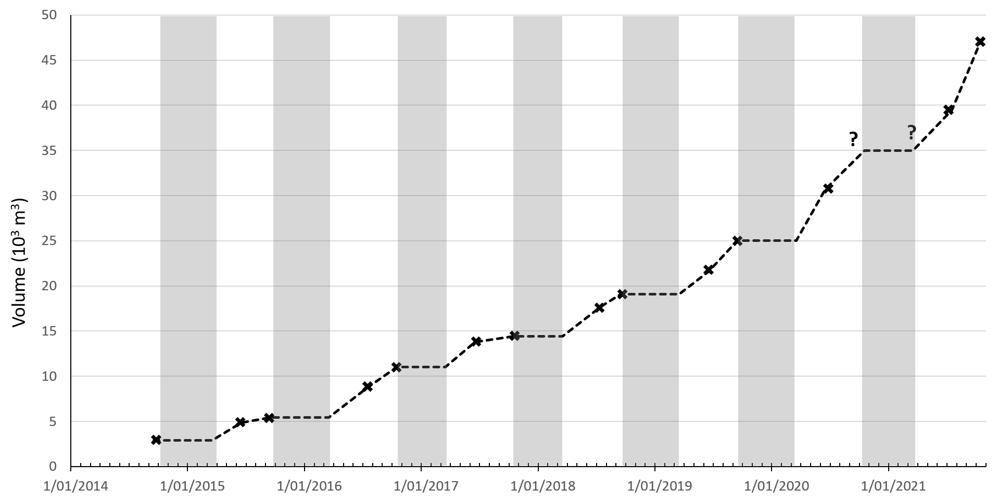
Case study 3: Tsarmine rock glacier
Kummert et al. 2018
m

Slide 14
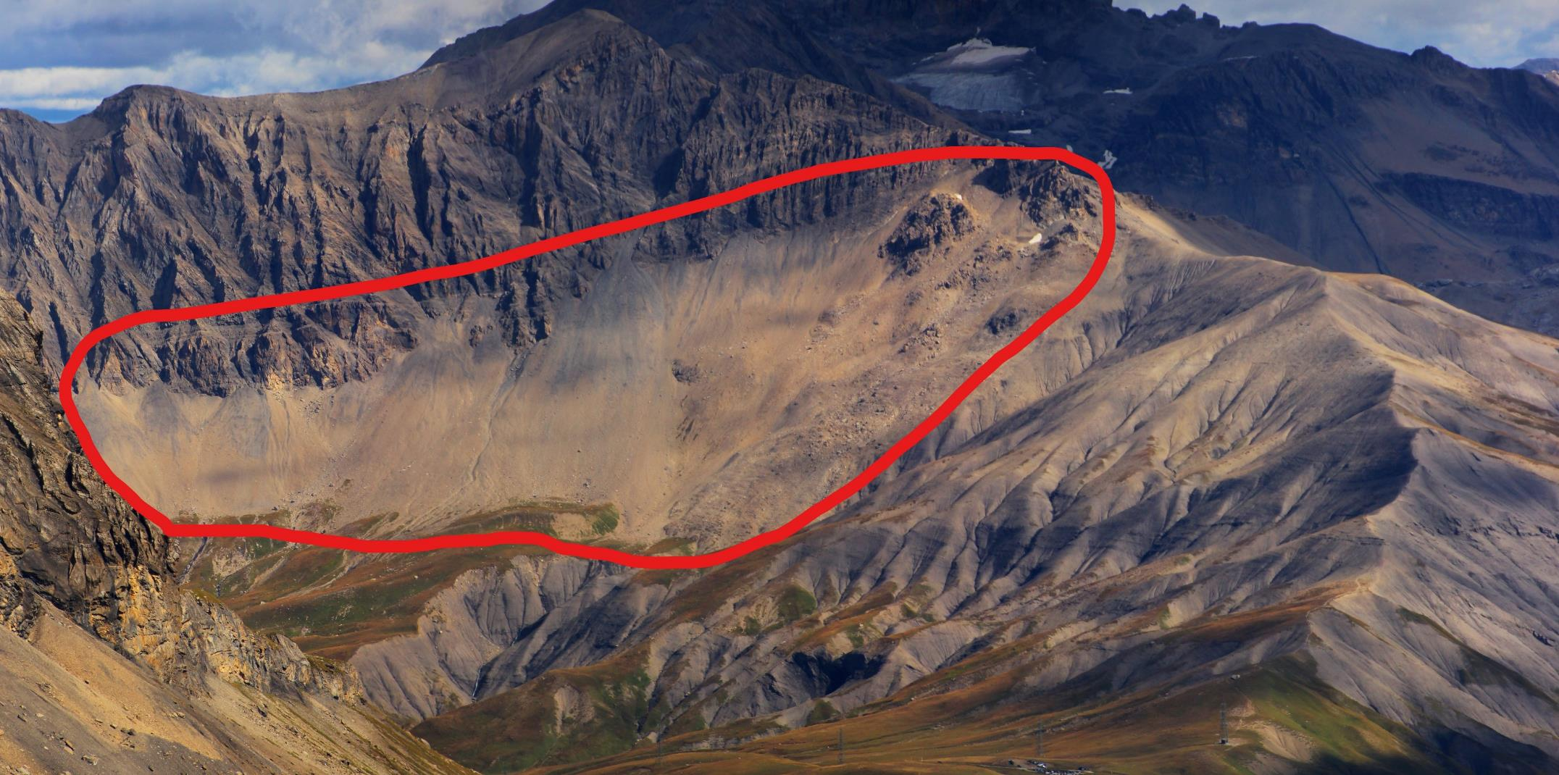

Case study 4: Talus slope processes
Hendrickx et al. 2020
TLS
UAV
Webcam
Aerial photos

Slide 15
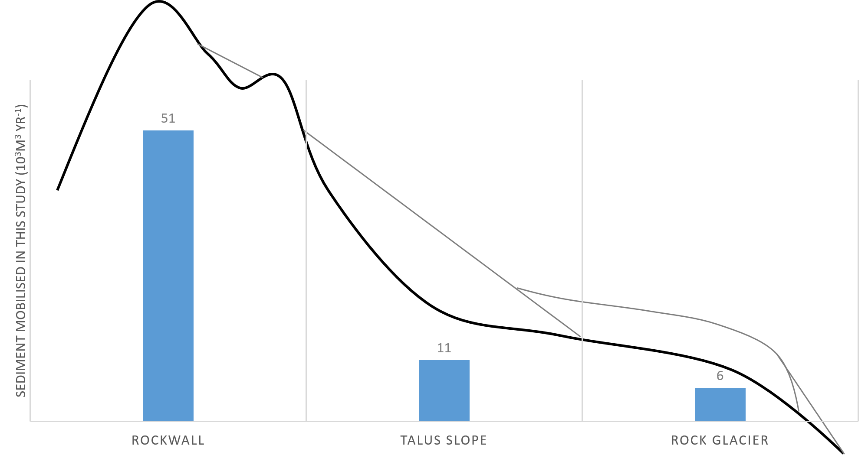
conclusion
Case studies are representative for zones with highest geomorphic activity
  process understanding
  insight in the future development of mountain regions under a changing climate
Close-range sensing techniques allow data gathering despite challenging field conditions
Limitations related to the sensor and monitoring intervals were overcome by the integration of the different datasets. Increased instrumentation in the European Alps unlocks interesting research paths.

Slide 16




Hanne Hendrickx
Research and teaching assistant
Department of Geography
E hanne.hendrickx@ugent.be
T +32 9 264 46 19 www.ugent.be www.geoweb.ugent.be
Geografie UGent
@HendrickxHanne
https://www.researchgate.net/profile/Hanne_Hendrickx

