Slide 1
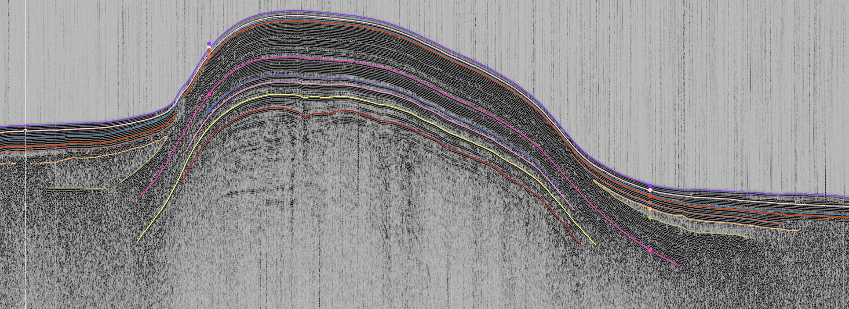




High resolution geophysical study of
Lake Maninjau, West Sumatra, Indonesia
Olajide Oladipo¹, Caroline Bouvet De La Maisonneuve^{2,3}, Nicolas Waldmann¹
Dr. Moses Strauss Department of Marine Geosciences, The Leon H. Charney School of Marine Sciences,
University of Haifa, Carmel 31905, Israel
2. Earth Observatory of Singapore, Nanyang Technological University, 639798, Singapore
3. Asian School of the Environment, Nanyang Technological University, 639798, Singapore

Slide 2
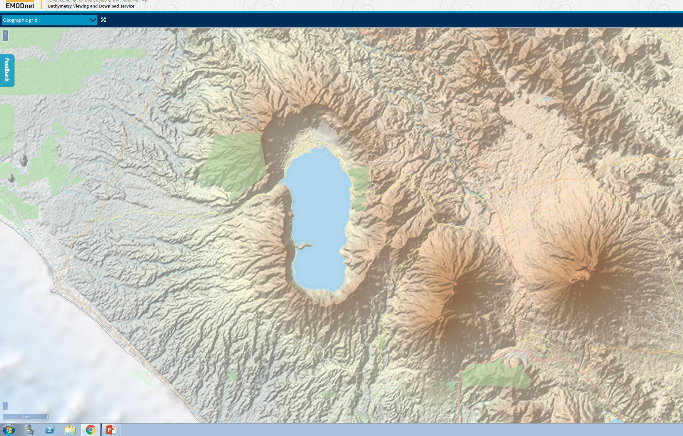
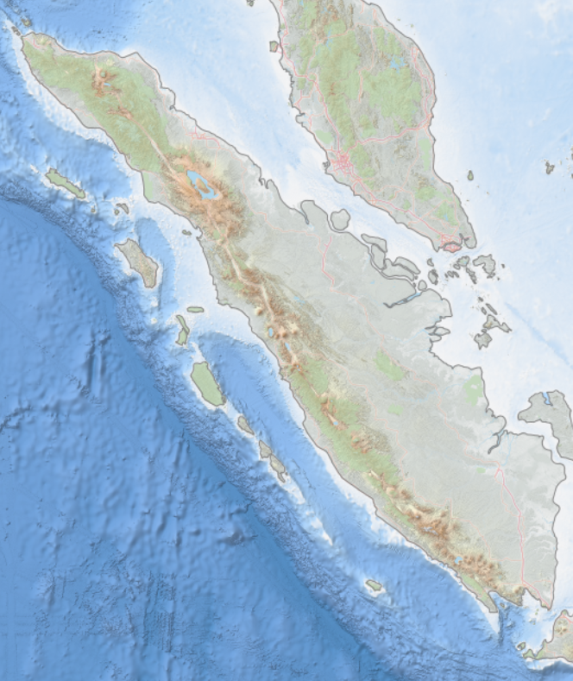
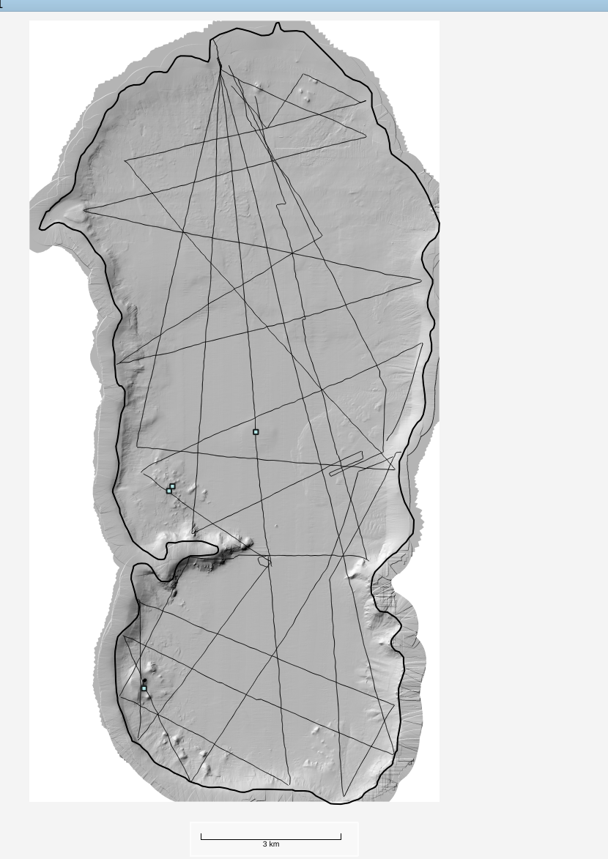
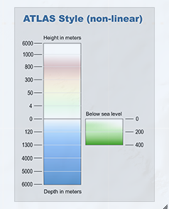
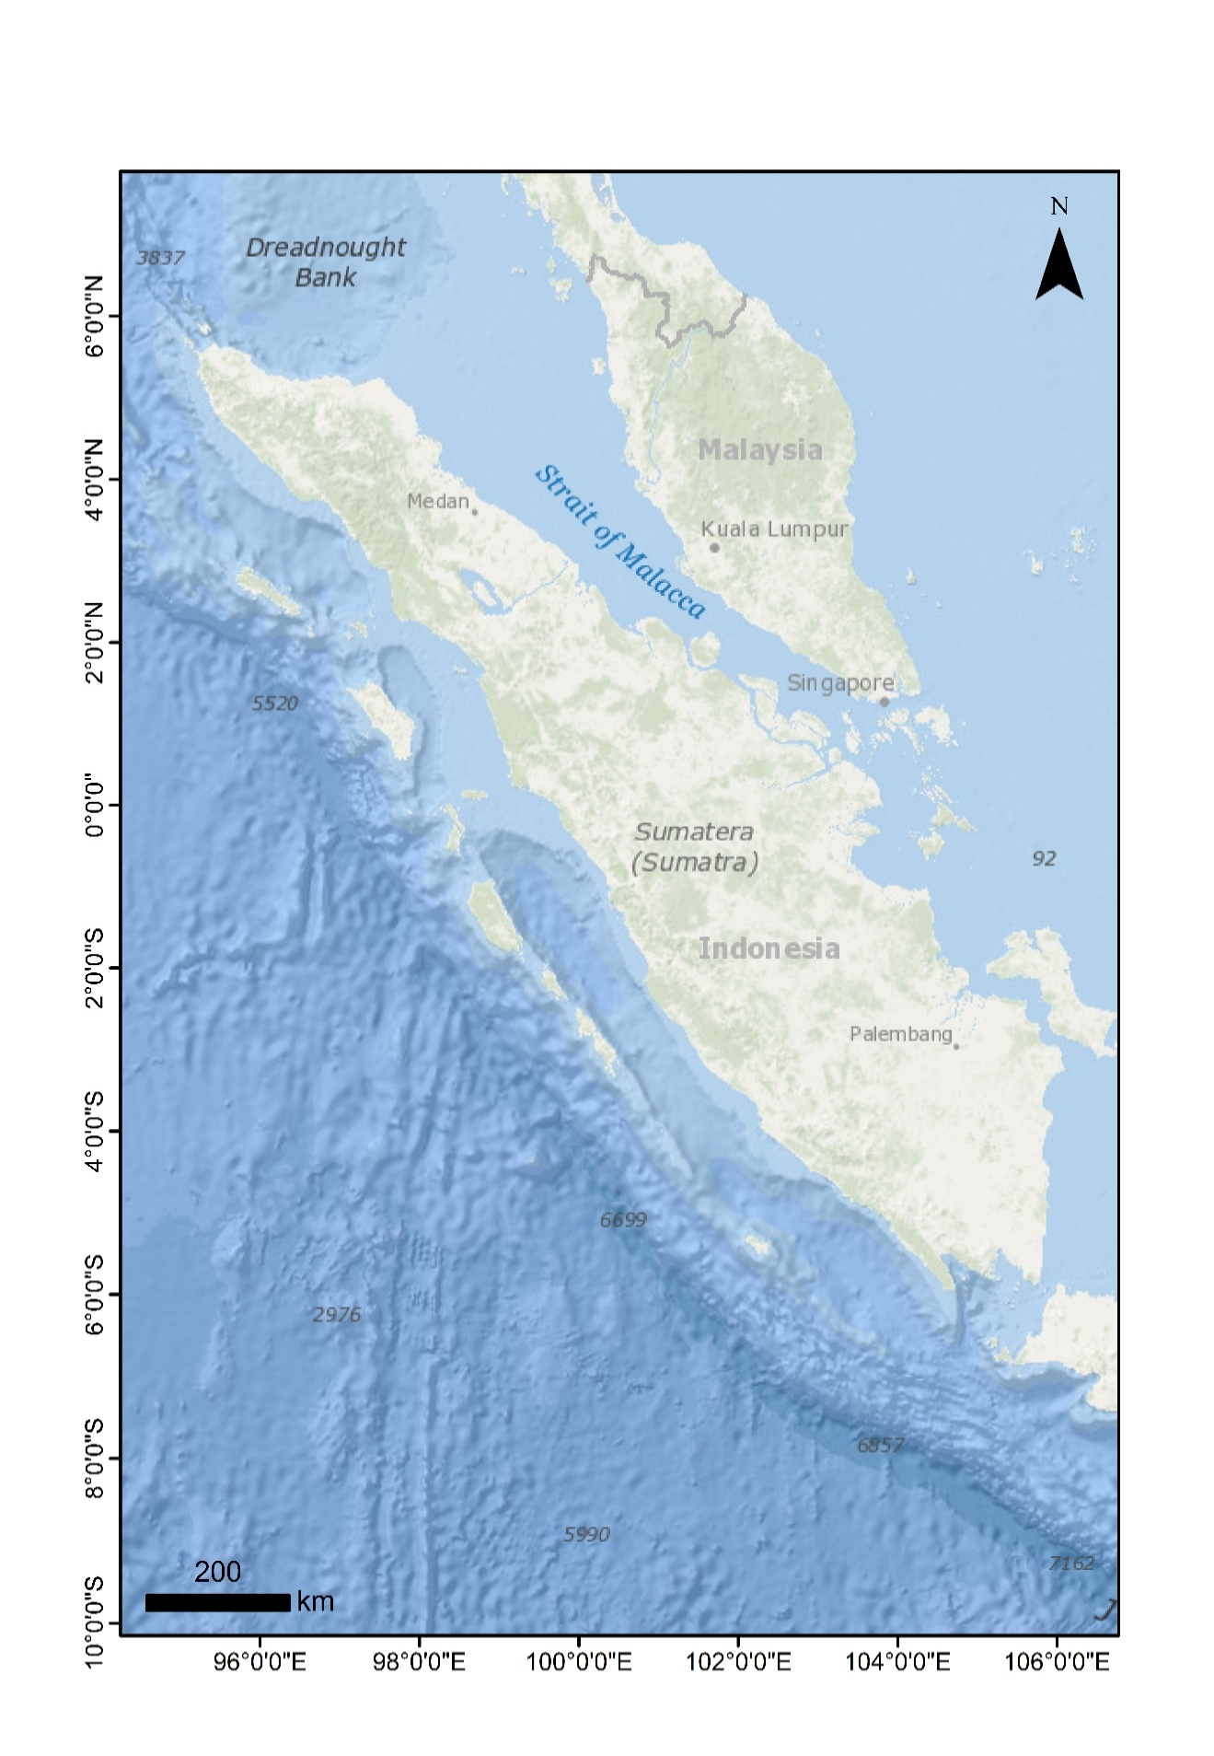
Introduction: Study area, tectonic framework and methods
N
N
N
0⁰15¹0¹¹S
N
0º10’0”S
CHIRP SBP
Bathymetry
Malaysia
Malaysia
Strait of Malaca
Lake boundary
Strait of Malaca
Lake
Toba
Lake
Toba
2-D
seismic line
0º15’0”S
0⁰18¹0¹¹S
Nias
Nias
Lake
Maninjau
0º20’0”S
Height km
Singgalang volcano
Height km
Sumatra
6
Sumatra
6
Mentawai Basin
Mentawai Basin
0.3
0⁰21¹0¹¹S
0.3
Sunda Megathrust
Sunda Megathrust
0º25’0”S
0
0
Great Sumatran fault
Great Sumatran fault
BSL m
4
Tandikat volcano
4
Mentawai Ridge
Mentawai Ridge
6
6
400
200
0
Depth km
Depth km
1.5 km
200 km
0º30’0”S
200 km
Eurasian Plate
5 km
Indo-Australian Plate
Eurasian Plate
0⁰24¹0¹¹S
Indo-Australian Plate
BSL: Below Sea level
100º5’0”E
100⁰9¹0¹¹E
100º10’0”E
100º15’0”E
100º20’0”E
EMODNET (https://portal.emodnet-bathymetry.eu/)
100⁰12¹0¹¹E

Slide 3
Results: Lake floor morphological features
a
a
b
a
e
MWD
c
Dome
b
a
Island
Gully-like feature
a
f
Block?
Lake Boundary
d
b
e
a
e
a

Slide 4
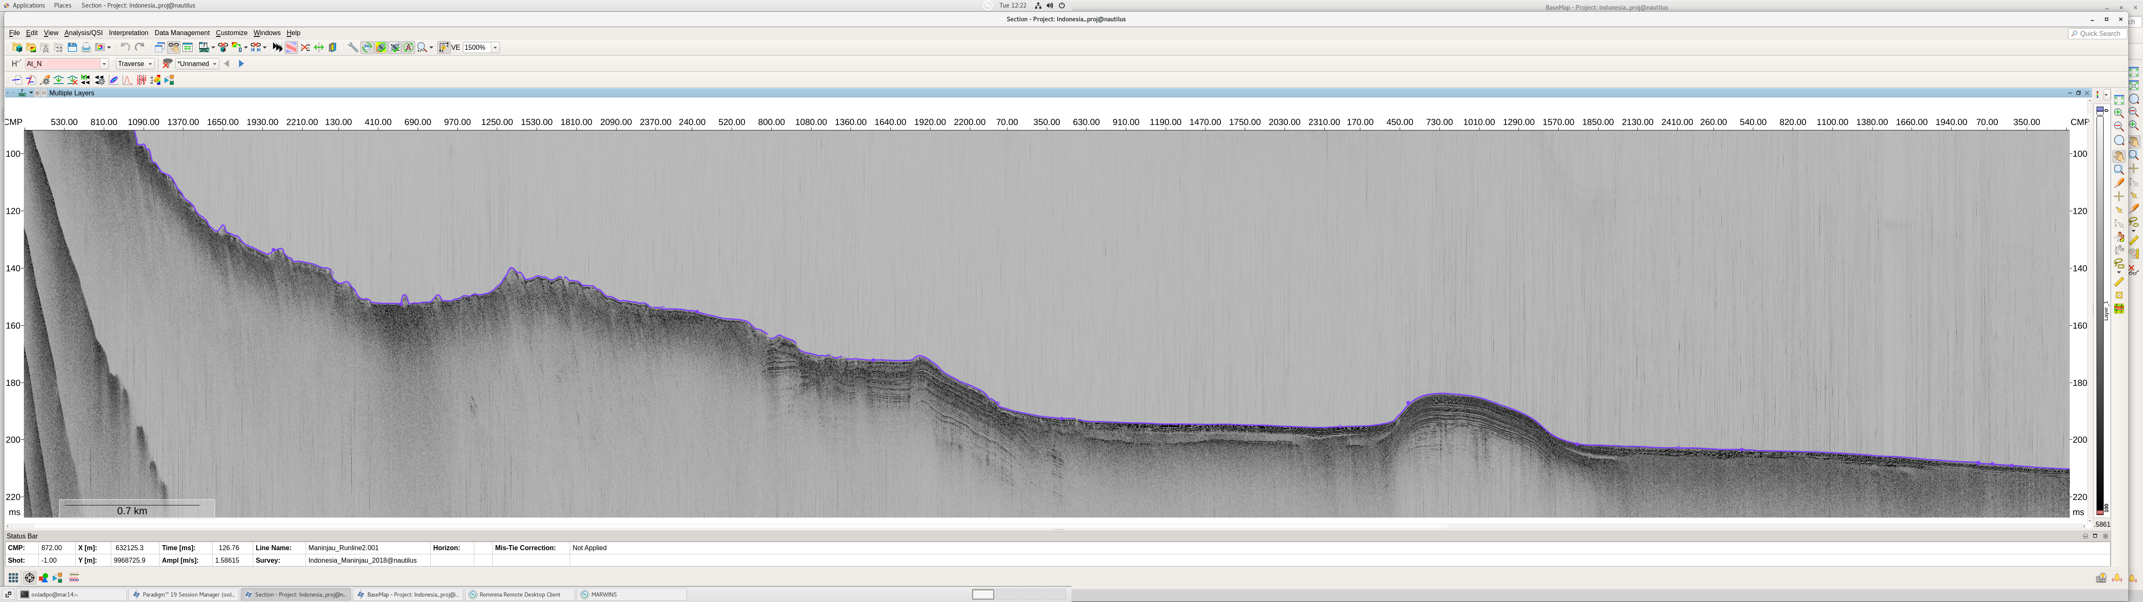
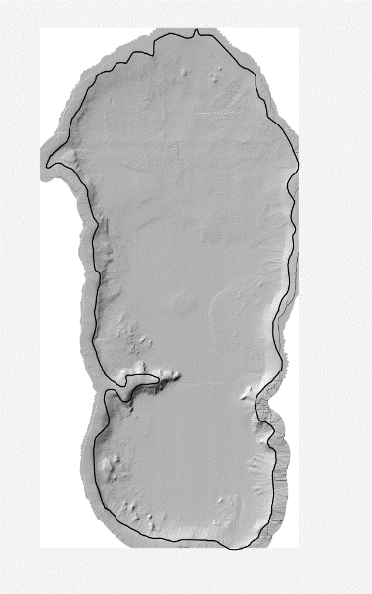
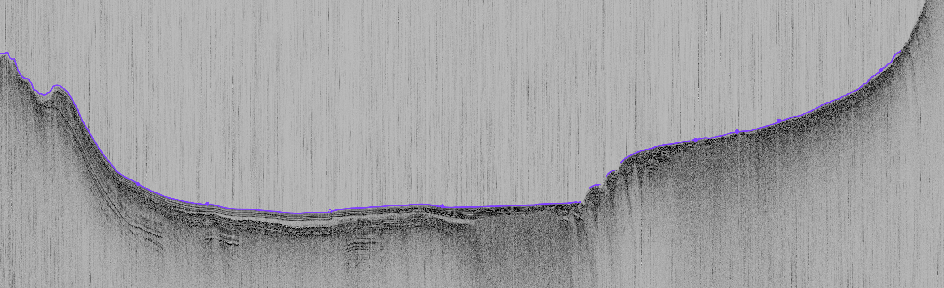
Results: Lake floor physiography
2 km
120
N
S
140
N
TWT [ms]
160
180
Lake floor
200
Shelf to Plateau
Shoulder & Slope
Central sub-basin
Dome
0.7 km
Southern sub-basin
220
VE x 15
W
E
160
TWT [ms]
180
200
Lake floor
0.35 km
220
VE x 20

Slide 5

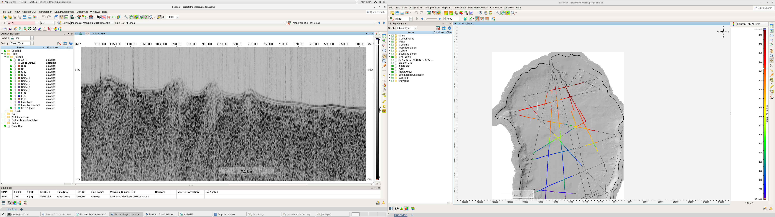
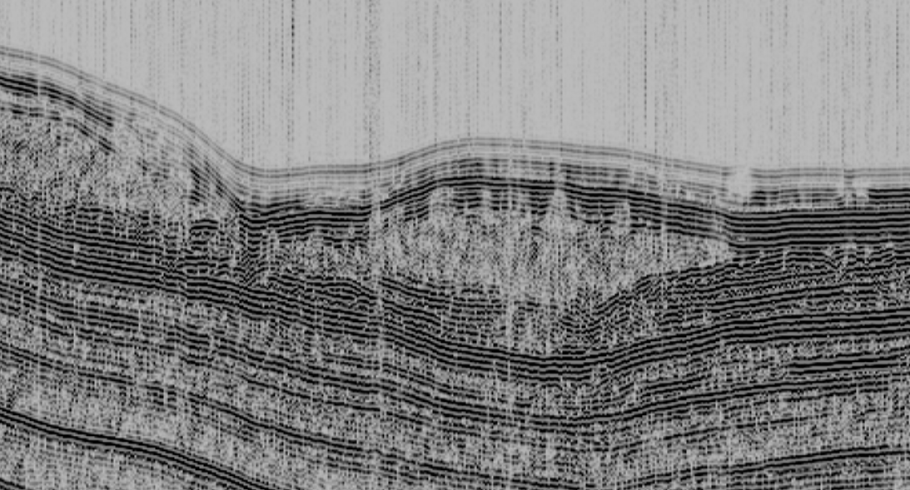
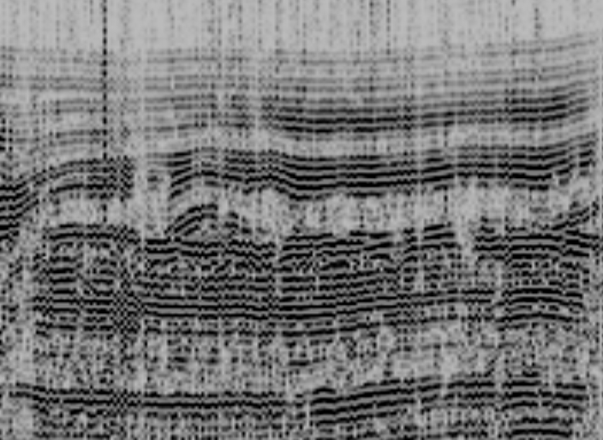
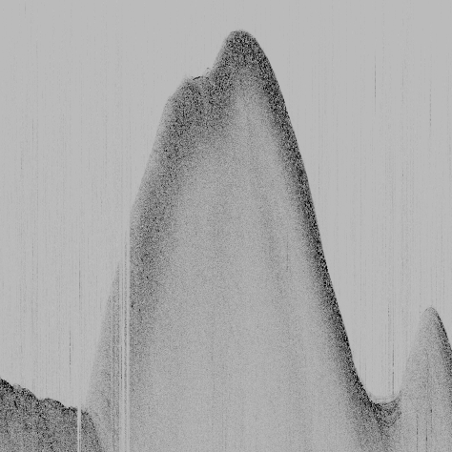
Results: Seismic facies
Seismic facies
Description
Interpretation
Low to high amplitude, high frequency, continuous and parallel patterns.
hemipelagic lacustrine deposits
I
Parallel to sub-parallel patterns interrupted by chaotic to transparent mounded structure.
mass wasting/debris flow deposits with embedded blocks
II
Chaotic reflection patterns within brighter reflections.
III
Mass wasting materials
Parallel continuous patterns interlaced with chaotic patterns.
dispersed volcanic
ash within lacustrine deposits
IV
represent huge blocks of rock fall events or block earthquake induced landslides
Mounded structures with hummocky top reflections and poorly-resolved internal reflections.
V

Slide 6
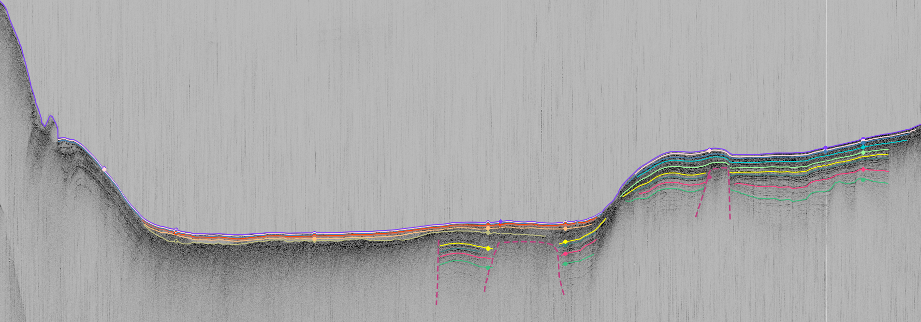
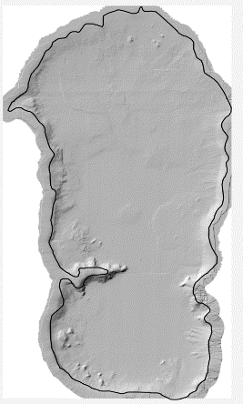
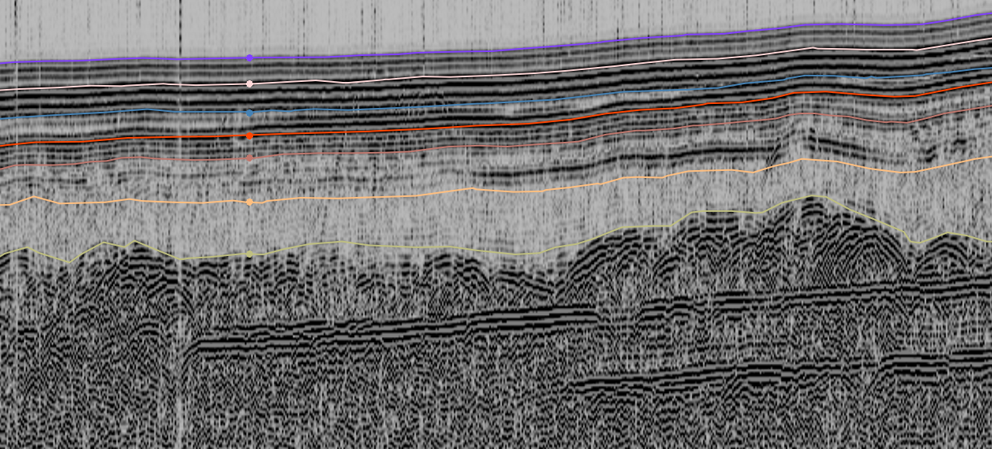
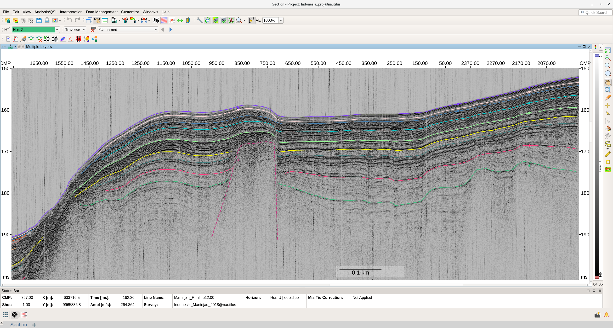
Results: Seismic stratigraphy
100
SW
2 km
NE
150
N
TWT [ms]
Caldera structural rim ?
Caldera structural rim ?
Intrusion?
Intrusion?
200
Ring fault ?
Ring fault?
Intrusion?
Intrusion?
0.5 km
a
VE X 10
188
b
150
c
Lake floor
SU I
160
190
SU II
SU I-s
SU III
SU II-s
SU IV
170
SU V
SU III-s
192
SU IV-s
SU VI
Intrusion?
180
SU V-s
194
SU VI-s
0.1 km
190
0.32 km
0.43 km

Slide 7
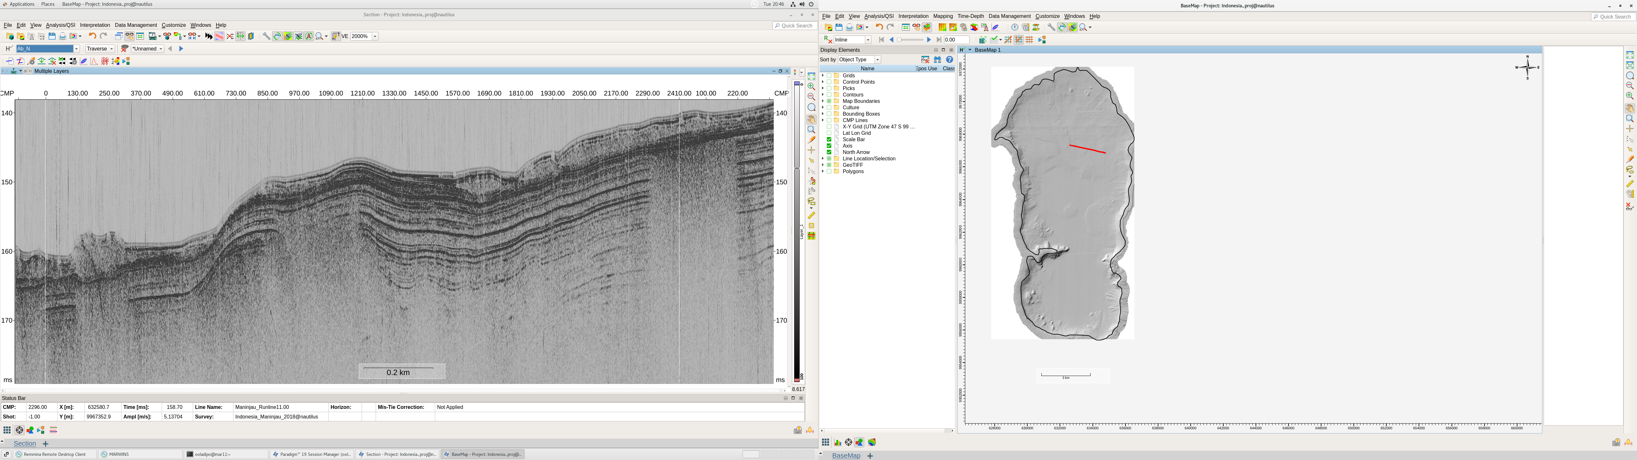
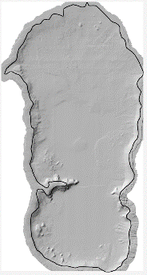
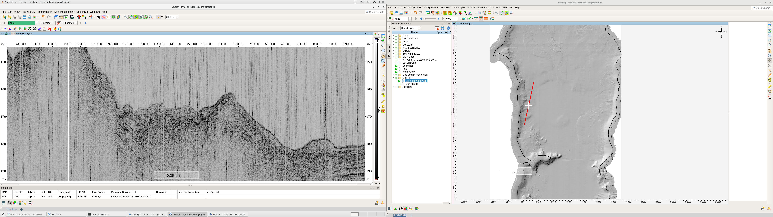
Results: Laterally-constrained MWD
140
NW
2 km
SE
N
150
Sliding surface
TWT [ms]
Acoustic blanking
160
Ramp?
0.2 km
170
VE X 20
150
SW
NE
160
170
TWT [ms]
180
0.13 km
VE x 20

Slide 8
Summary
Lake Maninjau has 4 physiographic provinces
The floor of Lake Maninjau has 5 distinct morphological features
The sedimentary fill is divided into 6 distinct seismic units
The lake sediments show evidence of response to earthquake
Long core(s) location?

Slide 9
Thank you

