Slide 1






BG3.9: Modelling agricultural systems under global change
To what extent our food production depends on anthropogenic phosphorus?
Josephine Demay, Thomas Nesme, Bruno Ringeval and Sylvain Pellerin
josephine.demay@inrae.fr
Vienna, Austria, 23–27 May 2022

Slide 2
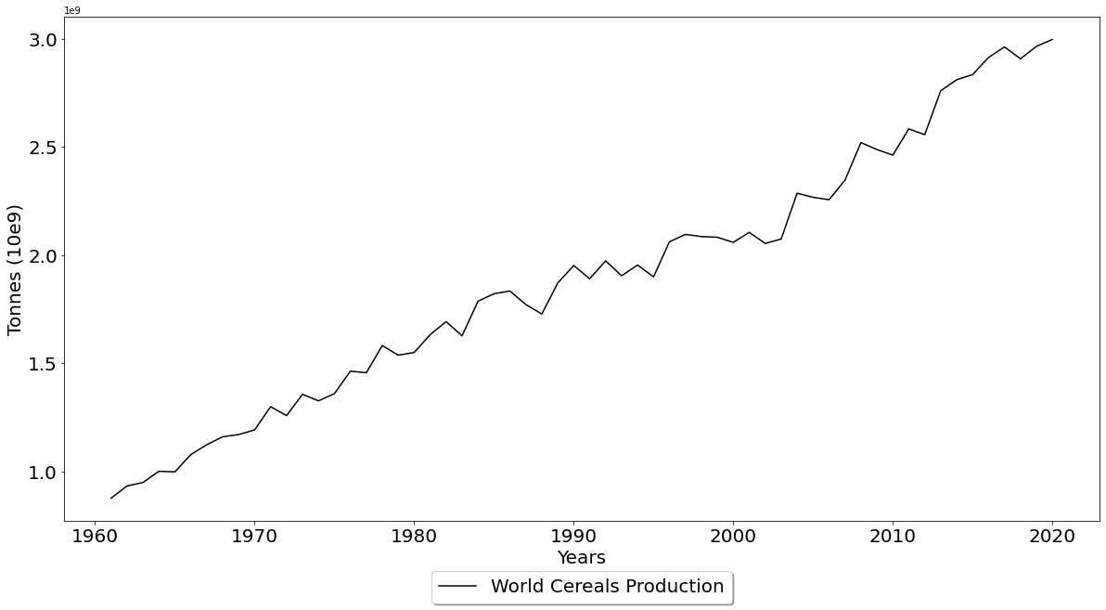
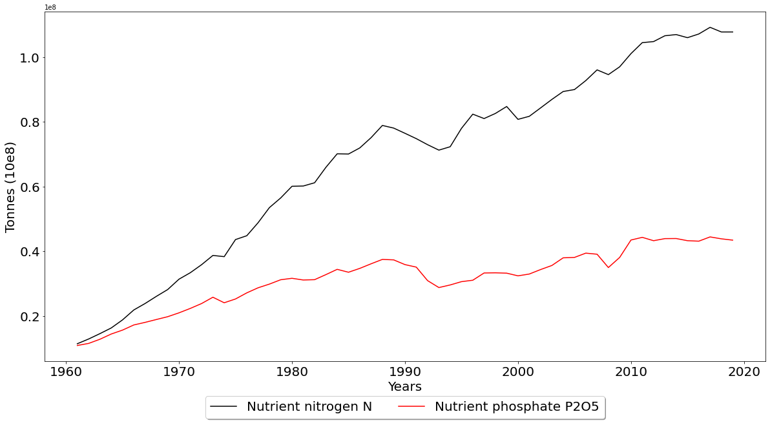
General Context
Methodology
Results
Conclusion
Global production of cereals
Global use of mineral fertilizers in agriculture
(FAOSTAT)
(FAOSTAT)
What is the contribution of anthropogenic P (i.e. mineral P fertilizer + mineral feed additives) to current soil P fertility and food production levels?
Notes:
In the last 60 years global production of cereals has been multiplied by 3.4
In the last 60 years global use of N mineral fertilizers 9.5
In the last 60 years global use of P mineral fertilizers 4.0

Slide 3

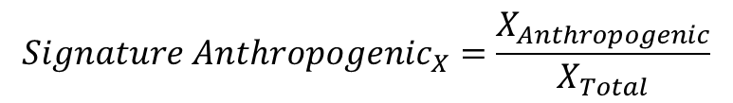
General Context
Methodology
Results
Conclusion
Chosen metric
Anthropogenic signature
$$Signature An{thropogenic}_{X}=\frac{X_{Anthropogenic}}{X_{Total}}$$
1950
2017

Slide 4
General Context
Methodology
Results
Conclusion
Domestic
Feed and Forage
Soil compartment
Mineral P fertilizer
Labile P pool
Stable P pool
Crop and forage P harvest
Anthropogenic
Labile P Pool
Anthropogenic Stable P Pool
Livestock
Manure
Domestic Crop Food
Sludge
Human
Natural Labile P Pool
Natural Stable P Pool
Feed additive
Losses
Imported Food and Feed products

Slide 5
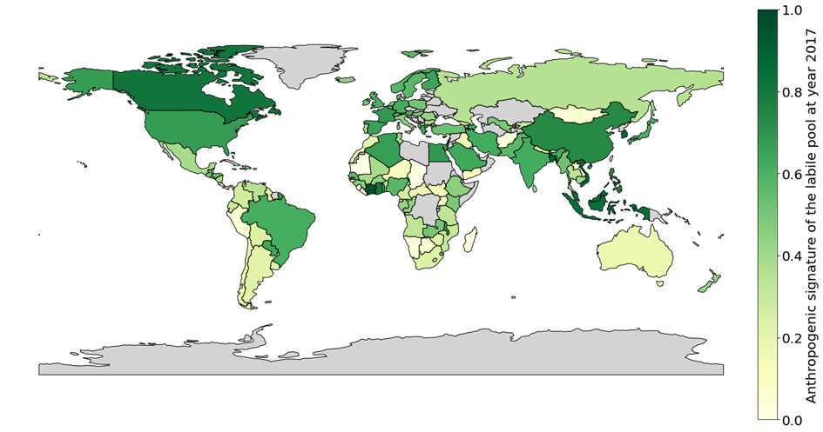
General Context
Methodology
Results
Conclusion
At the global scale, the anthropogenic signature of the soil labile pool was 45 ± 7% in 2017
This result hides large differences between countries and world regions
60 ± 3%
38 ± 10%
69 ± 8%
59 ± 5%
41 ± 9%
30 ± 4%
18 ± 11%

Slide 6
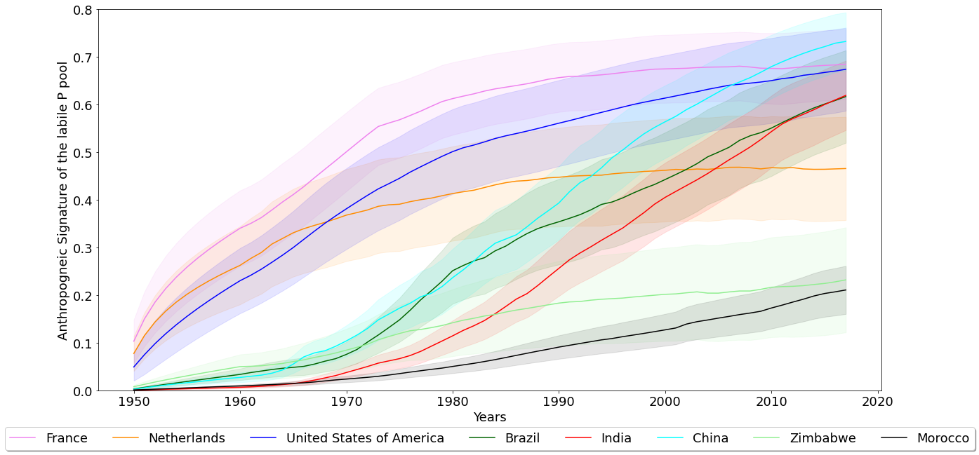
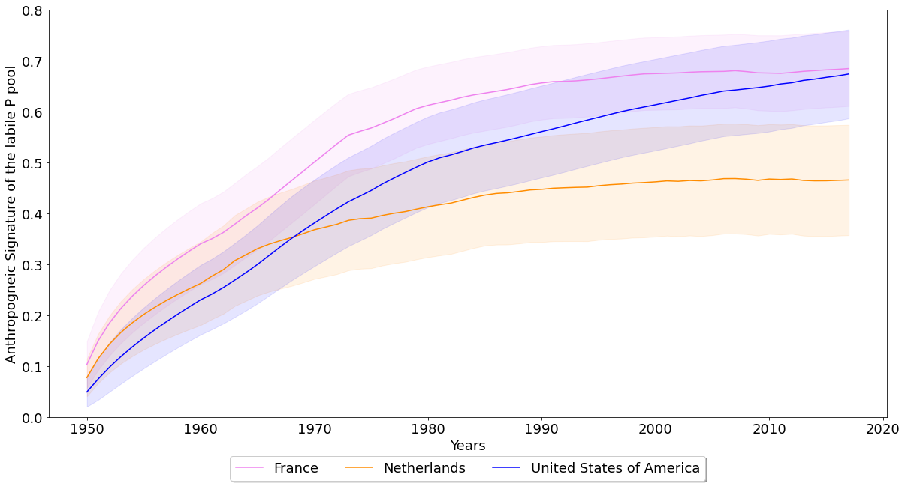
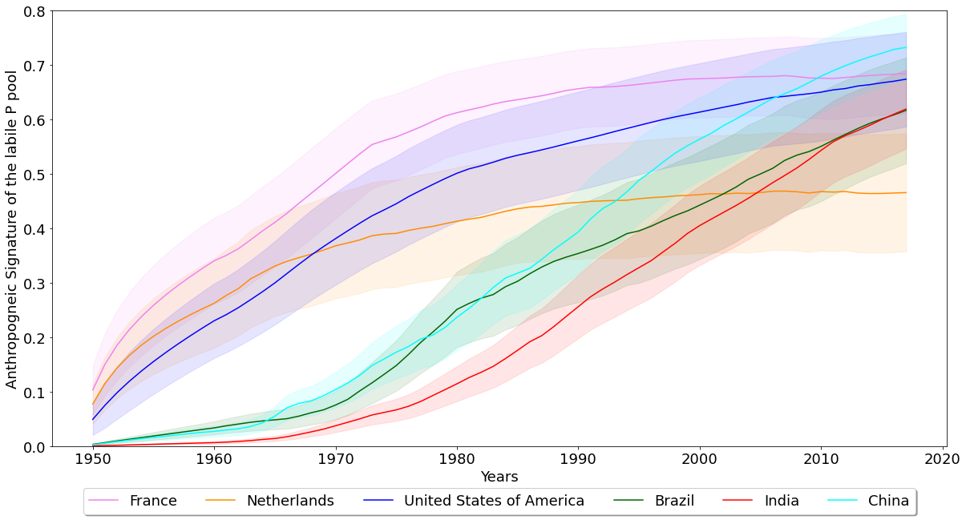
General Context
Methodology
Results
Conclusion
Different historical trajectories mainly driven by different use of mineral P fertilizers
USA
Notes:
Not only did we look at the spatial distribution of soil P anthropogenic signature but also on their temporal evolutions

Slide 7
General Context
Methodology
Results
Conclusion
Globally our agricultural systems have highly relied on the use of mineral P fertilizers
This raises questions regarding their vulnerability to P scarcity and their ability to shift toward less input-intensive production systems
The reliance on mineral P fertilizer displays great discrepancies both in space (between countries) and in time (temporal evolutions of the anthropogenic signatures)
(Not shown) The trade of agricultural products contributed to displace large quantities of anthropogenic P, even though it has no effect on the soil P anthropogenic signatures

Slide 8
Thank you for your attention !

