Slide 1



Ionospheric elves powered by negative NBEs in overshooting tops
Feifan Liu, Torsten Neubert, Olivier Chanrion, Ningyu Liu, Baoyou Zhu,
Gaopeng Lu, Jiuhou Lei, Nikolai Østgaard, and Victor Reglero
@EGU. 27.May. 2022

Slide 2
Introduction
ASIM and Sferic array
Observation result
Ongoing simulation work

Slide 3
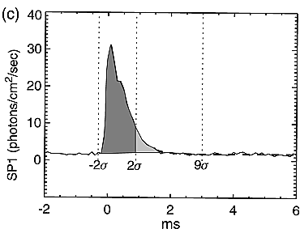
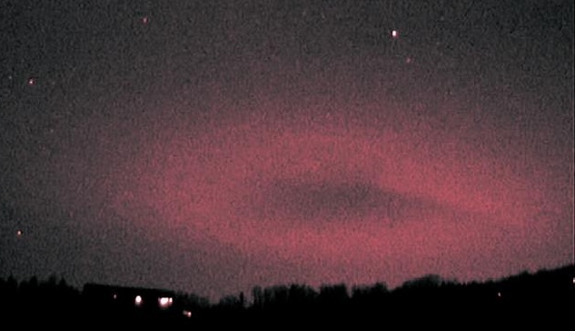
What is Elves?
Elves： Lightning‐induced transient optical emissions in the lower ionosphere
Viewed from ground
Optical signature from ISUAL
Frankie Lucena
Chang et al., 2010
Ring‐shaped optical emissions lasting less than 1 ms

Slide 4
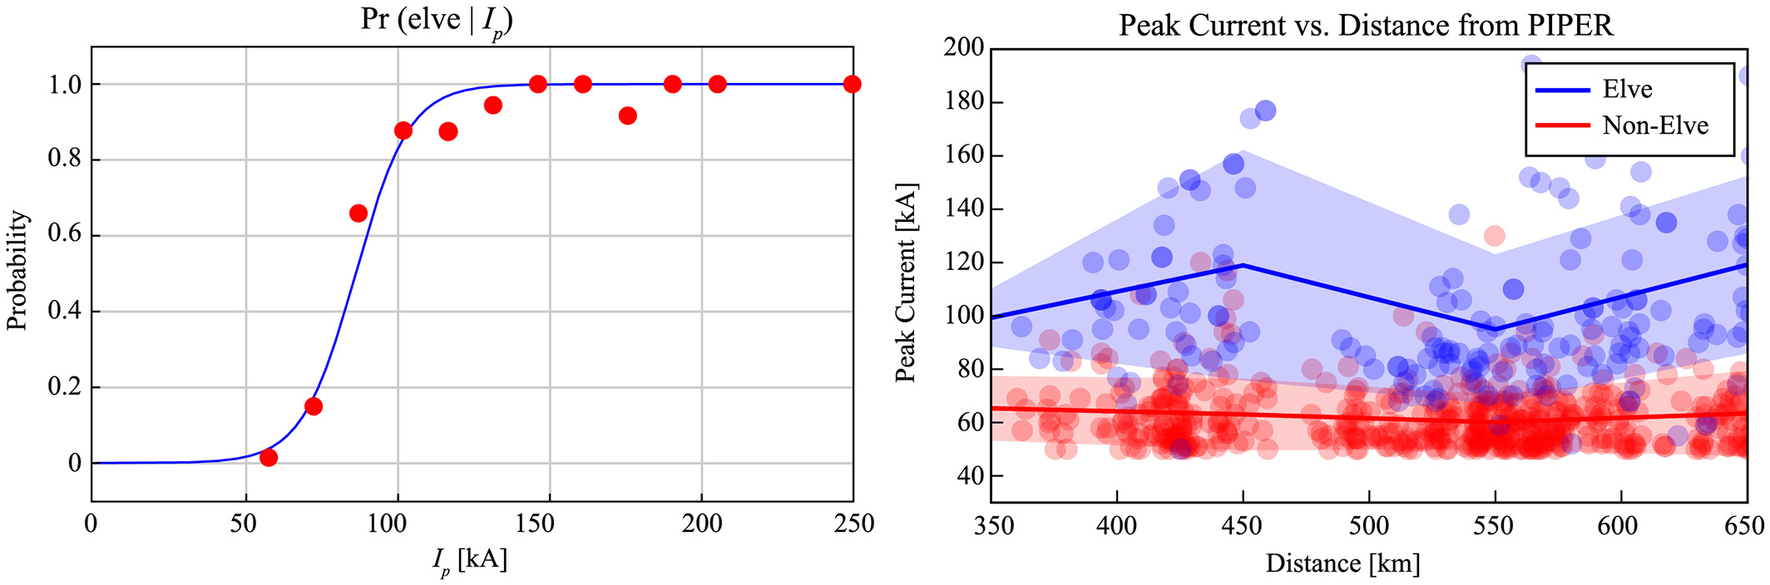
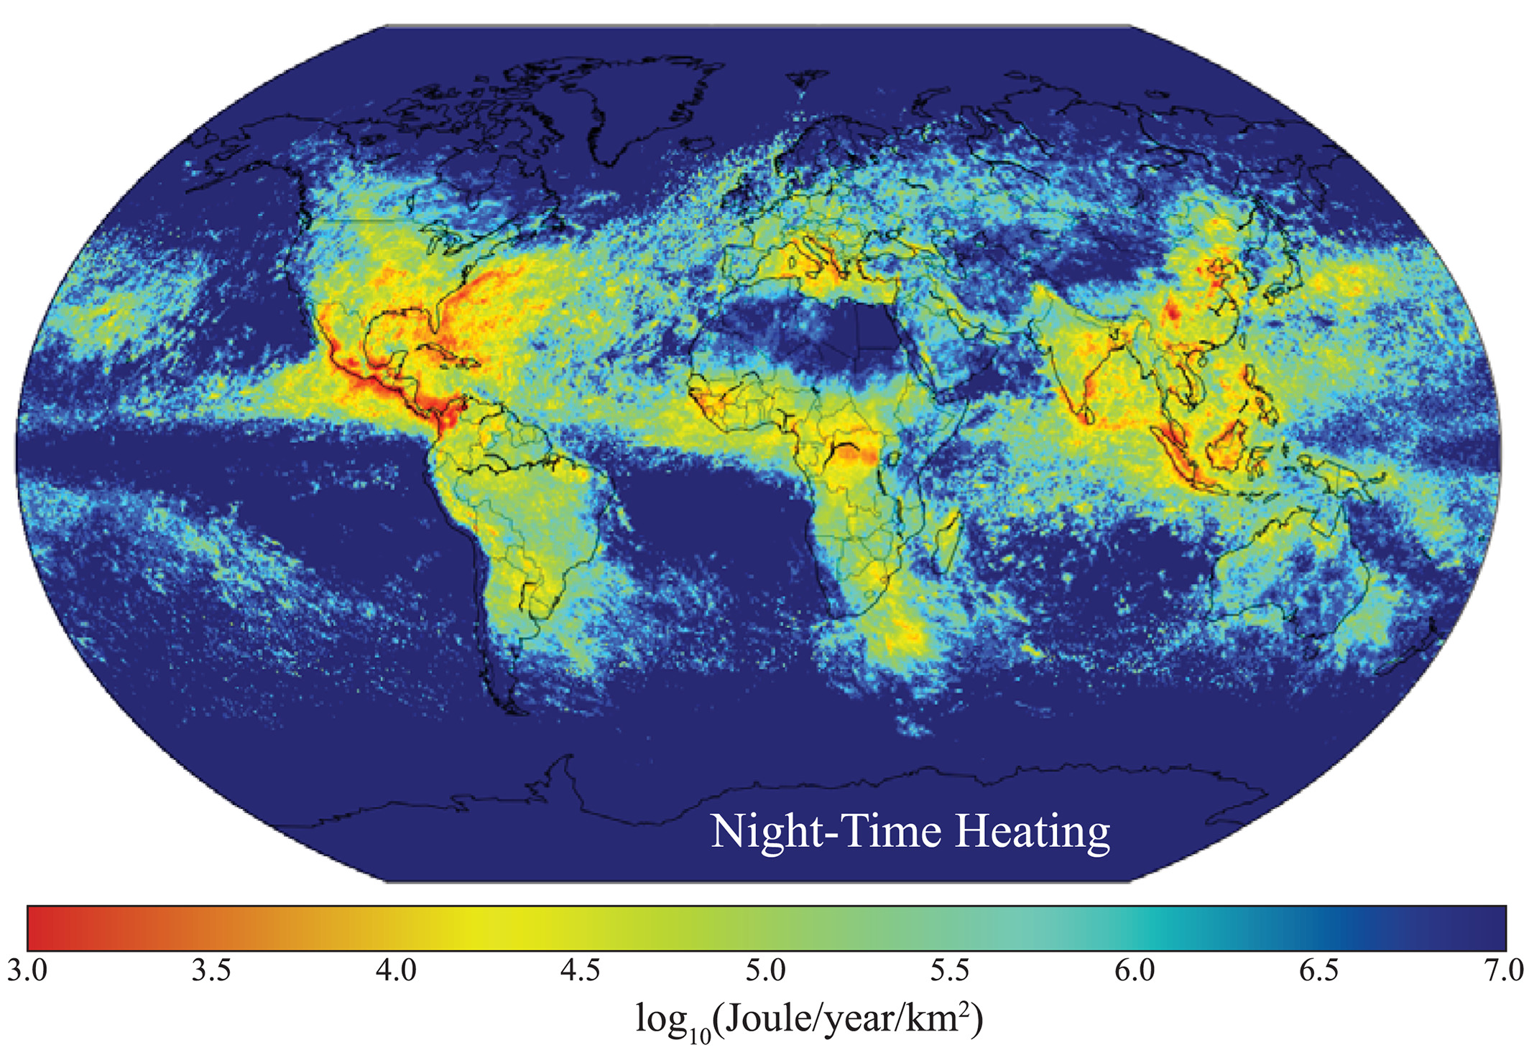
Global elves and ionospheric heating by CGs
A significant component of the energy coupled from thunderstorms to the ionosphere
Blaes et al., 2015

Slide 5
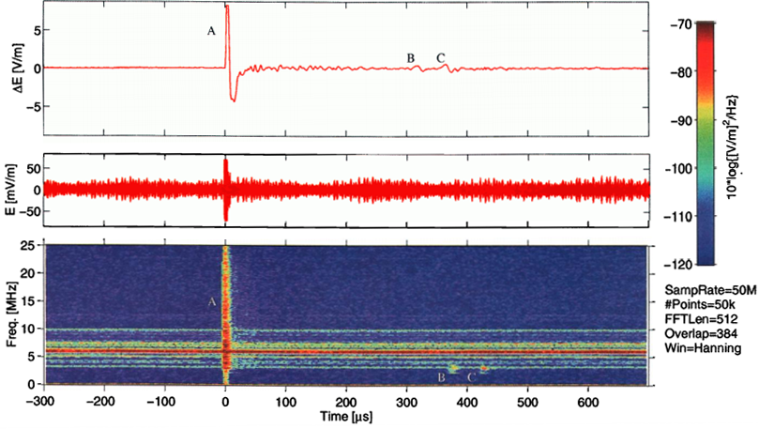
Narrow bipolar events (NBEs)
Short duration (20-30 us) in VLF/LF signal (Smith et al., 1999; Wu et al., 2011)
Strongest VHF signal in nature (Willett et al.,1989)
Fast breakdown of streamer discharges (Rison et al., 2016; N Liu et al. 2019)
Initiation of the lightning process (Leal and Rakov, 2019; Lyu et al., 2019)
1-500 kHz (VLF/LF)
3-30 MHz (HF)
Smith et al. 1999

Slide 6
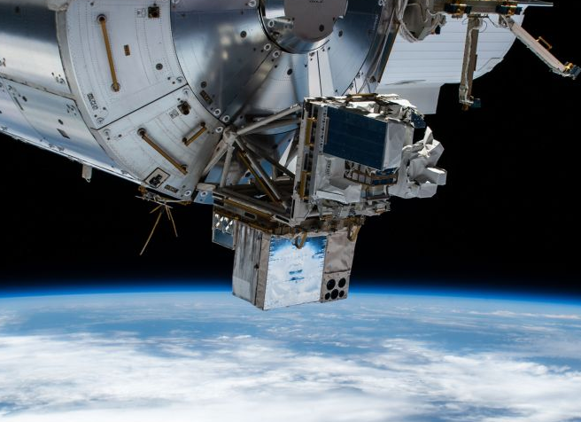
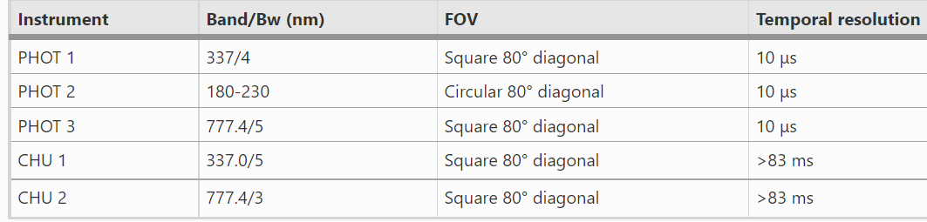
Atmosphere-Space Interactions Monitor (ASIM)
Nadir observation: 2018/04/02- 2022/01/09
Limb observation: 2022/01/10 -…
MXGS: The low energy (15 keV to 400 keV) and the high energy (200 keV to 40 MeV).
MMIA: Three optical bands and two filtered camera
Neubert et al., 2019
Chanrion et al., 2019

Slide 7
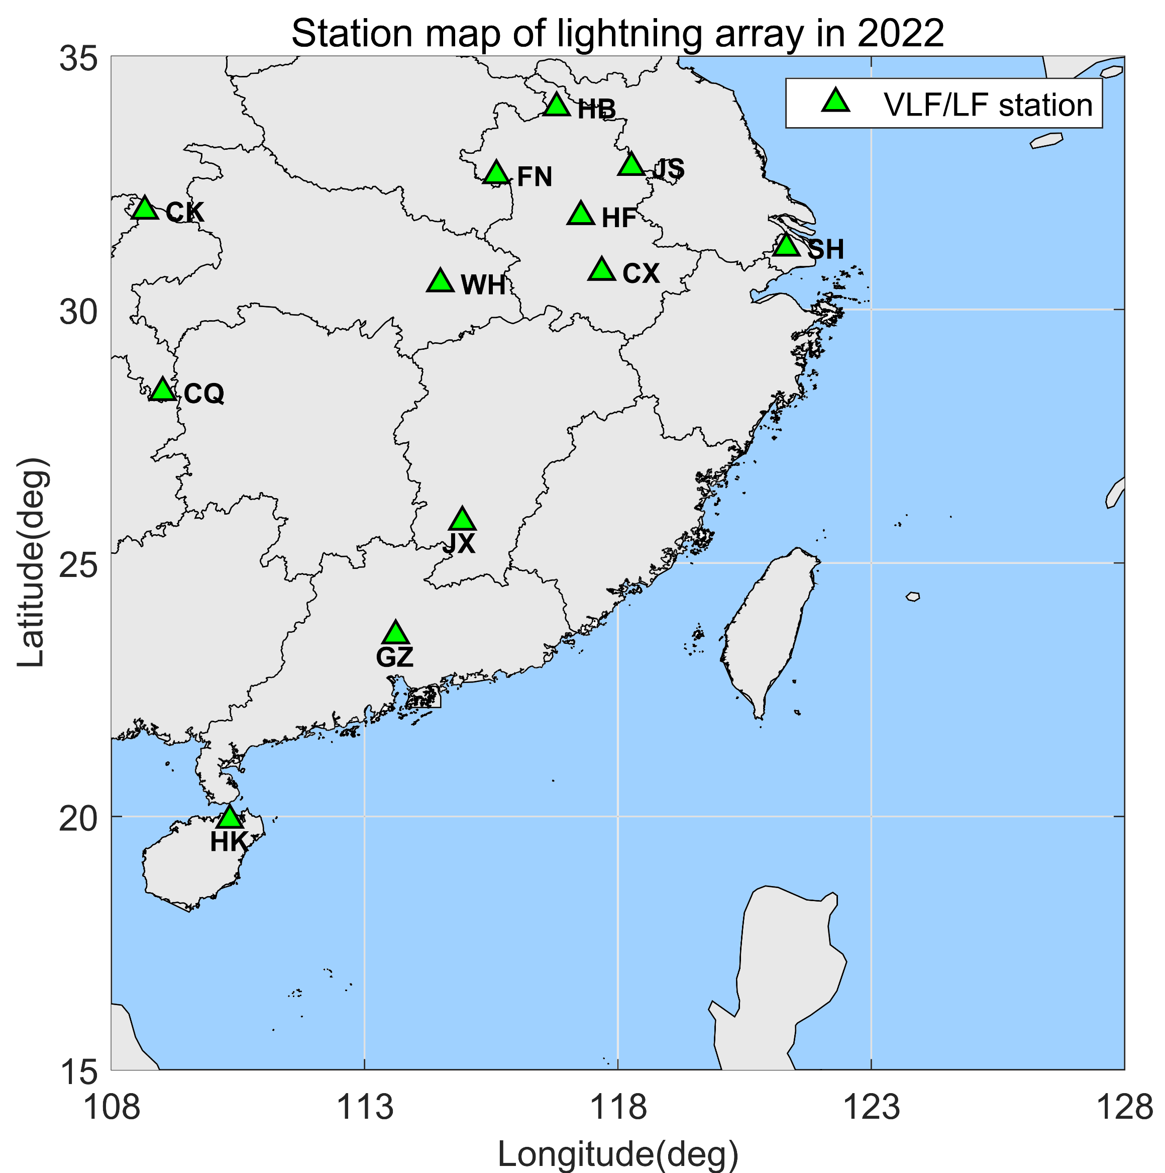
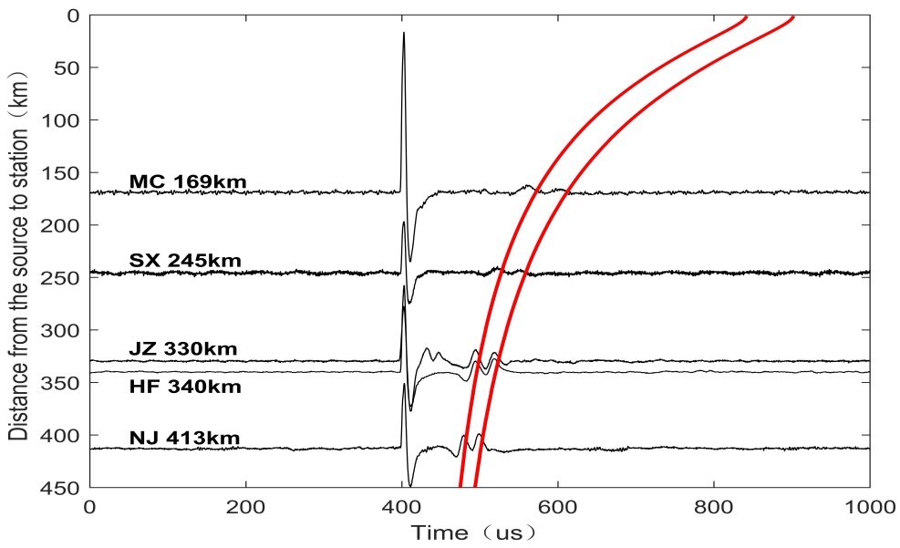
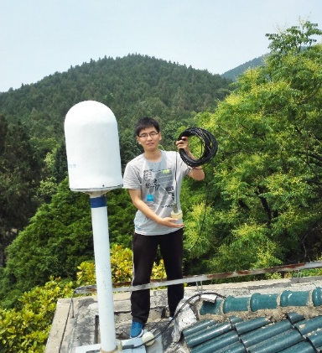
Ground Lightning Sferic Array
12 stations with GPS synchronized at a sampling rate of 5 MHz
Vertical E-field antenna (with 3dB-bandwidth of VLF/LF from 800 Hz to 300 kHz)
Continuous/Triggered sampling with no dead time

Slide 8
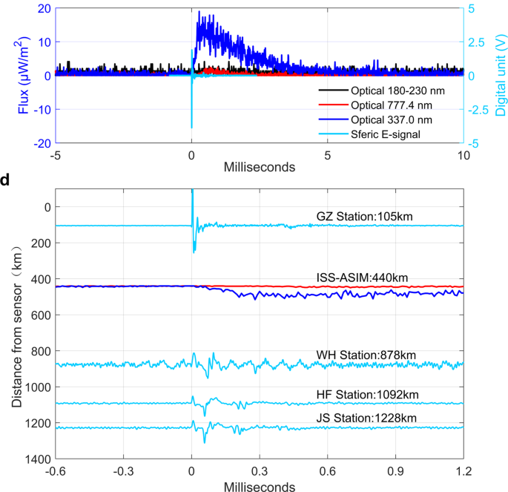
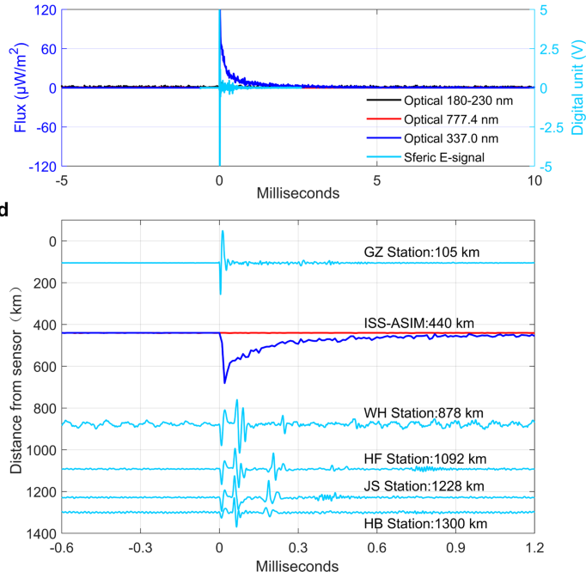
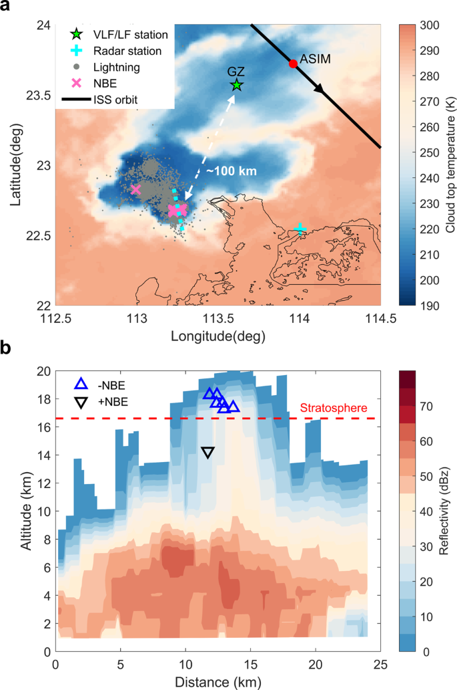
Observations of blue emissions with NBEs
Positive NBEs
Negative NBEs
Slow rise time
Fast rise time
F Liu et al. Nature communications,2021

Slide 9
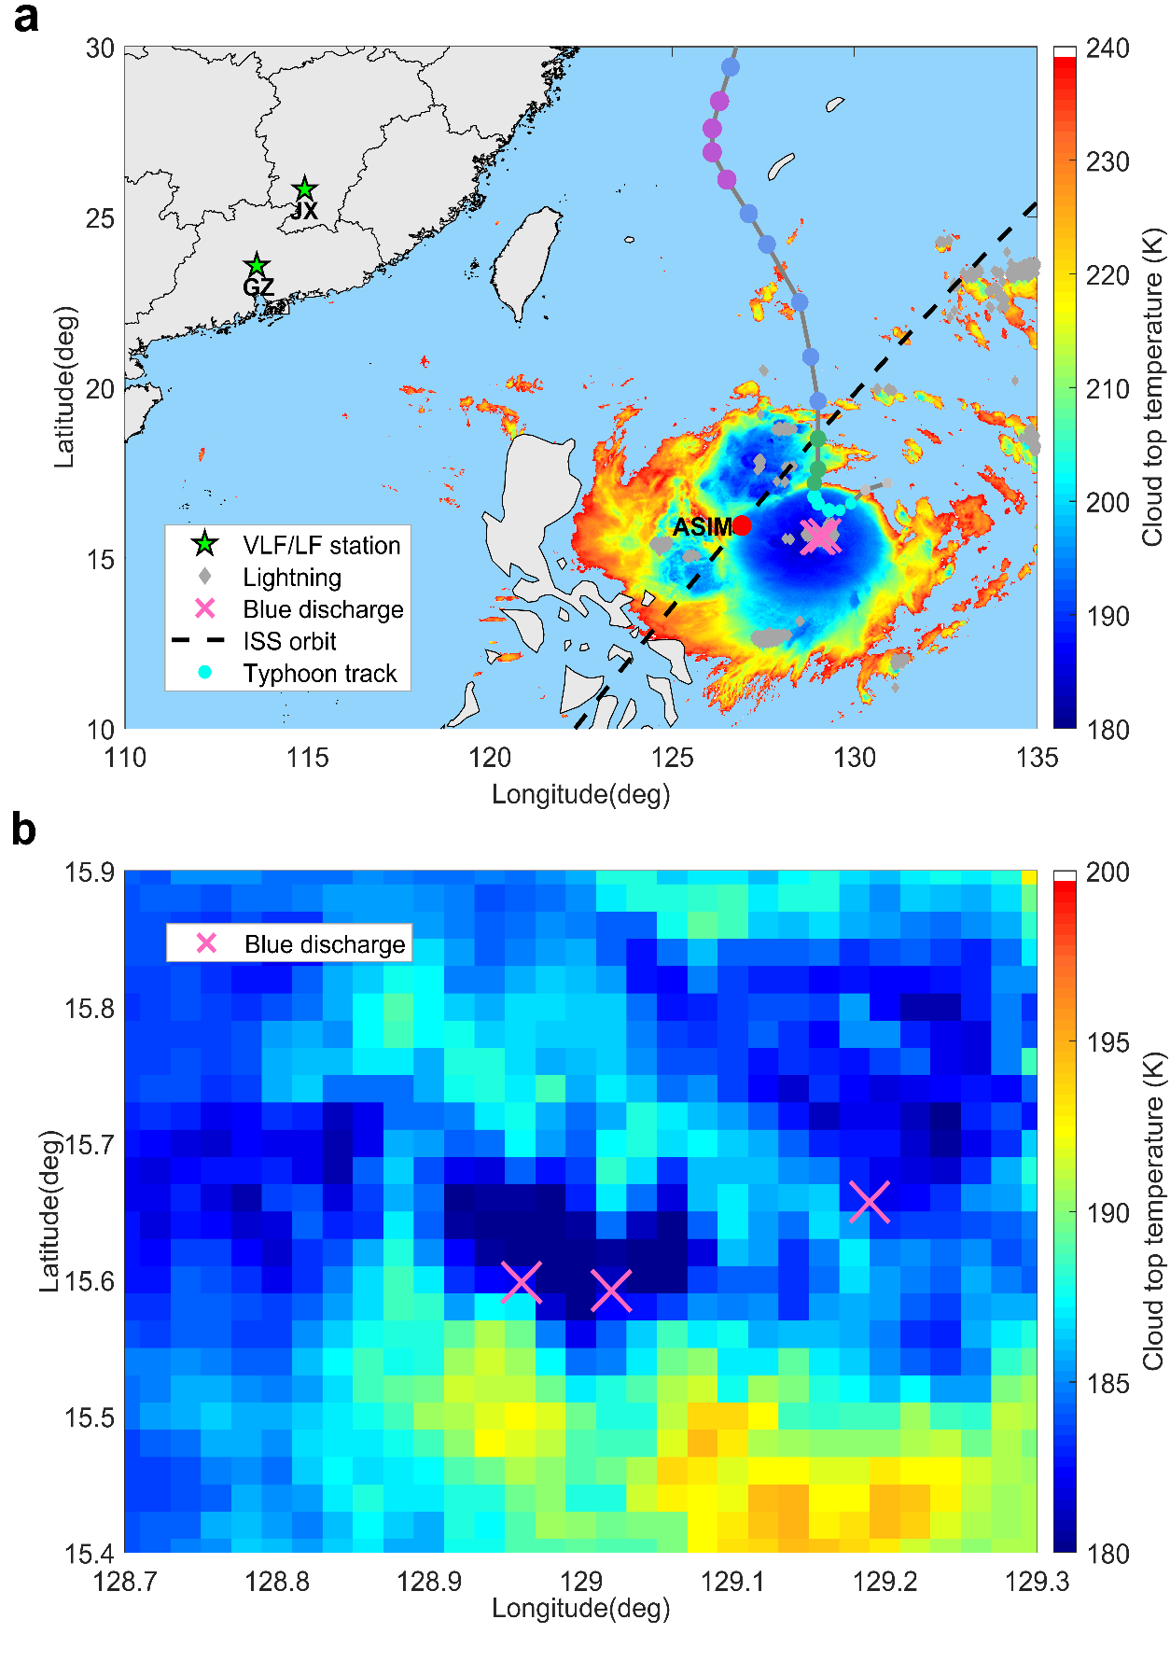
Intense negative NBEs produced in a tropical storm
Three intense blue emissions associated with negative NBEs by ASIM and sferic array

Slide 10
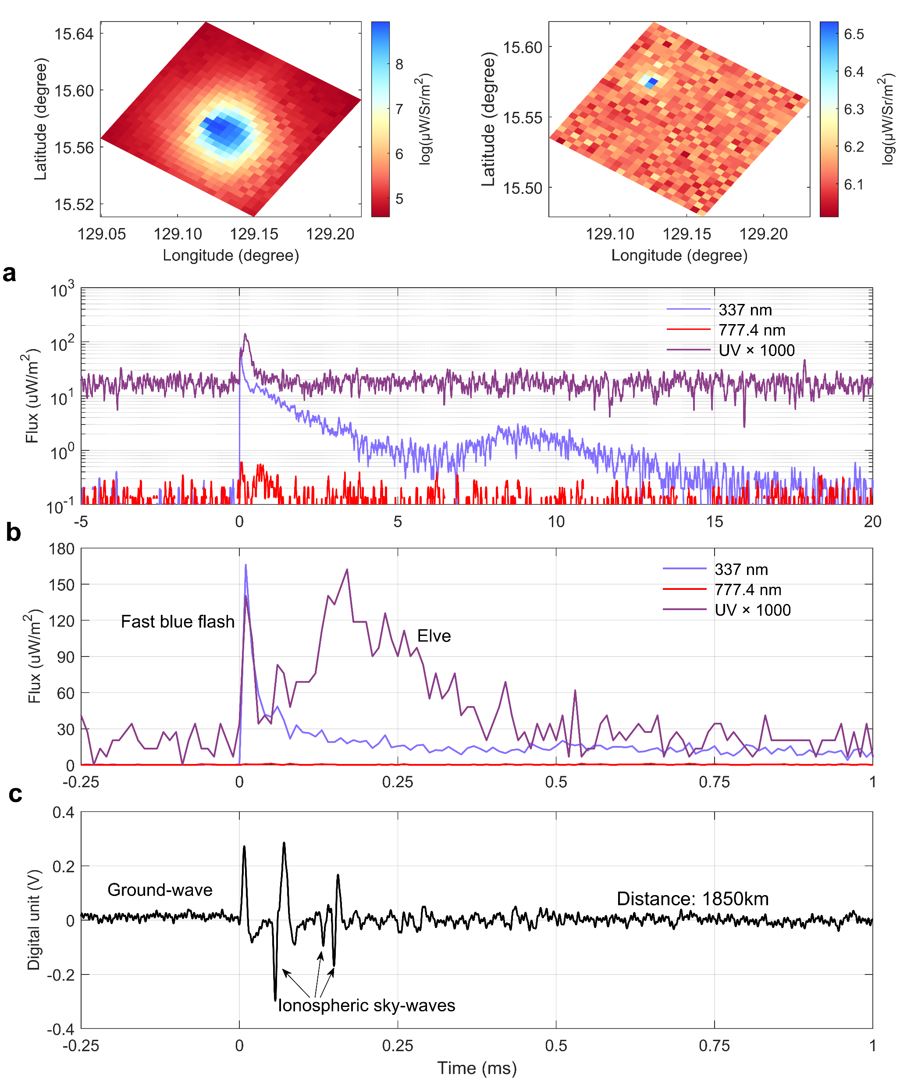
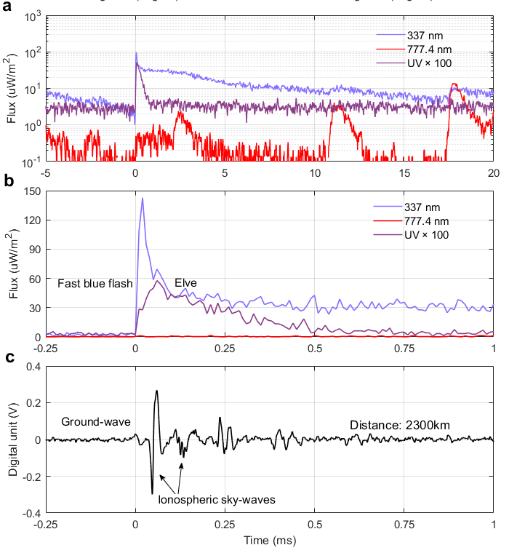
Observations of Elves produced by NBEs
Case 1
Case 2
GLD: 60 kA?
GLD: 70 kA?

Slide 11
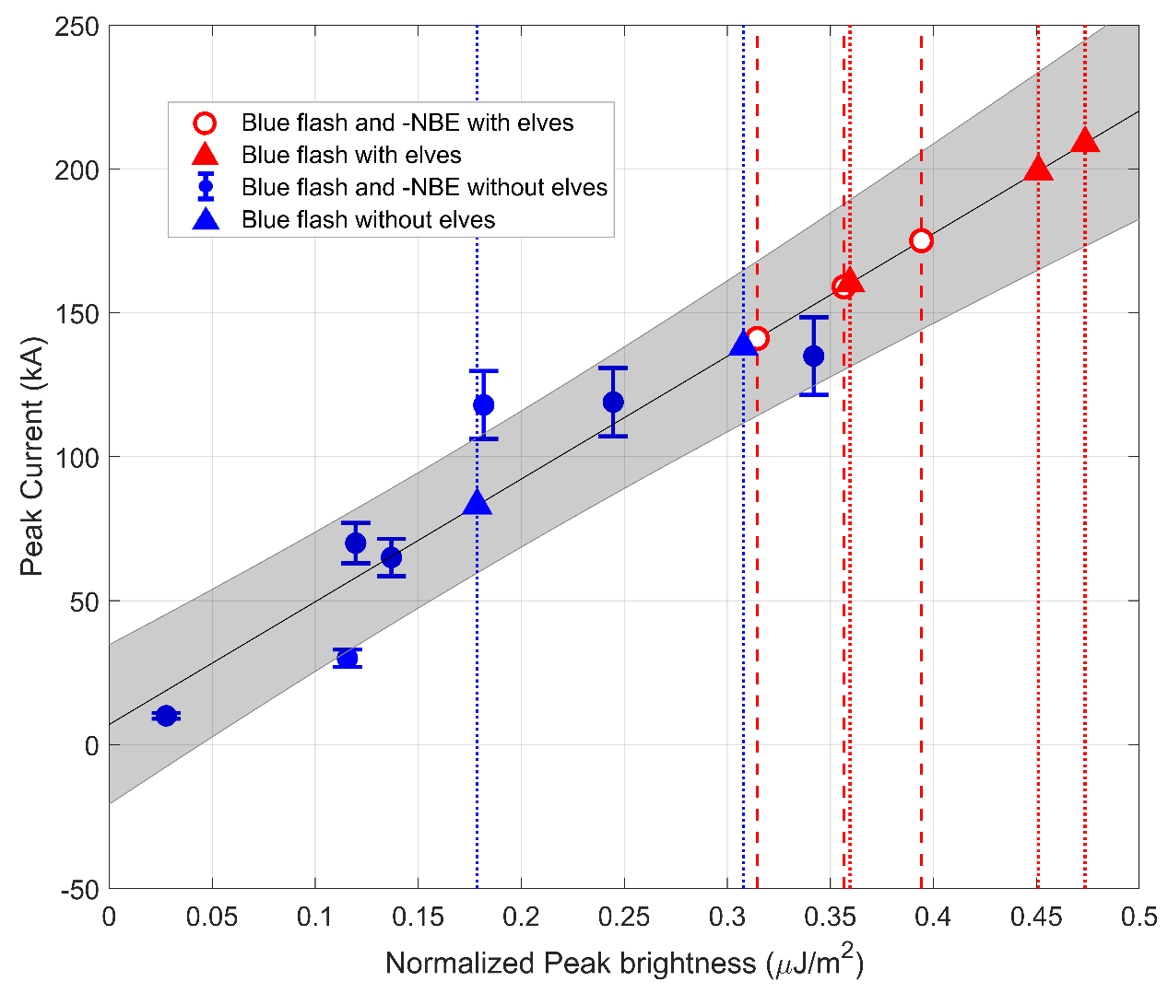
Estimated peak current of NBEs from blue emission
Notes:
To estimate the peak current of NBEs far away from the radio senor, we first obtain the nearly linear relationship between the normalized peak brightness and peak current according to the storm close to the radio senor. Then we derive the peak current of NBEs from the optical emission from the relationship.
The red mark presents the blue emissions with elves, and blue mark shows the blue emission without elves. We see the threshold of peak current for the elves is about 140 kA. We note that this method should have some uncertainness due to the small samples. But it may provide experimental evidence that strong NBEs can produce elves.

Slide 12
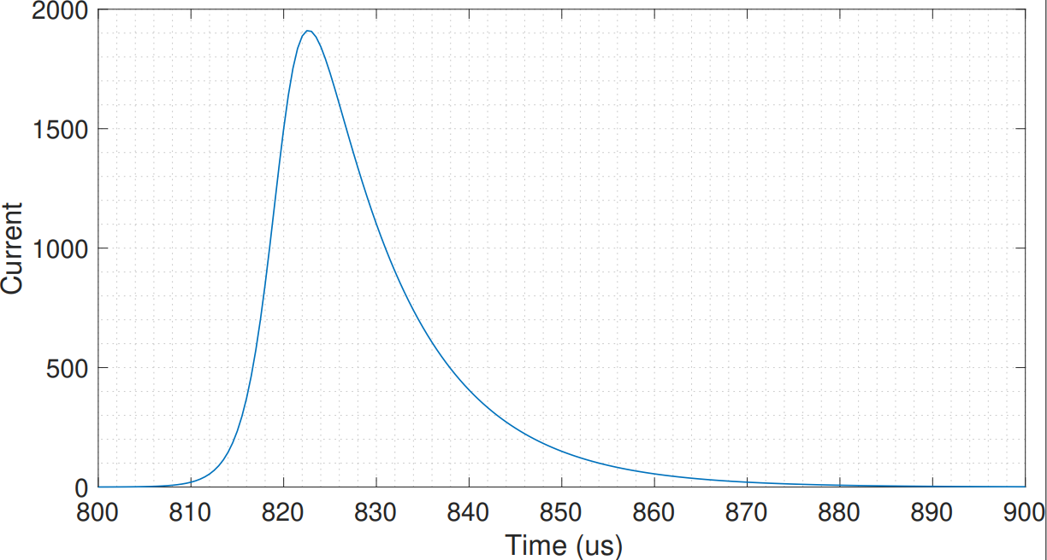
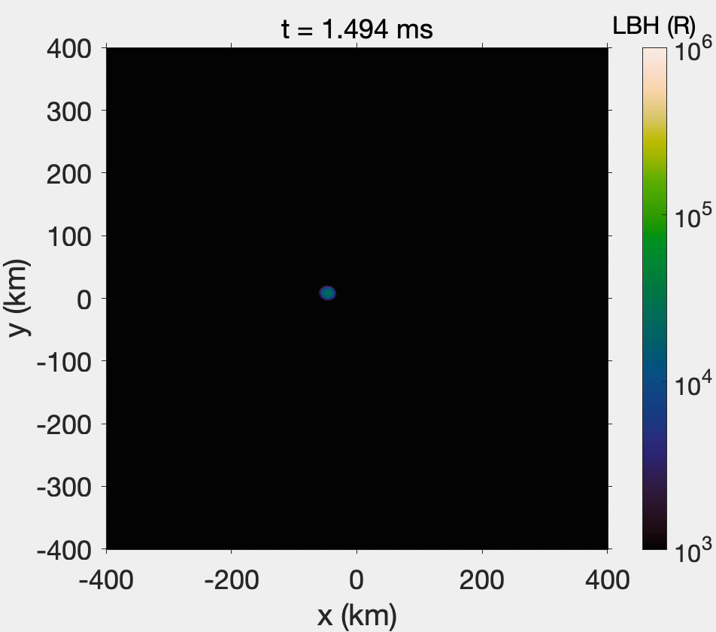
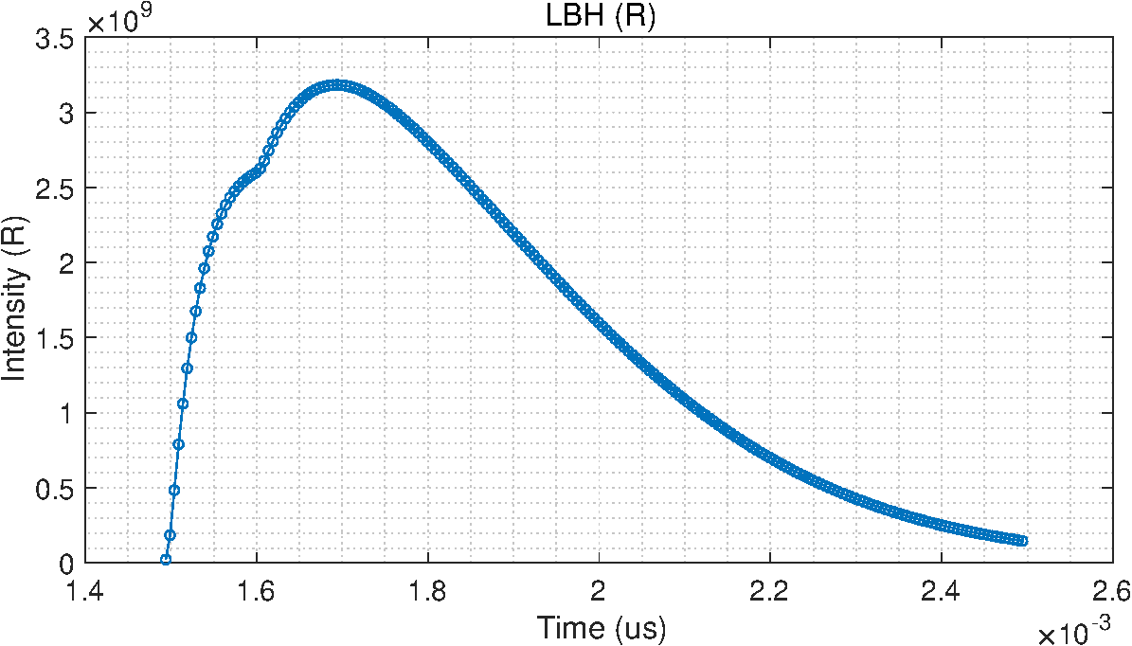
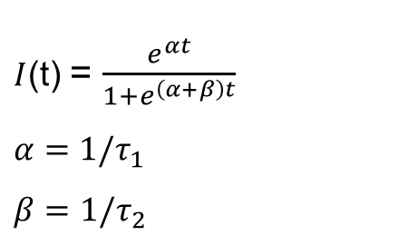
Ongoing simulation work
Double-exponential source current
$I$(t) = $\frac{e^{αt}}{1+e^{\left(α+β\right)t}}$
$$α=1/τ_{1}$$
$$β=1/τ_{2}$$
F Liu et al. In preparation, 2022

Slide 13
Summary
We present the simultaneous observations that strong negative NBE discharges can generate weak, but observable elves.
The appearance of elves would provide a new method to estimate the currents of corona discharges at cloud tops, where model currents of streamers can be adjusted to match observed elves.

Slide 14

Thanks for your attention
Email: feiliu@space.dtu.dk

