Slide 1
GBM improvement from Undifferenced Ambiguity Resolution
Zhiguo Deng¹, Jungang Wang¹, Maorong Ge^{1,2}
deng@gfz-potsdam.de
GFZ German Research Centre for Geosciences, Space Geodetic Techniques, Telegrafenberg, 14473 Potsdam
Institut für Geodäsie und Geoinformationstechnik, Technische Universität Berlin, Kaiserin-Augusta-Allee 104-106, 10553 Berlin
EGU General Assembly 2022 | Vienna, Austria | 23–27 May 2022, EGU22-794
Notes:
1

Slide 2
Ambiguity Resolution (AR) in POD: DD vs UD
In GNSS data processing the ambiguity-fixing can improve Precise Orbit Determination (POD)
Most POD software packages use the Double-Difference (DD) from independent base-lines to do AR
DD from shorter baseline reduce more errors from the global parameters (ERP, satellite orbit+clock) than longer baseline → better AR fix-rate
In other word, the shorter baseline is less sensitive to the global parameters
Longer baseline is better for POD
The Un-Difference (UD) AR connects all spacious ambiguities in a session
Deng et al., GBM and Undifferenced Ambiguity Resolution, EGU 2022, 26.05.2022
2

Slide 3
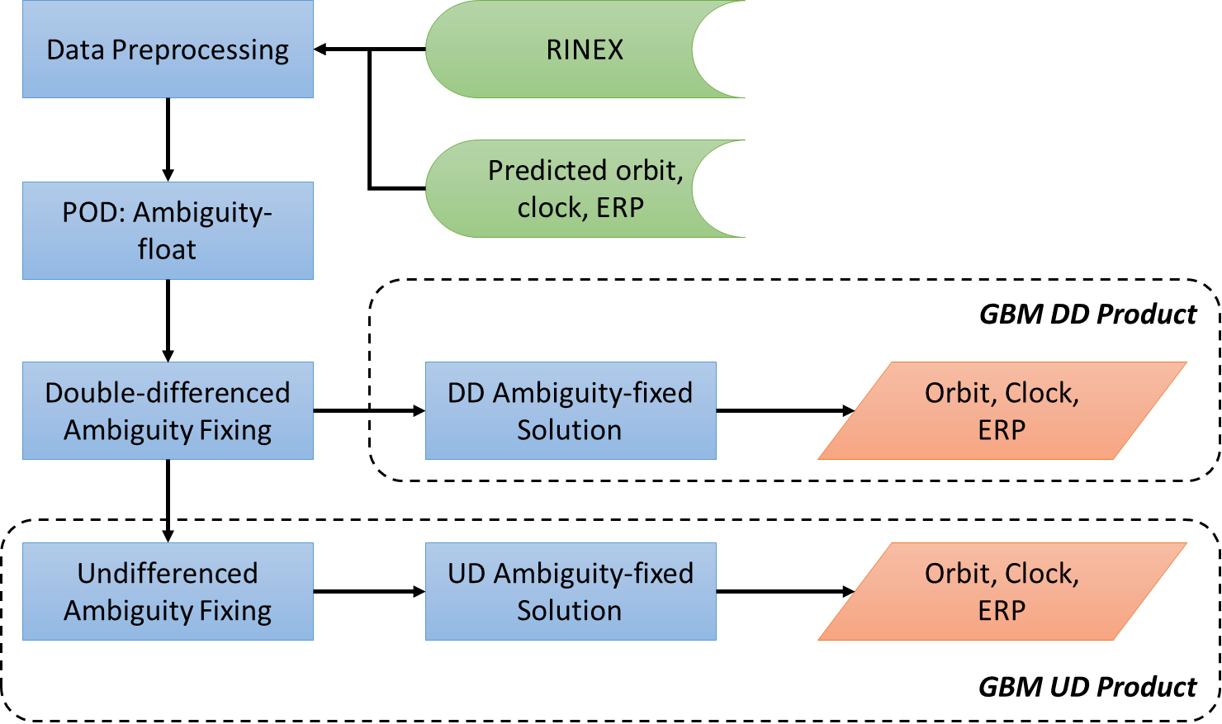
GBM moves from DD to UD
DD UD
Satellite Number
Year
Deng et al., GBM and Undifferenced Ambiguity Resolution, EGU 2022, 26.05.2022
3
Notes:
Left figure briefly illustrates the data processing strategy. The UD solutions is performed based on the DD solutions.
Right panel gives the number of satellites included in the GBM rapid products. Starting from 2014 the products already includes all systems, and now with the BDS-3 constellation, more than 120 satellites are available. The UD strategy is performed since the middle of 2021, at around DOY 176.
3

Slide 4
Orbit-overlap validation DD vs. UD
6-hour orbit prediction
DOY 001-150, 2021
Ambiguity resolution for GPS, Galileo and BeiDou 2/3
Three solutions (140 stations)
Significant improvement in longer baselines and UD solutions
 | Ambiguity resolution | Baseline length
DD0 | Double-differenced | 0--2000km (80%)
DD3 | Double-differenced | 3000--4000 km (90%)
UD | Undifferenced | ---
Deng et al., GBM and Undifferenced Ambiguity Resolution, EGU 2022, 26.05.2022
4

Slide 5
Earth Rotation Parameters (ERP) validation
Polar motion estimates significantly improved, especially the rates
No impact on LoD
ERP w.r.t. IGS final
Deng et al., GBM and Undifferenced Ambiguity Resolution, EGU 2022, 26.05.2022
5

Slide 6
Day-boundary-discontinuity (DBD) of polar motion
Polar motion DBD significantly reduced
Mainly due to the improvement of polar motion rates
Deng et al., GBM and Undifferenced Ambiguity Resolution, EGU 2022, 26.05.2022
6

Slide 7
Conclusions & Outlook
In GNSS POD the UD AR can improve satellite orbit and polar motion significantly.
Improvement of (UD.vs.DD) orbit overlap and EOP
GBM products switched into UD since DOY 176 in 2021, include ATT and OSB.
The impact on Earth center and station coordinate will be studied in the next step.
 | GPS | GLOASS | Galileo | BDS2M | BDS3M
Along | 15% | 19% | 13% | 6% | 33%
Cross | 15% | 19% | 13% | 7% | 31%
Radial | 12% | 20% | 12% | 16% | 24%
 | x-pole | y-pole
Offset | 26% | 12%
Rate | 27% | 35%
Deng et al., GBM and Undifferenced Ambiguity Resolution, EGU 2022, 26.05.2022
7

Slide 8
Thank you for your attention
Deng et al., GBM and Undifferenced Ambiguity Resolution, EGU 2022, 26.05.2022
8

Slide 9
Backup
Deng et al., GBM and Undifferenced Ambiguity Resolution, EGU 2022, 26.05.2022
9

Slide 10
Double-differenced (DD) Ambiguity Resolution
GNSS POD
Double-differenced (DD) ambiguity resolution
$$ρ_{r}^{s}=\left|x^{s}−R_{t2c}∙x_{r}\right|$$
$$x^{s}\left(t\right)=F\left(x_{0}^{s},v_{0}^{s},q,t\right)+{dx}^{s}$$
$$λ∙∇∆N_{r1,r2}^{s1,s2}=λ_{1}∙∇∆{NL}_{r1,r2}^{s1,s2}−λ_{WL}∙∇∆{WL}_{r1,r2}^{s1,s2}$$
Deng et al., GBM and Undifferenced Ambiguity Resolution, EGU 2022, 26.05.2022
10
Notes:
Here we have the Ionosphere-free combined pseudo-range and phase observations. We can easily setup the normal equations, estimate all necessary parameters, and obtain the ambiguities, but in the form of float instead of integer.
For DD ambiguity resolution, the hardware delays can be removed. We first fix the WL DD ambiguities, together with the IF DD ambiguities, we can fix the NL DD ambiguities. Then we solve for the IF ambiguities, where NL and WL are both fixed.
Given the IF conditions of four ambiguities, we apply the constraints to the NEQ to get the DD fixed solution
10

Slide 11

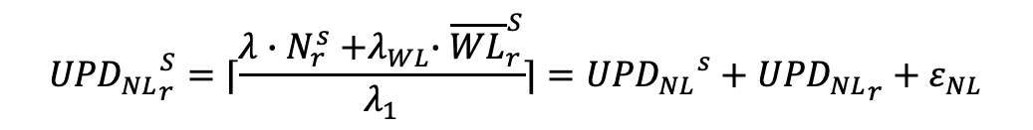
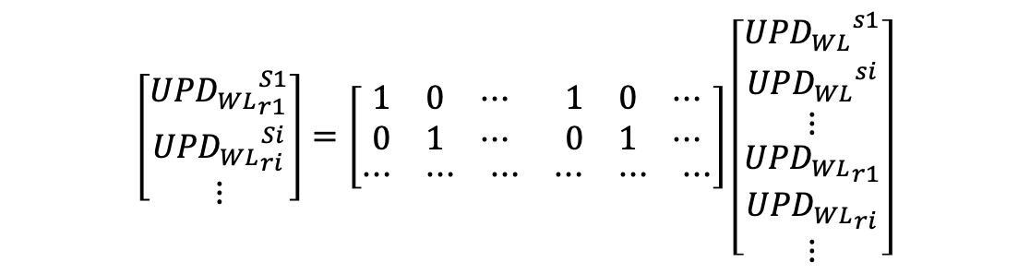
Undifferenced (UD) Ambiguity Resolution
Determine the undifferenced WL ambiguity and UPD
Form least-squares adjustment for satellite-/receiver- UPD
Obtain NL UPD
$${{UPD}_{WL}}_{r}^{S}={{UPD}_{WL}}^{s}+{{UPD}_{WL}}_{r}+ε_{WL}$$
$$\left[\begin{matrix}{{UPD}_{WL}}_{r1}^{S1} \\ {{UPD}_{WL}}_{ri}^{Si} \\ ⋮\end{matrix}\right]=\left[\begin{matrix}\begin{matrix}1 & 0 & ⋯\end{matrix} & \begin{matrix}1 & 0 & ⋯\end{matrix} \\ \begin{matrix}0 & 1 & ⋯\end{matrix} & \begin{matrix}0 & 1 & ⋯\end{matrix} \\ \begin{matrix}⋯ & ⋯ & ⋯\end{matrix} & \begin{matrix}⋯ & ⋯ & ⋯\end{matrix}\end{matrix}\right]\left[\begin{matrix}\begin{matrix}{{UPD}_{WL}}^{s1} \\ {{UPD}_{WL}}^{si} \\ ⋮\end{matrix} \\ \begin{matrix}{{UPD}_{WL}}_{r1} \\ {{UPD}_{WL}}_{ri} \\ ⋮\end{matrix}\end{matrix}\right]$$
$${{UPD}_{NL}}_{r}^{S}=⌈\frac{{λ∙N}_{r}^{s}{+λ}_{WL}∙{\overline{WL}}_{r}^{S}}{λ_{1}}⌉={{UPD}_{NL}}^{s}+{{UPD}_{NL}}_{r}+ε_{NL}$$
Deng et al., GBM and Undifferenced Ambiguity Resolution, EGU 2022, 26.05.2022
11
Notes:
For
11

Slide 12
Orbit Precision: CJ (GEO/IGSO)
Marginal impact on the orbit precision of GEO/IGSO satellite orbit precision
GEO/IGSO have bad quality anyway
  Tracking network
  Solar radiation pressure modeling
GEO/IGSO are less sensitive to ERP
Deng et al., GBM and Undifferenced Ambiguity Resolution, EGU 2022, 26.05.2022
12

