Slide 1

The most extreme heatwaves globally
Vikki Thompson
Alan Kennedy-Asser, Emily Vosper, Eunice Lo, Dann Mitchell, Oliver Andrews, Chris Huntingford, Mat Collins, Gabi Hegerl

Slide 2
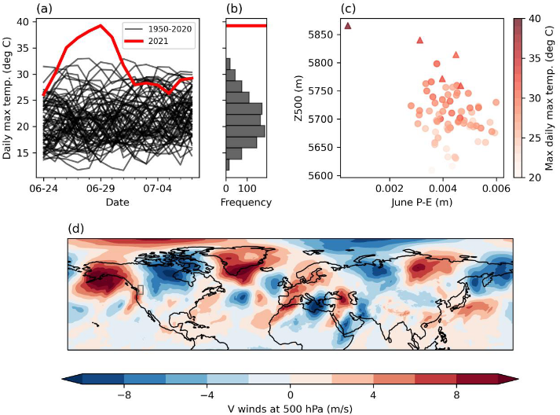
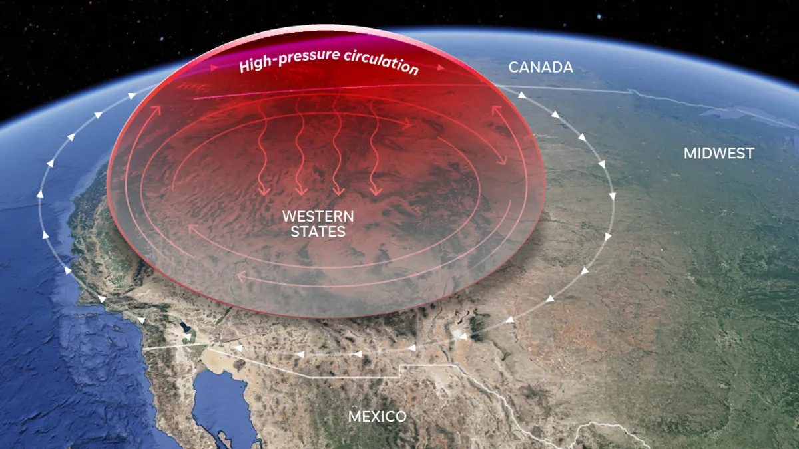
Western North America heatwave, June 2021
High temperatures
High pressure
Low P-E
3.6 SD from the mean
vikki.thompson@bristol.ac.uk

Slide 3
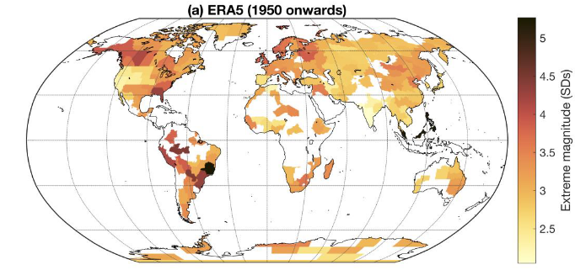
Extreme heat globally
vikki.thompson@bristol.ac.uk

Slide 4
Extreme heat globally
Alberta, Canada: 4.1SD
vikki.thompson@bristol.ac.uk

Slide 5
Extreme heat globally
South East Asia
1998, 5.1SD
Alberta, Canada: 4.1SD
Southern USA
1980, 4.3SD
Peru 2016, 4.2SD
Southern Brazil 1985, 4.3SD
Southeast Brazil 2020 3.7SD
vikki.thompson@bristol.ac.uk

Slide 6
Extreme heat globally
vikki.thompson@bristol.ac.uk

Slide 7
Extreme heat globally
vikki.thompson@bristol.ac.uk

Slide 8



Thompson et al, 2022. The 2021 western North America heatwave among the most extreme events
ever recorded globally. Science Advances
vikki.thompson@bristol.ac.uk
@ClimateVikki

Slide 10
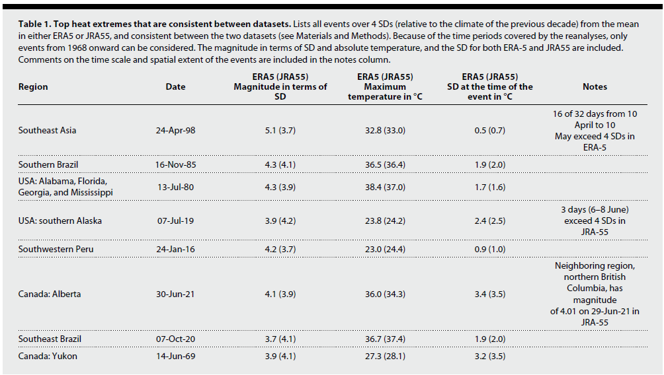
Extreme heat globally
vikki.thompson@bristol.ac.uk

Slide 11
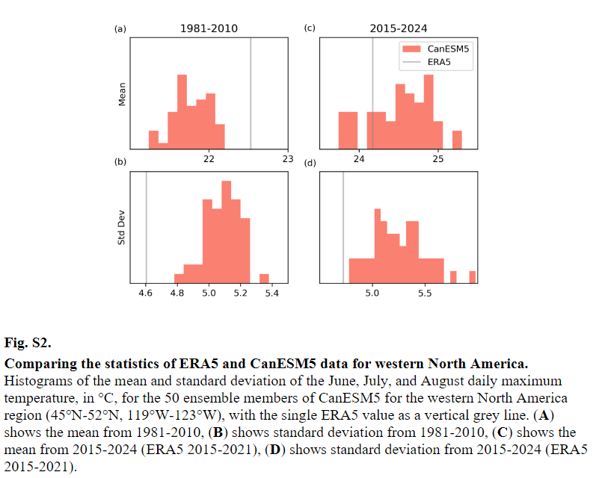

Slide 12
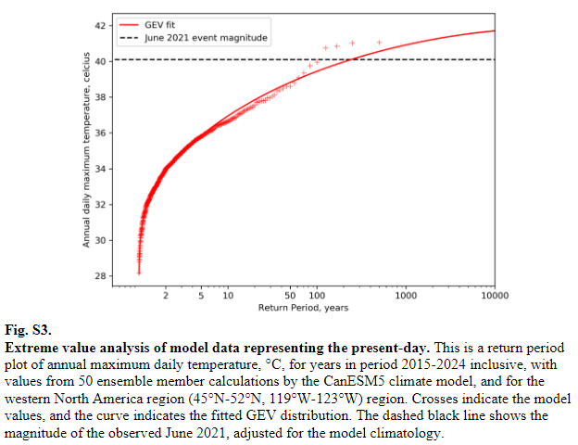

Slide 13
