Slide 1


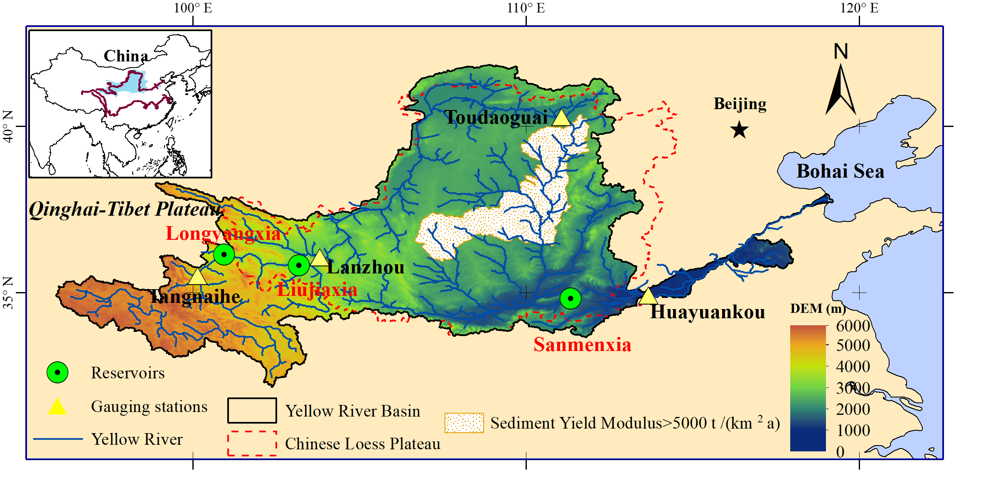
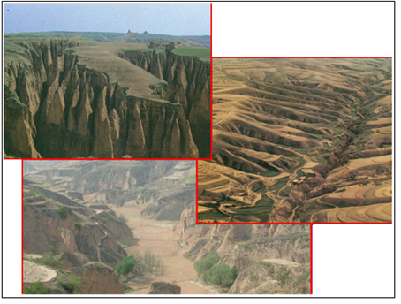


A model for continental-scale water erosion and sediment transport and its application to the Yellow River Basin
Cong Jiang ¹, Eric J. R. Parteli ², and Yaping Shao ¹
Institute of Geophysics and Meteorology, University of Cologne, Pohligstr. 3, 50969, Cologne, Germany
Faculty of Physics, University of Duisburg-Essen, Lotharstr. 1, 47057, Duisburg, Germany
Abstract:
Notes:
Good morning! Everyone. My presentation is a model for continental-scale water erosion and sediment transport and its application to the YRB.
Predicating water erosion and sediment transport at large-scale is very important. However, they are still missing in current climate model due to many challenges.
This map shows the areas of our planet where water erosion is most severe. This this Chinese Loess Plateau in the Yellow River Basin. Especially, in this dots areas with the typical permanent gully, sediment yield modulus is greater than 5000 tons/(km2 a). Gully erosion usually is estimated at a specific location. Using large-scale model, the coarse grid can not capture the sub grid gully information. So, we need a new method to quantify the gully erosion at large scale.

Slide 2
AHMS-SED: Integrated a water erosion and sediment transport model CASC2D-SED (R. Rojas and P. Julien, 2003) into an Atmospheric and Hydrological Modelling System AHMS (Xia, 2018)
AHMS:
Rainfall
splash
Revised CASC2D-SED:
Reanalysis dataset
Reanalysis dataset observation
LAI
Interception
Sediment Sources
K, S, C, P, G
K_{sat} , b, θ
Infiltration
Suspend
Offline AHMS
Calibration
shear
WRF
NoahMP-HMS
Runoff
Transport
Deposition
w_{s}
Online
AHMS
water flux
sediment flux
control link
input variables
Feedback
n, W, B
Overland and channel flow
Water Discharge
Sediment Discharge
Notes:
Firstly, we developed an AHMS-SED by integrating a water erosion and sediment transport model CASC2D-SED into an Atmospheric and Hydrological Modelling System (AHMS) .
Figure on the left shows how offline and online AHMS work. The difference between online and offline is weather the land surface model combined with weather forecast model WRF. Figure on the right shows water flux processes and sediment flux processes.
Universal soil loss equation is used to predict sediment sources.
Universal soil loss equation is further extent to consider the gully erosion by multiplying the gully factor G in this study.

Slide 3
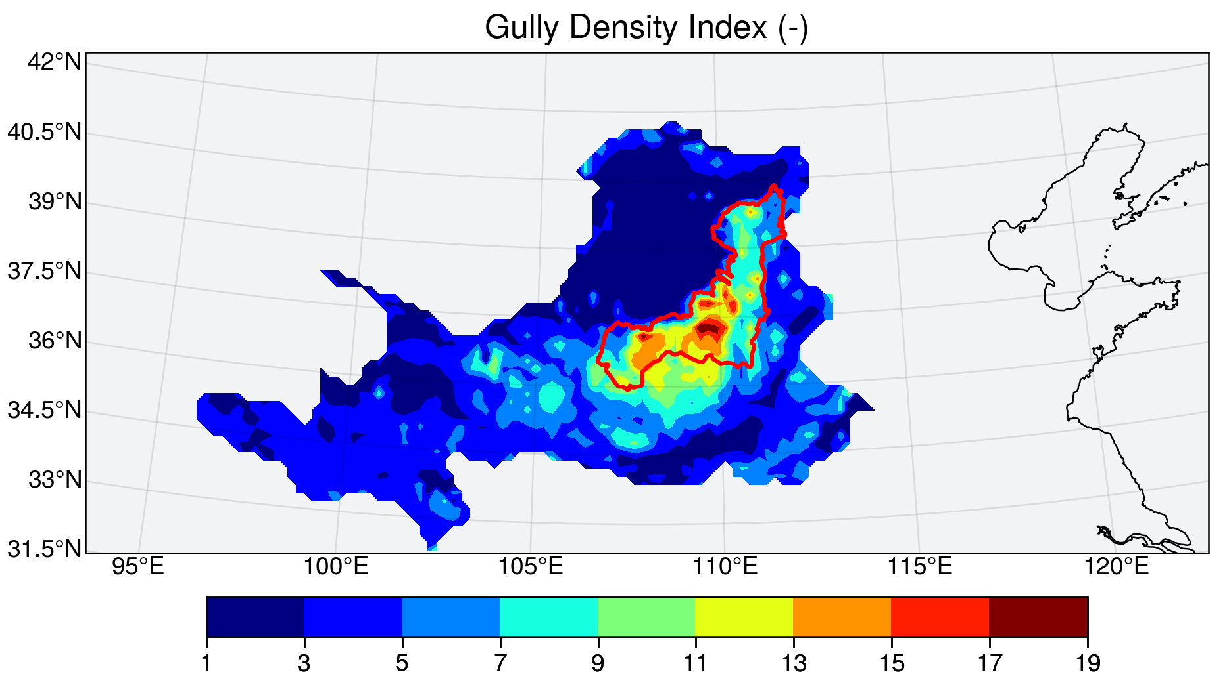
Required Additional Gully Density Index
Slope interpolated from slope at 30m resolution
Free parameter
Gully factor
Slope interpolated from slope at 1km resolution
S_{30m} / S_{1km}: gully density index, S_{30m} / S_{1km} ≥ 1.0
Gully density index distribution closely matches the observed permanent gully area
Notes:
Gully factor is calculated by this equation.
A gully density index is defined as a ratio of slope interpolated from very high-resolution slope and slope interpolated from relative low-resolution slope.
This figure shows spatial gully density index distribution closely matches the observed permanent gully area.
Interpolation Method: Four-point Bilinear interpolation.

Slide 4
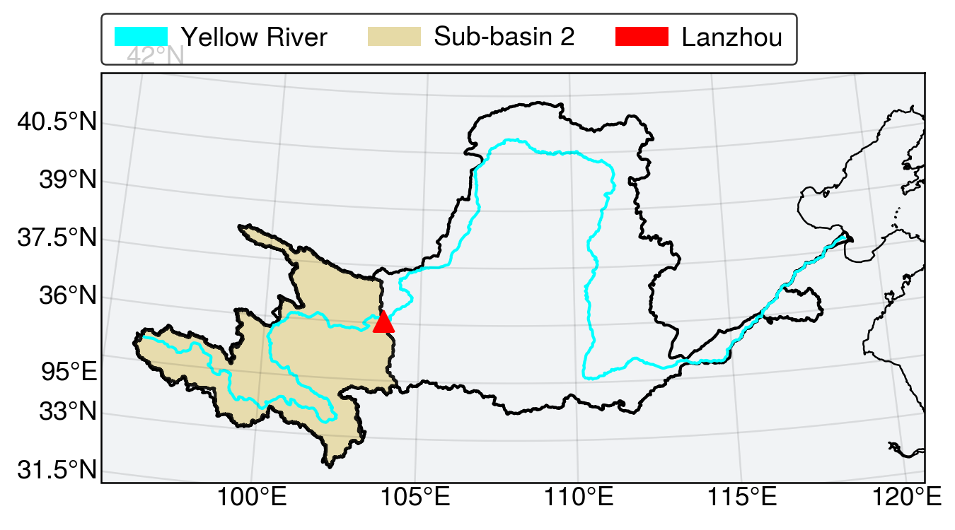
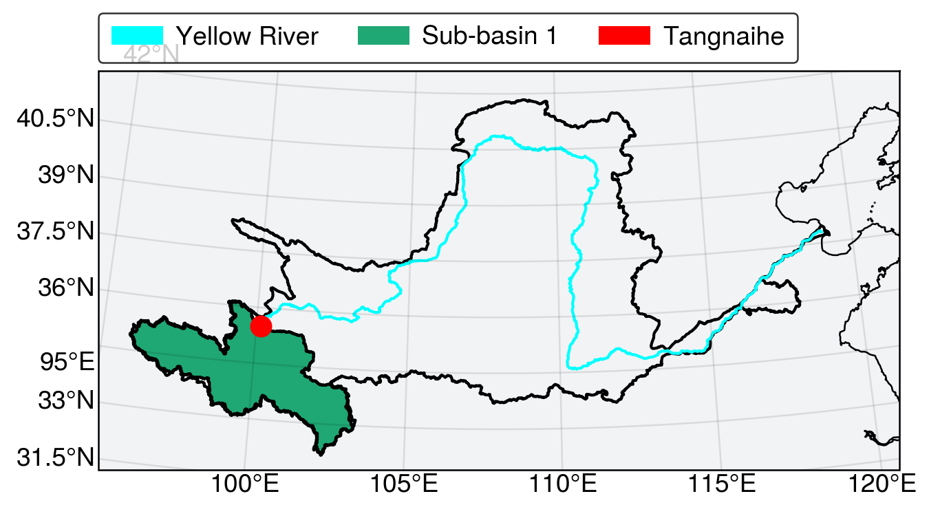
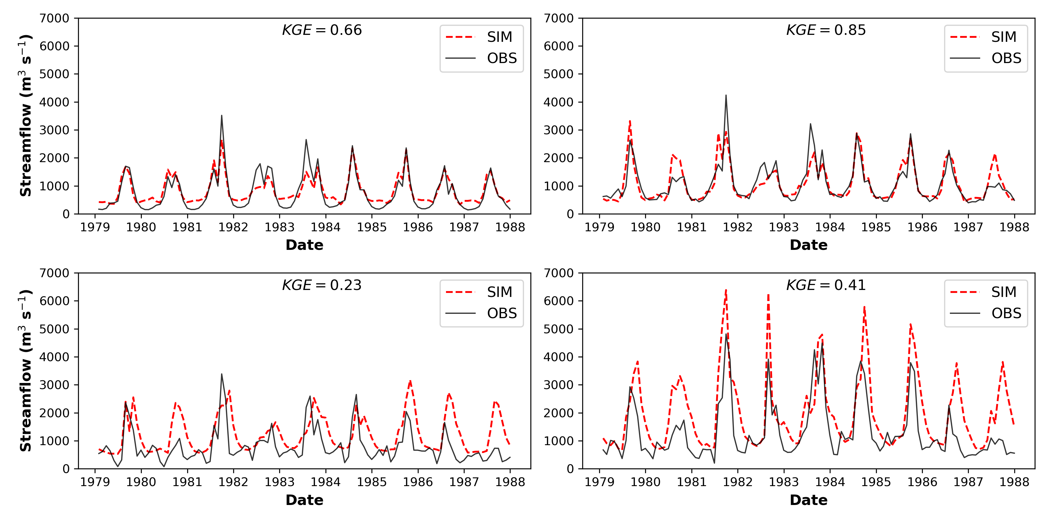
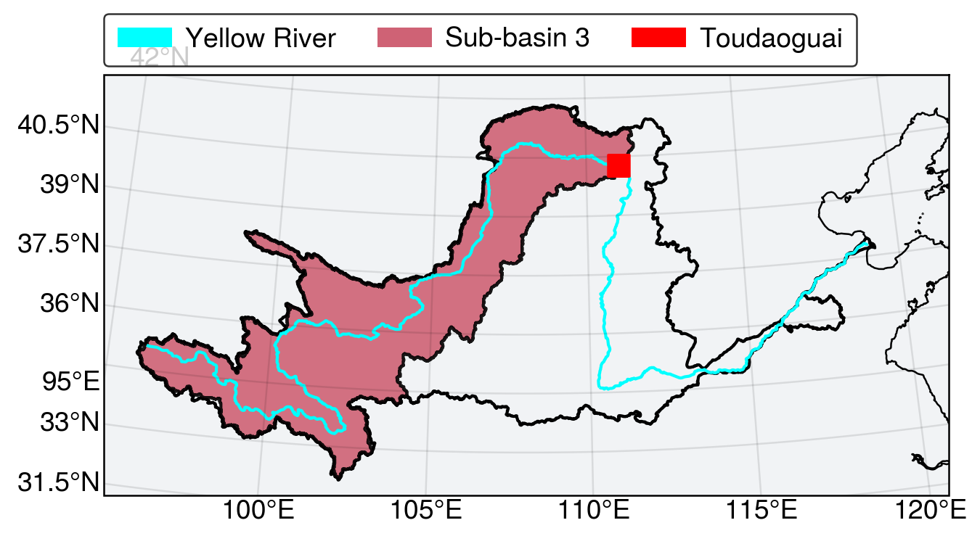
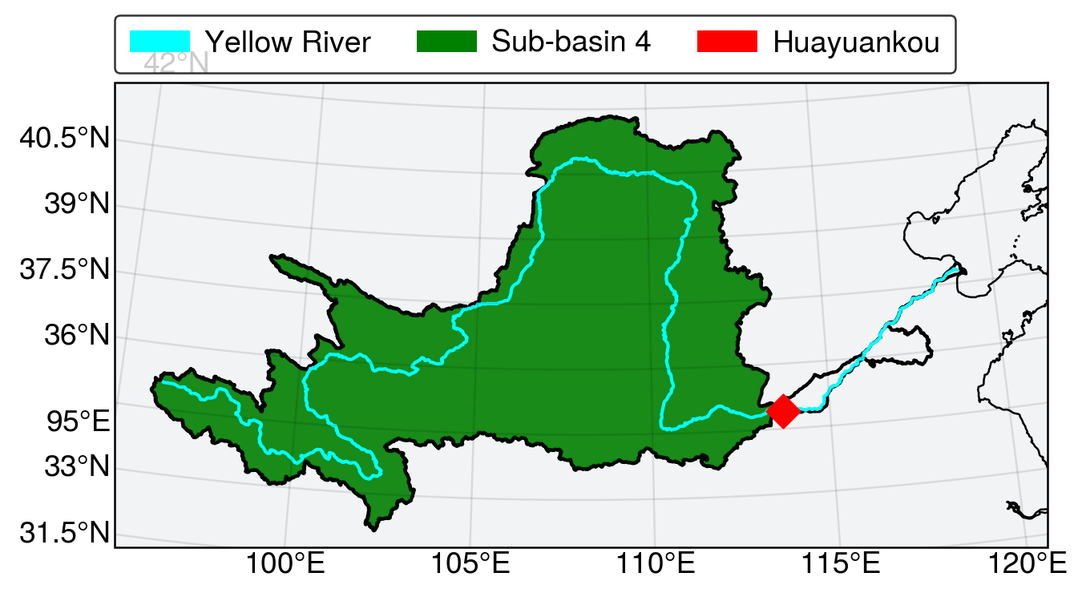
Results: Water Discharge (m³/s)
Anthropogenic activities impact
Notes:
This figure shows the predicted monthly streamflow are compared with the corresponding observations at four hydrological stations including Tangnaihe (a), Lanzhou (b), Toudaoguai (c) and Huayuankou (d) from 1979 to 1987.
Quantitative agreement is found between these observation and simulation results for all stations.
We also found that predicted water discharges well matched in the upper reaches of the basin , while they are overestimated in the lower reaches due to human actives impact.

Slide 5
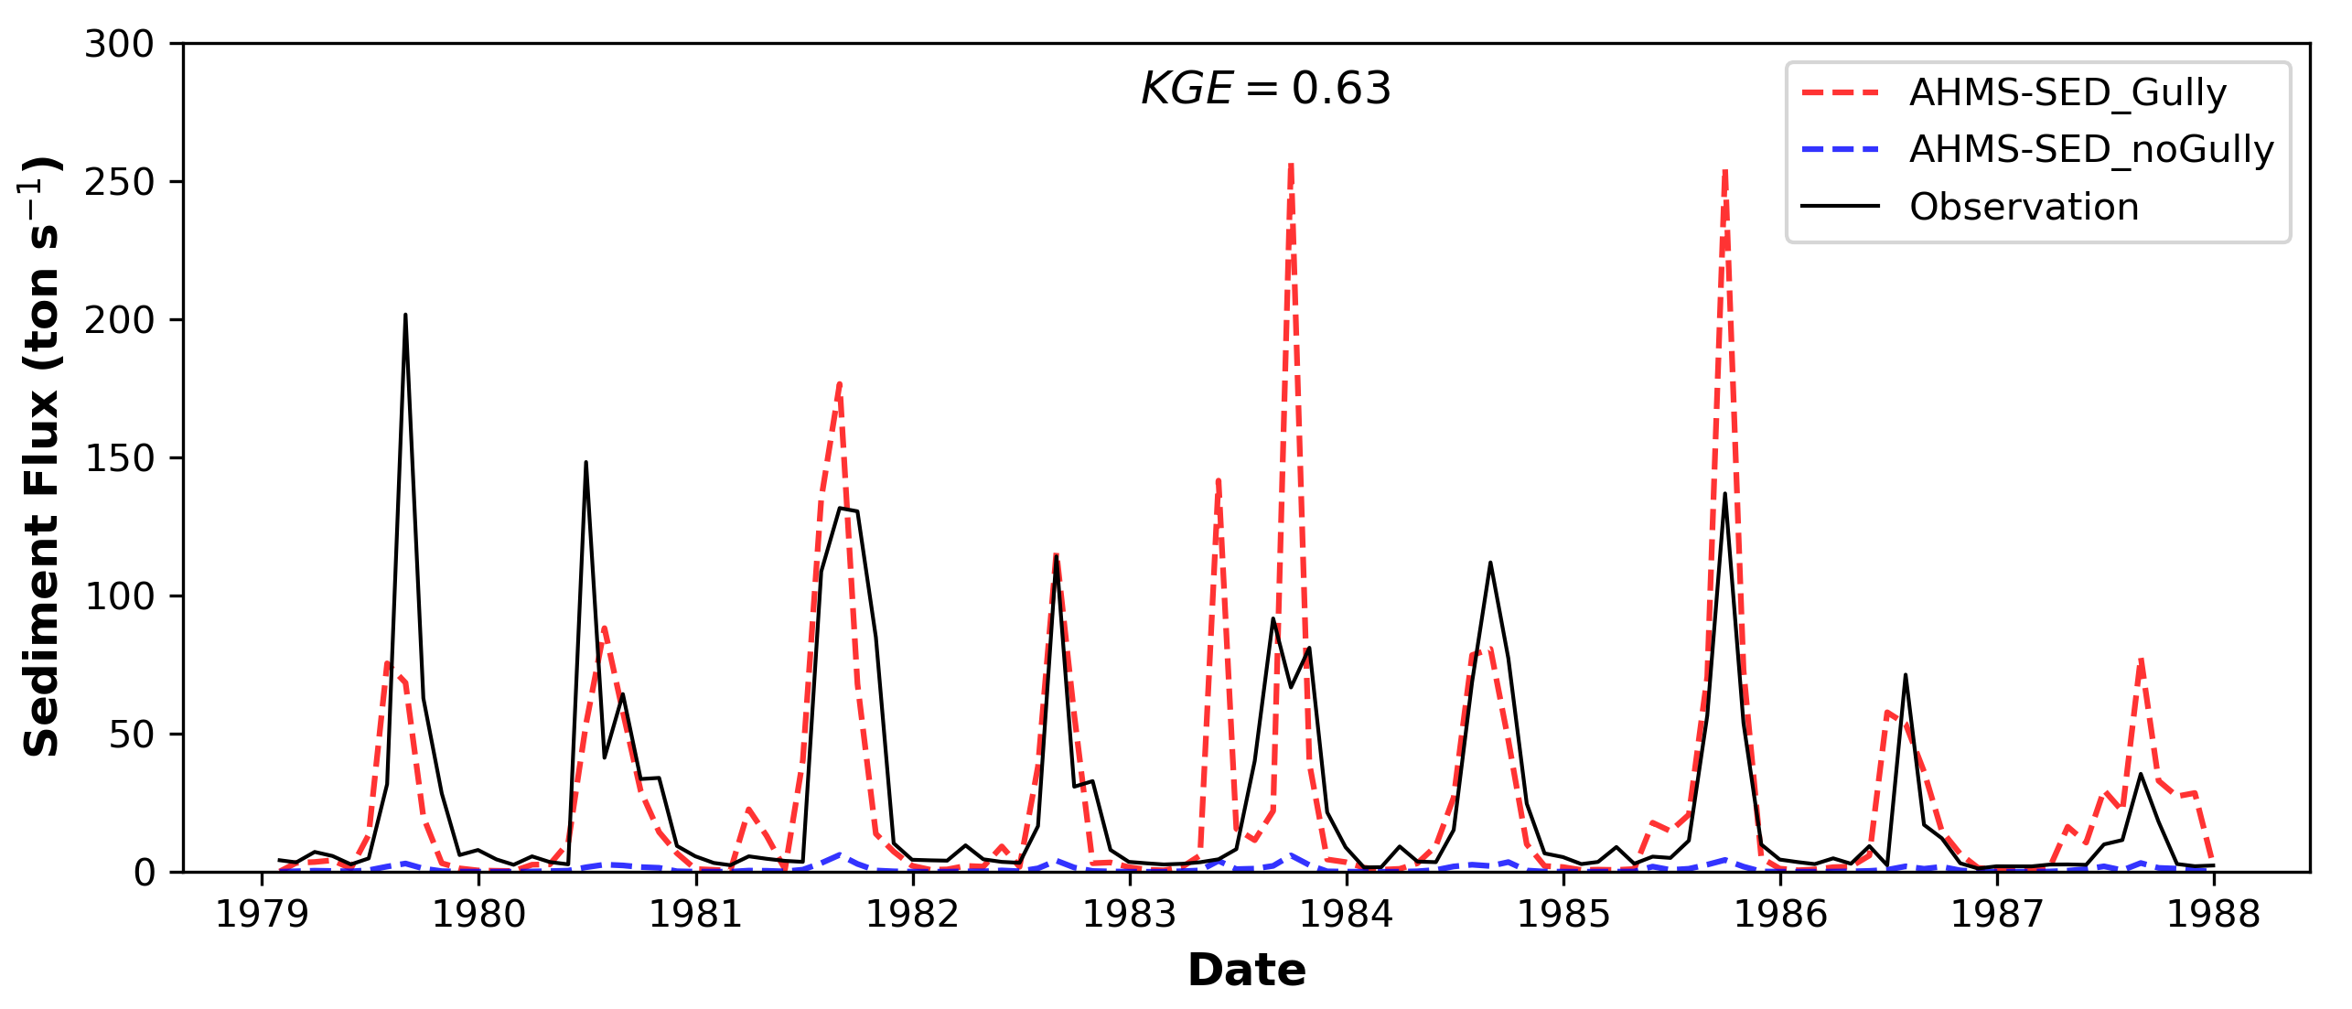
Results: Sediment Discharge (ton/s)
Kling-Gupta Efficiency:
r: correlation coefficient
β: bias ratio
γ: variability ratio
Considering the gully index, prediction is greatly improved!
Notes:
To finish my talk, This figure shows the predicted monthly sediment flux is compared with the corresponding observations at Huayuankou station.
We found that prediction is greatly improved considering the gully index.
Without the gully index, the model significantly underestimate the sediment flux.

Slide 6
Summary and Outlook
Summary:
Integrated a water erosion and sediment transport model (CASC2D-SED) to the large-scale atmospheric and hydrological modelling system AHMS.
Define a gully factor related to slope decay rate to quantify potential permanent gully erosion
Outlook:
Predict the evolution of sediment transport in the Yellow River Basin under consideration of specific climate change scenarios
Thank you for your attention!
Acknowledgements: DFG (German Research Foundation) for funding
Abstract:
Notes:
This work Integrated a water erosion and sediment transport model (CASC2D-SED) to the large-scale atmospheric and hydrological modelling system AHMS.
In addition, we define a gully factor related to slope decay rate to quantify potential permanent gully erosion.
In the next step, we are going to predict the evolution of sediment transport in the Yellow River Basin under consideration of specific climate change scenarios.

