Slide 1



Ancient Tillandsia landbeckii dune ecosystems and their potential to reveal past variations in coastal fog moisture during the Holocene in the Atacama Desert
Claudio Latorre, Sergio Contreras, Andrea Jaeschke, Juan Luis Garcia & Camilo del Río

Slide 2
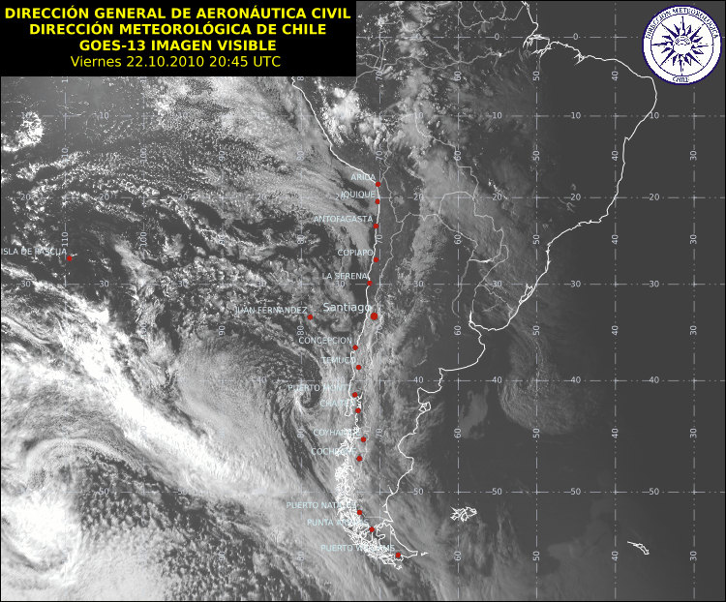
Advection fog in northern Chile
Garreaud et al., 2008
The extent, intensity and duration of fog events is likely coupled to variations in coastal SSTs and the strength of the thermal inversion (SPH) → stratocumulus clouds are a very stable feature of northern Chile and southern Peru

Slide 3
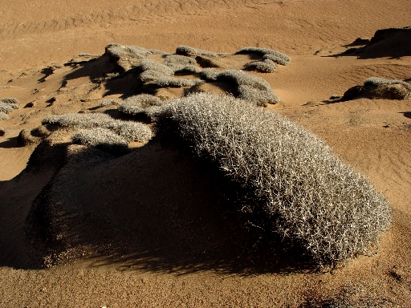
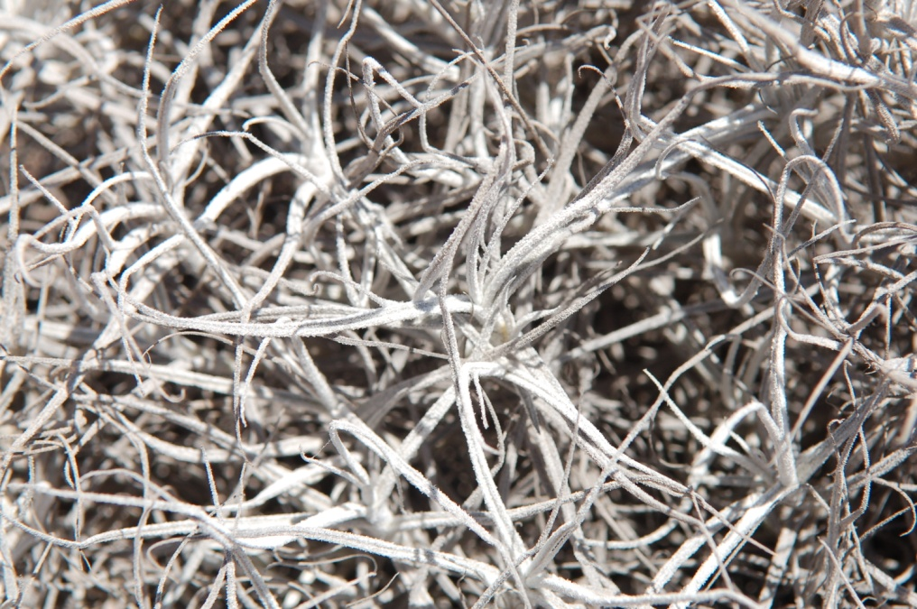
Tillandsia landbeckii dunes are unique self-organizing, fog dependent-ecosystems of the Atacama Desert

Slide 4
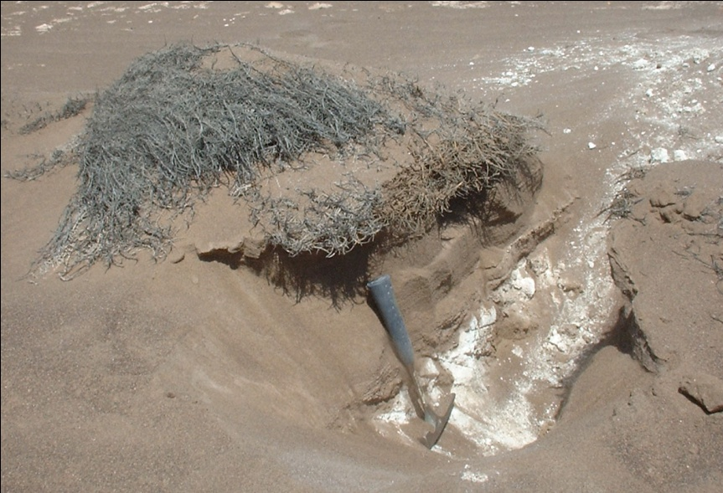
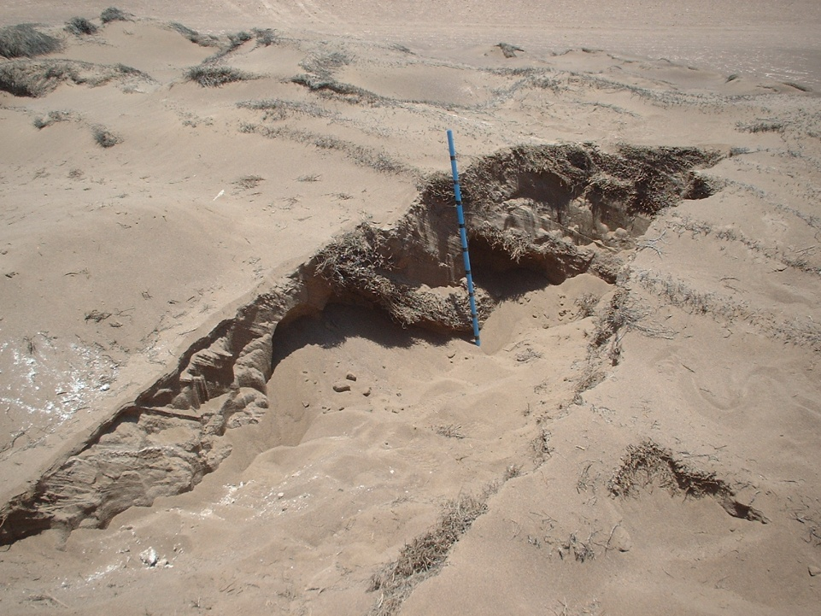
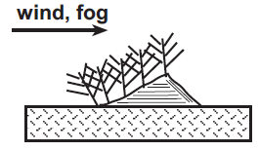
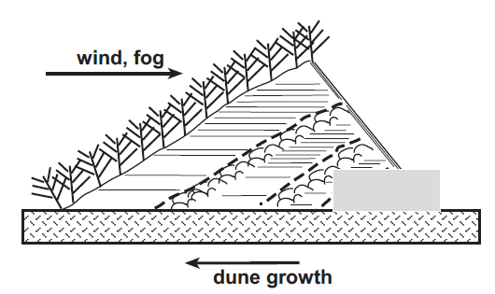
How Tillandsia dunes form over time
Latorre et al., 2011

Slide 5
Estimating past variations in coastal fog from Tillandsia landbecki dune ecosystems in three steps
Step 1: obtain datable stratigraphy
Step 3
Nitrogen and carbon isotopes from leaf tissue to reconstruct past amount (or source?) changes in fog
Step 2: Calibration via sampling of fog traps and living plants
Deuterium isotopes from leaf waxes for reconstructing past hydrologic changes (”amount effect”)

Slide 7
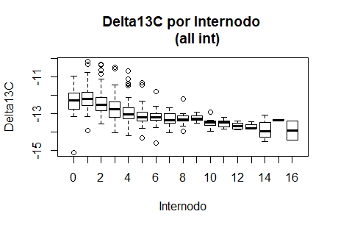
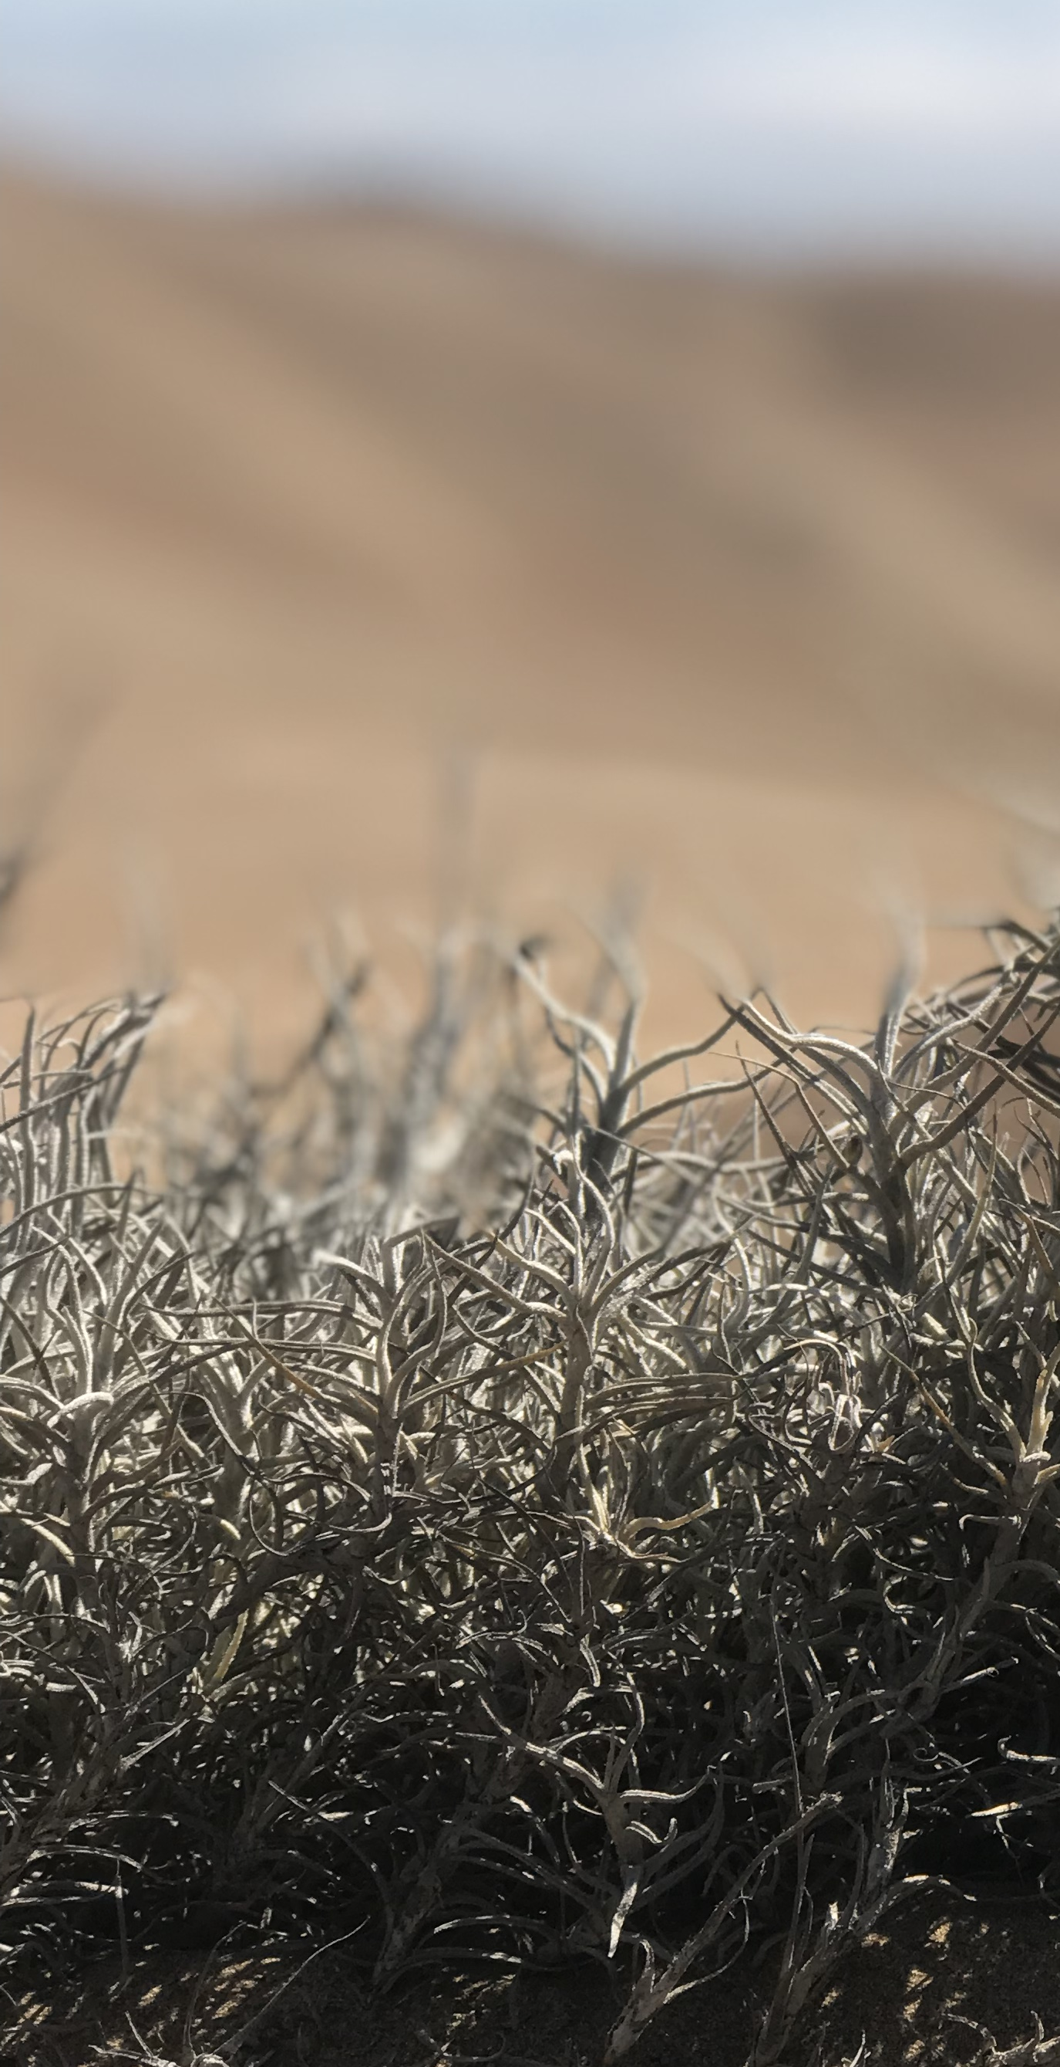
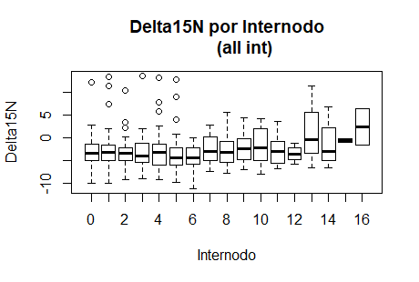
N = 357

Slide 8
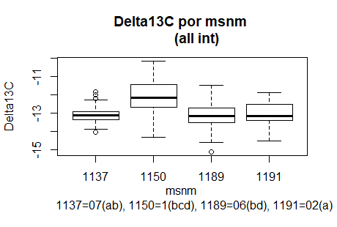
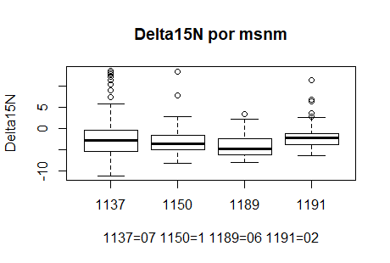
N = 357

Slide 9
δ¹⁵N_{foliar} values from Cº Oyarbide tilandsiales possibly distinct wet/dry cycles over the last 1000 years

Slide 10
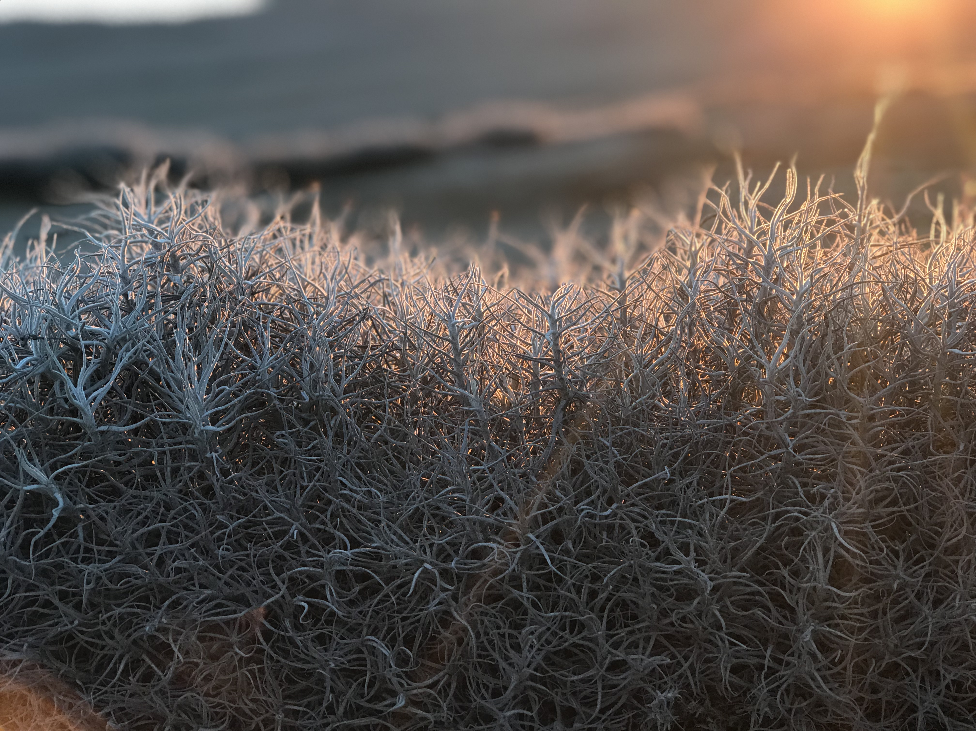
What we know so far…
The age of Tillandsia landbeckii dunes clearly correlates with height → larger dunes (> 1 m) exhibit ages older than 10,000 years
Stable C and N isotopes show consistent deviations that correlate with the age of the leaf → presence of vital effects on these values? Or is this due to changes in fog regime?
In the works… new C and N isotopes from buried layers together with stratigraphic changes in these dune ecosystems could reveal new evidence for variations in past fog availability and δD values on leaf waxes are being used to study past hydrologic change

Slide 11
Thank you for your attention!

Slide 12
But much more data is needed for the last 12,000 years!

Slide 13
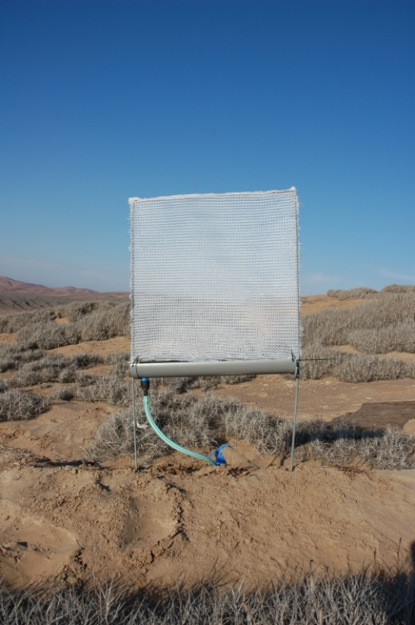
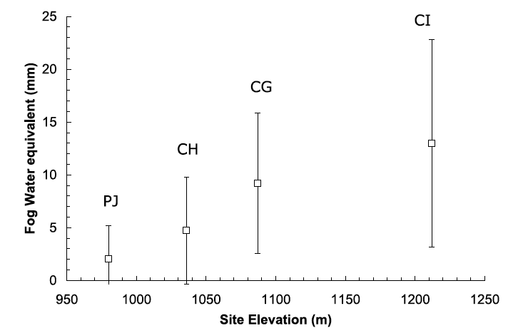
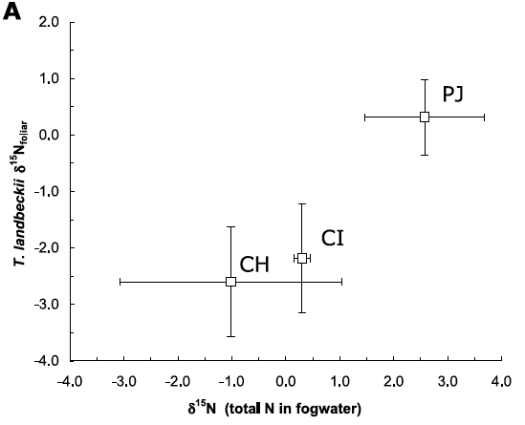
Our previous research using standard fog collectors at each locality revealed that fog water increases with elevation and δ¹⁵N in fog positively correlates with δ¹⁵N in the plants
Latorre et al., 2011

Slide 14
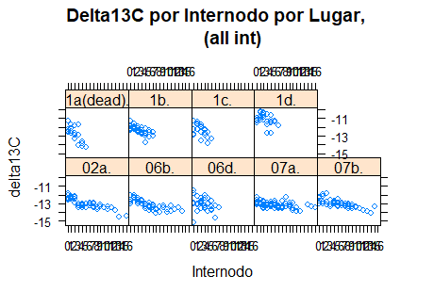
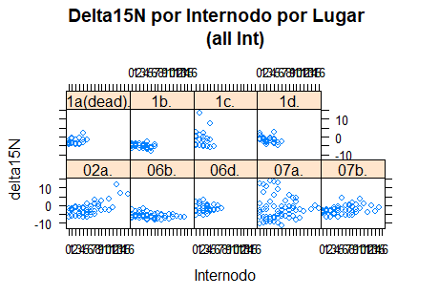

Slide 15
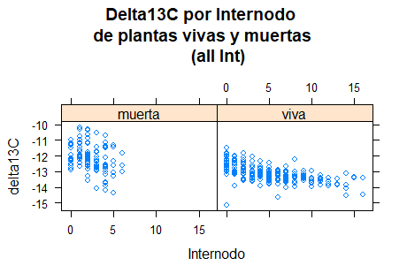
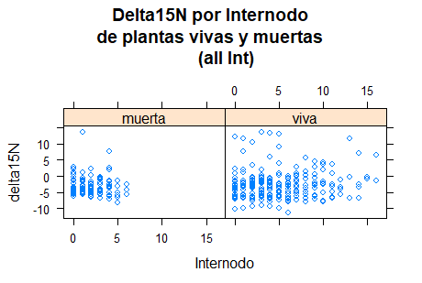

Slide 16
How much variation is actually present in the system? Are the signals replicable? Are there any vital effects?

