Slide 1
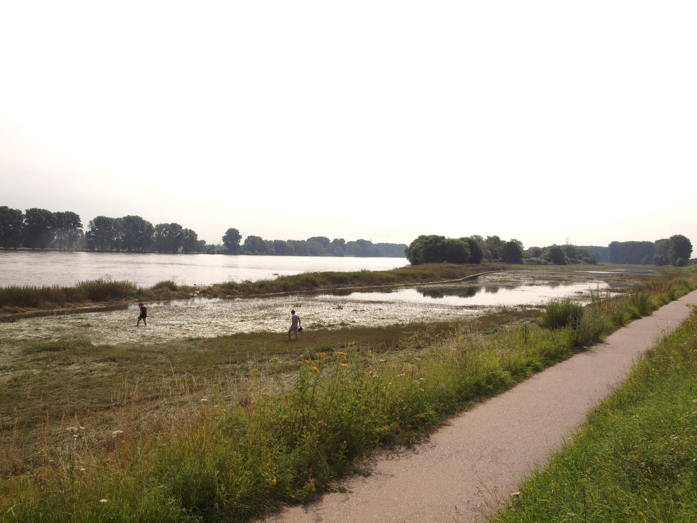

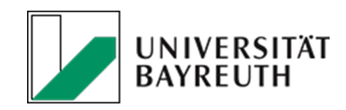

  Interplay of topography, flood frequency and soil properties
  determine the distribution of microplastics in a Rhine floodplain
Markus Rolf¹, Hannes Laermanns¹, Lukas Kienzler¹, Christian Pohl², Julia N. Möller³, Christian Laforsch³, Martin G.J. Löder³, Christina Bogner¹
¹Institute of Geography, University of Cologne, Cologne, Germany
²Director Business Development D-A-CH, DHI WASY GmbH, Berlin, Germany
³Animal Ecology I, BAYCEER, University of Bayreuth, Bayreuth, Germany

Slide 2
CRC 1357 Microplastics
B06: Behaviour and transport of MP in disturbed and undisturbed soils
Transport in porous media and soils
Transport, erosion and deposition on soil surfaces
Detection, quantification and visualization
Microplastics in Rhine floodplains
Research questions:
How are microplastics laterally transported in floodplains?
How microplastics migrate vertically through floodplain soil?

Slide 3
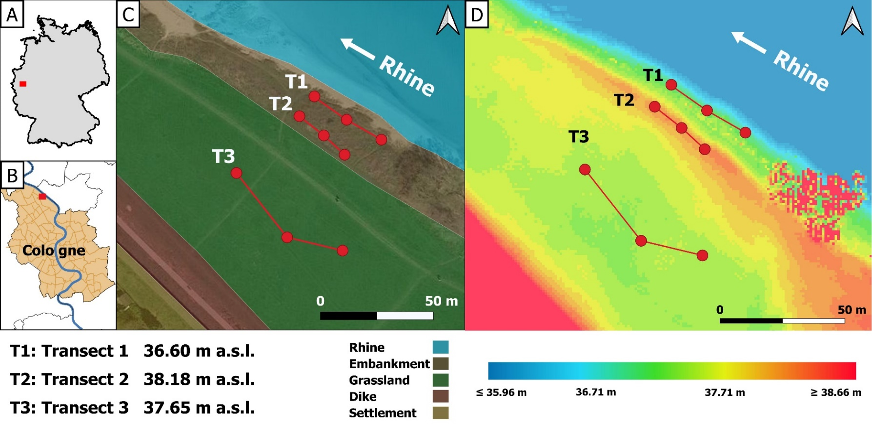
Sampling Site in Cologne, Germany
Municipal effluent
Industrial effluent
Land use:
Agriculture
Industry
Forest
Fig. 3: Sampling site with the transects.
2.500 m
Sampling
  Transects along contour lines
  mixed soil samples from 0-5 cm and 5 -20cm soil depth, one sample from each transect and depth
Fig. 2: Land use, industrial and municipal effluents.

Slide 4
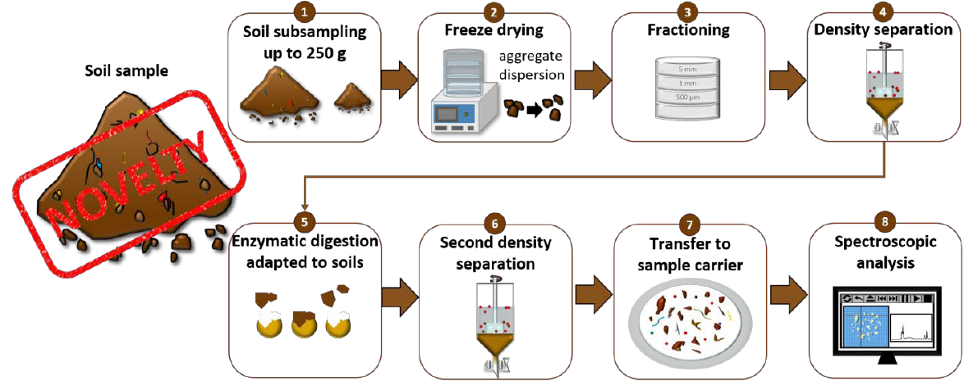
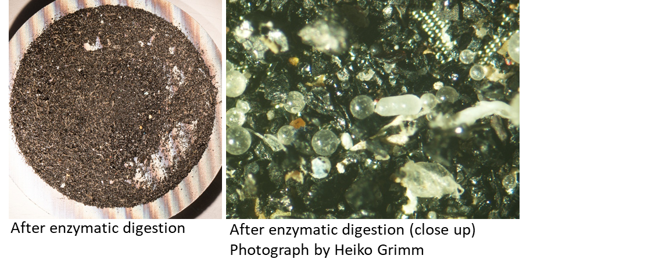
Material and Methods
  Möller et al. 2021, Tackling the Challenge of Extracting Microplastics from Soils: A Protocol to Purify Soil Samples for Spectroscopic Analysis

Slide 5
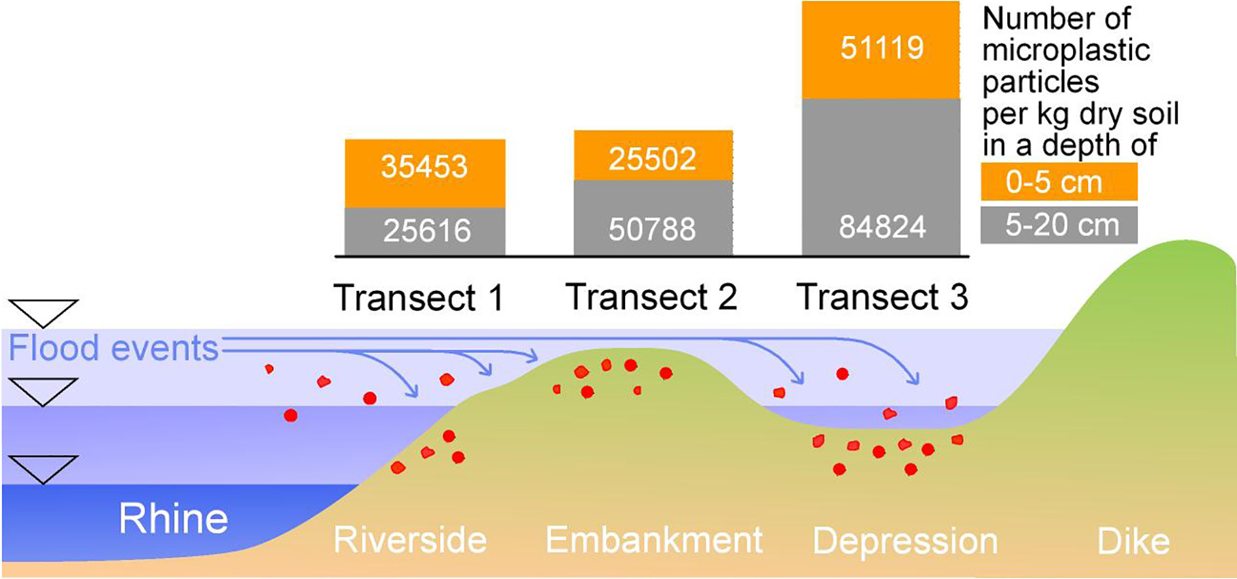
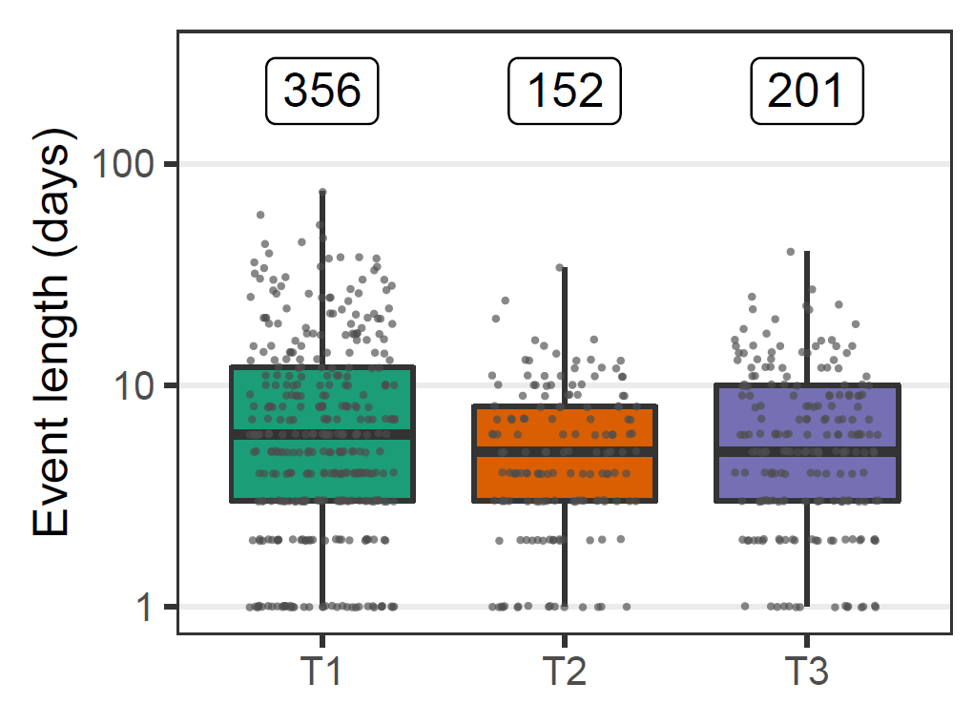
Flood frequency and local topography determine microplastic distribution
Rolf et al. 2022, Flooding frequency and floodplain topography determine abundance of microplastic in alluvial Rhine soil

Slide 6
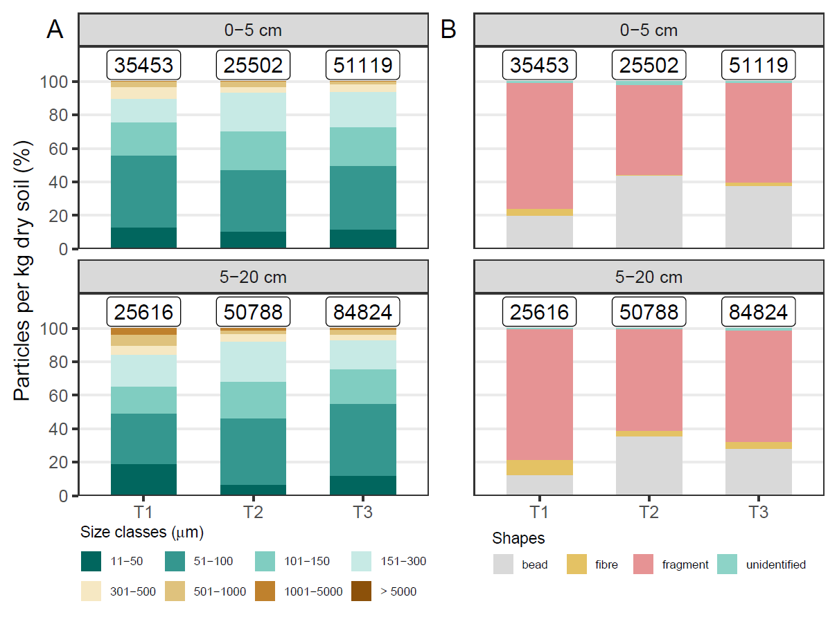
Microplastic analysis – size & shape

Slide 7
Flood frequency and local topography determine microplastic distribution
Conclusions:
Fluvial origin
Flood frequency & local topography
Microplastics accumulate
75% of microplastics are smaller than 150 µm
Limitations:
No deposition modelling
One floodplain type
No soil samples deeper than 20 cm
One method (FTIR)
Relevance:
Identifying microplastic hotspots in (floodplain) soils
Basis for informed sampling and ecological risk assessments

