Slide 1







Snowfall rates and their connection to cloud microphysics​
Franziska Hellmuth¹, Anne Sophie Daloz², Trude Storelvmo¹​
1 Department of Geosciences, University of Oslo, Norway ​
2 Center for International Climate Research (CICERO), Norway ​
franziska.hellmuth@geo.uio.no
Notes:
My name is Franziska and I’m a PhD student at the University of Oslo
Today I’m going to talk about how surface snowfall can be related to cloud microphysics in two different data sets

Slide 2


Objective
Mixed phase clouds are not well represented in GCMs.
Ice formation influences
radiative effect,
precipitation formation,
and cloud lifetime.
Notes:
MP clouds
consists of liquid water and ice crystals​
Dominant in latitudes higher than 45 deg
Produce majority of total precipitation reaching the ground
Not very well represented in GCMS
Separation between cloud liquid/ice phase has impact on radiative properties → impact on global energy budget
In warming climate:
# of MP clouds will change → ice reduction in atmosphere
Implication on radiative properties, precipitation formation
Important to represent cloud phase and associated snowfall correctly in GCMs

Slide 3
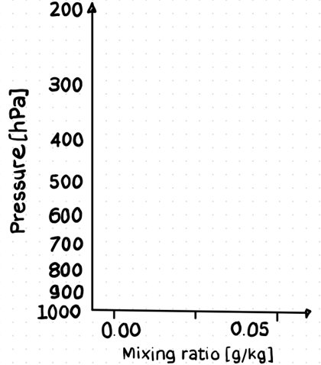
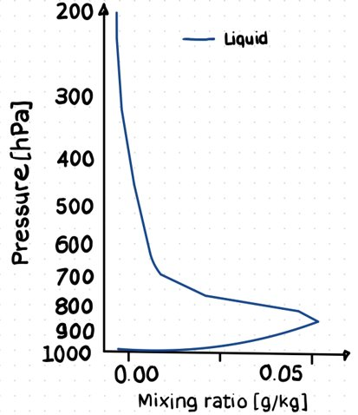
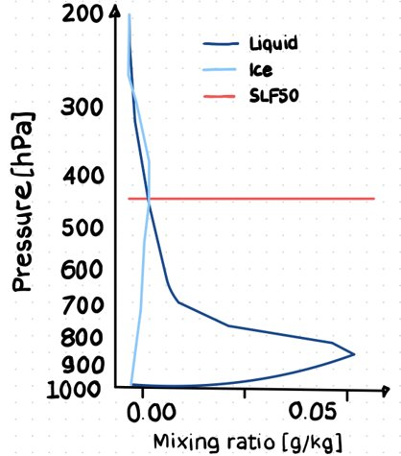
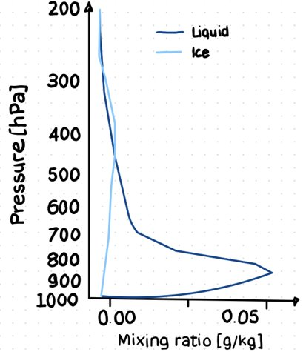
Defining a mixed-phase cloud (MPC)
Pressure level where fraction ​
Liquid / (Ice + Liquid) = 50% (SLF50)
SLF: Supercooled liquid water fraction
Notes:
How can we relate cloud phase bias to snowfall?
I define MP cloud and relate to surface snowfall
On x-axis we have the mixing ratio and on the y-axis the atmospheric pressure
See liquid water content, which is higher in the lower atmosphere
Ice water content, in general lower than liquid
Select lowest atmospheric pressure level where liquid and ice intersect at 50% → supercooled liquid water fraction
This relationship is widely used in the community and that is why I decided to define my mixed phase cloud like this
Here 450 hPa
Go through all grid cells and select the lowest atmospheric pressure where SLF50

Slide 4
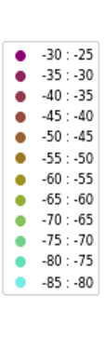
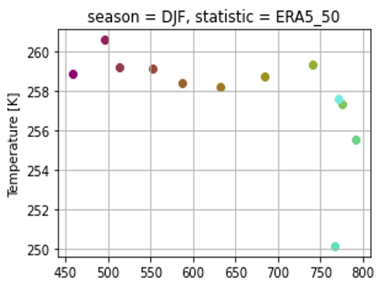
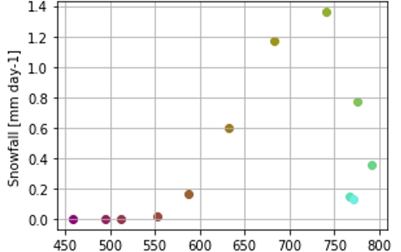
Mixed phase-clouds (ERA5)
Temperature
Latitude
Snowfall
Temperature constant in all latitudes
Highest snowfall related to storm track area
30 year, season: DJF
Notes:
Present the relationship between atmospheric pressure and snowfall for mixed phase clouds in ERA5
ERA5 is the ECMWF reanalysis dataset
Show here a 30 year mean for December, January and February
First we see on the x-axis the atmospheric pressure:
Going towards higher latitudes means that the atmospheric pressure is higher
Meaning that the MP cloud / supercooled liquid water fraction is lower in the atmosphere
Once we found the pressure level where supercooled liquid water fraction of is 50% we can relate it to the atmospheric temperature
For ERA5 we see that independent of the latitude the Temperature stays constant between -14C and -23 deg
We can now relate the atmospheric pressure to snowfall
For ERA5 we see that the snowfall is highest in the storm track region of the southern hemisphere (60-70deg) where most low pressure systems are located
How does it look in CMIP6?

Slide 5
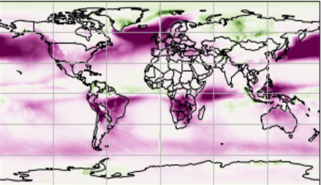
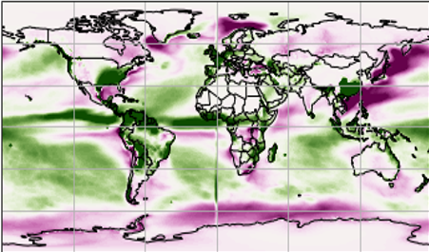
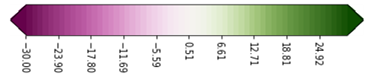
Ice water path/Liquid water path (ERA5 - CMIP6)
Ice
Liquid
(g m-2)​
Ice water path overestimate
Liquid water path underestimate
30 year, season: DJF
Notes:
Difference of 30 year ERA5 mean and model mean of CMIP6 for December, January and February
Ice water path:
Integral of ice water content through the dept of an ice cloud
Generally known, that the CMIP6 model mean overestimates the ice in comparison to ERA5
While the liquid water path:
Which is the integral of the liquid water content in the atmosphere
Is globally underestimated
But if we have a look on the storm track regions both ice and liquid are overestimated
If we recall the previous figure, where I relate atmospheric pressure to surface snowfall we saw that the highest snowfall is in the storm track regions.
So if we have a generally known cloud phase bias and the GCMs are not able to reproduce the magnitude of the phase partitioning how does the snowfall look in CMIP6 models compared to ERA5

Slide 6
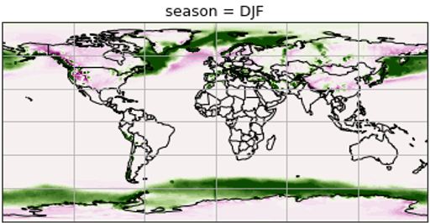

Snowfall (ERA5 - CMIP6)
Snowfall
(mm day-1)
Snowfall underestimate of ~20%
30 year, season: DJF
Notes:
In general we see an underestimation for the 30 year mean.
If we compare the Difference of ERA5 and CMIP6 to the 30 year average of ERA5 we find a snowfall bias of about 20%, especially in storm track regions
With this cliffhanger I have to end, but we expect that the snowfall in CMIP6 models is much lower in the storm track regions if we relate it to the atmospheric pressure where ice and water are 50%
It is known that the cloud phase bias is related to the paramterization of ice nucleation and growth processes in GCMs but we still don’t understand how this bias affects the precipitation in solid form!

Slide 7



Key points
Next steps
Snowfall from MP clouds is highest in storm track areas
GCM
  cloud phase Ice overestimated
  Liquid underestimated
  Snowfall Underestimated especially in storm track areas
Find MP clouds in CMIP6
Include satellite data (CloudSat)
OSSP
My Notebooks
franziska.hellmuth@geo.uio.no, EGU22-4566
Notes:
With this I want to end my presentation.
We found that snowfall from MP clouds is highest in storm track areas and it is known that a cloud phase bias exists. Which in turn seems to have an impact on the surface snowfall bias.
My next steps include to define MP clouds in the CMIP6 models and find the supercooled liquid water fraction.
Finally we will include satellite data to the study to have observations which help us to understand the connection between cloud phase and surface snowfall rates.

