Slide 1

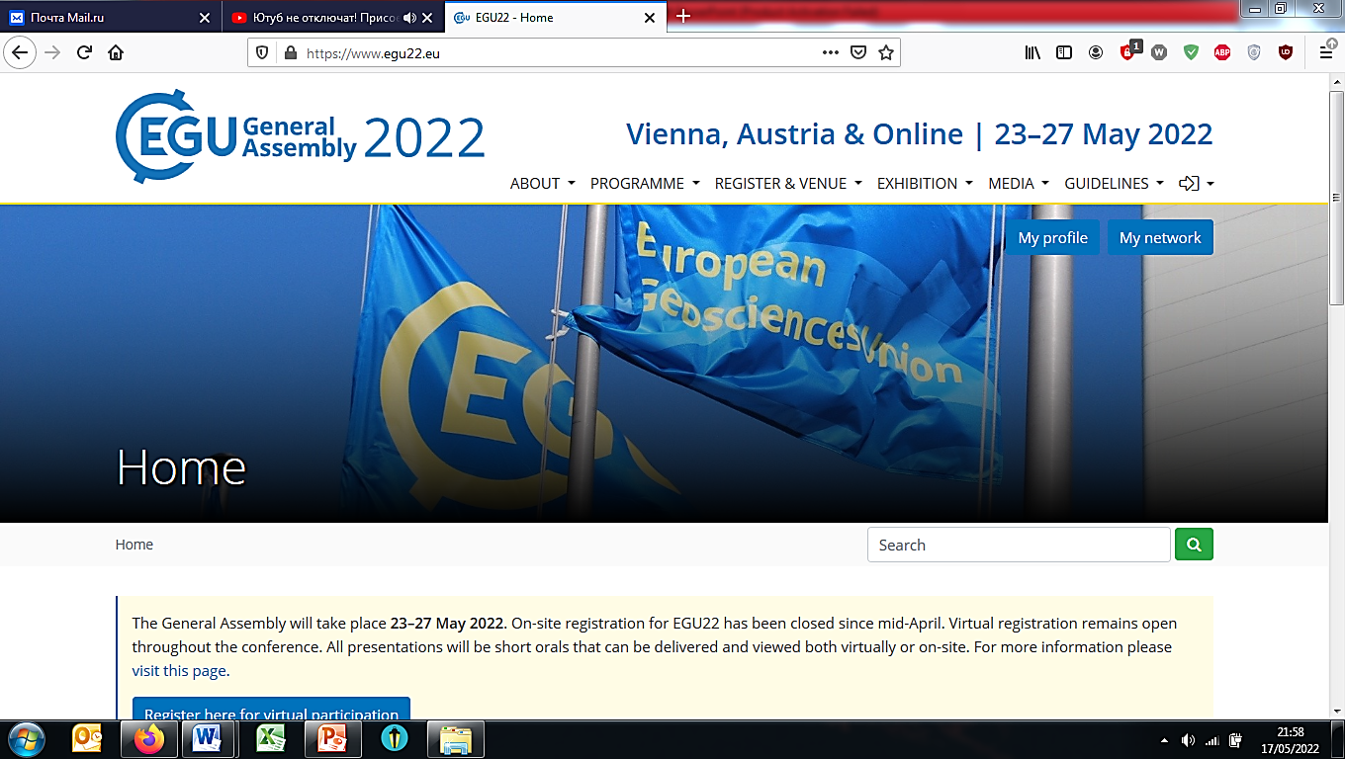
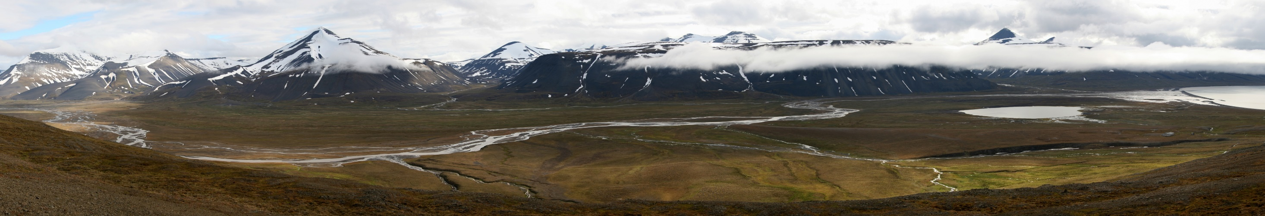
Exotic pollen in sediments from the high Arctic lake Tenndammen, Svalbard archipelago: Aspects of potential pollen sources and transportation ways
Anastasia Poliakova, postdoctoral researcher in vegetation history, palaeoecology and ancient DNA. UiT Museum. Tromso
EGU22-803

Slide 2
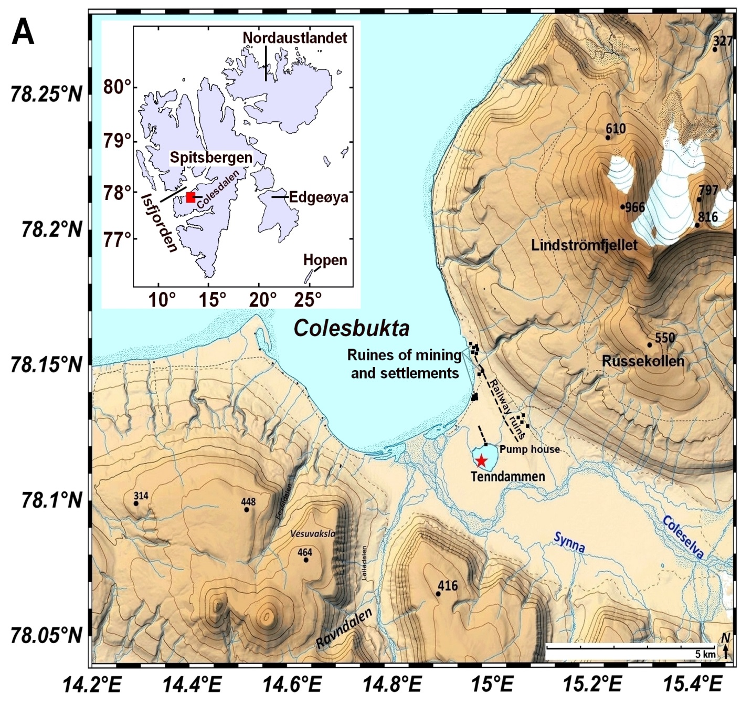
Lake Tenndammen: Core Te2019
Position of the core:
Latitude. N 78°5'52.77" Longitude. E N° 33°506.42″
Altitude, m. a.s.l.: 5
Catchment size, km²: 20/2
Vegetation: Wet tundra
Core length, cm: 85
Covered ages, cal yrs BP: 1200 - 2019 CE

Slide 3
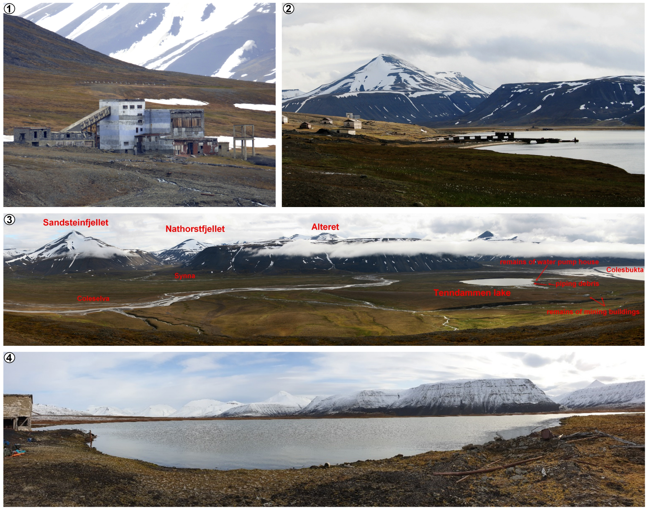
Remains of the coal burning power station, buildings and other constructions in Colesbukta
1. Remains of the coal burning power station in the former settlement Grumant (1912-1965). At the background - a narrow gauge railway running from coal mine to the port of Colesbukta.
2. Buildings of the miner’s settlement Colesbukta with two warehouses, two piers, several leaving houses, a canteen and a coal processing plant. At the seashore a coal port can be seen.
3. General view from the Russekollen highland on the Colesdalen with rivers Coleselva and its tributary Synna flowing into Tenndammen lake and Colelbukta of the Isfjord.
4. View on the lake Tenndammen from its shore. Remains of wooden and metal constructions can be seen. In the left corner - former water piping station.

Slide 4
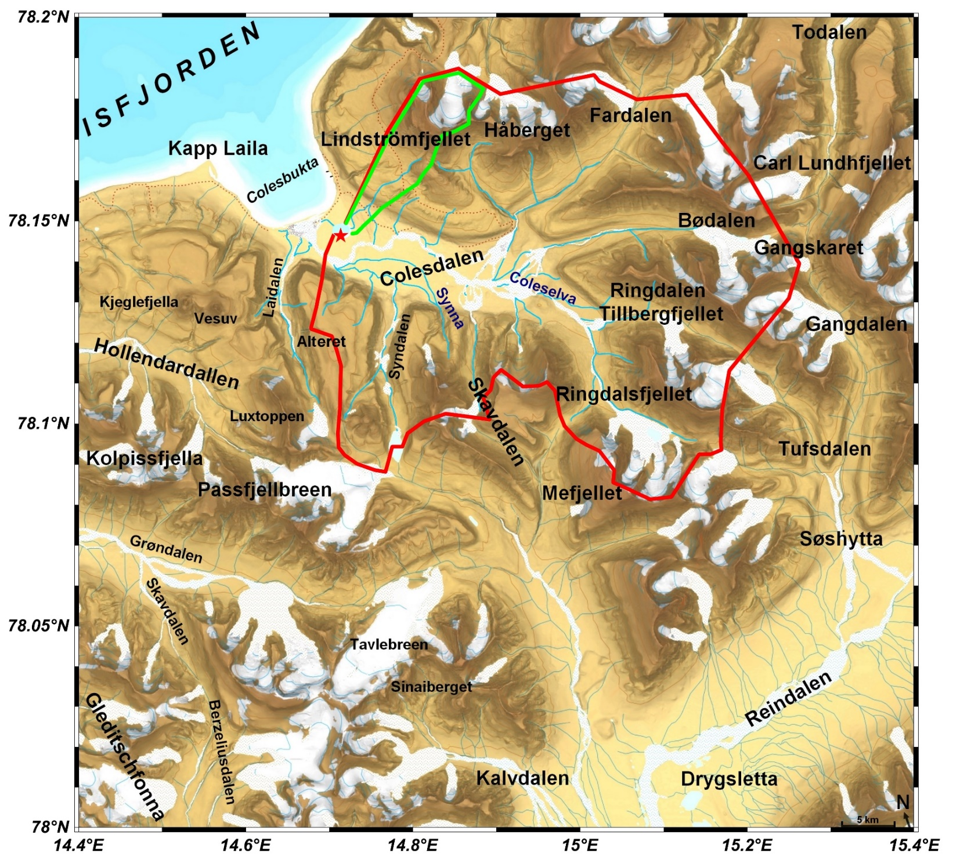
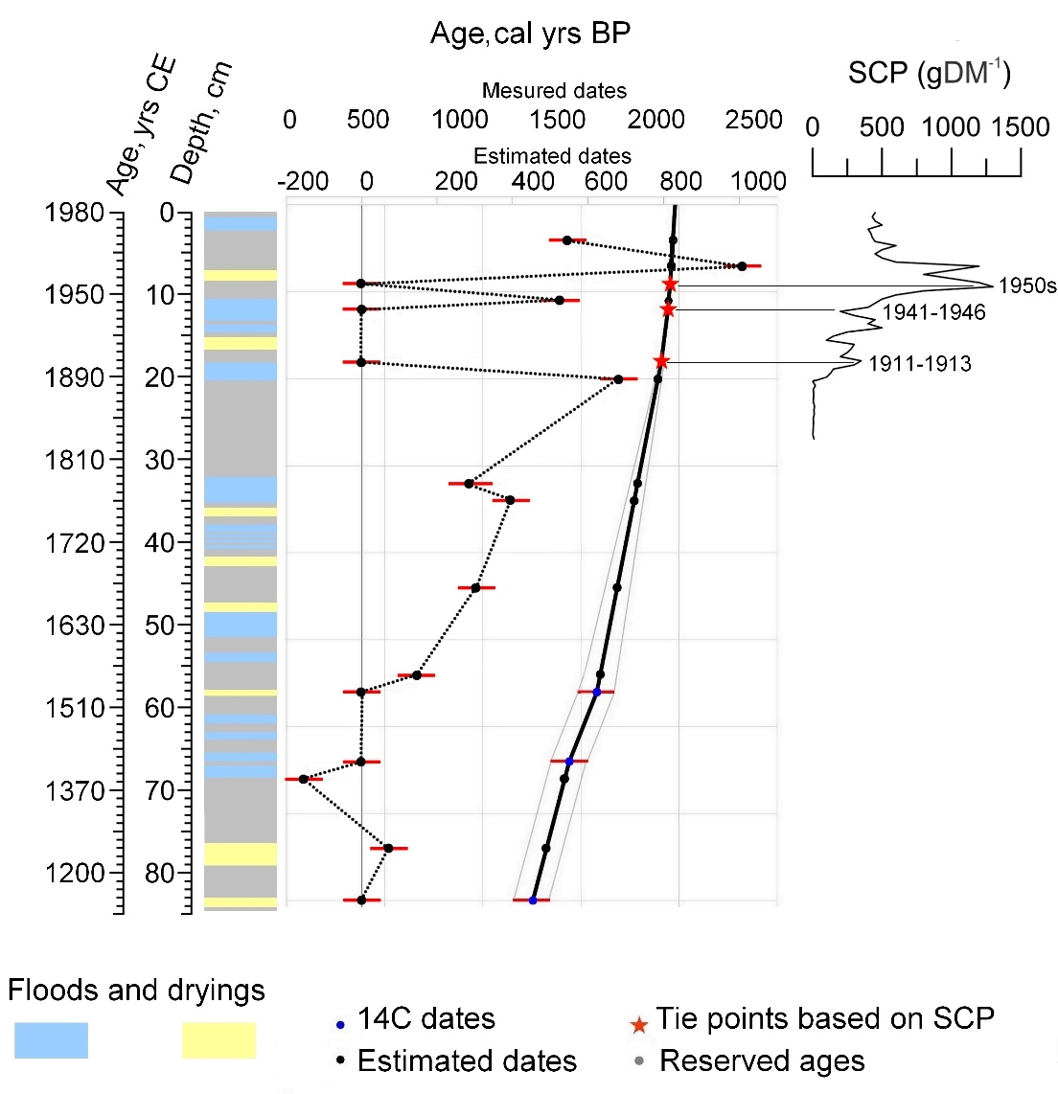
Tenndammen: lake catchment
Grater catchment: about 20 km²
Relevant to massive floods, 15 during the last 700 yrs
Smaller (“modern”) catchment: 2 km²
SCP - Spheroidal carbonaceous particles

Slide 5
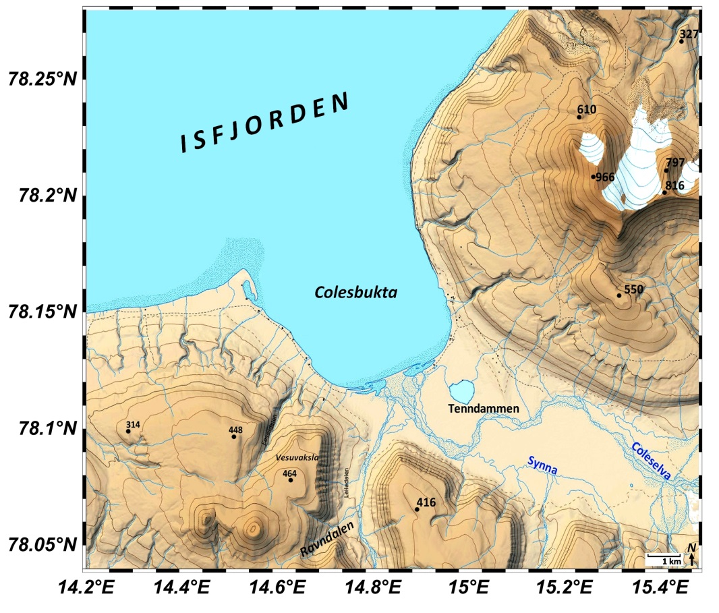
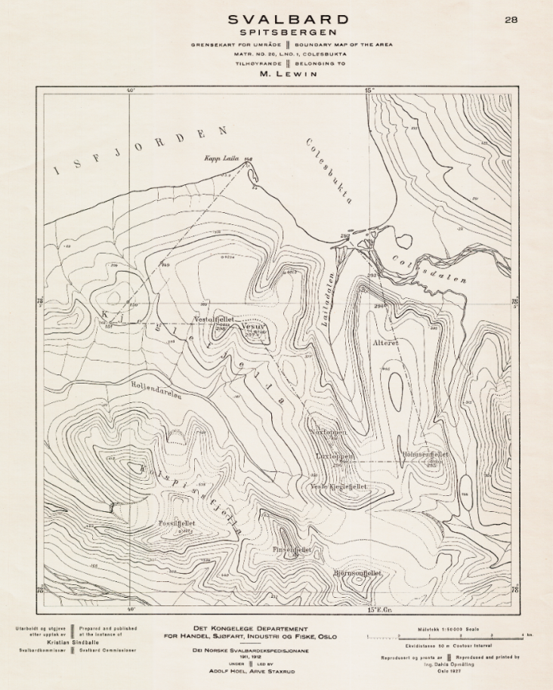
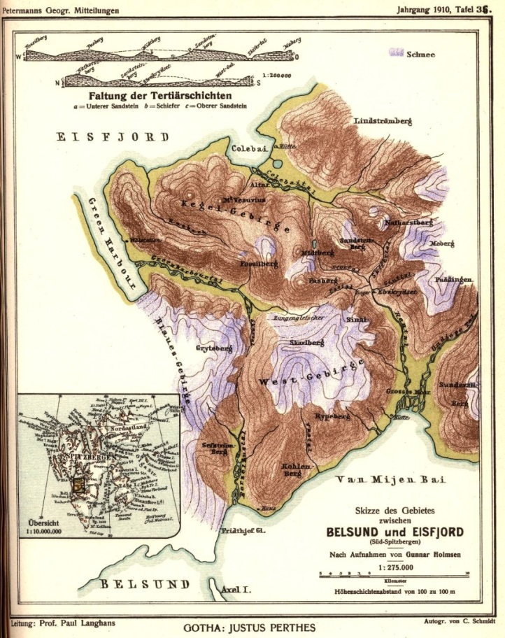
Lake Tenndammen: Depth was managed
1
2
3
1. modern map of the lake Tenndammen catchment. Left tribute inflow is clearly connected to the lake.
2. Map of Colesbukta, created by Adolf Hoel and Arve Sttaxrud, 1927 (Data collected 1911-1912).
3. Map of Colesbukta, created by Gunnar Holmsen, 1910. No inflow from the left is depicted; lake Tenndammen stays nameless.

Slide 6
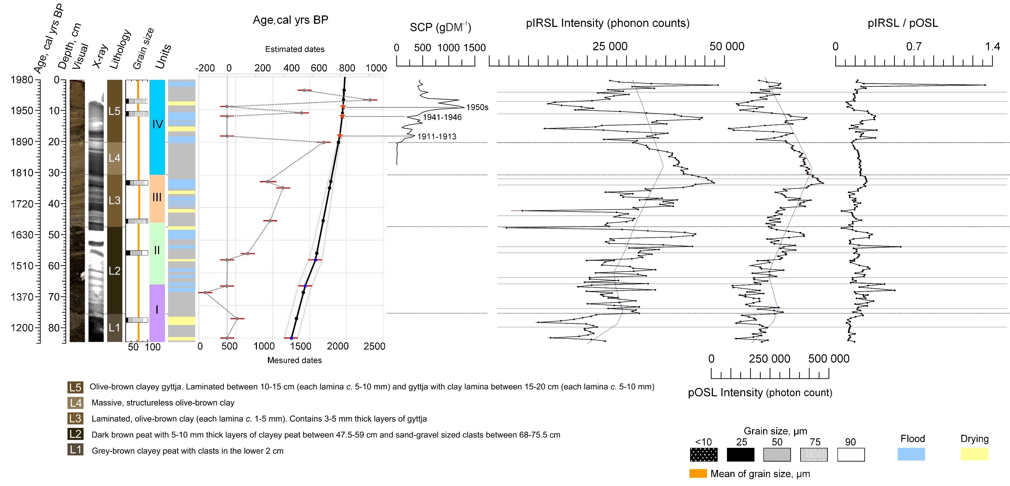
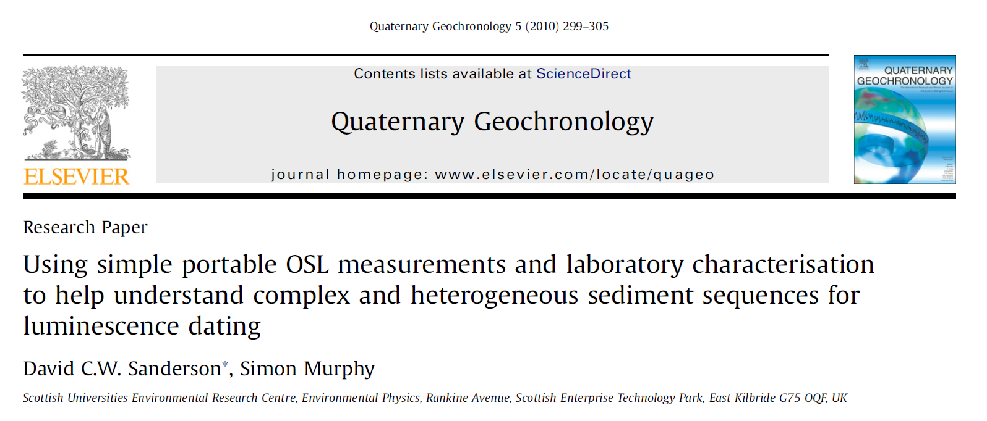
Portable OSL measurements as a tool to reconstruct the history of the floods and dryings
SCP - Spheroidal carbonaceous particles

Slide 7
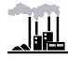
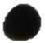
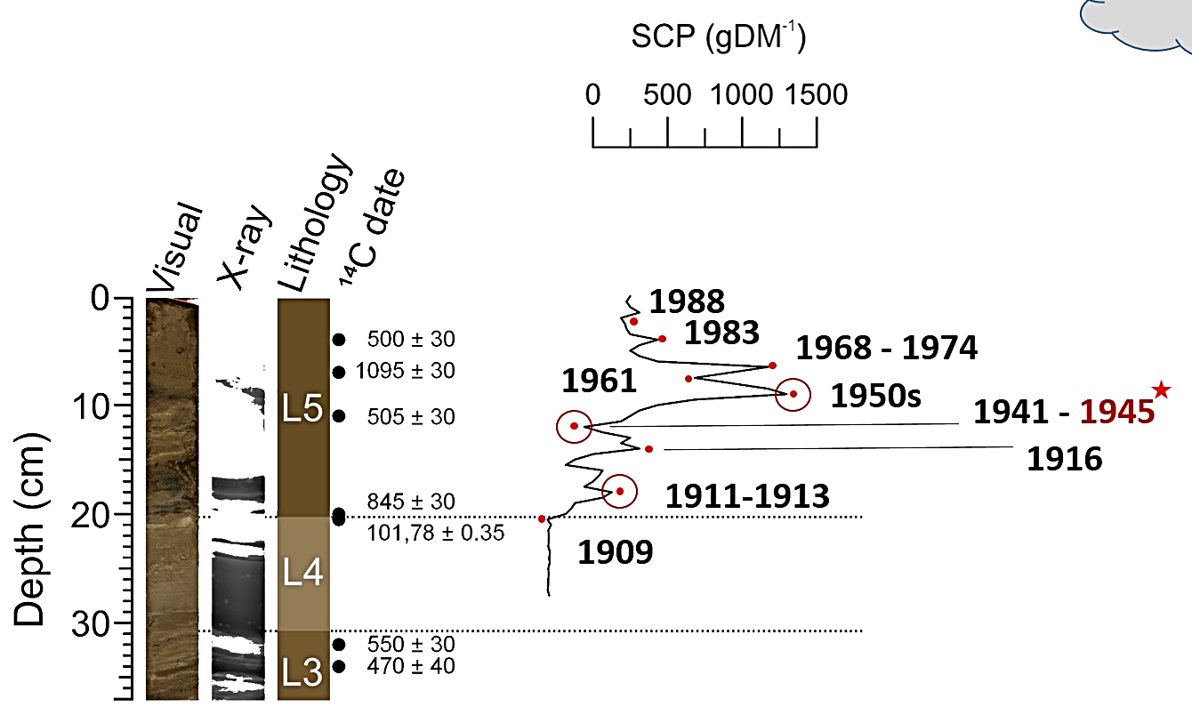
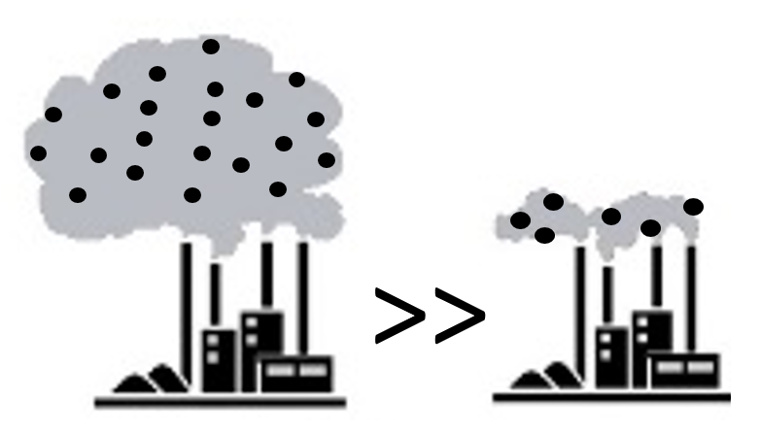
Power stations “produced” chronology…
DATA
Spheroidal carbonaceous particles (SCP)
Unambiguous indicator of the human activities (i.e. coal combustion)
not formed during any natural process or deposition
not found in the sedimentary record prior to the discovery and usage of coal for energy production

Slide 8
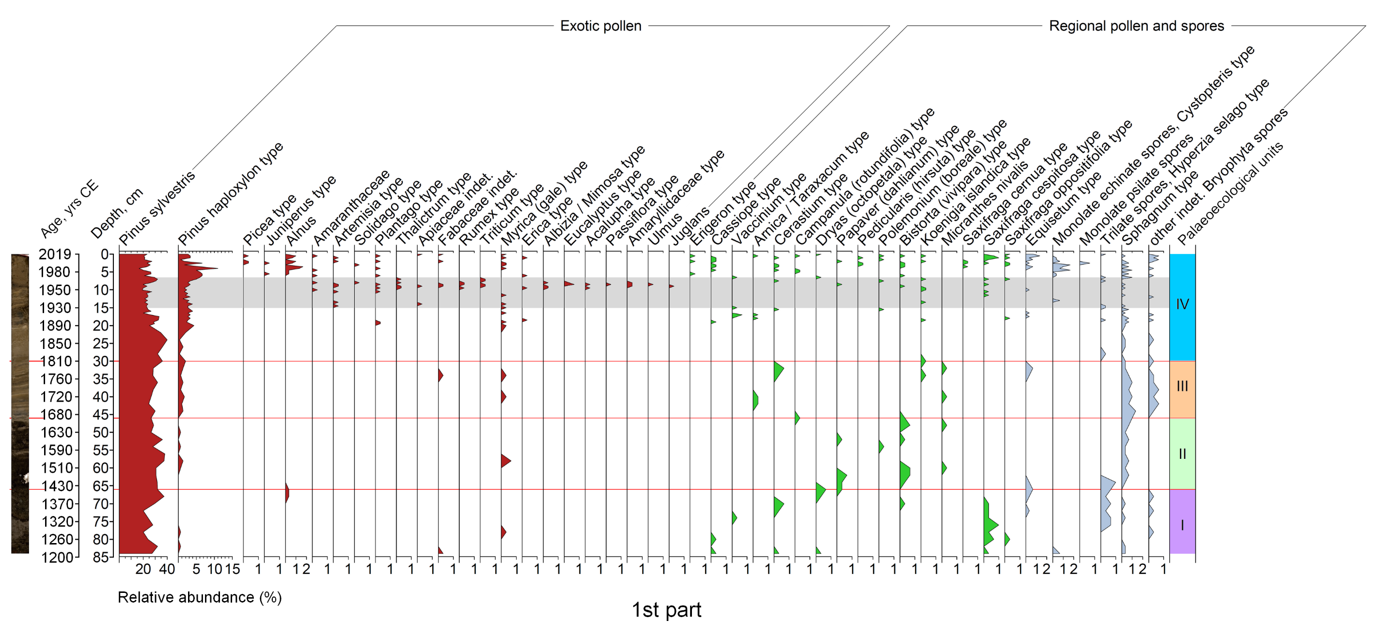
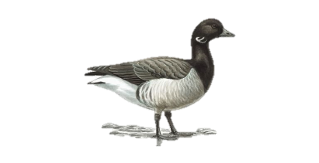
Svalbard, Colesdalen, Lake Tenndammen: tropical pollen?!
Wind
???
Only
30s-60s

Slide 9
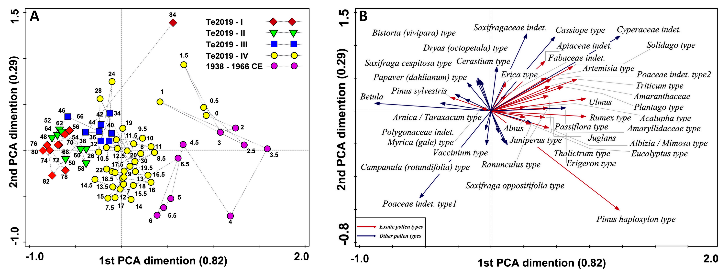
Exotic pollen and people migration
Results of principle component analysis (PCA) illustrating statistical relations of selected pollen types and sediment samples collected from the indicated core depths. Clusters of sediment samples clearly reflect pollen zones TePol-1 to TePol-4 (A) indicated in Figure 6. Only dominating pollen types with abundance more than 5% and exotic types are included (B).

Slide 10
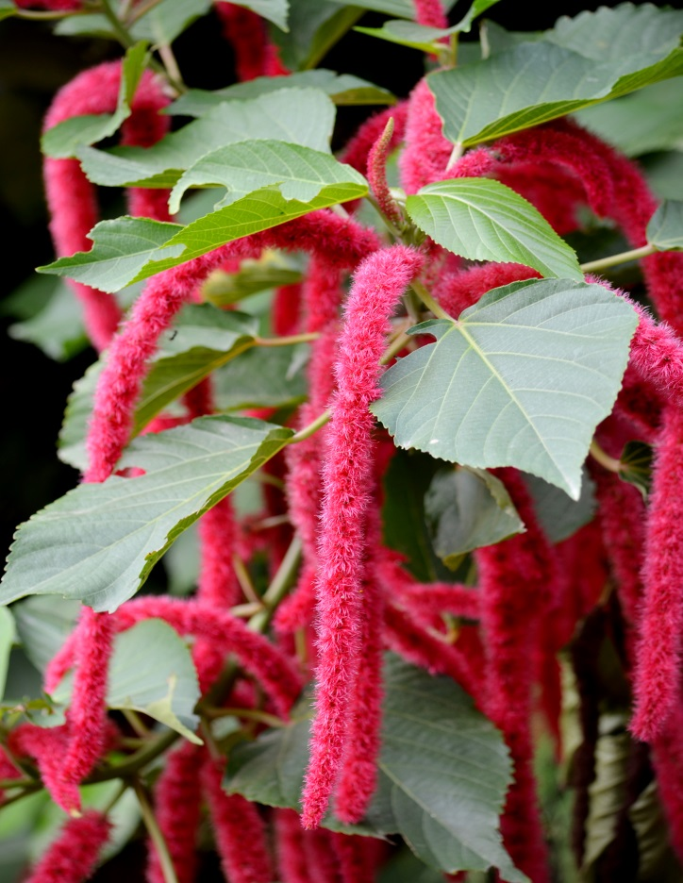
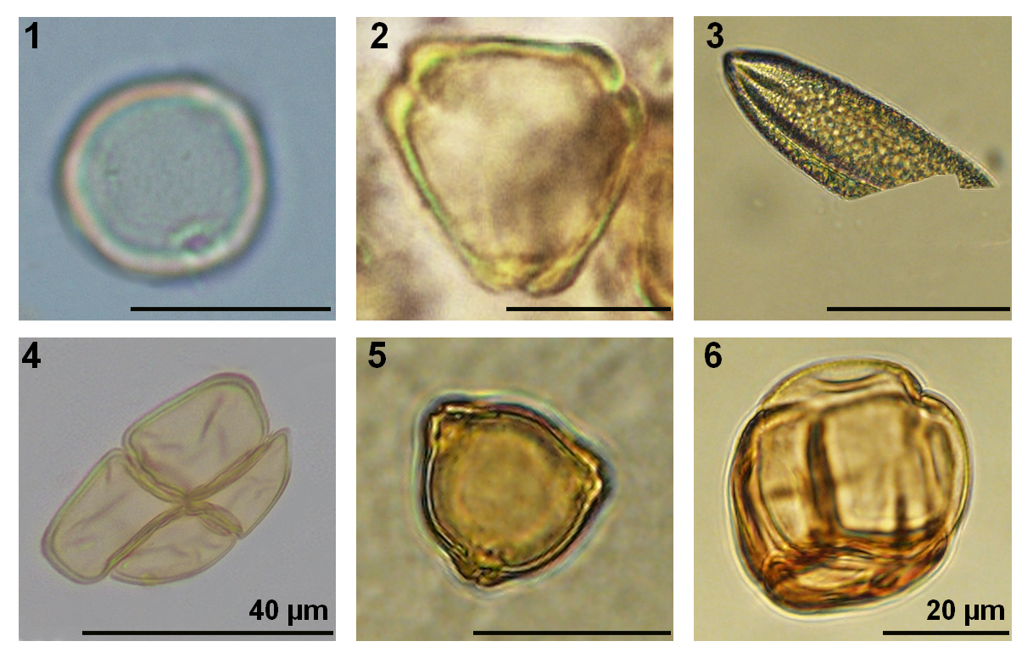
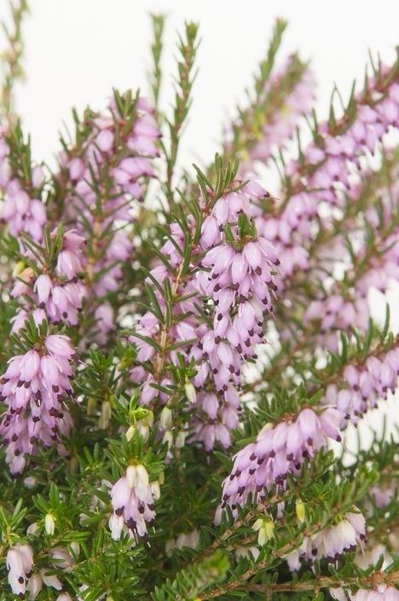
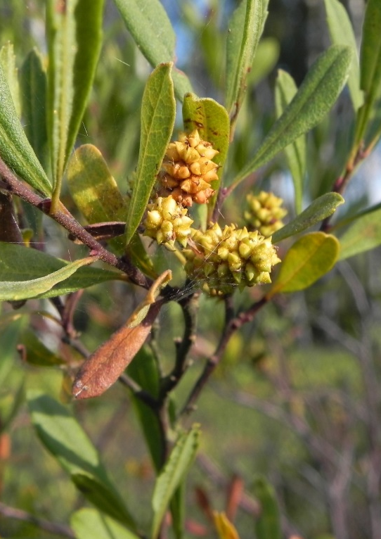
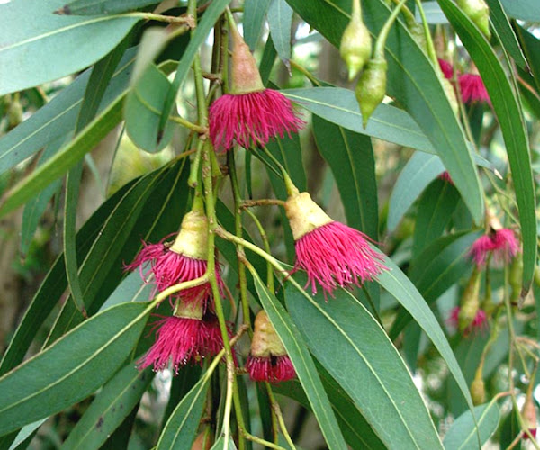
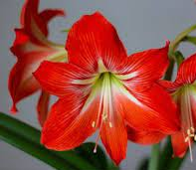
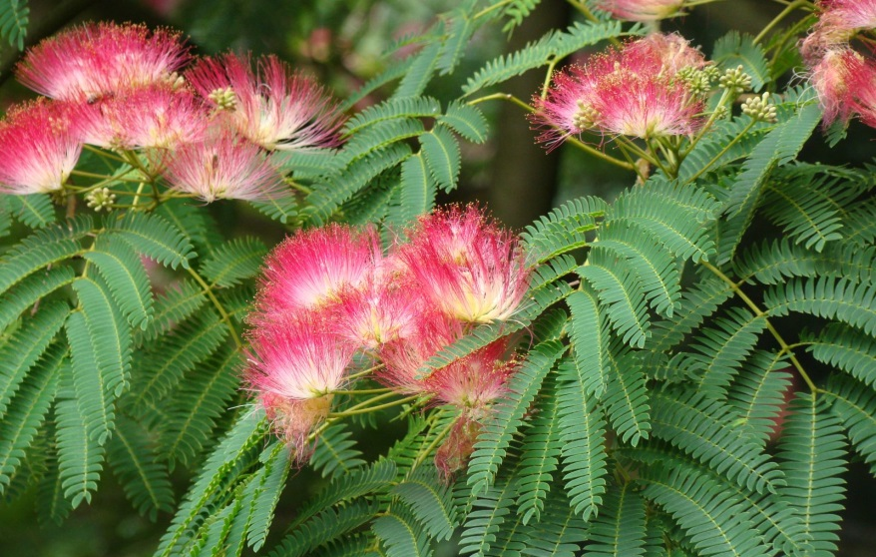
1
6
5
2
3
4

Slide 11
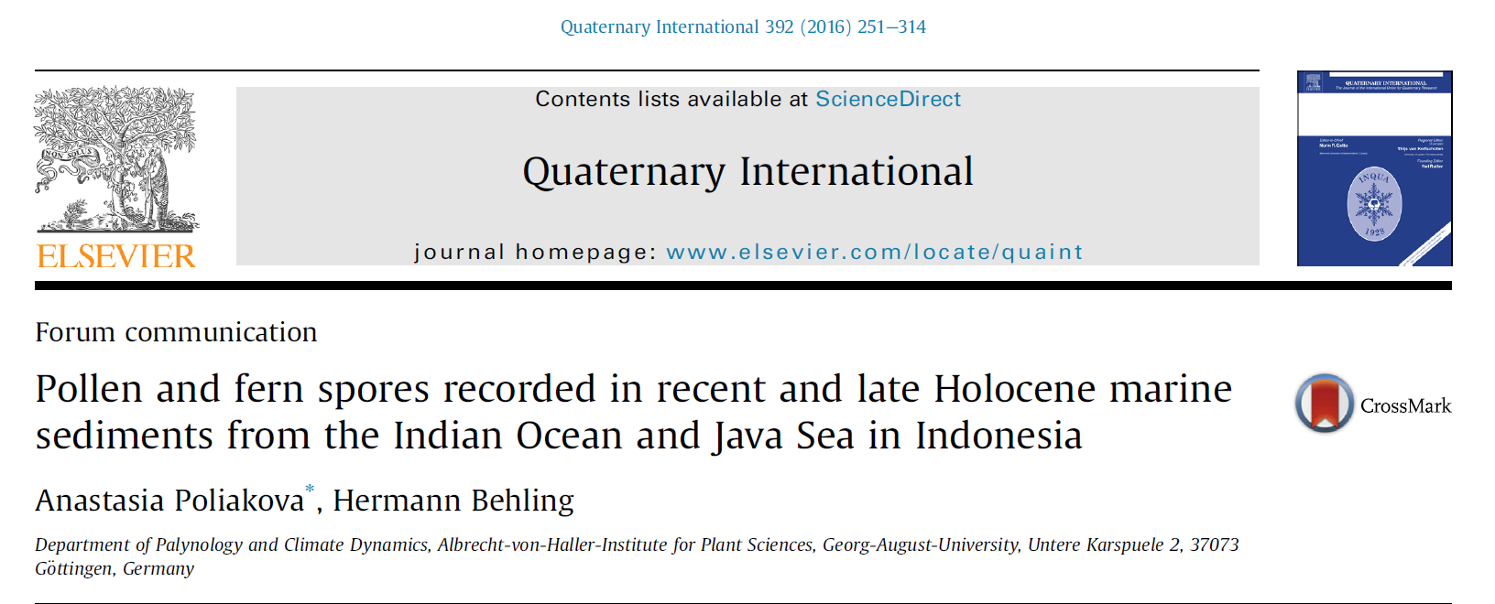
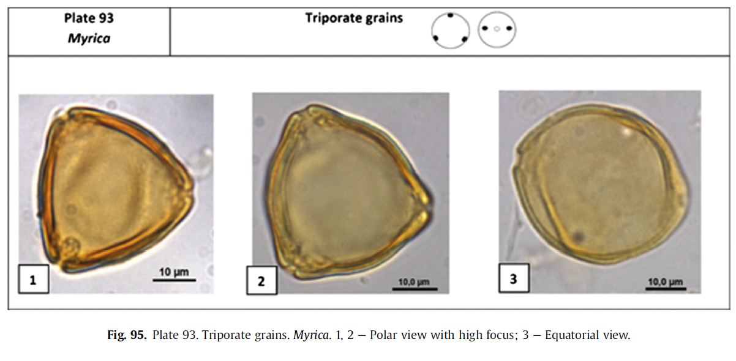
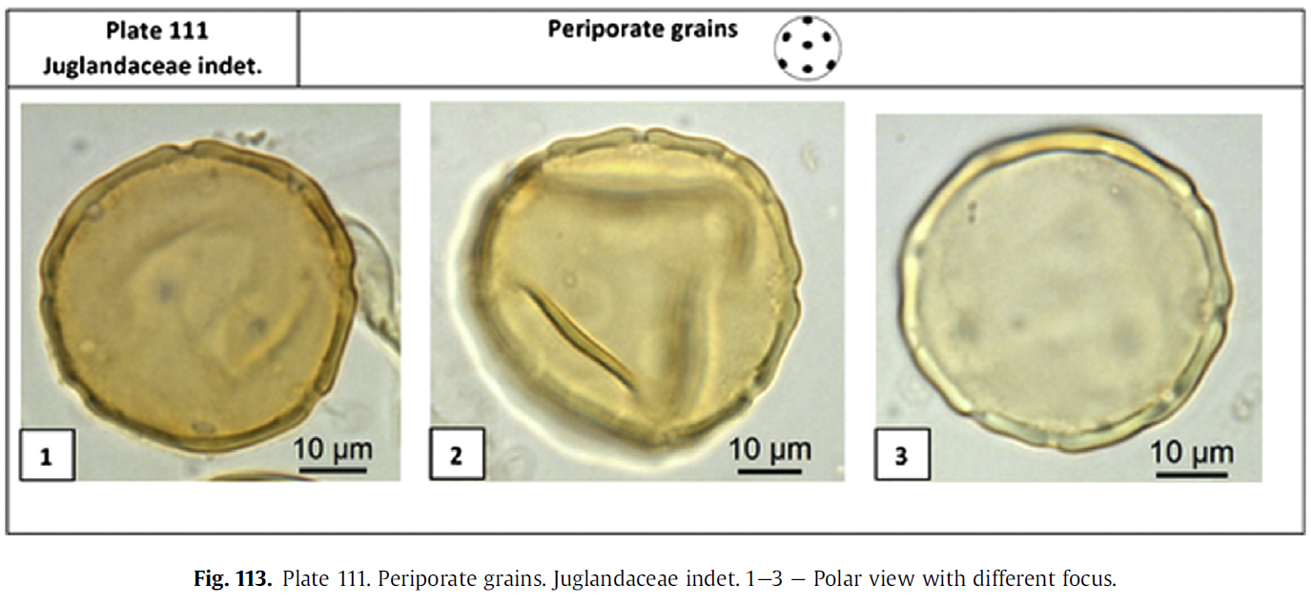
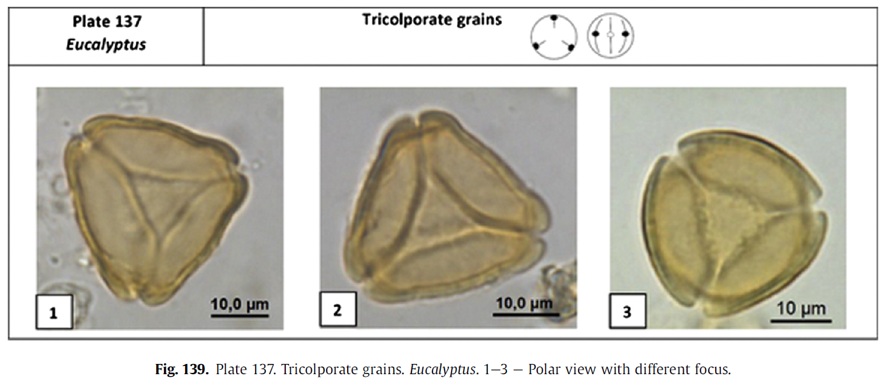
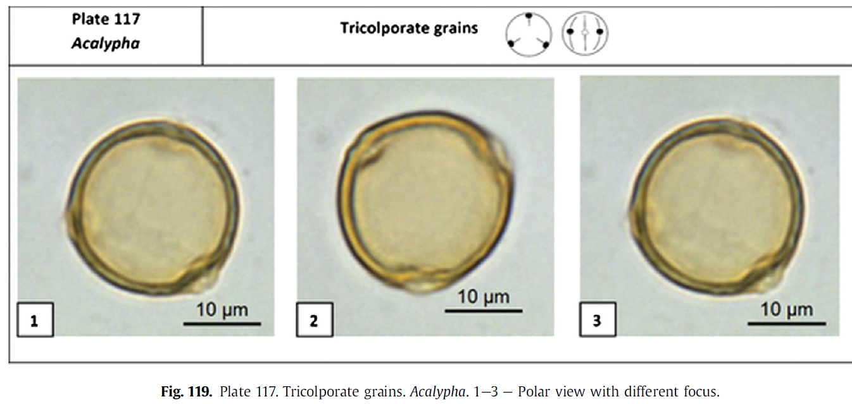

Slide 12
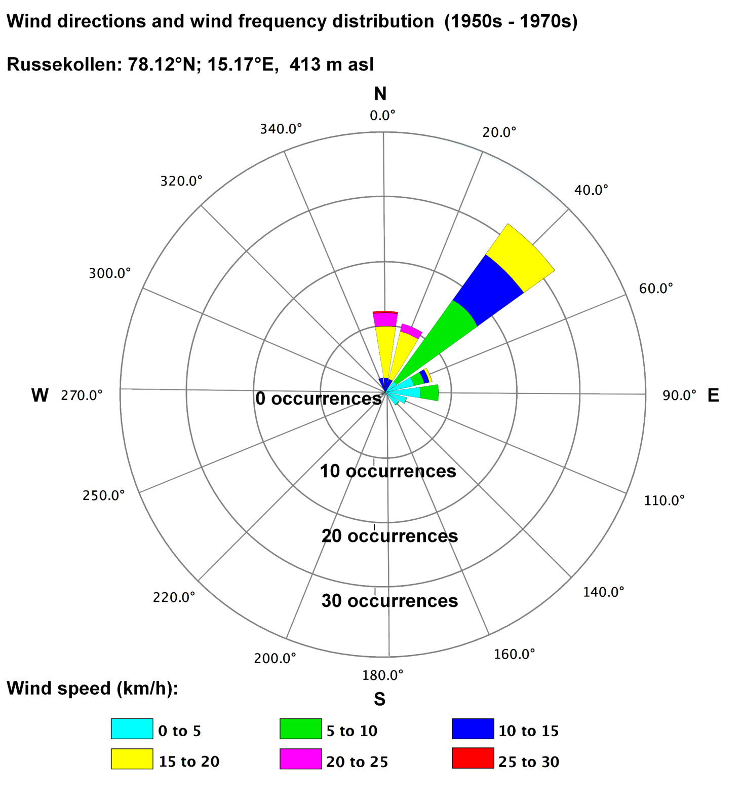
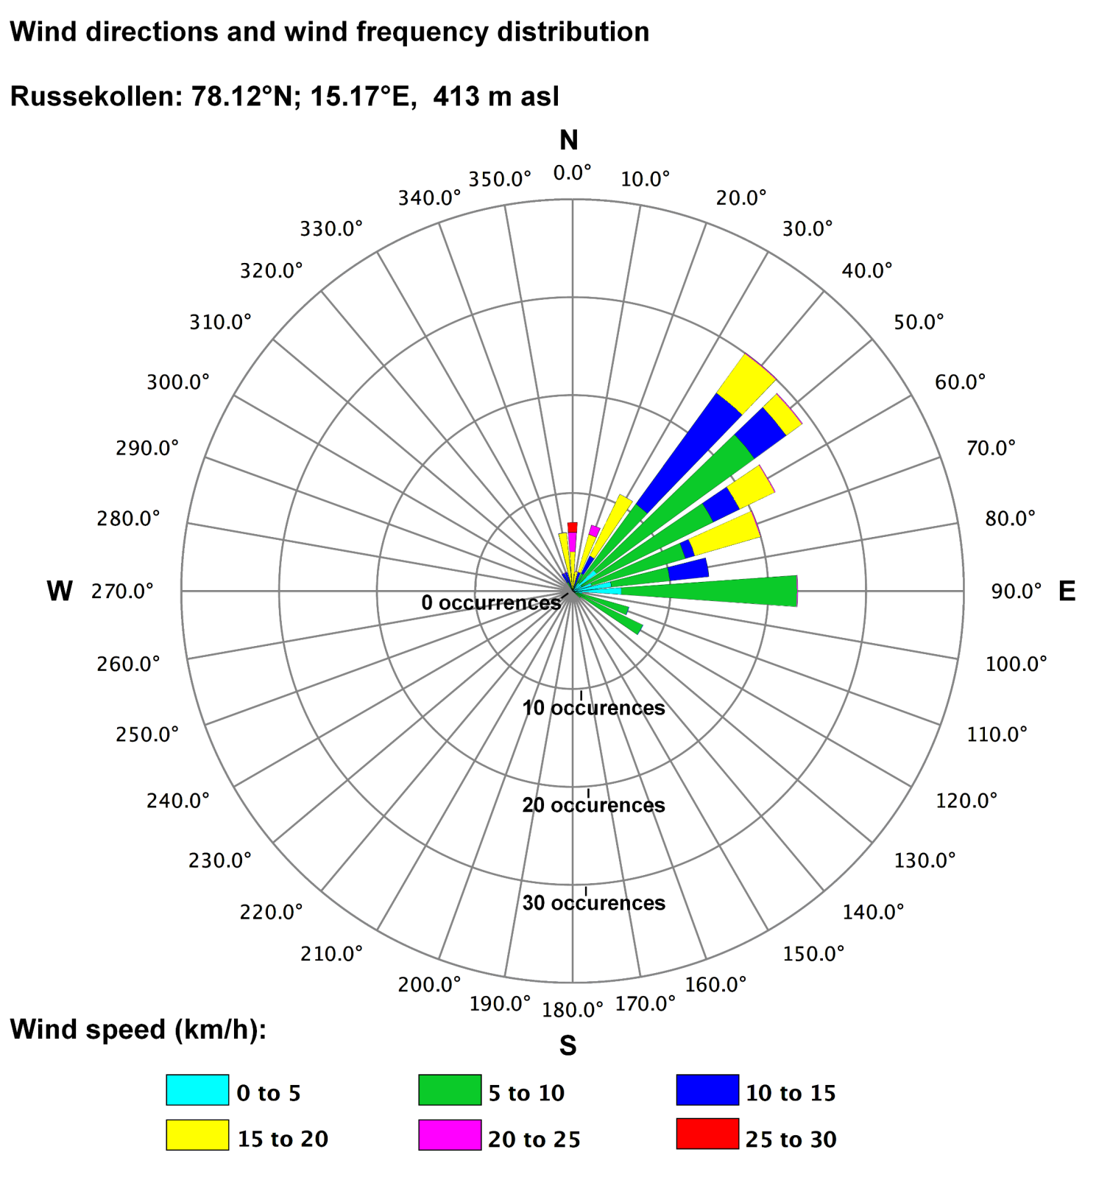
Wind

Slide 13
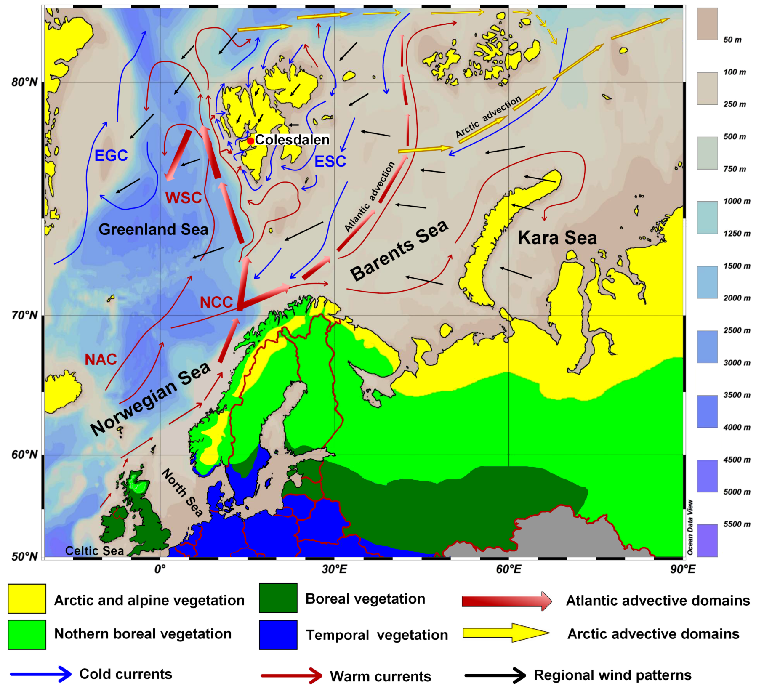
Marine currents
Distribution main type of northern-European vegetation and marine currents in Northern Atlantic and Western part of the Arctic Ocean.
Warm currents are abbreviated as following: NAC – North Atlantic Current, NCC – North Cape Current, WSC – West Spitsbergen Current.
Cold currents are indicated as EGC – East Greenland Current, ESC – East Spitsbergen Current.
The upper layer advective domain of the European sector of the Arctic Ocean with the Atlantic (red fat arrow) and Arctic (yellow fat arrow) advective domains are depicted following Wassmann et al. (2019).

Slide 14
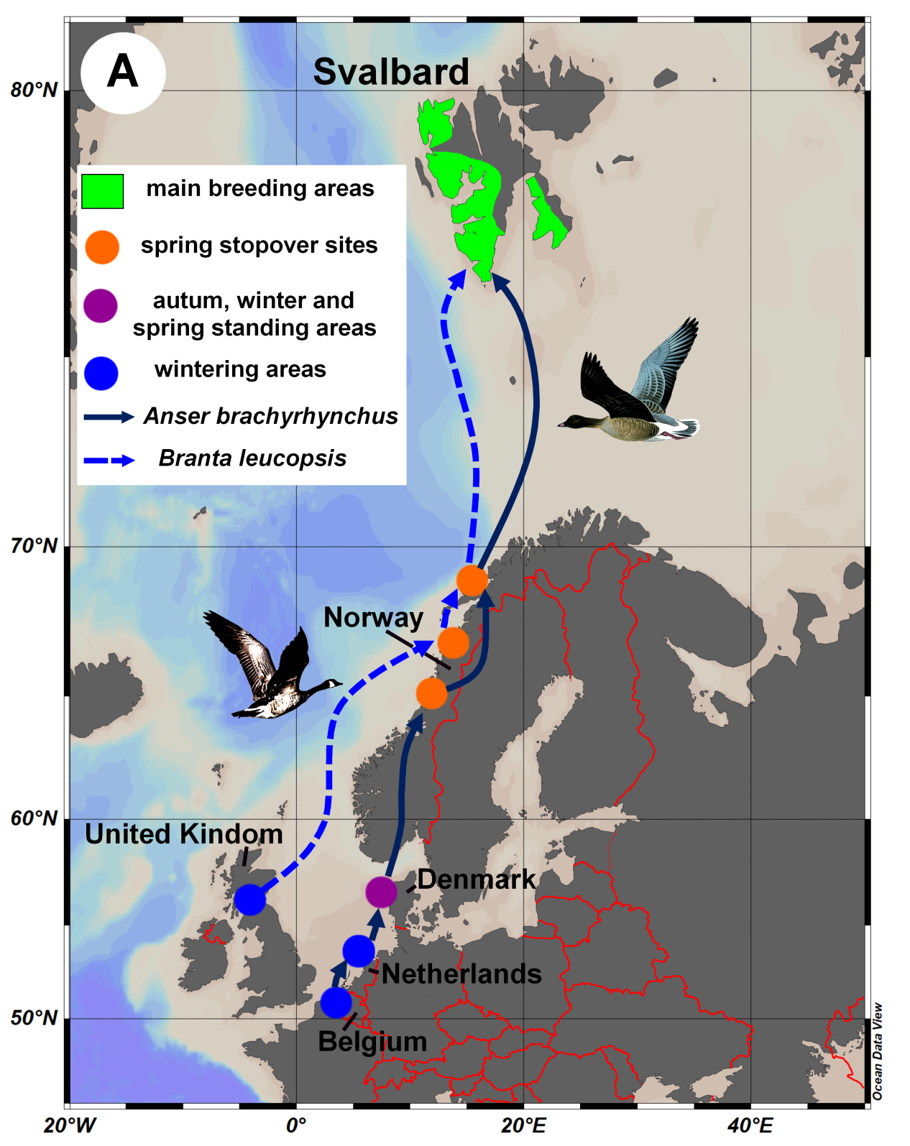


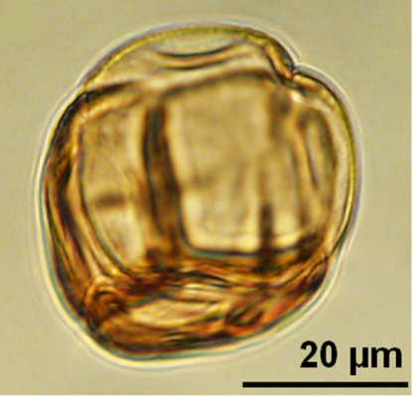

Birds: Branta leucopsis and Anser brachyrhynchus
Myrica gale Erica tetralix/cinerea

Slide 15
Coal burning and migration scales
Spheroidal carbonaceous particles (SCP)
1950s – maximal of mining work in Colesdalen
And maximal migration
30s 40s 50s 60s 70s 80s 90s

Slide 16
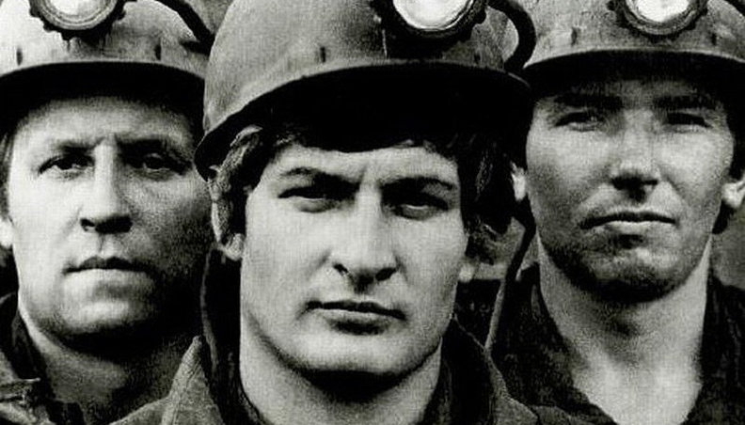
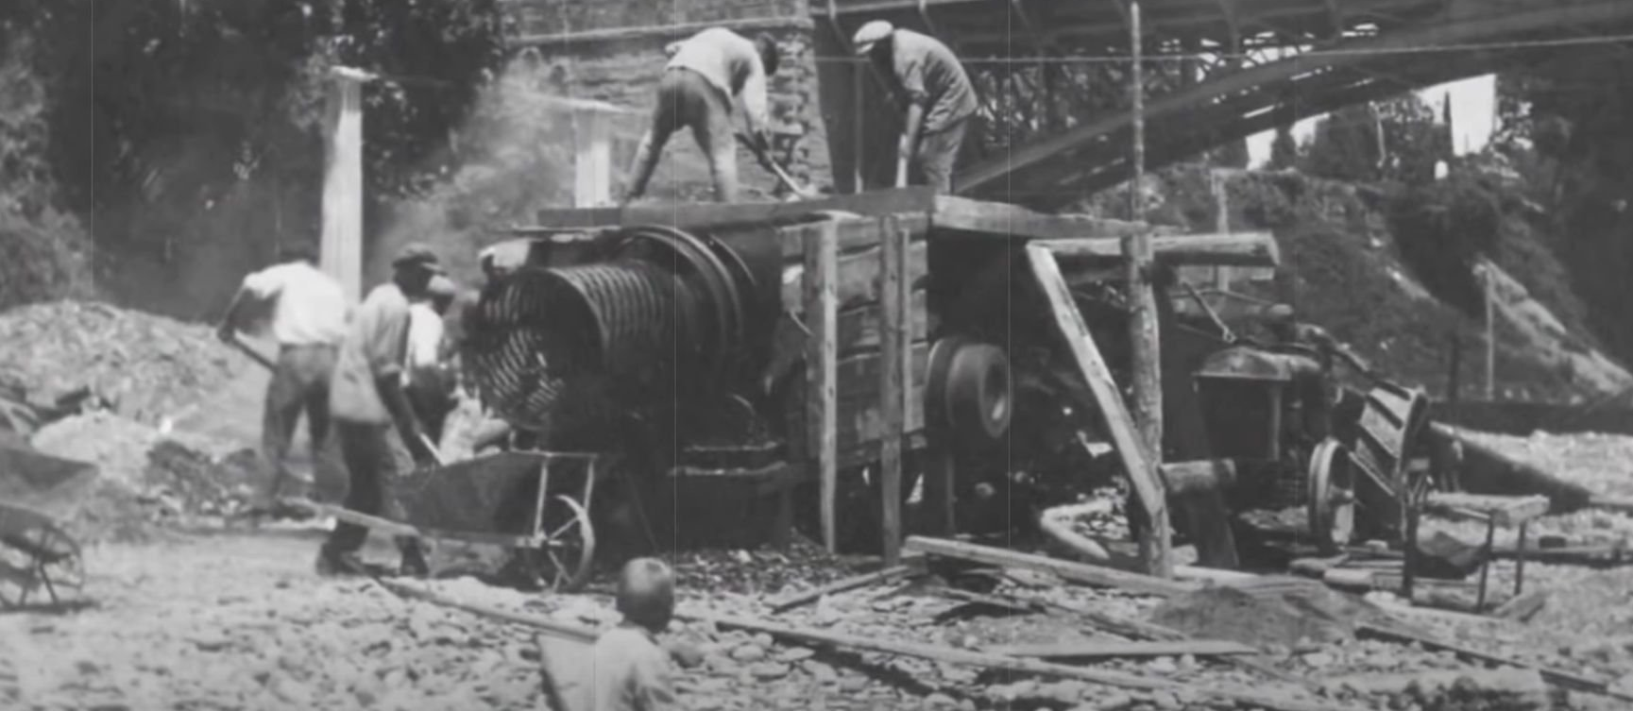
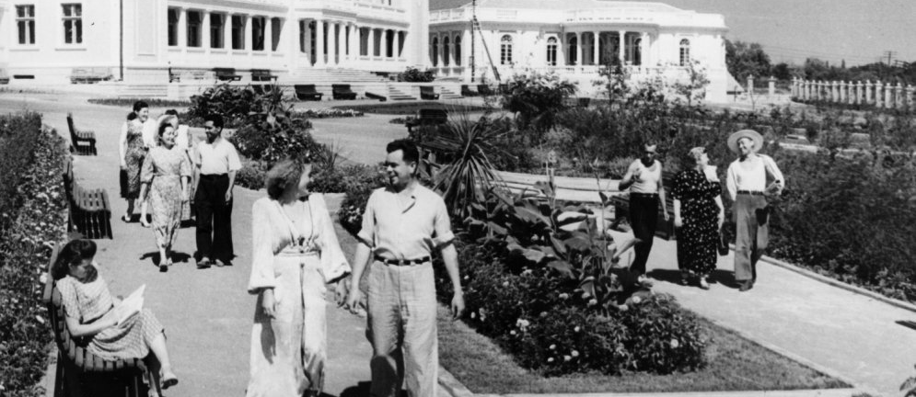


Slide 17
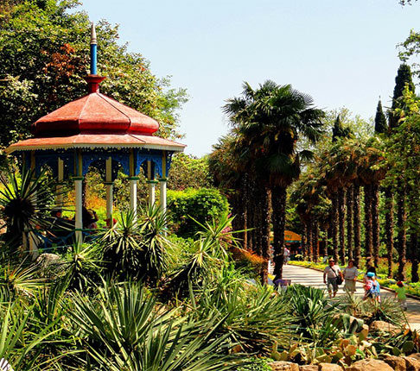
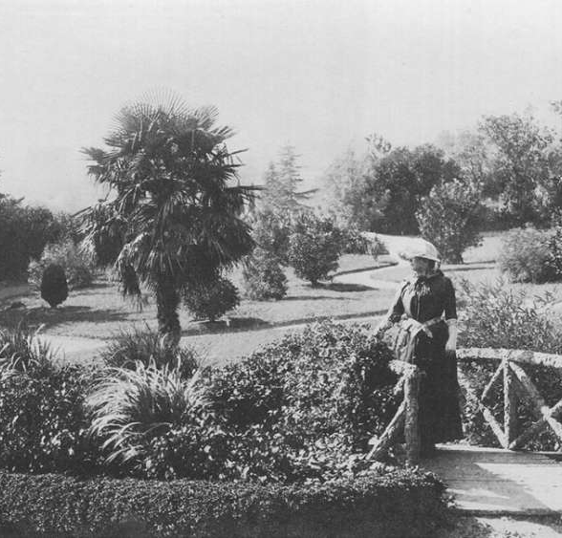
Nikinskiy Botanical Garden, 1921
Nikinskiy Botanical Garden, 2021

Slide 18

Conclusions
Taxonomical diversity of pollen spectra increases through the time (1200 – 2019 CE) from 21 to 56 types, both in terms of regional (increasing from 8 to 21 types) and exotic pollen (increasing from 5 to 12 types).
Increasing taxonomic diversity of exotic pollen is strongly correlated with human activities in the region.
Three ways of exotic pollen transport were described: long-distance wind transportation, bird and people migration.
Pollen of Myrica (gale) type and Erica type are discussed in terms of geese seasonal migration to and from Scotland (UK), Belgium and the Netherlands.
Other exotic pollen, including Ulmus, Juglans, and unexpected tropical pollen of Albizia / Mimosa type, Eucalyptus type, Acalupha type, Passiflora type, are found in the sediments exclusively during 1930s-1960s, in the period associated with the most intensive mining activity and human migration to and from Colesdalen, including holyday-associated migration to the sub-tropical regions and resorts of the former USSR.

