Slide 1
Hydropower and its Environmental Impacts: Quantifying Trade-offs in Data Scarce Regions
By Simbi Hatchard
Key Collaborator: Rafael Schmitt (Stanford University)
Supervisors: Paul Bates, Francesca Pianosi, Sam Williamson (UoB)
Special Mentions: James Savage (Fathom),
Miguel Rico Ramirez (UoB Engineering)
Notes:
Hmm… maybe lets have a shorter title.
“Hi All, I’m here to present the second part of my PhD”

Slide 2
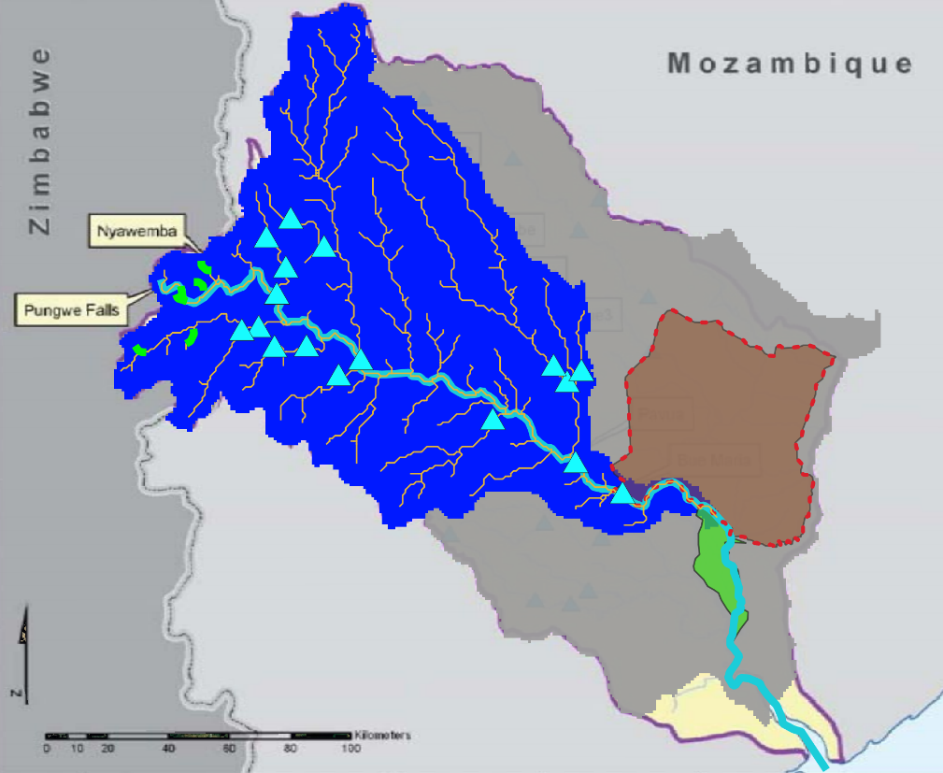
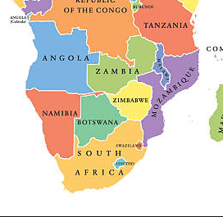
Hydropower Pros and Cons
HP positives
Power
Flood control
irrigation
Hydropower – generate electricity from rivers
Hydropower booming in developing countries
Hydropower has many pros and cons
Maximise
Upstream Hydropower Model, M_{U} Gorongosa National Park Hydropower Options Flow Gauge at Bue Maria Dinge Dinge Marshes Proposed Large Hydropower Stations
CONFLICT
Model this on Pungwe Basin, Mozambique
Minimise
Data Scarce catchment
17 Proposed HP locations selected
Ecologically sensitive downstream wetland
HP environmental negatives
Annual flood reduction
Sediment transport reduced
Fish passage
Where, and what kind of Hydropower should we build to maximise power generation, and minimize impact on Annual Flooding?
Minimise
Pavua Dam
Notes:
Hydropower: development apace in developing countries.
Provides many development pros and environmental cons
Power benefits and impact on downstream flow regime are important – two objectives in conflict
Say why the annual flood is important

Slide 3
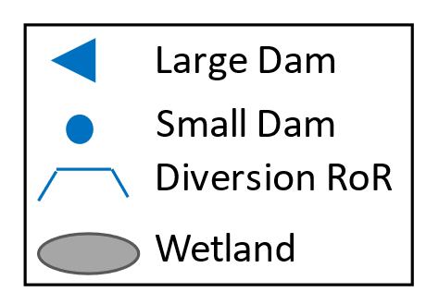

Which type, and where?
Design is important
Site and Design are important
Performance
P
Power generated
Lots of storage, so lots of Baseload power
Baseline
A
B
C
D
Q
Impact on Peak flow
Less storage, so less baseload power
A
t
Increasing
storage
B
Impact on flooded area of wetland
Little storage, so little baseload power
C
Best on Power
“Best” design is a complex function of site, design (and operation)
A
Trade off
No storage, no power
C
D
D
B
Best on wetland flooding
Notes:
Do we build one / few large dams?
DO we build ROR / small dams?
Build on mainstems or tributaries?
This is a complex problem with many possibilities
Adapt this slide to show options…
We focus on SITE AND DESIGN

Slide 4
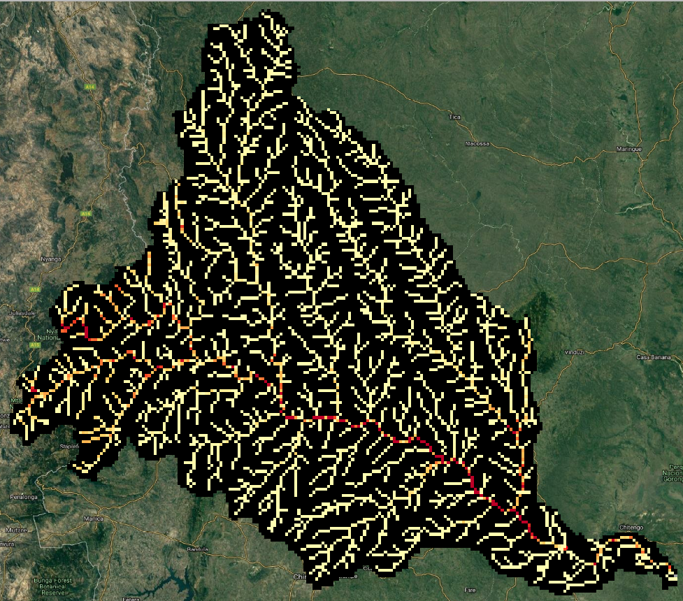
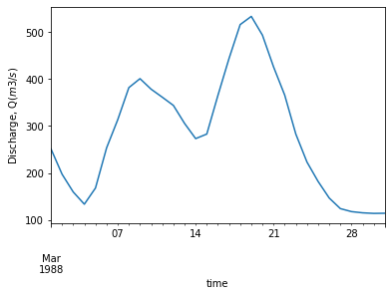
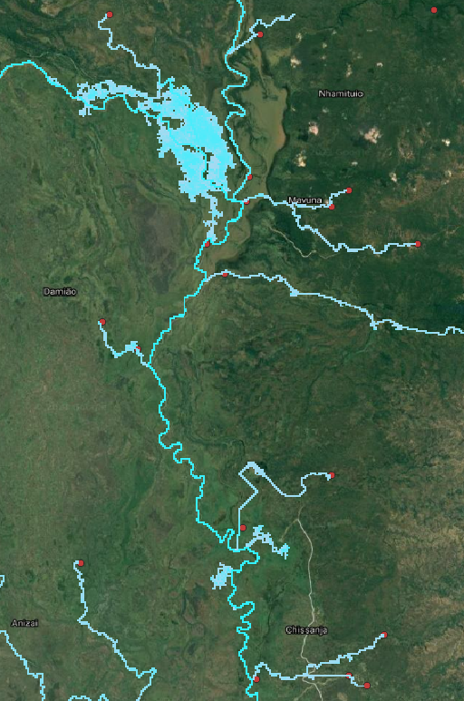
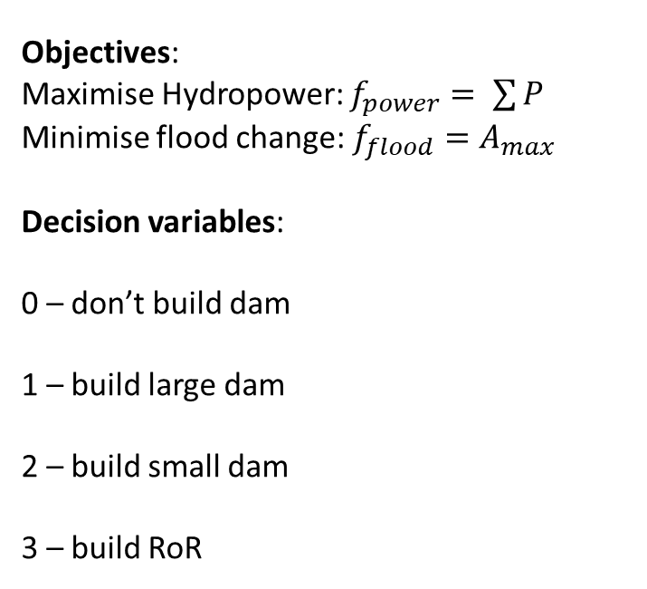
Simulation Model
Objectives:
Maximise Hydropower: $f_{power}= \sum{P}$
Minimise flood change: $f_{flood}=A_{max}$
Decision variables:
0 – don’t build dam
1 – build large dam
2 – build small dam
3 – build RoR
Distributed Hydrological Model
VIC (5km resolution)
Hydraulic Model
LISFLOOD-FP (1km)
Power Estimates
P
Dams
No dam
Q_{peak}
Fathoms 90m Floodplain
Model
Discharge, Q (m³s⁻¹)
A_{max}
Very slow! Replace with a surrogate regression model between Q_{peak} and Area
17 HP locations
4 design options
4¹⁷ = 17,179,869,184 options!
7 minute simulation
Time (days)
Hydraulics preserved throughout model chain
Notes:
Brief notes about VIC: semi distributed model, combining physically based and conceptual concepts. Soil parameters from FAO HWSD, Vegetation Parameters from GLCF, Temperature from MERRA-2. Rainfall
Data from CHIRPS, presenting here CHIRPS and could also show TAMSAT.
Brief Notes about LISFLOOD-FP:
“2d hydrodynamic model”
Brief Notes about Power Estimation:

Slide 5
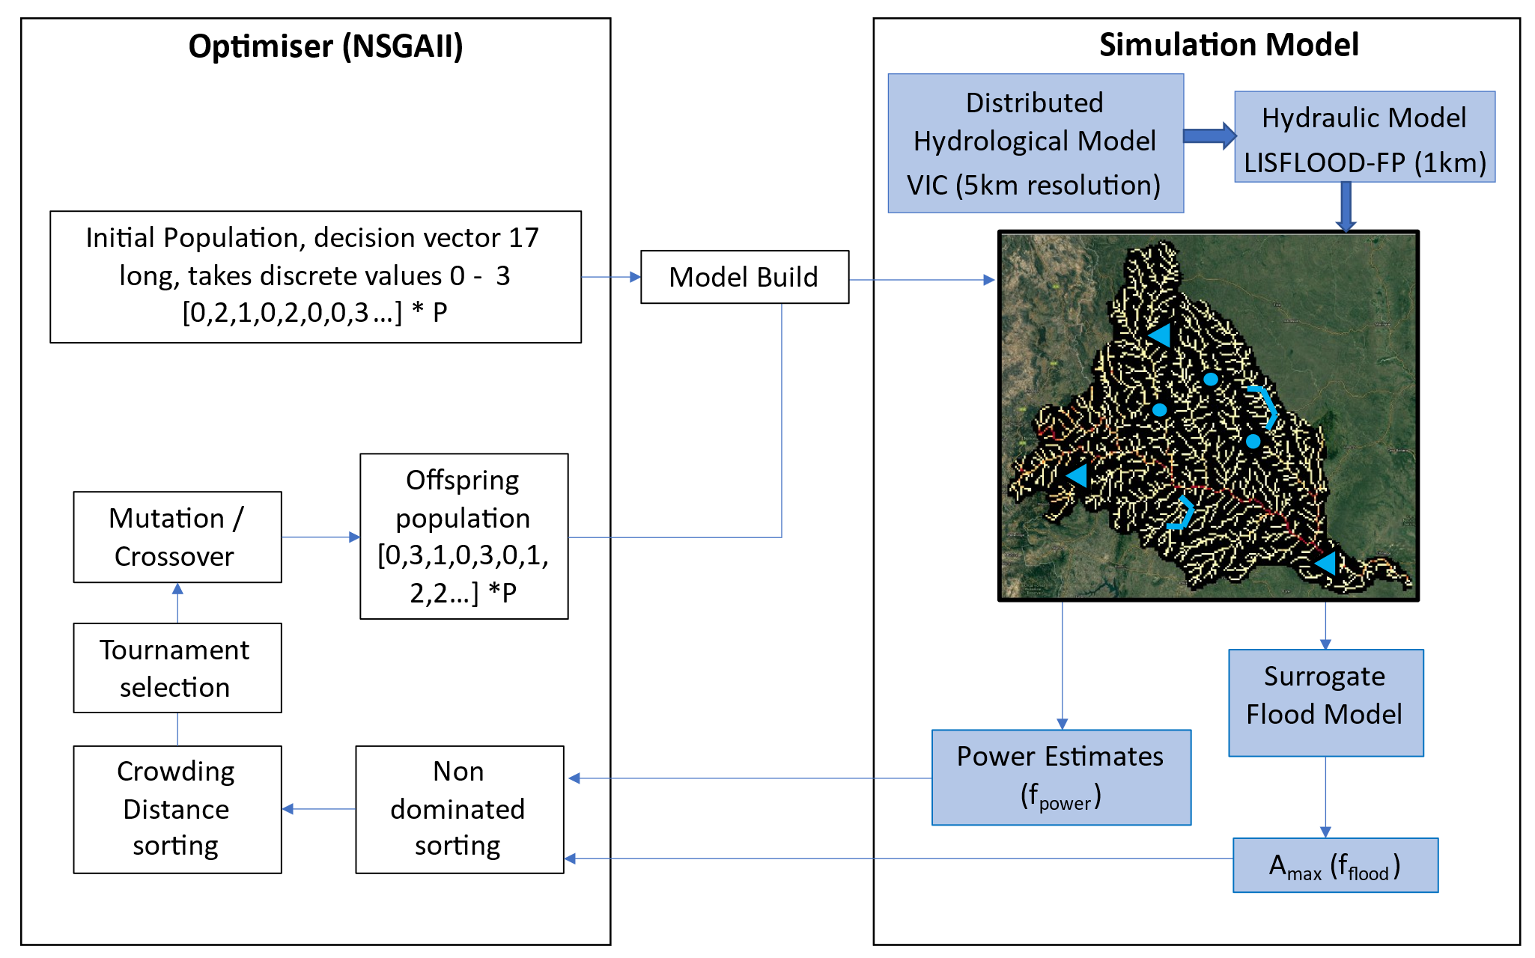
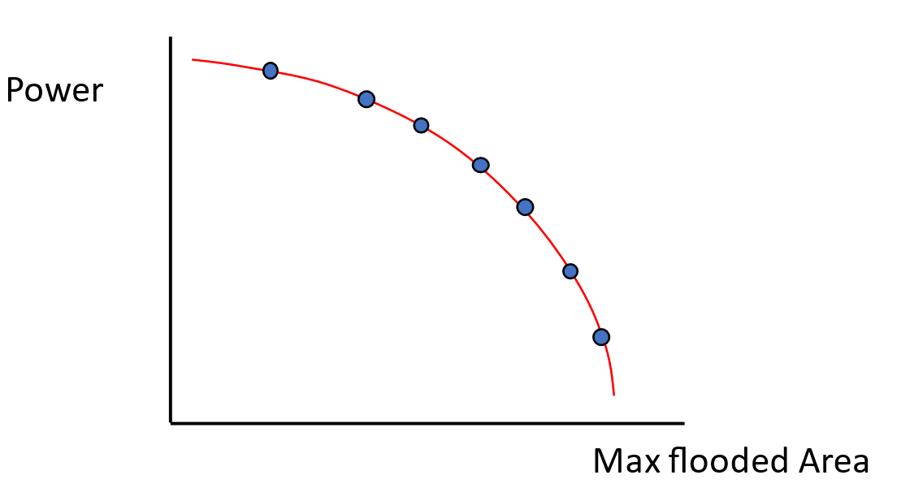
Simulation – Optimisation Model
Objectives:
Maximise Hydropower: $f_{power}= \sum{P}$
Minimise flood change: $f_{flood}=A_{max}$
Decision variables:
0 – don’t build dam
1 – build large dam
2 – build small dam
3 – build RoR
A
C
B
Run 100 different dam designs in parallel
50 generations
Optimal solutions are picked
D
Notes:
Lets take that simulation, and link it to an optmiser. In this case an evolutionary algorithm
NSGAII set up to suggest 100 random dam portfolios.
LISFLOOD model built of these dam portfolios
Edit figure – include floodplain model + and Amax objective + make the simulation model match the sketch in previous slide.

Slide 6
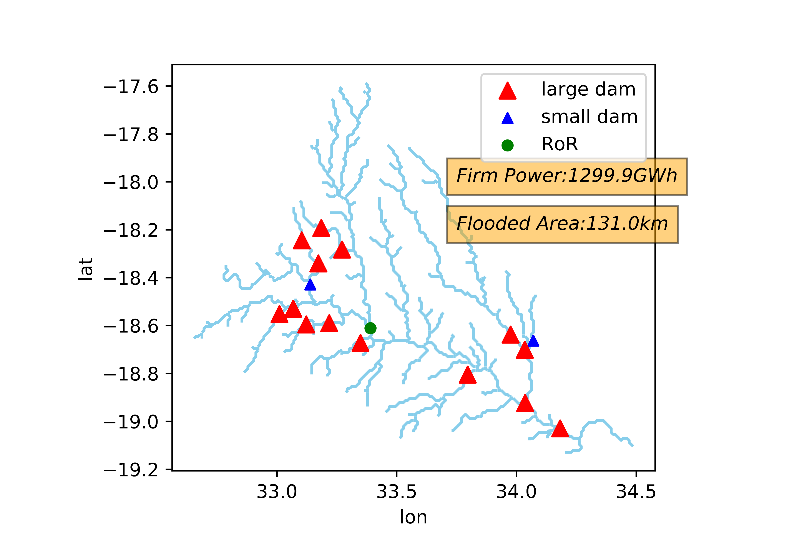
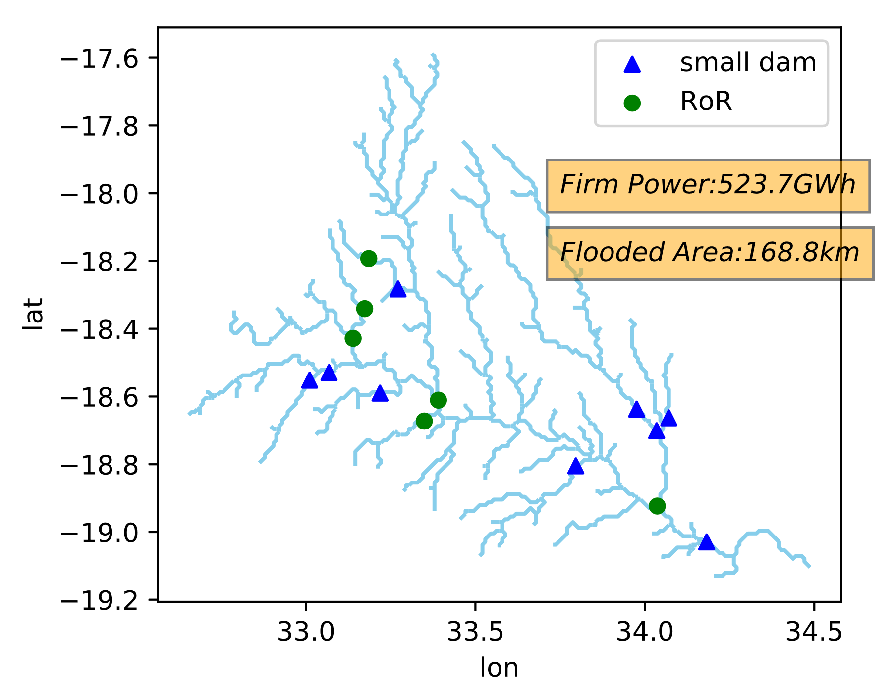
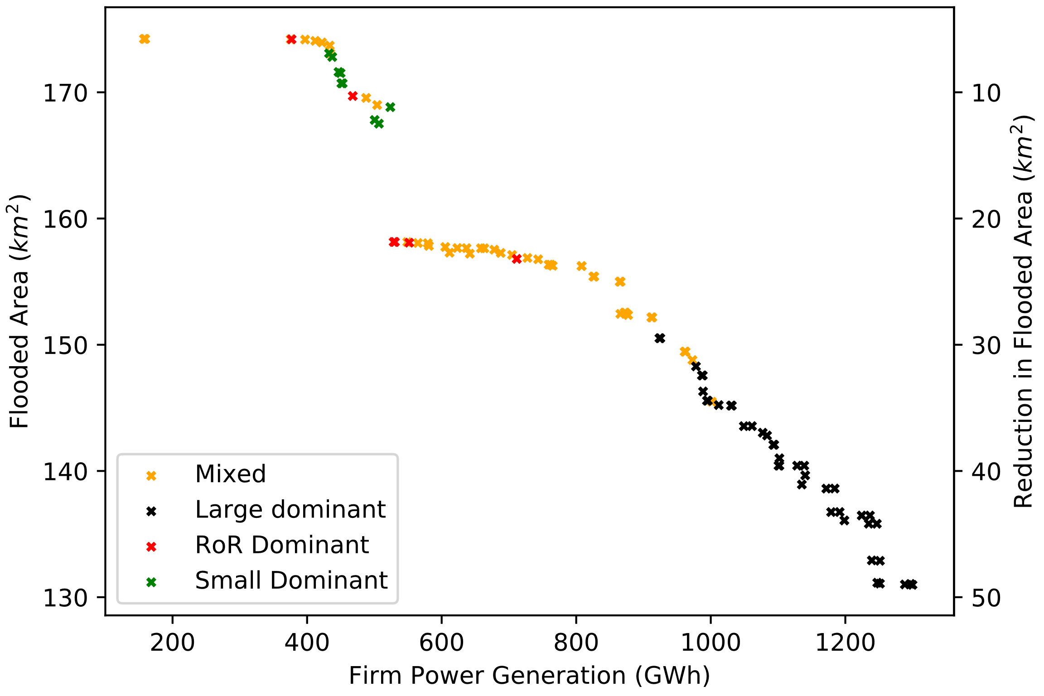
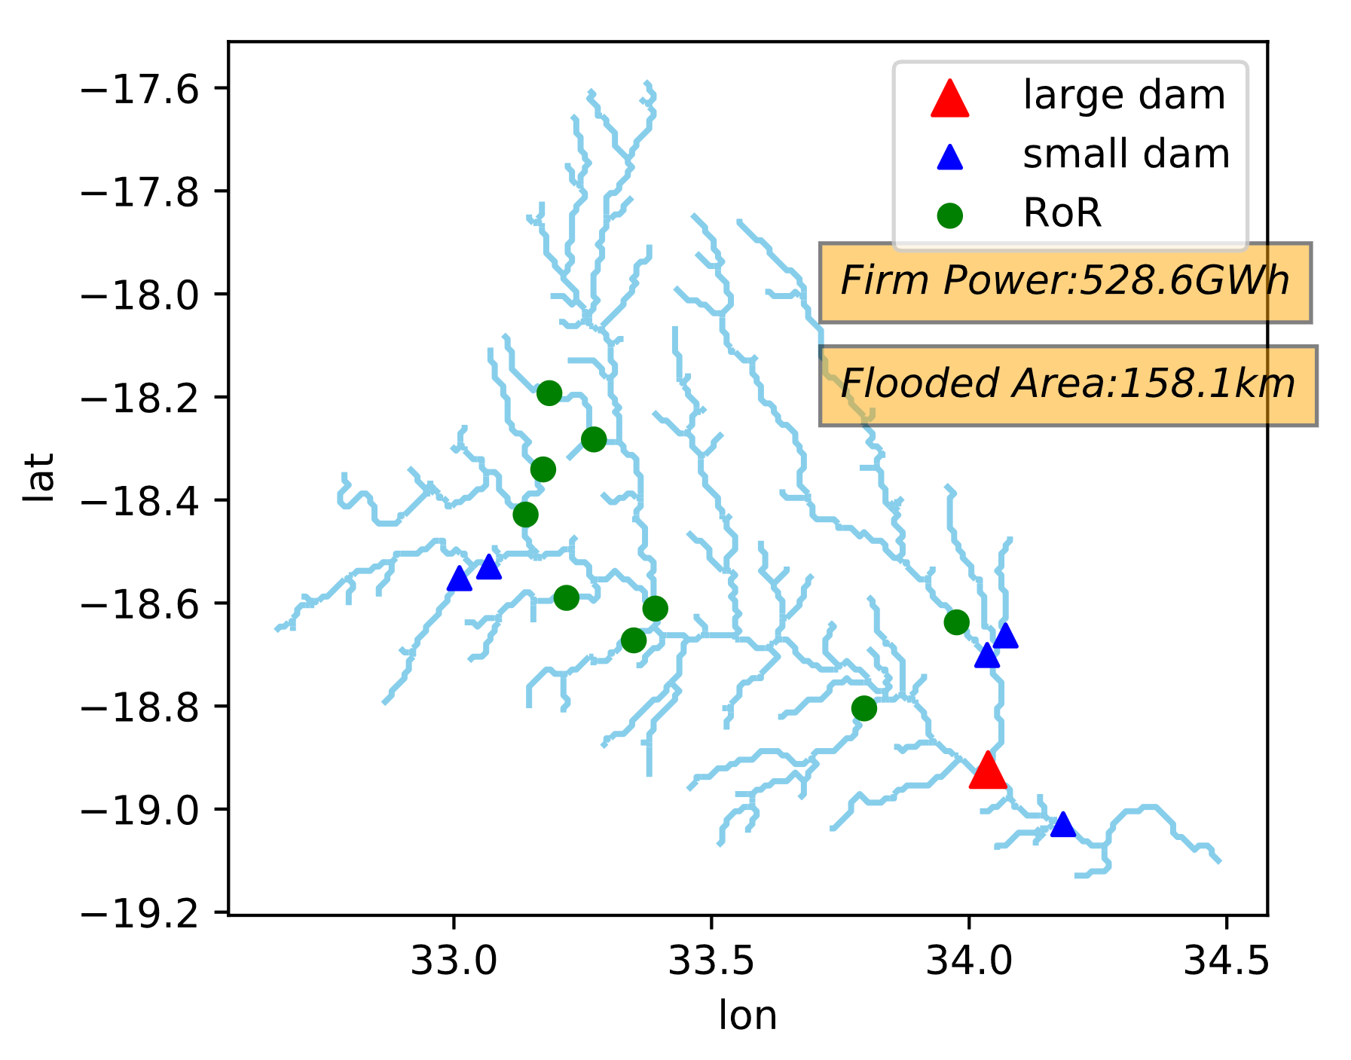
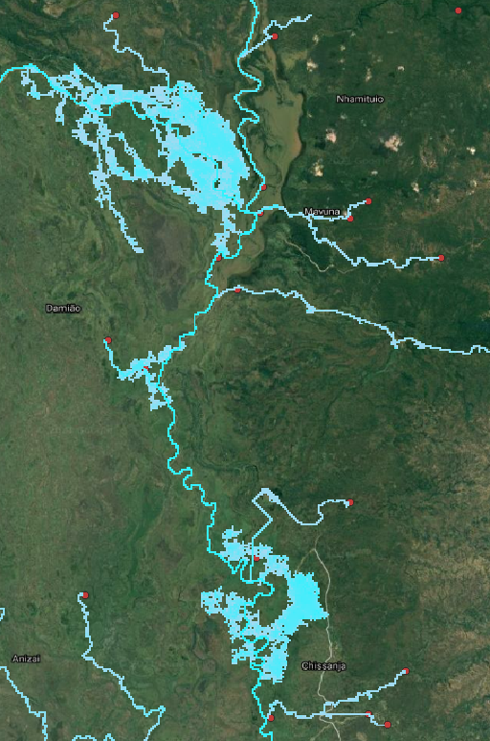

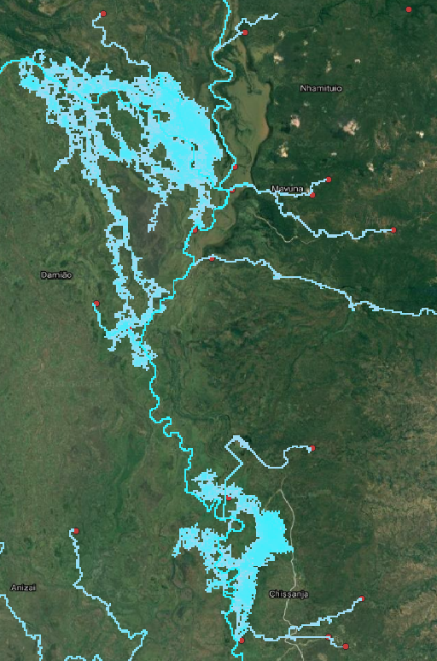
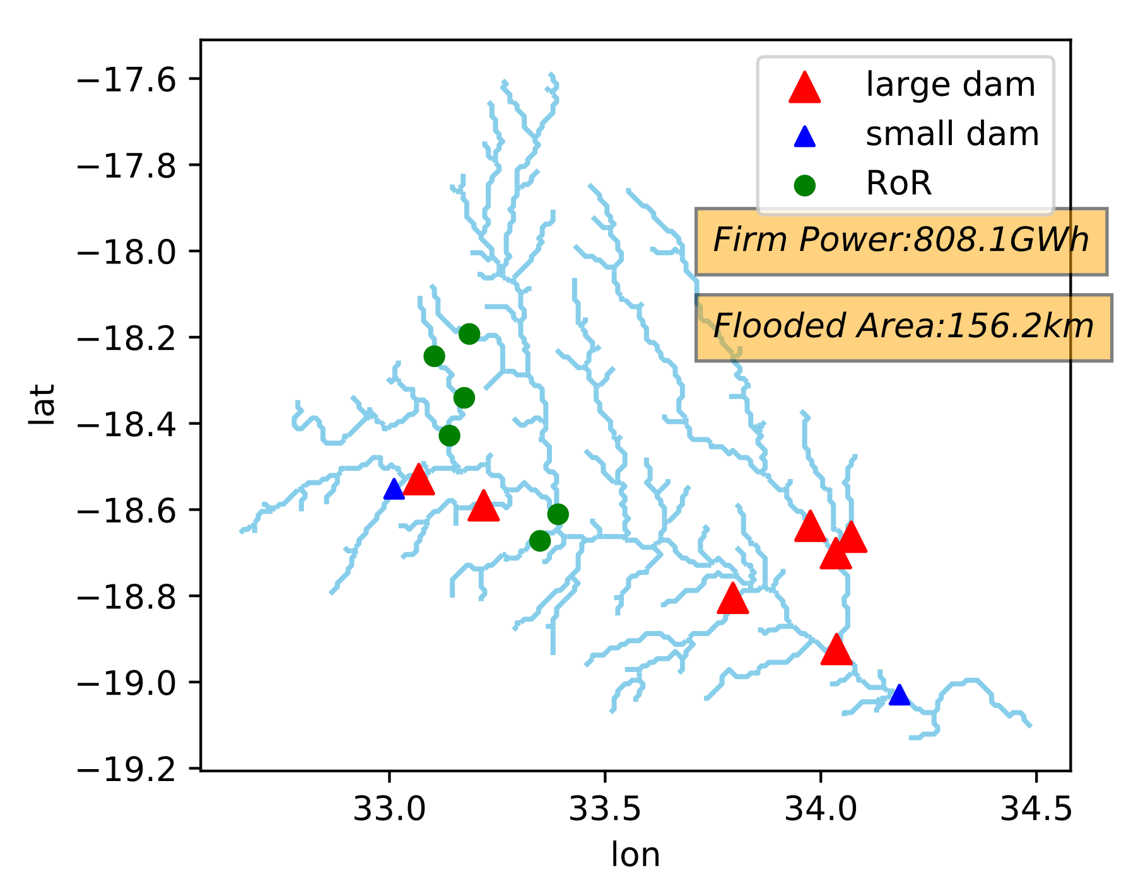
Results
A
D
Power: 523 GWh Flooded Area: 168 km²
Power: 1299 GWh Flooded Area: 131 km²
A
B
C
B
No Dam
D
A
C
B
Power: 528 GWh Flooded Area: 158 km²
D
Power Generation (GWh)
C
Power: 808 GWh Flooded Area: 156 km²
If the environmental cost certain large dams is acceptable, more small / ROR can be added with little environmental impact
Notes:
Here lets add the max power, max impact.

Slide 7
Contributions
Hydropower portfolio Site and design applicable in data scarce regions, balancing power outputs and environmental impact
Representation of hydraulics throughout model chain.
Limitations
Operations poorly represented
Slow hydraulic model chain – 7 minutes, only 5000 simulations (other frameworks do 100000 simulations for robustness)
Floodplain model requires proper validation

Slide 8
Thanks for Listening!

Slide 9
Future Work
Include operations as decision variables
Slow hydraulic model chain – 7 minutes, only 5000 simulations (other frameworks do 100000 simulations for robustness)
Floodplain model requires proper validation
Many other important objectives!
Flood control
Longitudinal disconnection
Irrigation
Economics

Slide 10
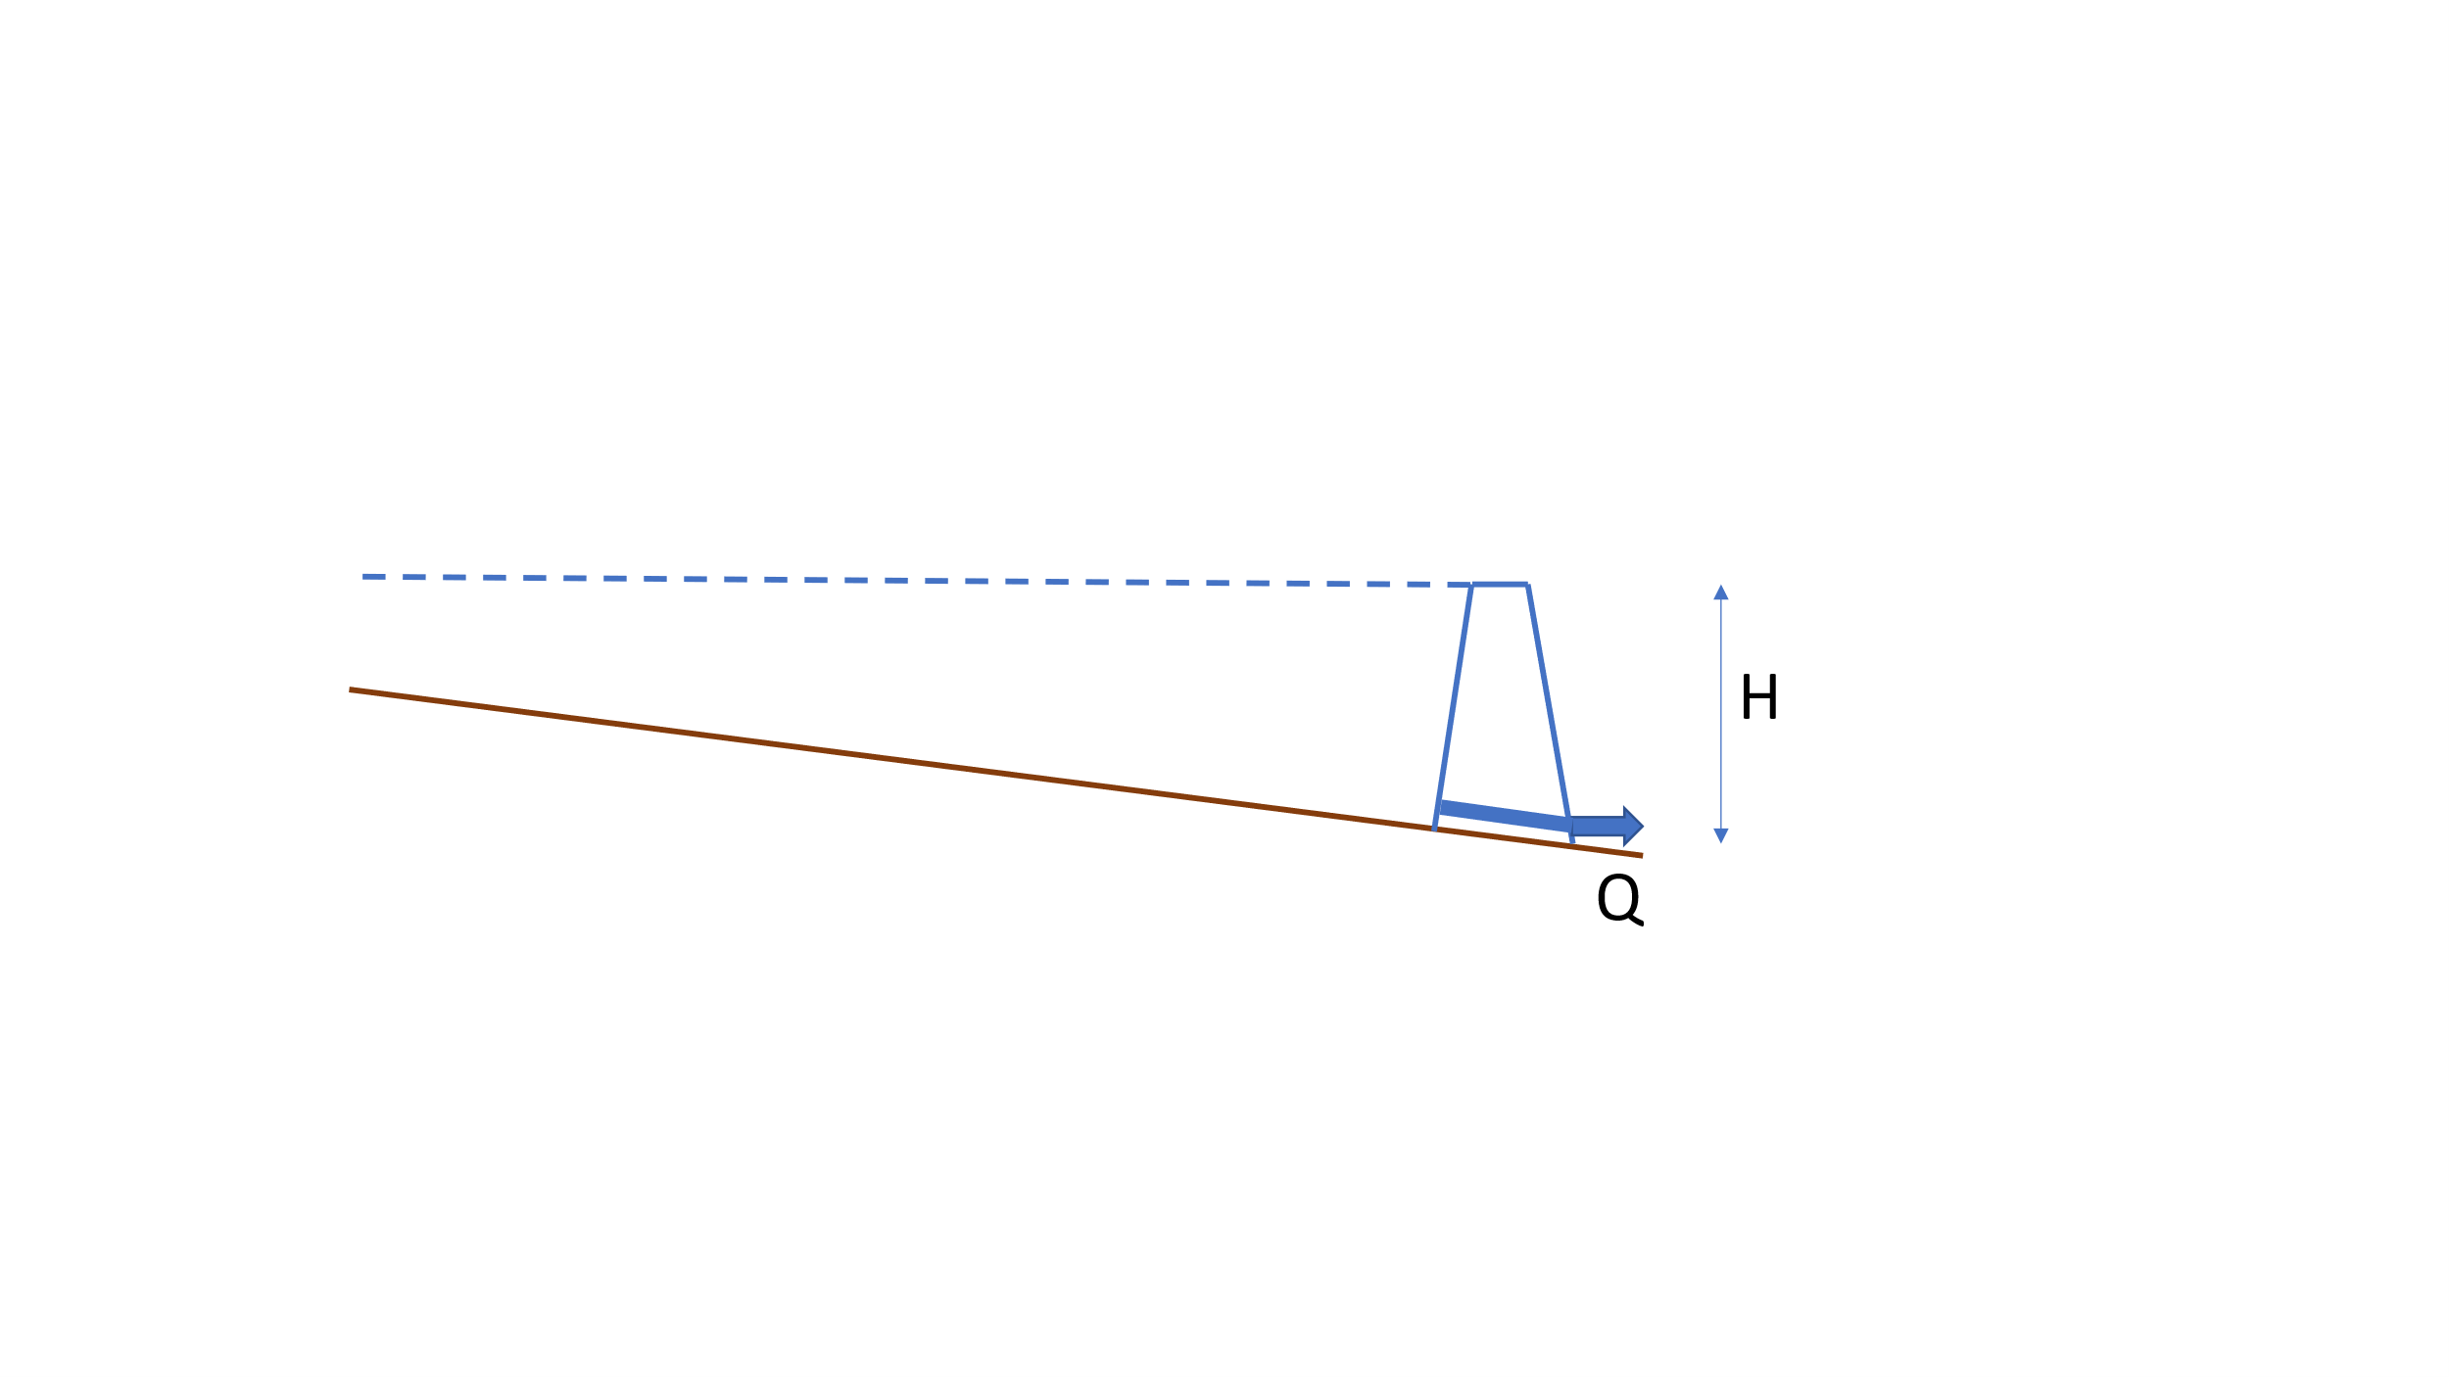
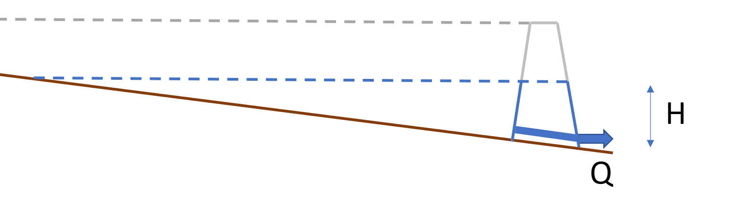
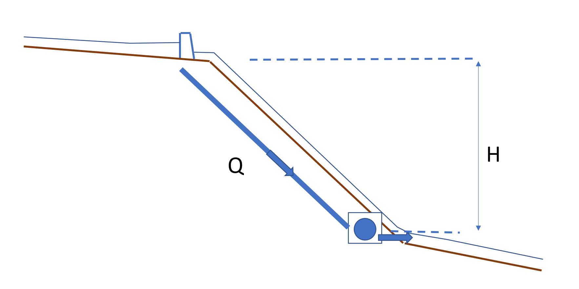
Which type of HP is best? How Much storage?
No Dam
No power, no storage
Lots of storage, so lots of Baseload power
“Large” Dam
Less Power, still some baseload power
“Small” Dam
Less Power,
Zero baseload power
Run of the River (RoR) Dam

Slide 11
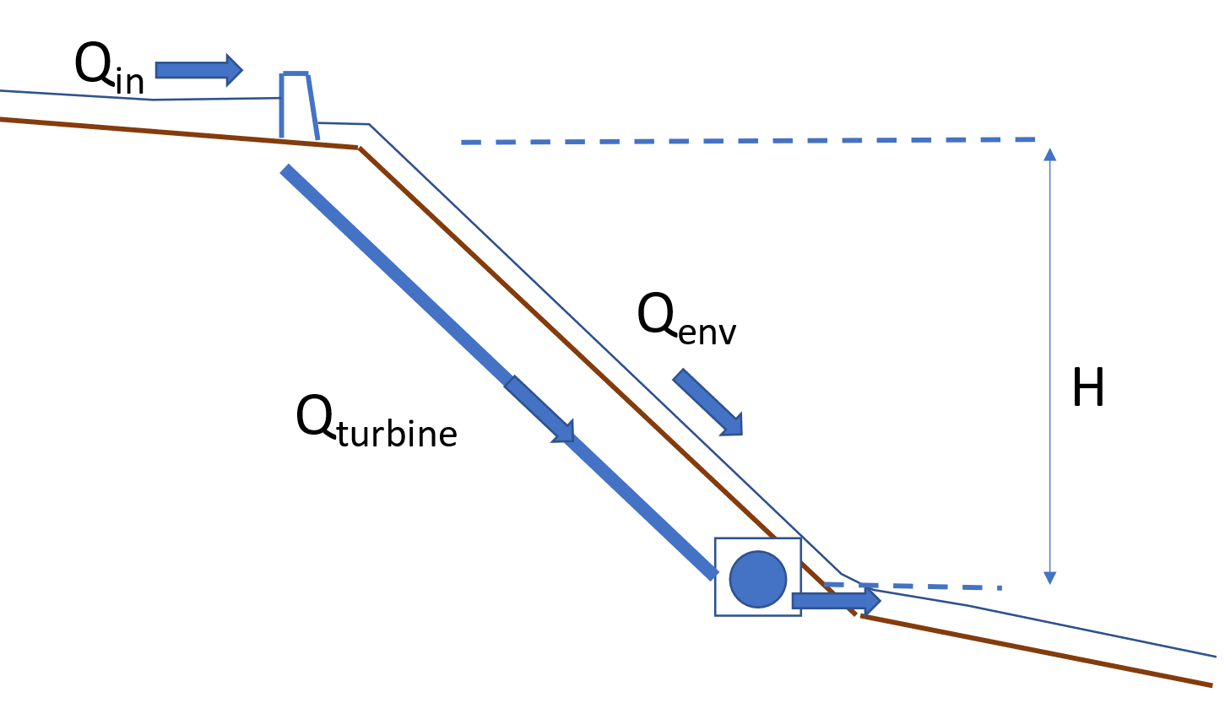
Conceptualisation of Run of the River HP
intake
outfall

Slide 12
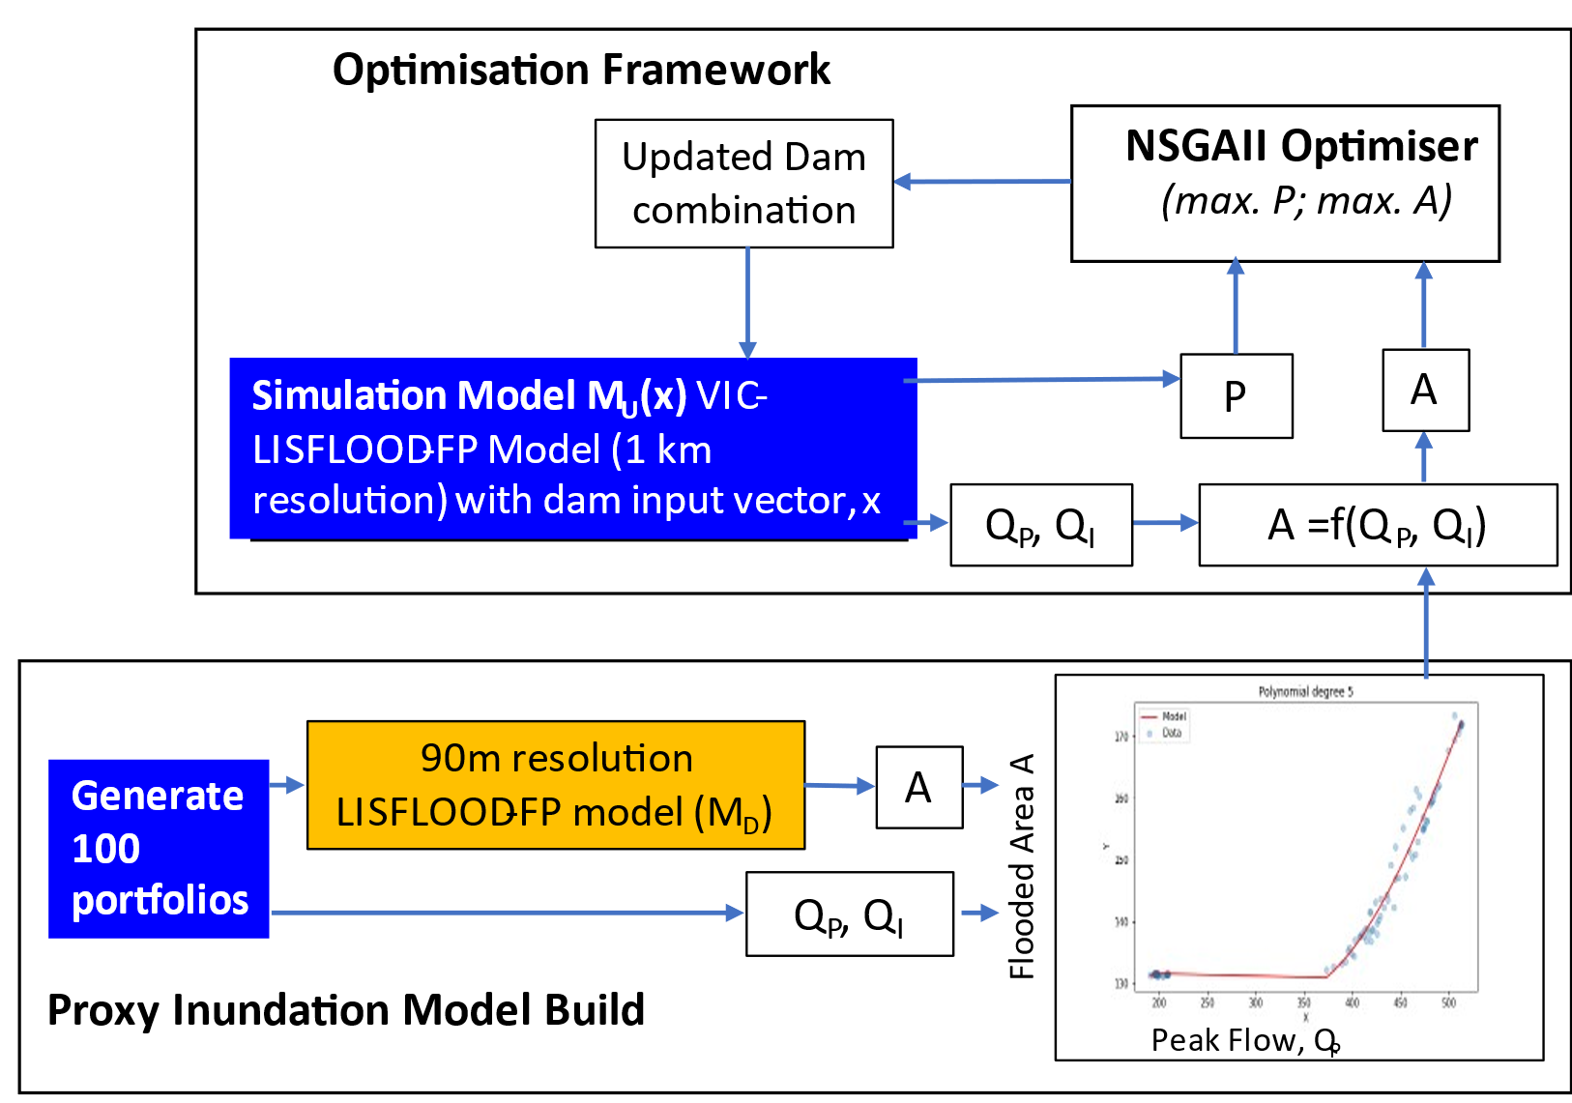
Add in high resolution flood simulation
90m LISFLOOD-FP model of river basin, built by James Savage at Fathom
3 hours to run – too long!
Solution: Build “proxy” flood model.
Notes:
Justification: peak flow is a crude estimator
What does peak flow mean in terms of inundation?
Can instead model inundation using a flood model.
Steps:
- Generate 100 portfolios – mix of pareto optimal and some random ones.
Run full simulations through 90m model -> get Area (target)
Extract peak flows

Slide 13
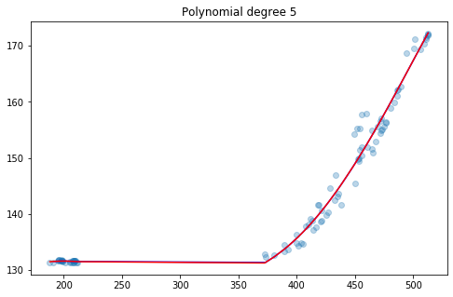
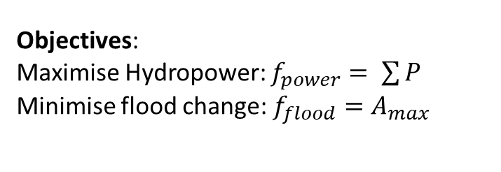
Simulation Model
Objectives:
Maximise Hydropower: $f_{power}= \sum{P}$
Minimise flood change: $f_{flood}=A_{max}$
Distributed Hydrological Model
VIC (5km resolution)
Hydraulic Model
LISFLOOD-FP (1km)
Power Estimates
Maximum Area, A_{max} (km²)
Peak Flow, Q_{P, peak} (m³s⁻¹)
Fathoms 90m Floodplain
Model
A_{max}
17 HP locations
4 design options
4¹⁷ = 17,179,869,184 options!
7 minute simulation
Very slow! Replace with a surrogate regression model between Q_{p} and Area
Notes:
Brief notes about VIC: semi distributed model, combining physically based and conceptual concepts. Soil parameters from FAO HWSD, Vegetation Parameters from GLCF, Temperature from MERRA-2. Rainfall
Data from CHIRPS, presenting here CHIRPS and could also show TAMSAT.
Brief Notes about LISFLOOD-FP:
“2d hydrodynamic model”
Brief Notes about Power Estimation:

Slide 14
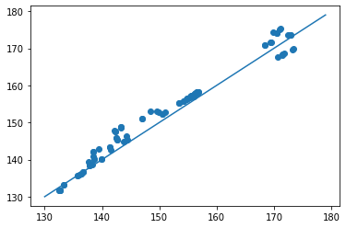
Validation of proxy model
Maximum Area inundated, calculated
from Proxy model M_{D, P} (km²)
Area Inundated, calculated from hydraulic model M_{D} (km²)

