Slide 1

One model fits all – on the generalizability of water distribution pipe deterioration models between utilities
Shamsuddin Daulat¹, Marius Møller Rokstad¹, Stian Bruaset², and Franz Tscheikner-Gratl¹
¹NTNU, Civil and Environmental Engineering, Trondheim, Norway
²SINTEF, Trondheim, Norway
25.05.2022

Slide 2
Purpose and Objectives
Small municipalities not benefiting from ML techniques
Even in big municipalities, “Minorities” are not represented well in ML techniques
e.g. Asbestos-cement (AAS) pipes
Objectives
Build a “Global” model by training it with 4 municipalities data and test it on another municipality
Compare the prediction results of locally trained models with the predictions of Globally trained model

Slide 3
Material and Method
Model: Random Survival Forest (RSF) ¹
Data:
Water ditribution network of 5 municipalities of Norway
Total length of pipes = ~ 4400 km
Considers right-censored data
Concordance index (C-index) is the metric to evalute the performance of RSF
C-index:
C-index-ipcw²
0.5 – random model
1.0 – perfect model
0.0 – perfectly wrong model
For high amount of censored data: C-index overestimates performance, use C-index-ipcw instead
¹Ishwaran, H., Kogalur, U. B., Blackstone, E. H., & Lauer, M. S. (2008). Random survival forests. The annals of applied statistics, 2(3), 841-860
²Uno, H., Cai, T., Pencina, M. J., D’Agostino, R. B., & Wei, L. J. (2011). “On the C-statistics for evaluating overall adequacy of risk prediction procedures with censored survival data”. Statistics in Medicine, 30(10), 1105–1117

Slide 4
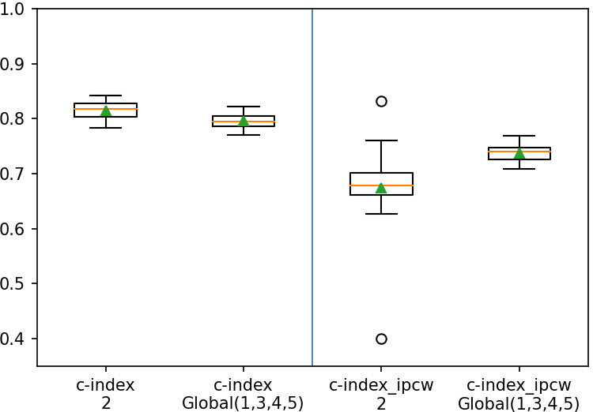
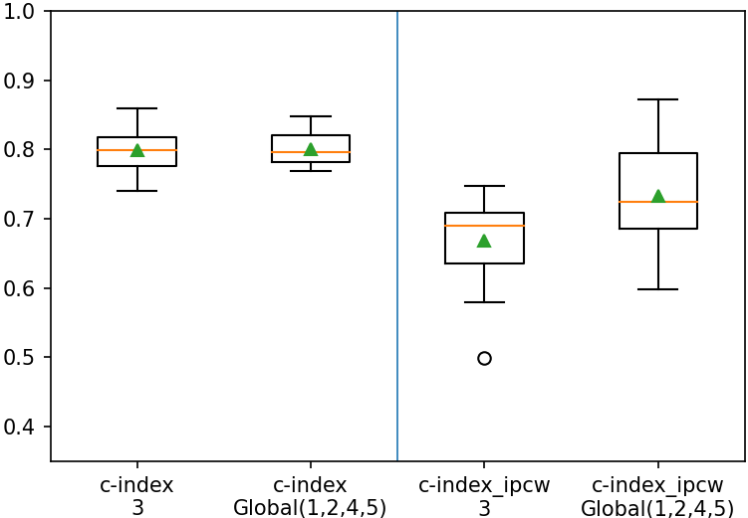
Results
Municipality 2 and global model 1,3,4,5
Municipality 3 and global model 1,2,4,5
Mun. 2 is small, but geographically, and climatically close to a big municipality in the global model
Mun. 3 is small, but geographically, and climatically close to a big municipality in the global model

Slide 5
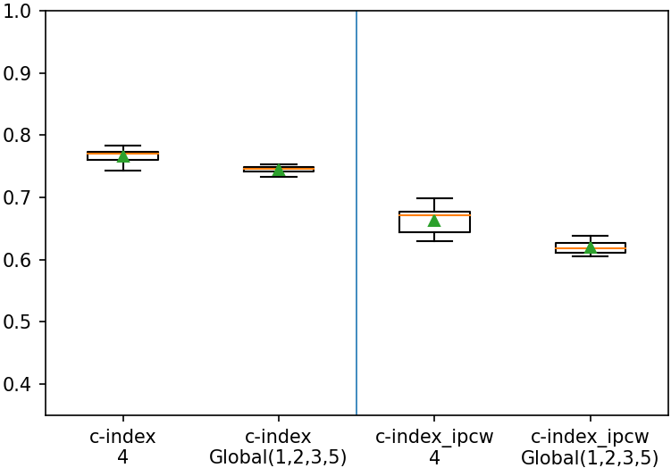
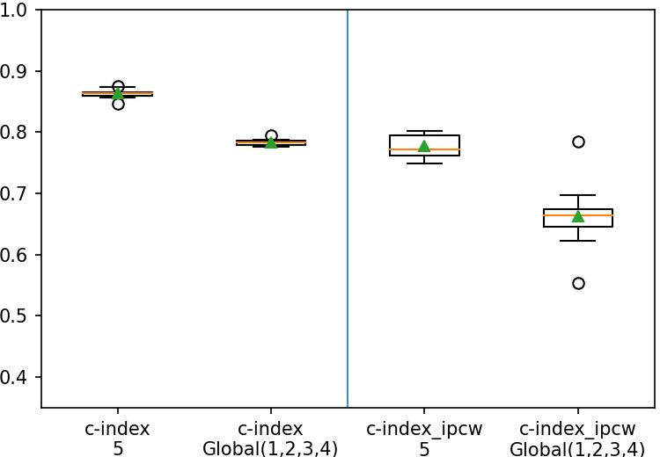
Results
Municipality 4 and global model 1,2,3,5
Municipality 5 and global model 1,2,3,4
Municipality 4 is big, geographically far, but climatically close to one of the big municipalities
Municipality 5 is big, geographically far, but climatically close to one of the big municipalities

Slide 6
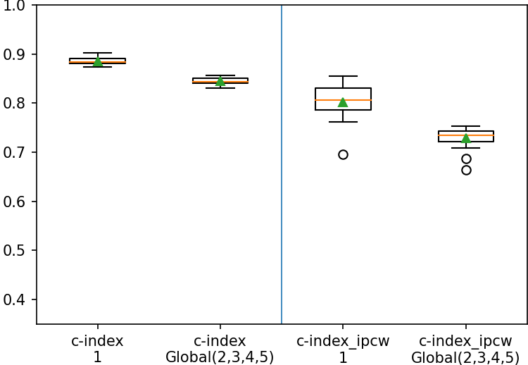
Results
Municipality 1 and global model 2,3,4,5
Municipality 1 is big, geographically far, and climatically different from the rest four municipalities

Slide 7
Analysis of feature (or variable) importance
Municipality 4 model
Global model
 | Features | weight | std
0 | number_of_previous_breaks | 0.1367 | 0.0031
1 | LENGTH | 0.0179 | 0.0023
2 | number of connections_atEnd | 0.0159 | 0.0026
3 | Material_GRP=SJK | 0.0147 | 0.0017
4 | TRAFFIC | 0.0117 | 0.0023
5 | PROTECTIN=none | 0.0108 | 0.0014
6 | PROTECTEX=none | 0.0062 | 0.0011
7 | NETTYPE=O | 0.0055 | 0.0013
8 | THICKNESS | 0.0046 | 0.0016
9 | GROUNDSURFACE=LE | 0.0029 | 0.0009
10 | SONE=193 | 0.0025 | 0.0011
11 | average_pipe_depth | 0.0017 | 0.0003
12 | NOMPRESSURE=none | 0.0017 | 0.0007
13 | number of connections_atStart | 0.0015 | 0.0004
14 | FORCECLASS=unknown | 0.0015 | 0.0014
15 | DIM_ID_OD=ID | 0.0014 | 0.0010
16 | EXTERIORMASS=unknown | 0.0012 | 0.0007
 | Features | weight | std
0 | number_of_previous_breaks | 0.1063 | 0.0023
1 | LENGTH | 0.0291 | 0.0021
2 | NOMPRESSURE=none | 0.0134 | 0.0021
3 | DIM | 0.0095 | 0.0014
4 | average_pipe_depth | 0.0081 | 0.0009
5 | FORCECLASS=unknown | 0.0077 | 0.0016
6 | NETTYPE=H | 0.0064 | 0.0010
7 | NETTYPE=S | 0.0047 | 0.0008
8 | number of connections_atEnd | 0.0042 | 0.0013
9 | pipe_depth_atEnd | 0.0041 | 0.0009
10 | Material_GRP=SJK | 0.0034 | 0.0014
11 | PROTECTIN=SEP | 0.0033 | 0.0010
12 | FORCECLASS=K9 | 0.0031 | 0.0005
13 | pipe_depth_atStart | 0.0023 | 0.0007
14 | Material_GRP=SJG | 0.0021 | 0.0010
15 | PROTECTIN=none | 0.0012 | 0.0016
16 | PROTECTEX=PE | 0.0010 | 0.0006

Slide 8
THANK YOU
Acknowledgements
This work is supported by the project:
B for VA-net, project number 309604
You can reach me at:
Shamsuddin.Daulat@NTNU.NO
BYPRANJAL MEHAR, FEBRUARY 12, 2019

