Slide 1



pmvlab.com
Self-organization of Dissolution/Precipitation Patterns for Reactive Transport in Porous Media
Evgeny Shavelzon
eshavelzon@campus.technion.ac.il
Yaniv Edery
yanivedery@technion.ac.il
24.5.2022

Slide 2
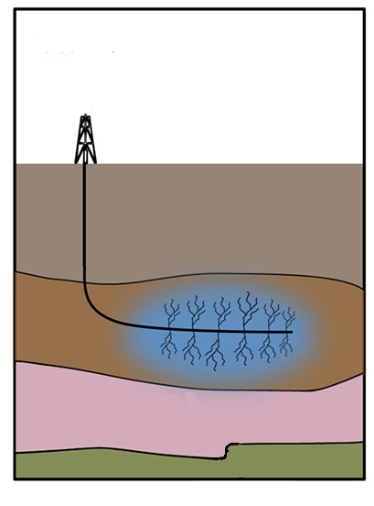
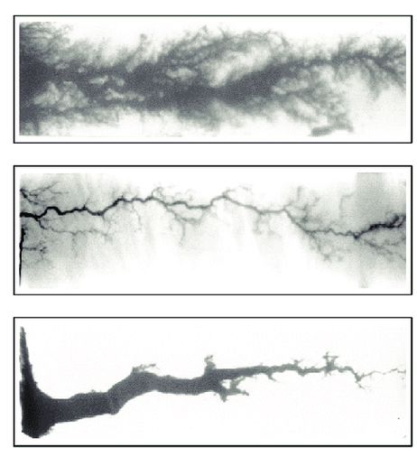
Dissolution/Precipitation Patterns in Porous Media
Dissolution/precipitation patterns
Acid injection
Porter et al 2019
Seigneur et al 2019
Porter et al., Addressing the risks of induced seismicity in subsurface energy operations in WIREs Energy and Environment, 2019 Vol.8 issue 2
Seigneur et al., Reactive Transport in Evolving Porous Media in Reviews in Mineralogy & Geochemistry , 2019, Vol. 85/197-238

Slide 3
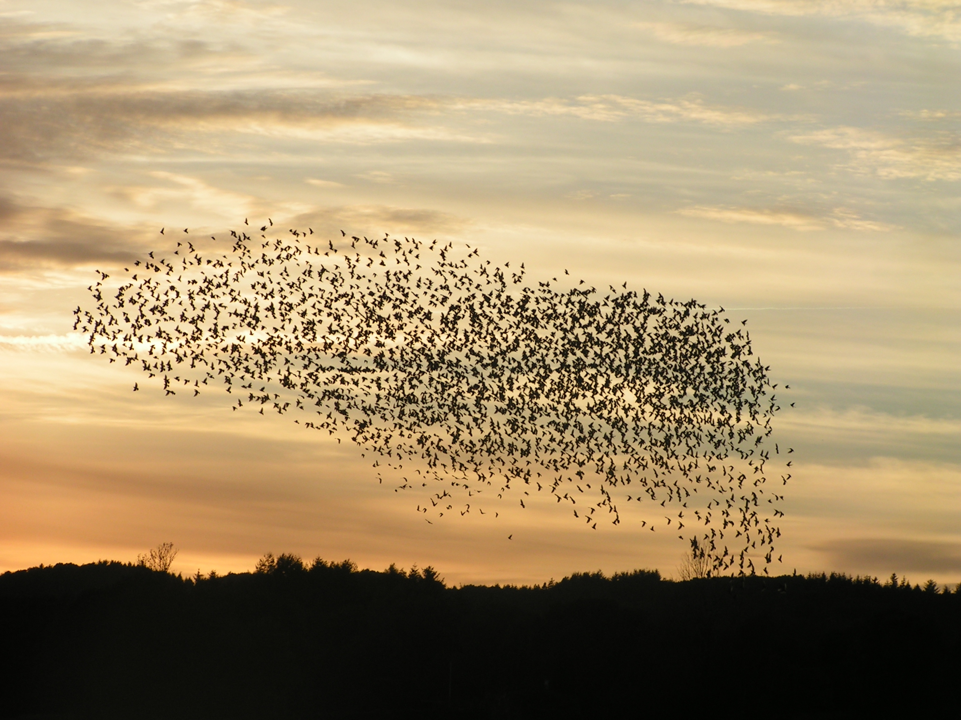

Self-organization in physical systems
SO: pattern emergence in an initially disordered system

Slide 4
Self-organization in physical systems
SO: pattern emergence in an initially disordered system
SO def’d by entropy deviation from maximum

Slide 5
Self-organization in physical systems
SO: pattern emergence in an initially disordered system
SO def’d by entropy deviation from maximum
Shannon entropy to characterize SO for transport in PM [Zehe et al, 2021]
Zehe et al., Preferential Pathways for Fluid and Solutes in Heterogeneous Groundwater Systems: Self-Organization, Entropy, Work in HESS, 2021/254

Slide 6
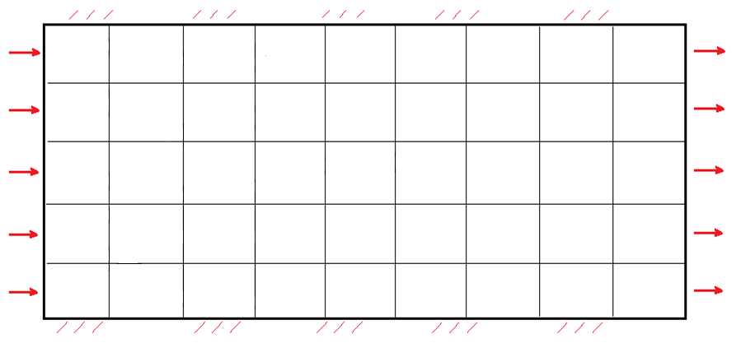
Computational Setting
reflective b.c.
flow direction
Hyd. head gradient

Slide 7
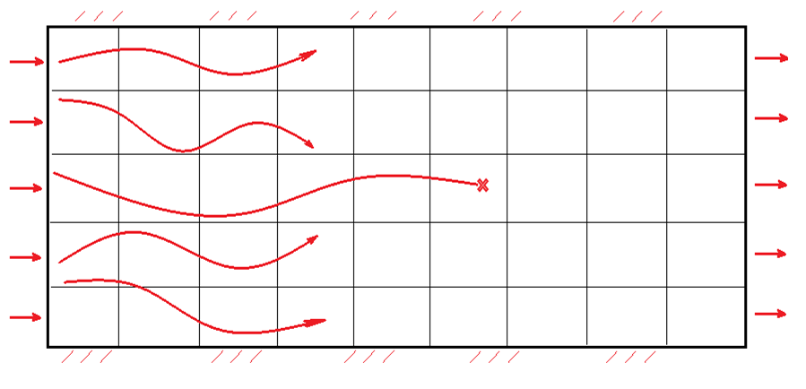
Computational Setting
Langevin eq: particle movement = adv. term + diff. term
reactive particles
reaction
reflective b.c.
flow direction
Hyd. head gradient

Slide 8
Computational Setting
Langevin eq: particle movement = adv. term + diff. term
Reaction-transport feedback: Kozeny-Carman
reactive particles
reaction
reflective b.c.
flow direction
Hyd. head gradient

Slide 9
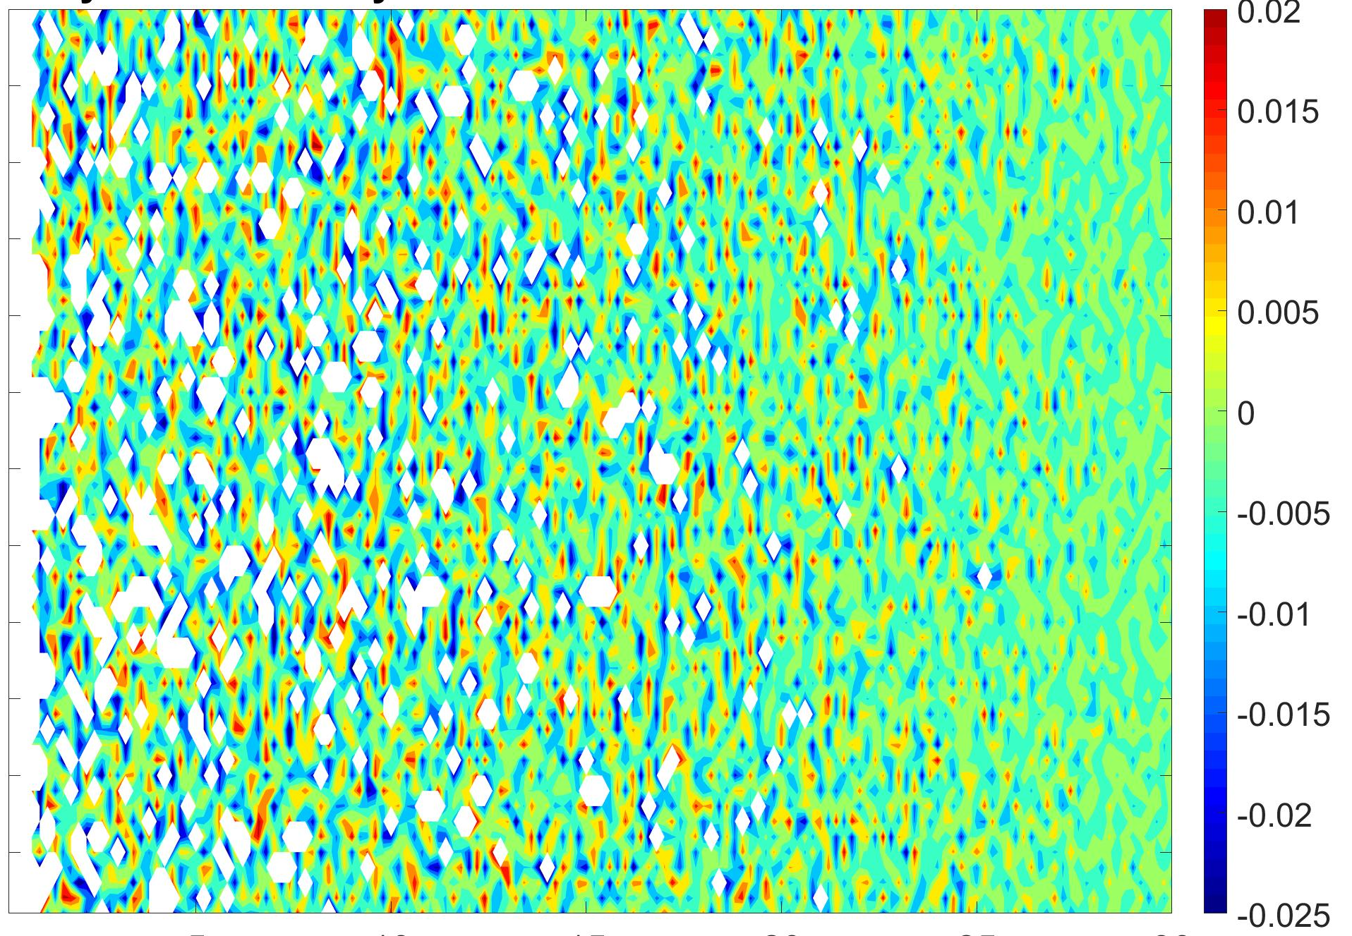
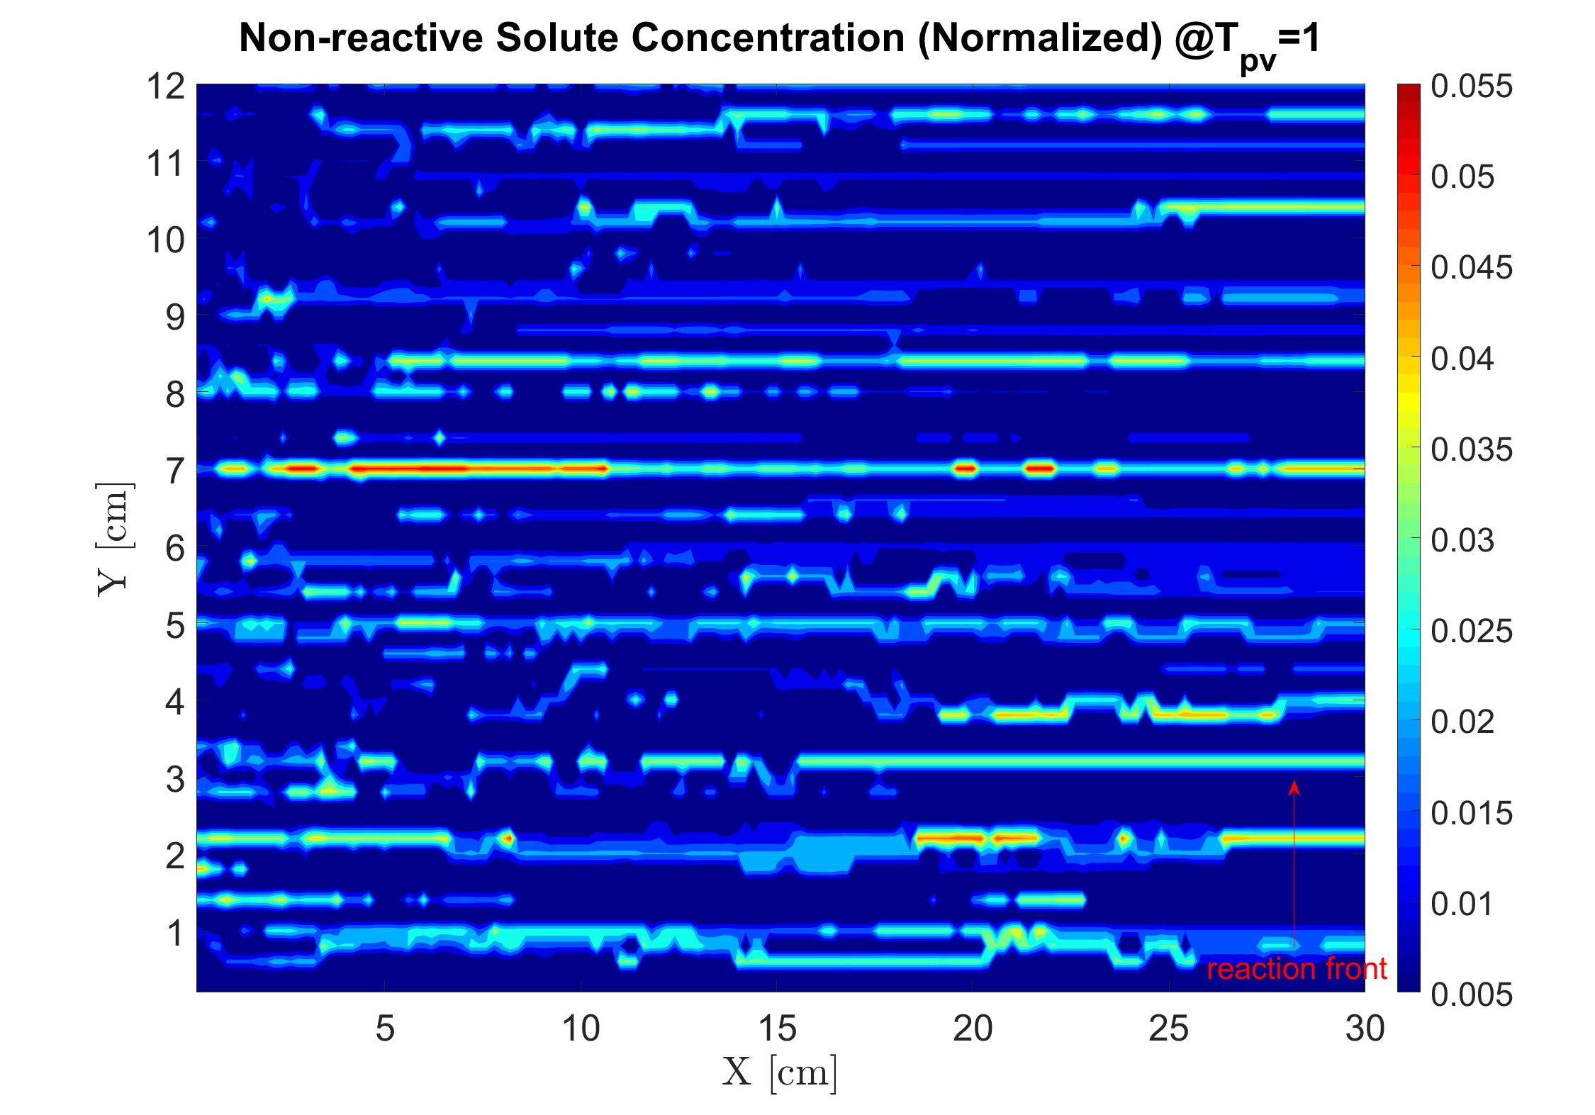
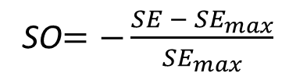
Self-organization quantization
Non-reactive tracer tests: tracer concentration -> Shannon entropy ->
SO$=−\frac{SE − {SE}_{max}}{{SE}_{max}}$
Non-reactive tracer
Computational field snapshot
Non-reactive tracer concentration

Slide 10
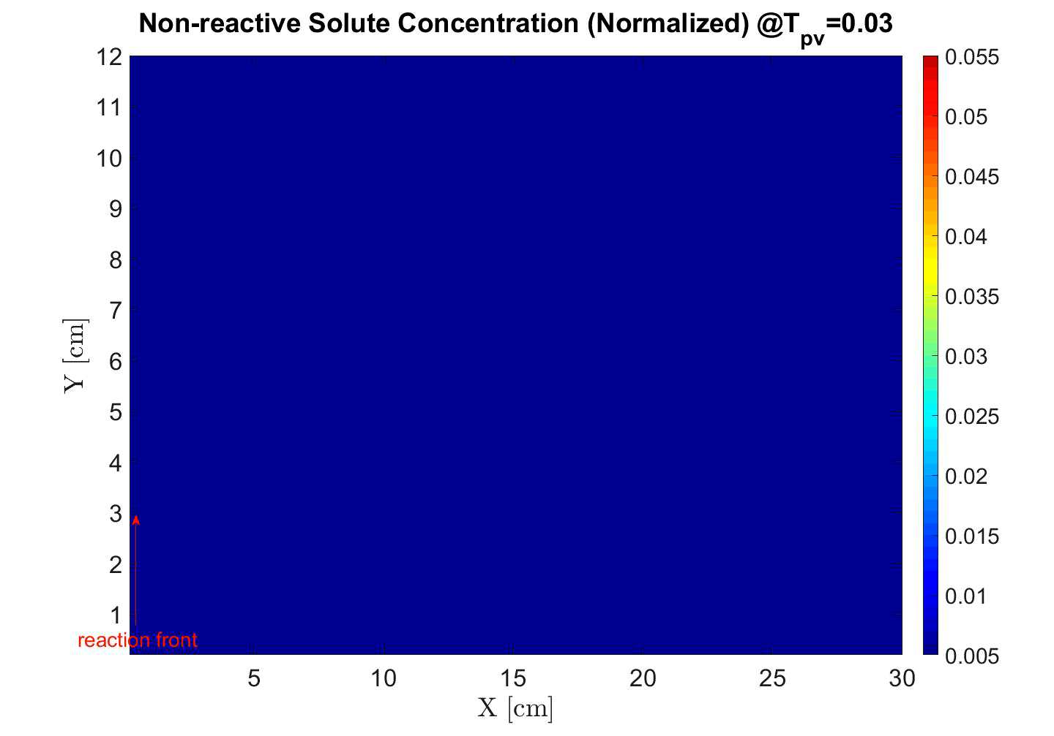

Results – Transport Self-organization
Non-reactive tracer solute
Computational field

Slide 11
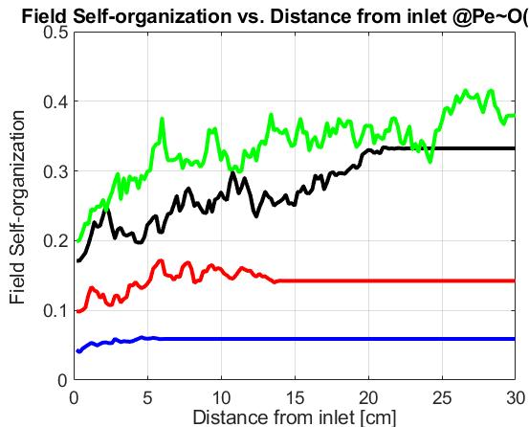
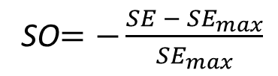
Results – Transport Self-organization
Non-reactive tracer solute
SO$=−\frac{SE − {SE}_{max}}{{SE}_{max}}$
Computational field
t1 > t2 > t3 > t4
t4
t3
t2
t1
reaction front

Slide 12
Results – Transport Self-organization
Non-reactive tracer solute
SO$=−\frac{SE − {SE}_{max}}{{SE}_{max}}$
Computational field
t1 > t2 > t3 > t4
t4
t3
t2
t1
reaction front

Slide 13
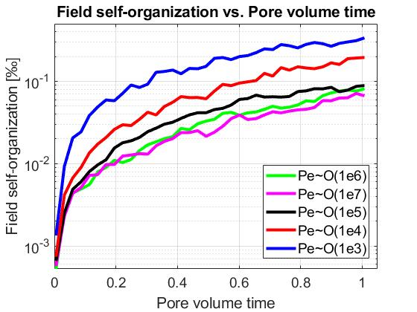

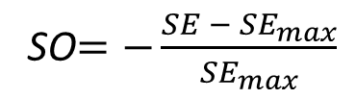
Results – Diffusion vs. Advection
Pe$=\frac{advective transport rate}{diffusive transport rate}$
SO$=−\frac{SE − {SE}_{max}}{{SE}_{max}}$

Slide 14
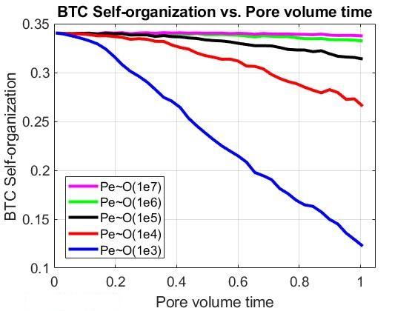
Results – Diffusion vs. Advection

Slide 15
Conclusions
Dissolution/precipitation reactive process increases transport self-organization.

Slide 16
Conclusions
Dissolution/precipitation reactive process increases transport self-organization.
Diffusion is the dominant mechanism in creating self-organization.

Slide 17
Acknowledgements
pmvlab.com
Dr. Yaniv Edery
Dr. Ludmila Abezgauz
Everyone at the PMV Lab / Technion – Israeli Institute of Technology
Questions?
eshavelzon@campus.technion.ac.il

Slide 18
Additional slides

Slide 19
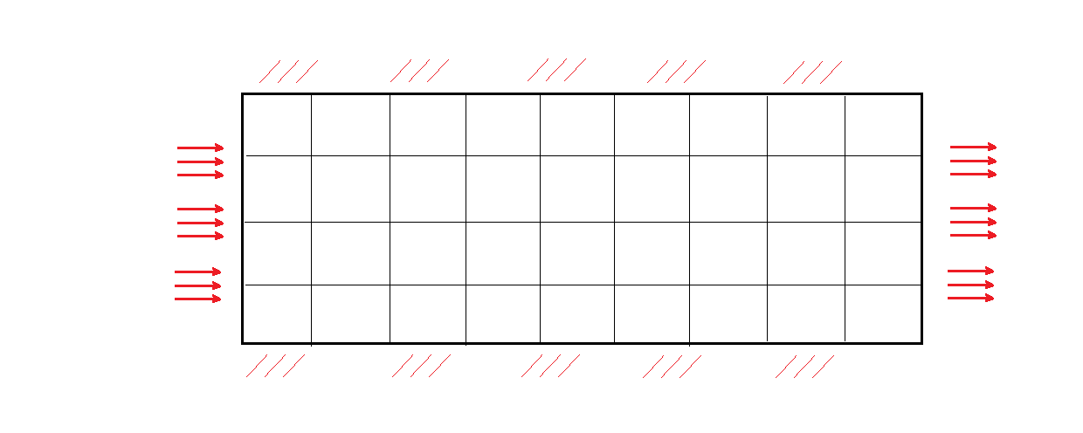
Methodology – Flow and transport simulation
Initially uniform 2D p.m. field (calcite), discretized into 60X150 cells.

Slide 20
Methodology – Flow and transport simulation
Initially uniform 2D p.m. field (calcite), discretized into 60X150 cells.
H+ particles injected at constant rate, govn’d by Langevin eq (advection + diffusion).
reflective b.c.
low-pH inlet flow
(A particles injected)

Slide 21
Methodology – Flow and transport simulation
Initially uniform 2D p.m. field (calcite), discretized into 60X150 cells.
H+ particles injected at constant rate, govn’d by Langevin eq (advection + diffusion).
Particles advance and react within the field, causing dissolution/precipitation.
reflective b.c.
low-pH inlet flow
(A particles injected)

Slide 22
Methodology – Flow and transport simulation
Initially uniform 2D p.m. field (calcite), discretized into 60X150 cells.
H+ particles injected at constant rate, govn’d by Langevin eq (advection + diffusion).
Particles advance and react within the field, causing dissolution/precipitation.
Direction of reaction govn’d by the local deviation from the chemical equilibrium.
reflective b.c.
low-pH inlet flow
(A particles injected)

Slide 23
Methodology – Flow and transport simulation
Initially uniform 2D p.m. field (calcite), discretized into 60X150 cells.
H+ particles injected at constant rate, govn’d by Langevin eq (advection + diffusion).
Particles advance and react within the field, causing dissolution/precipitation.
Direction of reaction govn’d by the local deviation from the chemical equilibrium.
Hyd. conductivity of the field is updated (Kozeny-Carman).
reflective b.c.
low-pH inlet flow
(A particles injected)

Slide 24
Methodology – Self-organization quantization
Self organization defined as reduction in Shannon entropy (Shannon, 1948)
Uniform distribution (high SE)
Non-uniform distribution (low SE)
47
11
47
117
47
0
47
67

Slide 25
Methodology – Self-organization quantization
Self organization defined as reduction in Shannon entropy (Shannon, 1948)
SE calc’d from non-reactive tracer particle visitation data of the field (recall Boltzmann’s definition of entropy).
Uniform distribution (high SE)
Non-uniform distribution (low SE)
47
11
47
117
47
0
47
67

Slide 26
Methodology – Self-organization quantization
Self organization defined as reduction in Shannon entropy (Shannon, 1948)
SE calc’d from non-reactive tracer particle visitation data of the field (recall Boltzmann’s definition of entropy).
Max. SE corresponds to the most uniform state (the least self-organization).
Uniform distribution (high SE)
Non-uniform distribution (low SE)
47
11
47
117
47
0
47
67

Slide 27
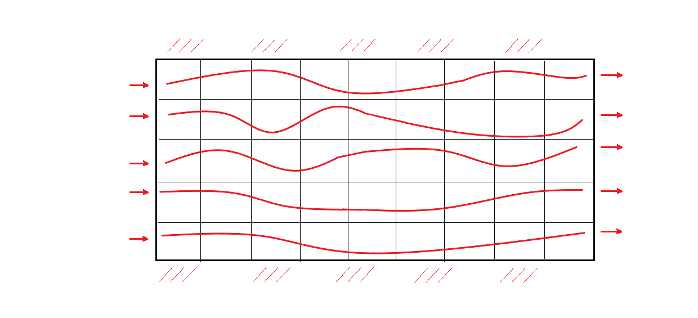
Results – Field self-organization
Field SE ~ Pe
Field self-organization increases with time
BTC SE ~ 1 / Pe
BTC self-organization decreases with time
High Pe -> Advection dominated transport -> High SE

Slide 28
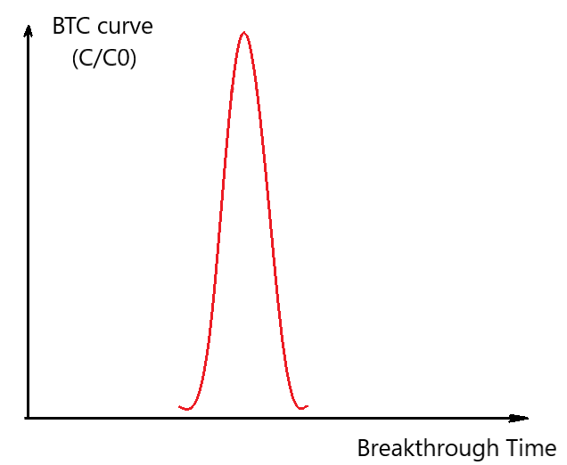
Results – Field self-organization
Field SE ~ Pe
Field self-organization increases with time
BTC SE ~ 1 / Pe
BTC self-organization decreases with time
High Pe -> Advection dominated transport -> High SE Low BTC SE

Slide 29
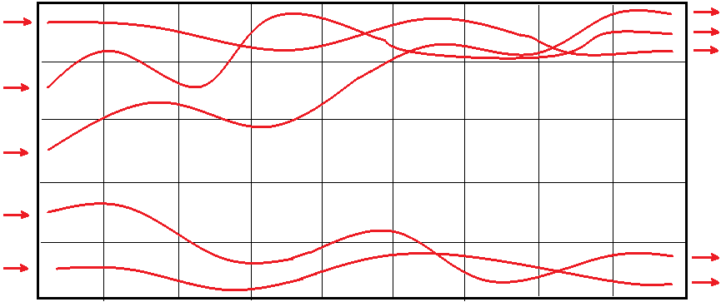
Results – Field self-organization
Field SE ~ Pe
Field self-organization increases with time
BTC SE ~ 1 / Pe
BTC self-organization decreases with time
High Pe -> Homogeneous Field -> High SE Low BTC SE
Low Pe -> Diffusion dominated transport -> Low SE

Slide 30
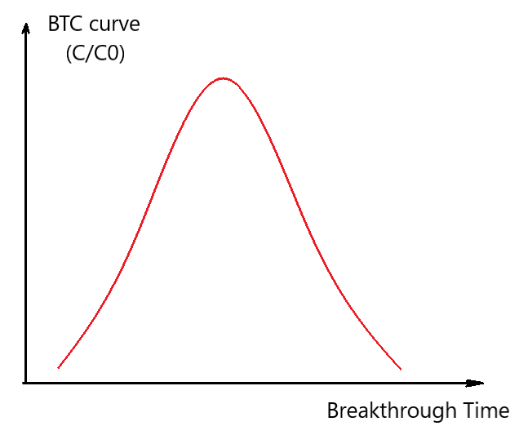
Results – Field self-organization
Field SE ~ Pe
Field self-organization increases with time
BTC SE ~ 1 / Pe
BTC self-organization decreases with time
High Pe -> Homogeneous Field -> High SE Low BTC SE
Low Pe -> Diffusion dominated transport -> Low SE High BTC SE

Slide 31
Self-organization in physical systems

Slide 32
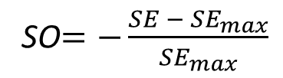
Self-organization quantization
SO$=−\frac{SE − {SE}_{max}}{{SE}_{max}}$
Non-reactive tracer
Computational field snapshot
Non-reactive tracer concentration

Slide 33
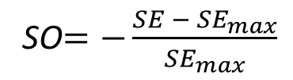
Computational Setting
Langevin eq: particle movement = adv. term + diff. term
SO$=−\frac{SE − {SE}_{max}}{{SE}_{max}}$
reactive particles
reaction
reflective b.c.
flow direction
Hyd. head gradient

