Slide 1





Subsolidus crystallization in the A-type Pikes Peak batholith
L. M. Fonseca Teixeira, J. Troch, J. Allaz, O. Bachmann
ludmila.fonseca@erdw.ethz.ch

Slide 2
GOAL: to understand and quantify subsolidus crystallization in a-type granites
Granite solidus curve: 700-650°C (Luth et al., 1964; Piwinskii, 1968; Tuttle and Bowen, 1958)
Evidence of up to 80% subsolidus crystallization in granitic systems (e.g. Ackerson, 2018)
Nature of the subsolidus crystallization: melt or fluid?
Pegmatites: link between the hydrothermal and magmatic realms

Slide 3
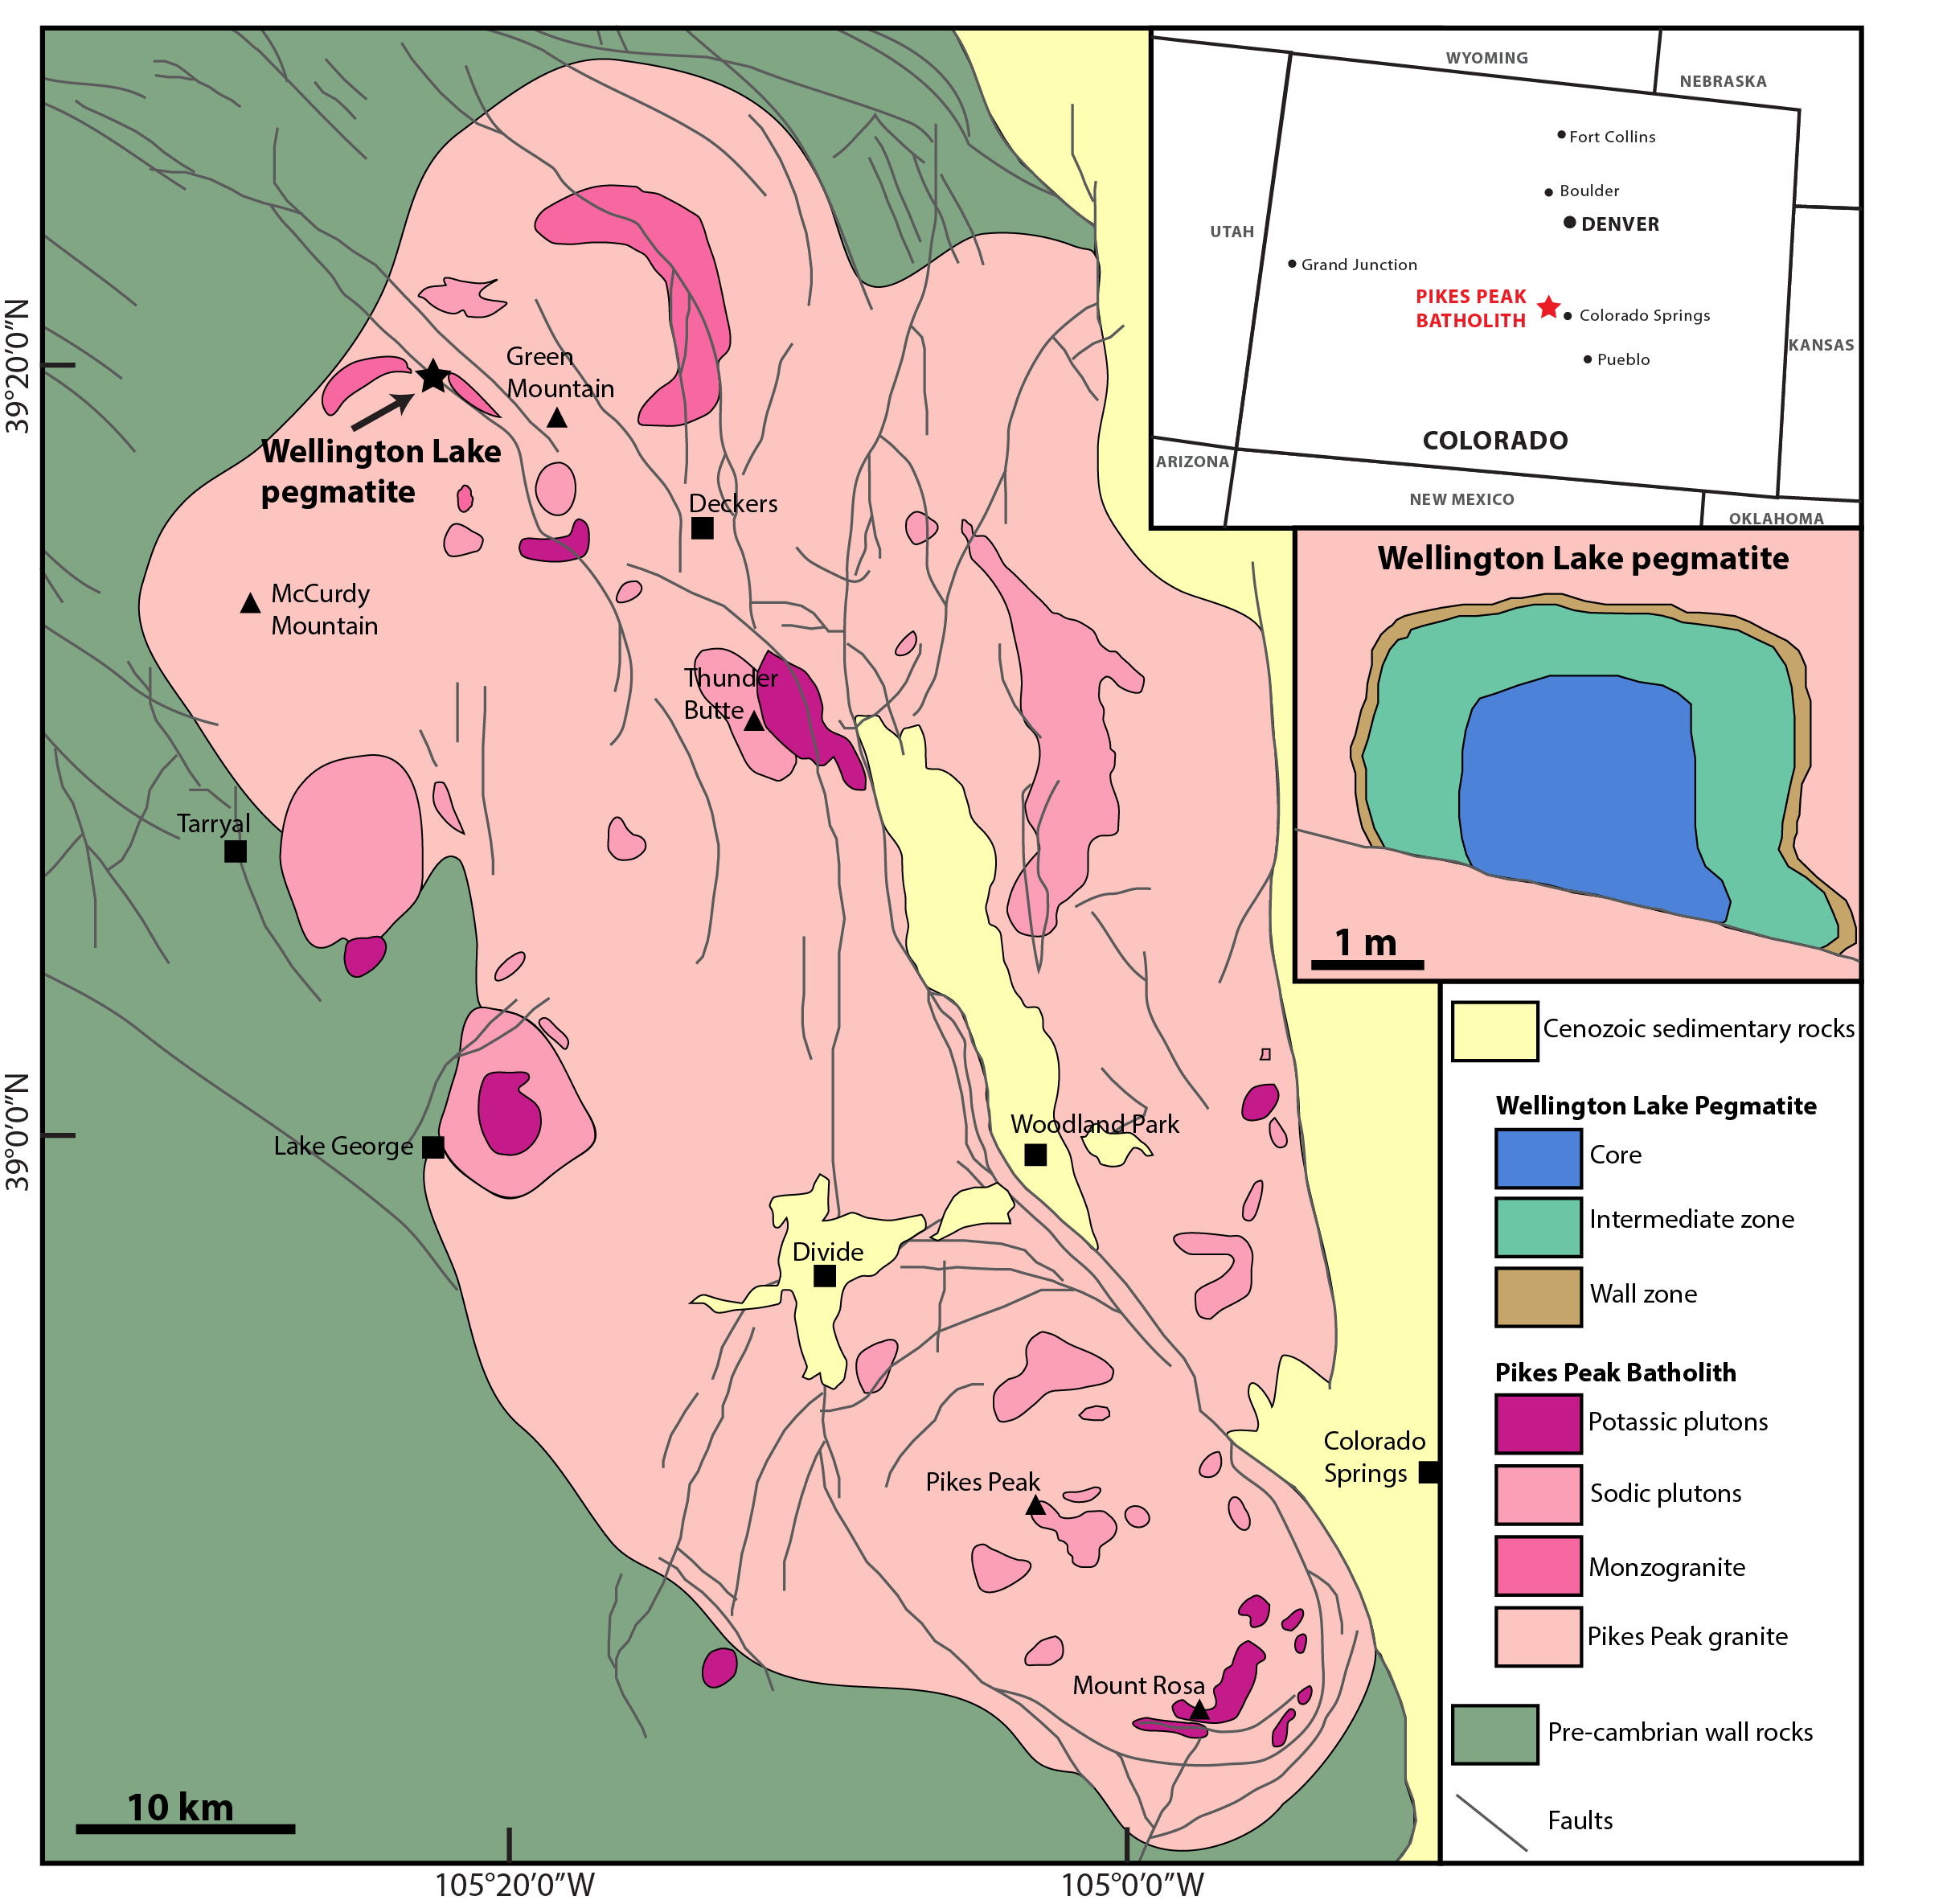
samples and methods
The Pikes Peak batholith:1.1 Ga A-type anorogenic granite in Colorado (USA)
  Hosts over 200 pegmatites, many with a REE-dominated mineralisation
Wellington Lake Pegmatite
  NYF-pegmatite divided in 3 main zones:
  Wall zone: fine grained graphic granite (kspar + qtz)
  Intermediate zone: coarse grained albite + qtz
  Pure blocky quartz

Slide 4
Methods
Cathodoluminescence images
Quartz trace elements: EPMA, LA-ICP-MS
Feldspar compositions: EPMA
Microthermometry of fluid inclusions
Thermometers:
  Ti-in-quartz (Huang & Audetat, 2012)
  2-feldspars

Slide 5
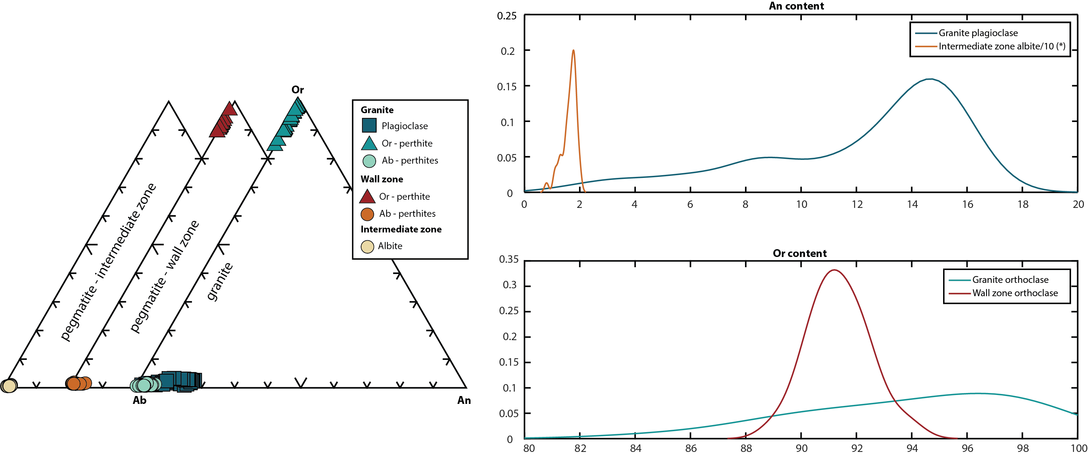
Feldspars composition
Feldspars from the pegmatite zones show more homogeneous compositions than the granite ones
No real plagioclase in the pegmatite: only orthoclase (wall zone) and pure albite (intermediate zone)

Slide 6
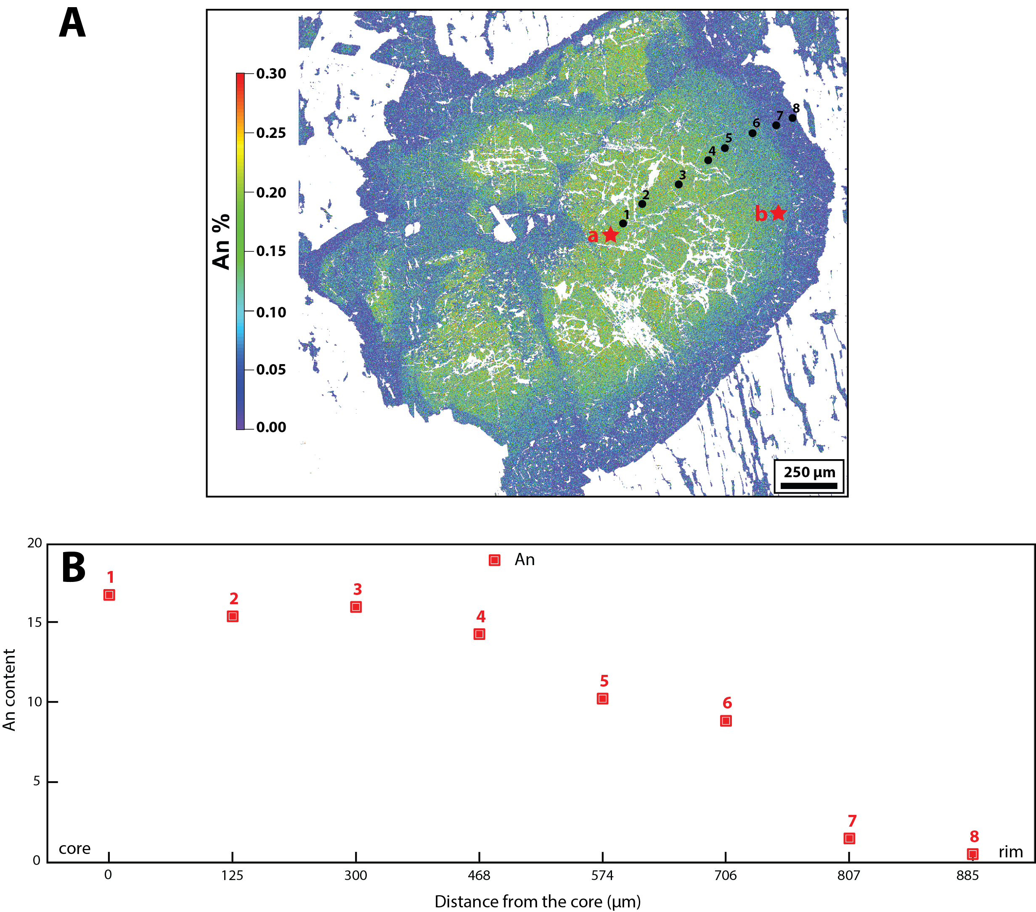
Plagioclase albitic rim

Slide 7
Feldspar Temperatures
Method | Plagioclase core | Plagioclase rim | Expected uncertainty
Elkins & Grove, 1990 | 618°C | 632°C | +- 20°C
Fuhrman & Lindsley, 1988 | 686°C | 645°C | +- 40°C
Ghiorso, 1984 | 715°C | 590°C | +- ca. 30°C
Green & Usdansky, 1986 | 672°C | 581°C | +- 14-72°C
Nekvasil & Burnham, 1987 | 682°C | 573 °C | +- ca. 20°C
Lindsley & Nekvasil, 1989 | 691°C | 620°C | N.A.
Plagioclase shows an albitic rim, to which temperatures could not be calculated
Temperatures were calculated homogenizing Kfspar compositions (An<1, Ab5, Or5) and paring the highest and lowest An content in plagioclase (except the rim)

Slide 8
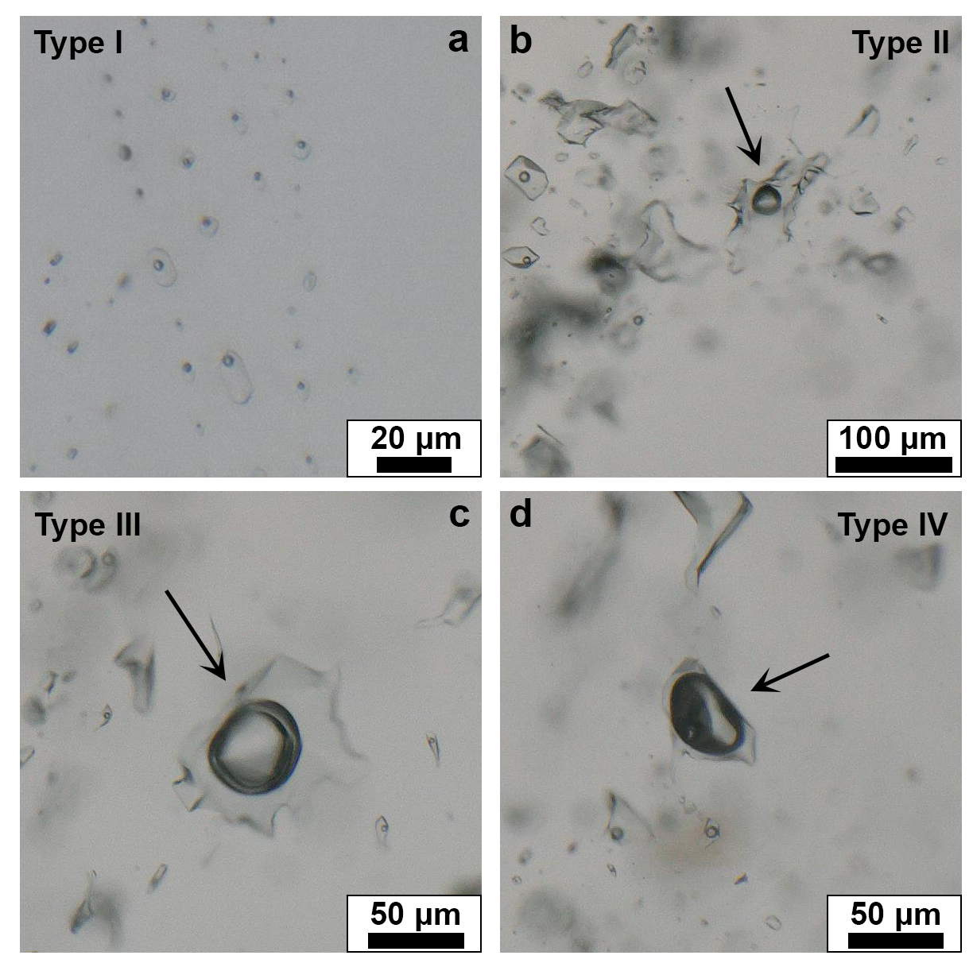
Fluid inclusions in qtz
Core and intermediate zone:
  Type I: primary, salinity = ca.10%
  Type II: secondary, salinity = ca.10-18%
  Type III: CO₂ inclusions
  Type IV: vapor inclusions
Granite and wall zone: small (<10 um) and scarce secondary inclusions (challenging to analyze)
 | 200 MPa | 300 MPa
Intermediate zone | 380°C | ~450°C
Core | 325°C | 380°C

Slide 9
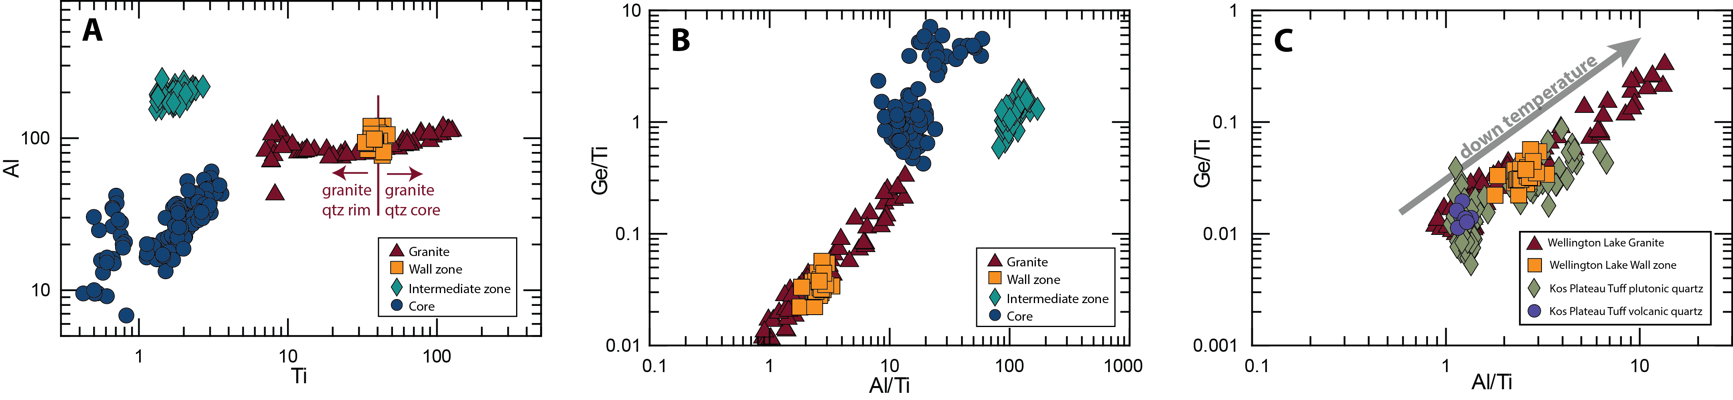
Trace elements in granite and pegmatite quartz
Most of the granite quartz crystallises above 30 ppm
Wall zone: narrow range, homogenous quartz
Granite and wall zone overlap with Kos Plateau tuff data (known to have crystallised from a melt)
Gap between wall and intermediate zone: change of the precipitating medium from melt to fluid
Kos Plateau Tuff data from Fiedrich et al. (2020)

Slide 10
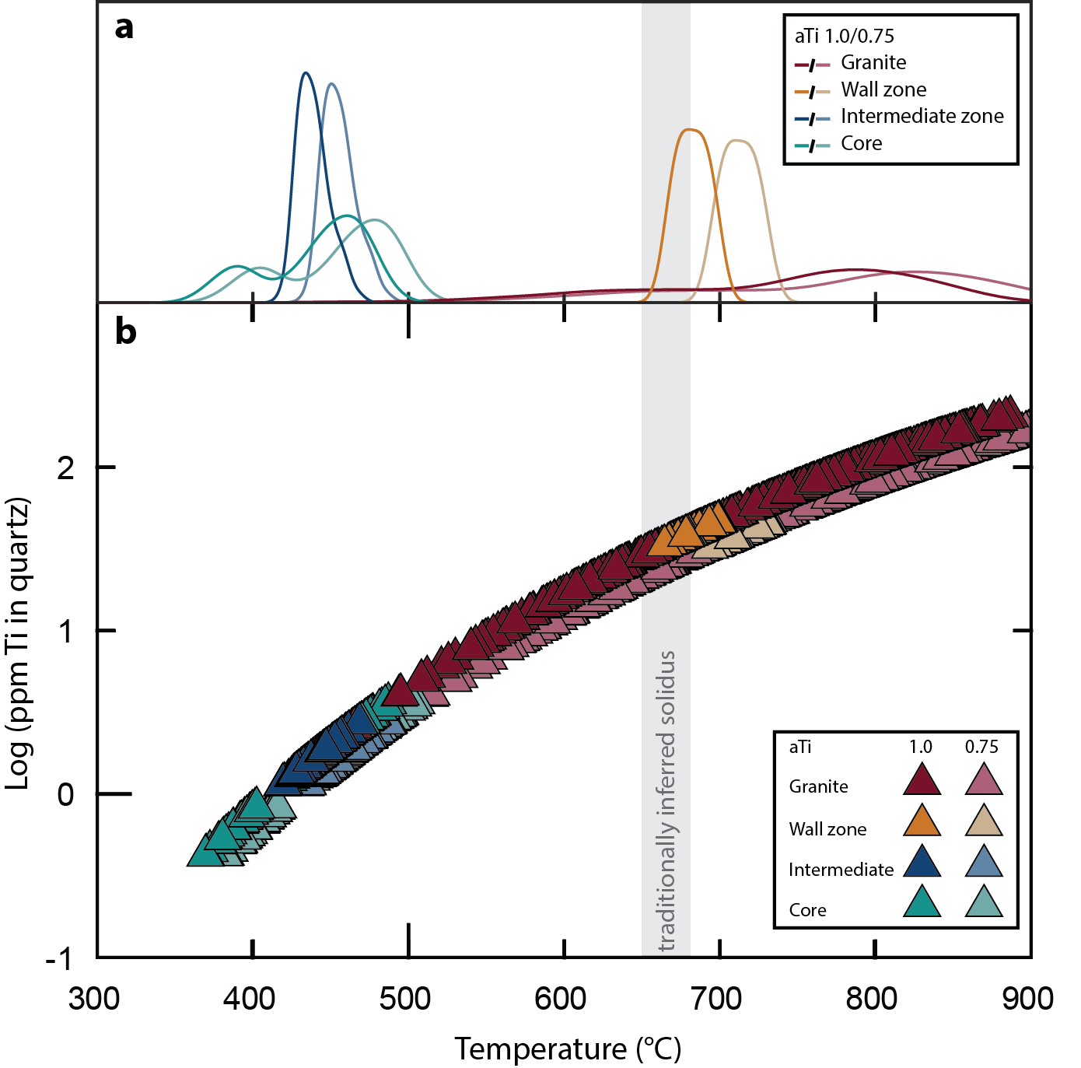
Crystallisation temperatures
Ti-in-quartz thermometer (Huang & Audétat, 2012)
Granite: 900-500°C
Pegmatite wall zone: 700-670°C
Pegmatite intermediate and core zones at cold conditions (< 500°C)
Rutile in wall zone suggests aTi ~ 1.0, but a slightly lower Ti activity (e.g. 0.75) does not promote significant changes

Slide 11
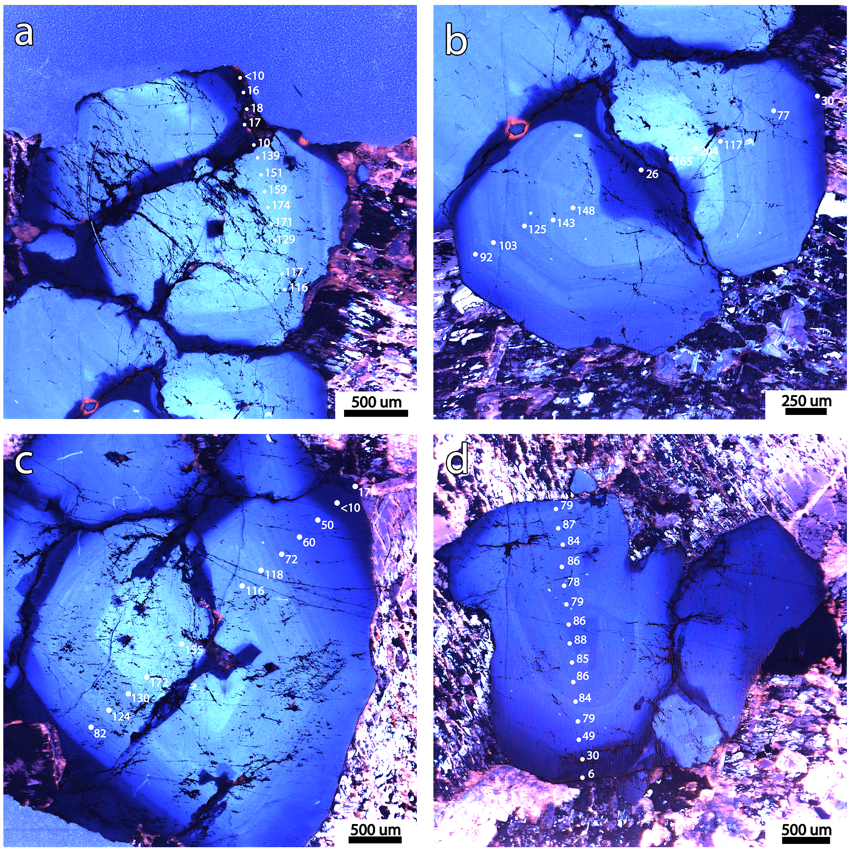
Subsolidus quartz:
Rims and dark fractures
Bright core
Dark rim
Fluid inclusion trails
CL images with Ti content measured by EPMA

Slide 12
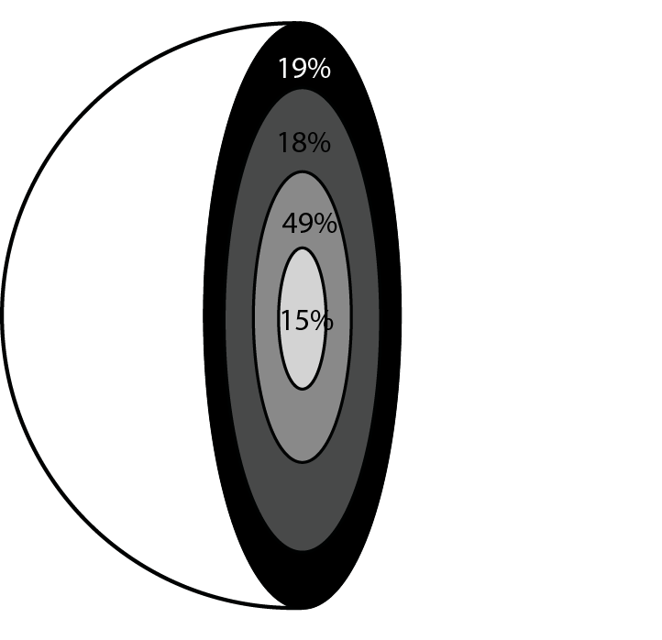
Quantifying the rim
Approximation of 25 quartz crystals to spheres to obtain the volume
Division into 4 subzones based on CL response and Ti content
  > 810°C (bright core)
  810-720°C (fluid exsolution)
  720-660°C (solidus)
  <660°C (dark rim)

Slide 13
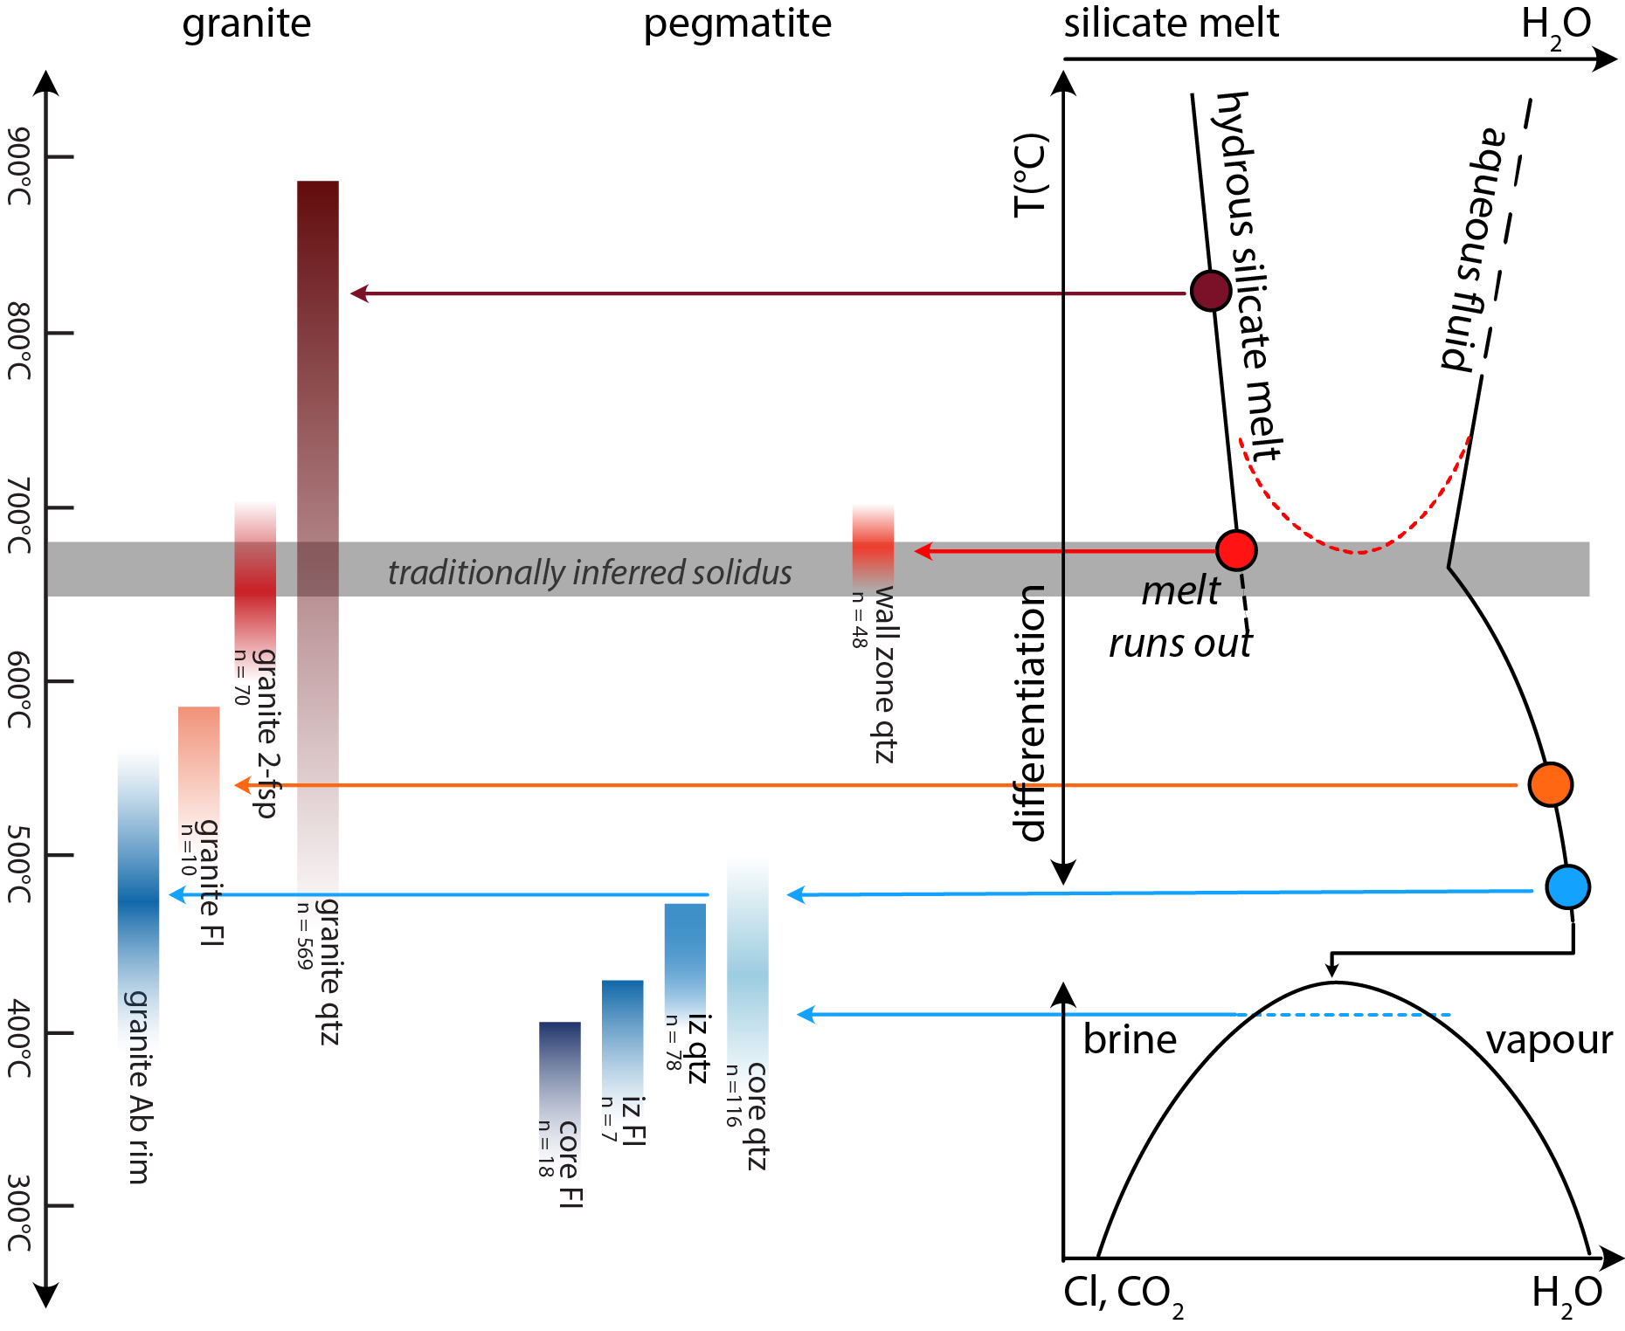
summary
Granite and wall zone above 660°C, precipitation from a silicate melt
  Fluids likely already abundant near solidus
  Wall zone: melt runs out
Precipitation medium shift near solidus
Granite quartz rim and fractures continue to ca. 500°C
Pegmatite intermediate and core zones at cold conditions (< 500°C)

