Slide 1






Deep-learning based classification of ice crystals: habits and microphysical processes
Huiying Zhang (huiying.zhang@env.ethz.ch)
Alexander Binder, Julie Pasquier, Benjamin Krummenacher, Fabiola Ramelli, Trude Storelvmo, Robert Oscar David and Jan Henneberger

Slide 2
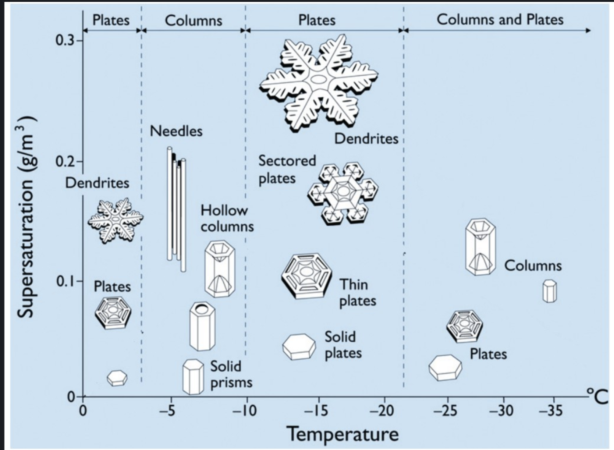
Motivation: What can we learn from ice crystal images?
Step1: In-cloud conditions (Newly-formed Ice)
Step2: Microphysical processes (Aged Ice)
Riming
Super-cooled
droplets
Ice crystal
Aggregation
Libbrecht, 2016
Ice crystal
Ice crystal
Ice crystal habits represent the environment (e.g., T & Si) in which they grow in and decide the radiative properties of ice
Ice crystals can undergo different microphysical processes which further shape the ice crystal based on its habit and impacts precipitation
huiying.zhang@env.ethz.ch
2

Slide 3
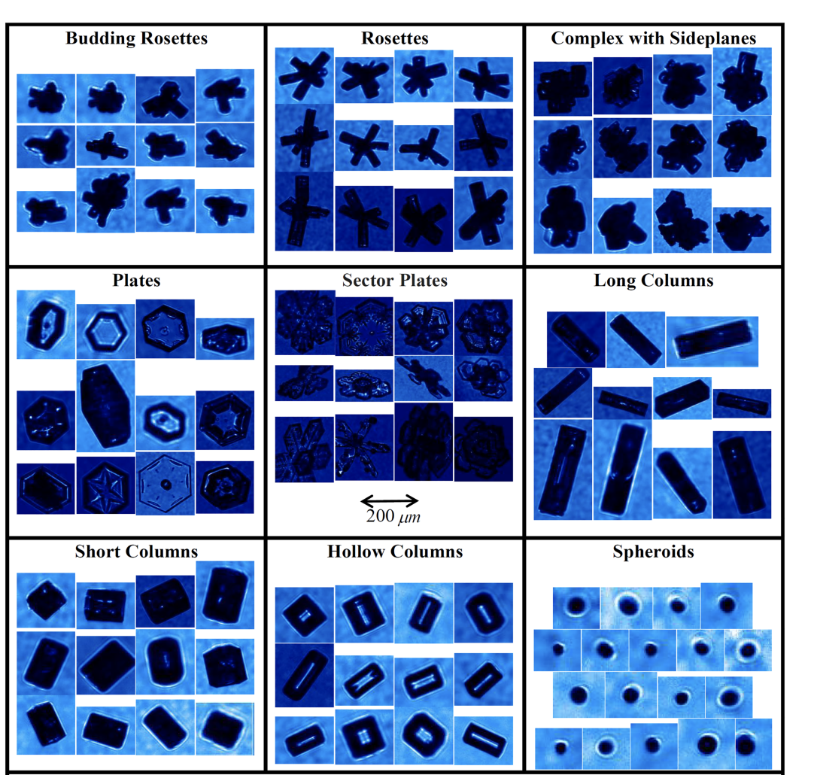
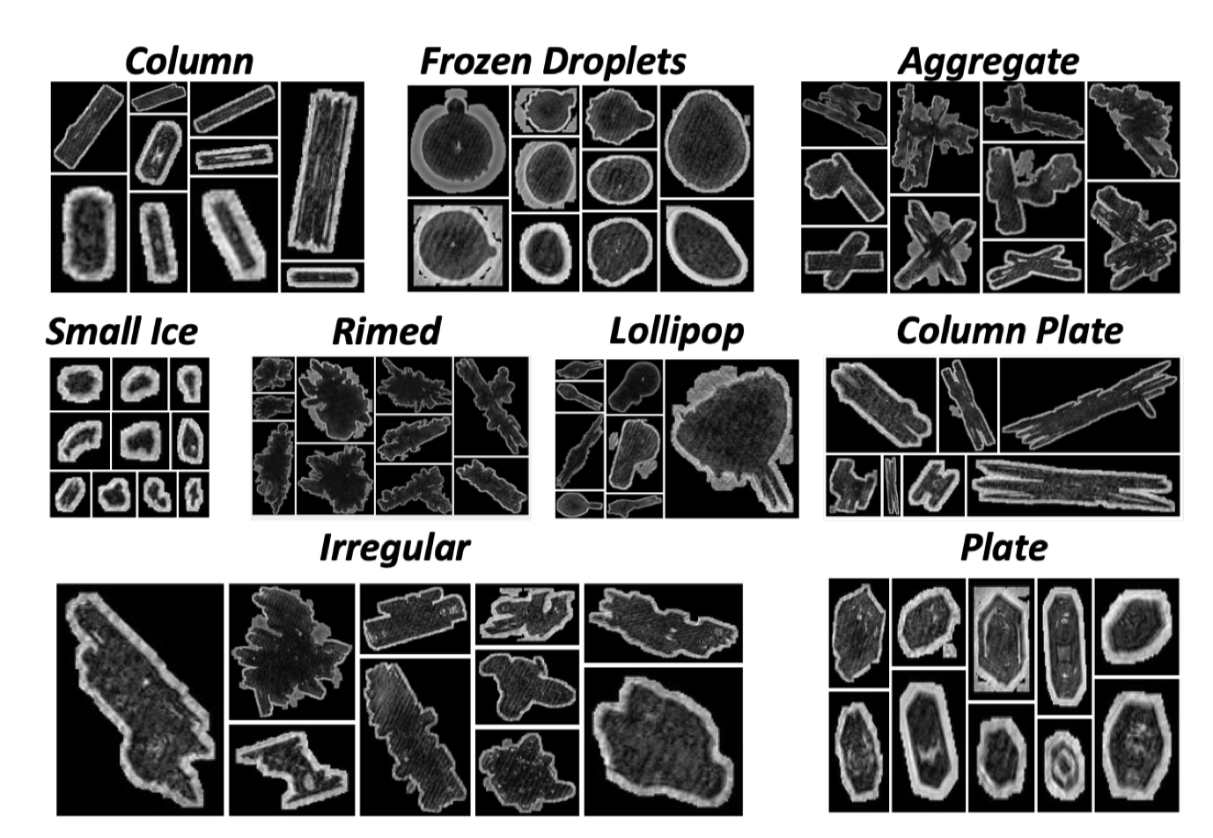
How were ice crystal images classified before?
Ice habits
Physical processes
Zhang, 2021
Classifier for ice habit and physical processes exist
Overall accuracy > 90%
Xiao et al., 2019
huiying.zhang@env.ethz.ch
3

Slide 4
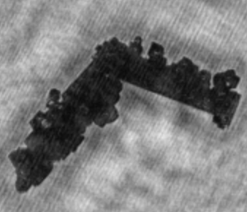
Limitations of current classification algorithms
Column?
Rimed?
Aggregate?
Algorithms are limited to single-label classification
Trade-off between ice habit and physical processes → loss of information
huiying.zhang@env.ethz.ch
4

Slide 5
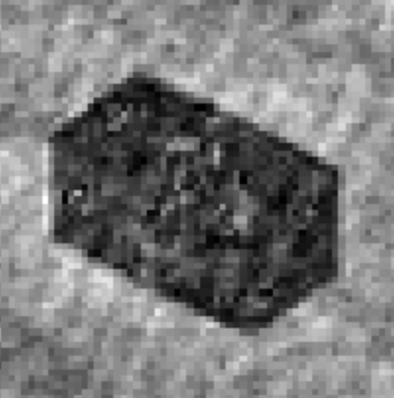
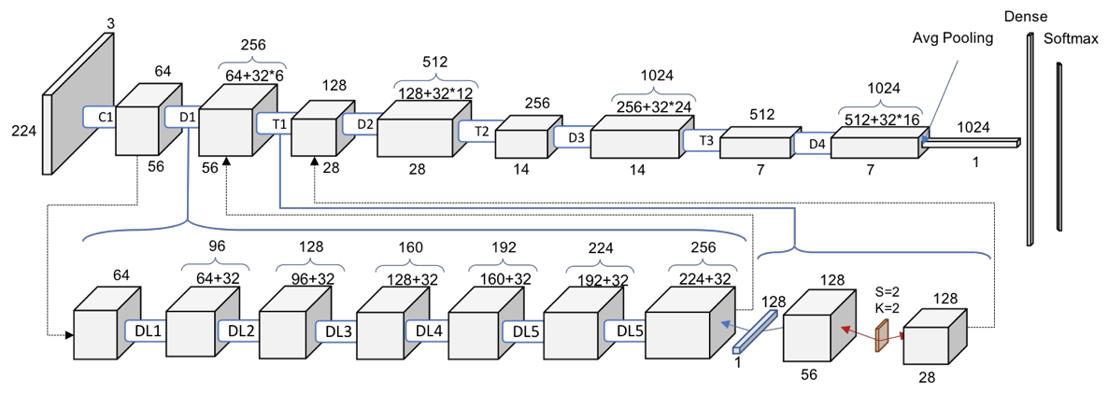
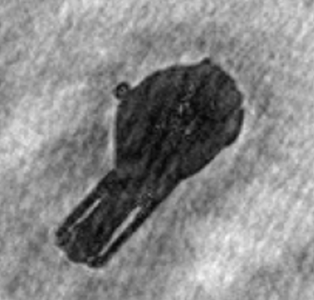
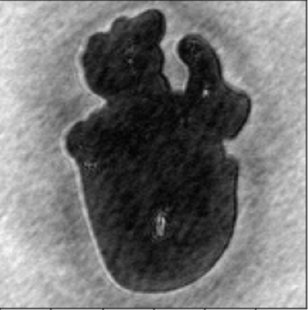
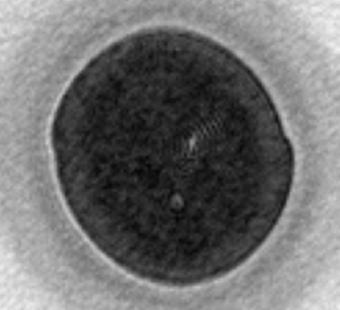
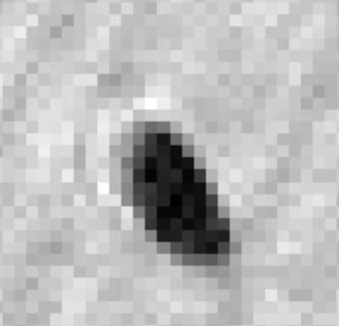
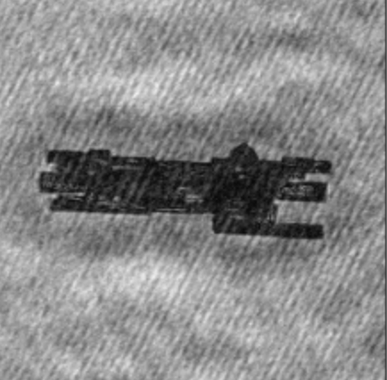
Solution: A multi-label
classification algorithm
Column
Plate
Basic Habit Classifier
Lollipop
Irregular
Input
Frozen
droplets
Final Habit:
Small ice
Hidden
Layers
Column Aged Aggregate
Column
plate
Physical Processes
Classifier
Aggregate
Aged
huiying.zhang@env.ethz.ch
5

Slide 6

Results and Conclusions
Overall accuracy habit | Overall accuracy physical process
79.6% | 77.8%
Column Aged Aggregate
A multi-label classification algorithm to infer ice crystal habits and microphysical processes was developed
The best model achieved an overall accuracy of 80% for basic habit and physical processes
’Liberates’ us from the tedious hand-labeling process and improves understanding and representation of microphysical processes
huiying.zhang@env.ethz.ch
6

