Slide 1
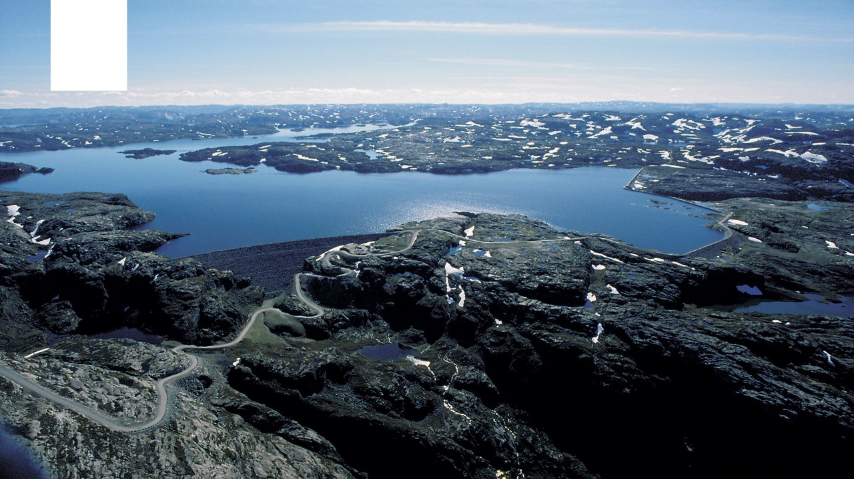
New environmental restrictions – aggregate effects on the Norwegian power system
Lennart Schönfelder, Birger Mo, Ingeborg Graabak, Atle Harby
Notes:
Bildet illustrerer:
· bredden i SINTEFs ekspertise, fra havrom til verdensrom.
· hvilke områder og bransjer vi jobber innen for å realisere visjonen Teknologi for et bedre samfunn.
Bildestilen er basert på stikkordene fremtidsrettet, teknologi og norsk natur (naturressurser). SINTEFs visuelle univers er utviklet for SINTEF av Headspin Productions AS.

Slide 2



Background
Reservoir
Norway: hydropower nation
>400 hydropower plant concessions: revision of terms
Environmental flow
Reservoir filling
Production restrictions: minimum & ramping
2030: consequences for the power market
Production – loss and impact on flexibility
Market response
Industry project: Sumeffekt
Bypass reach
Downstream reach
Notes:
Hydropower nation: favorable precipitation and topology. 1690 plants, more than 90% of power production originates in hydro
updated & new restrictions
Typical set-up, very simple example
Q95 very low flow, exceeded 95% time
Reservoir filling is too low

Slide 3
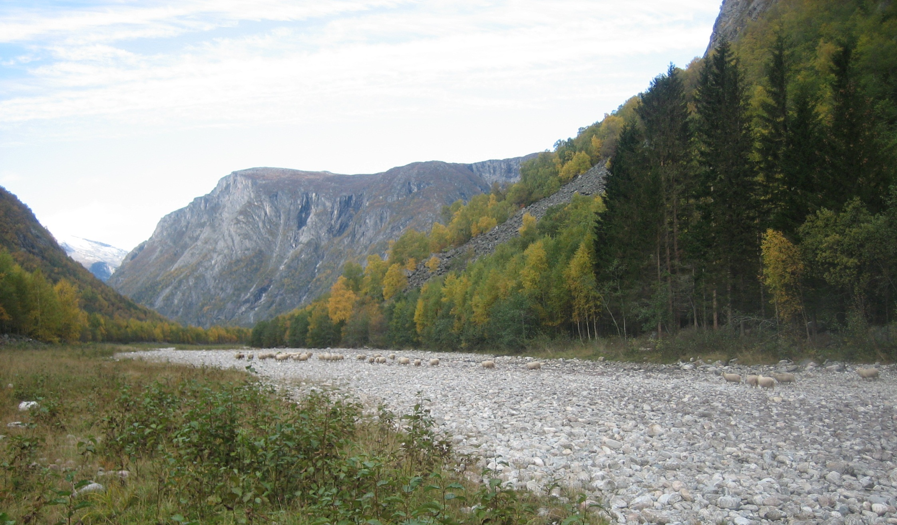
Photo: Atle Harby
Notes:
Example for a bypass reach

Slide 4
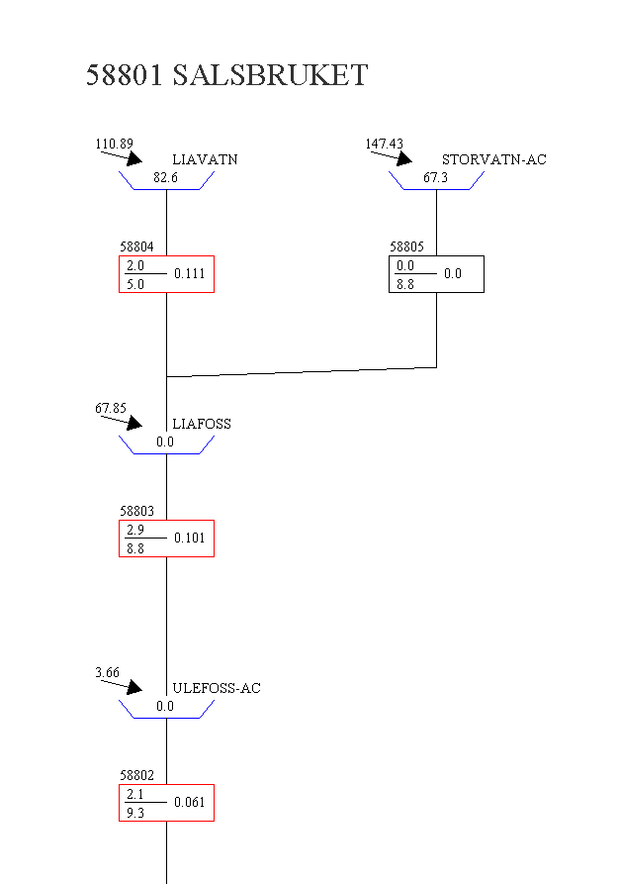

Modelling framework
2030 dataset
wind, solar, thermal
Int. interconnectors
Power demand
30 inflow years
0-scenario
Scenario Fan Simulator (FanSi)
-stochastic market model
-detailed hydro
New bypass reach
New Restrictions :
Environmental flow release: Q95 (seasonal)
Summer filling of reservoirs
Result: Scenario comparison

Slide 5
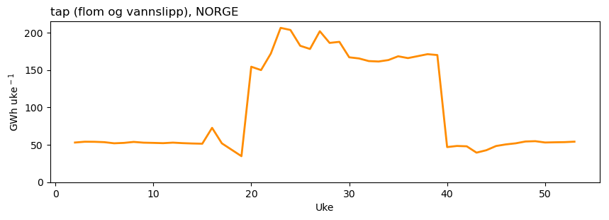
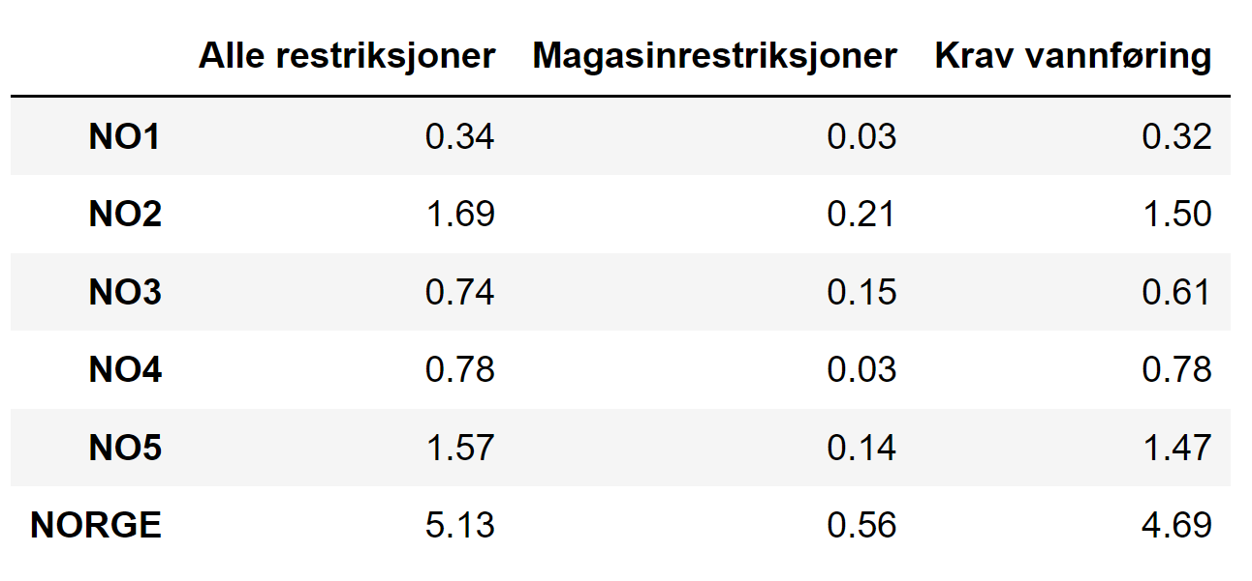
Results – production loss
Production loss: flood spill and env. flow release (Norway)
Seasonal Q95 (summer/winter) → Seasonal power loss
Production loss 5.1 TWh/a (total 150TWh/a)
Main driver: env. flow release
GWh / week
Week
Joint effect
Reservoir
restrictions
Environmental flow
Notes:
Increased production loss
uke 1-17 og uke 40-52): 1.6 TWh
Summer uke 18-39): 3.6 TWh
Main driver: environmental flows

Slide 6
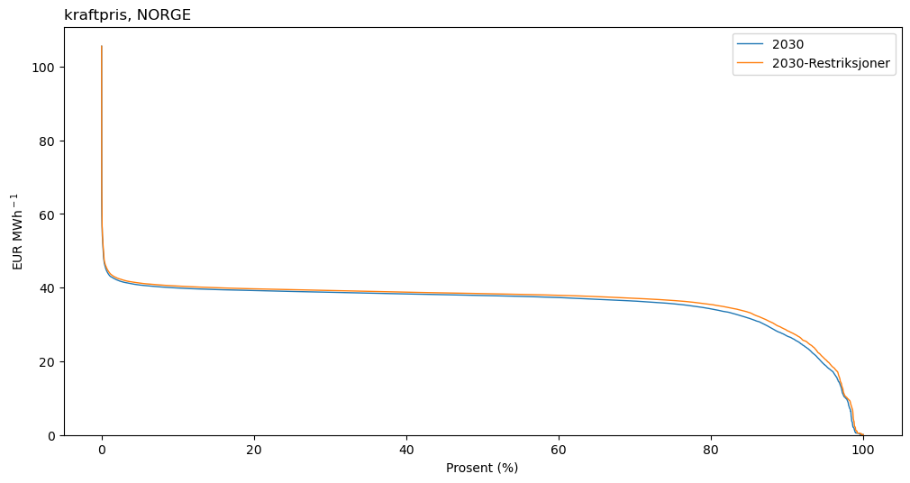
Results – power price
Power price, Norway
Power price + 0.8 €/MWh
Rainy sommer periods
Maximum prices similar
Many other effects
Notes:
Results of 30 weather years, all prices sorted from lowest to highest

