Slide 1

Novel Holocene temperature reconstruction of Greenland summit
from GISP2 nitrogen isotope data reveals similarities with North
Atlantic Circulation and temperature proxies
Michael Döring^{1,2,3} and Markus C. Leuenberger^{2,3}
¹University of Copenhagen, Niels Bohr Institute, Physics of Ice, Climate and Earth, København, Denmark
(michael.doring@nbi.ku.dk)
²Climate and Environmental Physics, University of Bern, Switzerland
³Oeschger Centre for Climate Change Research (OCCR), Bern, Switzerland

Slide 2
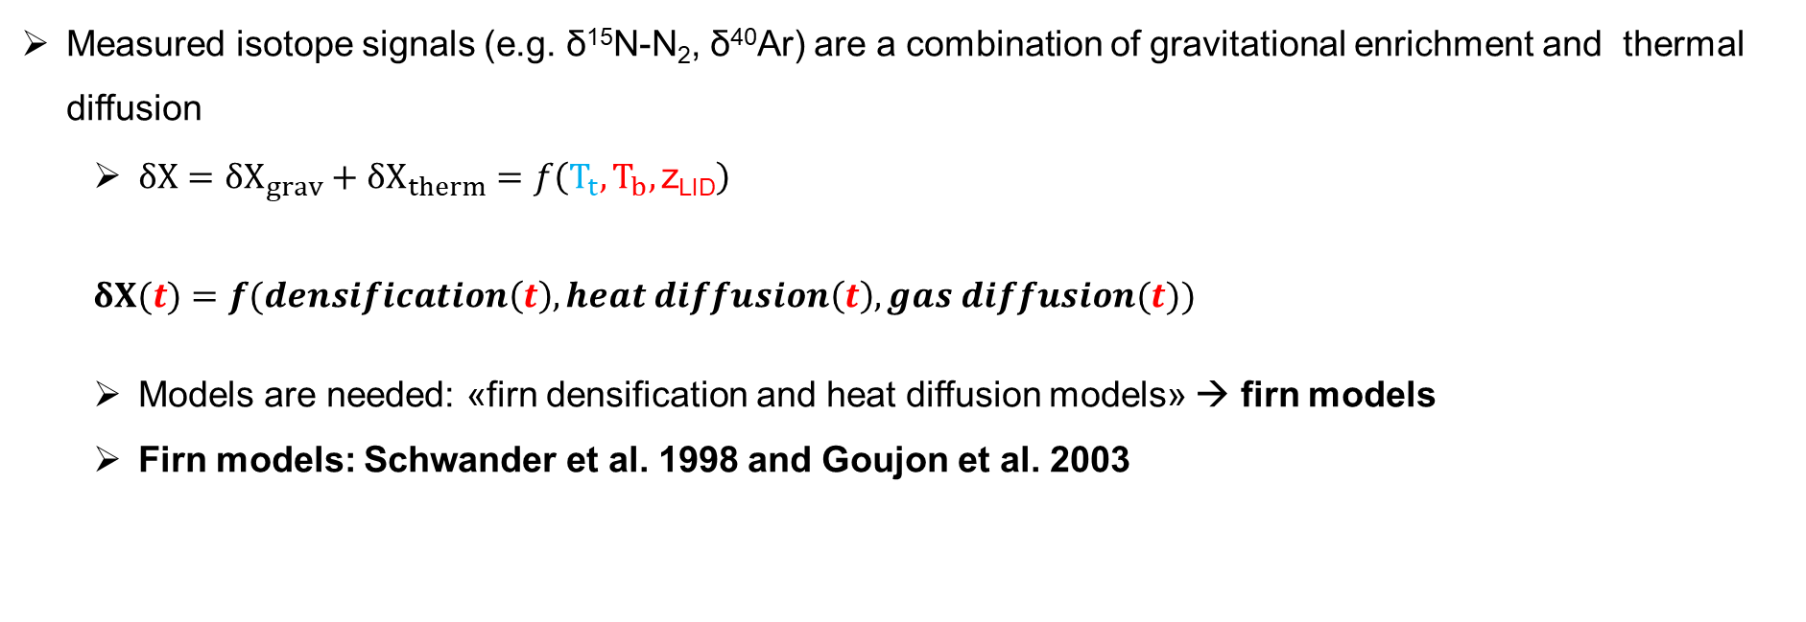
Measured isotope signals (e.g. δ¹⁵N-N₂, δ⁴⁰Ar) are a combination of gravitational enrichment and thermal diffusion
  $δX=δX_{grav}+δX_{therm}=f\left(T_{t},T_{b},\text{z}\text{LID}\right)$
$δX(t)=f(densification\left(t\right), heat diffusion\left(t\right), gas diffusion(t))$
  Models are needed: «firn densification and heat diffusion models» → firn models
  Firn models: Schwander et al. 1998 and Goujon et al. 2003
  Inert Gas Isotope Thermometer

Slide 3
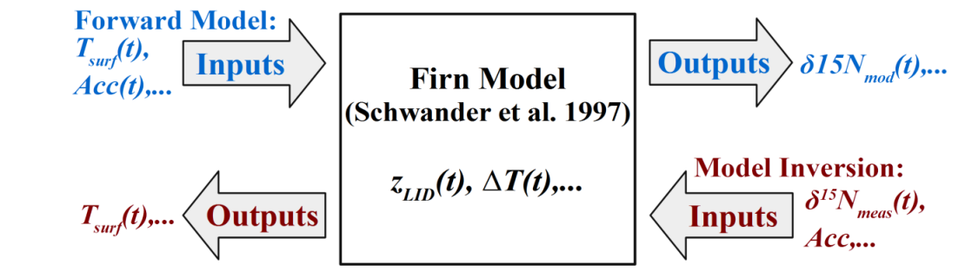
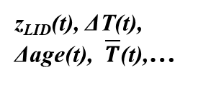
Forward model:
  Model calculates the firn state (output) from surface temperature T_{surf}(t) and snow accumulation Acc(t) time-series (input) in forward mode
δ¹⁵N_{mod}(t),
δ⁴⁰Ar_{mod}(t)
z_{LID}(t), ΔT(t), Δage(t), $\overline{T}$(t),…
  Inert Gas Isotope Thermometer

Slide 4
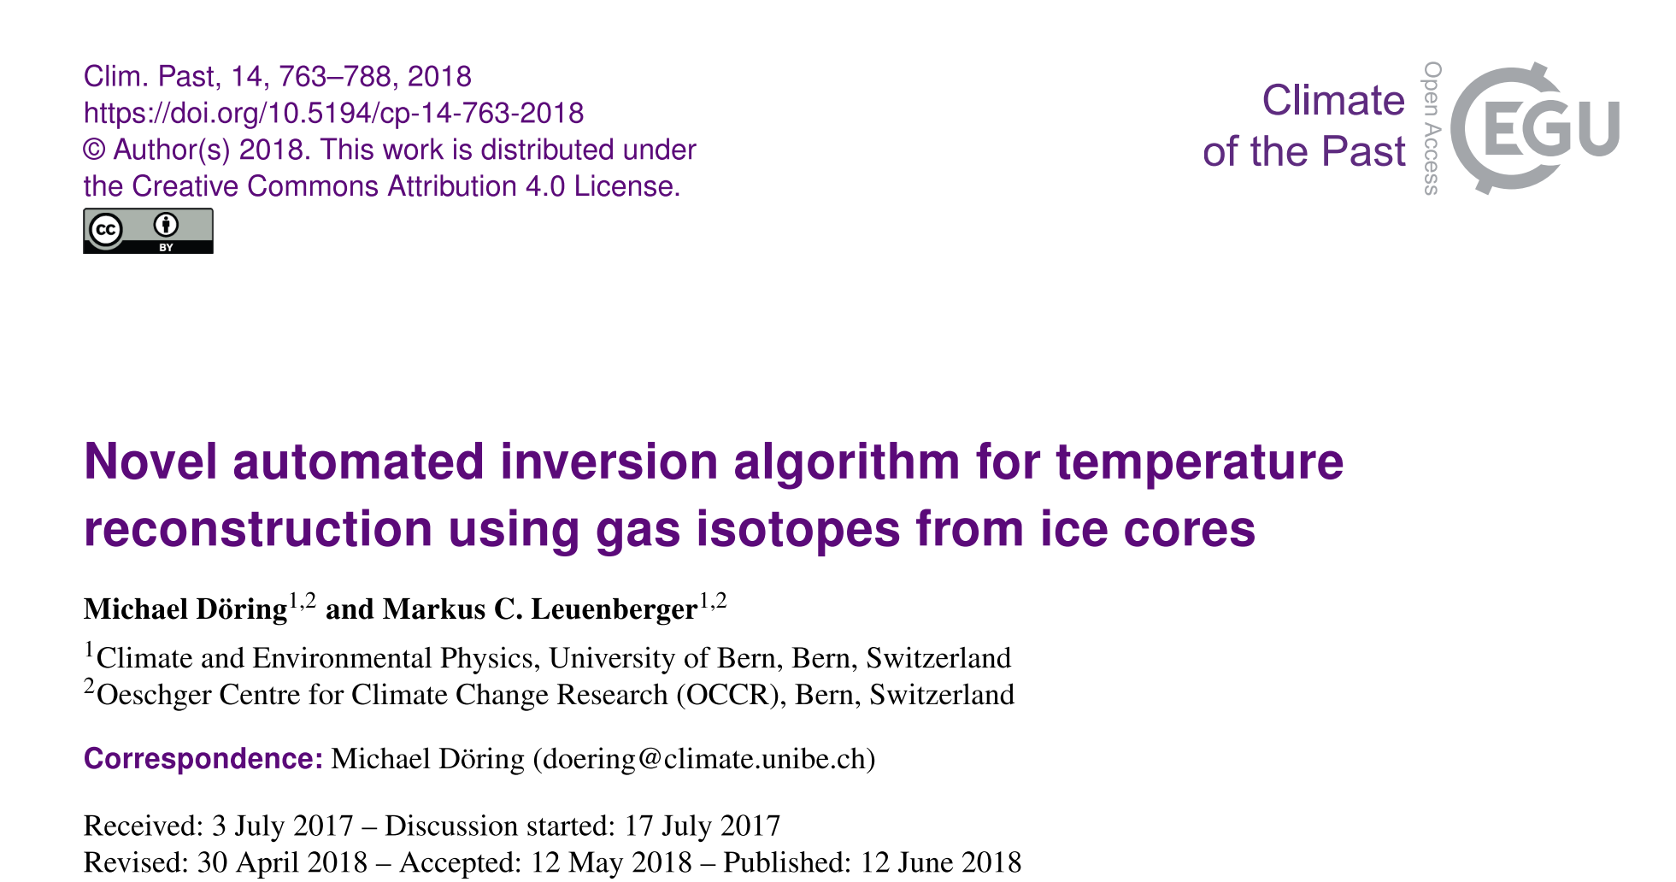
Forward model:
  Model calculates the firn state (output) from surface temperature T_{surf}(t) and snow accumulation Acc(t) time-series (input) in forward mode
Model inversion:
  Inverse for reconstructing T_{surf}(t) from measurement data (δ¹⁵N, δ⁴⁰Ar, δ¹⁵N_{excess})
z_{LID}(t), ΔT(t), Δage(t), $\overline{T}$(t),…
  Inert Gas Isotope Thermometer

Slide 5
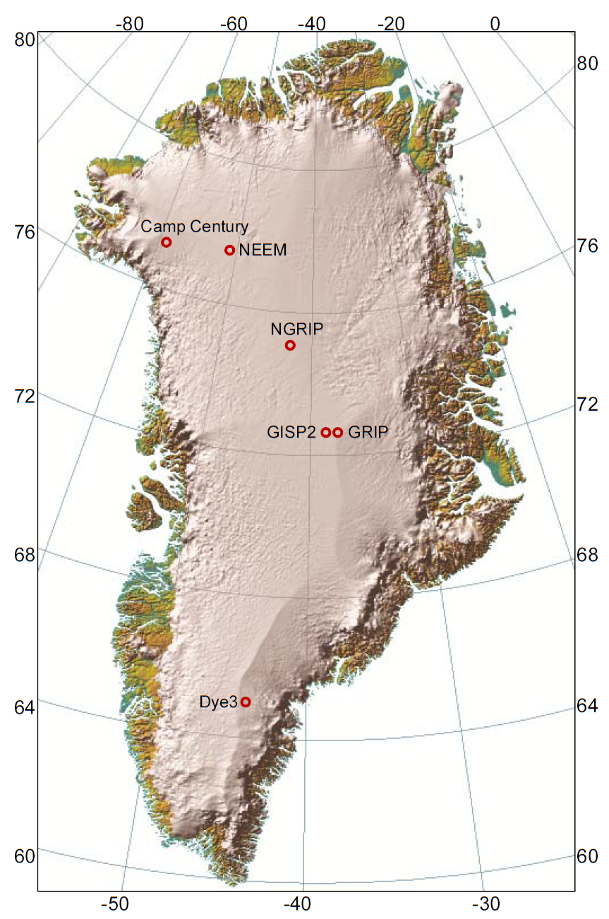
Using δ¹⁵N, δ⁴⁰Ar, and δ¹⁵N_{excess} data measured on the GISP2 ice core
(Kobashi et al., 2008b)
Entire Holocene
Mean sample resolution: 17.8 yr
Uncertainties (2σ):
δ¹⁵N: 6.0…8.0 permeg
δ⁴⁰Ar/4: 8.0…18.0 permeg
δ¹⁵N_{excess}: 10.0…19.6 permeg
Figure adapted from Kindler et al. (2014)/
Simon Ekholm, Danish cadastre
  Inert Gas Isotope Thermometer

Slide 6
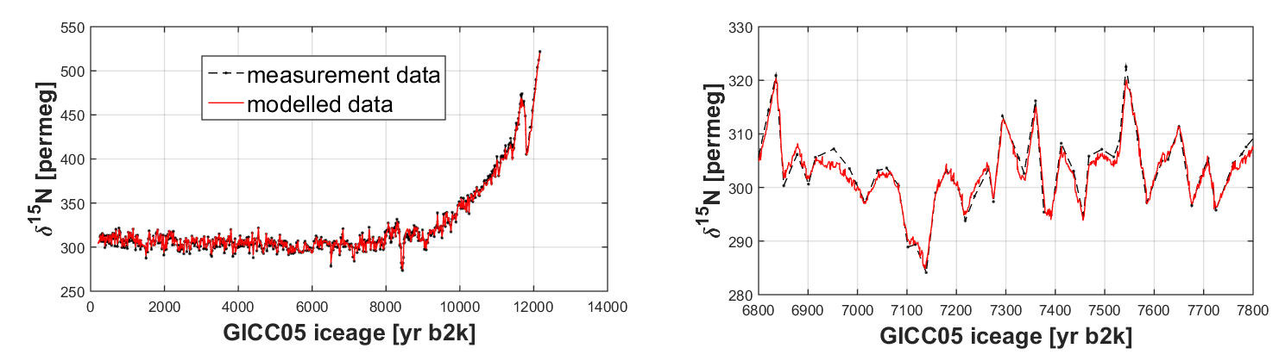
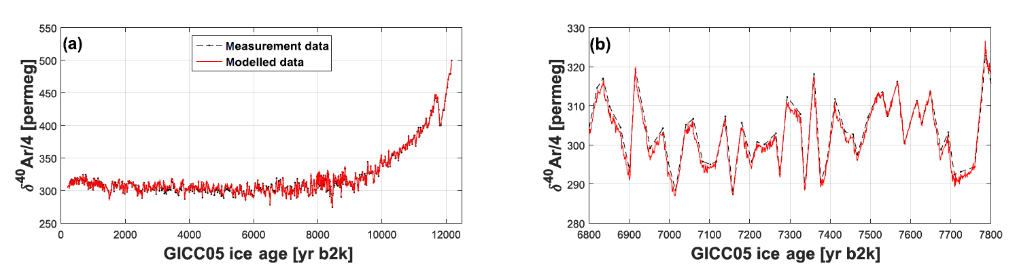
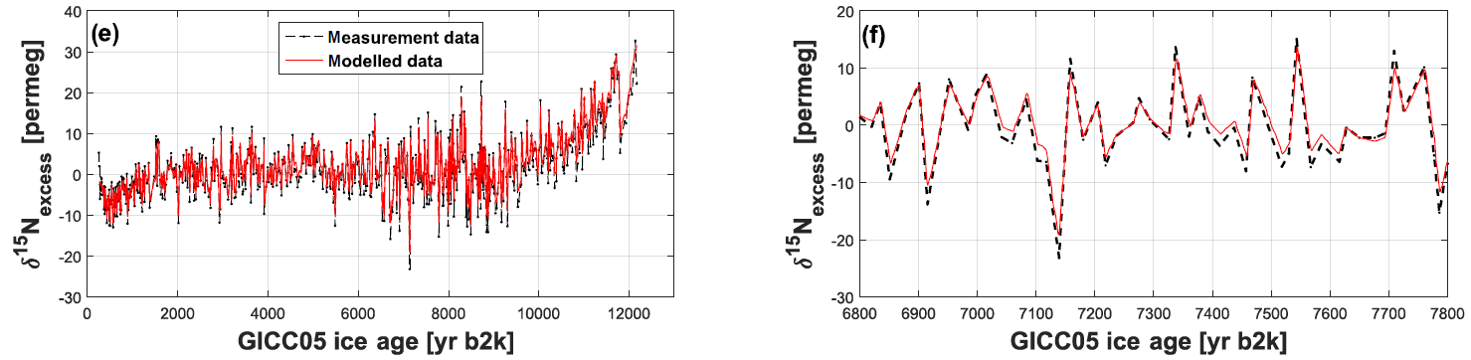
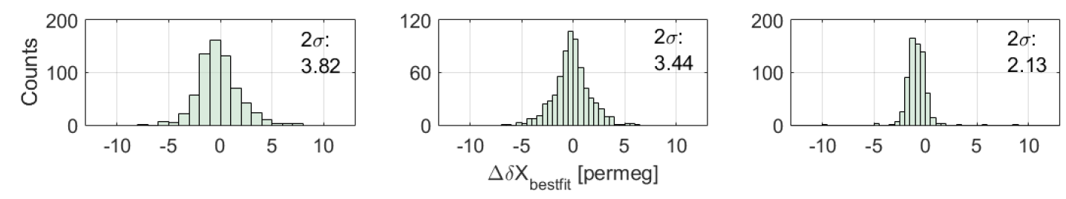
Final misfits (2σ):
δ¹⁵N: 3.8 permeg
δ⁴⁰Ar/4: 3.4 permeg
δ¹⁵N_{excess}: 2.1 permeg
  Inert Gas Isotope Thermometer

Slide 7
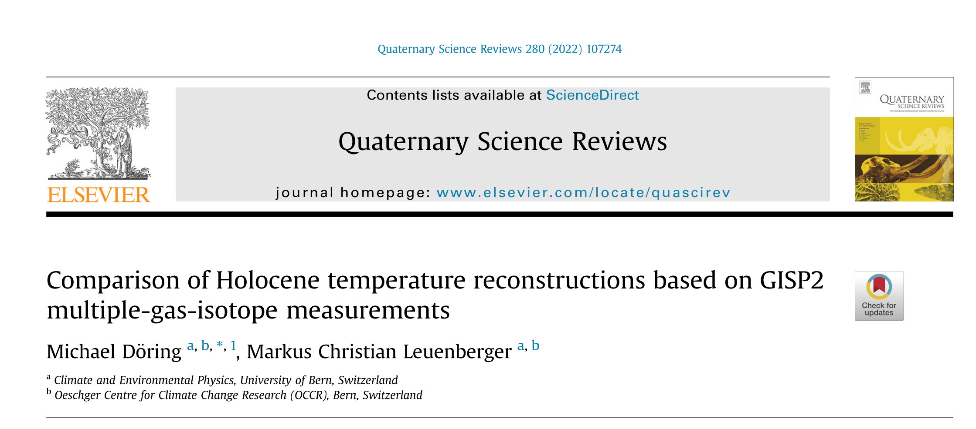
Final misfits (2σ):
δ¹⁵N: 3.8 permeg
δ⁴⁰Ar/4: 3.4 permeg
δ¹⁵N_{excess}: 2.1 permeg
  Inert Gas Isotope Thermometer
Notes:
d15N has best signal to noise ratio, and is less influenced by systematic data uncertainty compared to d40Ar and d15Nexcess

Slide 8
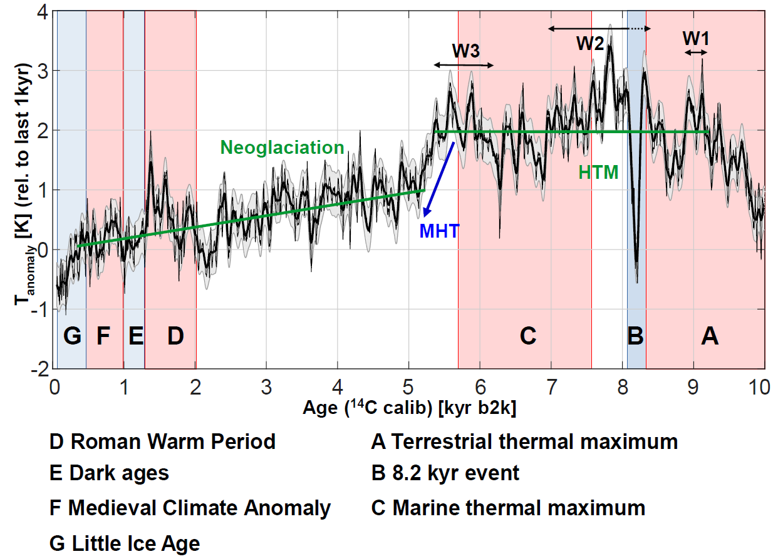
Holocene Thermal Maximum (HTM) from 5.4 to 9.2 ka (b2k) about 2 K warmer then average of last millennial (with “fine structure”)
“Mid Holocene Transition” MHT:
  rapid cooling of about 1 K at 5.2-5.4 ka b2k
“Neoglaciation”
  long-term cooling trend (about 1K) between 0.4 to 5.1 ka b2k
late Holocene warm-phase 1.3 to 2.0 ka b2k (D)
  Holocene Temperature T(δ¹⁵N)
Notes:
HTM is 2K warmer then averages of last
MHT: It was found in other studies that MHT is associated with
- major change in atmospheric circulation patterns, glacial advance on Iceland,
- weakening of AMOC
- rapid climate change associated with cooling in the North Atlantic, the transition from low to high solar activity

Slide 9
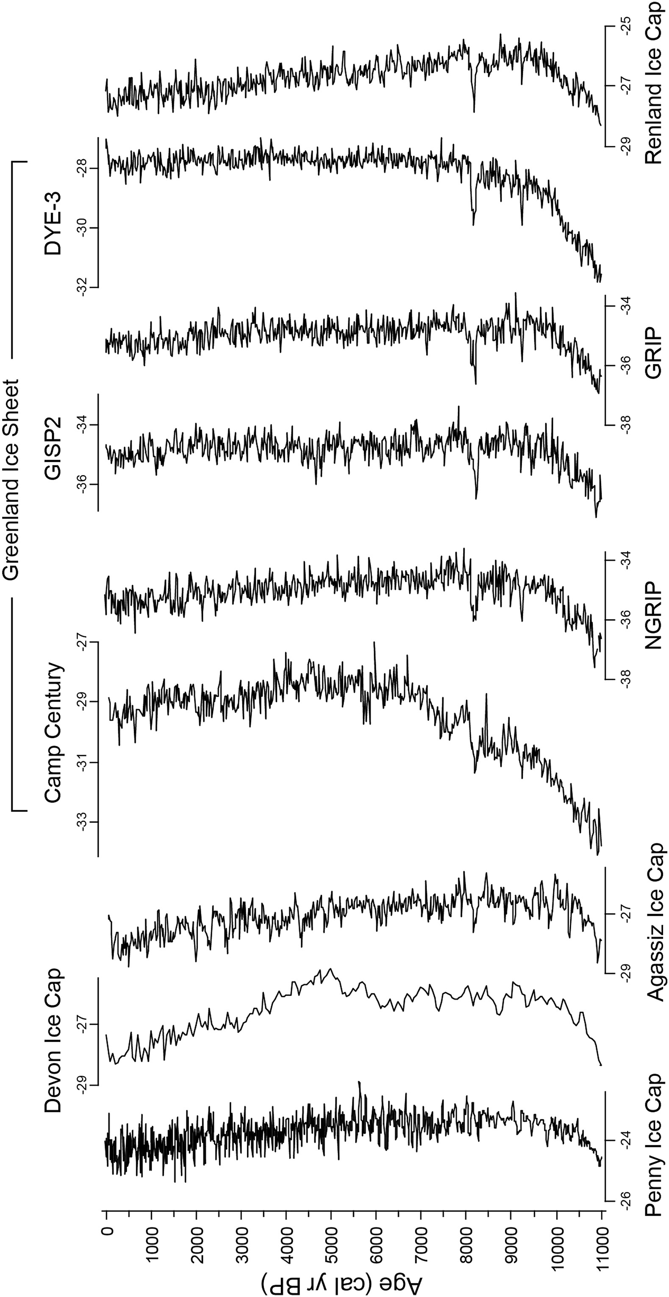
Vinther et al. (2009):
Low accordance between spatially inhomogeneous ice core δ¹⁸O-based reconstructions over the Holocene and many high latitude marine temperature reconstructions
E.g. many δ¹⁸O-based Greenland temperatures do not show a consistent Holocene Thermal Maximum found in many high-latitude climate records (Briner et al. 2016, Kaufman et al. 2004, Vinther et al. 2009)
  Comparison – δ¹⁸O
Notes:
It is known that changes in seasonal distribution of precipitation as well as of evaporation conditions at the source region influence d18O variations

Slide 10
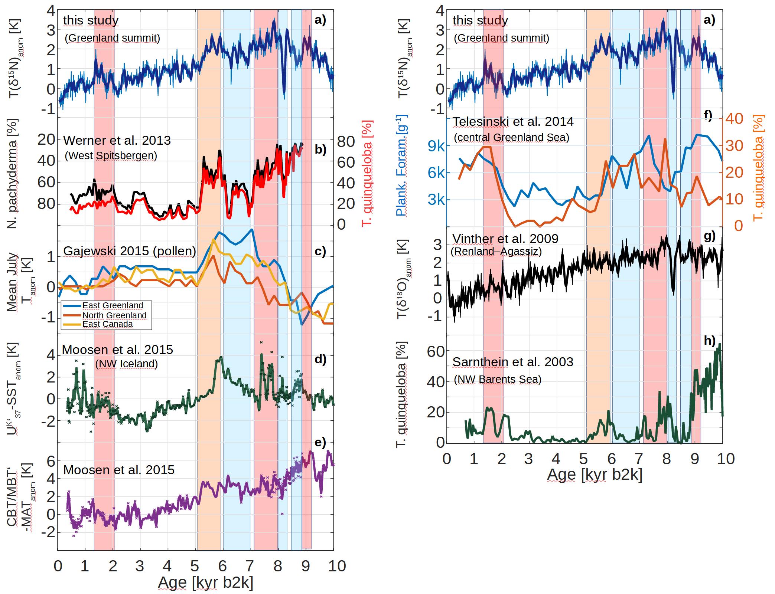
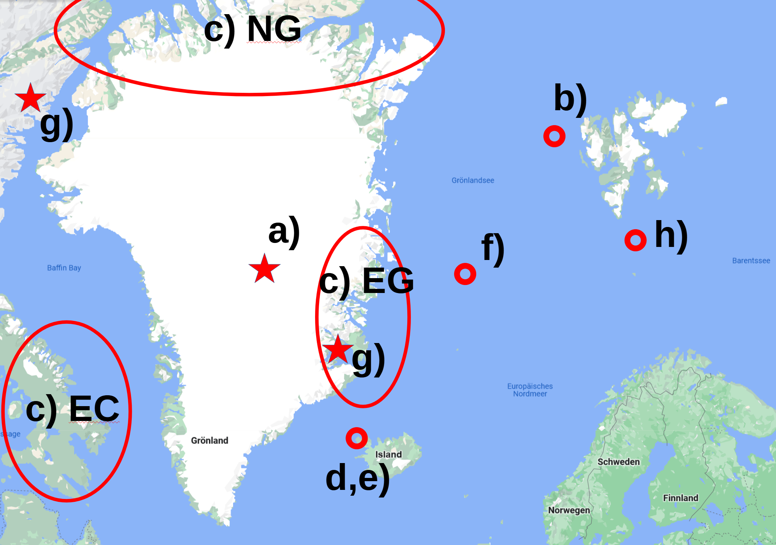
v
  Comparision to marine and terrestrial temperature proxies from the North Atlantic region region
Notes:
Different high latitude Sea surface and Terrestrial temperature proxy from North Atlantic region. The letter on the graphs corresponds to the locations on the map.
b) foraminifera West from Spitzbergen: sub surface temperatures
c) pollen data from lake sediment cores from Greenland and East Canada, mean July temperatures were estimated
d,e) air- and sea surface temperature from a fjordic sediment core from Iceland, revealing North Atlantic terrestrial and marine climate
• d) Marine Climate (SST)
• e) Terrestrial Climate (Air surface temperature)

Slide 11
v
  Comparision to marine and terrestrial temperature proxies from the North Atlantic region region
Notes:
f) sediment record from central Greenland Sea, Based on planktic foraminiferal, SST
h) Planktic foraminifera counts from sediment core from NW Barents Sea, SST
g) Temperature reconstruction for coastal Greenland sites from ice core d18O.

Slide 12
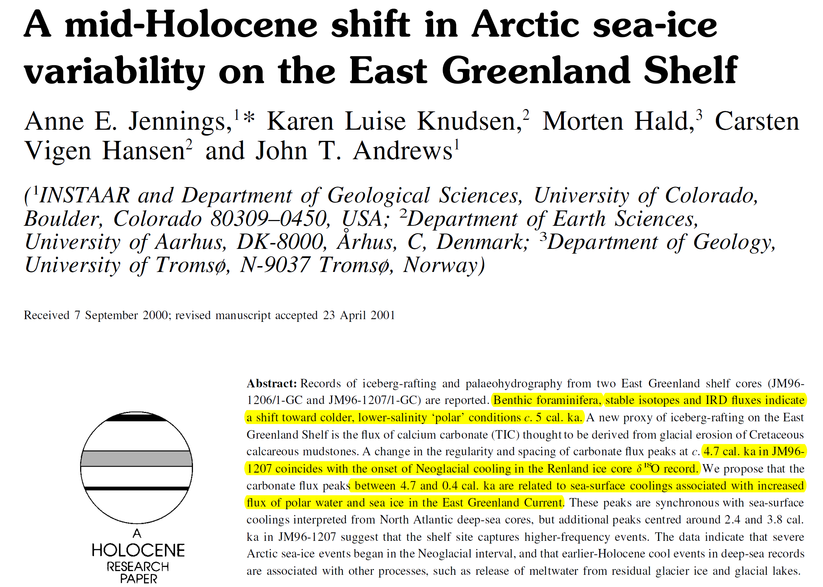
  Potential drivers
Notes:
analysis of 2 East Greenland shelf cores indicating a shift towards colder conditions at about 5kyr b2k

Slide 13
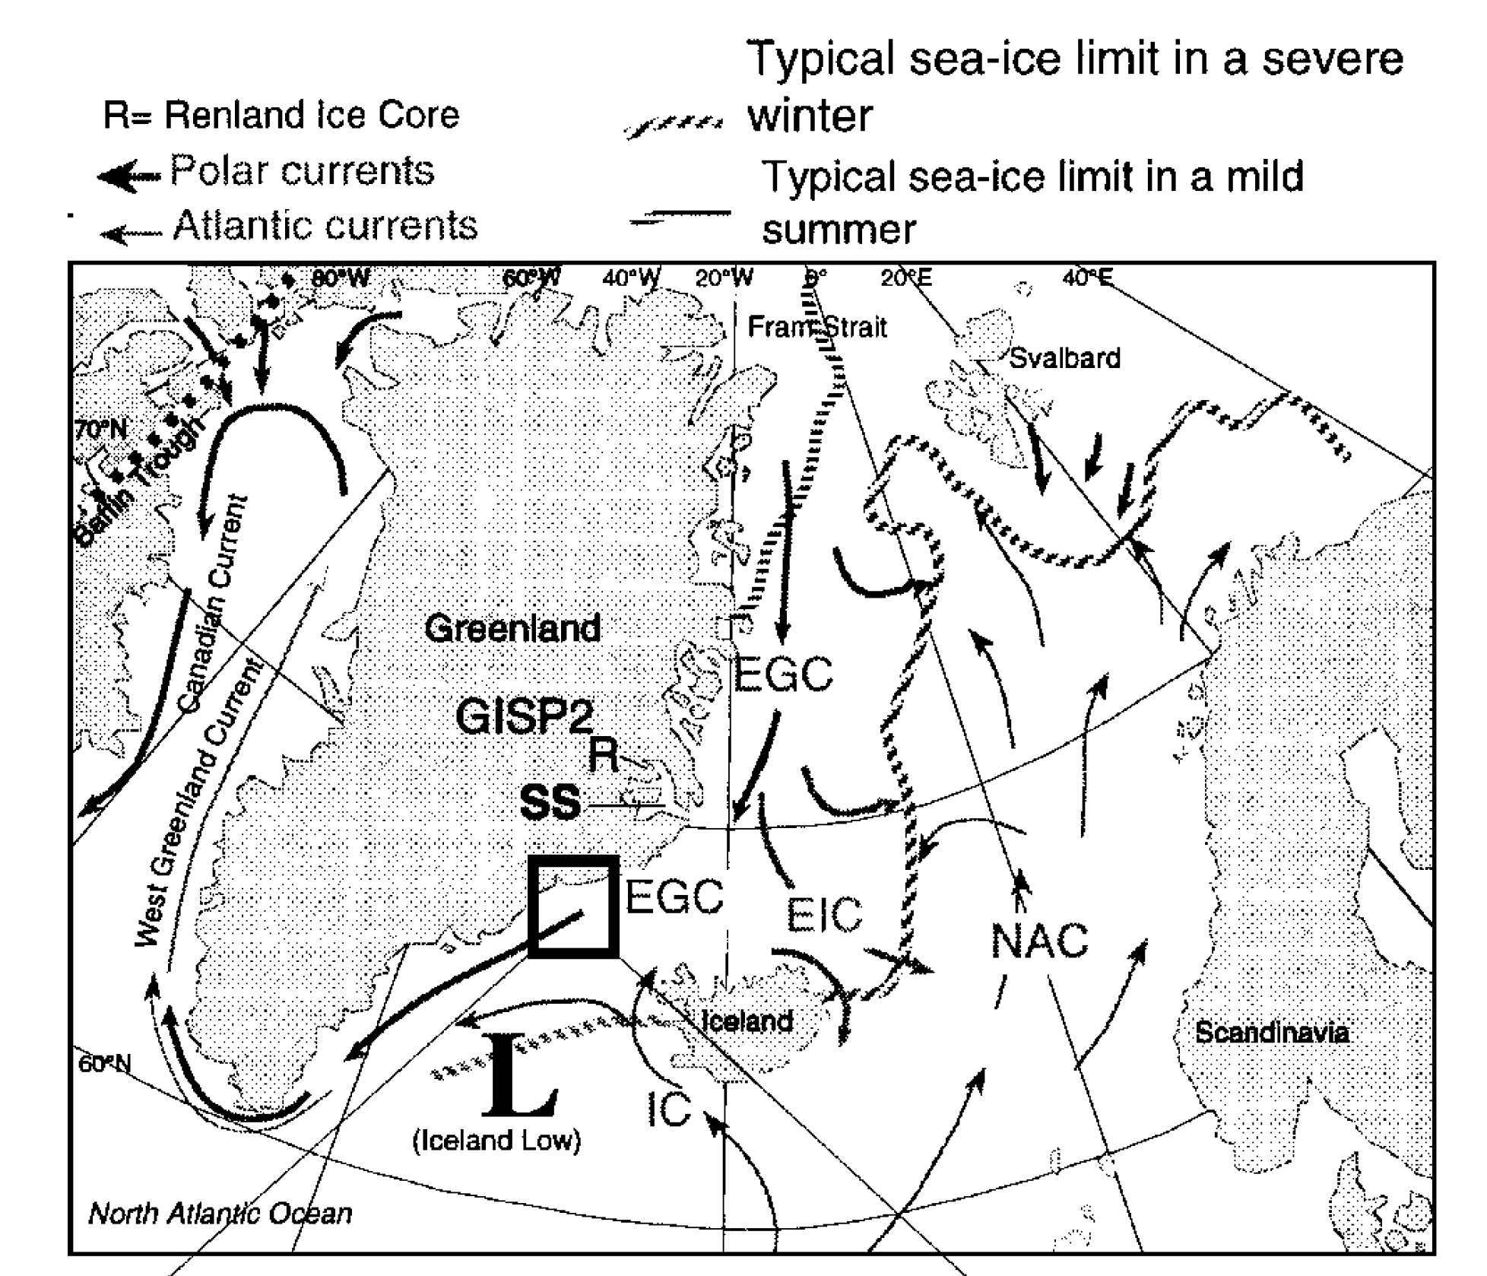
  Potential drivers

Slide 14
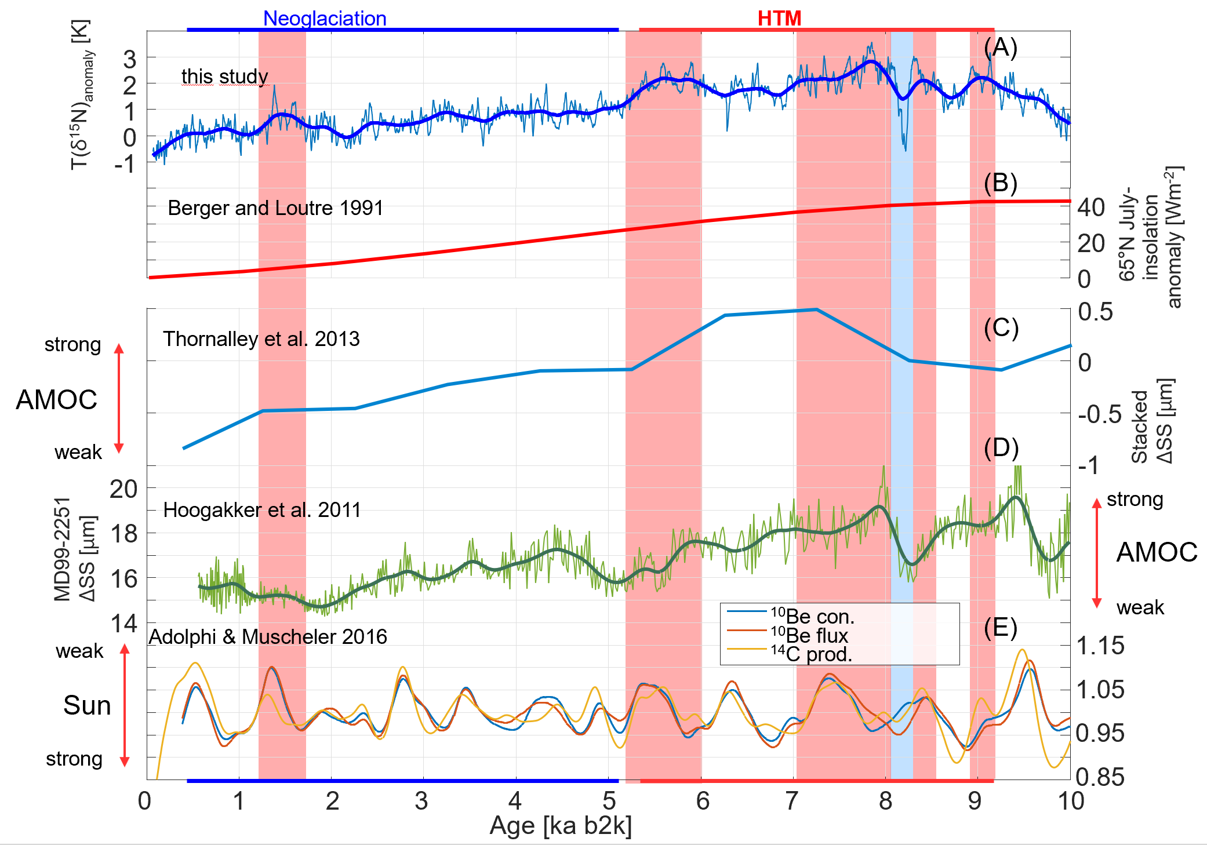
  Other potential drivers
Notes:
B: NH solar insolation
C: stack of 13 sediment cores from the Iceland Basin records AMOC strength
D: The data from a sediment core from northeast Atlantic Basin records AMOC strength
E: sun spot intensity

Slide 15
Conclusion
Holocene Thermal Maximum in Greenland was 2K warmer than the average temperature of the last 1 ka and occurred from 5.4 to 9.2 ka b2k
mid-Holocene cooling event (Mid Holocene Transition) at 5.2-5.4 ka b2k
Late Holocene warm-phase from 1.3 to 2.2 ka b2k
Summit temperature T(δ¹⁵N) showing comparable signatures with a variety of marine and terrestrial temperature proxies from the North Atlantic region
Coherence of AMOC variability and Greenland summit temperature during the Holocene
  Conclusion

Slide 16
Thank You!
Questions, Comments, Suggestions?
Please reach out:
michael.doring@nbi.ku.dk

Slide 17
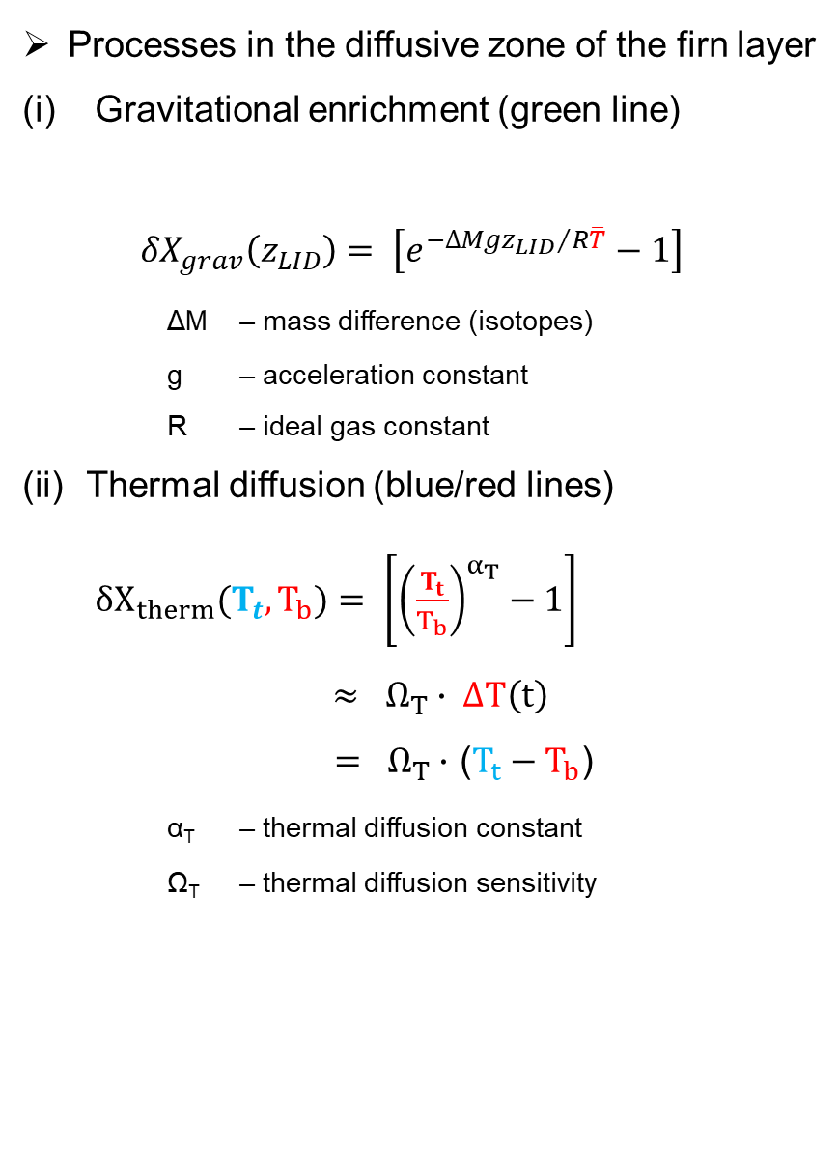
Processes in the diffusive zone of the firn layer
(i) Gravitational enrichment (green line)
  ${δX}_{grav}\left(z_{LID}\right)= \left[e^{{−∆Mgz_{LID}}/{R\overline{T}}}−1\right]$
  ΔM – mass difference (isotopes)
  g – acceleration constant
  R – ideal gas constant
Thermal diffusion (blue/red lines)
$δX_{therm}(T_{t},T_{b})= \left[{\left(\frac{T_{t}}{T_{b}}\right)}^{α_{T}}−1\right]$ $≈ Ω_{T}∙ ∆T\left(t\right)$
        $= Ω_{T}∙$ ($T_{t}−T_{b}$)
          α_{T} – thermal diffusion constant
          Ω_{T} – thermal diffusion sensitivity
Figure adapted from Kindler et al. (2014)
  Inert Gas Isotope Thermometer

