Slide 1

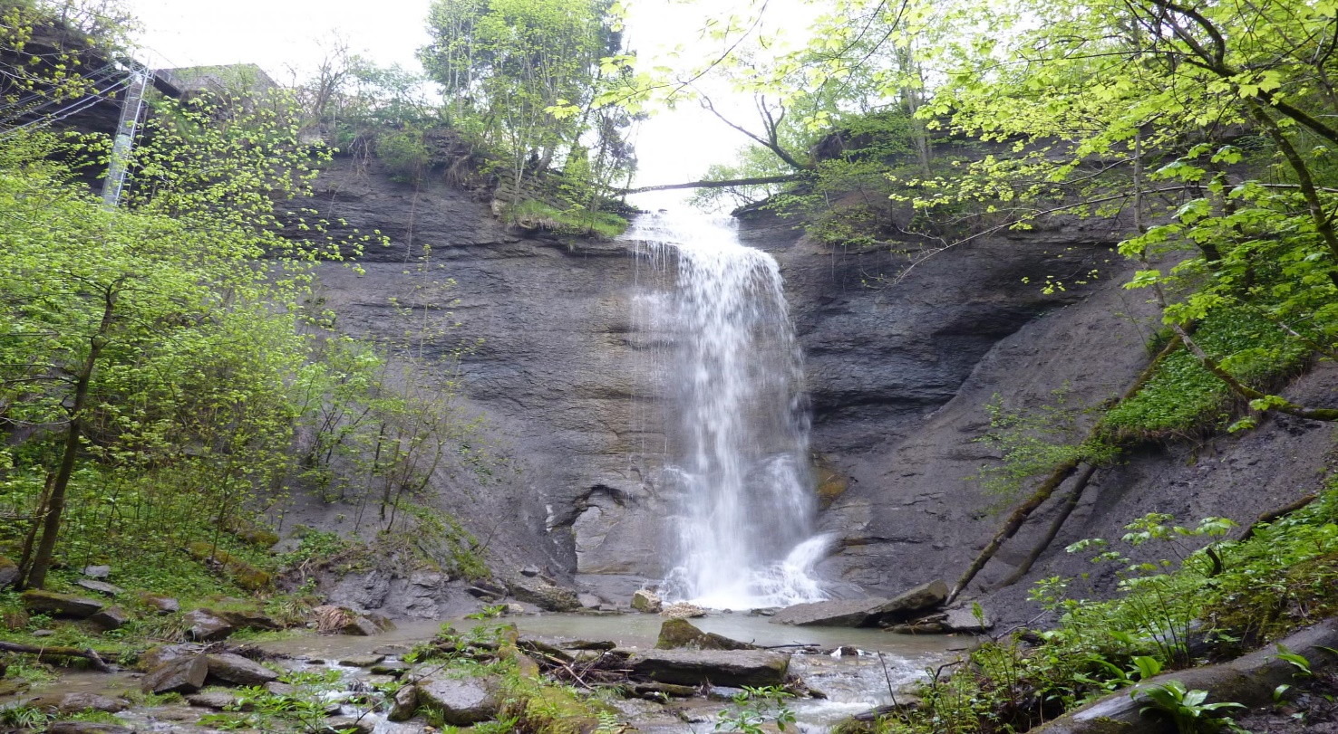



Cyclostratigraphy of the Aalenian Opalinuston Formation in the Swabian Alb deduced from downhole logging data
Katharina Leu¹, Christian Zeeden¹, Thomas Mann², Jochen Erbacher², André Bornemann², Thomas Wonik¹
¹Leibniz Institute for Applied Geophysics (LIAG), Hanover, Germany
²Federal Institute for Geosciences and Natural Resources (BGR), Hanover, Germany
Upper Opalinuston, waterfall at Balingen-Zillhausen, Southern Germany (lgrb-bw.de)

Slide 2
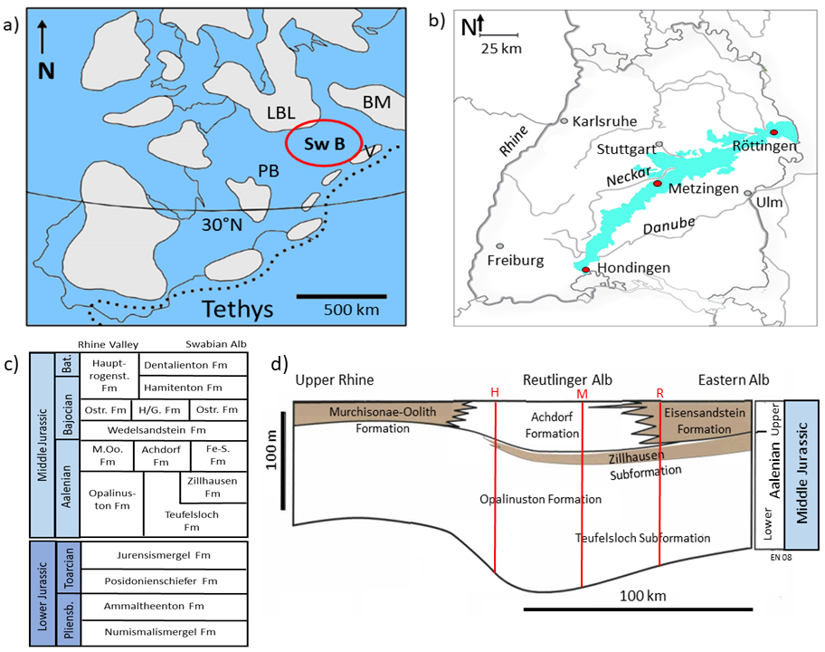
Geological Overview

Slide 3
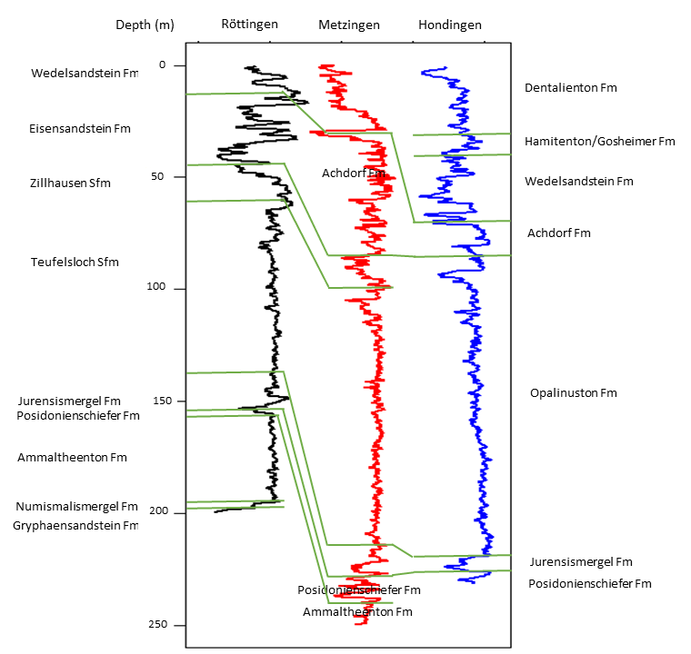
Downhole logging data: gamma ray (GR)
Why logging data?
In-situ conditions
Continuous record
Directly available after measurement
Why GR log and why Teufelsloch Subformation?
Teufelsloch most extended Formation
Uninterrupted shaly environment
GR is not disturbed by thick sand beds, hiatus, ash layers or turbidites
Orbital signal not overprinted

Slide 4
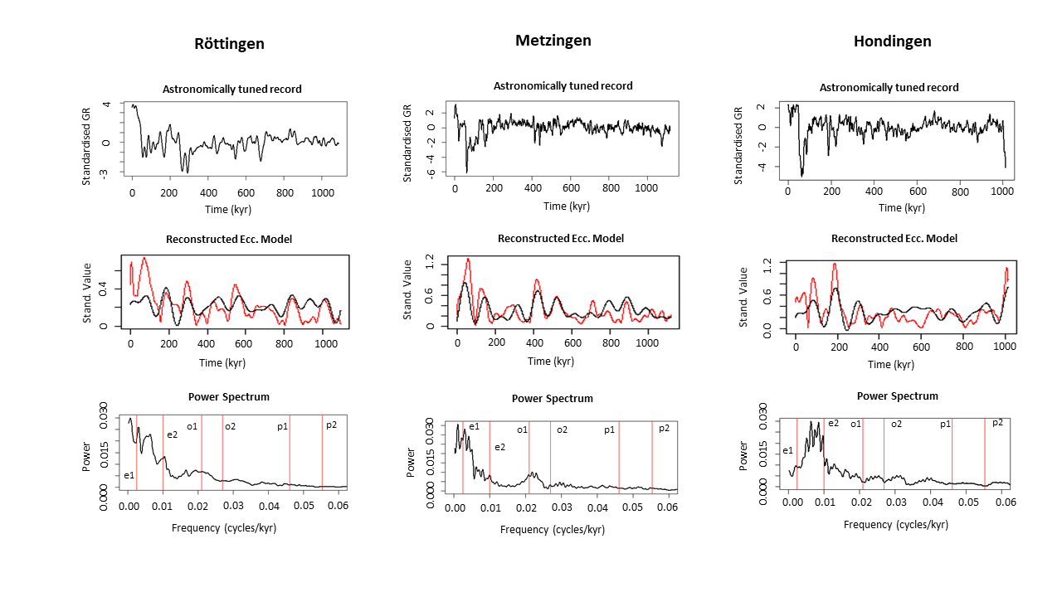
Cyclostratigraphic analysis: TimeOpt function

Slide 5
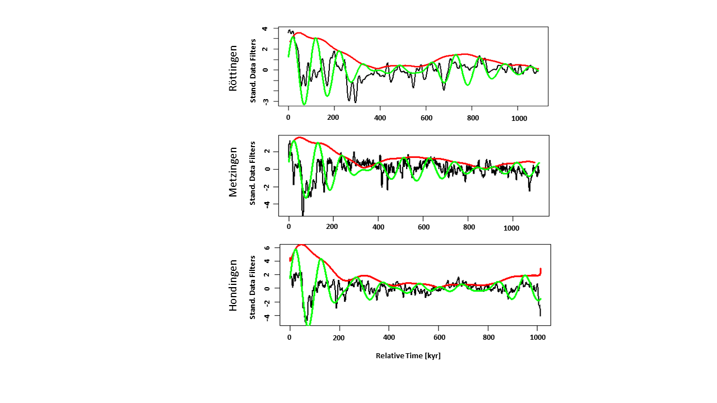
Results
Sedimentation rate: 7 cm/kyr
-> 1100 kyr
Sedimentation rate: 10 cm/kyr
-> 1117 kyr
Sedimentation rate: 13 cm/kyr
-> 1007 kyr
similar estimations for all boreholes
accurate to other estimations of lowest Lower Aalenian time (~1 Ma, Hinnov & Park 1999), 800 kyr (Hardenbohl et. al. 1998)
Range of sedimentation rates (7-13 cm/kyr)
statistical/ analytical uncertainties, differing sedimentary processes due to geographical position
Next: perform cyclostratigraphy on XRF data of the cores

