Slide 1
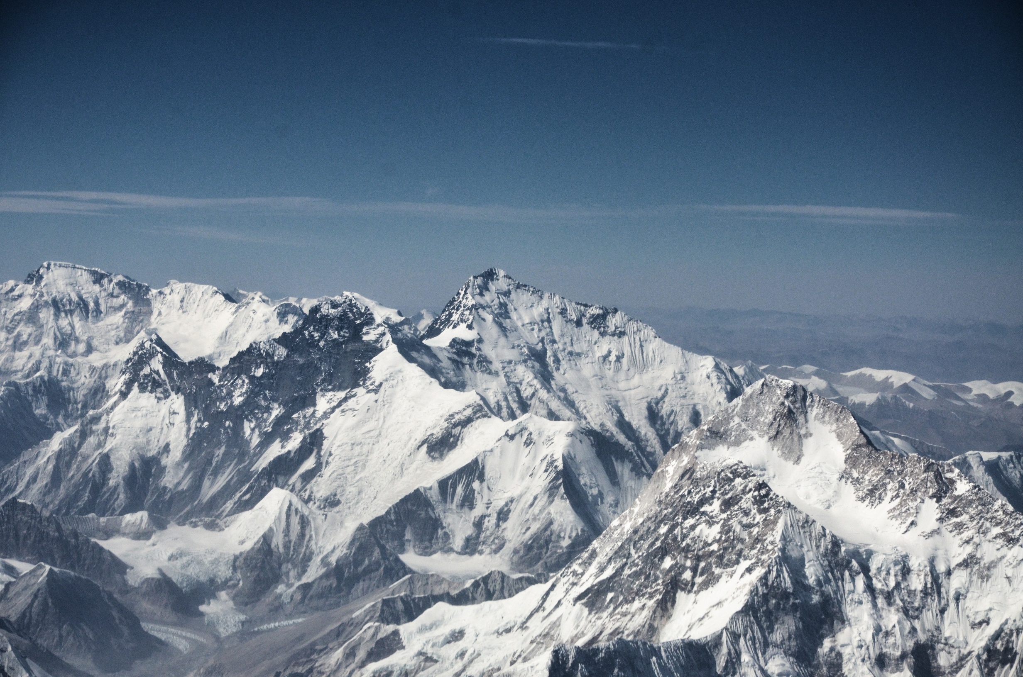

Zhangwei Ding, Gert-Jan Steeneveld
The role of surface coupling, turbulent mixing, and radiation in modeling a stable boundary layer over Tibetan Plateau
Yaoming Ma, Xuelong Chen

Slide 2
Motivation
Can 3D-WRF reproduce 3 archetypes of the clear sky stable boundary layer (time series and profiles) over the Tibetan plateau?
Which land surface properties are most important for a successful SBL representation?
Can so called process diagrams identify key physical processes in the 3 SBL archetypes?

Slide 3
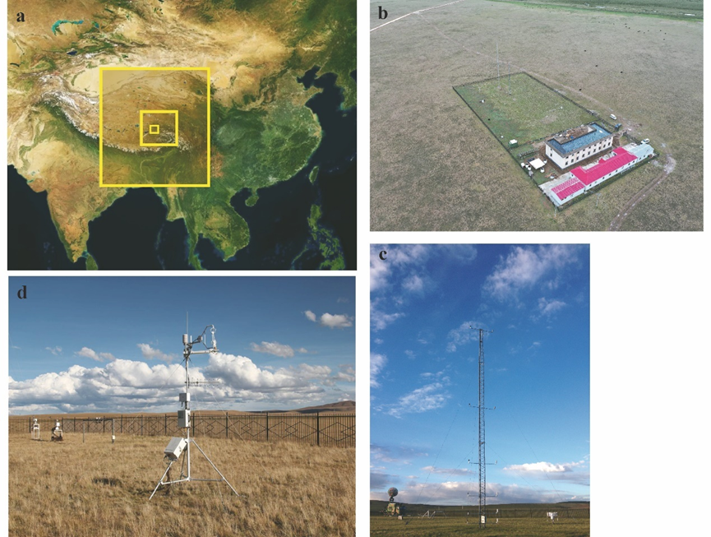

Materials & Methods
Experiment site: Nagqu, Tibet (31.37º N,91.90º E,4509m a.s.l)
IOP: 21-25th October, 2019
Notes:
2阶TKE闭合湍流参数

Slide 4
Intermittent
Rad
Turb
SBL classification
1900-0500
1900-0000
0000-0500
(following Van de Wiel et al .2002)
Date | SBL Type | LE (Wm⁻²) | Hs (Wm⁻²) | G0 (Wm⁻²) | U* (ms⁻¹) | NR (Wm⁻²) | U1.5 (ms⁻¹) | T1.5 (°C)
22-23th Oct 19:00-05:00（N1） | intermittent | 6.1 | -9.8 | -41.3 | 0.13 | -82.8 | 1.4 | -5.9
23th Oct 19:00-00:00（N2a） | radiative | 2.3 | -2.3 | -38.5 | 0.12 | -108.3 | 1.0 | 0.0
24th Oct 00:00-5:00 (N2b） | turbulent | 12.9 | -24.9 | -20.5 | 0.51 | -111.9 | 6.2 | 0.8
22.5=1200 22th Oct (LST) 23.0=0000 23th Oct (LST)
Notes:
It is necessary to classify SBL into 1) radiative, 2) intermittently turbulent and 3) fully turbulent archetypes, depending on leading role on turbulence and radiation.
Surface energy partitioning for the period of 22–24 Oct 2019; LE is the latent heat flux (gray line), Hs is the sensible heat flux (black line), NR is the net radiation (dash line), and G0 is the soil heat flux (dot line). The first night N1 is classified as intermittent, the earlier part of second night (N2a) as radiative and the later parts of second night (N2-b) as fully turbulent.
We can define easily our nights cases by the surface sensible heat flux (Hs). Hs presented intermittent characteristics nearly constant during the first night (hereinafter referred to N1), and disappeared in the early part of the second night (denoted by N2-a hereafter) under weak wind conditions at 1.5m level (U1.5),

Slide 5
Numerical experiments designed to test augmentations in WRF sensitivity runs
EXP | Soil volumetric heat capacity (Cs) | Surface thermodynamic roughness (Z0) m | Soil thermal conductivity (λ) Wm⁻¹K⁻¹ | Snow cover
CTL-snow | Default | Default | Default | Yes(Default)
EXP1-no snow | Default | 0.1(Default) | Default | No
EXP2-no snow _lowheatcap | 25% | 0.1(Default) | Default | No
EXP3- no snow_obs_Z0 | Default | 0.01 | Default | No
EXP4-no snow_obs_heatconduct | Default | 0.1(Default) | 1.28 | No
EXP5-no_snow_all | 25% | 0.01 | 1.28 | No
Notes:
Six model experiments are selected to assess the impact of the augmentations

Slide 6
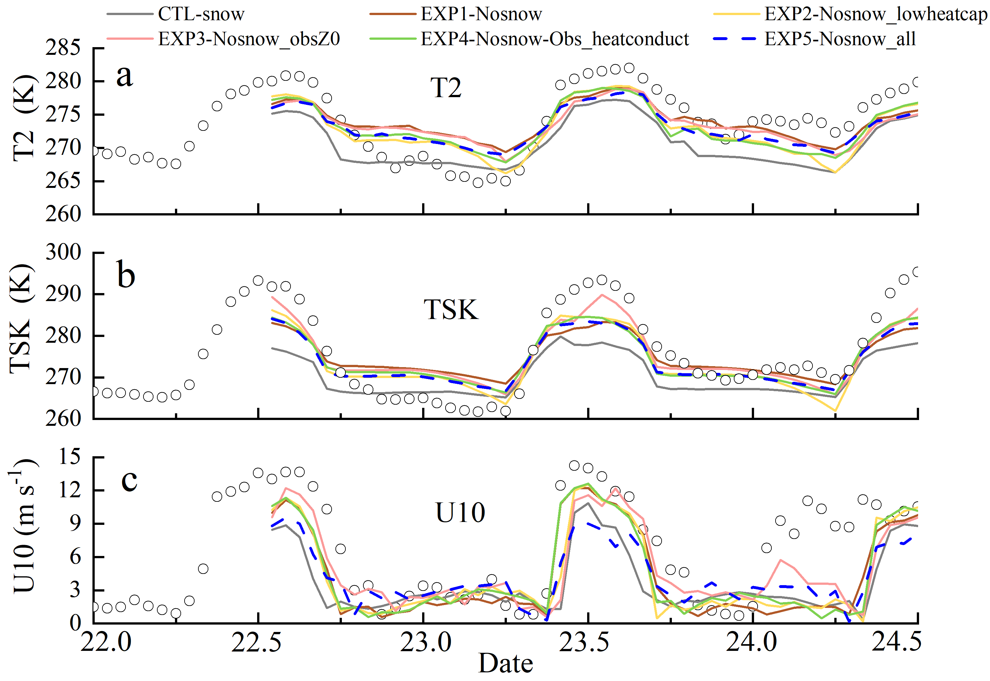
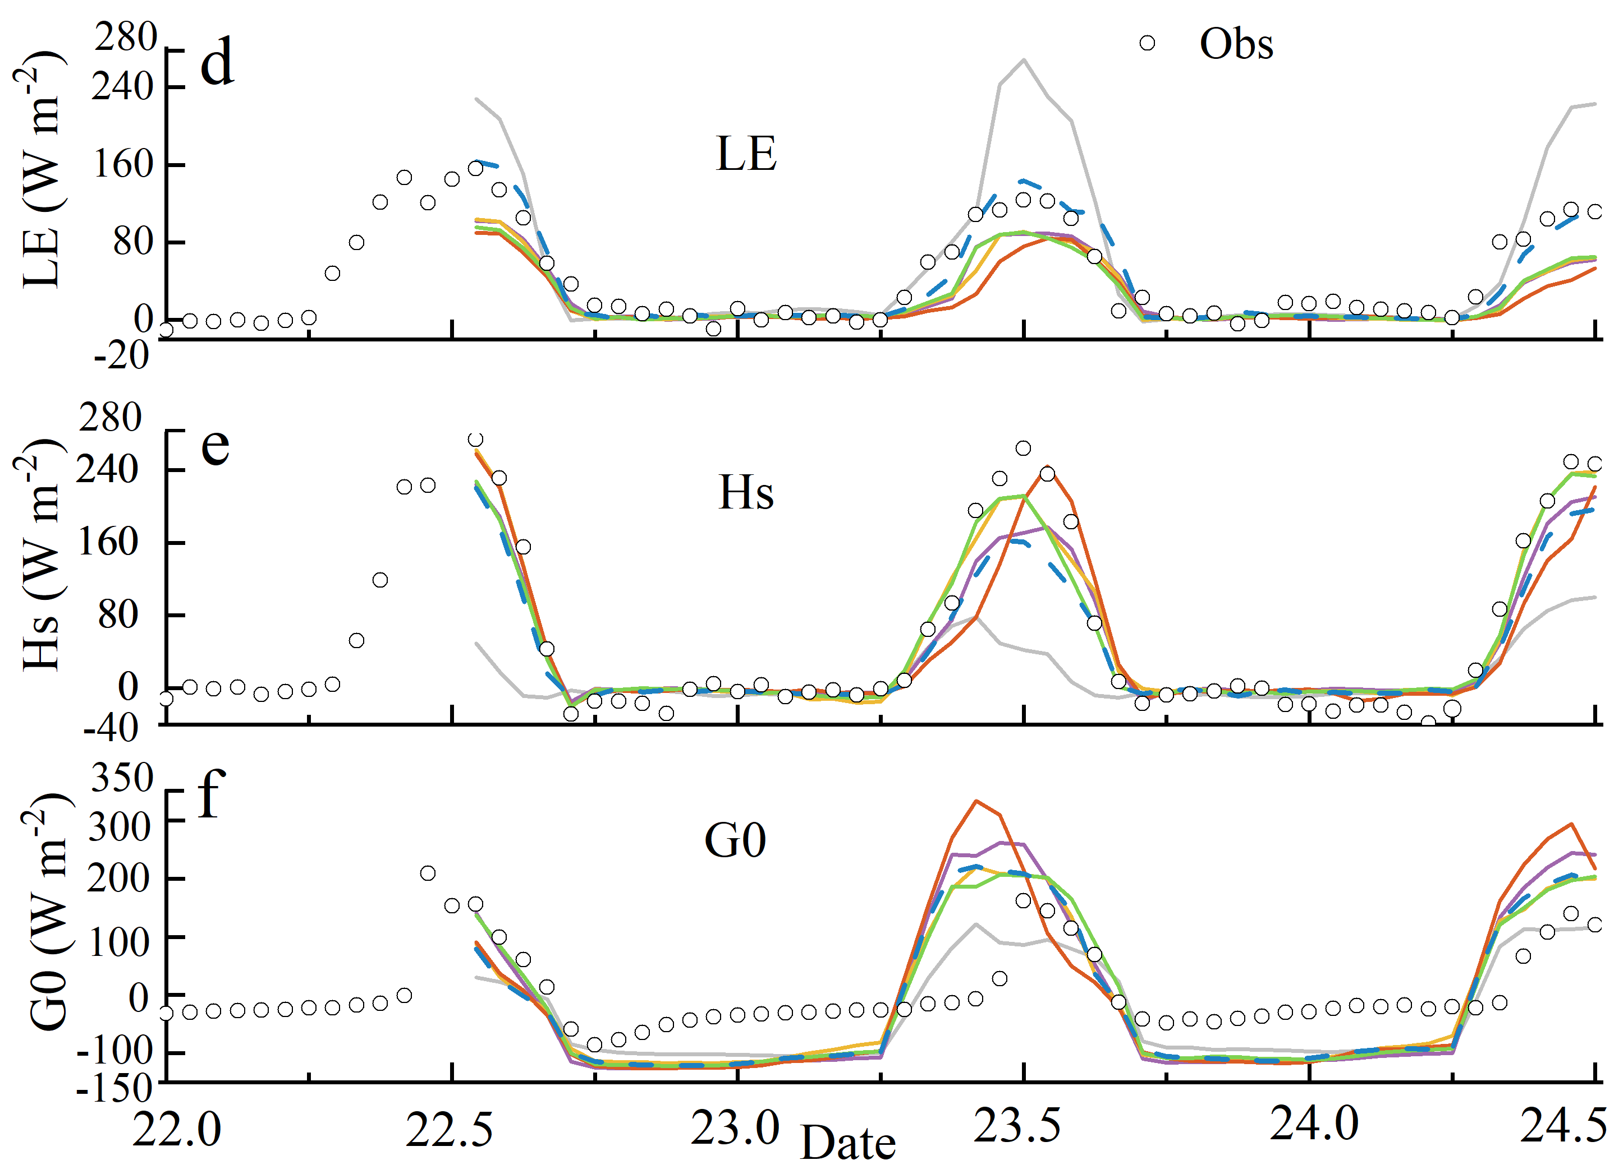
Impacts of augmentations
24.5=1200 24th Oct (LST) 22.0=0000 22th Oct (LST)
Hourly time evolution of different meteorological variables of simulations and observations

Slide 7
Statistics RMSEs of simulated surface meteorological variables

Slide 8
Amplification Strategy for the sensitivity tests
Para. | Reference | Values
K | 1.0 (Mult. factor) | X 0.5 (Mult. factor)
 | 1.0 | X 1.5 (Mult. factor)
λ | 1.0 (Mult. factor) | X 0.5 (Mult. factor)
 | 1.0 | X 1.5 (Mult. factor)
CO₂ | 380 ppmv | 50 ppmv
 |  | 1500 ppmv
Notes:
K represents the change in mixing in both surface and boundary layer, λ represents the soil heat conductivity and therefore the coupling, and CO₂ represents the amount of CO₂ in ppmv and thus also the incoming long-wave radiation.

Slide 9
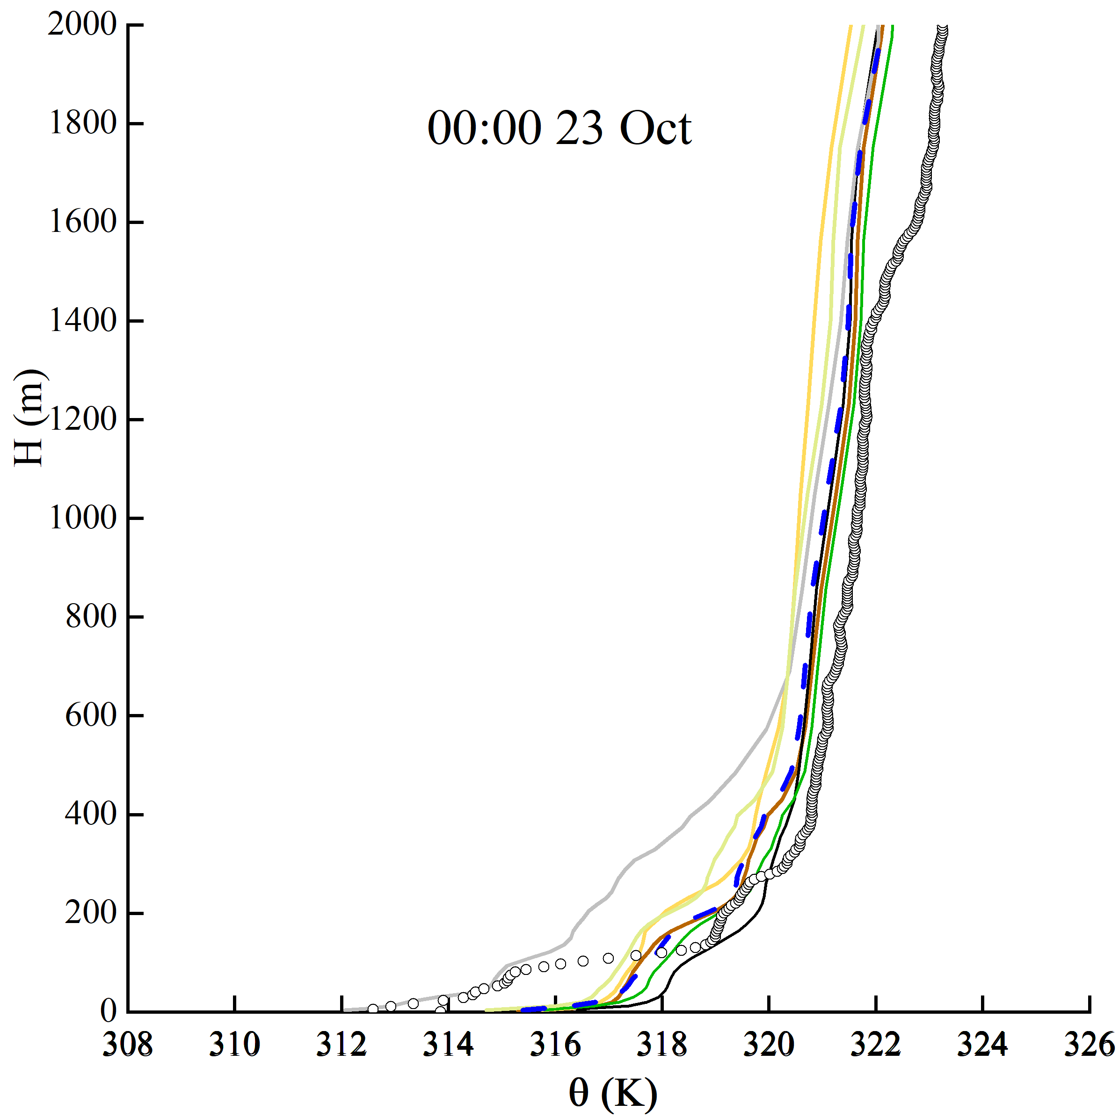
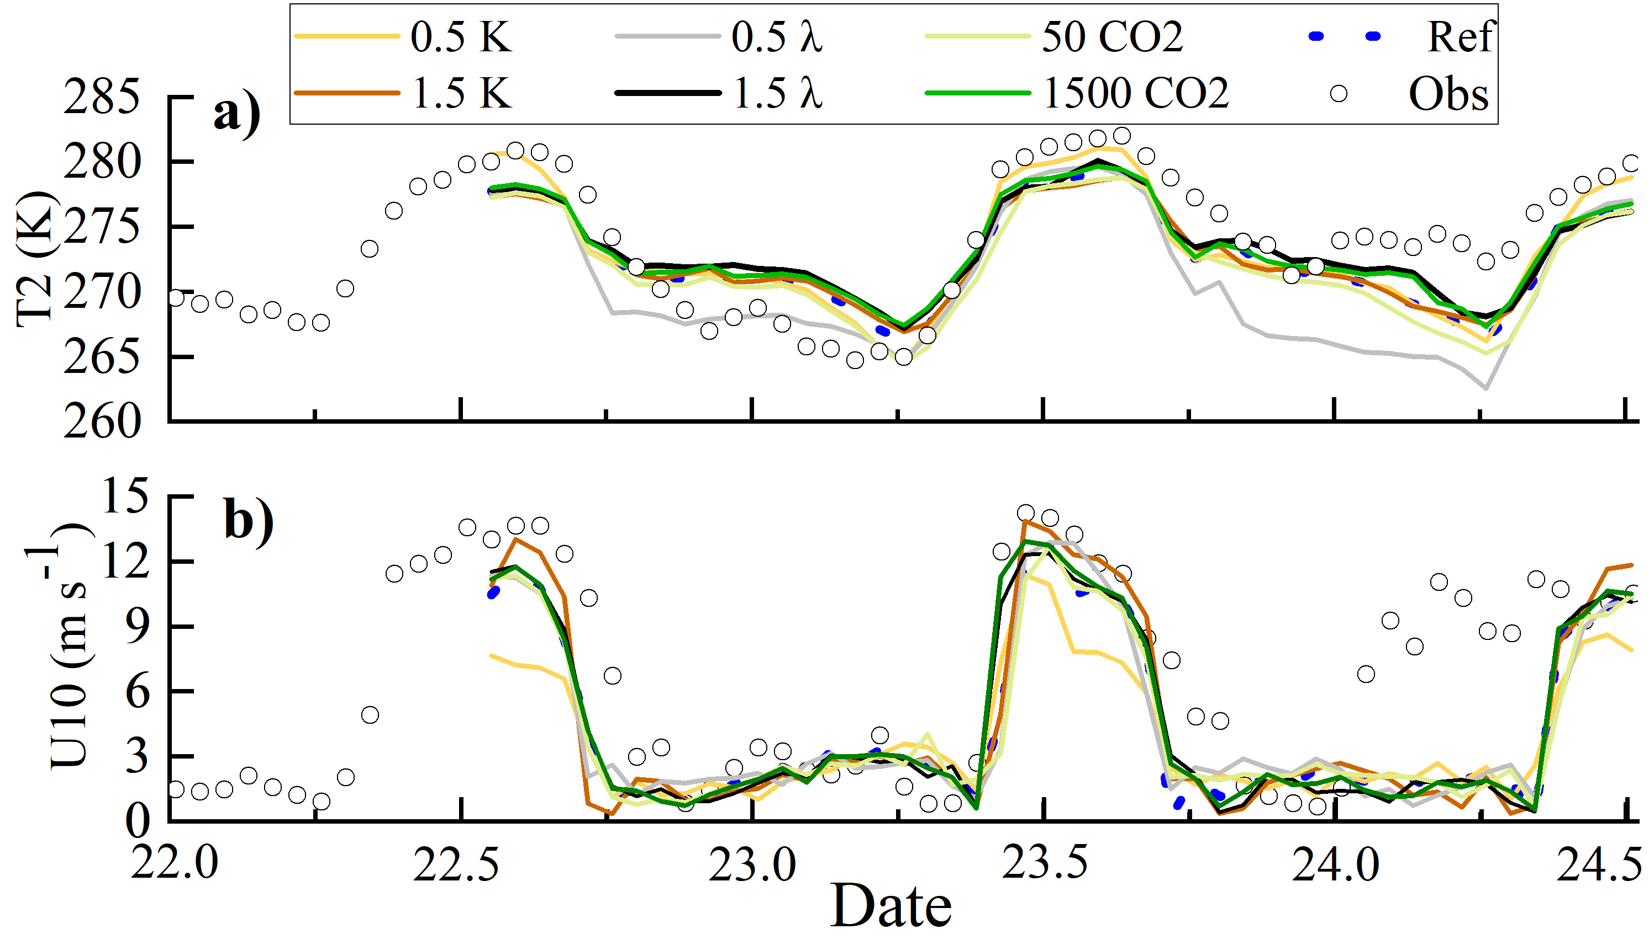
Time series & profile of modelled and observed for variables
Modelled and observed vertical structure of the potential temperature θ , the wind speed at 10m for (a–b) and vertical structure of potential temperature at 0000 23th October 2019 (after 24h simulation)

Slide 10
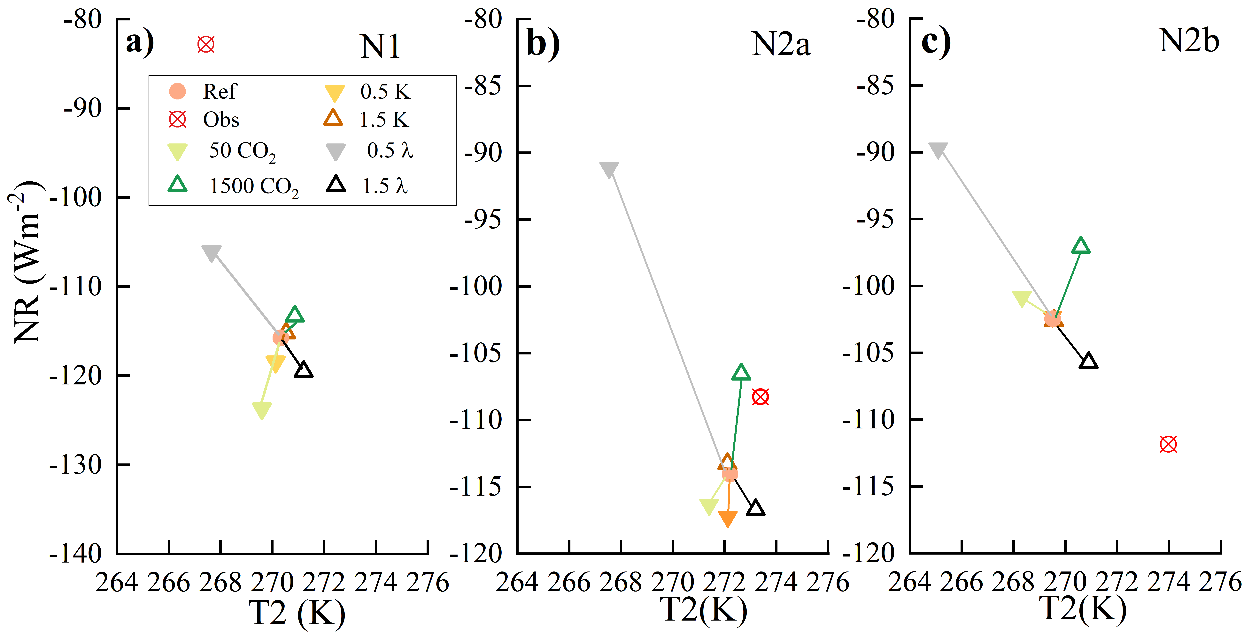
Process diagrams: longwave radiation
Average 10h (1900-0500 LST) for N1, 5h (1900-0000 LST) for N2a, and 5h (0000-0500 LST) for N2b

Slide 11
CONCLUSION
3D-WRF are able to reproduce the gross features of the observed SBL.
The influence degree of surface properties disturbance on the simulation results of different physical quantities
Process diagrams depict model sensitivity to uncertainties in model representations, and as such may assist in implementing model improvements

Slide 12
Additional materials

Slide 13
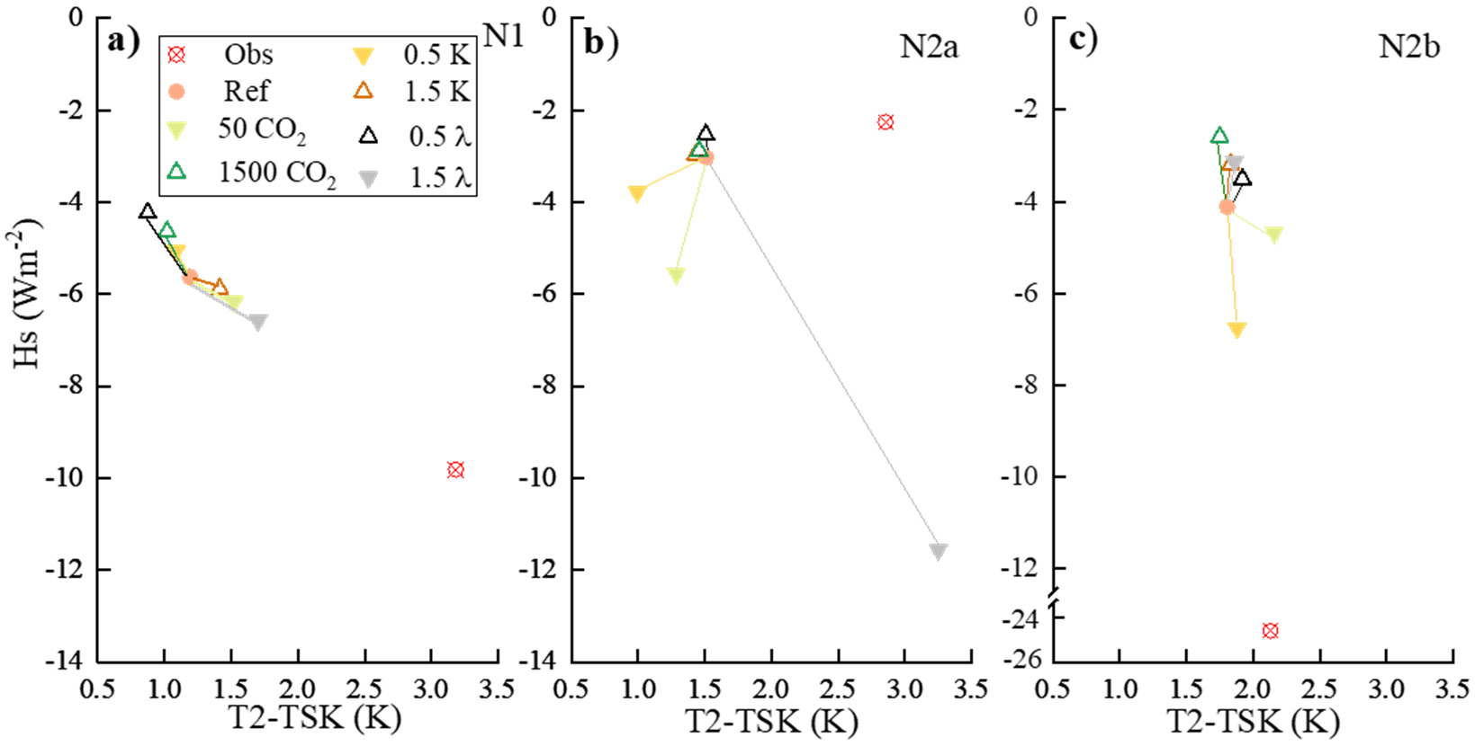
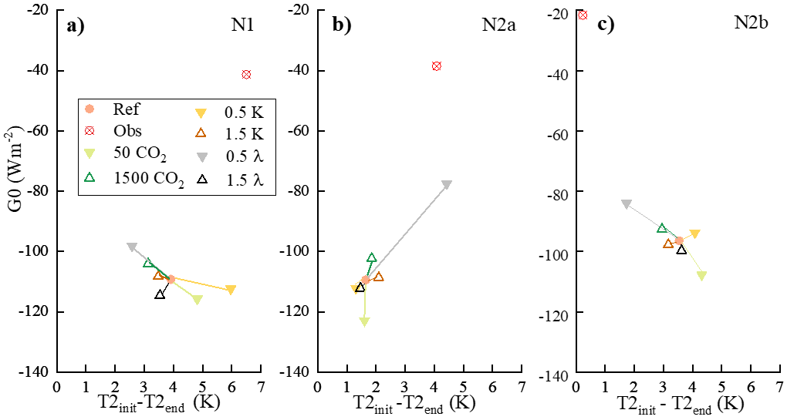
Long wave radiation
Turbulent mixing
Land-air coupling
Process diagrams
Average 10h (1900-0500 LST) for N1, 5h (1900-0000 LST) for N2a, and 5h (0000-0500 LST) for N2b

Slide 14
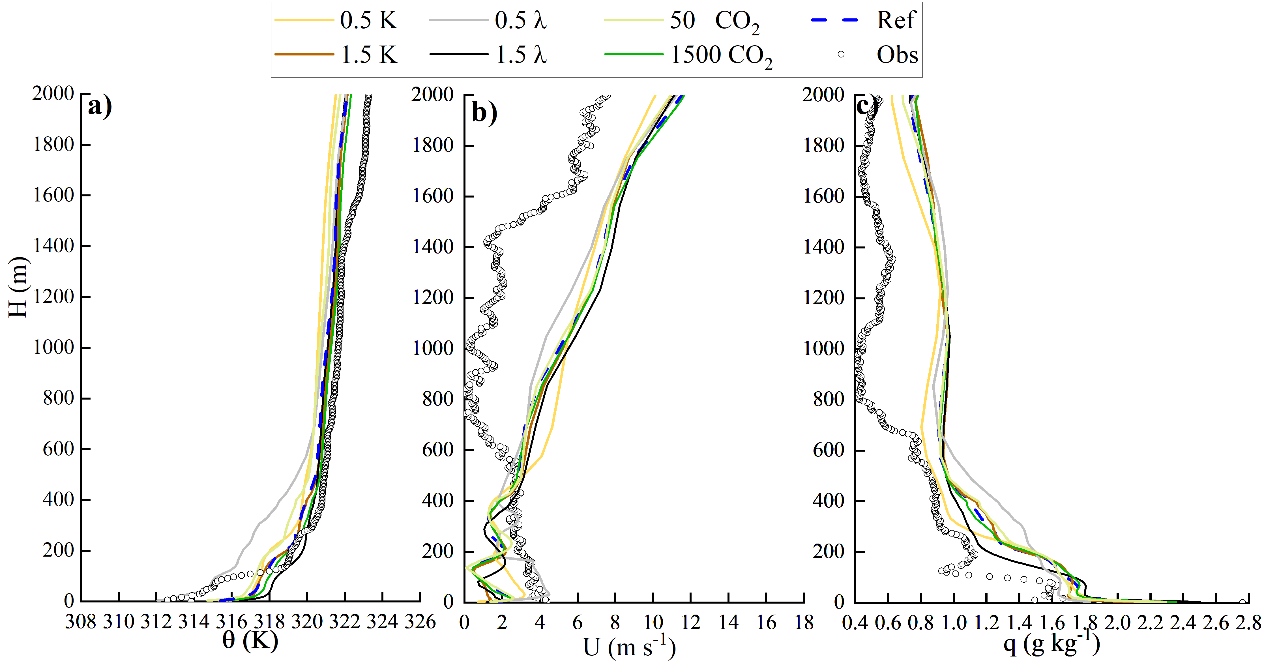
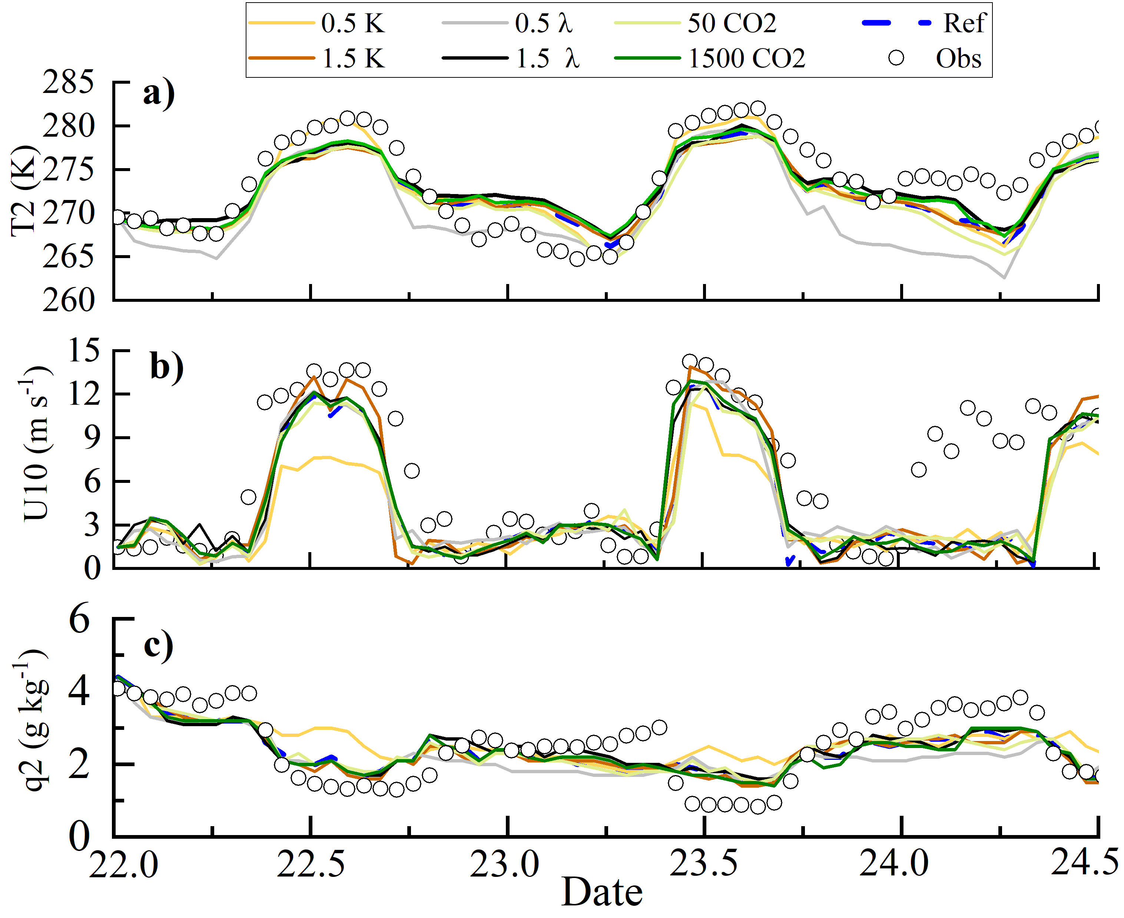
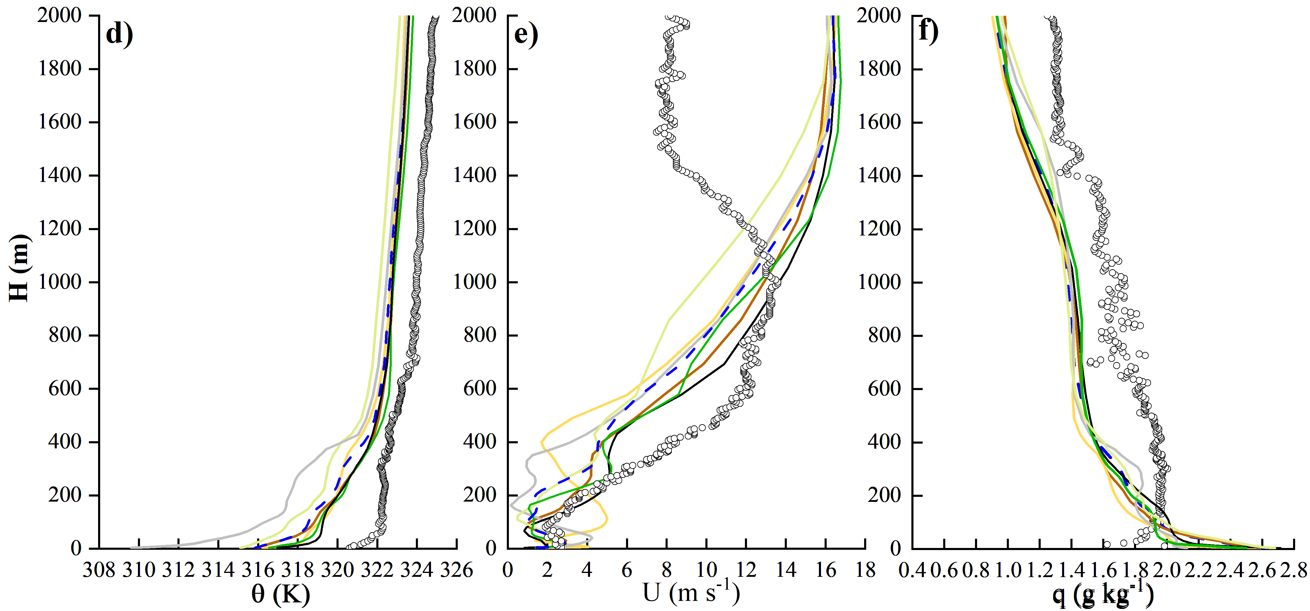
Time series & profile of modelled and observed for variables
00:00 23 Oct
00:00 24 Oct

Slide 15
Details of the Model Configuration Used in the WRF Simulations
WRF | V4.14
Vertical sigma levels | 65, 21 levels (<2km), Hmin=3.2m
Forcing condition | 0.11°×0.11° ，6h (ECWMF, Operational Model Analysis）
Grid size and Resolution | 101×101（25km）, 101×101（5km）, 89×89（1km）
Land surface option | Noah land surface
Cumulus parameterization | WSM 3
Shortwave radiation | RRTMG
Longwave radiation | RRTMG
Cumulus parameterization | Grell–Devenyi scheme in Domain 1 and 2 and no scheme in Domain 3
Surface layer physics | MYNN， Yang‘s Schemes (iz0tland=2) :
PBL schemes | MYNN2.5
Modelled Period | 60 hrs (spin up 13 hrs)

Slide 16
Statistics MAEs & RMSEs of simulated surface meteorological variables
 | MAE
 | Hs | LE | G0 | TSK | T2 | U10 | Q2 | T5cm | W5cm
CTL | 51.47 | 28.89 | 134.04 | 6.82 | 4.13 | 3.71 | 0.116 | 4.09 | 0.12
EXP1 | 20.95 | 18.76 | 174.68 | 5.43 | 3.08 | 2.78 | 0.07 | 1.84 | 0.07
EXP2 | 16.22 | 20.00 | 74.08 | 4.68 | 2.95 | 2.94 | 0.07 | 2.84 | 0.07
EXP3 | 23.04 | 23.32 | 94.20 | 4.43 | 3.31 | 2.46 | 0.07 | 2.32 | 0.07
EXP4 | 16.45 | 19.11 | 74.38 | 4.87 | 3.07 | 2.90 | 0.07 | 2.67 | 0.07
EXP5 | 25.17 | 13.92 | 78.38 | 5.00 | 3.14 | 3.36 | 0.07 | 2.34 | 0.08
 | RMSE
 | Hs | LE | G0 | TSK | T2 | U10 | Q2 | T5cm | W5cm
CTL | 84.12 | 47.99 | 143.97 | 8.27 | 4.54 | 4.79 | 0.62 | 5.00 | 0.11
EXP1 | 28.57 | 25.30 | 194.33 | 6.42 | 3.41 | 3.81 | 0.20 | 2.47 | 0.06
EXP2 | 20.87 | 26.56 | 84.18 | 5.38 | 3.27 | 4.16 | 0.20 | 3.61 | 0.06
EXP3 | 35.30 | 33.00 | 113.98 | 5.00 | 3.60 | 3.48 | 0.20 | 2.94 | 0.06
EXP4 | 22.31 | 25.21 | 83.28 | 5.62 | 3.31 | 3.99 | 0.20 | 3.34 | 0.06
EXP5 | 36.04 | 18.73 | 89.09 | 5.81 | 3.33 | 4.09 | 0.32 | 3.15 | 0.08
Minimal values in every test variable column are marked as the bold
Notes:
Table 5-6 list the statistical mean absolute error (MAE) and root-mean square error (RMSE) . Clearly, the simulations with the original scheme in WRF are significantly improved by implementing the updated scheme.
The impact of the augmentations made to WRF-3D model structure on the simulated these variables is illustrated by Figure 4.

