Slide 1






Detecting Microseismicity in Jammu and Kashmir Himalaya Using Template Matching Technique
Ayon Ghosh¹, Blaž Vičič², Supriyo Mitra¹, Keith Priestley³, and Sunil Kumar Wanchoo⁴
¹Department of Earth Sciences, Indian Institute of Science Education and Research Kolkata, India
²Quantectum AG, Pfäffikon, Switzerland
³Bullard Laboratories, University of Cambridge, UK
⁴Department of Physics, Shri Mata Vaishno Devi University, Katra, India

Slide 2
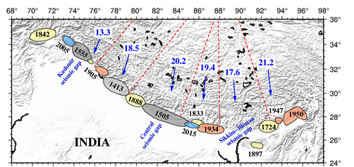
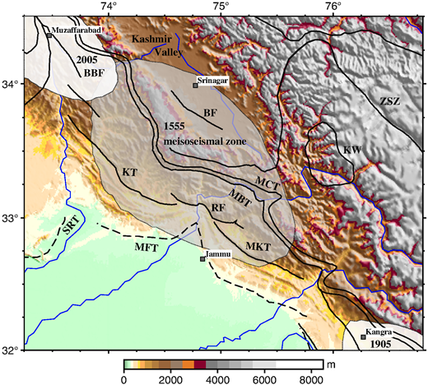
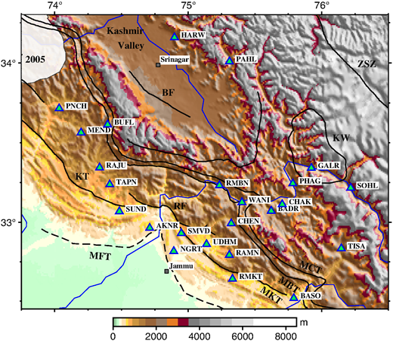
Motivation and Objectives:
Major Earthquakes and rupture area in the Himalayan Collision Zone
The Kashmir Seismic Gap
Earthquake detection & (re)location to
(a) model locked-to-creep transition on MHT
(b) evaluate the seismotectonics of the region
JAKSNET Stations operated by IISER-K, Cambridge University and SMVDU (Sharma et al. 2020).

Slide 3
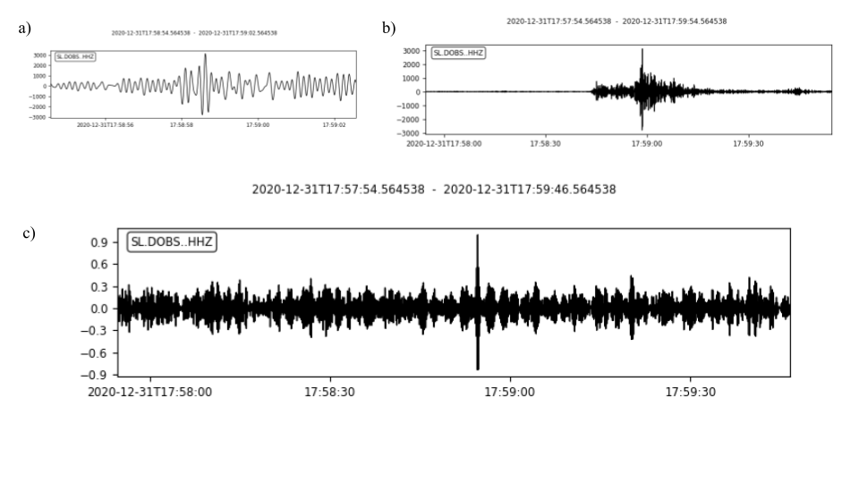

Matched Filter Detection
Cross-correlation, an efficient tool to detect similar signals from a continuous data.
Earthquakes originated from nearby locations are expected to generate similar signal at same stations.
[Vuan et al. 2018]

Slide 4
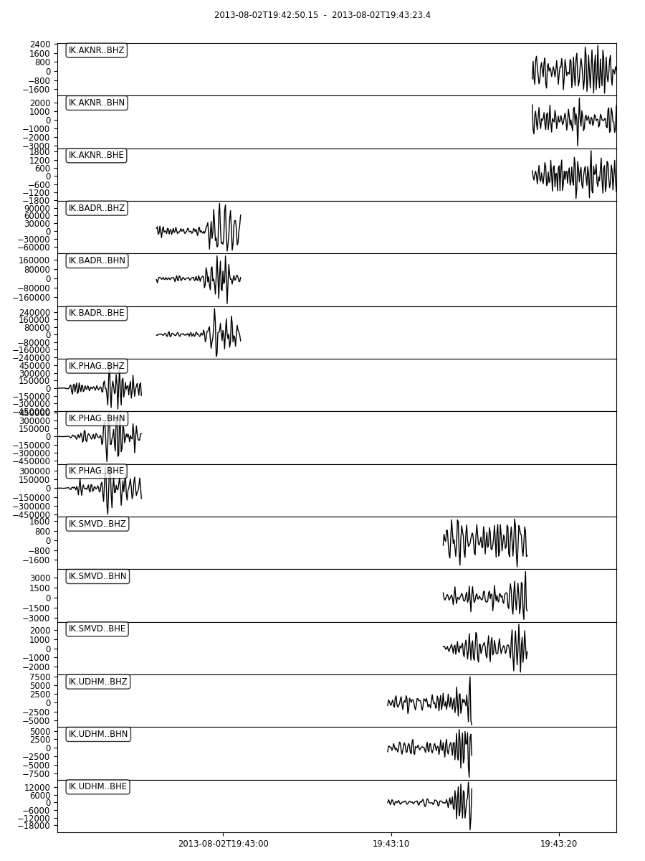
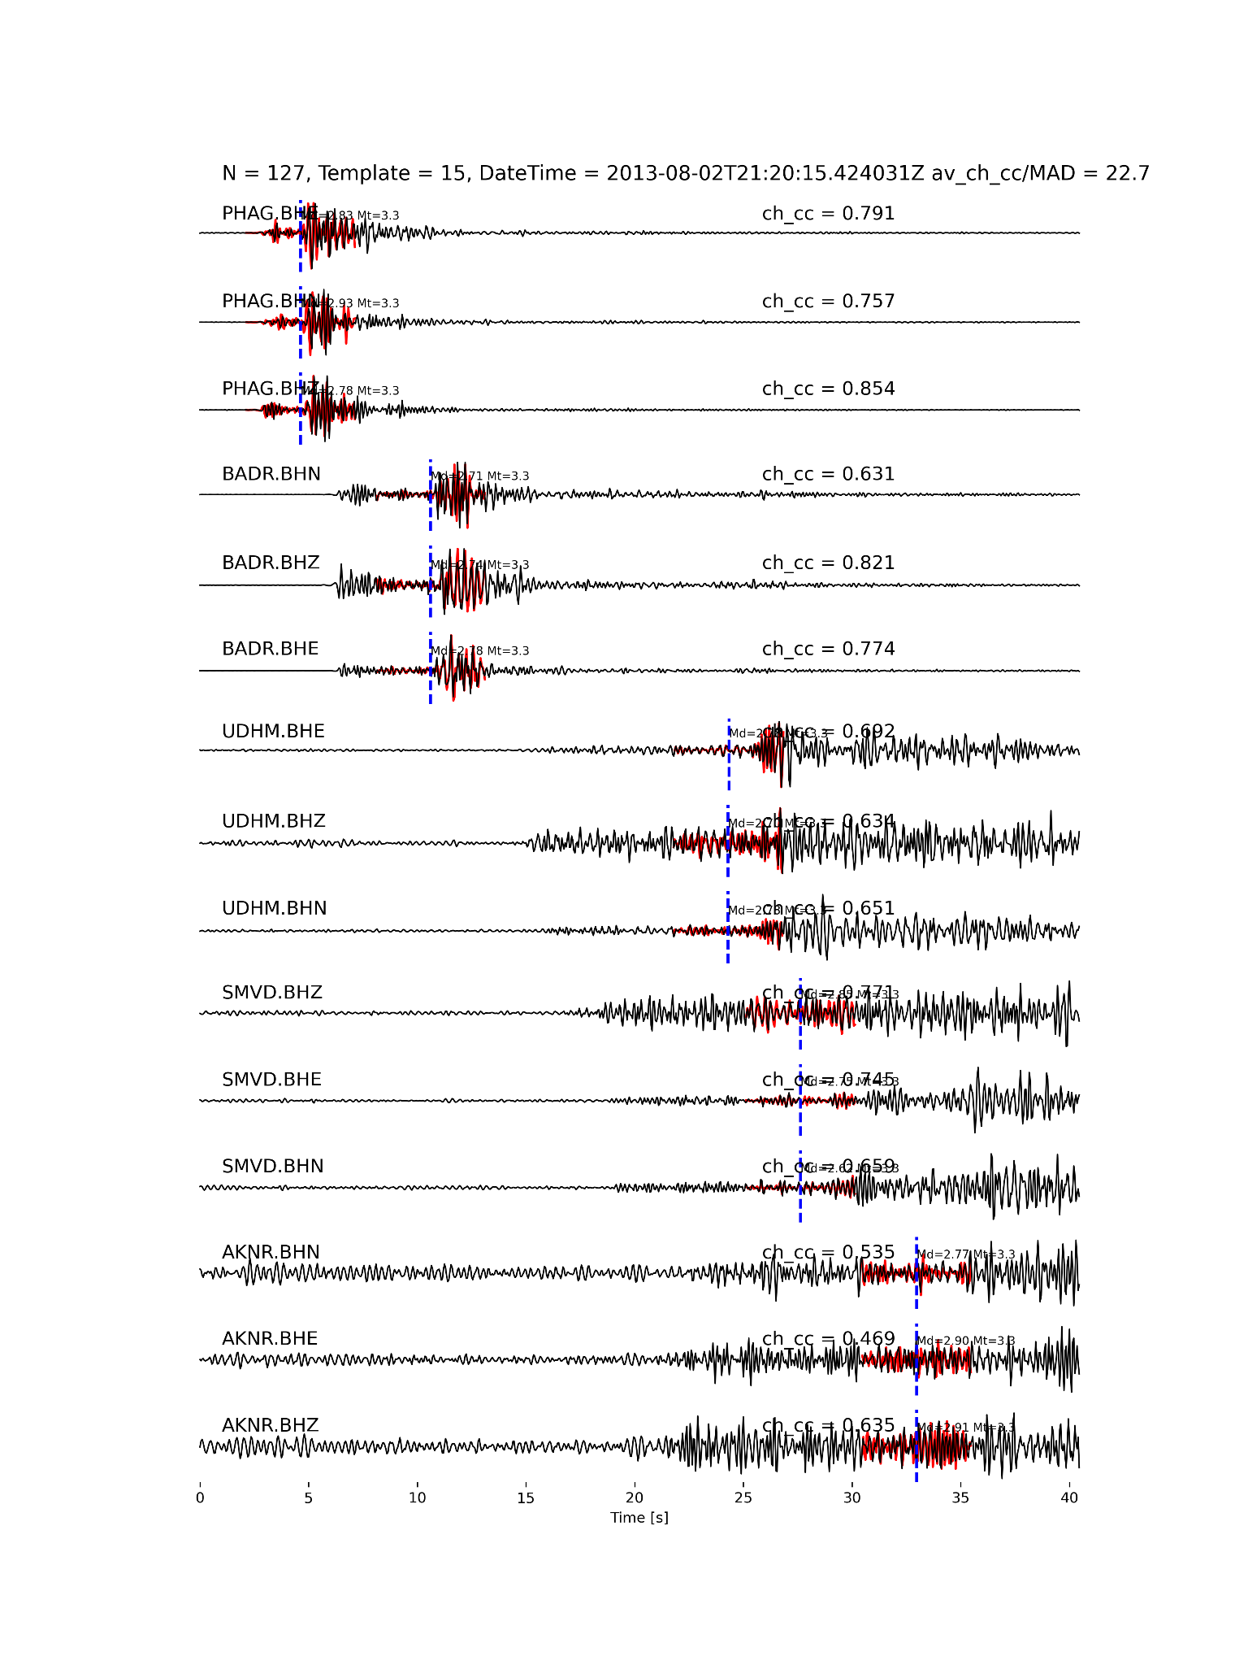
Matched Filter Detection
Templates for the 2nd August earthquake:
A new detected event:
2.5 seconds before and after s-arrival

Slide 5
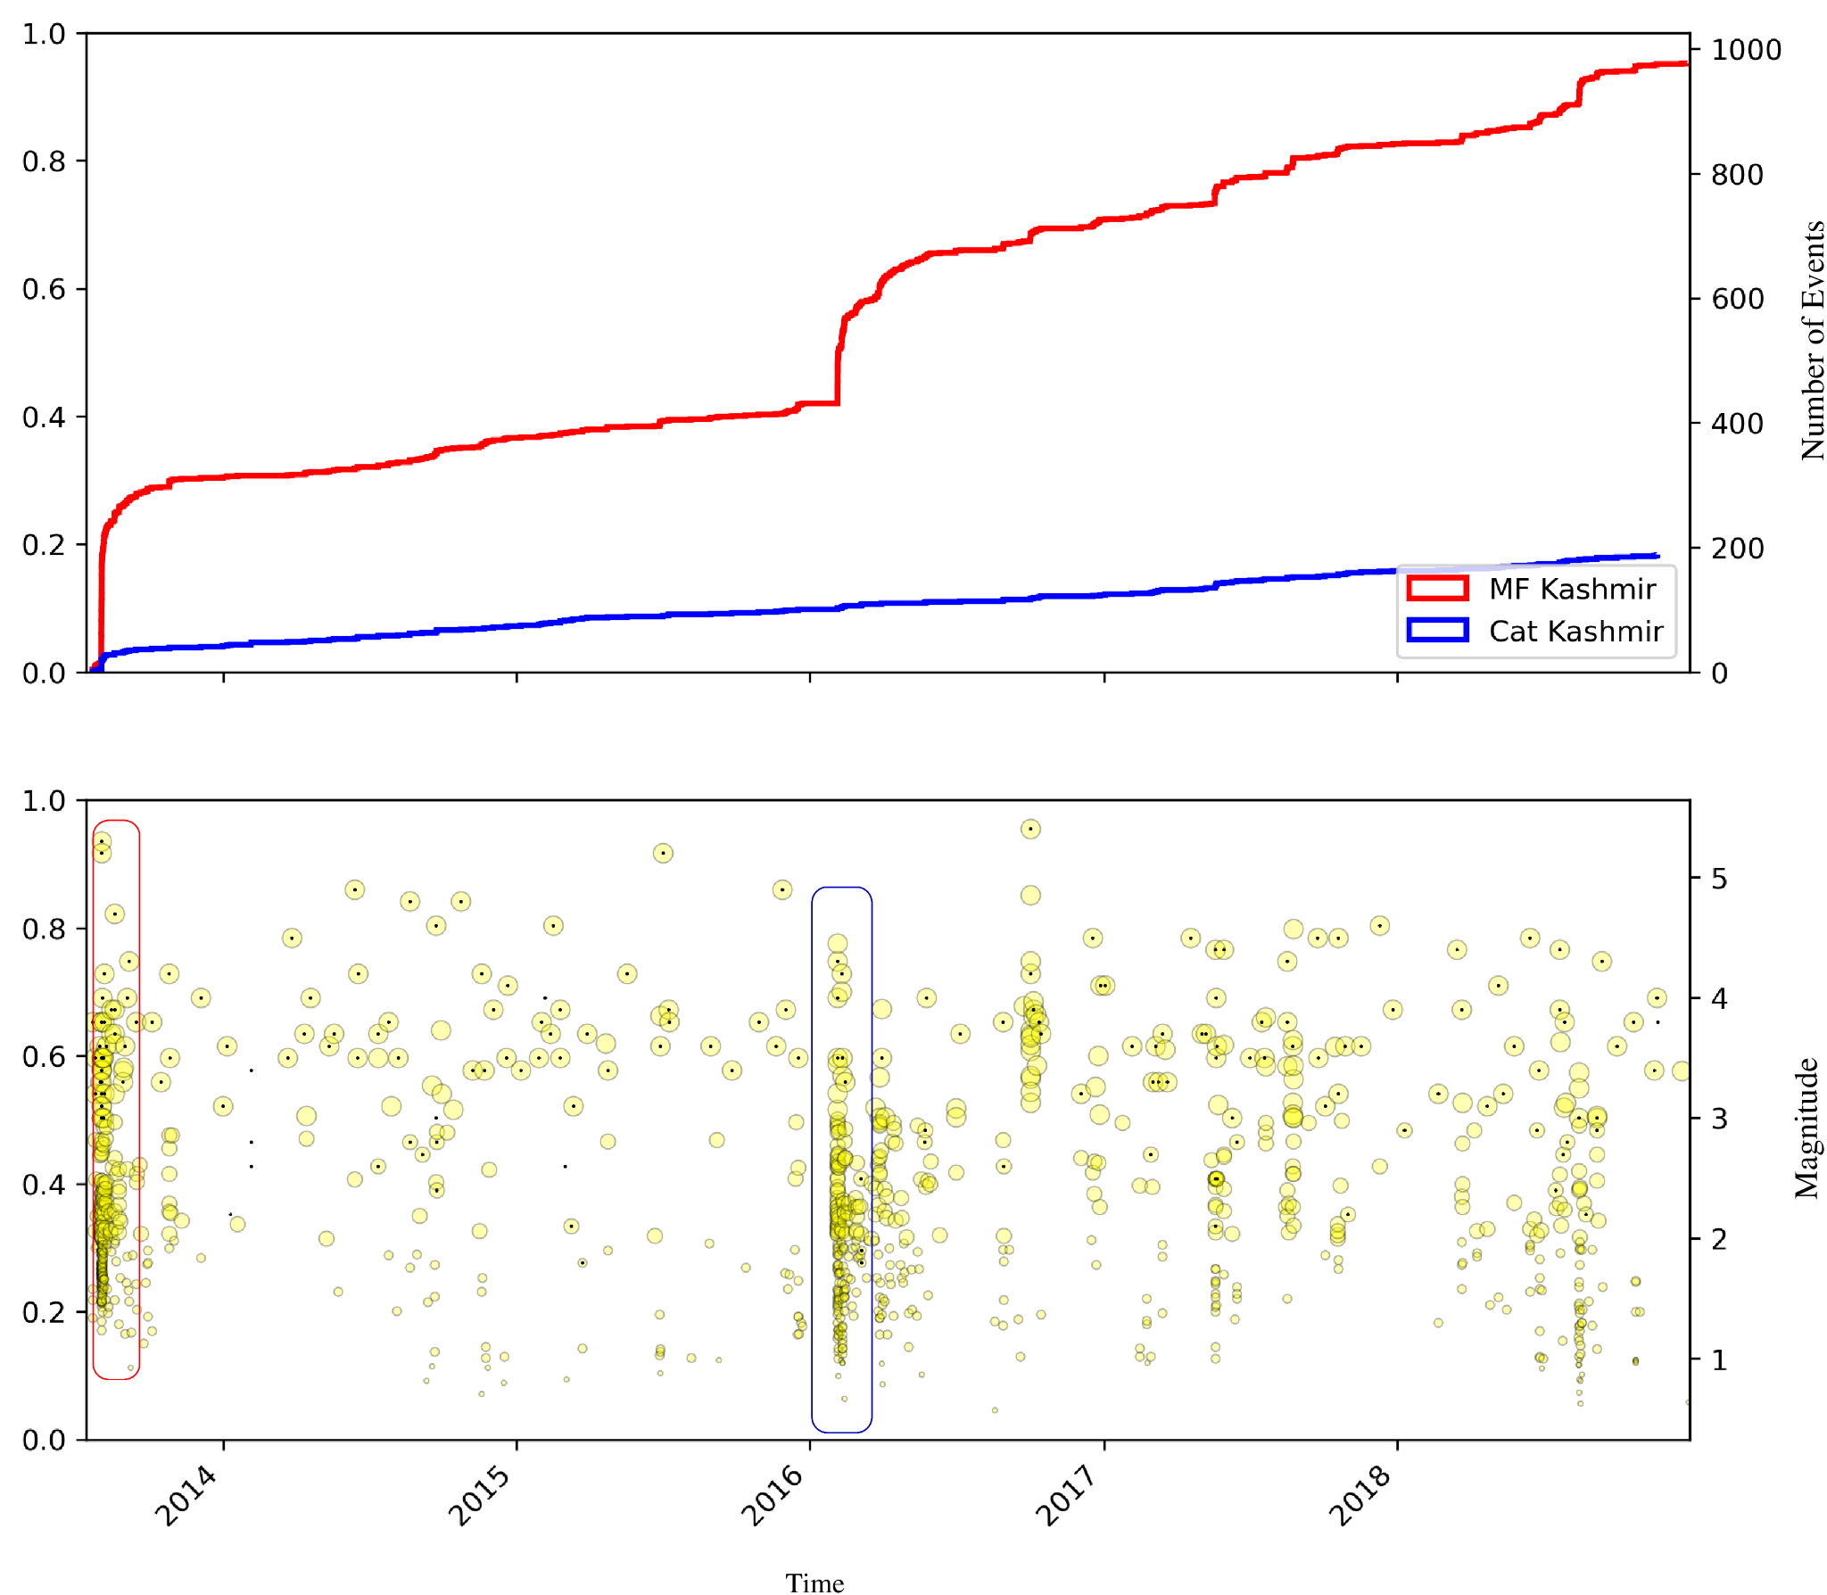
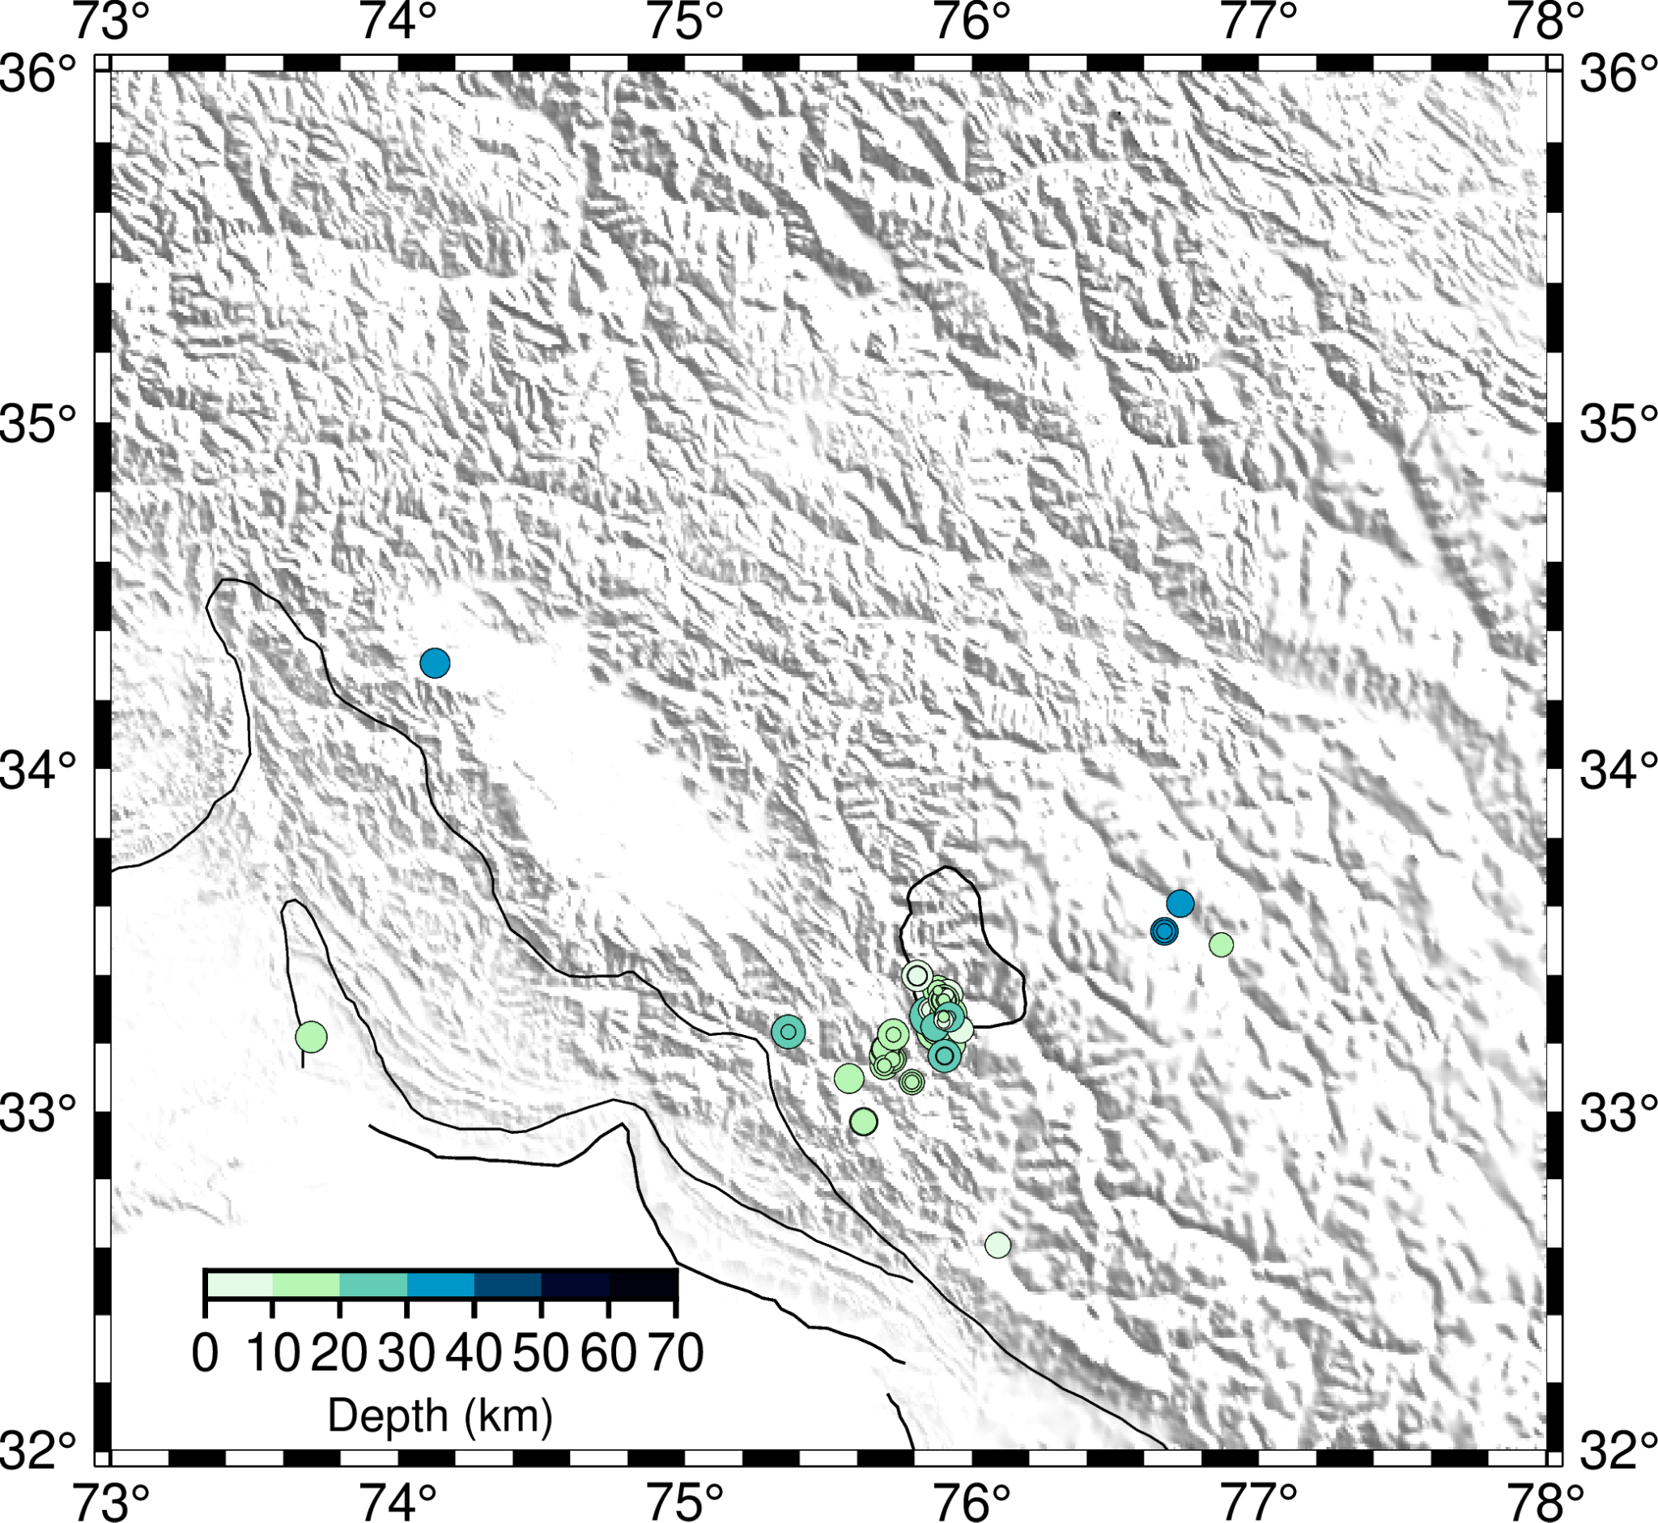
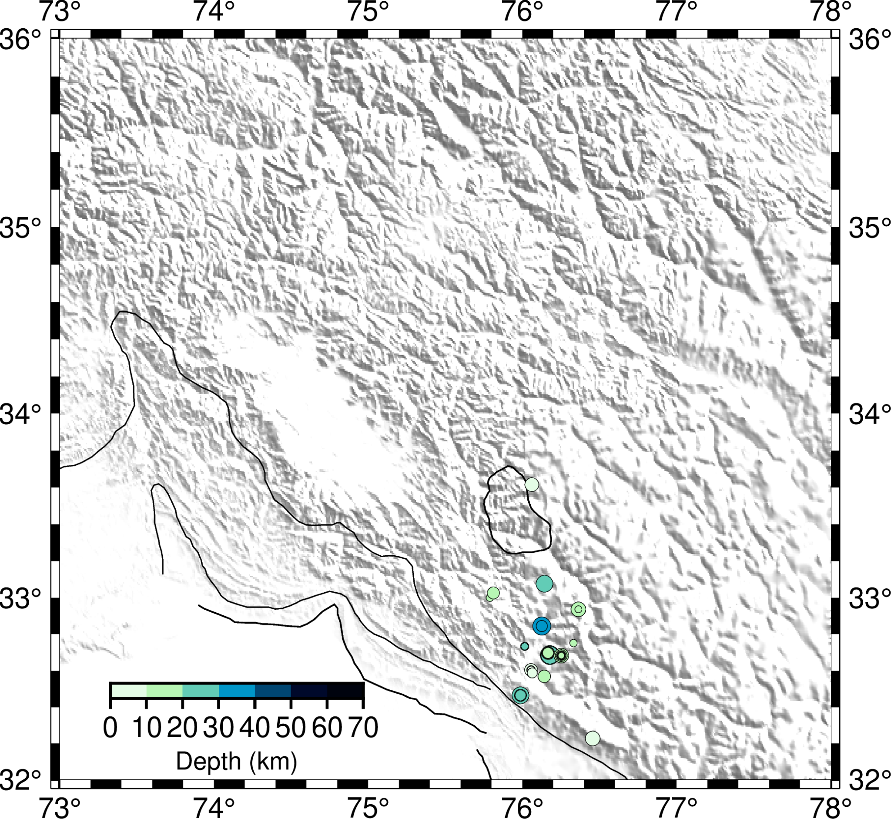
Results:
A total of 935 events are detected, a 5-fold increase in the number of events.
Two distinct bursts of seismicity are observed in the middle of 2013 and the start of 2016.
2013
2016

Slide 6
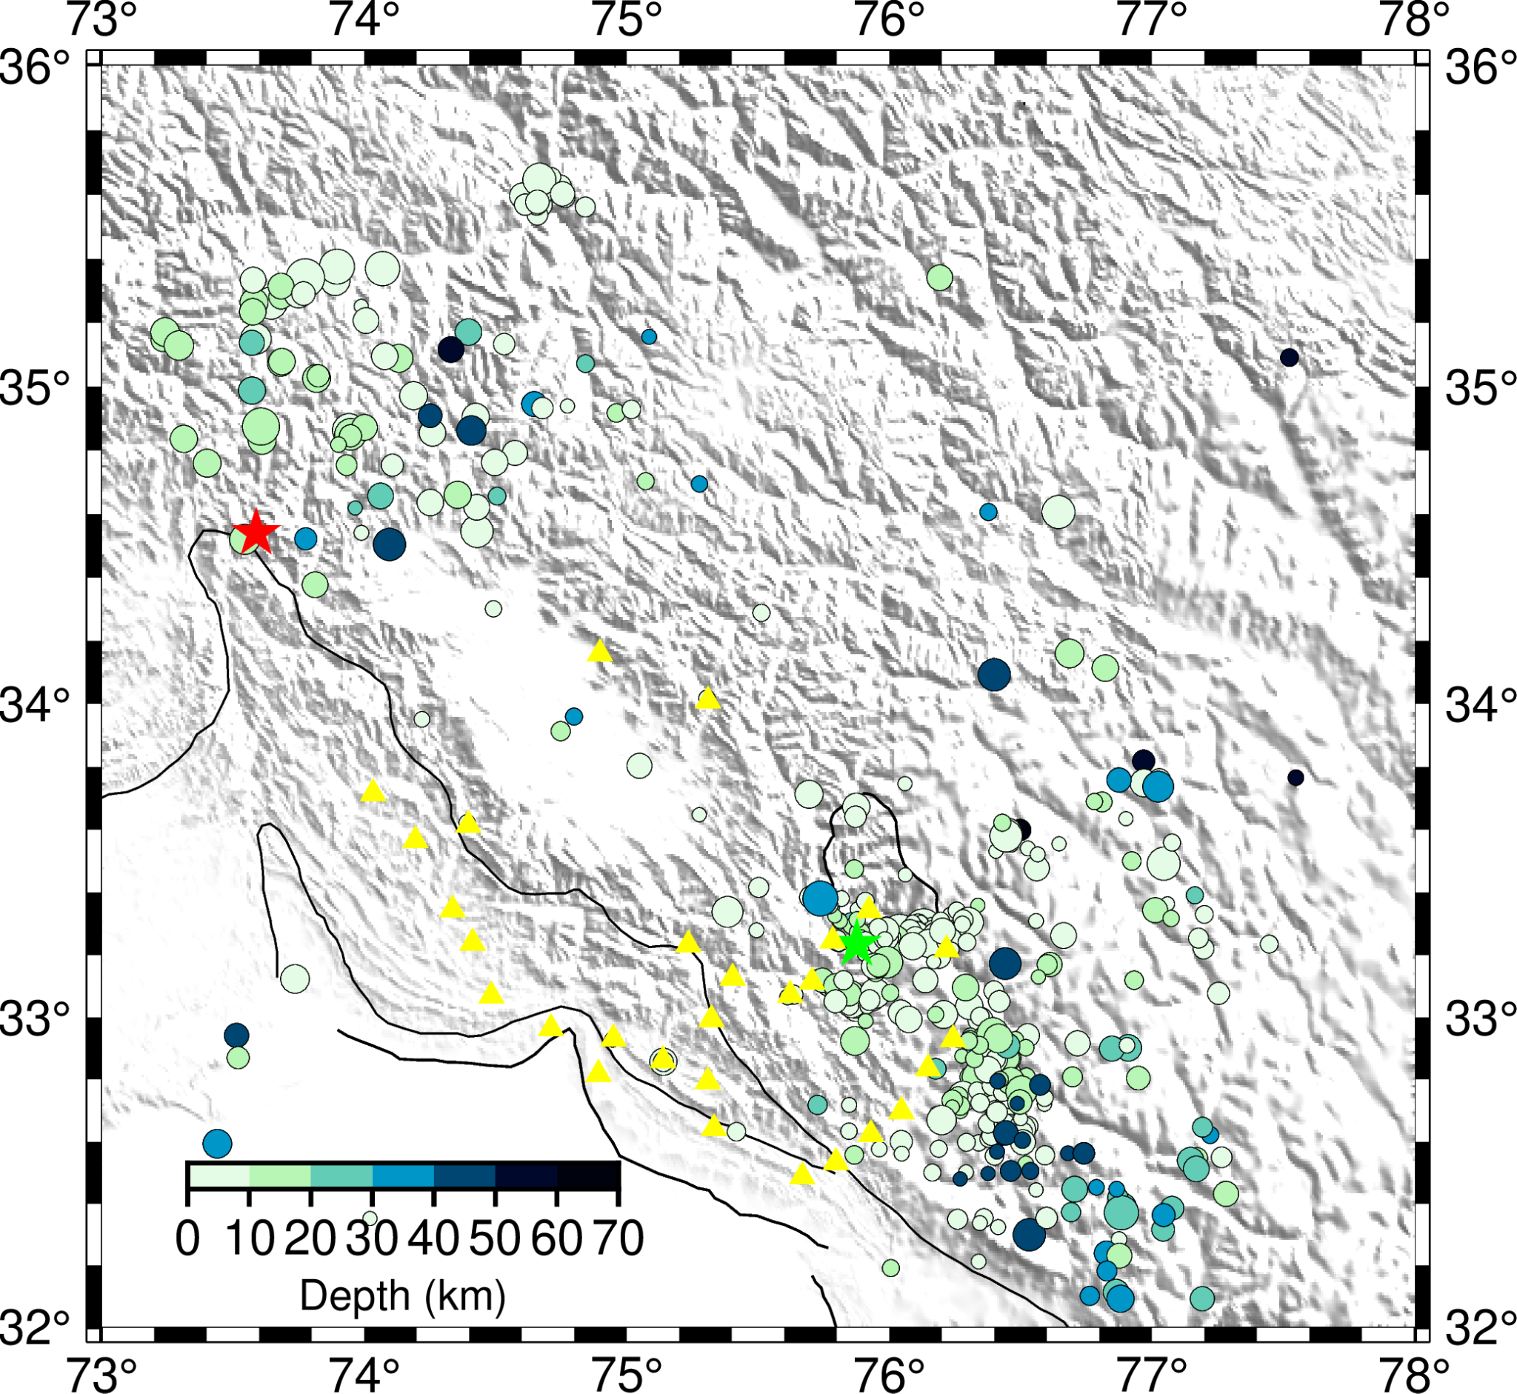
Probabilistic Relocation of the detected events:
After relocating 506 events using NonLinLoc (Lomax et al. 2000), this is the overall distribution of earthquakes in this region.
These earthquakes are clustered underneath the Higher Himalayas in the Jammu-Kishtwar segment.
Similar clusters are observed beneath the NW syntaxis surrounding the 2005 earthquake epicentral zone.
Very few earthquakes beneath the Kashmir Basin, where the MHT appears to be fully locked and accumulating stress.
NW Syntaxis
Kashmir Basin
Jammu-Kishtwar Segment
Red Star: 2005 Kashmir earthquake Green Star: 2013 Kishtwar Earthquake

Slide 7
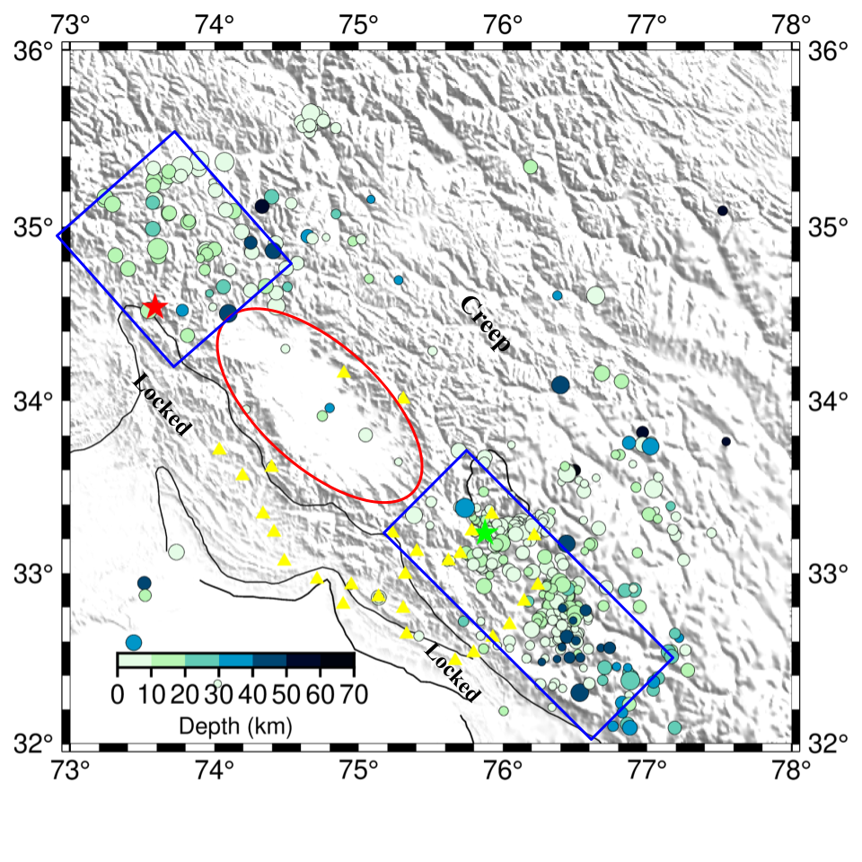
Summary:
A total of 935 small-to-moderate events are detected with two clear sequences in 2013 and 2016.
Locked-to-creep transition zone beneath the Higher Himalaya in Kishtwar & NW syntaxis
Absence of small-to-moderate earthquakes beneath the Kashmir Basin → Fully locked and accumulating stress.
NW Syntaxis
Kashmir Basin
Future Work:
Jammu-Kishtwar Segment
Obtain a more detailed catalog of this region and understand the seismotectonics.
Put them in a MFT search and look at the evolution and migration of seismicity.

Slide 8
Acknowledgement
GMT 6: Wessel, P., Luis, J. F., Uieda, L., Scharroo, R., Wobbe, F., Smith, W. H. F., & Tian, D. (2019). The Generic Mapping Tools version 6. Geochemistry, Geophysics, Geosystems, 20, 5556–5564.
SEISMIC ANALYSIS CODE [11/11/2013 (Version 101.6a)] (Goldstein et al., 2013)
We acknowledge Royal Society, DST-INSPIRE and IISER Kolkata for funding this research.
References:
Sharma, S., S. Mitra, S. Sharma, K. Priestley, S. K. Wanchoo, D. Powali, and L. Ali (2020). A Report on Broadband Seismological Experiment in the Jammu and Kashmir Himalaya (JAKSNET), Seismol. Res. Lett. 91, 1915–1926, doi: 10.1785/0220190389
Lomax, A., J. Virieux, P. Volant and C. Berge, 2000. Probabilistic earthquake location in 3D and layered models: Introduction of a Metropolis-Gibbs method and comparison with linear locations, in Advances in Seismic Event Location Thurber, C.H., and N. Rabinowitz (eds.), Kluwer, Amsterdam, 101-134..
Alessandro Vuan, Monica Sugan, Giorgio Amati, Aitaro Kato; Improving the Detection of Low‐Magnitude Seismicity Preceding the Mw 6.3 L’Aquila Earthquake: Development of a Scalable Code Based on the Cross Correlation of Template Earthquakes. Bulletin of the Seismological Society of America 2018;; 108 (1): 471–480. doi: https://doi.org/10.1785/0120170106
Questions, Suggestions?? Feel free to ask and don’t hesitate to write to me at
ayon.8181@gmail.com & ag17ms077@iiserkol.ac.in

