Slide 1



In the context of climate change, how do farmers change their practices or not, why, and with what consequences on water fluxes? Insights from the Rhine Valley (France, Germany, Switzerland)
Gaël Bohnert, Brice Martin, CRESAT, Université de Haute Alsace
EGU general assembly 2022

Slide 2
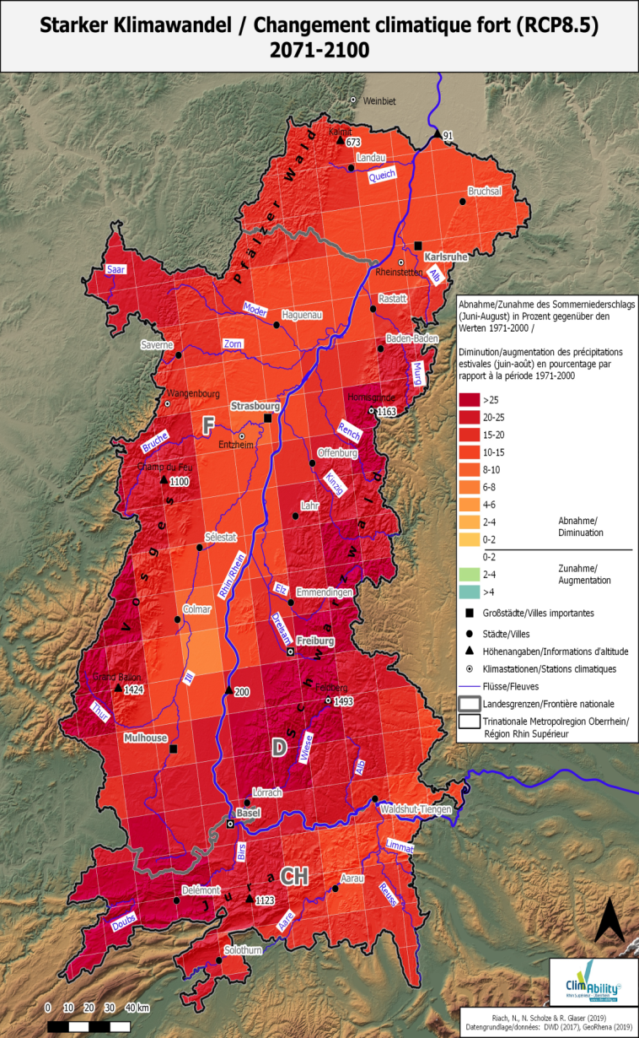
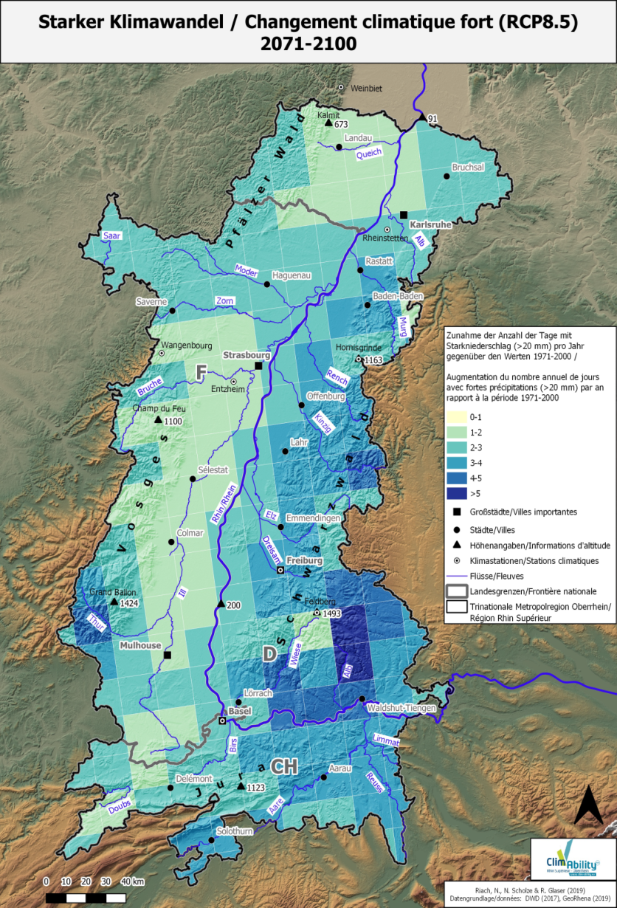
Important change in precipitations through the year
Decrease in summer precipitations
Increase in heavy rains events

Slide 3
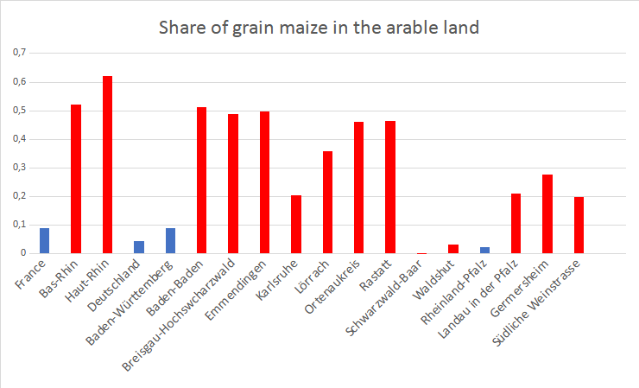
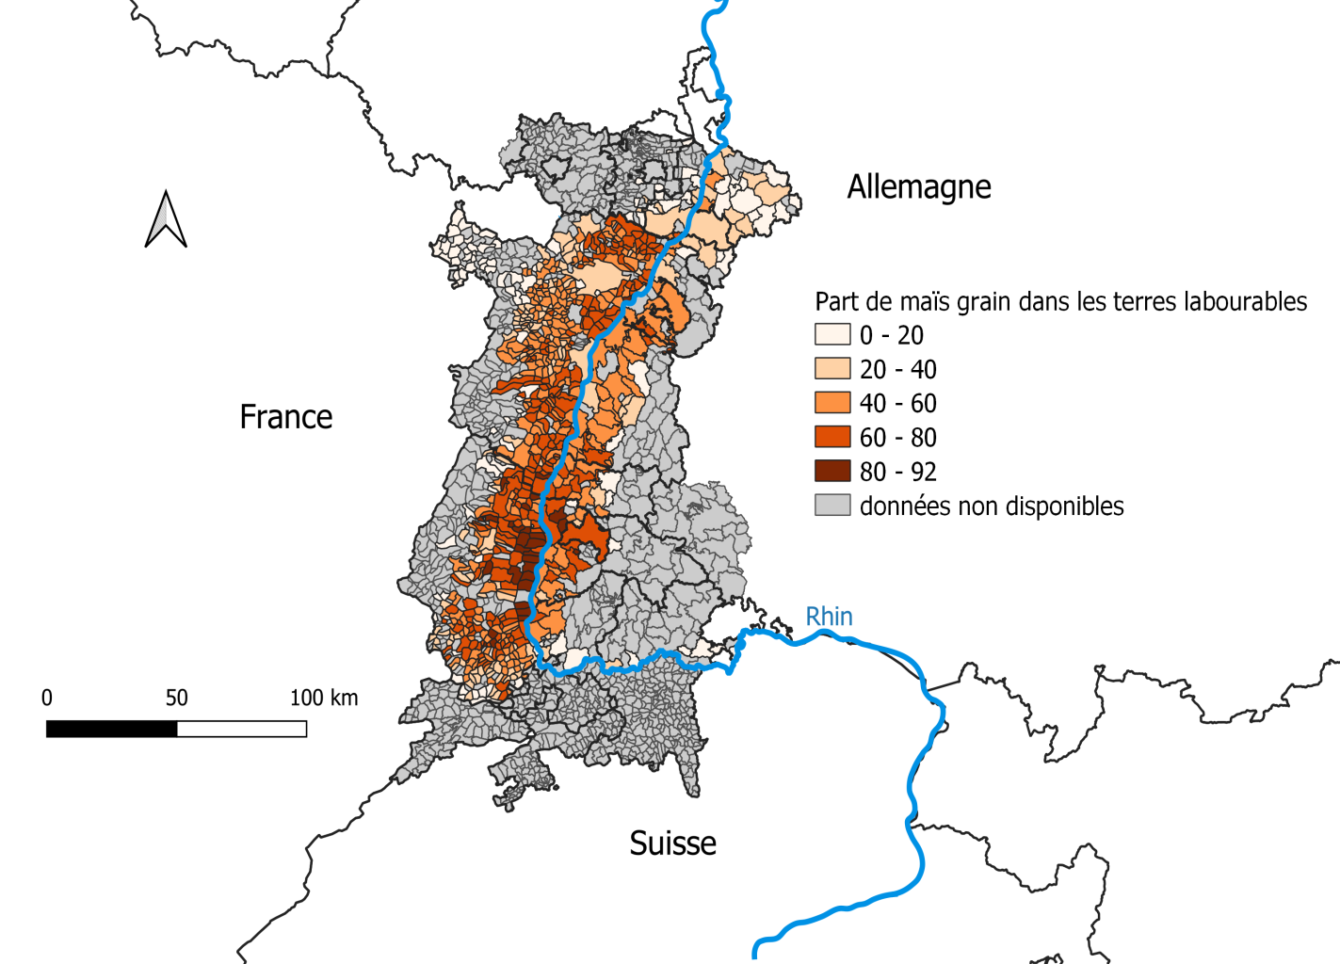
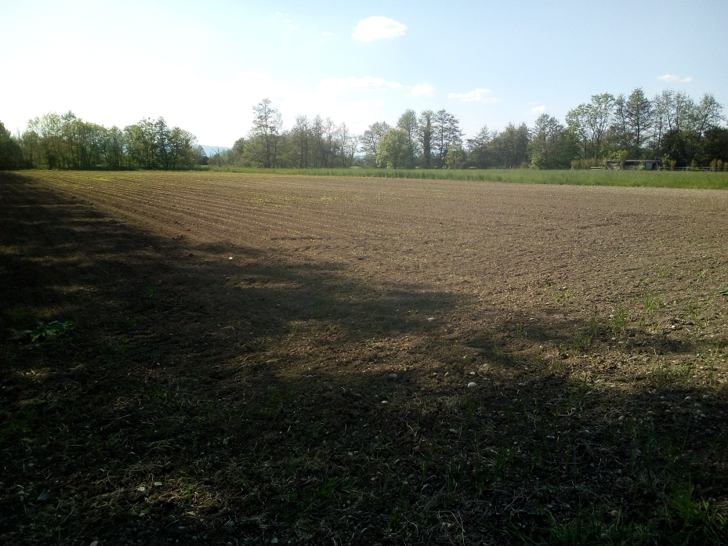
Sensitive crops : maize
Source: Agreste, Statistisches Bundesamt, Statistisches Landesamet Baden-Württemberg, Statistisches Landesamt Rheinland-Pfalz
Share of grain maize in arable land
Poor soil covering
Gaël Bohnert (CRESAT)
Gaël Bohnert (CRESAT)

Slide 4
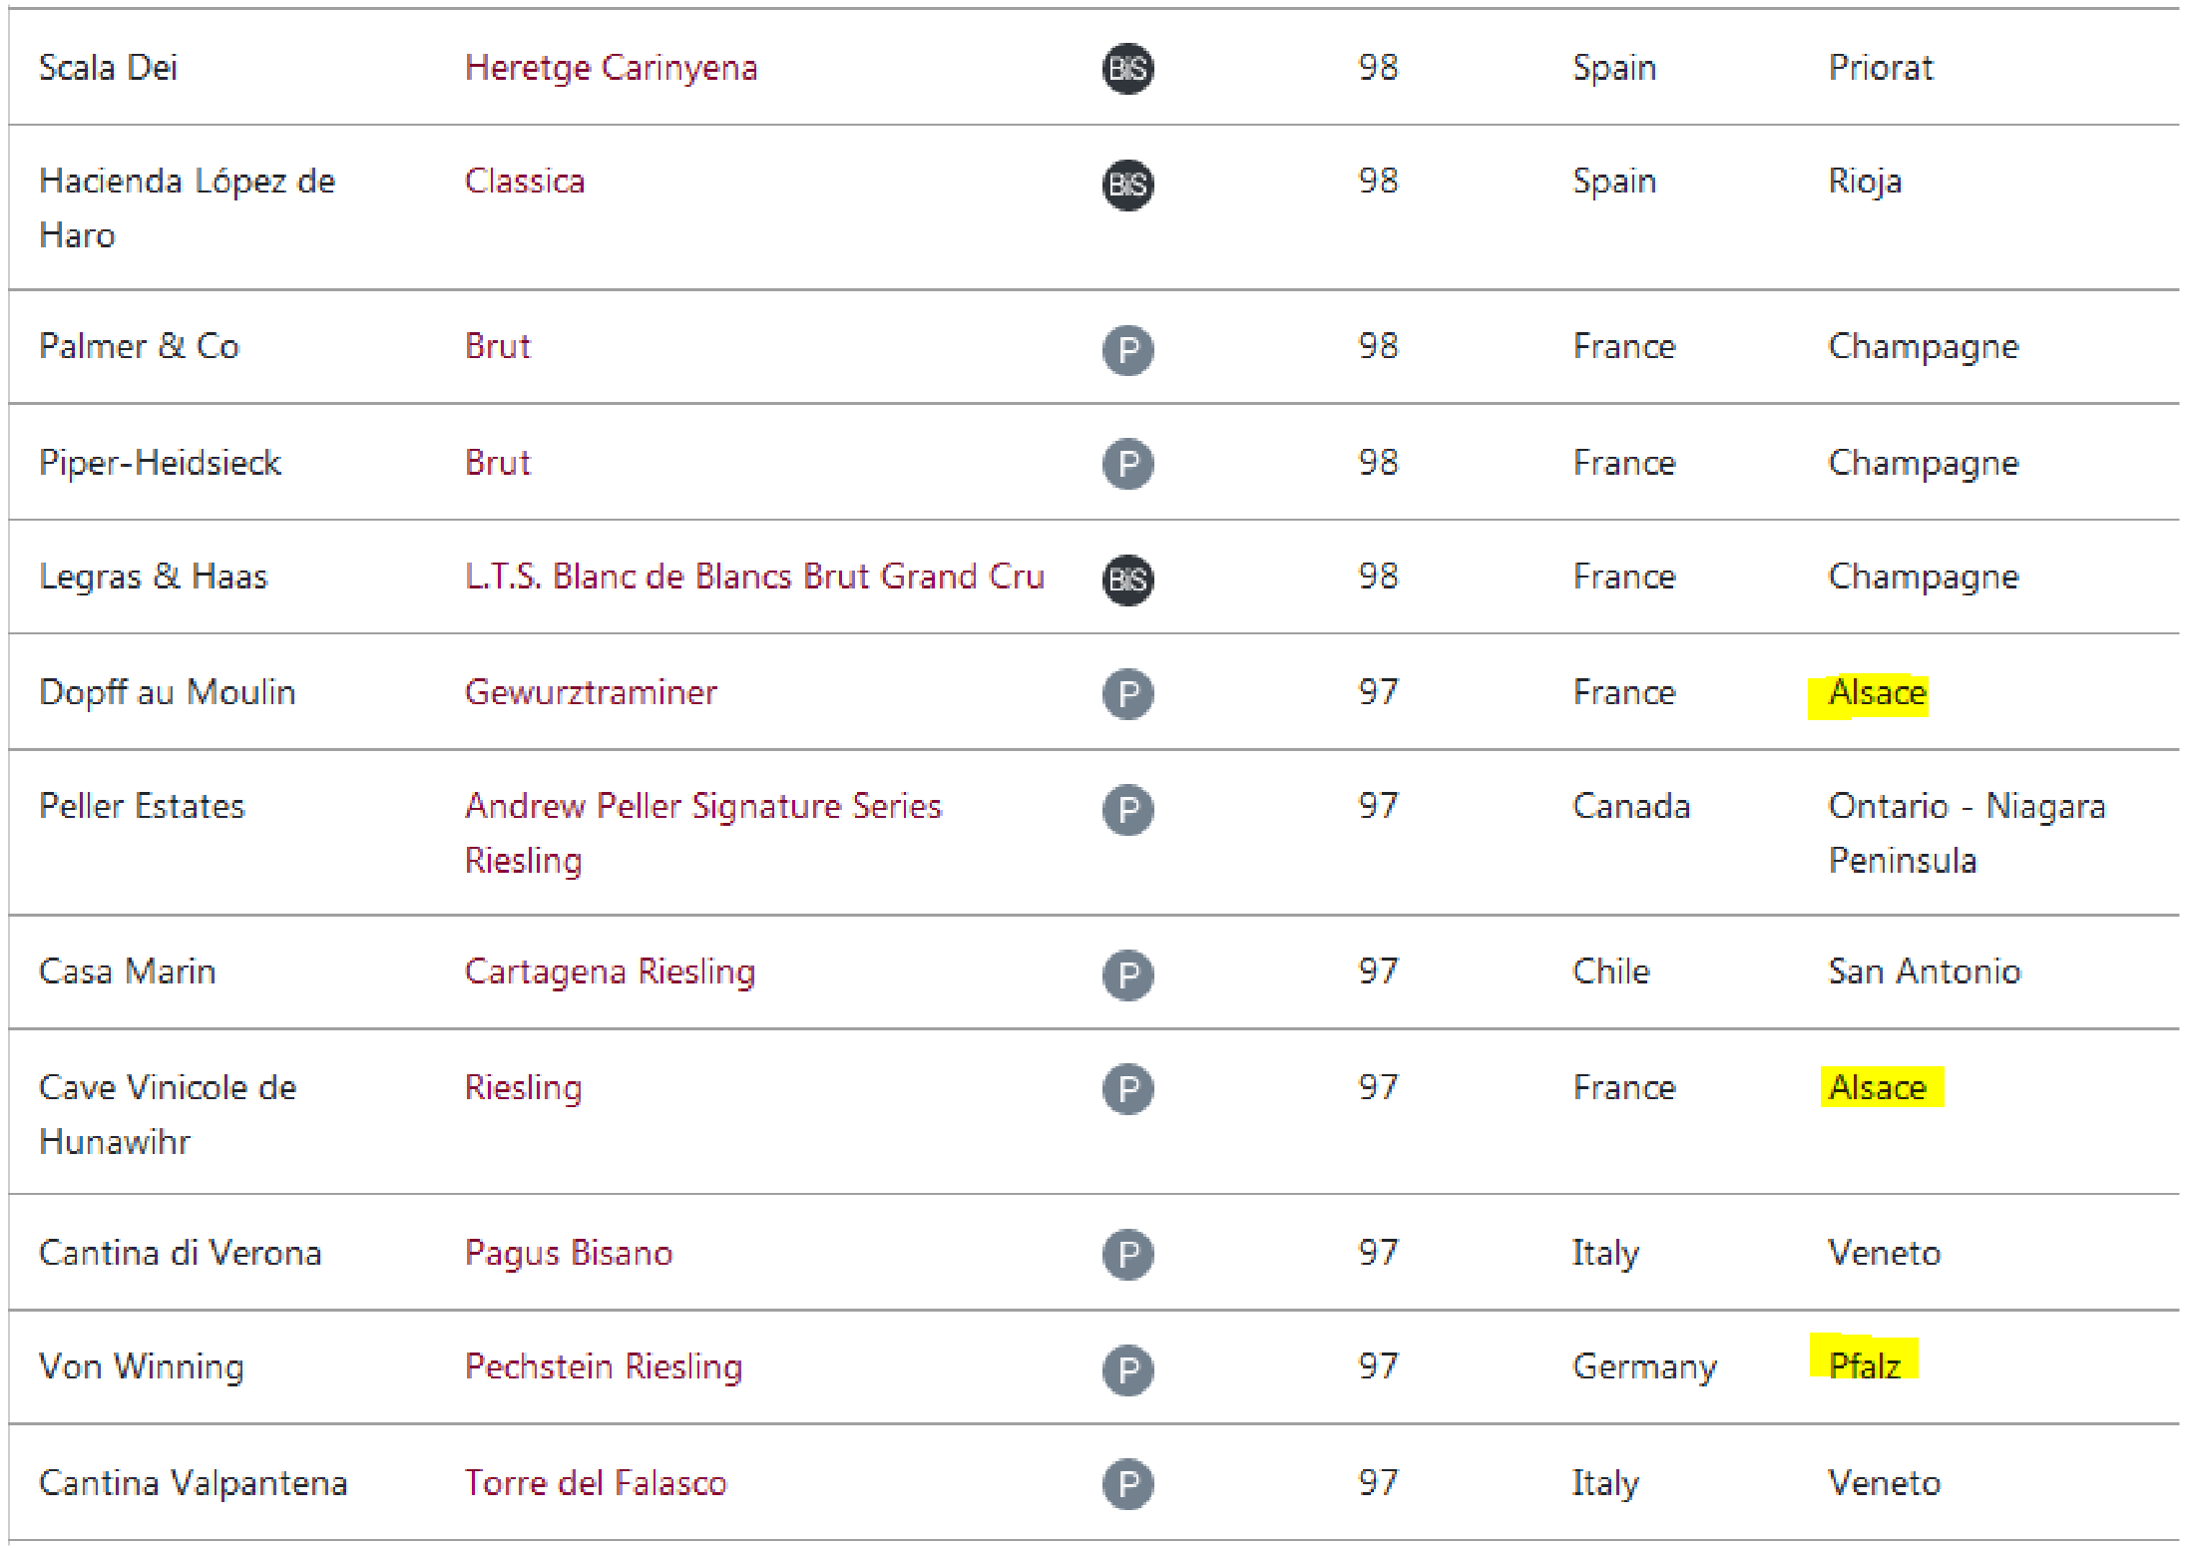
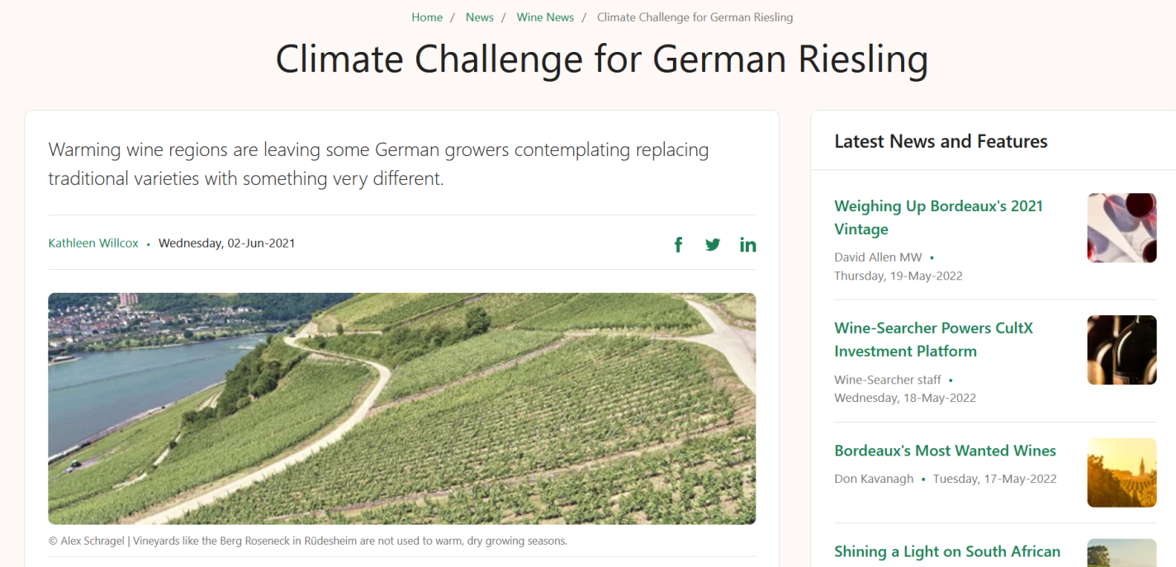
Sensitive grape varieties
« Decanter World Wine Awards » (maximal grade : 100)
https://awards.decanter.com/DWWA/2021/search/wines?award=Best%20in%20Show&competitionType=DWWA
https://www.wine-searcher.com/m/2021/06/climate-challenge-for-german-riesling

Slide 5
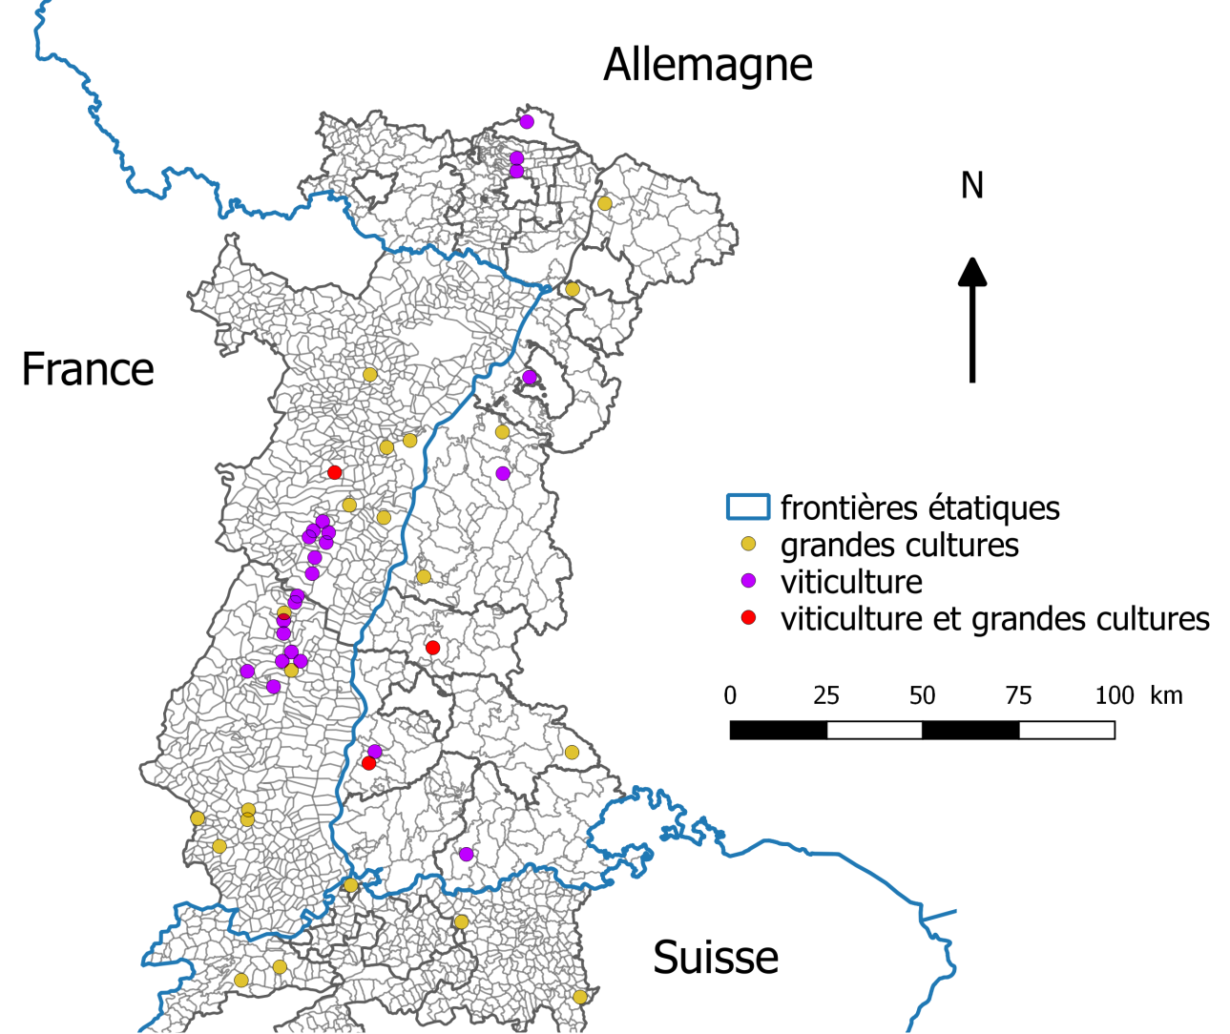
Interviews conducted
Gaël Bohnert (CRESAT)

Slide 6
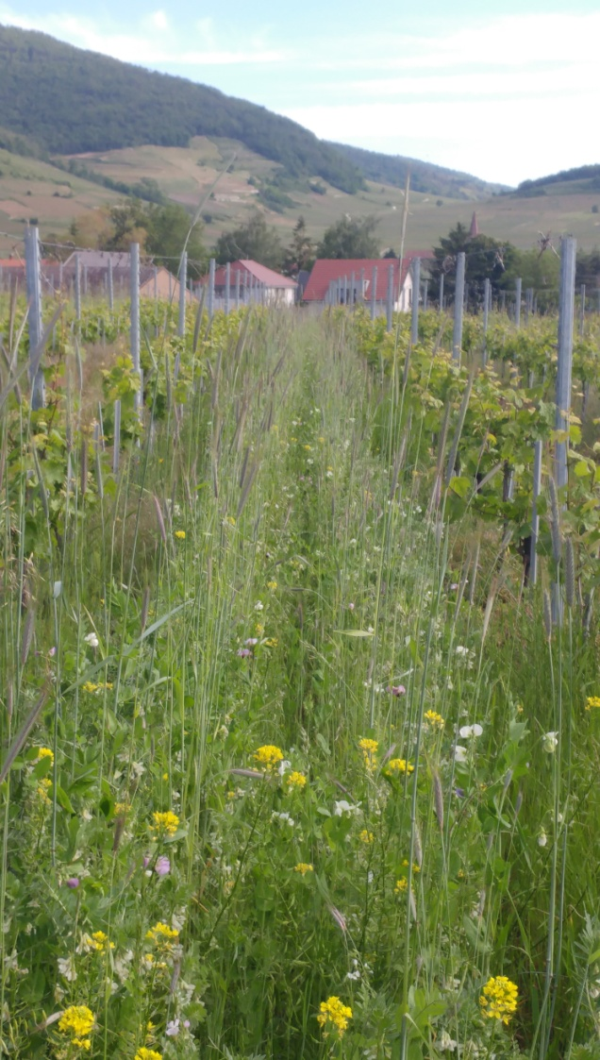
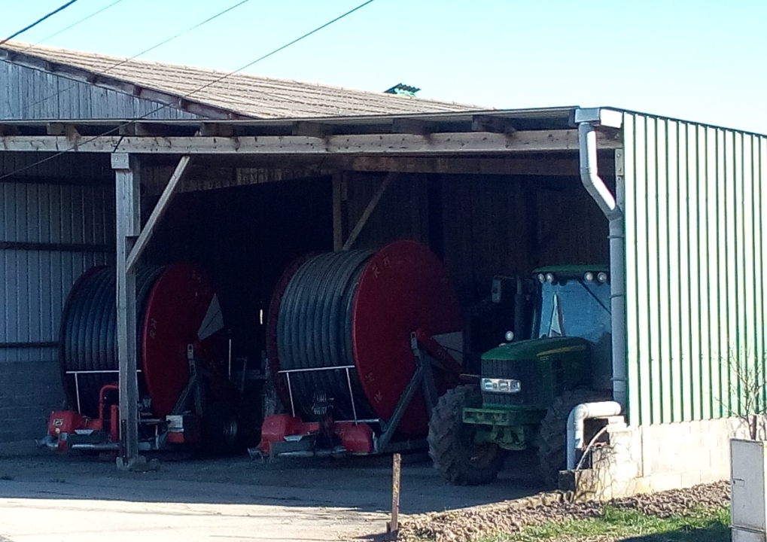
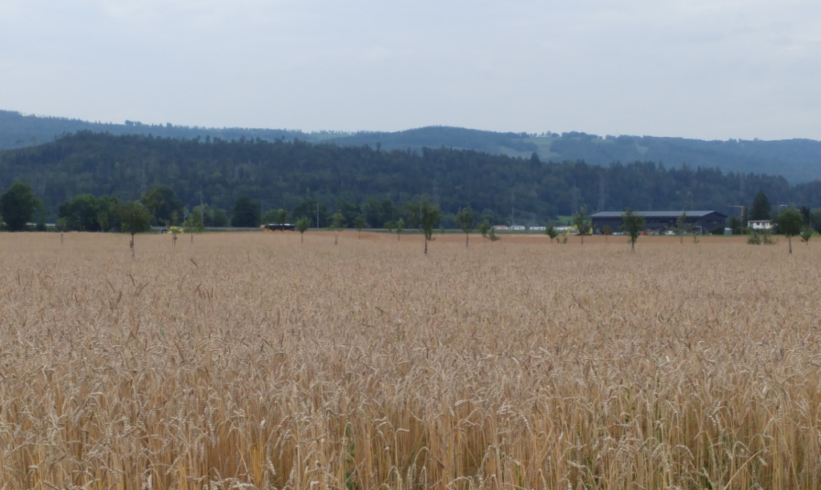

Various adaptation measures
Soil covering
Gaël Bohnert (CRESAT)
Irrigation
Agroforestry
Gaël Bohnert (CRESAT)
Gaël Bohnert (CRESAT)
Gaël Bohnert (CRESAT)

Slide 7
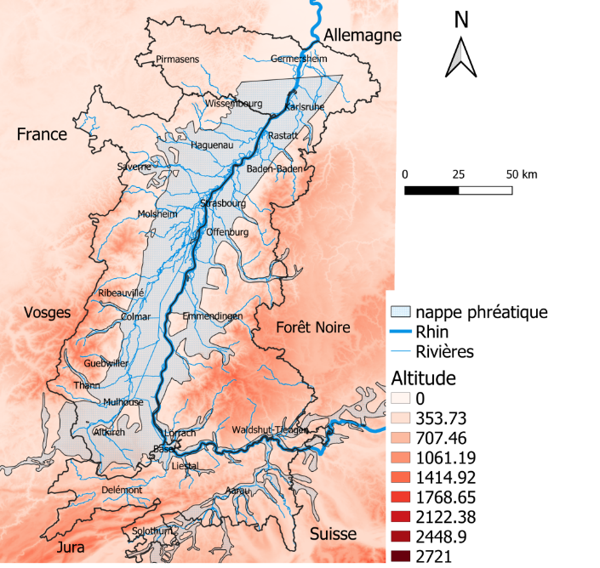
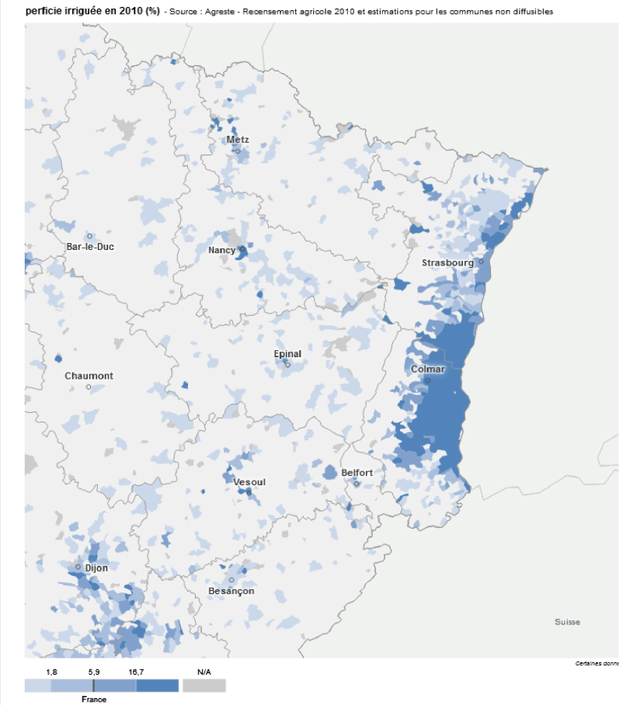
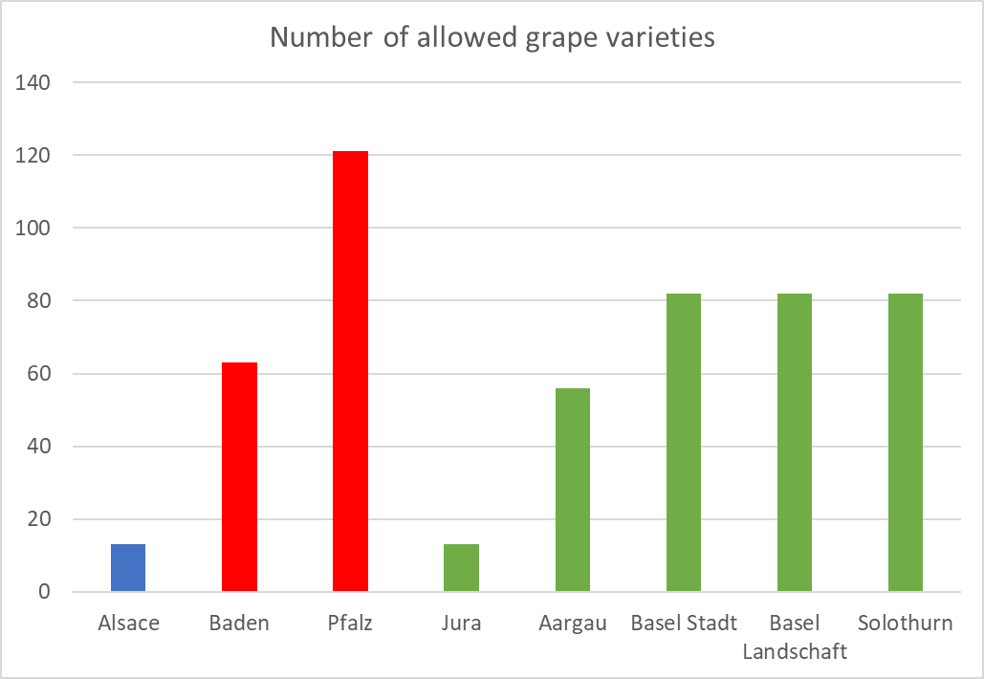
Territorial resources and constraints
Share of irrigated land
Gaël Bohnert (CRESAT)
Agreste. « Part de le superficie irriguée dans la superficie agricole utilisée (SAU) en 2010 (%) ». Consulté le 27 octobre 2021. https://stats.agriculture.gouv.fr/cartostat/#bbox=797775,6958289,522743,309176&c=indicator&i=cult1.sauirrig10&view=map1.
Source: PDO specifications

Slide 8
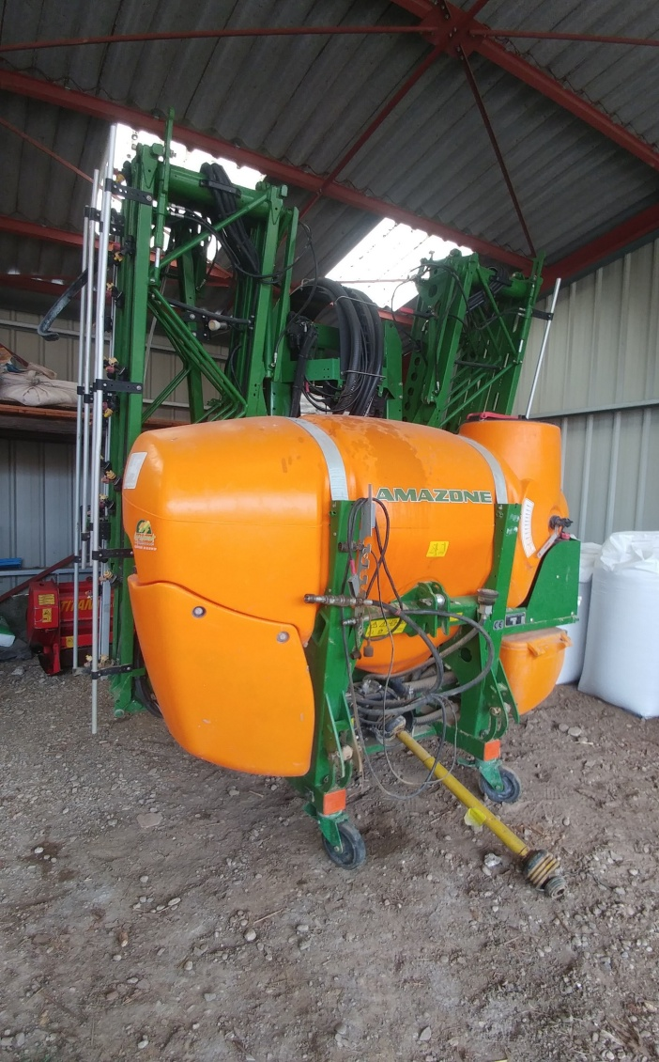
Conflicting objectives
Gaël Bohnert (CRESAT)

Slide 9
Conclusion
CC
Different individual characteristics
Different territorial characteristics
Modification of the water fluxes
Different objectives
Different impacts
Different adaptation measures
Heterogeneous and inequal systems
Debates

