Slide 1

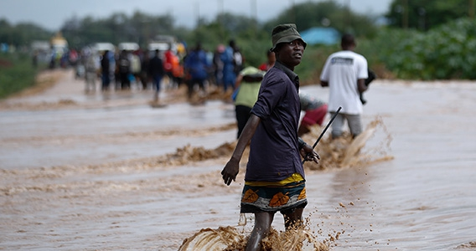
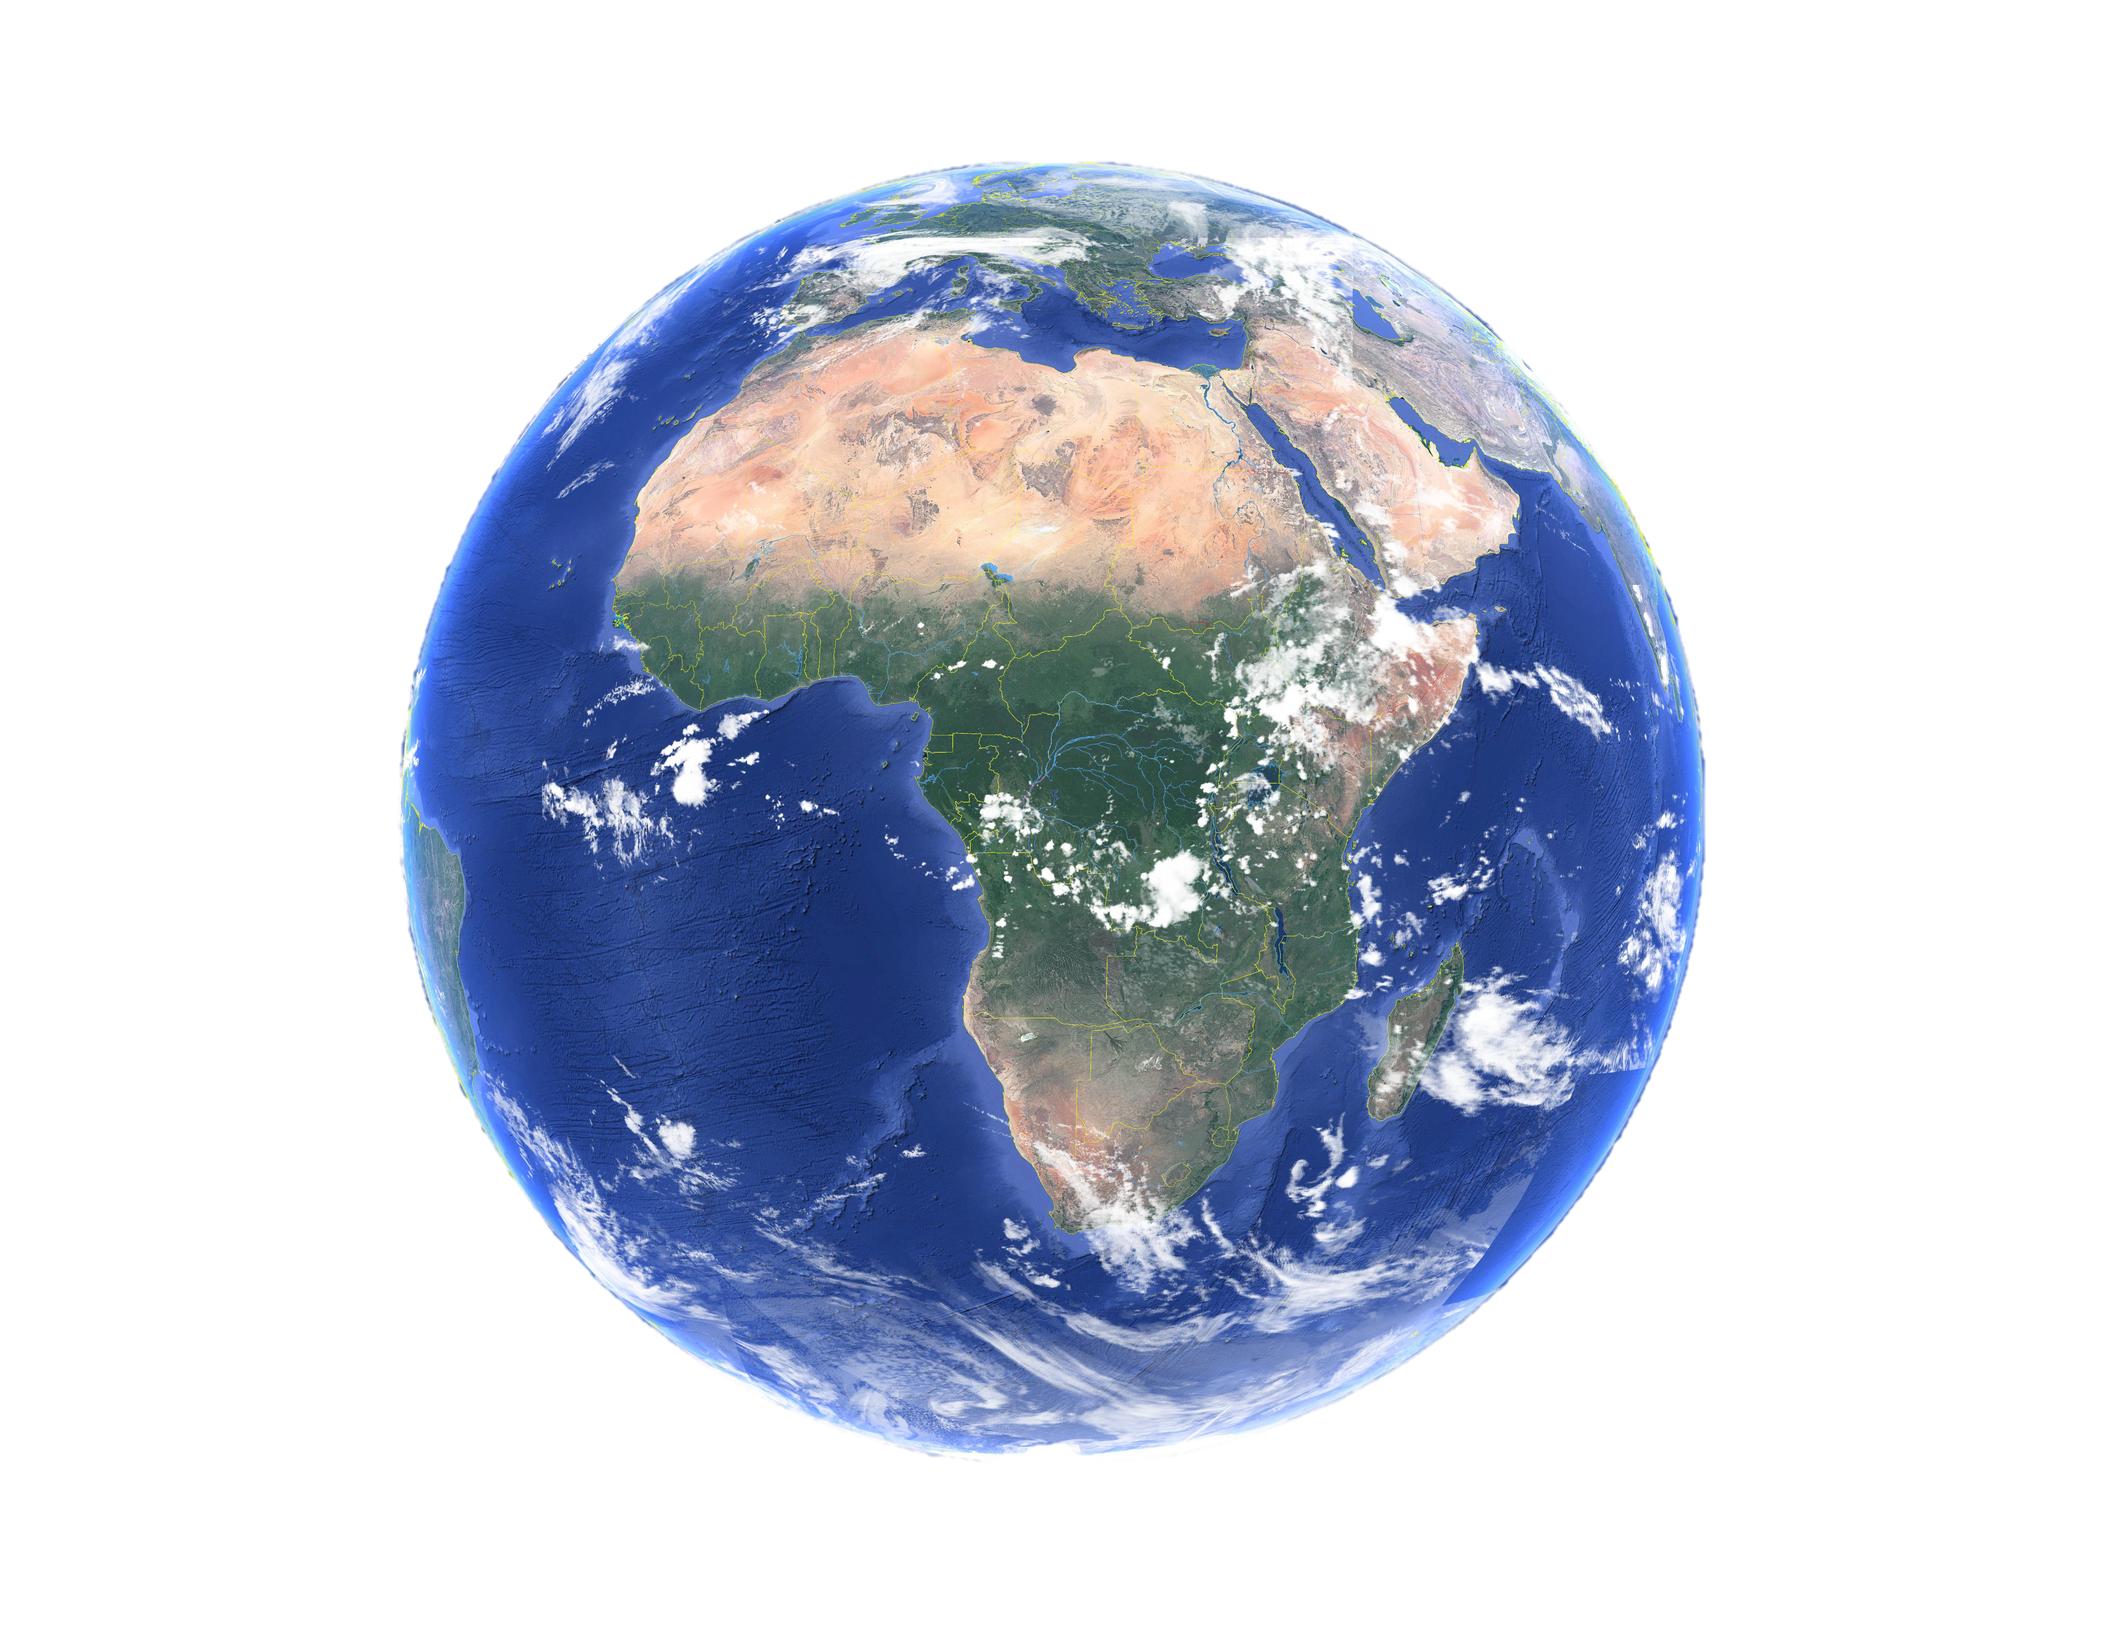
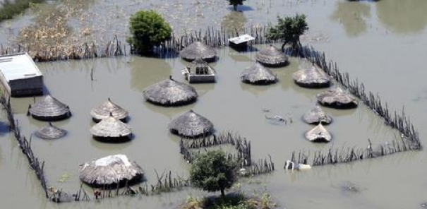
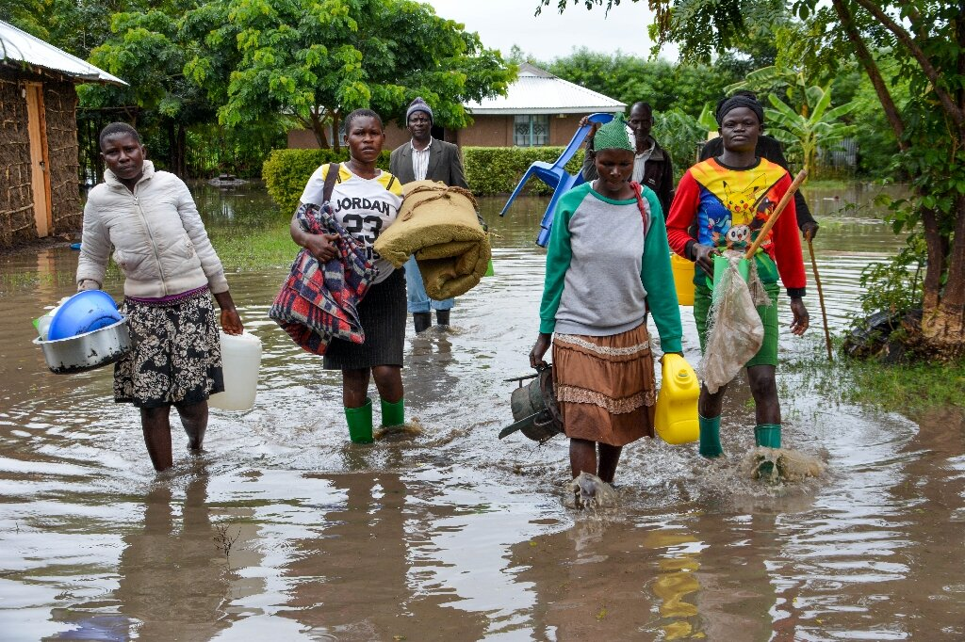
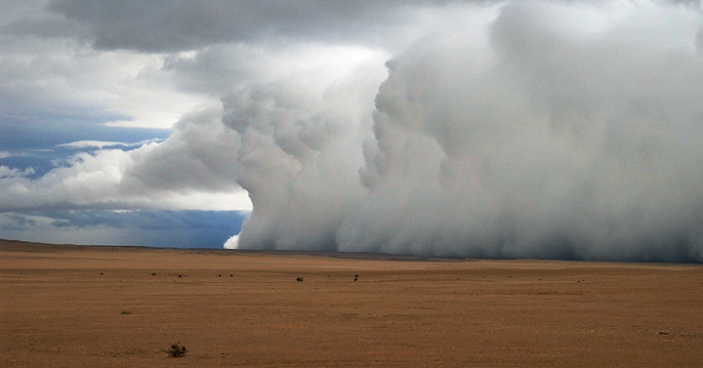




Decadal to multidecadal variability in long- and short-lived hydrological extremes in sub-Saharan Africa
Job Ekolu¹, Bastien Dieppois¹, Jonathan Eden¹, Yves Tramblay³, Gabriele Villarini⁴, Gil Mahé³, Jean-Emmanuel Paturel³,Marco van de Wiel¹
1- Coventry University, Coventry, UK, 2- HSM, Univ. Montpellier, CNRS, IMT, IRD, Montpellier, France, 3- IIHR – Hydroscience & Engineering, University of Iowa, Iowa City, Iowa, USA
Notes:
Hello Everybody!
My name is Job Ekolu, and I am a second year PhD student at Coventry University in the United Kingdom.
I will be presenting a study that looks at, “Decadal to multidecadal variability in long- and short-lived, hydrological extremes in sub-Saharan Africa”.
The image of Earth (centre) was taken from Google Earth.
Images clockwise and their sources
1. Man walking through a flooded road (East Africa) :
Link: https://ec.europa.eu/echo/news/floods-east-africa-eu-provides-initial-emergency-assistance_en
2. Flooded homestead (Namibia) :
Link: https://watchers.news/2011/05/11/heavy-rain-in-namibia-and-south-africa/
3. Rainfall Storm (Namibia) :
Link: https://earthobservatory.nasa.gov/images/50573/heavy-rain-in-namibia-and-south-Africa

Slide 2

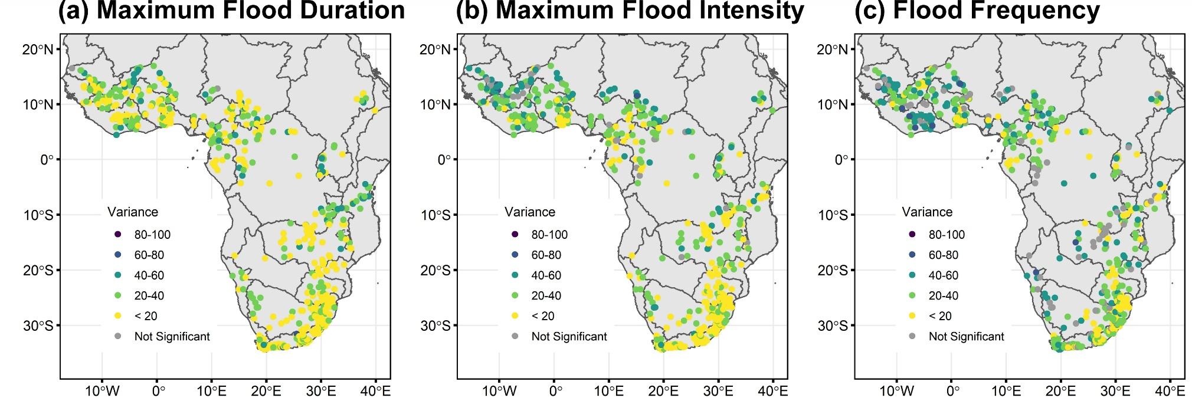
Decadal to multidecadal variability in long- and short-lived hydrological extremes in sub-Saharan Africa
Decadal to multidecadal variability in long- and short-lived hydrological extremes in sub-Saharan Africa
Job Ekolu¹, Bastien Dieppois¹, Jonathan Eden¹, Yves Tramblay³, Gabriele Villarini⁴, Gil Mahé³, Jean-Emmanuel Paturel³, Marco van de Wiel¹
Job Ekolu¹, Bastien Dieppois¹, Jonathan Eden¹, Yves Tramblay³, Gabriele Villarini⁴, Gil Mahé³, Jean-Emmanuel Paturel³, Marco van de Wiel¹
Introduction
Approach
Local-scale Driver: Magnitude
Local-scale Driver: Frequency
Large-scale Driver: Magnitude
Large-scale Driver: Frequency
Conclusion ?
Periodic increasing and decreasing trends in flood characteristics in sub-Saharan Africa.
Frequent Flooding and Climatic extremes
Flooded homestead (Namibia, 2011)
Flooding (Kenya, 2018)
What it means …
Major disaster types affecting people in Africa (2000-2019)
(Source: Yaghmaei and Below, 2019)
Significant Decadal variability in Flood characteristics [1950- 2014] (Source: Ekolu et al. 2022)
Notes:
Introduction
The region has been highly impacted by hydrological extremes leading to a loss of human lives and property.
A recent study of floods using 65-years of data across sub-Saharan Africa has shown that aperiodic increasing and decreasing trends are present in all flood characteristics and can be attributed to decadal variations.
Here, we investigate the largescale and local scale drivers to further understand the link between floods and climate change.

Slide 3
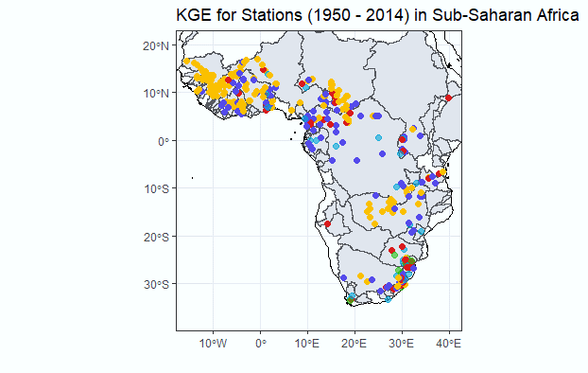
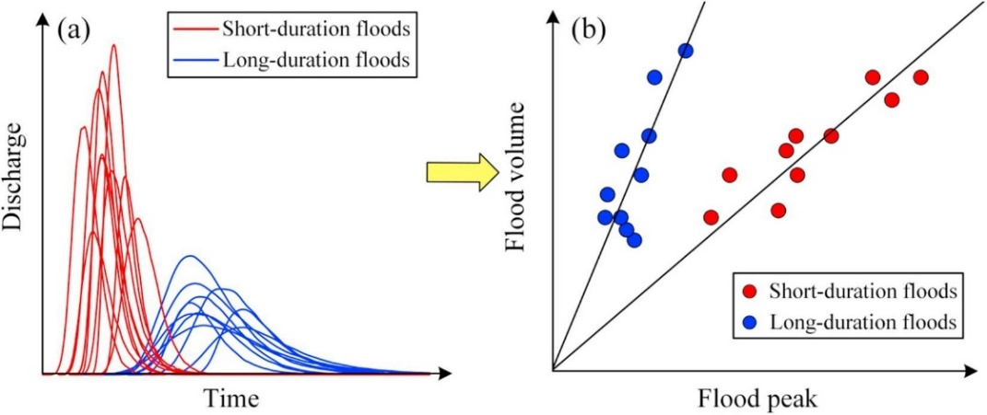
Decadal to multidecadal variability in long- and short-lived hydrological extremes in sub-Saharan Africa
Decadal to multidecadal variability in long- and short-lived hydrological extremes in sub-Saharan Africa
Job Ekolu¹, Bastien Dieppois¹, Jonathan Eden¹, Yves Tramblay³, Gabriele Villarini⁴, Gil Mahé³, Jean-Emmanuel Paturel³, Marco van de Wiel¹
Job Ekolu¹, Bastien Dieppois¹, Jonathan Eden¹, Yves Tramblay³, Gabriele Villarini⁴, Gil Mahé³, Jean-Emmanuel Paturel³, Marco van de Wiel¹
Introduction
Approach
Local-scale Driver: Magnitude
Local-scale Driver: Frequency
Large-scale Driver: Magnitude
Large-scale Driver: Frequency
Conclusion ?
Relative contribution from Local scale and Largescale drivers of flood change in sub-Saharan Africa (1950-2014)
Flood data – Ekolu et al. 2022
Hydro-meteorological data – ERA5 land
Sea Surface Temperatures – ERSST.v5
Short Duration Floods [SDF] vs Long Duration Floods [LDF]
(source: Gaal et al. 2015)
Flood Magnitude and Frequency using:
Linear model (Multiple linear regression)
Non-linear model (Decision tree)
Mapping relative importance of multiple drivers of Short or Long duration flood events
Notes:
Methodology and Data
Data for this study covers the period 1950 to 2014.
Flood data is gotten from Ekolu et al. 2022.
Hydro-meteorological data used to investigate the local scale factors was gotten from ER5land data set.
This consists of daily rainfall, temperature, and soil moisture.
For the largescale, we use NOAA Extended Reconstructed Sea Surface Temperature dataset.
Floods can be separated into different families based on the peak-volume relationship.
The factors controlling this relationship are mainly related to climate rather than catchment characteristics.
In this study, we quantify the influence of these drivers on the magnitude and frequency of both short and long duration floods.
This is achieved through a relative importance analysis done with both linear and non-linear regression models.

Slide 4
Decadal to multidecadal variability in long- and short-lived hydrological extremes in sub-Saharan Africa
Decadal to multidecadal variability in long- and short-lived hydrological extremes in sub-Saharan Africa
Job Ekolu¹, Bastien Dieppois¹, Jonathan Eden¹, Yves Tramblay³, Gabriele Villarini⁴, Gil Mahé³, Jean-Emmanuel Paturel³, Marco van de Wiel¹
Job Ekolu¹, Bastien Dieppois¹, Jonathan Eden¹, Yves Tramblay³, Gabriele Villarini⁴, Gil Mahé³, Jean-Emmanuel Paturel³, Marco van de Wiel¹
Introduction
Approach
Local-scale Driver: Magnitude
Local-scale Driver: Frequency
Large-scale Driver: Magnitude
Large-scale Driver: Frequency
Conclusion ?
Selected indices to study drivers of flood magnitude and frequency [1950-2014]
Flood Magnitude and Frequency Large Scale Drivers:
E – Eastern Pacific ENSO
C – Central Pacific ENSO
TPI - Tripole Index of Pacific
NP –North Pacific SST
TSA – Tropical South Atlantic
TNSD - Tropical North and South Atlantic Detrended
SAOD – South Atlantic Ocean Dipole
AMO – North Atlantic Ocean
EMED – East Mediterranean Sea
SWIO – South-West Indian Ocean
TIO – Tropical Indian Ocean
Flood Frequency Local Scale Drivers
Maximum Wet spell length
Number of heavy rainfall event
Total Annual Rainfall
Annual Rainfall Intensity
Number of Wet days
Number of Wet spells
Average Annual Temperature
Average Maximum Temperature
Average Minimum Temperature
Maximum 5-day soil moisture
Flood Magnitude Local Scale Drivers
Maximum 1-day Rainfall
Maximum 5-day Rainfall
Total Annual Rainfall
Annual Rainfall Intensity
Average Annual Temperature
Average Maximum Temperature
Average Minimum Temperature
Maximum 5-day soil moisture
Notes:
Methodology and Data
For short and long duration floods each, these are the indices that were used in the investigation at the local scale and largescale.

Slide 5
Decadal to multidecadal variability in long- and short-lived hydrological extremes in sub-Saharan Africa
Decadal to multidecadal variability in long- and short-lived hydrological extremes in sub-Saharan Africa
Job Ekolu¹, Bastien Dieppois¹, Jonathan Eden¹, Yves Tramblay³, Gabriele Villarini⁴, Gil Mahé³, Jean-Emmanuel Paturel³, Marco van de Wiel¹
Job Ekolu¹, Bastien Dieppois¹, Jonathan Eden¹, Yves Tramblay³, Gabriele Villarini⁴, Gil Mahé³, Jean-Emmanuel Paturel³, Marco van de Wiel¹
Introduction
Approach
Local-scale Driver: Magnitude
Local-scale Driver: Frequency
Large-scale Driver: Magnitude
Large-scale Driver: Frequency
Conclusion ?
LOCALSCALE DRIVERS
Flood magnitude
Linear model
Magnitude LDFs better modelled than SDFs in W.A.
Soil moisture most important LDF vs SDF.
Rainfall Intensity and Temperature important.
Max 5day and Total Rainfall important in S.A.
Notes:
Results and Discussion
Local scale driver - Flood magnitude – Linear model
Looking at our results, most stations had the correlation between flood peaks and volume being above 70% in both the short and long duration floods.
This figure shows the results for the best performing linear model of local scale drivers of flood magnitude.
The first column shows the variance explained for each station and remaining columns show the first, second and third ranked predictors for both short and long duration floods.
Most of the stations were modelled with less than 25% of the variance explained.
Overall, the performance of the model in both short and long duration floods is similar except for parts of western Africa.
Soil moisture and total rainfall seem be stronger drivers in long duration floods than in short duration floods.
Regionally, the Rainfall and Soil extremes are more important drivers in southern Africa.

Slide 6
Decadal to multidecadal variability in long- and short-lived hydrological extremes in sub-Saharan Africa
Decadal to multidecadal variability in long- and short-lived hydrological extremes in sub-Saharan Africa
Job Ekolu¹, Bastien Dieppois¹, Jonathan Eden¹, Yves Tramblay³, Gabriele Villarini⁴, Gil Mahé³, Jean-Emmanuel Paturel³, Marco van de Wiel¹
Job Ekolu¹, Bastien Dieppois¹, Jonathan Eden¹, Yves Tramblay³, Gabriele Villarini⁴, Gil Mahé³, Jean-Emmanuel Paturel³, Marco van de Wiel¹
Introduction
Approach
Local-scale Driver: Magnitude
Local-scale Driver: Frequency
Large-scale Driver: Magnitude
Large-scale Driver: Frequency
Conclusion ?
LOCALSCALE DRIVERS
Flood magnitude
Non-Linear model
Magnitude LDFs better modelled than SDFs.
Soil moisture most important LDF vs SDF.
Max 1 day rainfall most important in SDF vs LDF.
Non-linear model better.
Notes:
Results and Discussion
Local scale driver - Flood magnitude – Non-linear model
This figure shows the results for the best performing non-linear model of local scale drivers of flood magnitude.
We find that the magnitude of long duration floods is better modelled than short duration floods especially in western Africa and a few stations in southern Africa.
Most of the stations were modelled between 40-50% of the variance explained.
Max 1 day rainfall most important in Short Duration Floods vs Long Duration Floods.
Overall, the patterns of the results are similar between the non-linear and linear models, but the non-linear models are better estimators for the local driver drivers.

Slide 7
Decadal to multidecadal variability in long- and short-lived hydrological extremes in sub-Saharan Africa
Decadal to multidecadal variability in long- and short-lived hydrological extremes in sub-Saharan Africa
Job Ekolu¹, Bastien Dieppois¹, Jonathan Eden¹, Yves Tramblay³, Gabriele Villarini⁴, Gil Mahé³, Jean-Emmanuel Paturel³, Marco van de Wiel¹
Job Ekolu¹, Bastien Dieppois¹, Jonathan Eden¹, Yves Tramblay³, Gabriele Villarini⁴, Gil Mahé³, Jean-Emmanuel Paturel³, Marco van de Wiel¹
Introduction
Approach
Local-scale Driver: Magnitude
Local-scale Driver: Frequency
Large-scale Driver: Magnitude
Large-scale Driver: Frequency
Conclusion ?
LOCALSCALE DRIVERS
Flood frequency
Linear model
Frequency of SDFs better modelled than LDFs.
Soil moisture and Rainfall Intensity most important LDF vs SDF.
Temperature also important.
Max wet spell characteristics in SDFs vs LDFs.
Notes:
Results and Discussion
Local scale driver - Flood frequency – Linear model
This figure shows the results for the best performing linear model of local scale drivers of flood frequency.
Most of the stations are modelled with less than 25% of the variance explained.
Overall, the frequency of short duration floods is slight better modelled than long duration floods.
Soil moisture and total rainfall seem be stronger drivers in long duration floods than in short duration floods.
Temperature also an important driver in several catchments.
Max wet spell length seems be a stronger driver in short duration floods than in long duration floods.

Slide 8
Decadal to multidecadal variability in long- and short-lived hydrological extremes in sub-Saharan Africa
Decadal to multidecadal variability in long- and short-lived hydrological extremes in sub-Saharan Africa
Job Ekolu¹, Bastien Dieppois¹, Jonathan Eden¹, Yves Tramblay³, Gabriele Villarini⁴, Gil Mahé³, Jean-Emmanuel Paturel³, Marco van de Wiel¹
Job Ekolu¹, Bastien Dieppois¹, Jonathan Eden¹, Yves Tramblay³, Gabriele Villarini⁴, Gil Mahé³, Jean-Emmanuel Paturel³, Marco van de Wiel¹
Introduction
Approach
Local-scale Driver: Magnitude
Local-scale Driver: Frequency
Large-scale Driver: Magnitude
Large-scale Driver: Frequency
Conclusion ?
LOCALSCALE DRIVERS
Flood frequency
Non-Linear model
Frequency of SDFs better modelled than LDFs.
Rainfall Intensity most important LDF vs SDF.
Temperature also important.
Non-linear model better.
Notes:
Results and Discussion
Local scale driver - Flood frequency – Non-Linear model
For the non-linear model at the local scale, we find that the frequency of short duration floods is better modelled than long duration floods especially in western Africa and a few stations in southern Africa.
Overall, the patterns of the results are similar between the non-linear and linear models, but the non-linear models are better estimators for the local driver drivers.

Slide 9
Decadal to multidecadal variability in long- and short-lived hydrological extremes in sub-Saharan Africa
Decadal to multidecadal variability in long- and short-lived hydrological extremes in sub-Saharan Africa
Job Ekolu¹, Bastien Dieppois¹, Jonathan Eden¹, Yves Tramblay³, Gabriele Villarini⁴, Gil Mahé³, Jean-Emmanuel Paturel³, Marco van de Wiel¹
Job Ekolu¹, Bastien Dieppois¹, Jonathan Eden¹, Yves Tramblay³, Gabriele Villarini⁴, Gil Mahé³, Jean-Emmanuel Paturel³, Marco van de Wiel¹
Introduction
Approach
Local-scale Driver: Magnitude
Local-scale Driver: Frequency
Large-scale Driver: Magnitude
Large-scale Driver: Frequency
Conclusion ?
LARGESCALE DRIVERS
Flood magnitude
Linear model
LDFs better modelled than SDFs especially in W.A.
EMED and AMO most important W.A and C.A.
S.A and E.A the Indian (SWIO, TIO) and Pacific oceans (NP, C, E).
TSA impacts LDFs more than SDFs.
Notes:
Results and Discussion
Largescale driver - Flood magnitude – Linear model
At the largescale, we investigated the drivers of flooding using a linear mode.
Our results indicate that the performance of the model in both short and long duration floods is similar except for parts of western Africa.
For western and central Africa, the East Mediterranean and North Atlantic seem to be the main drivers of flooding.
For southern and eastern Africa, the Indian ocean and Pacific oceans seem to be the main drivers of flooding.
Overall, the patterns of results are similar between the non-linear and linear models.
However, there are differences across some regions like the southeastern part of Africa where the linear models suggest that the Indian ocean plays a more dominant role than the Pacific ocean which non-linear model seems to suggest.

Slide 10
Decadal to multidecadal variability in long- and short-lived hydrological extremes in sub-Saharan Africa
Decadal to multidecadal variability in long- and short-lived hydrological extremes in sub-Saharan Africa
Job Ekolu¹, Bastien Dieppois¹, Jonathan Eden¹, Yves Tramblay³, Gabriele Villarini⁴, Gil Mahé³, Jean-Emmanuel Paturel³, Marco van de Wiel¹
Job Ekolu¹, Bastien Dieppois¹, Jonathan Eden¹, Yves Tramblay³, Gabriele Villarini⁴, Gil Mahé³, Jean-Emmanuel Paturel³, Marco van de Wiel¹
Introduction
Approach
Local-scale Driver: Magnitude
Local-scale Driver: Frequency
Large-scale Driver: Magnitude
Large-scale Driver: Frequency
Conclusion ?
LARGESCALE DRIVERS
Flood magnitude
Non-Linear model
LDFs better modelled than SDFs especially in S.A.
EMED and AMO most important W.A and C.A.
S.A and E.A the Indian (SWIO, TIO) and Pacific oceans (NP, C, E).
TSA impacts LDFs more than SDFs.
Differences E.A.
Notes:
Results and Discussion
Largescale driver - Flood magnitude – Non-Linear model
We investigated the drivers of flooding using a non-linear mode At the largescale, we find that the modeling of the magnitude of long duration floods and short duration floods show comparable performance except for parts of southern Africa.
For western and central Africa, the East Mediterranean and North Atlantic seem to be the main drivers of flooding.
For southern and eastern Africa, the Indian ocean and Pacific oceans seem to be the main drivers of flooding.
Overall, the patterns of results are similar between the non-linear and linear models.
However, there are differences across some regions like the southeastern part of Africa where the linear models suggest that the Indian ocean plays a more dominant role than the Pacific ocean which non-linear model seems to suggest.

Slide 11
Decadal to multidecadal variability in long- and short-lived hydrological extremes in sub-Saharan Africa
Decadal to multidecadal variability in long- and short-lived hydrological extremes in sub-Saharan Africa
Job Ekolu¹, Bastien Dieppois¹, Jonathan Eden¹, Yves Tramblay³, Gabriele Villarini⁴, Gil Mahé³, Jean-Emmanuel Paturel³, Marco van de Wiel¹
Job Ekolu¹, Bastien Dieppois¹, Jonathan Eden¹, Yves Tramblay³, Gabriele Villarini⁴, Gil Mahé³, Jean-Emmanuel Paturel³, Marco van de Wiel¹
Introduction
Approach
Local-scale Driver: Magnitude
Local-scale Driver: Frequency
Large-scale Driver: Magnitude
Large-scale Driver: Frequency
Conclusion ?
LARGESCALE DRIVERS
Flood frequency
Linear model
SDFs better modelled than LDFs especially in W.A.
EMED and AMO most important W.A and C.A.
S.A and E.A the Indian (SWIO, TIO) and Pacific oceans (NP, C,E).
Notes:
Results and Discussion
Largescale driver - Flood frequency – Linear model
At the largescale, we investigated the drivers of flooding using a linear mode.
Our results indicate that the performance of the model in both short and long duration floods is similar except for parts of western Africa.
For western and central Africa, the East Mediterranean and North Atlantic seem to be the main drivers of flooding.
For southern and eastern Africa, the Indian ocean and Pacific oceans seem to be the main drivers of flooding.
Overall, the patterns of results are similar between the non-linear and linear models.
However, there are differences across some regions like the southeastern part of Africa where the linear models suggest that the Indian ocean plays a more dominant role than the Pacific ocean which non-linear model seems to suggest.

Slide 12
Decadal to multidecadal variability in long- and short-lived hydrological extremes in sub-Saharan Africa
Decadal to multidecadal variability in long- and short-lived hydrological extremes in sub-Saharan Africa
Job Ekolu¹, Bastien Dieppois¹, Jonathan Eden¹, Yves Tramblay³, Gabriele Villarini⁴, Gil Mahé³, Jean-Emmanuel Paturel³, Marco van de Wiel¹
Job Ekolu¹, Bastien Dieppois¹, Jonathan Eden¹, Yves Tramblay³, Gabriele Villarini⁴, Gil Mahé³, Jean-Emmanuel Paturel³, Marco van de Wiel¹
Introduction
Approach
Local-scale Driver: Magnitude
Local-scale Driver: Frequency
Large-scale Driver: Magnitude
Large-scale Driver: Frequency
Conclusion ?
LARGESCALE DRIVERS
Flood frequency
Non-Linear model
SDFs better modelled than LDFs especially in E.A.
EMED and AMO most important W.A and C.A.
S.A and E.A the Indian (SWIO, TIO) and Pacific oceans (NP, C,E).
TSA impacts LDFs more than SDFs.
Notes:
Results and Discussion
Largescale driver - Flood frequency – Non-Linear model
We investigated the drivers of flooding using a non-linear mode At the largescale, we find that the modeling of the magnitude of long duration floods and short duration floods show comparable performance except for parts of southern Africa.
For western and central Africa, the East Mediterranean and North Atlantic seem to be the main drivers of flooding.
For southern and eastern Africa, the Indian ocean and Pacific oceans seem to be the main drivers of flooding.
Overall, the patterns of results are similar between the non-linear and linear models.
However, there are differences across some regions like the southeastern part of Africa where the linear models suggest that the Indian ocean plays a more dominant role than the Pacific ocean which non-linear model seems to suggest.

Slide 13
Decadal to multidecadal variability in long- and short-lived hydrological extremes in sub-Saharan Africa
Decadal to multidecadal variability in long- and short-lived hydrological extremes in sub-Saharan Africa
Job Ekolu¹, Bastien Dieppois¹, Jonathan Eden¹, Yves Tramblay³, Gabriele Villarini⁴, Gil Mahé³, Jean-Emmanuel Paturel³, Marco van de Wiel¹
Job Ekolu¹, Bastien Dieppois¹, Jonathan Eden¹, Yves Tramblay³, Gabriele Villarini⁴, Gil Mahé³, Jean-Emmanuel Paturel³, Marco van de Wiel¹
Introduction
Approach
Local-scale Driver: Magnitude
Local-scale Driver: Frequency
Large-scale Driver: Magnitude
Large-scale Driver: Frequency
Conclusion ?
We developed a framework to understand decadal to multidecadal variability in long- and short-lived hydrological extremes in sub-Saharan Africa, with higher spatial and temporal coverage (1950-2014) than previously explored
Short and long duration floods (SDF and LDFs) separated with a correlation > 70% for most stations.
Non-linear models (between 40-50%) are better than linear models (<25% of variance explained).
Frequency better estimated than magnitude using local scale factors , and vice-versa for large scale factors.
Large scale factors better than the local scale drivers (--> quality of ERA5 land used)
What it means …
Local scale factors
Large scale factors
Soil moisture, rainfall and temperature, respectively are most important.​
Rainfall intensity more important in western Africa than southern Africa.​
Soil moisture more important in long duration floods than short duration floods.​
SSTAs in the Mediterranean sea, North Atlantic , Pacific and Indian oceans, respectively, are most important. ​
SDFs linked to AMO and LDFs mostly linked to EMED.​
Western Africa linked to the Atlantic and Southern Africa linked to the Pacific.
Notes:
Conclusion
We’ve developed a framework to understand decadal to multidecadal variability in long- and short-lived hydrological extremes in sub-Saharan Africa.
We were able to separate the observed floods in sub-Sharan Africa into short and long duration floods.
We also found that for both local scale and largescale drivers, the non-linear models were better.
Frequency of flooding was better estimated than magnitude using local scale factors, and vice-versa for large scale factors.
Largescale factors were better predictors than local scale factors, but we think that this due to the quality of ER5land data used for the local factors.
Amongst the local scale factors, soil moisture, rainfall, and temperature, respectively are most important for both the magnitude and frequency of flooding.
Amongst the largescale factors, the Mediterranean sea, North Atlantic, Pacific, and Indian oceans, respectively, are most important ocean basins.
We found that short duration floods are more closely linked to the North Atlantic while the longer duration floods are more closely linked with the East Mediterranean sea in most of sub-Saharan Africa.
But in southern Africa, the main largescale drivers seem to be the Pacific ocean more than the Indian ocean.

Slide 14
Decadal to multidecadal variability in long- and short-lived hydrological extremes in sub-Saharan Africa
Job Ekolu¹, Bastien Dieppois¹, Jonathan Eden¹, Yves Tramblay³, Gabriele Villarini⁴, Gil Mahé³, Jean-Emmanuel Paturel³, Marco van de Wiel¹
THANK YOU !

