Slide 1

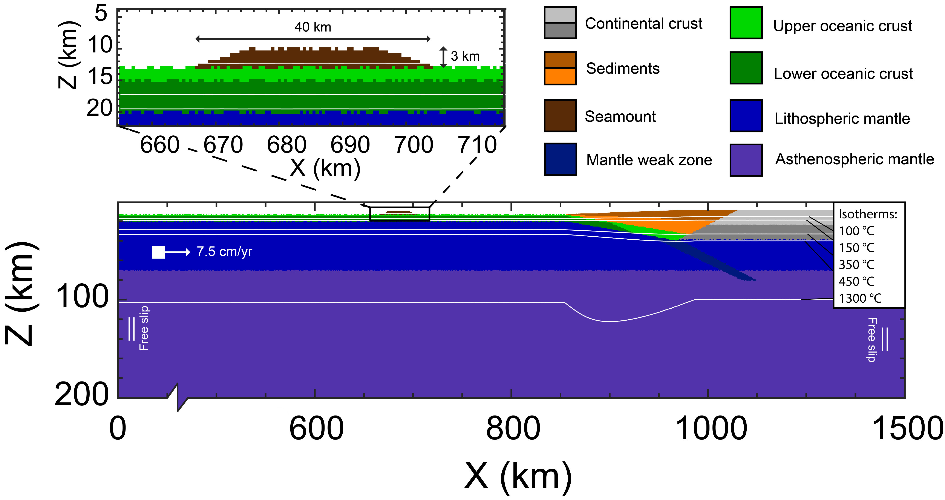


How do seamounts impact: - overriding plate deformation - seismicity?
Maaike Fonteijn, Elenora van Rijsingen, Ylona van Dinther
0

Slide 2
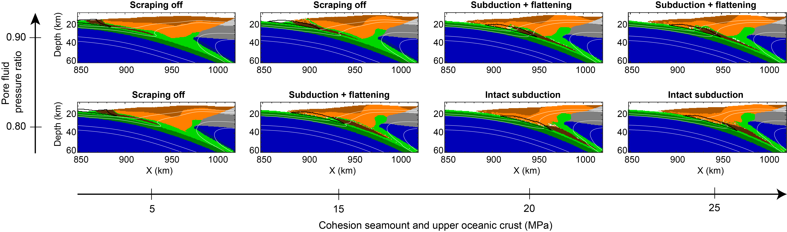
Styles of seamount subduction
Maaike Fonteijn, m.j.fonteijn@students.uu.nl

Slide 3
Styles of seamount subduction
Maaike Fonteijn, m.j.fonteijn@students.uu.nl

Slide 4
Styles of seamount subduction
→ Intact subduction occurs with cohesion ≥ 20 MPa
Maaike Fonteijn, m.j.fonteijn@students.uu.nl

Slide 5
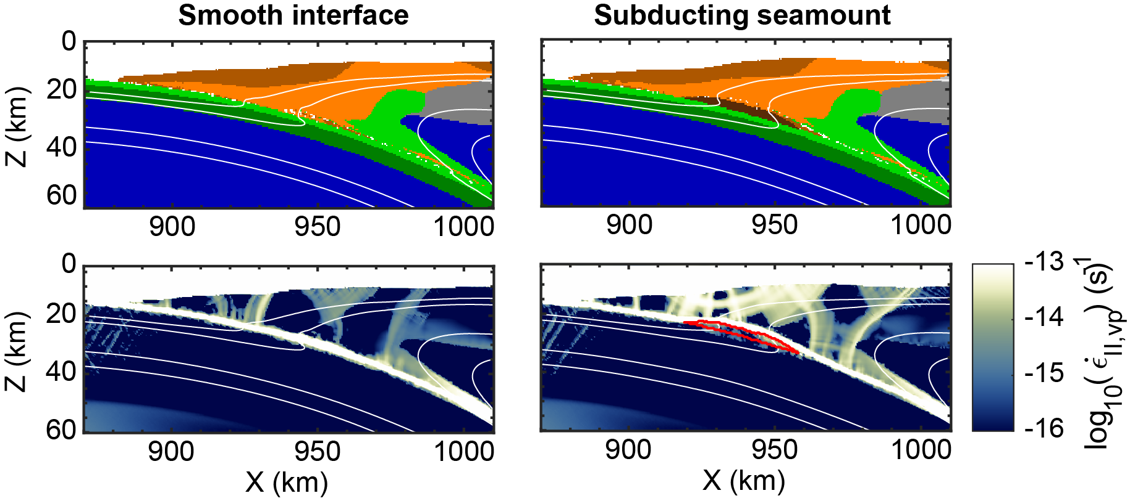
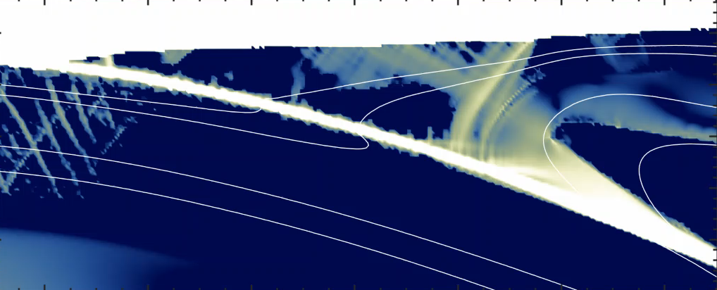

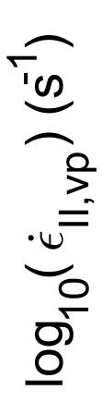
Strain in overriding plate
Subducting seamount
Smooth interface
→ Seamount breaks overriding plate
Maaike Fonteijn, m.j.fonteijn@students.uu.nl

Slide 6
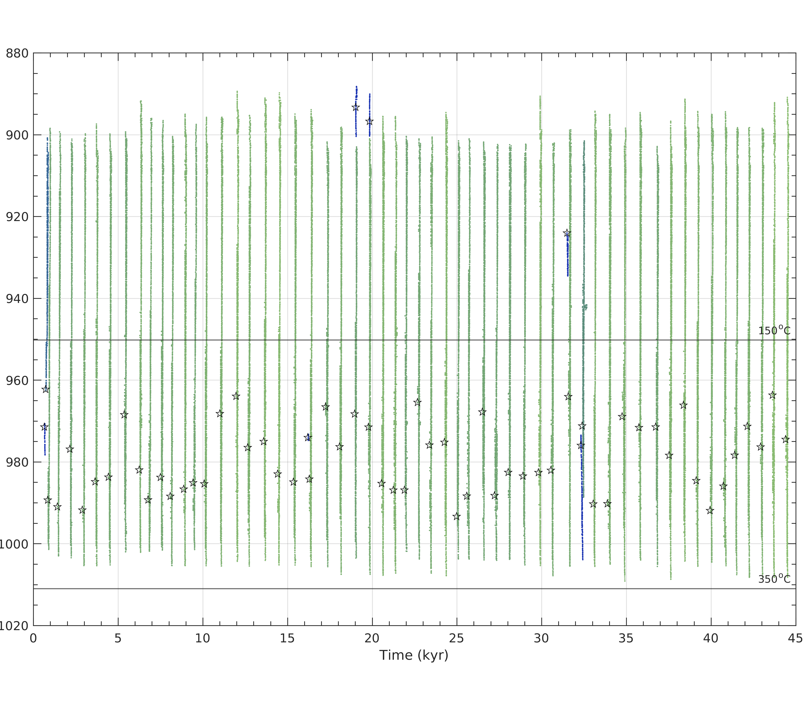
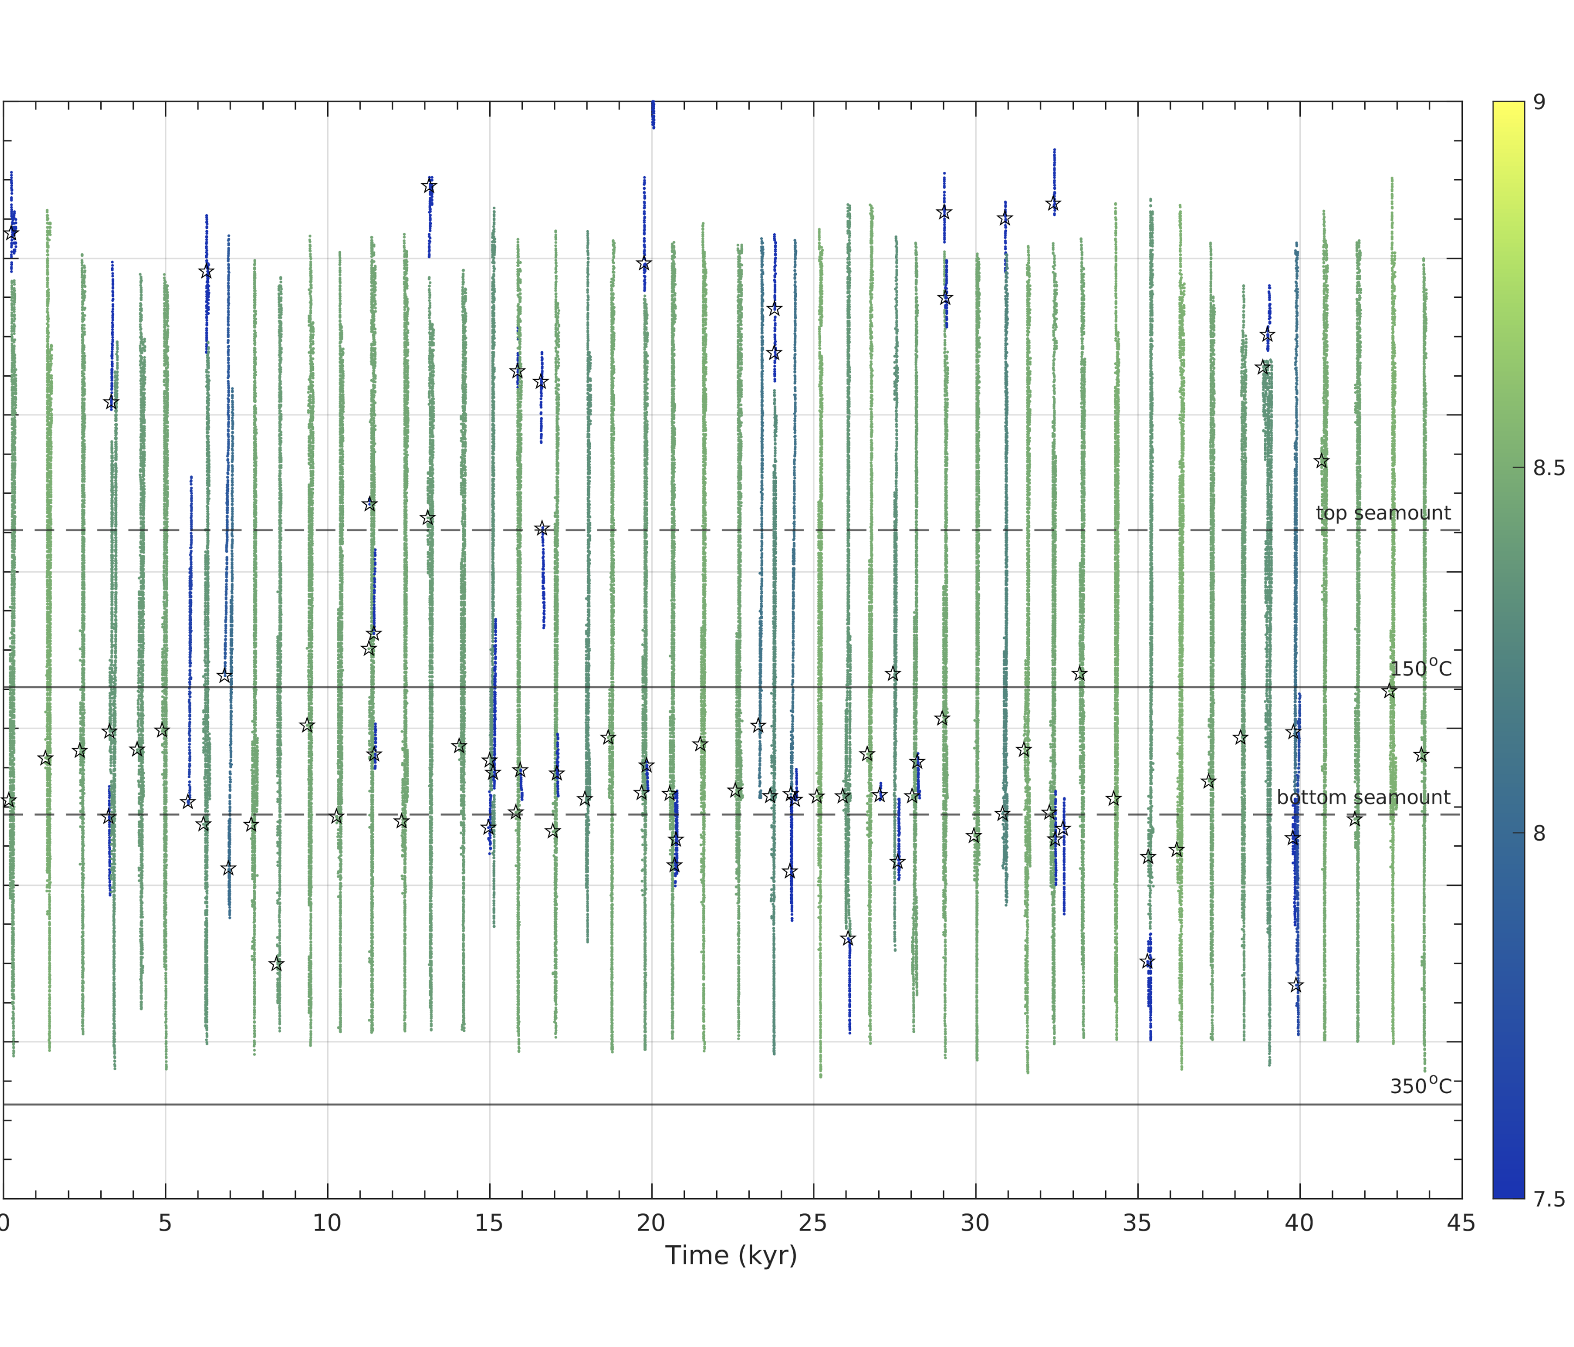
Seismicity through time
Smooth interface
Subducting seamount
trench
trench
☆ = hypocenter
Horizontal distance (km)
Magnitude
☆ = hypocenter
→ Mainly regular megathrust ruptures
More smaller ruptures
Hypocenters shift to edge of seamount
Maaike Fonteijn, m.j.fonteijn@students.uu.nl

Slide 7
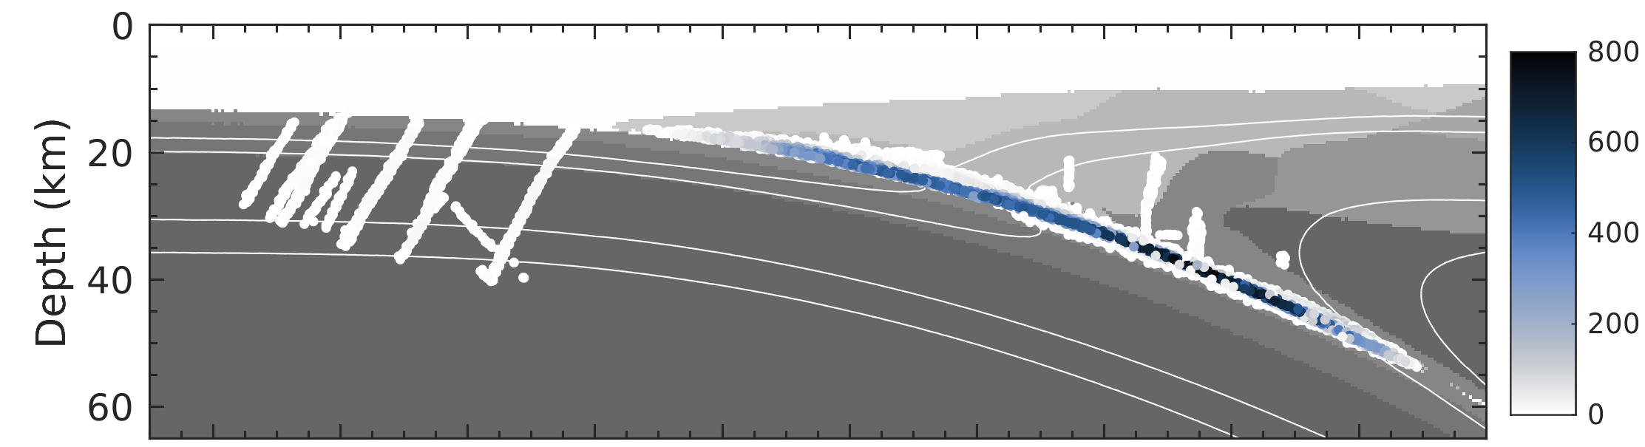
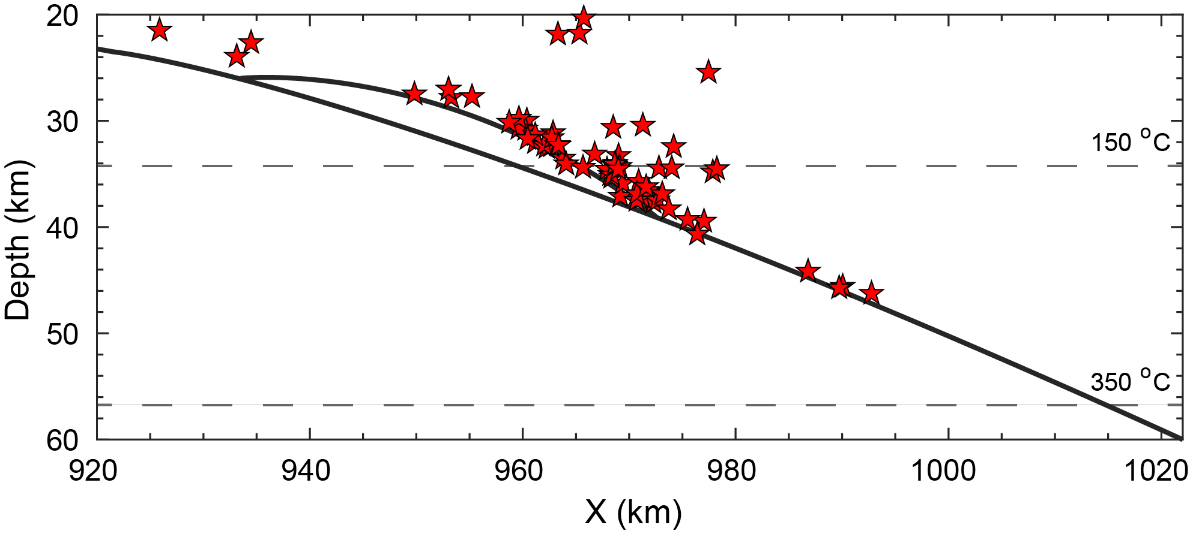
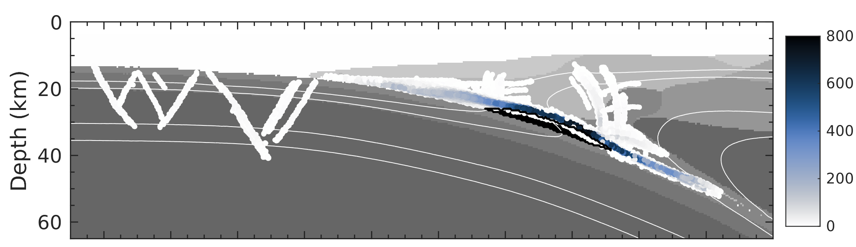

Rupture paths
Smooth interface
Event density
Hypocenter locations
Subducting seamount
Event density
Ruptures concentrate on top of seamount
Nucleation at edge of seamount
Imposed seamount
Event density
Seamount introduces more splay faults
Maaike Fonteijn, m.j.fonteijn@students.uu.nl

Slide 8
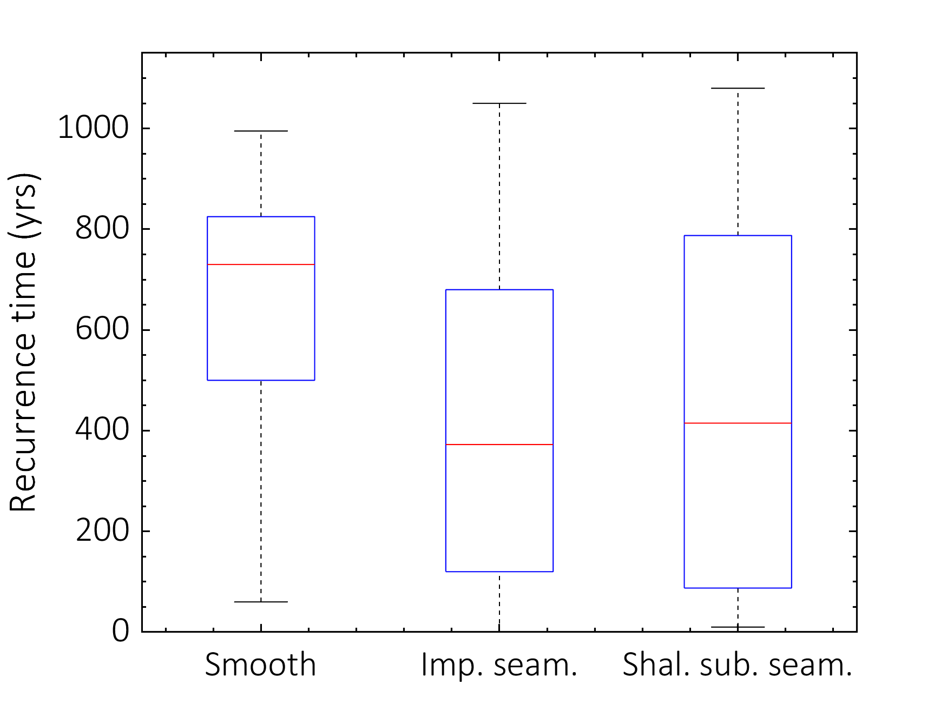
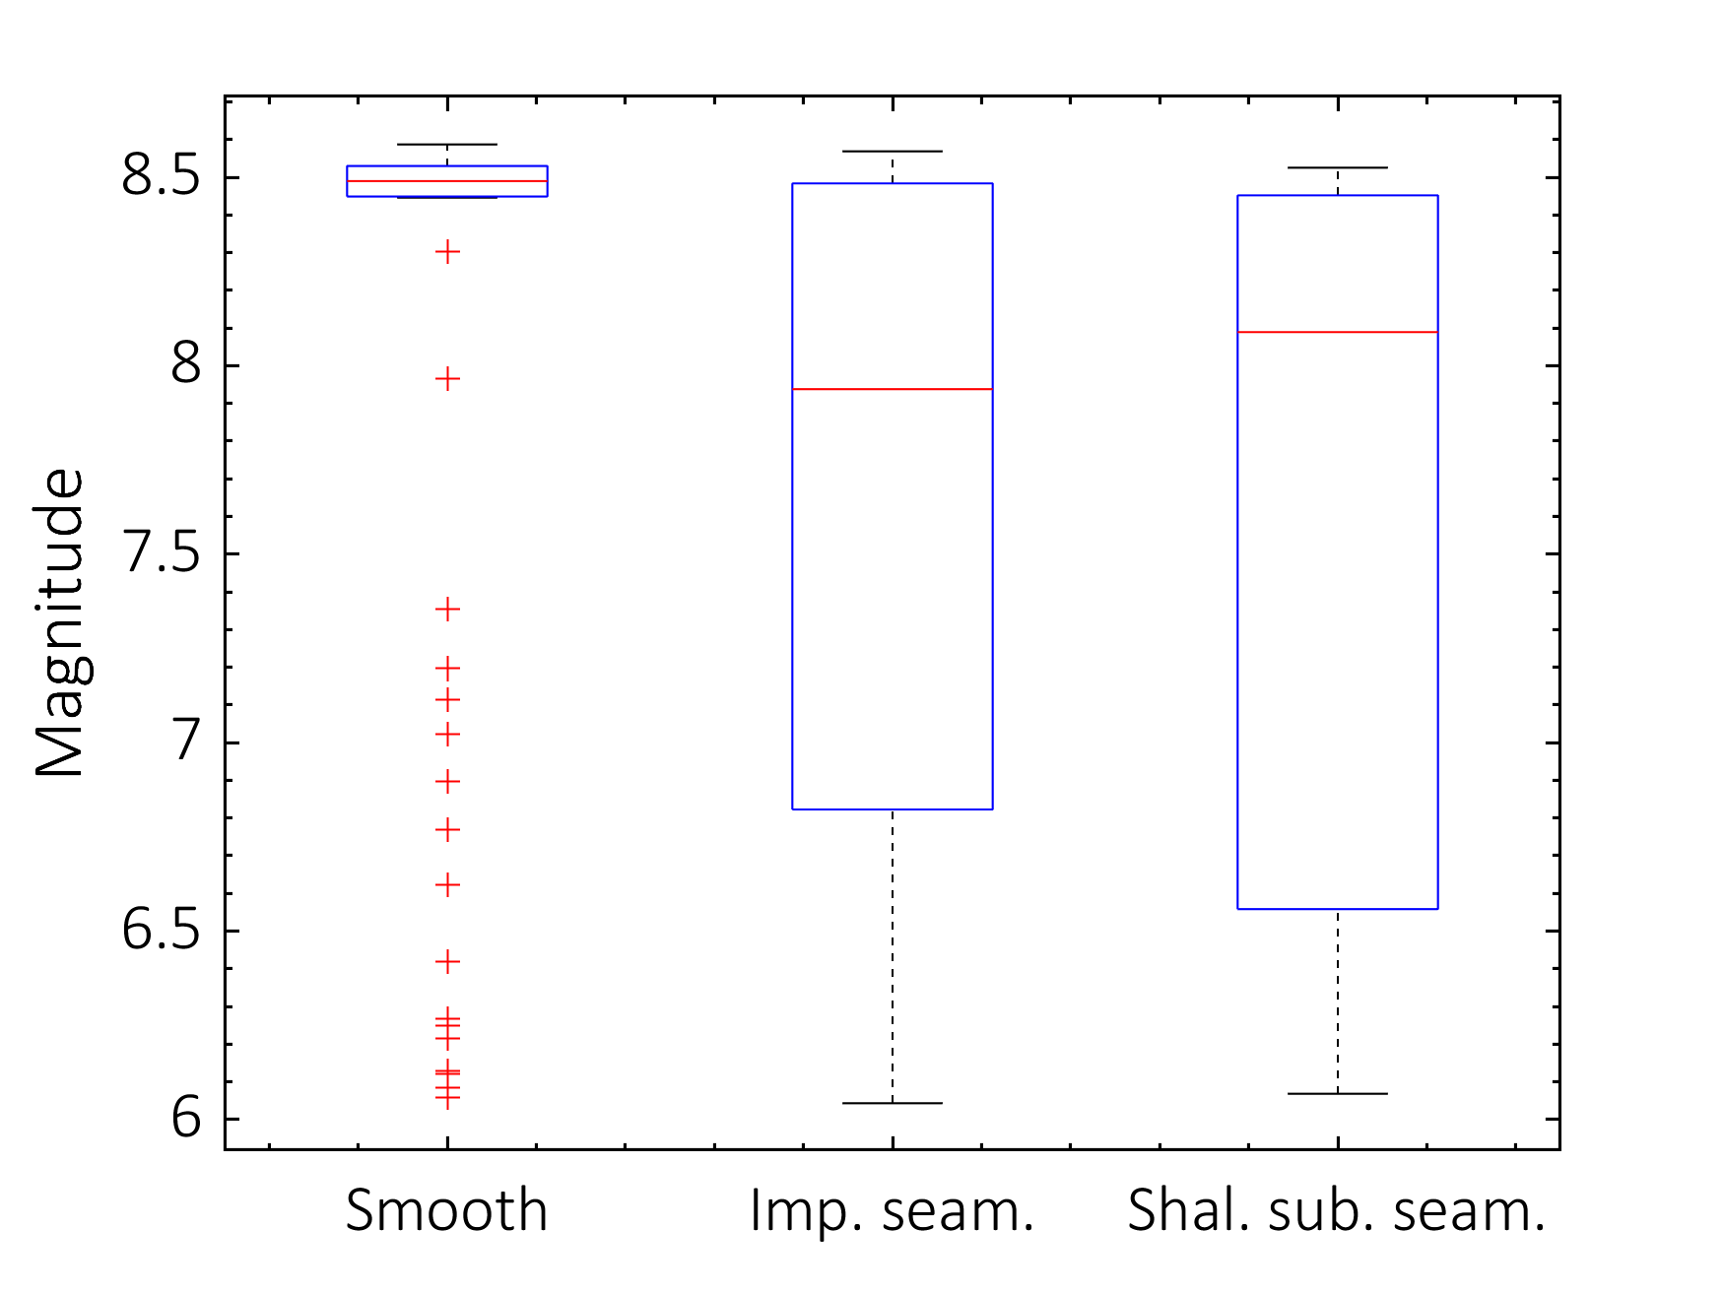
Statistics seismic events
Recurrence time
Magnitude
Seamount reduces overall recurrence time and magnitude
But longer recurrence megathrust events
Smooth interface
Smooth interface
Subducting seamount
Subducting seamount
= box megathrust events
Maaike Fonteijn, m.j.fonteijn@students.uu.nl

Slide 9
Conclusions
Strong seamount needed to subduct intact and break overriding plate
Subducting instead of imposing seamount distinctly impacts seismicity
Subducting seamount acts as asperity
Subducting seamount results in:
Increasing amount of splay faults
Longer recurrence of slightly smaller megathrust events
More smaller off-megathrust events
Maaike Fonteijn, m.j.fonteijn@students.uu.nl

