Slide 1



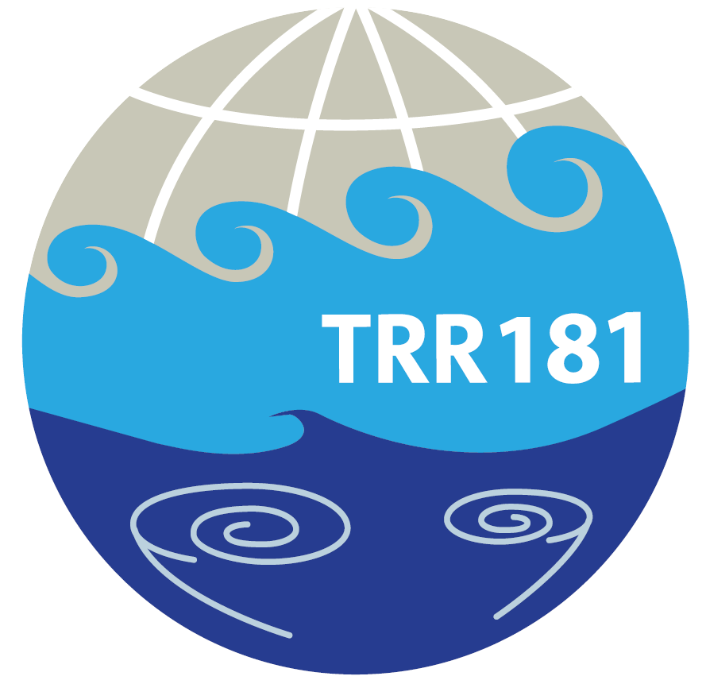

Zonal wavenumber spectra of the vertical velocity and horizontal divergence associated with the Rossby and non-Rossby waves in the tropics
Valentino Neduhal ¹, Nedjeljka Žagar ¹, Žiga Zaplotnik ²
¹ Meterological institude, CEN, Universitat Hamburg, Hamburg, Germany
² Faculty of Mathematics and Physics, Univerza v Ljubljani, Ljubljana, Slovenia

Slide 2

Goal
Quantification of the vertical momentum fluxes associated with Rossby and non-Rossby waves across scales in the tropics.
Non-Rossby = Kelvin, mixed Rossby-gravity and inertia-gravity waves
Linear regime decomposition of horizontal velocities across scales
Regime decomposition of vertical velocity and momentum fluxes across scales
✔
?
1

Slide 3
Method
Decomposition of the horiontal divergence, vertical velocity and momentum fluxes for Rossby and non-Rossby waves across scales
2
✔
Computation of the vertical pressure velocity ω from the continuity equation:
$$ω\left(λ,φ,p\right)=−\sum_{k=−K}^{K}{\sum_{n=1}^{R}{\sum_{m=1}^{M}{2 Ω i { ν}_{n}^{k}\left(m\right){ χ}_{n}^{k}\left(m\right){ Z}_{n}^{k}\left(m;φ\right){ e}^{−iλk} }} \int_{0}^{p}{{ G}_{m}\left(p′\right) dp′}}$$
Vertical structure function
Frequency
Hough function for
the geopotential
height
Hough expansion coefficient
Earth’s rotation rate
2

Slide 4
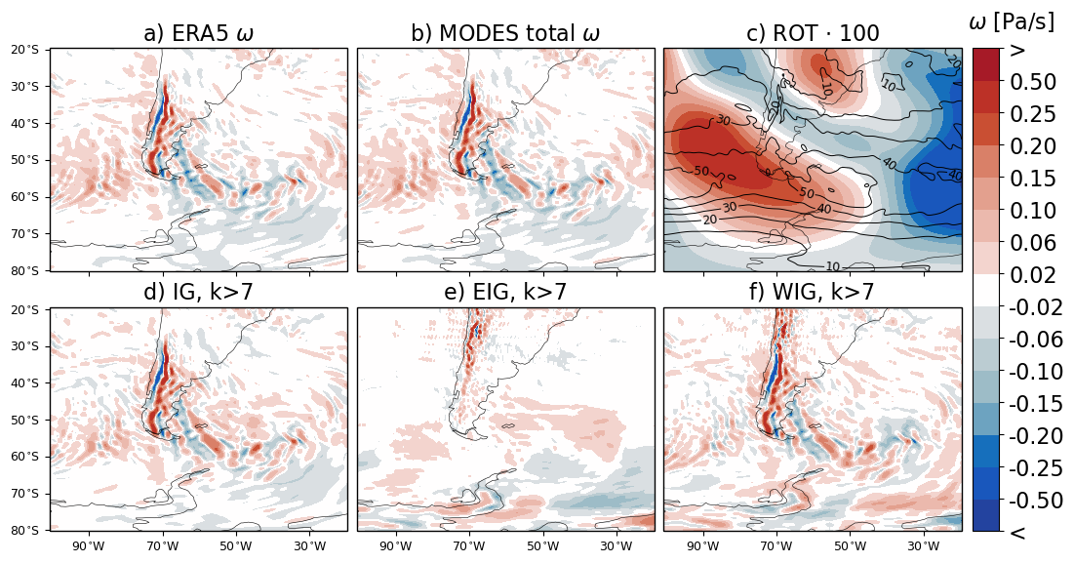
Comparison of ω from MODES with ω from ERA5
18.08.2018 at 100hPa
3

Slide 5
Decomposition of ω with MODES
18.08.2018 at 100hPa
4

Slide 6
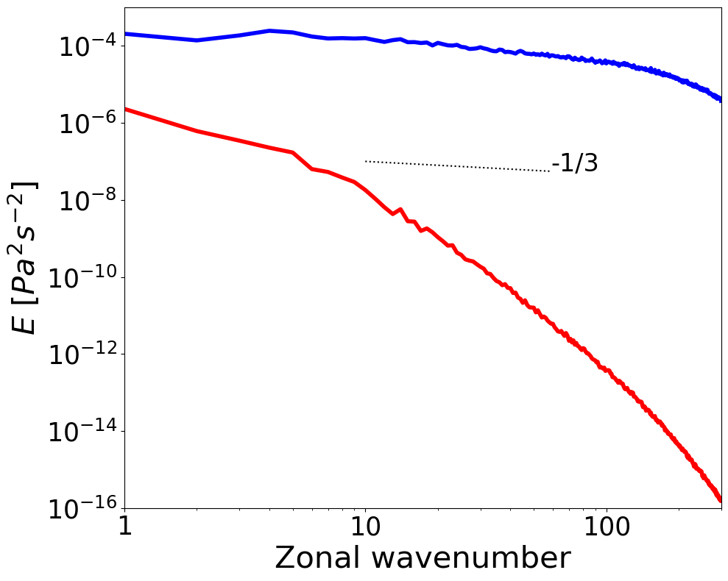
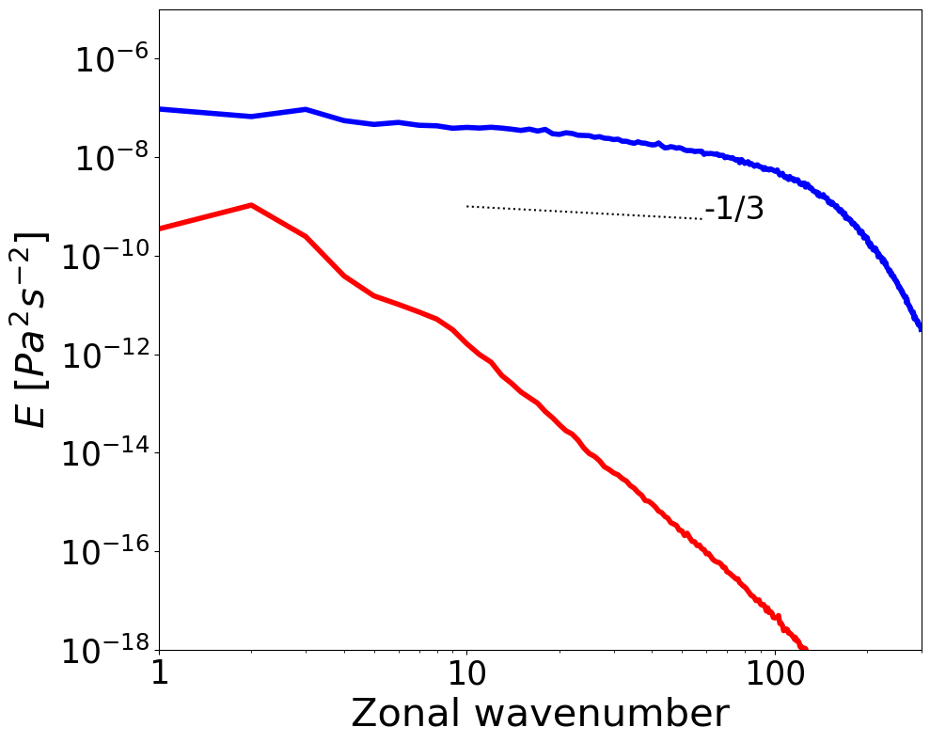
Vertical kinetic energy spectra of Rossby and non-Rossby modes
0 ͦ- 10 ͦN, 200-250 hPa
0 ͦ- 10 ͦN, 1-10 hPa
5

Slide 7
Summary & Outlook
Normal-mode function decomposition provides a framework for the separation of vertical motions and momentum fluxes into Rossby and non-Rossby parts, especially useful in the tropics.
Spectra of the vertical kinetic energy in the tropics are almost entirely associated with the non-Rossby modes.
Ongoing work focuses on the computation of regime and scale-dependent vertical momentum fluxes.
6

Slide 8
Zonal wavenumber spectra of the vertical velocity and horizontal divergence associated with the Rossby and non-Rossby waves in the tropics
Valentino Neduhal ¹, Nedjeljka Žagar ¹, Žiga Zaplotnik ²
¹ Meterological institude, CEN, Universitat Hamburg, Hamburg, Germany
² Faculty of Mathematics and Physics, Univerza v Ljubljani, Ljubljana, Slovenia
Email: Valentino Neduhal - valentino.neduhal@uni-hamburg.de
Nedjeljka Žagar – nedjeljka.zagar@uni-hamburg.de

