Slide 1
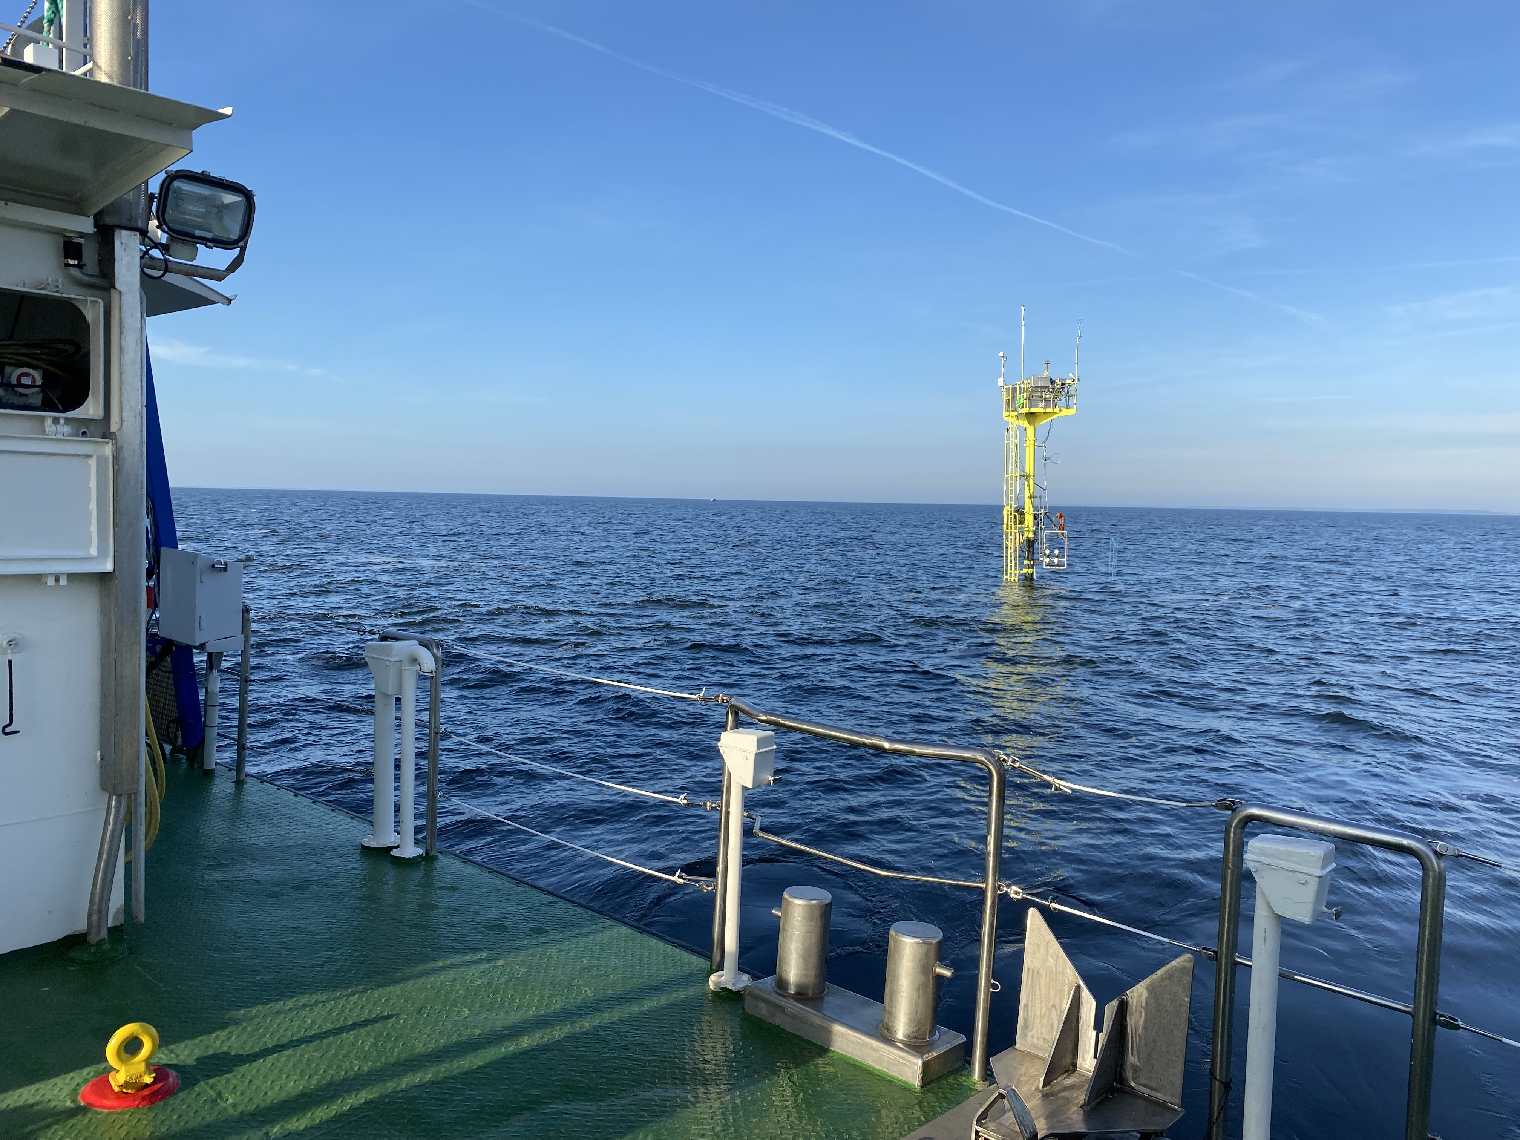
Effect of Langmuir circulation on mixing & carbon dynamics in a shallow lagoon
Yoana G. Voynova
Marc P. Buckley, Michael Stresser, Marius Cysewski, Jan Bödewadt, Martina Gehrung, Jochen Horstmann

Slide 2
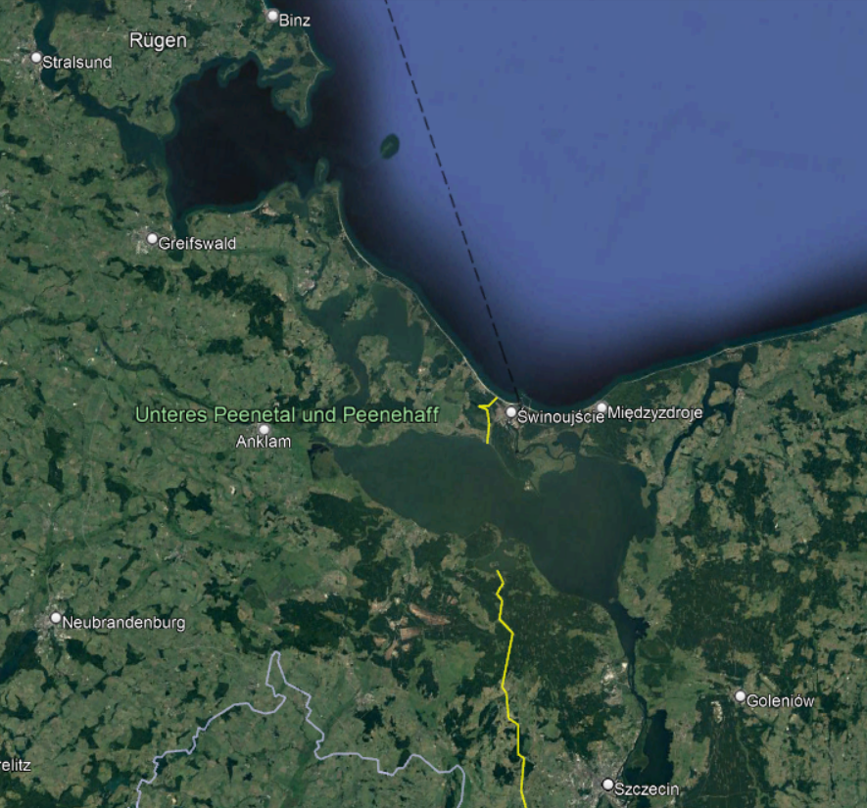
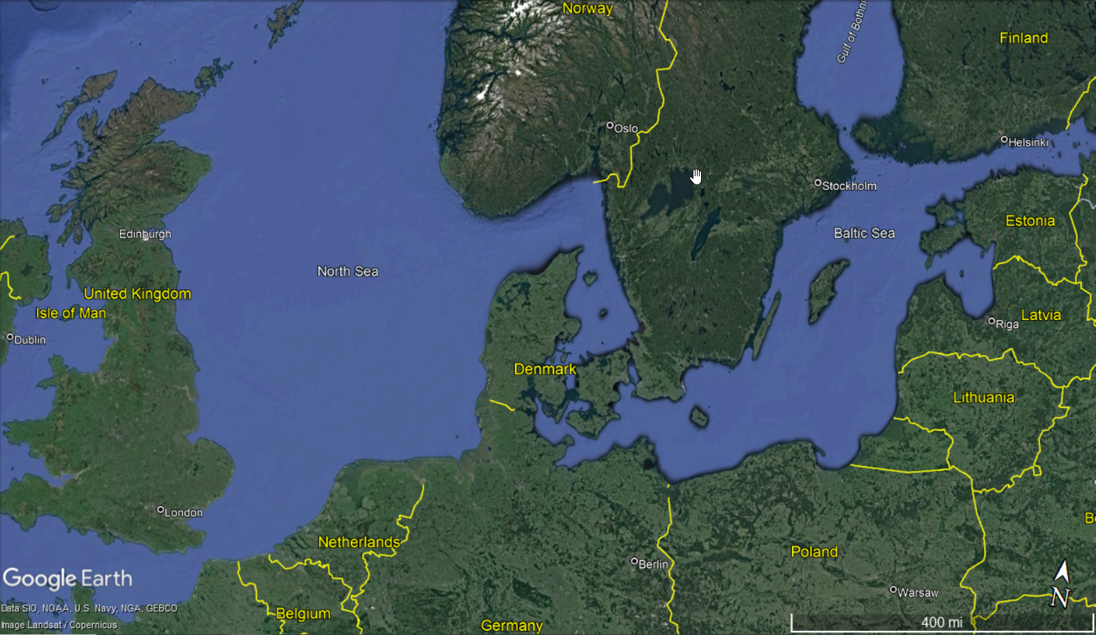
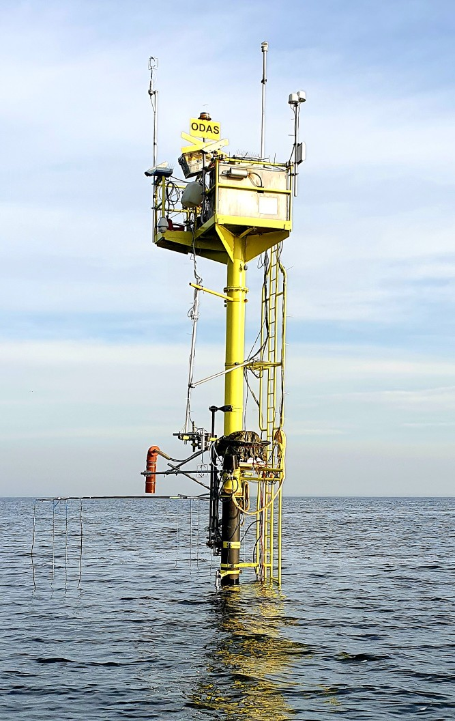
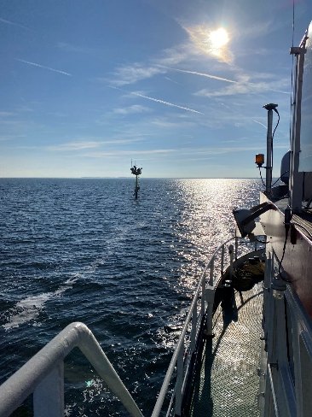
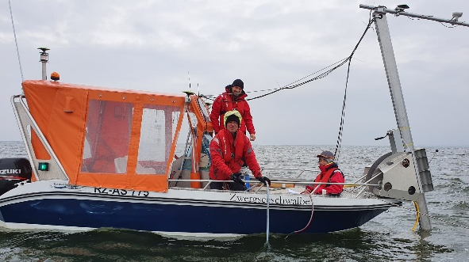
Experiment
Shallow lagoon between Poland & Germany
Experiments on momentum flux & wind-wave dynamics
Water column biogeochemistry
Measurement station + small boat + RV + ADCP + drifters + drones
Pocket FerryBox

Slide 3
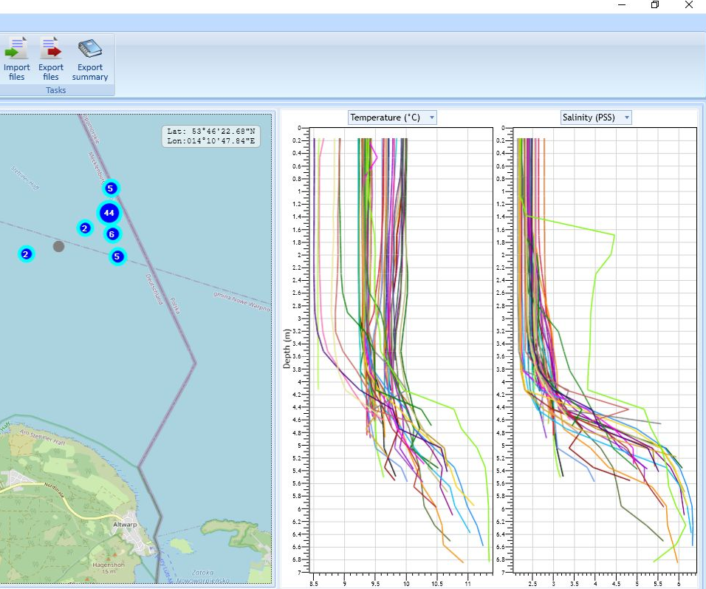
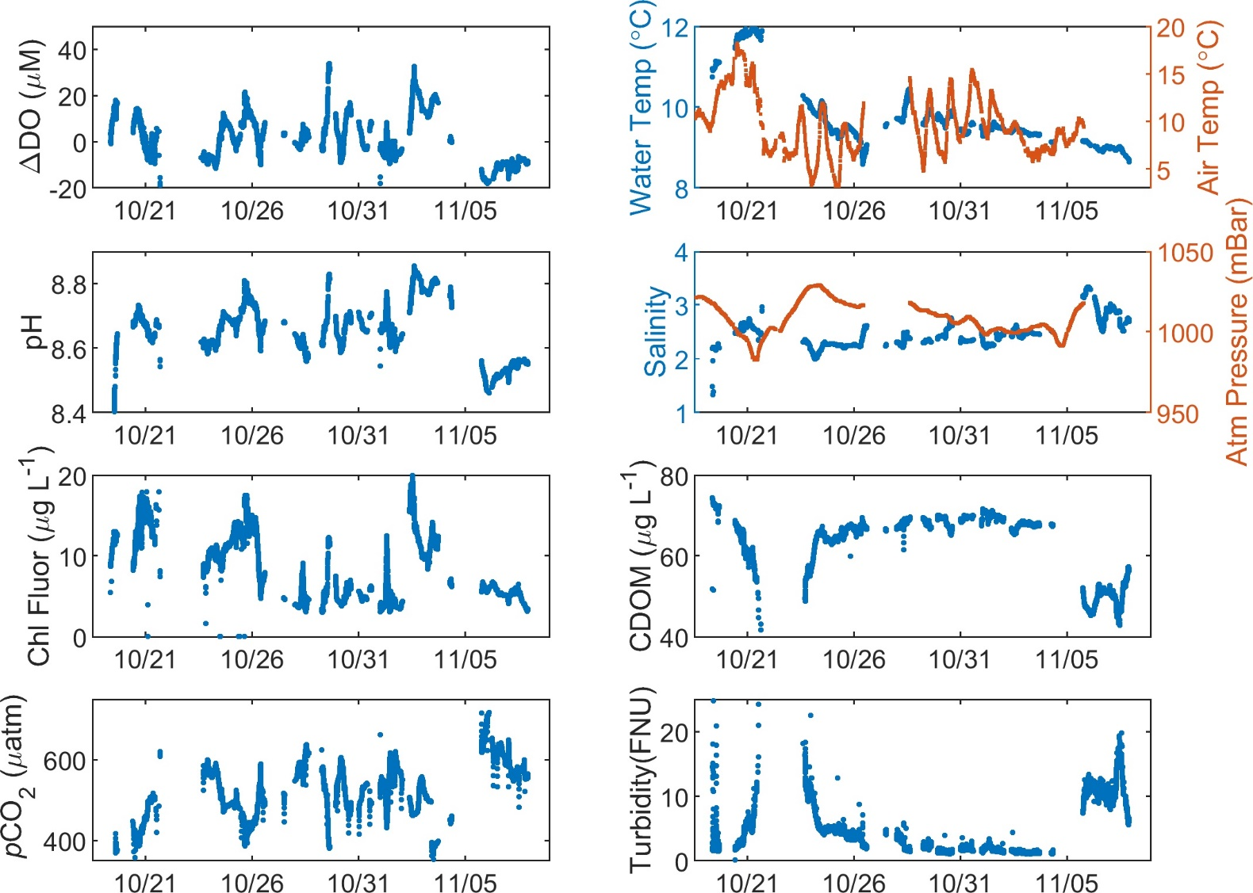
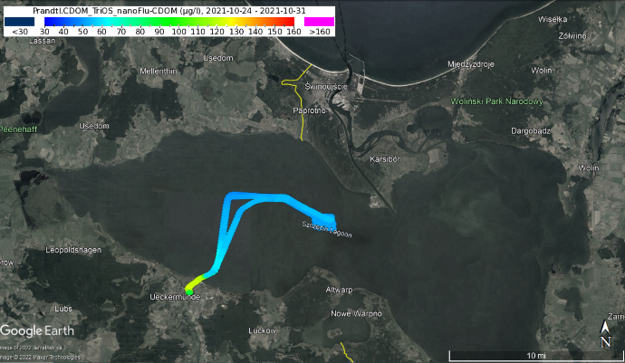
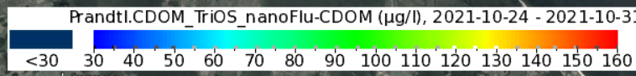
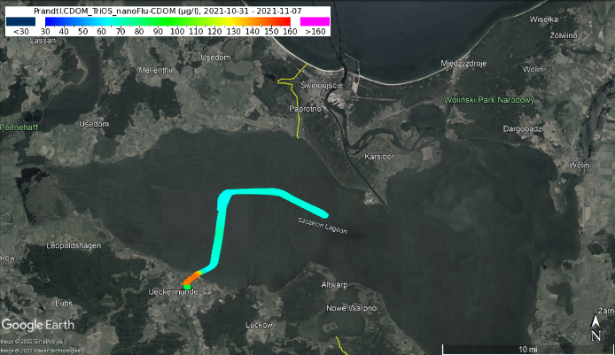
Preliminary Data
DO : ~ 95-110 in % Saturation
pCO₂ ~400-500 µatm
DO : ~ 60 in % Saturation
pCO₂ ~700-1285 µatm

Slide 4
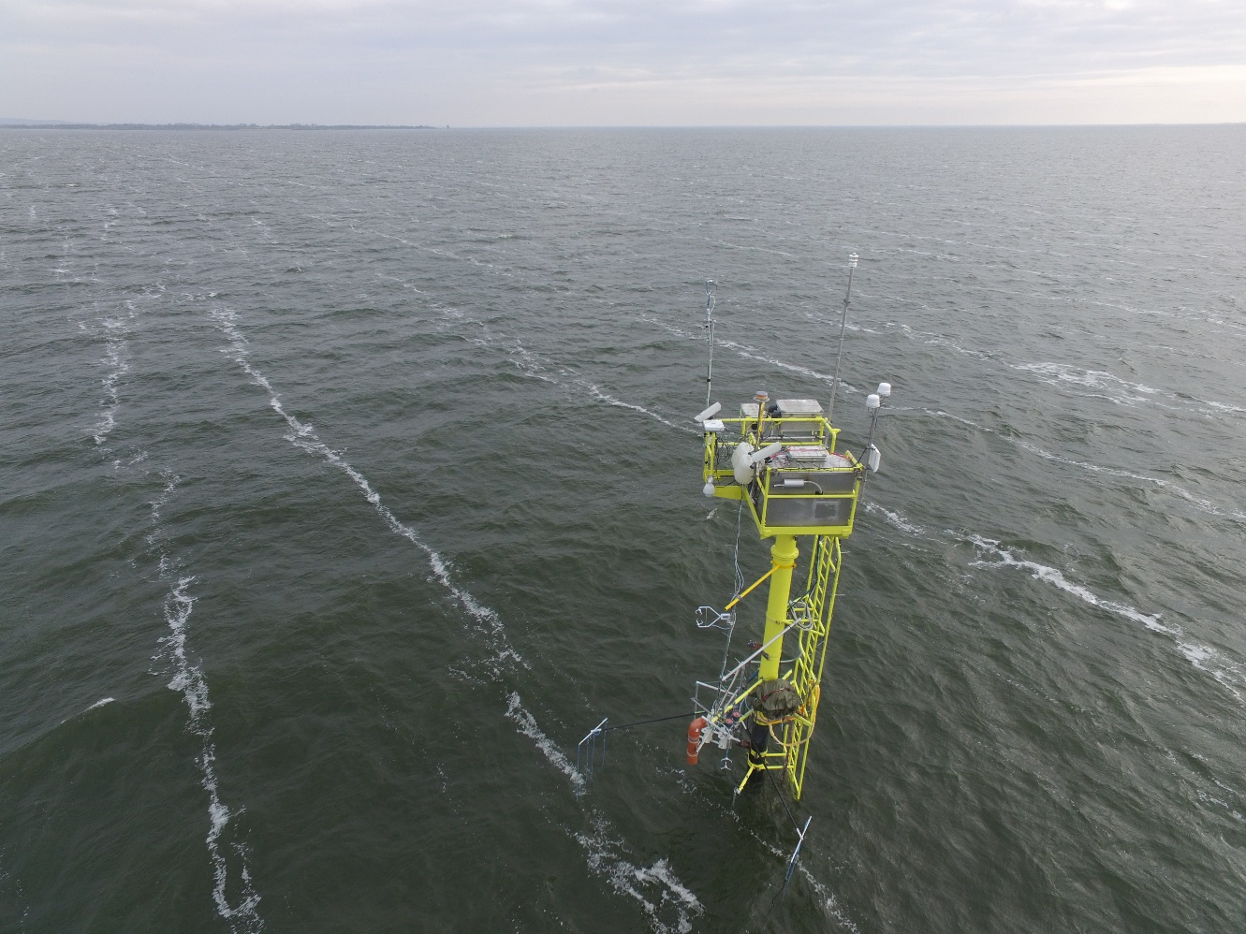
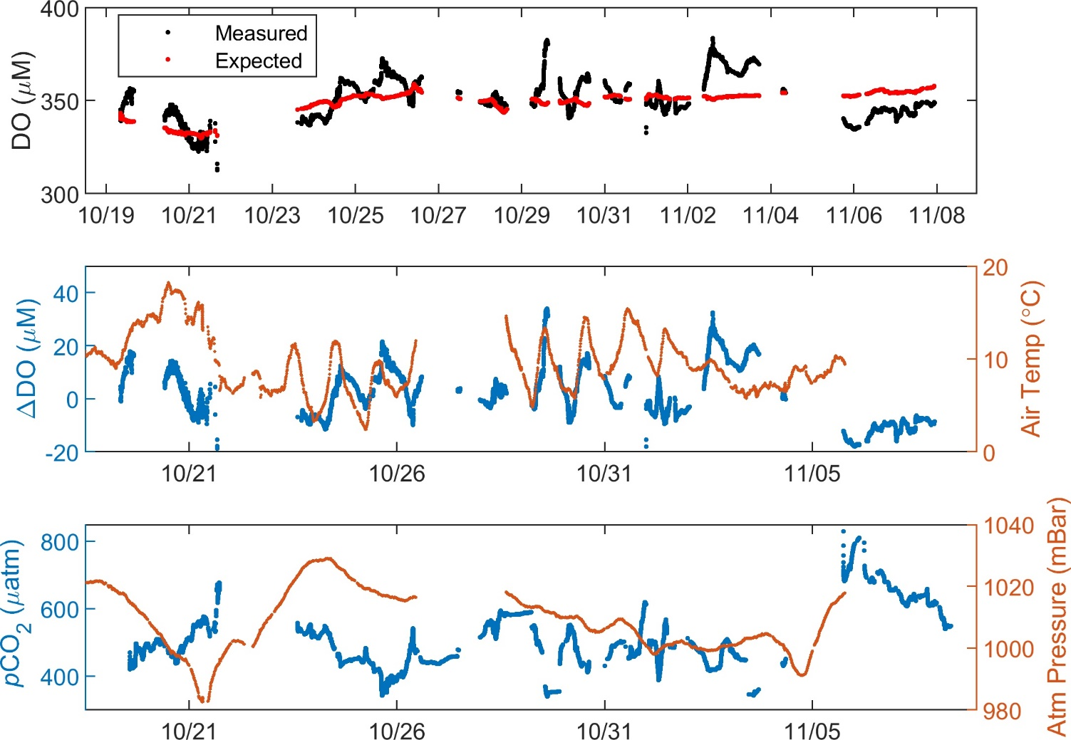
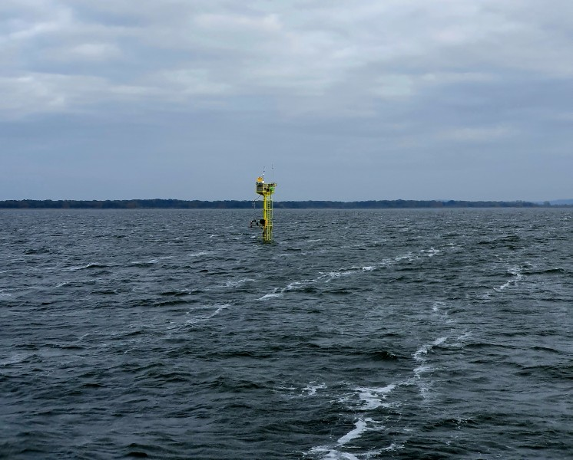
How do dynamics affect biogeochemistry?

Slide 5
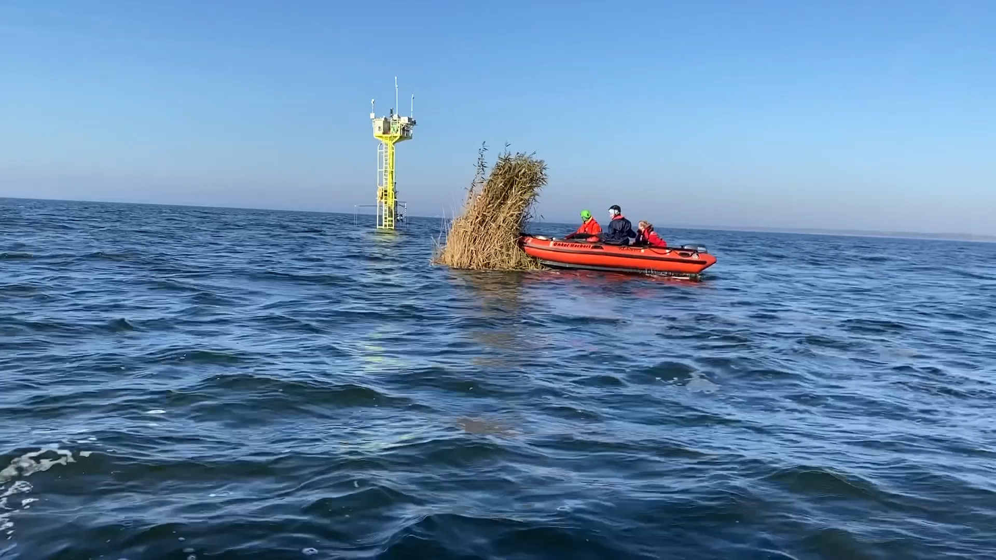
Thanks!

