Slide 1






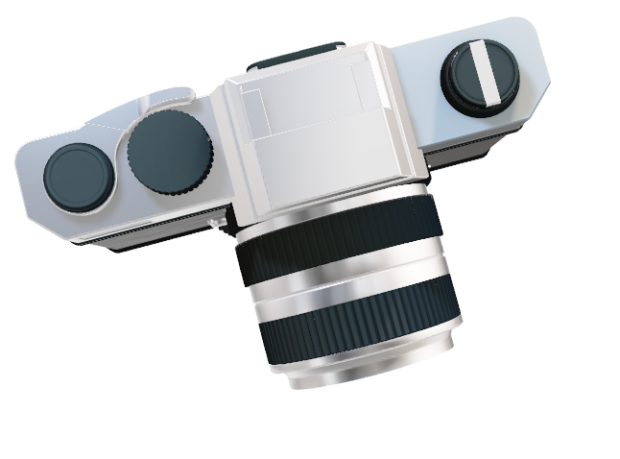
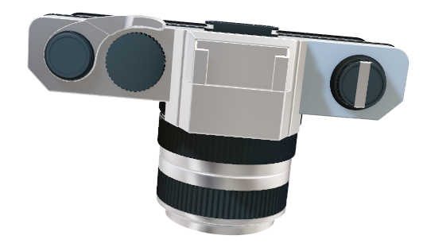
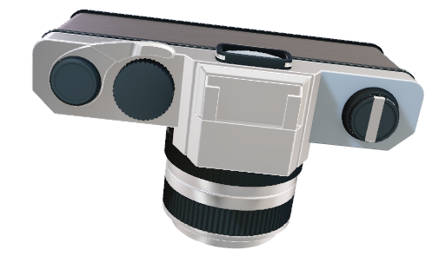

Primary-level site effect zoning in developing urban areas through the geomorphic interpretation of landforms
Zahra Pak Tarmani¹, Zohreh Masoumi^{1,2}, Esmaeil Shabanian¹
1: Department of earth sciences, Institute for advanced studies in basic sciences (IASBS), Zanjan, Iran.
2: Center for Research in Climate Change and Global Warming (CRCC), Zanjan, Iran.

Slide 2
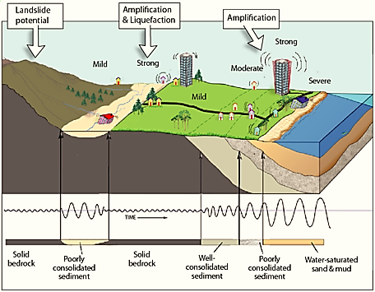

Problem Definition
The site effect has a great impact on seismic hazard assessment in urban and industrial regions.
A layer of soft soil with a thickness of several meters amplifies seismic waves from 1.5 to 6 times relative to the underlying bedrock.
How to investigate earthquake site effect in urban areas using historical photographs?
Figure1: Site Effects in Structural Response

Slide 3
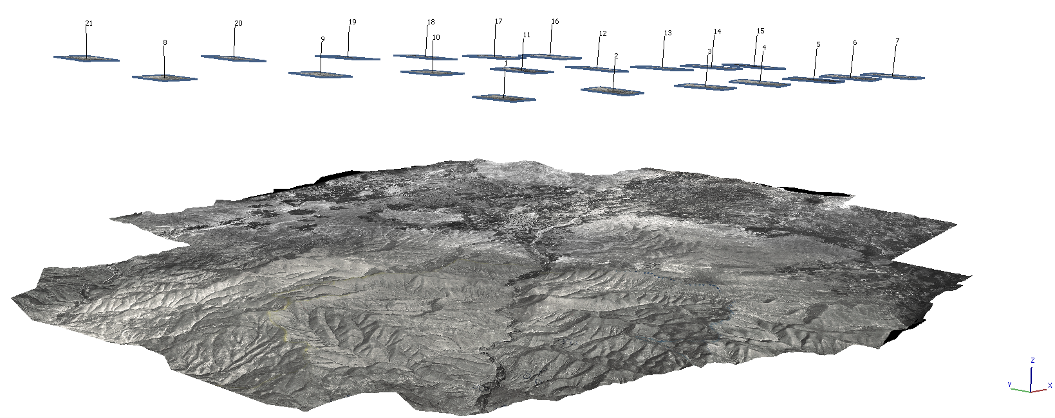
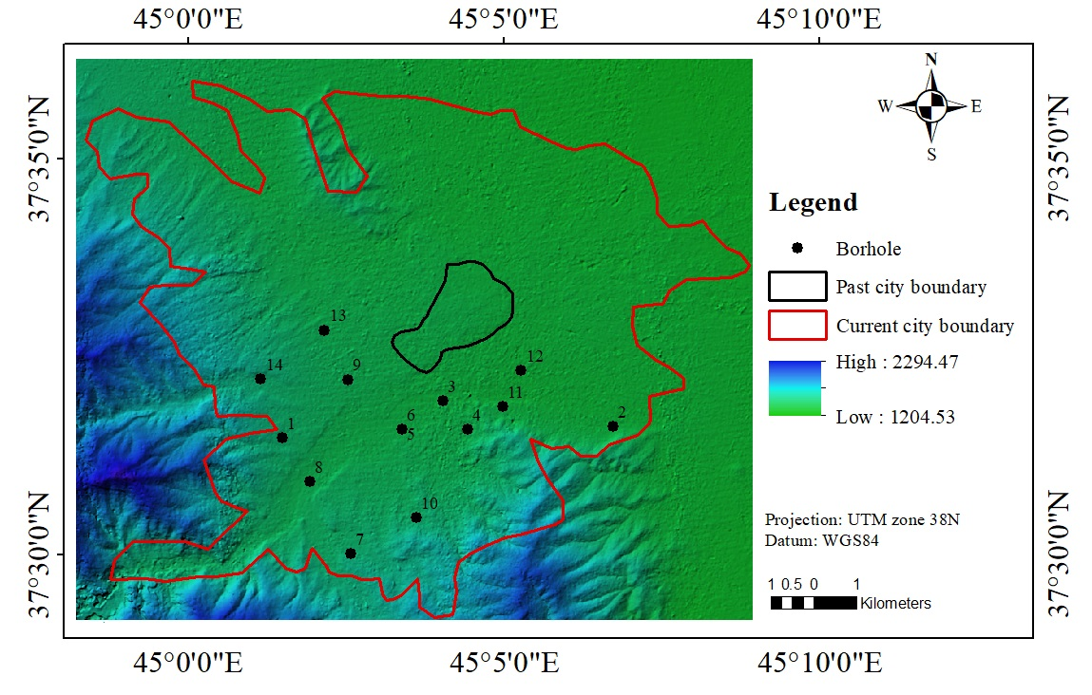
Methods
Photogrammetry
  Aerial Photogrammetry: 21 Ancient Aerial Photos/ 600 dpi
  Algorithm Structure from Motion (SfM)
    |Algorithm Scale Invariant Feature Transform (SIFT)
    |Algorithm RANdom Sample Consensus (RANSAC)
    |Algorithm Semi-Global Matching (SGM)
  Digital Elevation Model (DEM)
Geomorphology
  Geomorphologic Map of Quaternary (units terrains)
Boreholes geotechnic information
  Primary site effect results from boreholes
Figure2: Orthophoto mosaic - Perspective 30
5.18 m / Pix
Figure3: DEM from ancient aerial photos processing

Slide 4
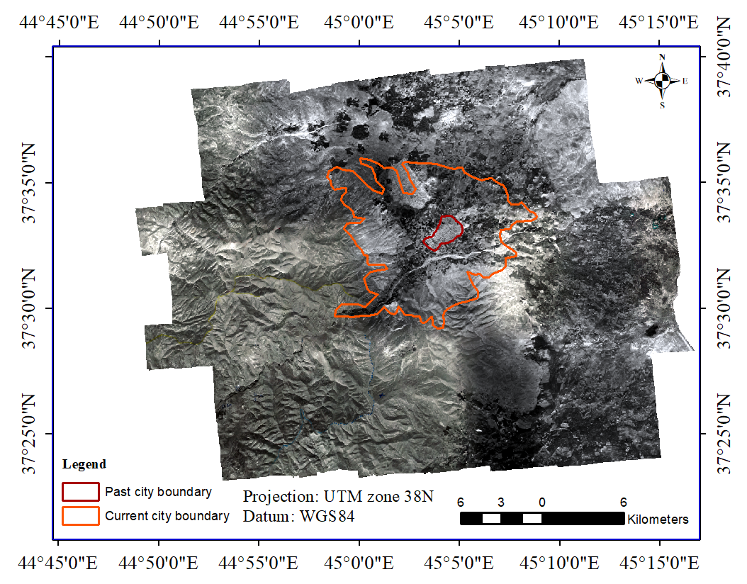
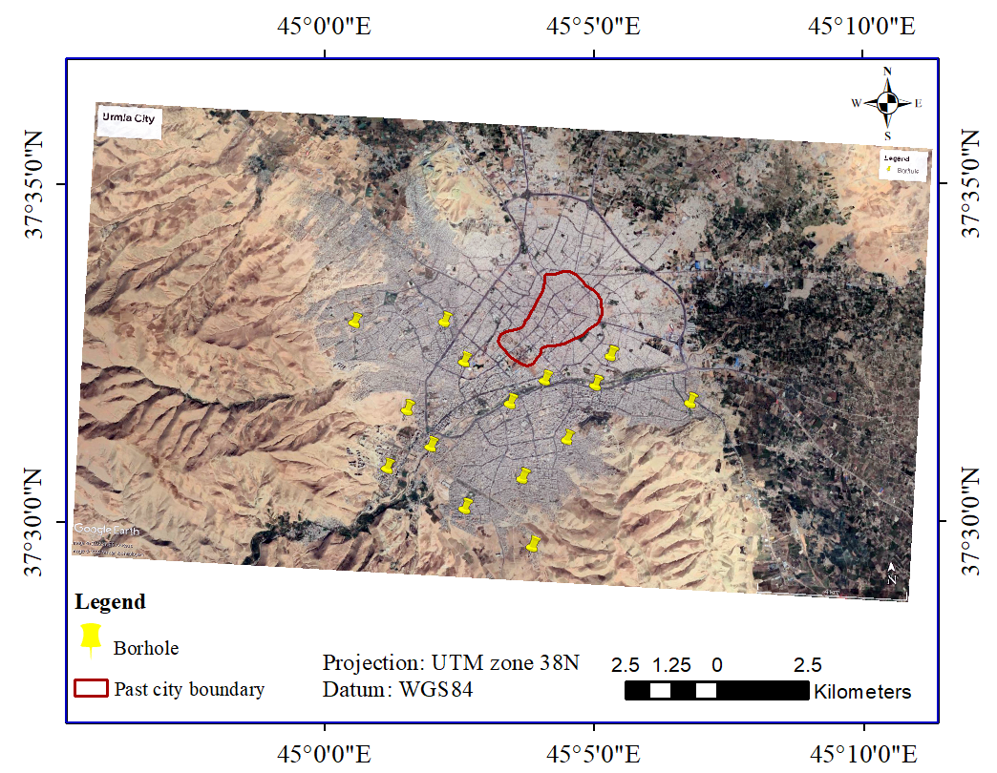

Study Area
Figure5: Orthophotomosaic prepared from ancient aerial photos
1:50000 / 8 Aug 1955
Figure4: Map from archived satellite photos of the area.

Slide 5
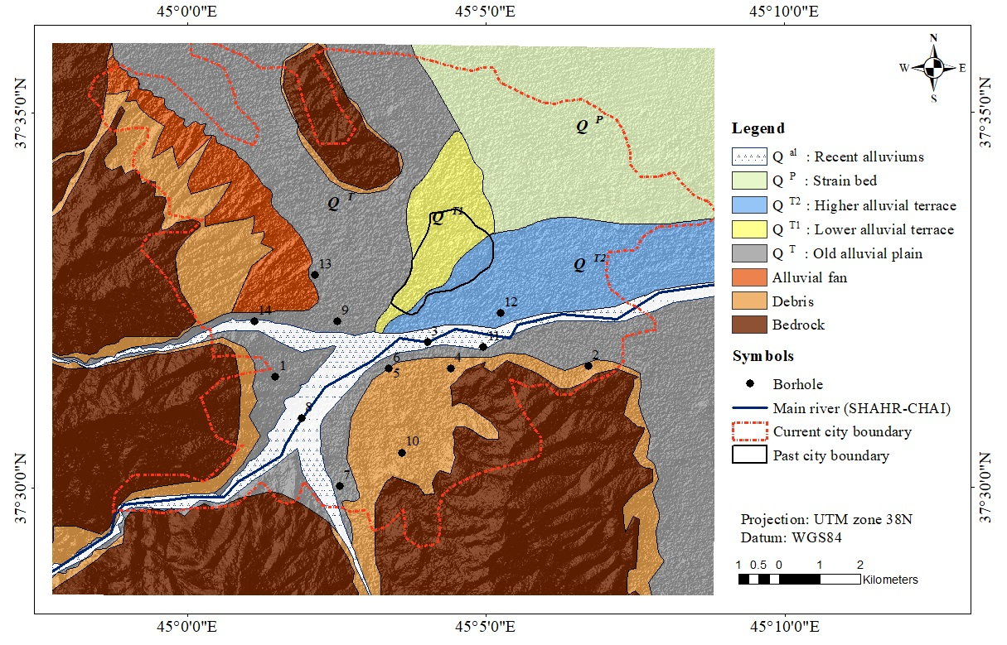
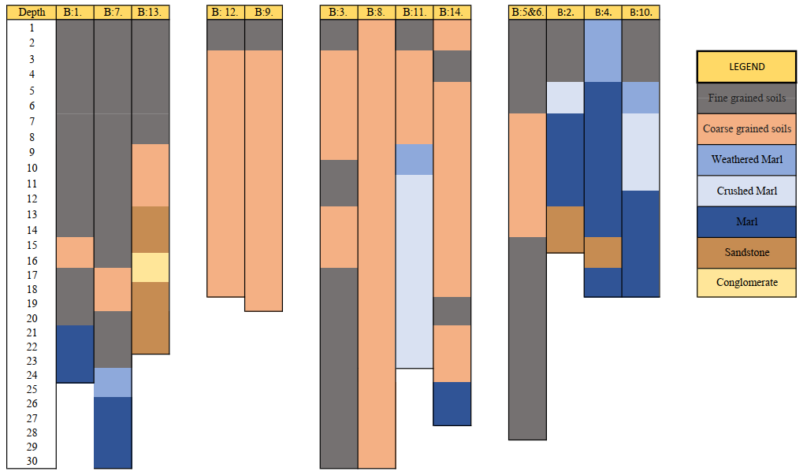
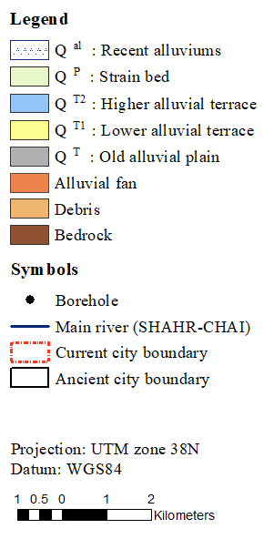
Results
Stream bed
Figure6: Geomorphology map extracted from DEM
Figure7: Borehole layers information

Slide 6
Results
Stream bed

Slide 7
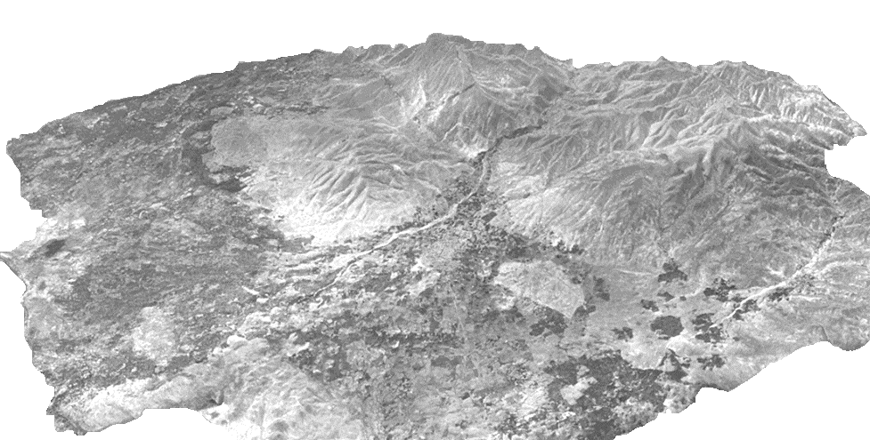
Conclusion
Our study provides a cost- and time-efficient tool to evaluate primary site effect in urban areas at risk of geological hazards prior to implementing geophysical investigations such as Nakamura microtremor H/V and multichannel analysis of Surface Waves.
Prepared: Zahra Pak Tarmani
p.74.zahra@gmail.com
Supervisor: Zohreh Masoumi
z.masoumi@iasbs.ac.ir
Advisor: Esmaeail Shabanian
shabanian@iasbs.ac.ir
Mentor: Solmaz Mohadjer
solmaz.mohadjer@ucentralasia.org

