Slide 1



Spatial Correlation between Intraplate Volcanism and Thin Lithosphere in the Circum-Mediterranean: New Evidences from Surface Wave Tomography and Thermomechanical Modelling
Amr El-Sharkawy (University of Kiel, Germany, NRIAG in Egypt)
Thor Hansteen (GEOMAR, Kiel, Germany)
Carlos Gomez & Javier Fullea (Barcelona Uni., Spain)
Sergei Lebedev (Cambridge Uni., UK)
Thomas Meier (University of Kiel, Germany)

Slide 2
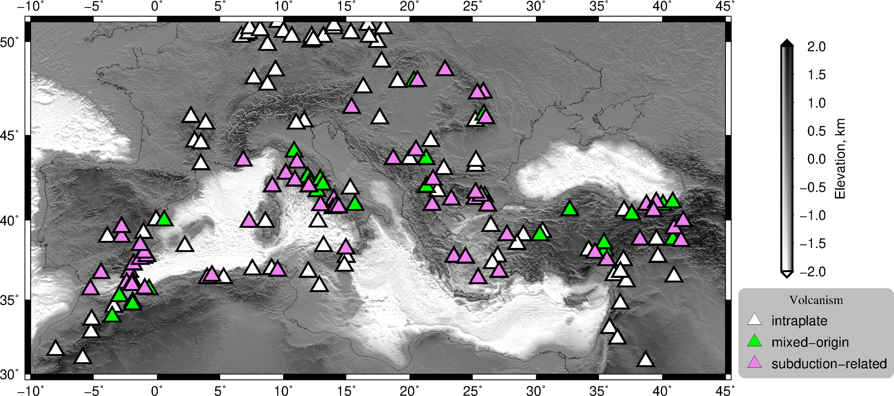
Cenozoic anorogenic volcanism in the Mediterranean realm, 75 m.y.
EGU 2022 Mai 26th, 2022 El-Sharkawy et al.,

Slide 3
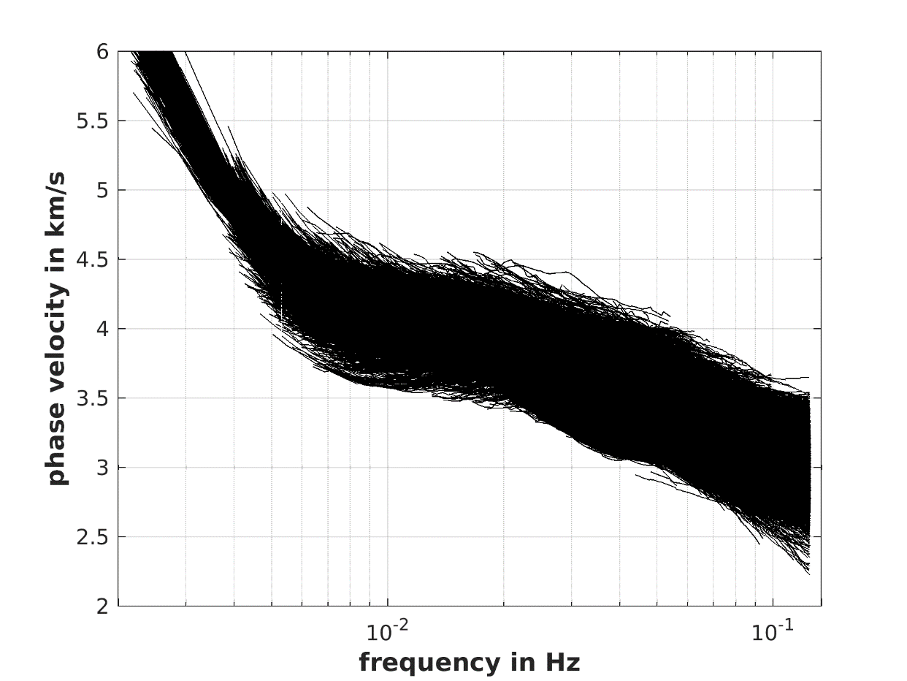
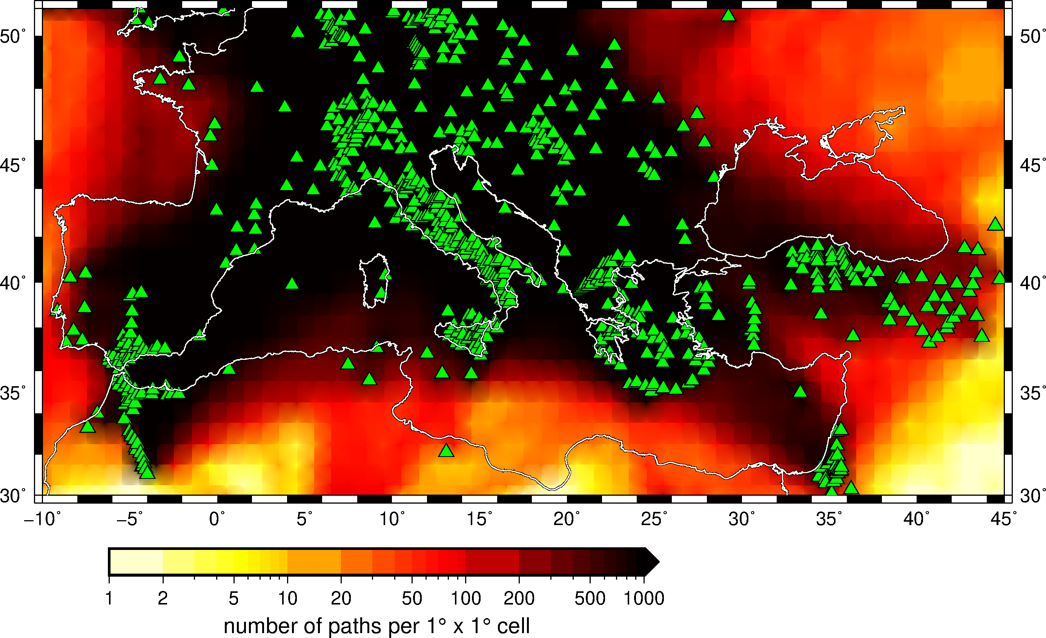
Surface wave tomography: Dataset
(25 years of data, 3900 events, 4500 stations, 3.5 M waveforms)
Automated inter-station phase velocities
200.000 dispersion curves
8 – 300 seconds
EGU 2022 Mai 26th, 2022 El-Sharkawy et al.,

Slide 4
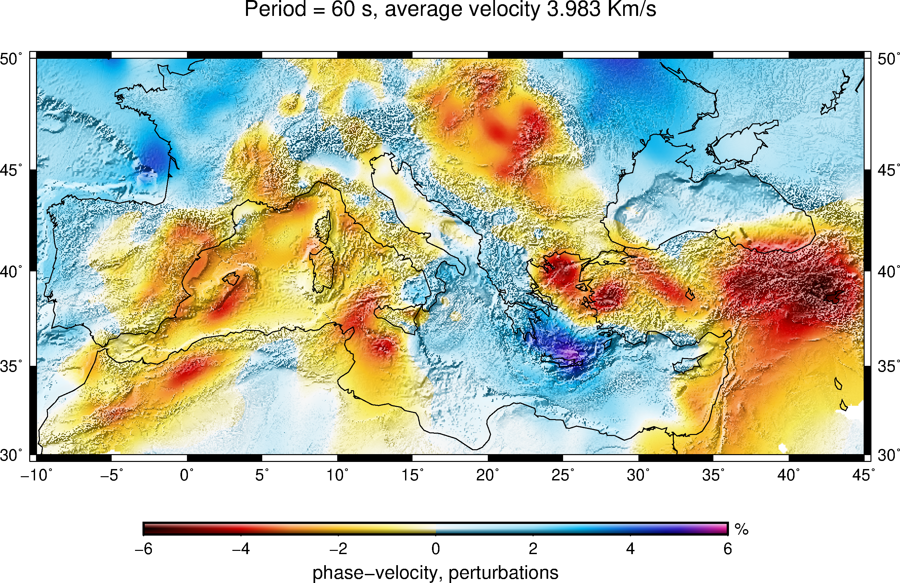
Phase velocity tomography: @period of 60 s
EGU 2022 Mai 26th, 2022 El-Sharkawy et al.,

Slide 5
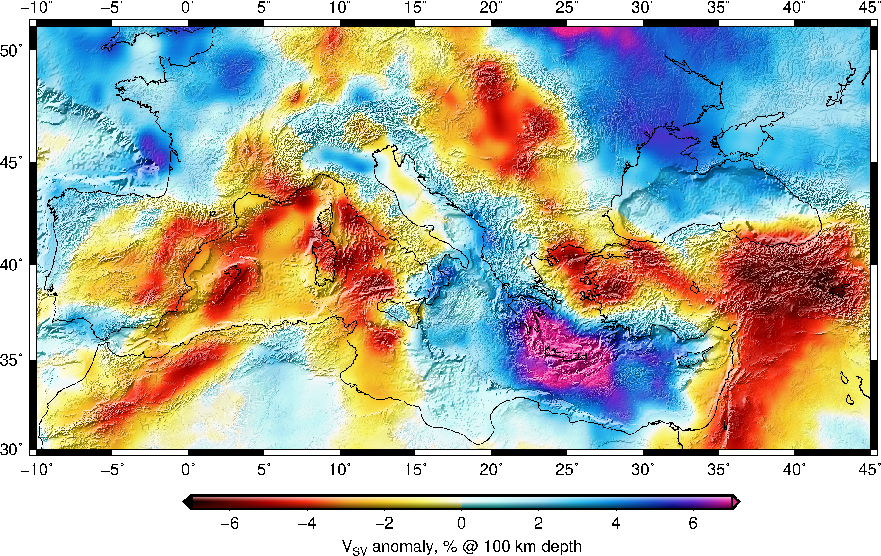
3-D Vs model of the Mediterranean “MeRE2020”
Lateral resolution < 100 km
EGU 2022 Mai 26th, 2022 El-Sharkawy et al.,

Slide 6

EGU 2022 Mai 26th, 2022 El-Sharkawy et al.,

Slide 7
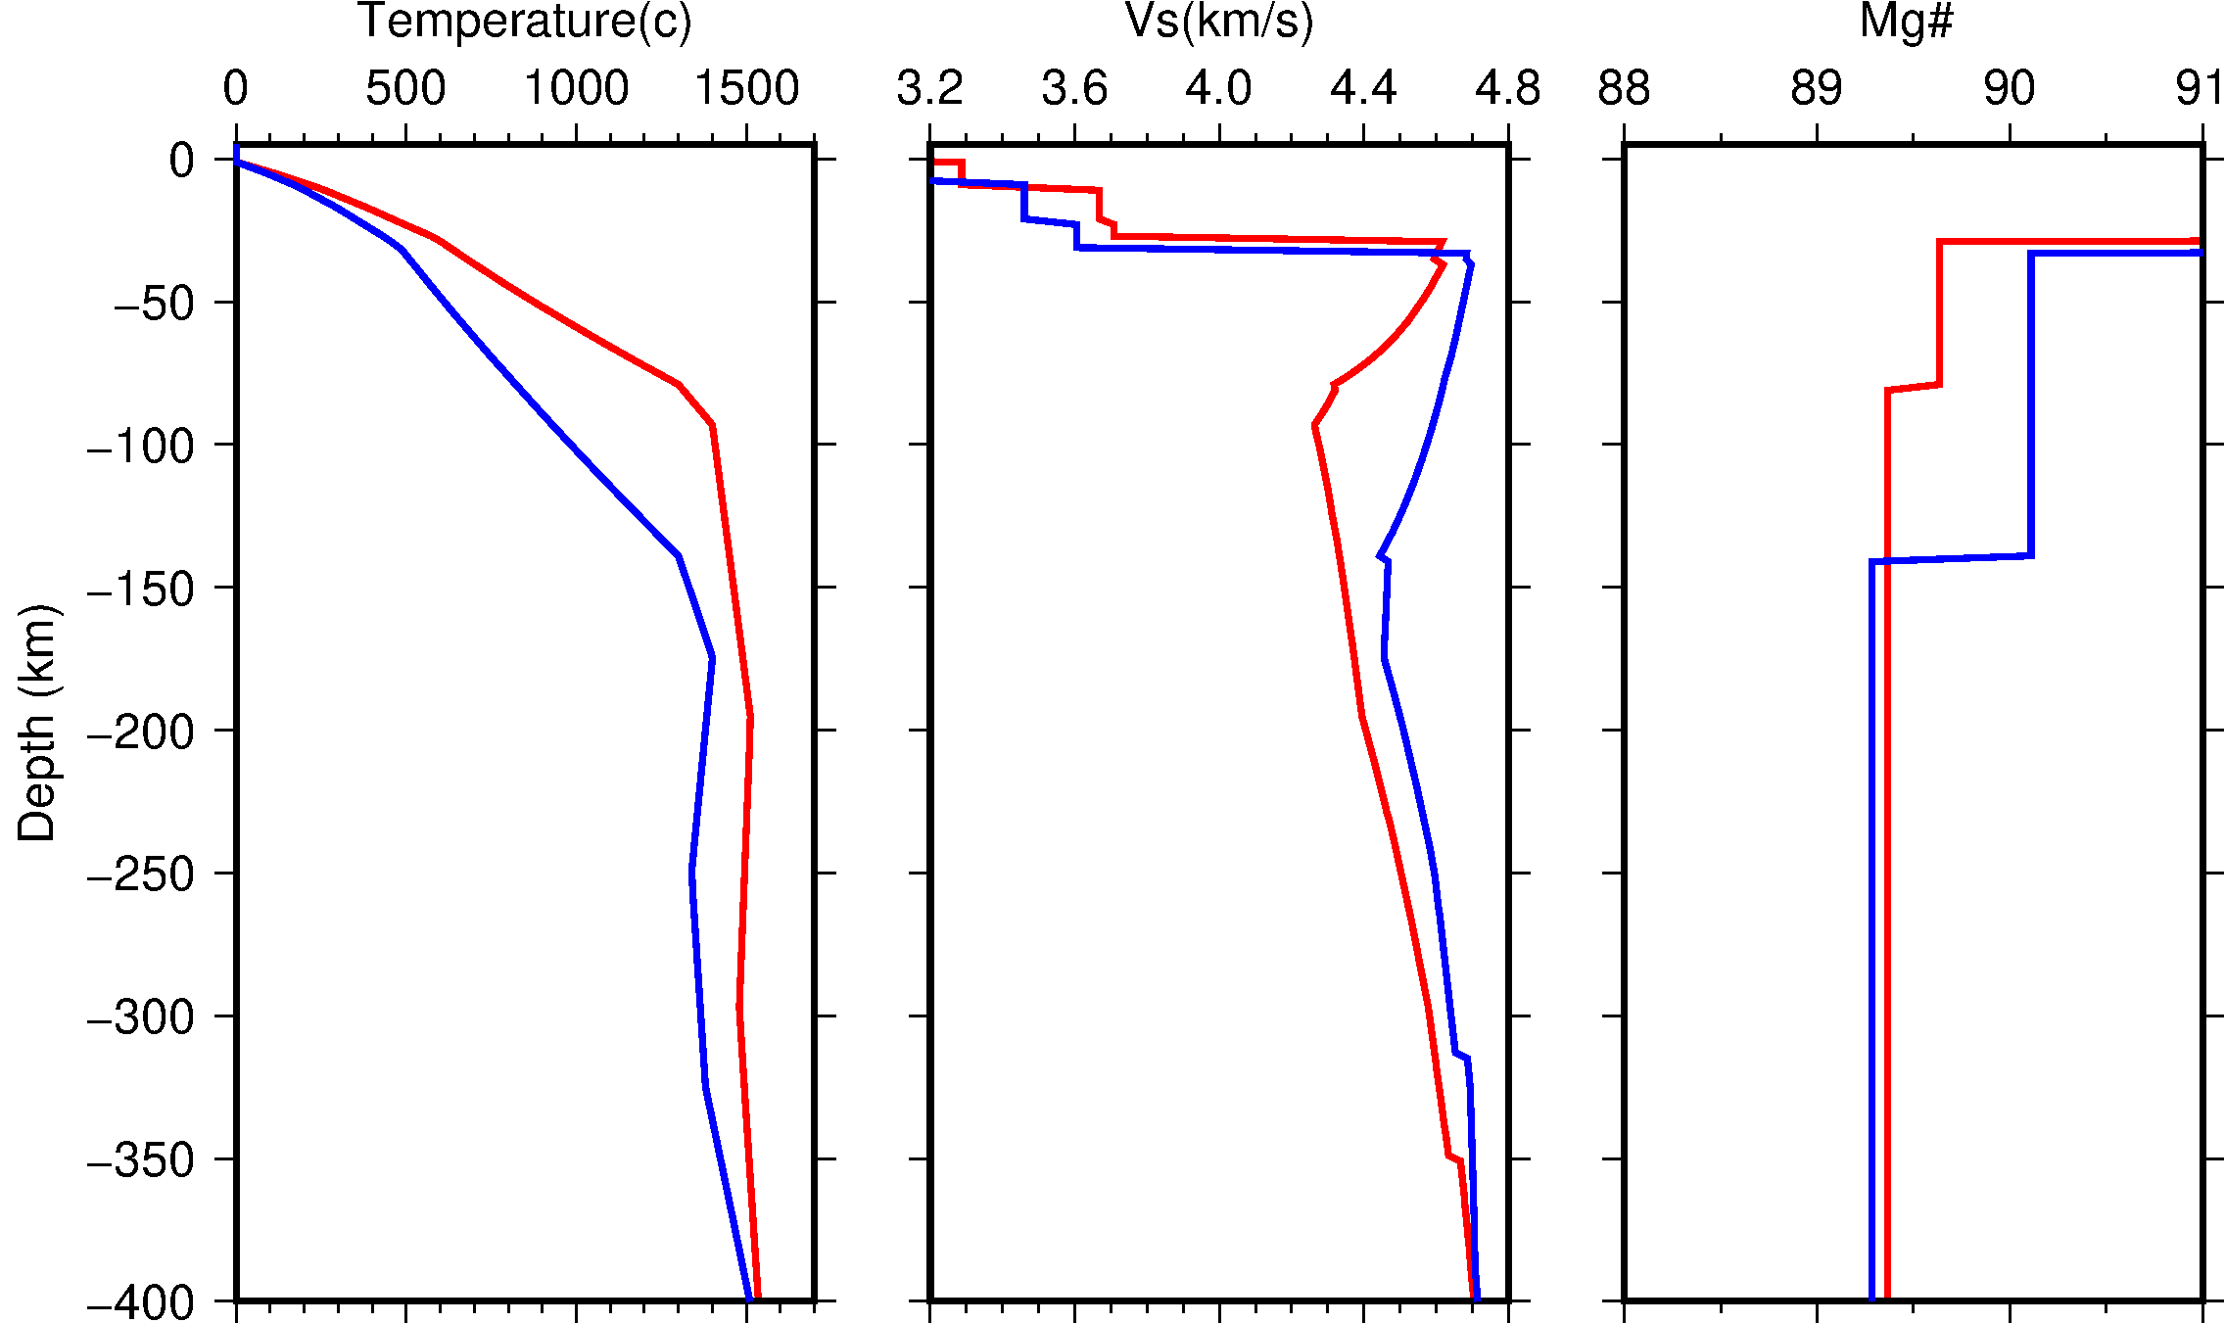
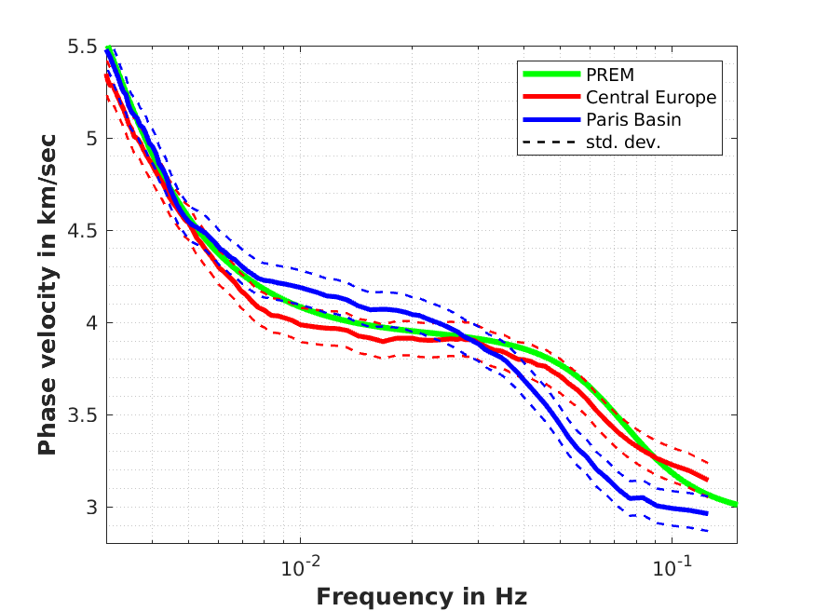
Integrated Geophysical-Thermochemical Modeling
WINTREC-G
(phase velocities + heat flow + topography + Gravity data ➔ temperature and compositional variables)
----- Paris Basin ----- Central Europe
Mg# =Mg/(Mg+Fe)*100
EGU 2022 Mai 26th, 2022 El-Sharkawy et al.,

Slide 8
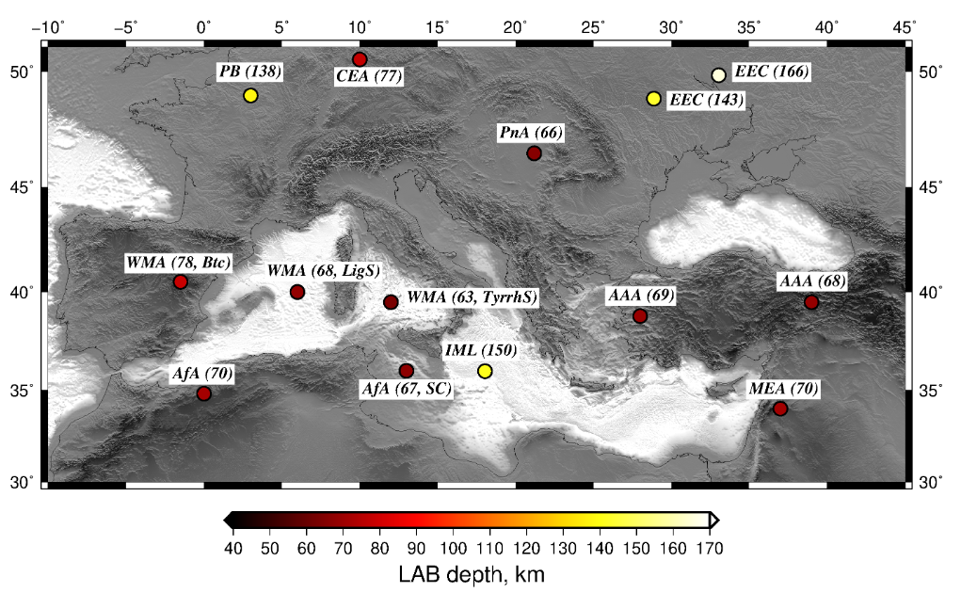
NAA (70)
NAA (67, SC)
EGU 2022 Mai 26th, 2022 El-Sharkawy et al.,

Slide 9
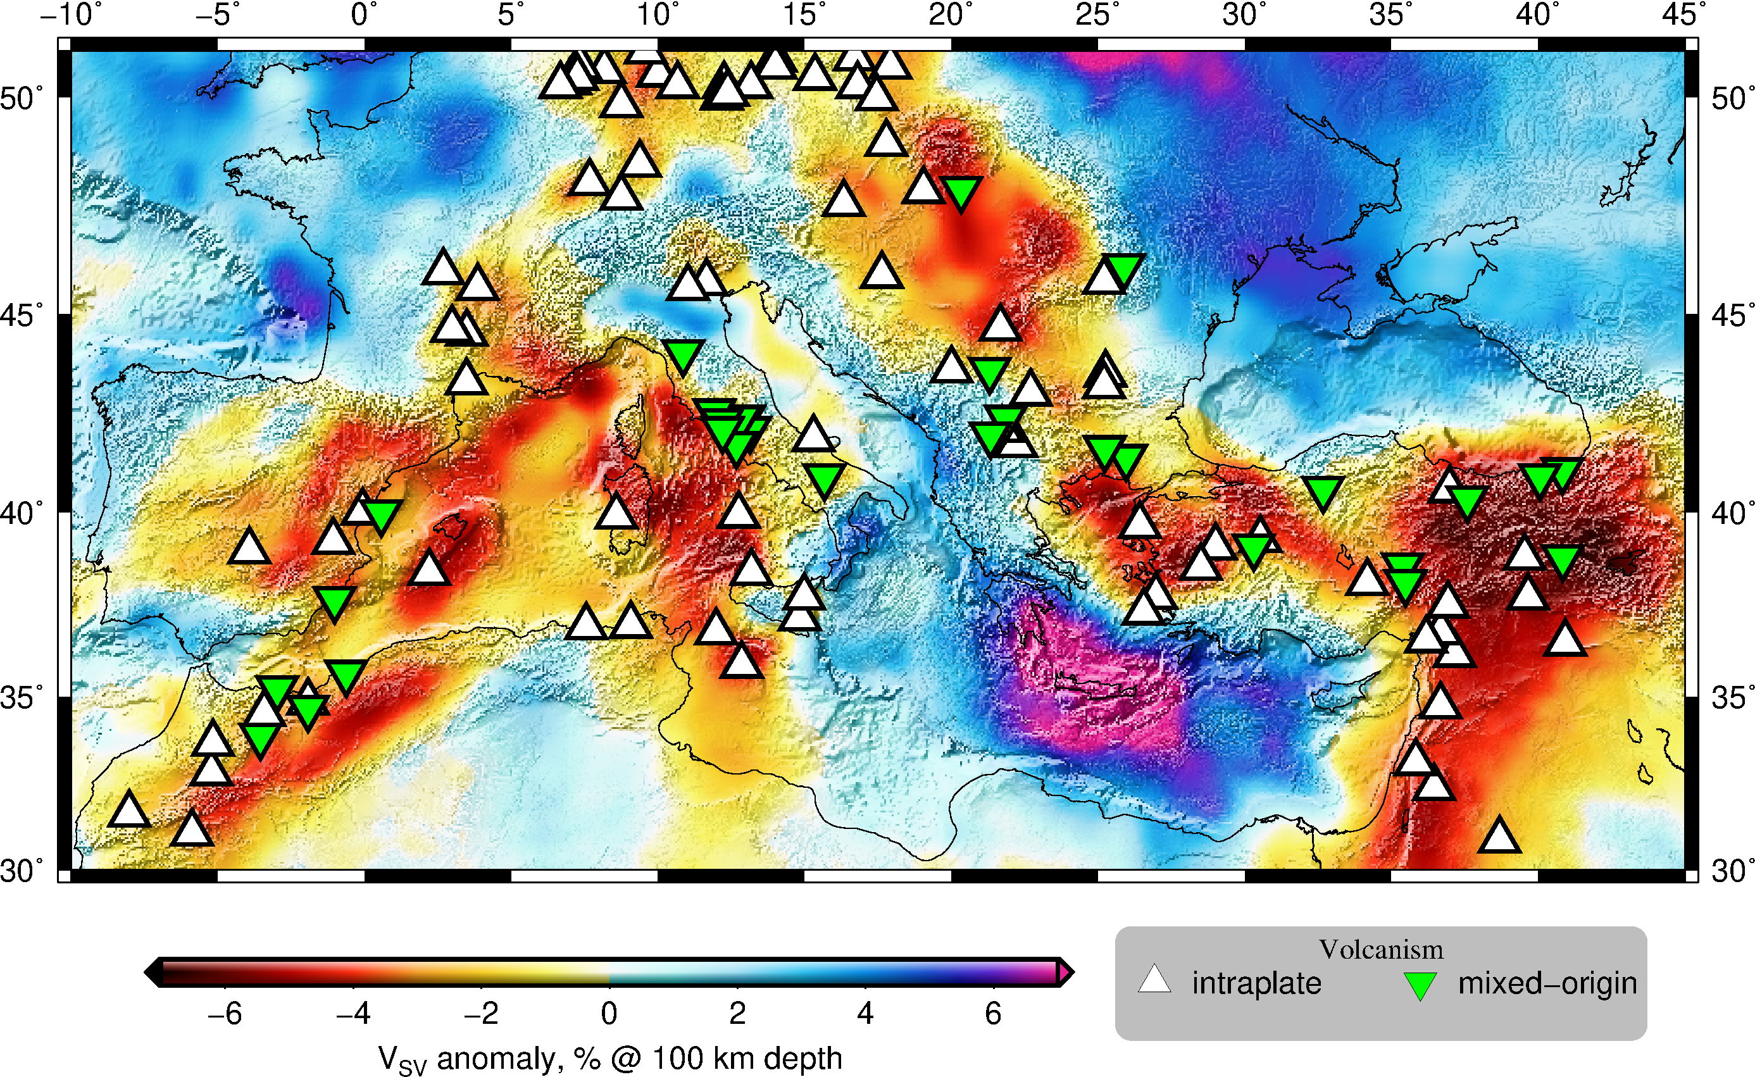
EGU 2022 Mai 26th, 2022 El-Sharkawy et al.,

Slide 10
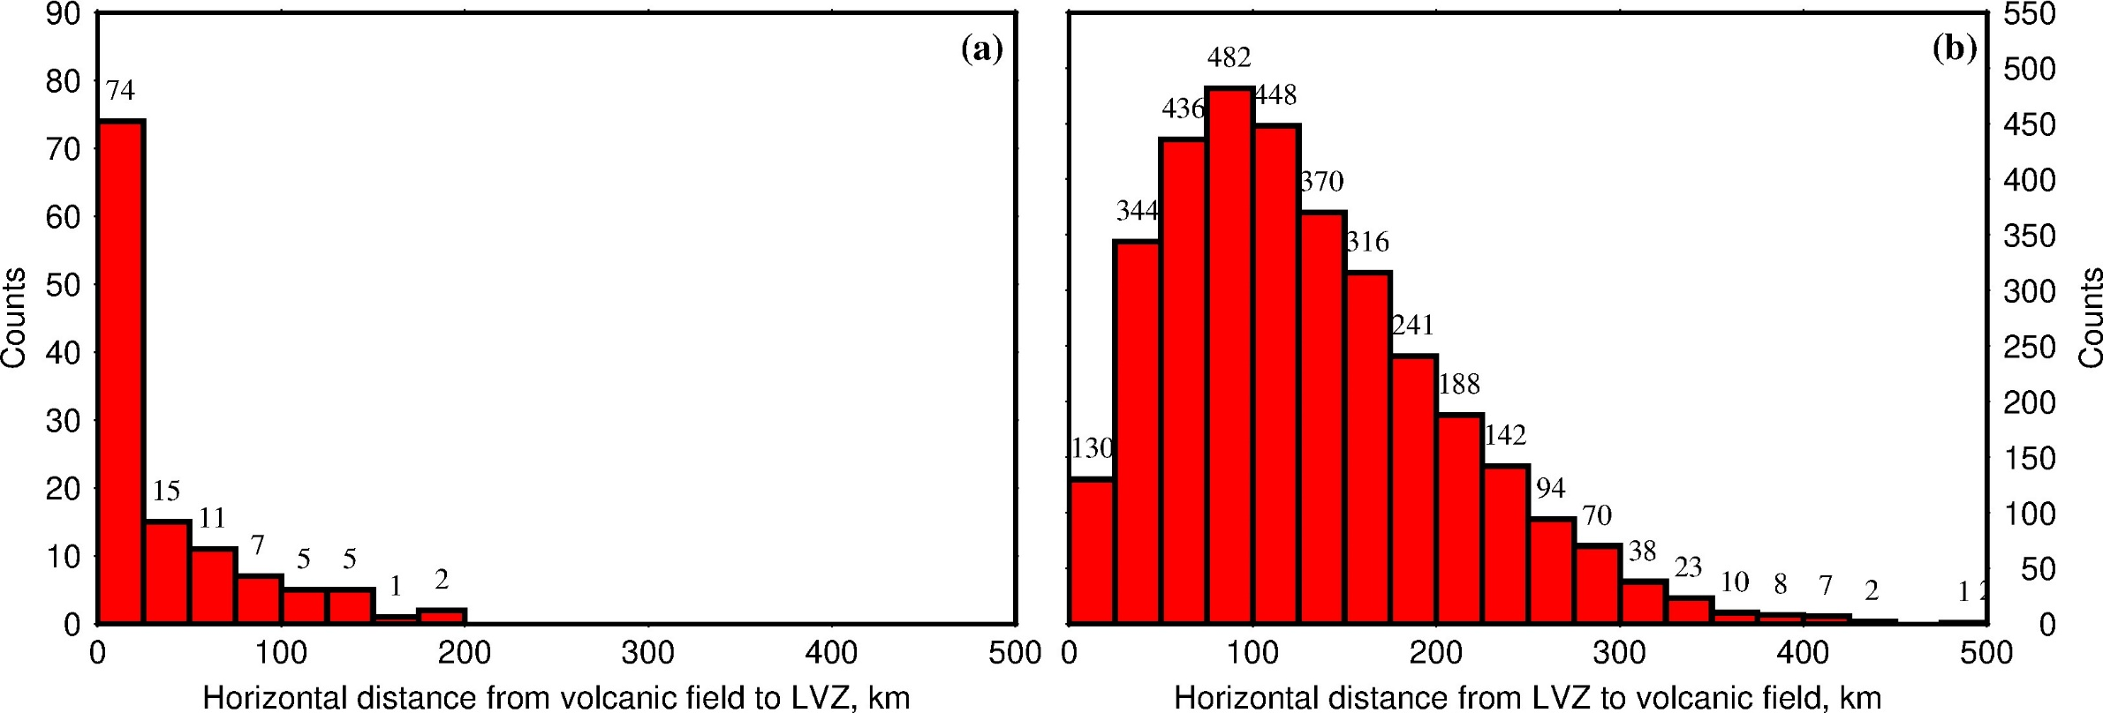
El-Sharkawy et al. (in prep.)
EGU 2022 Mai 26th, 2022 El-Sharkawy et al.,

Slide 11
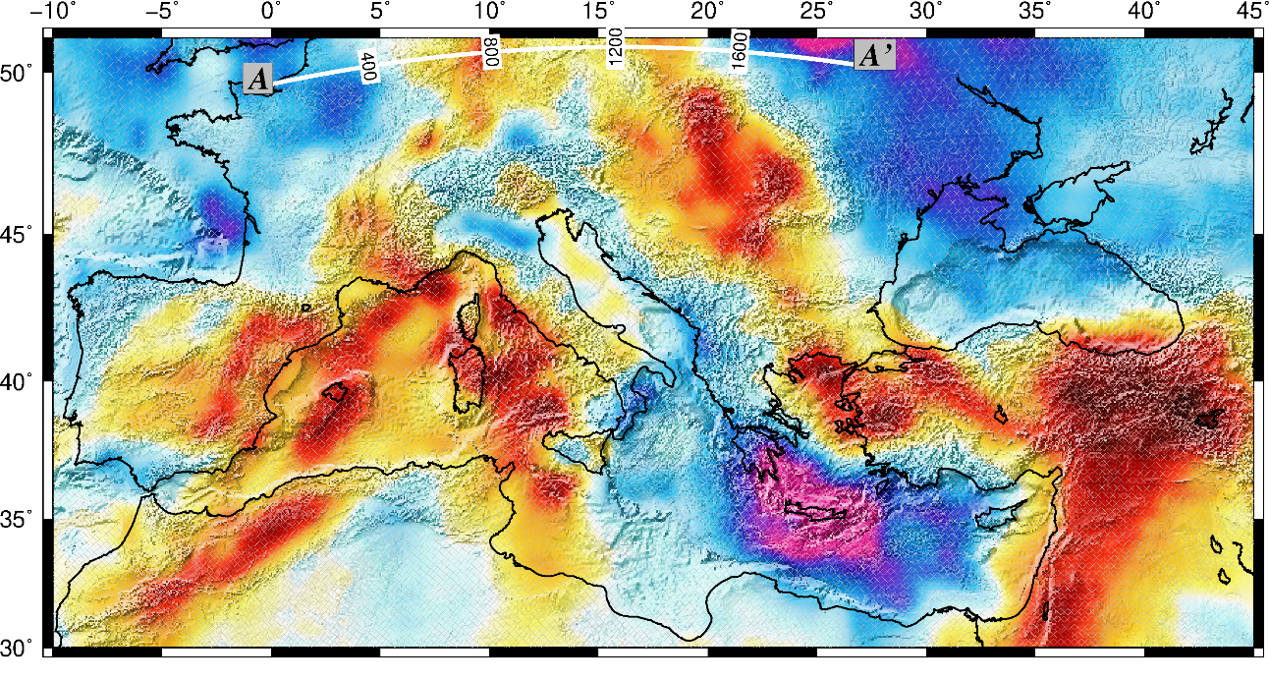
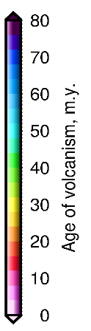
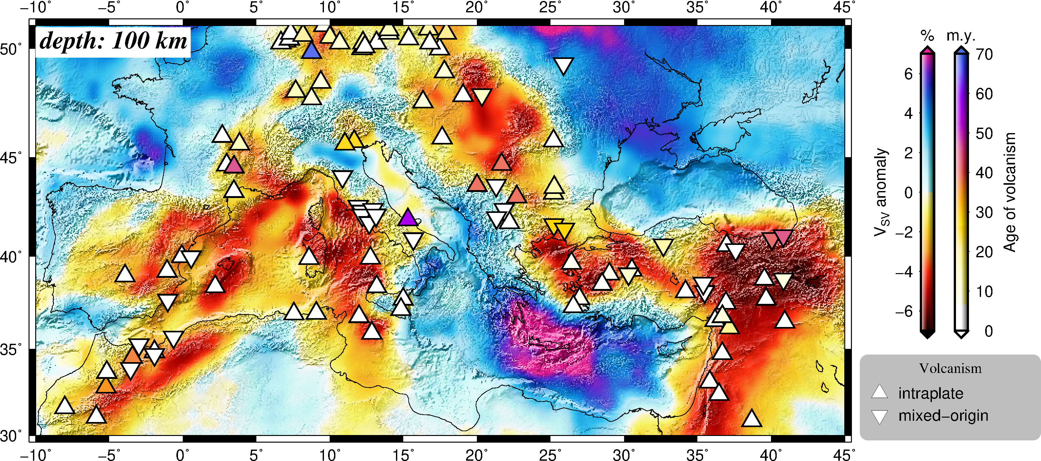
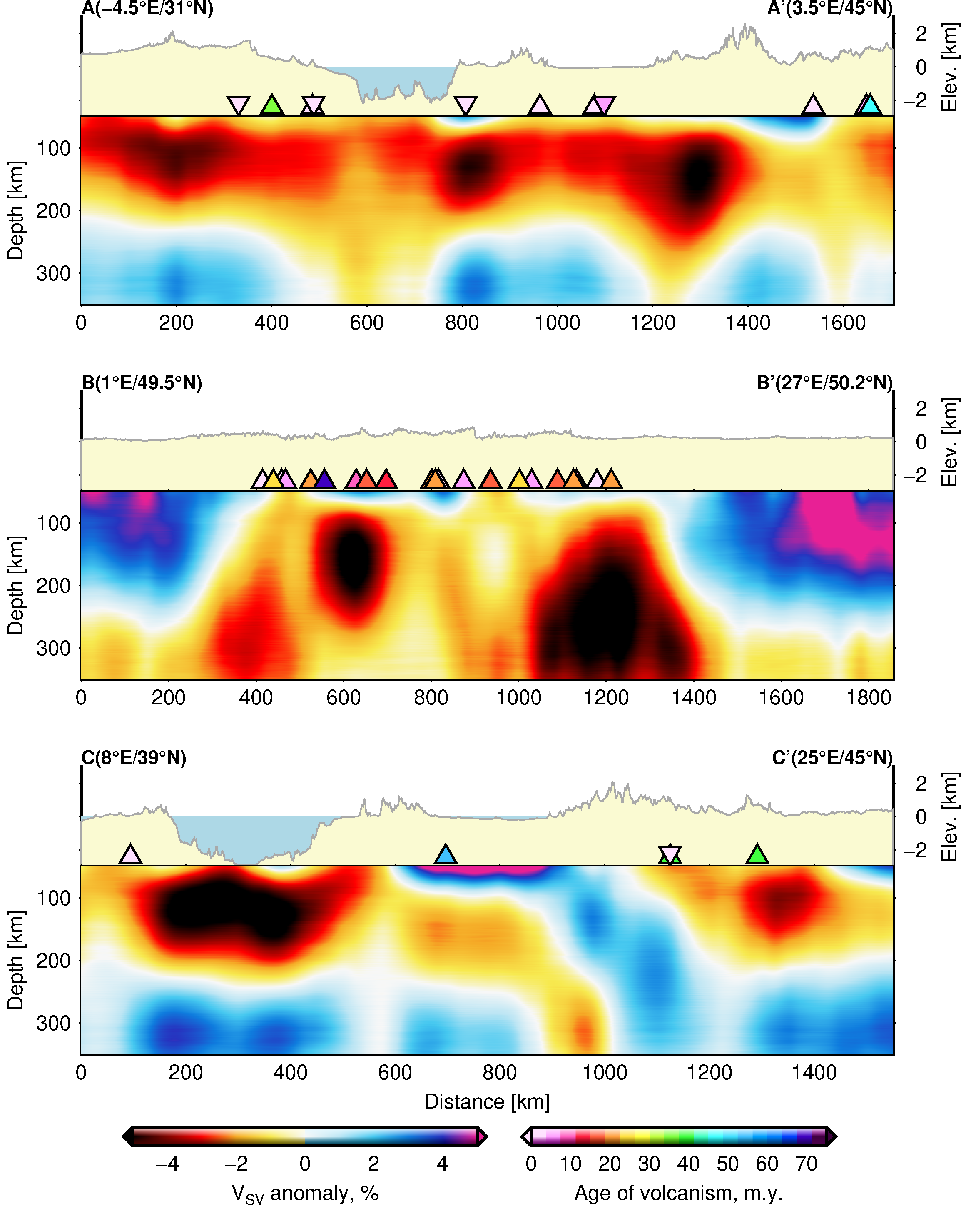
Shallow asthenosphere beneath Central Europe
Thick mantle lithosphere beneath the Paris Basin
BF: Black Forest
BM: Bohemian Massif
W-Cp: Western Carpathians Mountains
Sr-Cp: Serbian Carpathians Mountains
EEP: East Eorpean Platform
CEA: Central Eurpean Asthenoshere
EEC: East Eorpean Craton
PnA: Pannonian Asthenosphere
WECML: Western European Continental Mantle Lithosphere
A(1°E/49.5°N) A’(27°E/50.2°N)
PB Vosges BF BM W-Cp EEP
WECML
EEC
CEA
PnA
El-Sharkawy et al. (in prep.)
EGU 2022 Mai 26th, 2022 El-Sharkawy et al.,

Slide 12
Conclusions:
Consistent high-resolution imaging of the Medietrranean upper mantle using surface wave tomography is helpful to investigate areas of thin lithospheric thickness
Integrated thermochemical modelling indicates a remarkable variability of the lithospheric thickness across the area.
Thick lithosphere is found in the Paris Basin, the East European Craton, and the eastern Mediterranean whereas thin lithosphere is found in areas of pronounced negative shear-wave anomalies at depth between 70 km and 200 km
Cenozoic intraplate volcanic fields colocate with areas of thin lithosphere/shallow asthenosphere.
Thank you for listening!
EGU 2022 Mai 26th, 2022 El-Sharkawy et al.,

