Slide 1
Soil sampling for variable-rate fertilization using spatial clustering
Robert Minařík, Daniel Žížala, Jan Skála, Michal Kraus, and Vojtěch Lukas

Slide 2
Motivation
Farmers want to stabilize the yield of unbalanced fields using variable-rate fertilization.
Farmers are able to fertilize zone-wise or pixel-wise. They need a proper sampling design.
Farmers want schema with variable soil sample density to minimize costs.
Clustering can be used for both fertilization approaches.
Cluster centers can be soil samples for DSM, or they can characterize management zone.

Slide 3
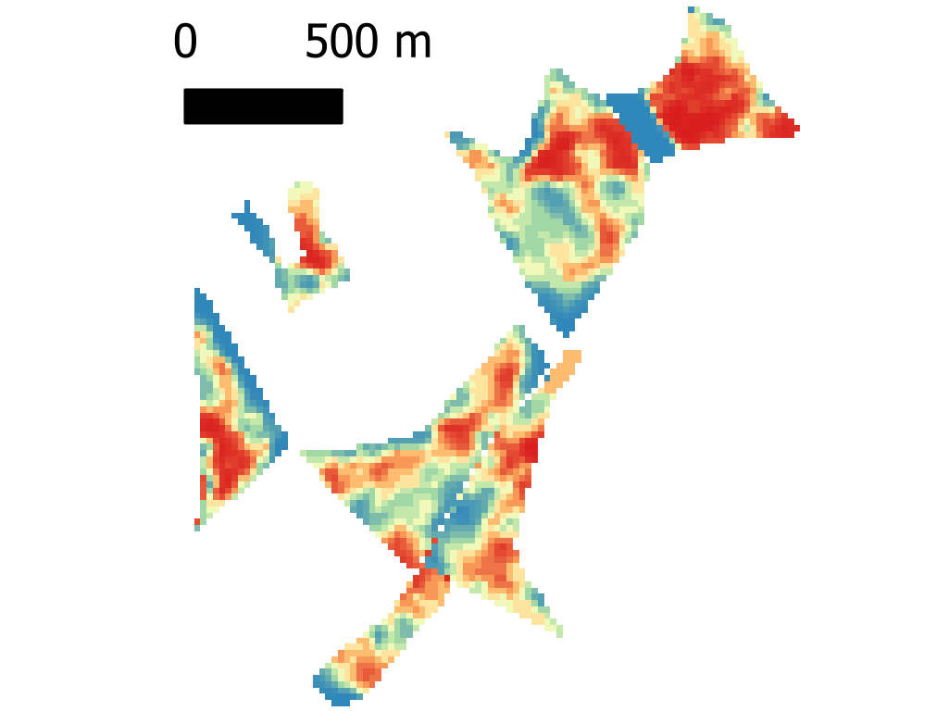
Why use spatial clustering?
YP
nonspatial
spatial
This study compares a nonspatial and spatial clustering enabling sampling design for both site specific and zonal fertilization.

Slide 4

Workflow
Yield potential (Sentinel 2)
Maps of soil texture
(Žížala et al. 2022)
Searching for optimal number of clusters for every field
Clustering into optimal N of clusters
Soil samples localization
Inputs
Clustering to 2:N groups.
(aglom., nonspatial, Ward).
Optimum N selected by weighted elbow method of silhouette.
Nonspatial hierarchical clustering
or
REDCAP (Guo, 2008)
Queen weights, 1st order.
One per cluster
Pixel with shortest distance to cluster centroid and closest to geometrical center of the cluster.
Žížala et al. (2022) 10.1016/j.catena.2022.106024
Guo (2008) 10.1080/13658810701674970
rstudio.com

Slide 5
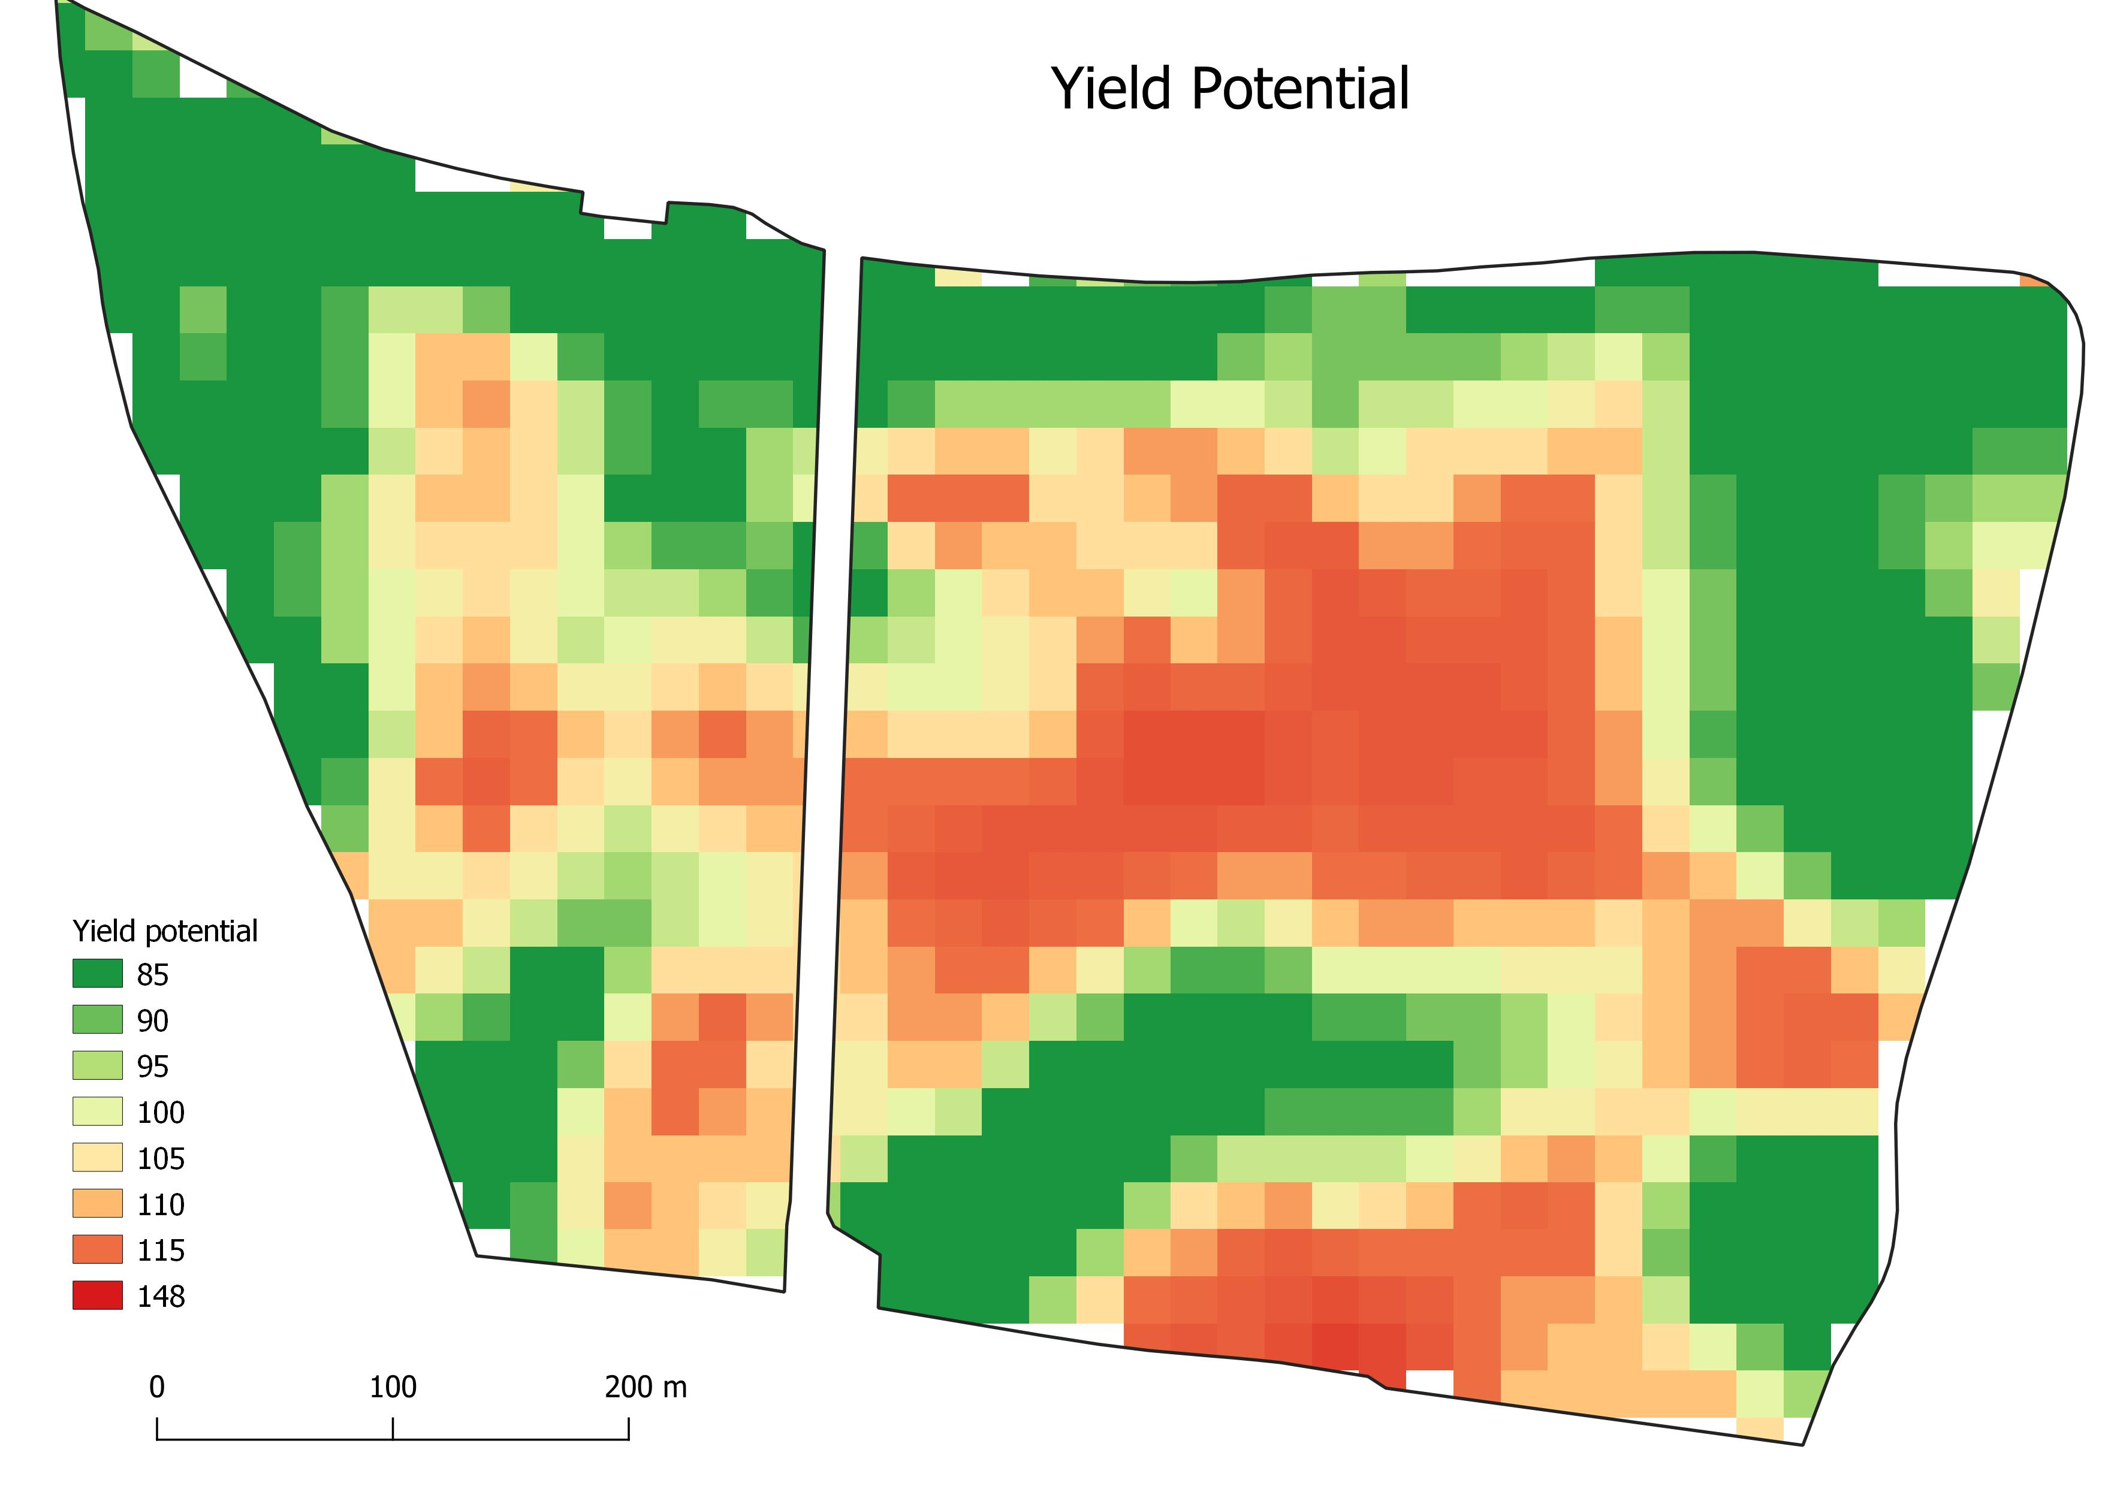
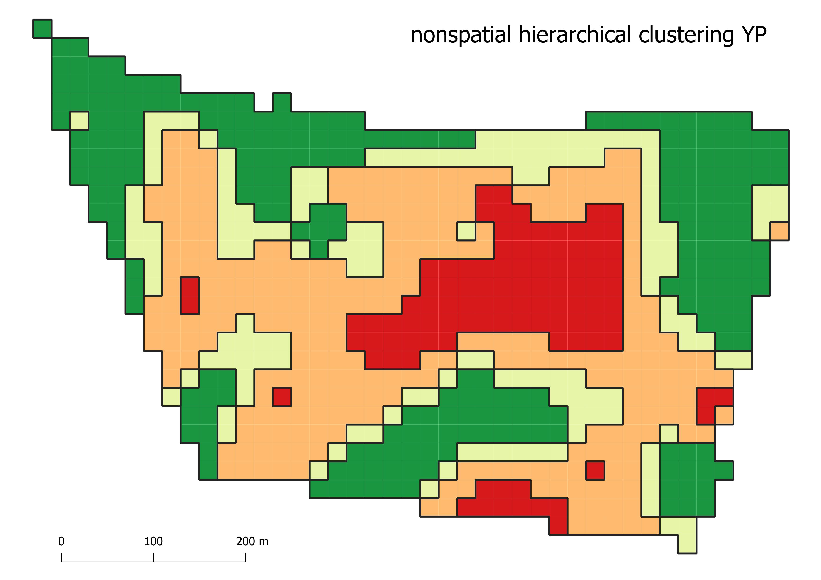
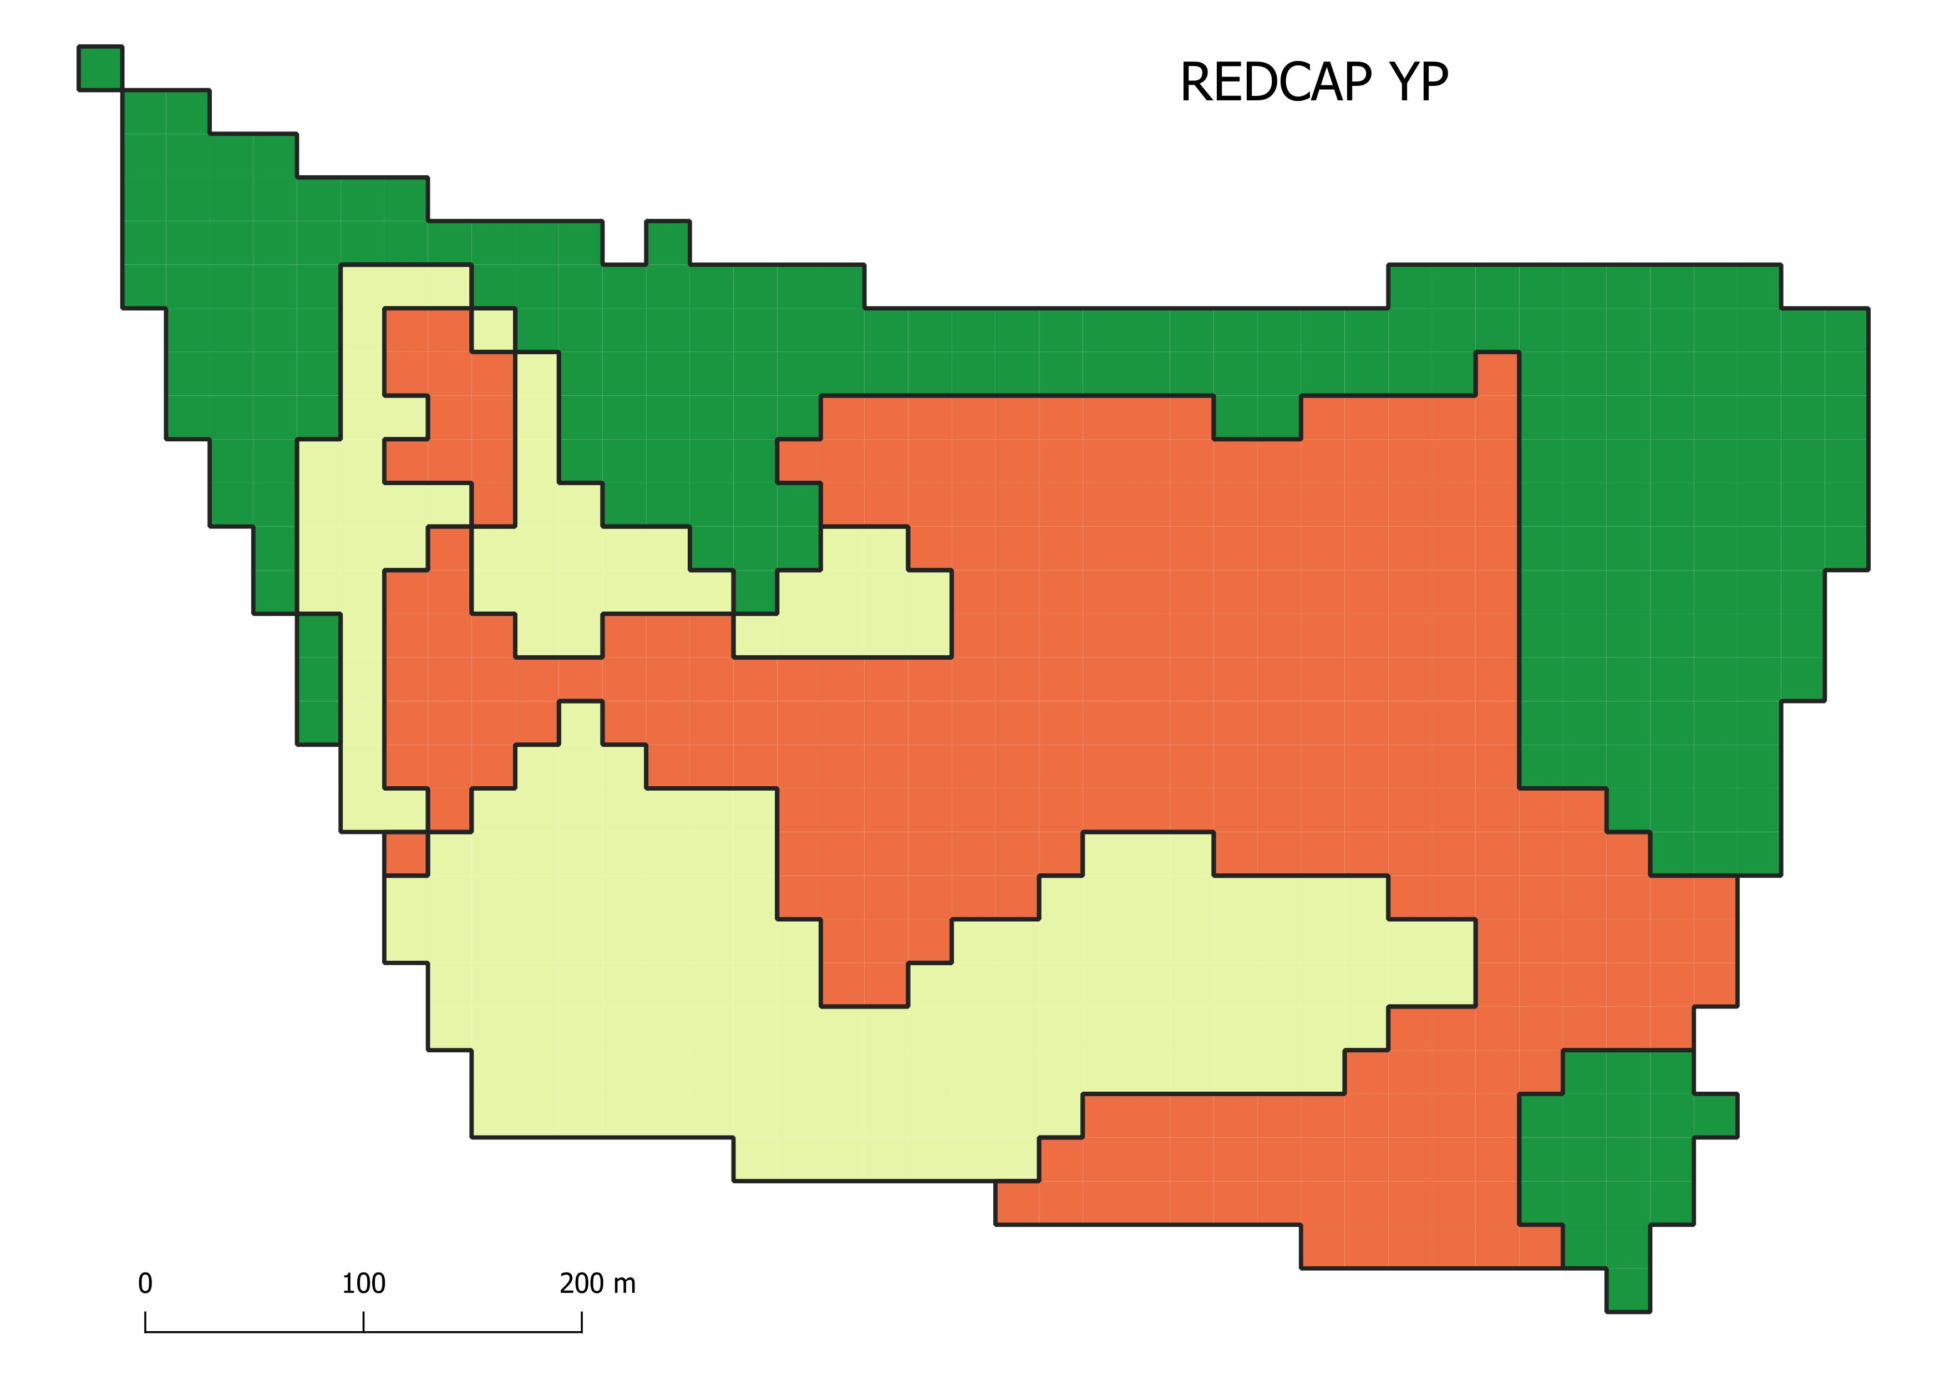
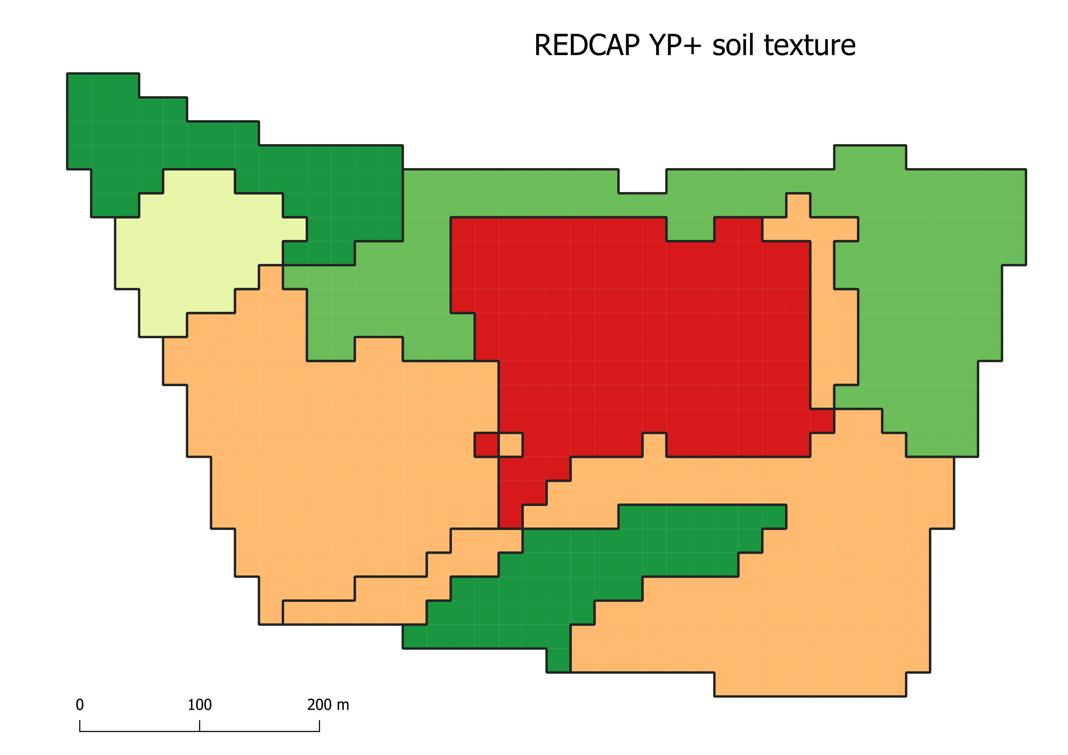
Results

Slide 6
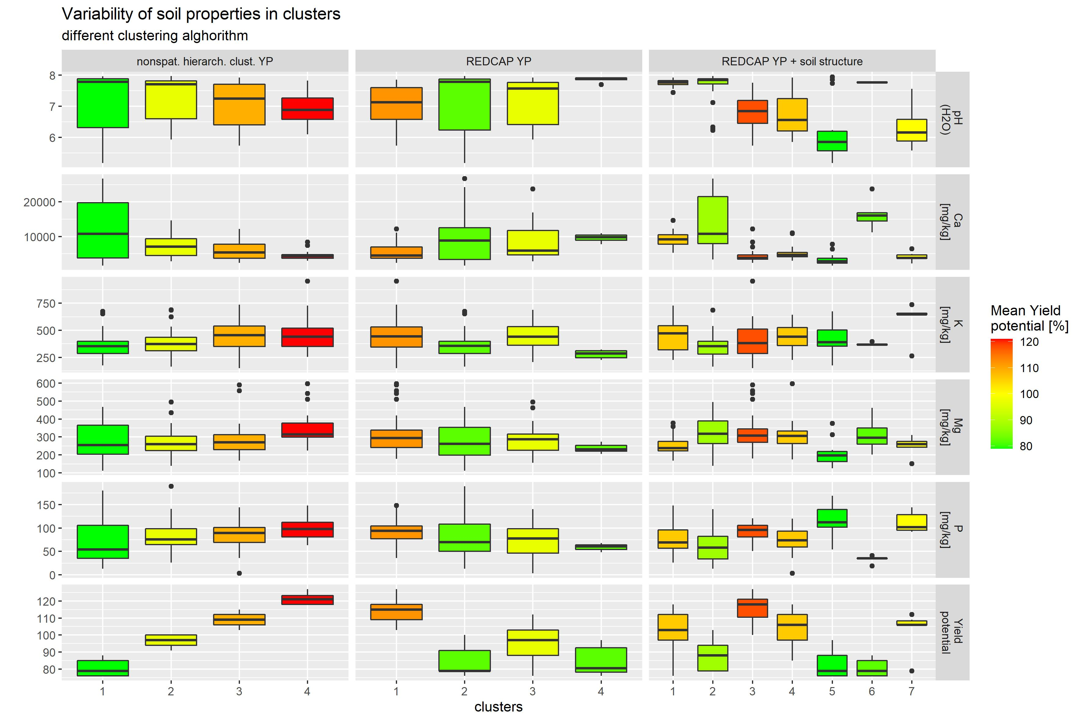
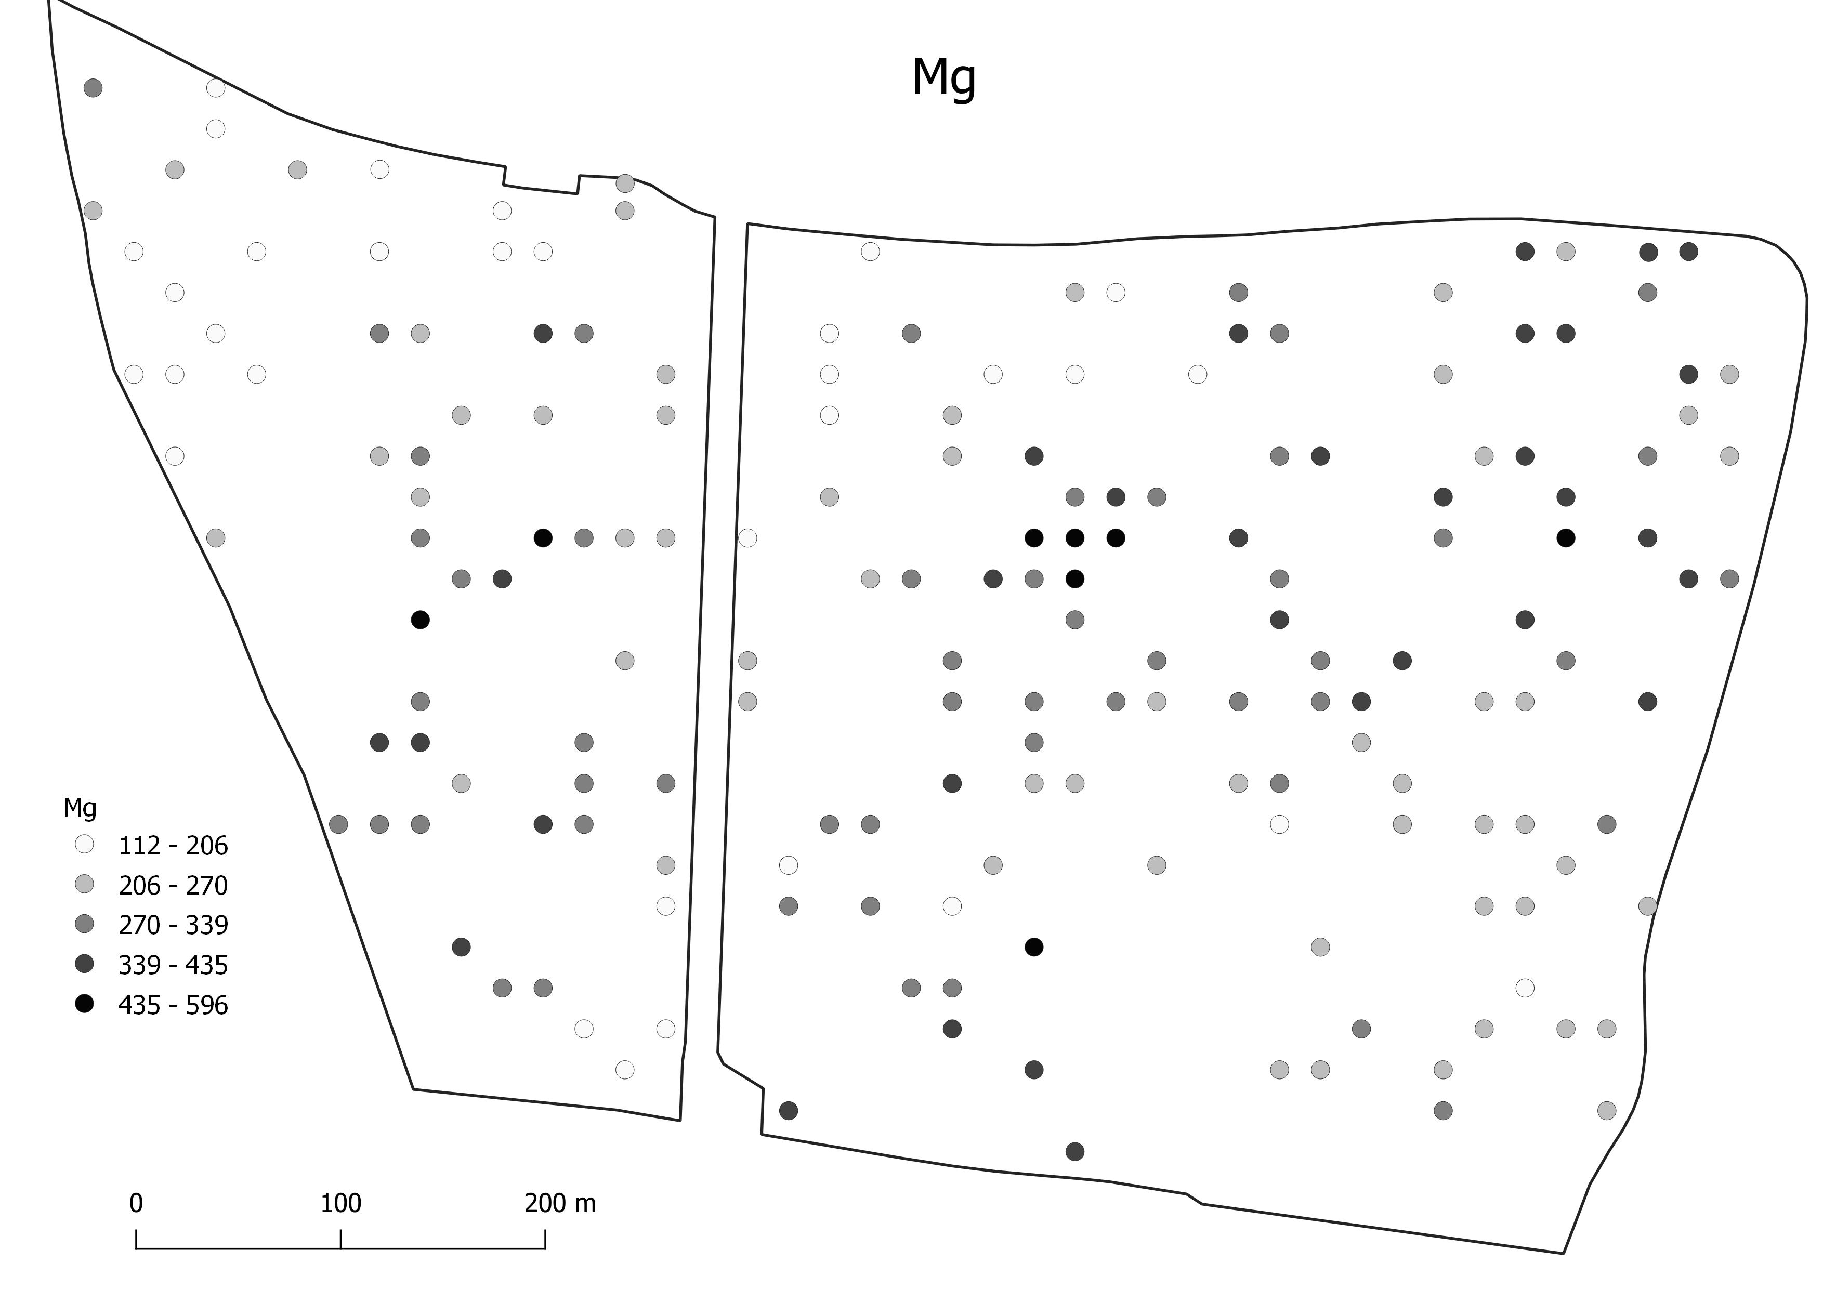
Results
Clusters are more compact using REDCAP.
However, the intra-cluster variability increase, and extremes are not covered using REDCAP.

Slide 7
Conclusions and Outlook
Spatial sampling results in more compact clusters, but it increase the intra-cluster variability of covariates and nutrients.
The higher compactness of clusters is great for zone management, but it is the limiting factor for DSM and locally targeted (pixel-wise) fertilization.
Continue in the data analysis. How to select sampling points ?
Control the weight of spatial constraints using another algorithm (ClustGEO)?
Perform the clustering of final nutrient map instead of clustering in the covariate space to find a sampling network?

Slide 8
Thank you for attention

