Slide 1
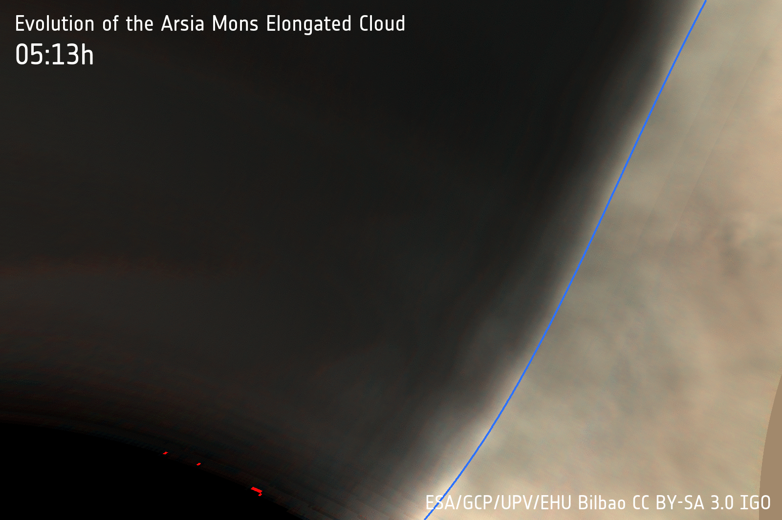
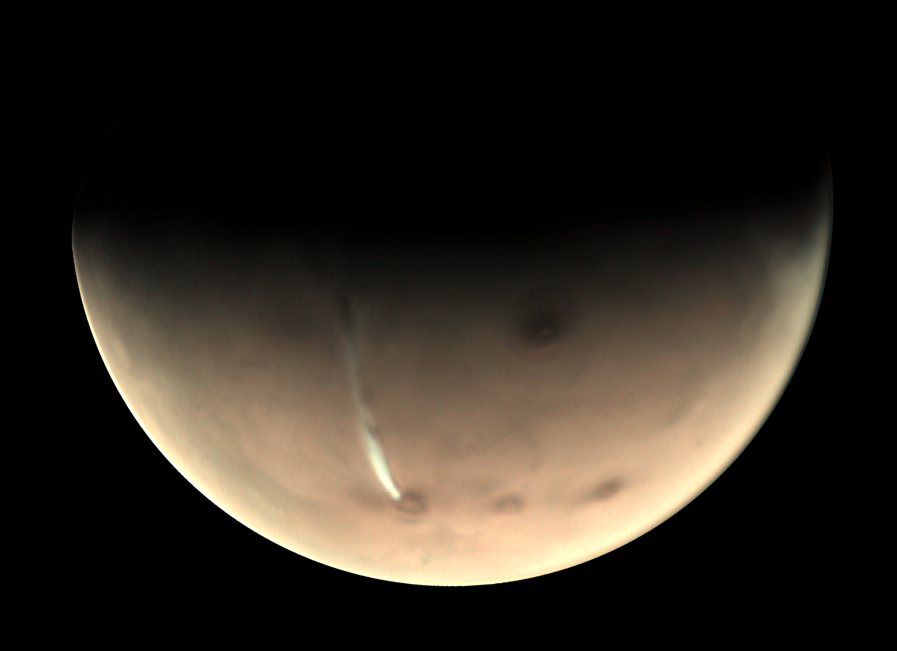
Mesoscale modeling of the Arsia Mons Elongated Cloud (AMEC) on Mars
J. Hernández-Bernal, A. Spiga, A. Sánchez-Lavega, T. del Río-Gaztelurrutia, F. Forget, E. Millour
Hernández-Bernal et al. “An Extremely Elongated Cloud over Arsia Mons Volcano on Mars: II. Mesoscale modeling”, in review

Slide 2
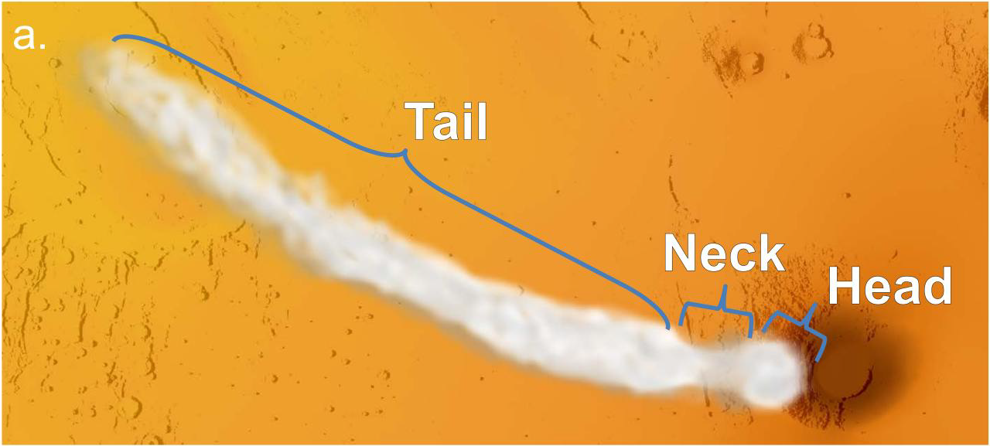
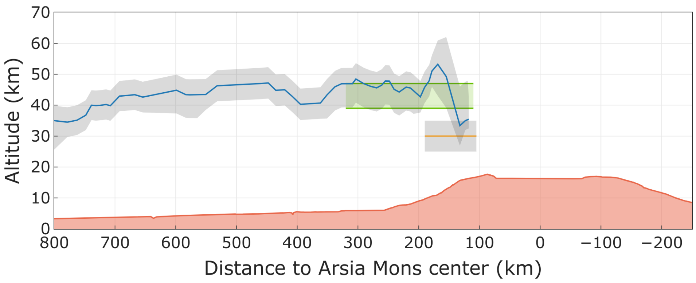
The Arsia Mons Elongated Cloud (AMEC) - Observations
Appears at sunrise next to Arsia. Grows quickly to the West. Fades in a few hours.
This daily cycle repeats regularly around Ls 240º-300º (not well constrained)
Reaches a length of up to 1800 km in only 3 hours.
The cloud is at an altitude of ~45 km
Based on Hernández-Bernal et al. “An Extremely Elongated Cloud over Arsia Mons Volcano on Mars: I. Life Cycle” JGR 2021

Slide 3
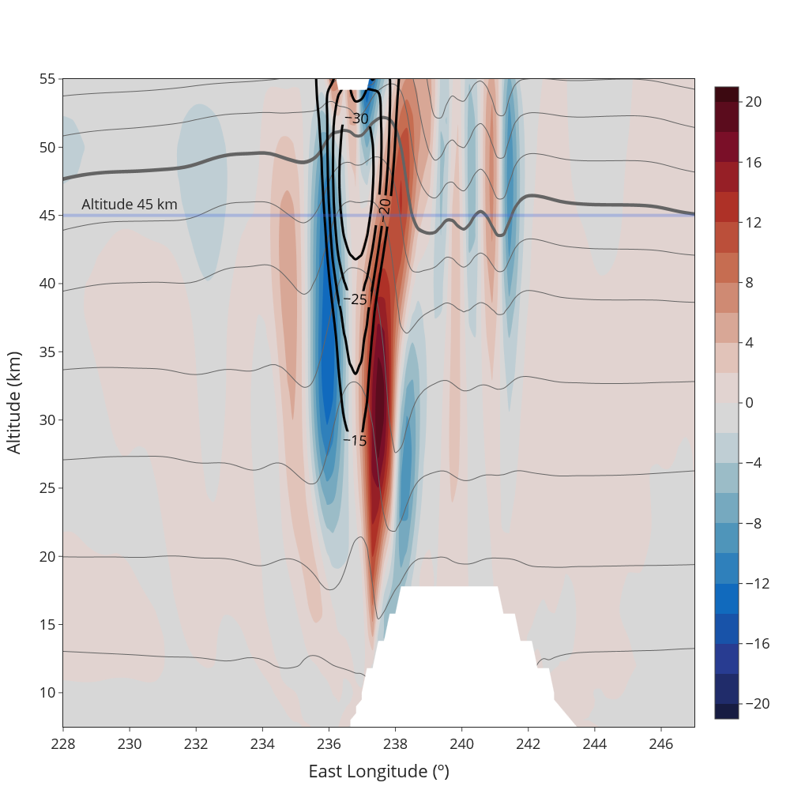
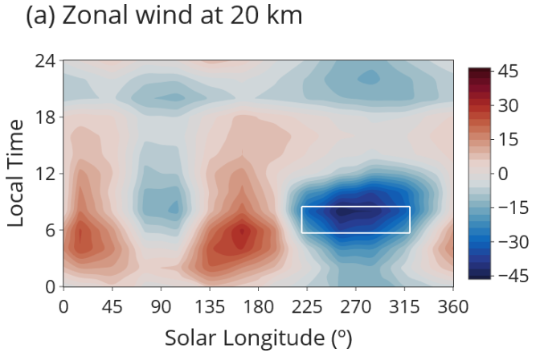
Mesoscale modelling of the AMEC
LMD-Mars Mesoscale Model (MMM)
Reference mesoscale simulation: Ls 270º
(GCM)
Vertical wind
Background colorscale -> vertical winds
Thin gray lines -> potential temperature (flow)
Black closed curves -> equal ΔT

Slide 4
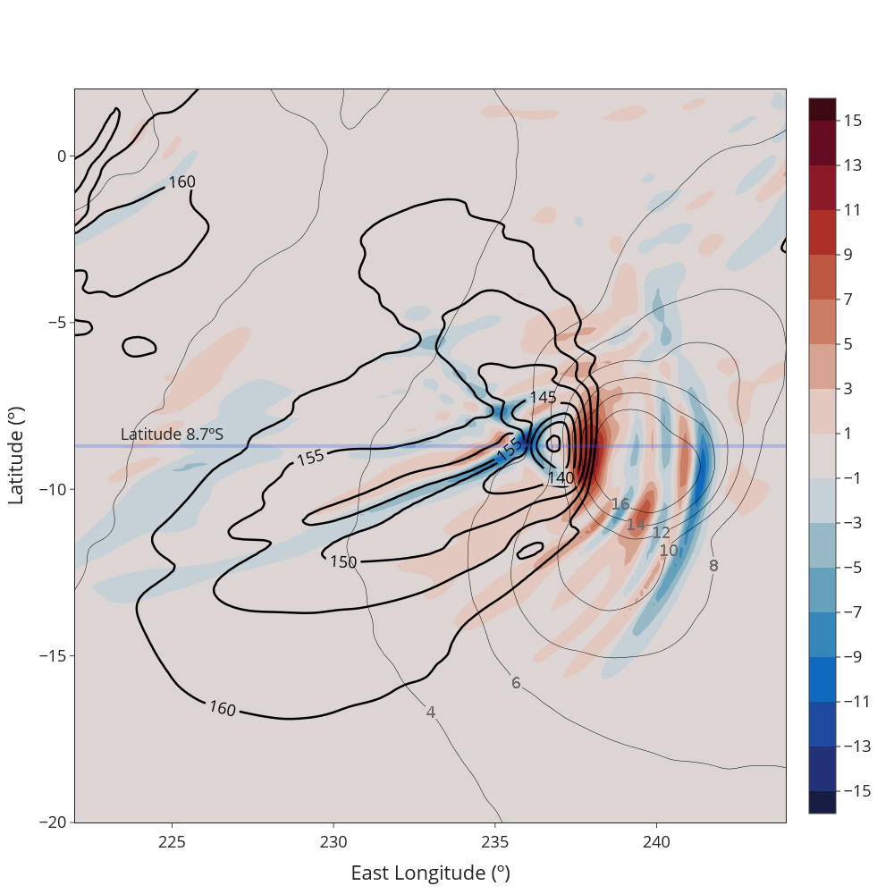
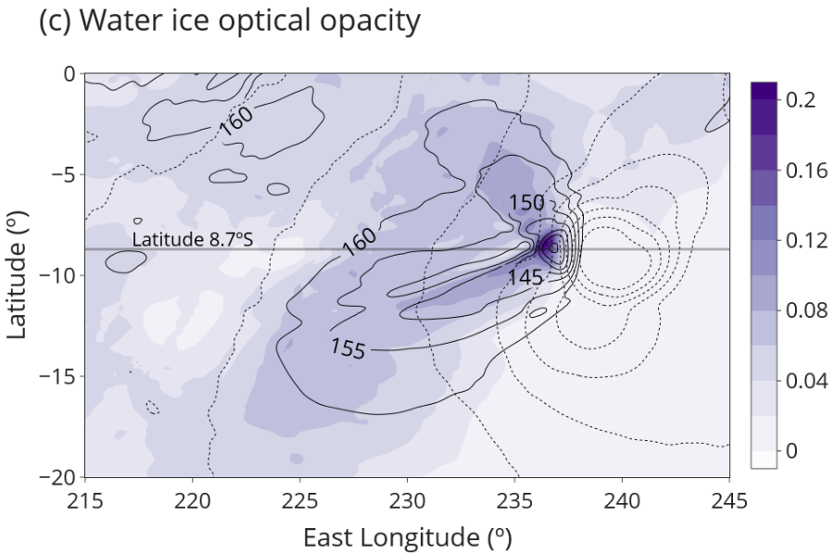
Mesoscale modelling of the AMEC
Horizontal profile at 45 km
Horizontal profile at 45 km
Background colorscale -> vertical winds
Black closed curves -> isotherms <160K

Slide 5
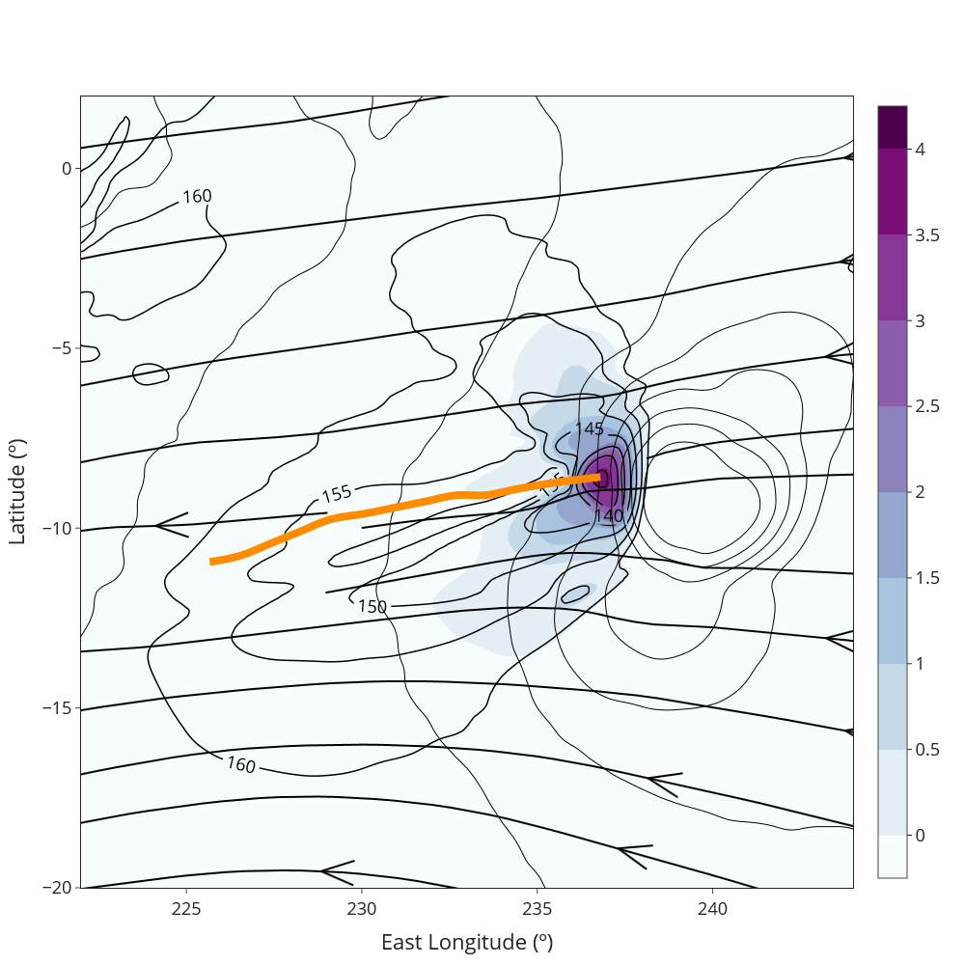
Mesoscale modelling of the AMEC
(Repeated plot for reference)
Relative Humidity index (logarithmic)
Horizontal profile at 45 km
Horizontal profile at 45 km
Background colorscale -> RHi (log)
Black closed curves -> equal ΔT
Orange curve: expected advection trajectory

Slide 6
Conclusions
The GCM predicts transient fast winds coincident in Ls and Local Time with observations of the AMEC.
The MM predicts a temperature drop 30K below the environment temperature, coincident with the observed head of the AMEC.
No tail appears in the model and the expected advection trajectory is not coincident with observations, which challenges our understanding of local winds and cloud microphysics.

