Slide 1
How will Ireland's slope systems respond to future climate change?
Dr. Niamh Cullen¹ and Dr. Mary Bourke²
¹School of History and Geography, DCU
²Department of Geography, TCD

Slide 2


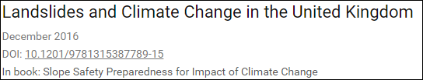
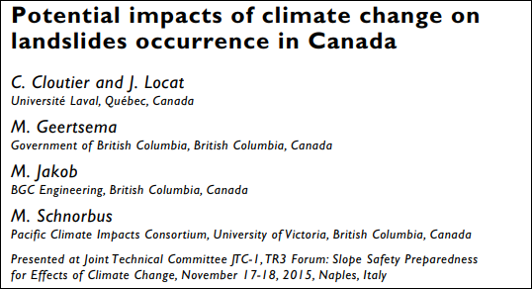



Notes:
Studies of more recent mass wasting have benefited from a record of documented events combined with weather data and climate models.
These analyses suggest there is likely overall increase in the frequency of all types of mass movement in the future, particularly in locations of cryosphere changes
Studies that have specifically focussed on the future response of slopes to climate change highlight the specific requirement for a bespoke approach that takes into account the local parameters of slope, drainage, weather and land use
The combination of a predicted increase in landslide frequency, combined with a recommendation for regional specific studies of potential landscape response to climate change outlines a direction for future research in Ireland.
However, none of the several peer reviewed compendiums that include regional landslide studies and climate change have a dedicated contribution on Irelands landscape.
We are clearly behind, in moving forward to provide stakeholders with the data required to effectively manage landscapes for landslides in a changing climate.
Here we begin to address this.
First, we undertake a qualitative assessment of the role of Irish climate and climate change on landslides. We use the approach of Crozier (2010) who identified the specific climate aspects that are important for slope instabilities.
Second, we provide a summary of the known climate of Ireland from Holocene to future modelled predictions.
Third we looked at documented reports of landslieds that cited the causal or contributary factor to slope faaileuer

Slide 3


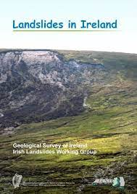







Ireland’s Landslide Record
Geological Survey of Ireland (GSI) Landslide database
2805 landslides (as of 2019)
Our database + GSI database
2834 landslides (as of July 2021)
Oldest - 4200 cal. BP Derryfada (Murray, 1997)
First recorded -1488 Clogher, Tyrone (Annals of the Four Masters)
Latest – 2021 New Ross, Wexford (Personal communication)
Notes:
Rich historical archives - Longest drought record globally 250 years extending back to the mid 18th century demonstrated that the past 40-50 years are anomalous in terms of the persistence of drought events. Instrumental and written records including newspapers like the Belfast Newletter 1738 , Freemans Journal (Daily all Ireland) supplemented with supporting historical documents including 1851 Census of Irelan

Slide 4
Ireland’s Landslide Record
n = 269
Notes:
Visually this is what the landslide record looks like. Starting here back duinrg the holocence with those earliest record that come from acrcheological studies

Slide 5
Climate factors that influence slope stability
Climate predictions for Ireland
Adapted from Crozier (2010) Deciphering the effect of climate change on landslide activity: A review
1. Wetter antecedent conditions
1. Increase in average winter precipitation receipts (?)
2. Higher rainfall intensities
2. Increase in winter precipitation intensity
3. Hotter and drier summers
3. Drier, hotter summers
4. Antecedent dry conditions followed by rain
4. Drier summers interrupted by intense rainfall events
5. Increased wind speed and duration
5. Overall decrease in energy content of wind
6. A shift in cyclone tracks and other rain bearing weather systems
6. North Atlantic storm track expected to strengthen and extend further eastwards

Slide 6
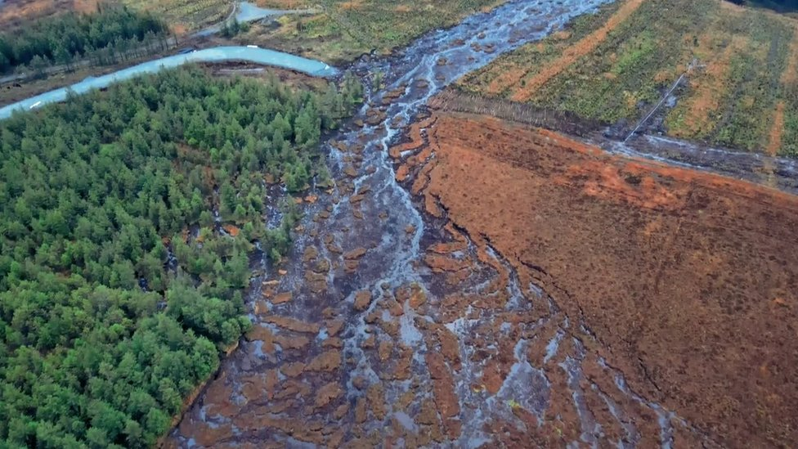
1. Wetter antecedent conditions
Past failures:
Bog flow at Knocknageeha. Co. Kerry
  Cole, 1897, Praeger, 1897
1960s Bog flows in NI
  Colhoun et al., 1965
1984 Peat bog failure in Straduff, Co. Sligo
  Alexander et al. 1986
Recent failures: Meenbog, Donegal (13/11/2020)
Image captured from a video posted to Youtube.
Notes:
So the first climatic factor that has cited as a factor that influences slope stability i.e. wetter antecedent conditions and is also predicted as part of Irelands climate future as an increase in average winter precipitation receipts is wetter antecedent conditions.
Periods of wetter-than-normal conditions are known to have several effects on slope stability.
These include a reduction in the rainfall threshold required to trigger slope failure; a reduction in soil capillary action which leads to reduced cohesion, and higher water tables that promoting a decrease in shear strength
If as we did we look into the climatic conditions for mass movement events even a rudimentary look at the published literature immediately demonstrates a number of examples even back to the earliest studies of slope failure where wetter antecedent conditions are cited as a contributing factor to significant mass movement. Particularly interesting is the observation that the majority of failure that occurred under these condition have occurred in peat. Again this just highlights he importance of these regionally specific studies in order to really understand and predict the potential response of a landscape to predicted changes in climate.
Reduction in rainfall threshold to trigger event
Reduction in soil capillary action
reduced cohesion
Higher water tables
Reduction in shear strength

Slide 7
Meenbog, Donegal antecedent conditions
Notes:
This is the rainfall data for the 28 days prior toa nd including the event itself and what is most important to note about this figure is for the two weeks prior to the failure event precipitation receipts are above average and this is on the back of above average receipts for the preceding three months BUT even more importantly in the days leading up to the failure event yes cumulative receipts are increasing but the precipitation on the day and in the hours leading up to the event low rainfall was recorded and this is not unique there are other events such in Ballincollig in 2008 where in the week leading up to the event above average rainfall was recorded but in the days leading up to the event low rainfall was recorde - a similar pattern was observed in Co. Leitrim in Sep 2009 where high rainfall occurred 2 weeks prior but the days leading up to the event recorded low rainfall. So there are aspects
SO yes this is just one example, but we performed this basic analysis on the three most recent events at the time we didn’t pick and choose we just took the three most recent events and did the same basic analysis to and immediately identified one of those climatic factors identified as a potentially contributary factor for slope failure.
Worth noting that - The peat adjacent to the failure has been drained for extensive Sika Spruce plantations and the area is also the site of wind farm construction

Slide 8
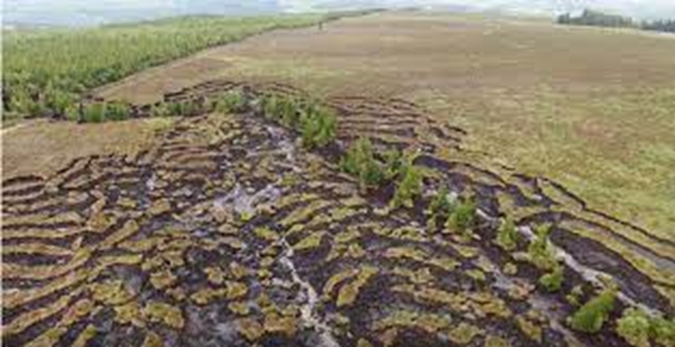
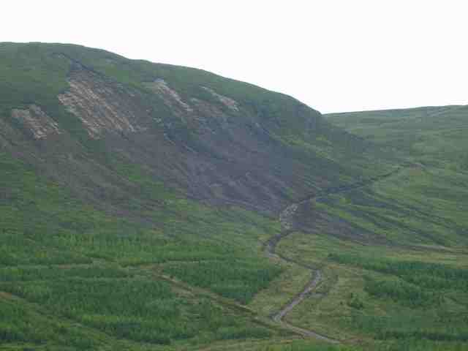
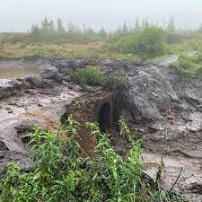
(2) Intense rainfall and (3) dry antecedent conditions followed by (4) intense rainfall
Past failures e.g. Dykes et al. (2000), Long et al. (2011) and many more
Recent failures: Dawn of Hope (Shass Mountain)
28/06/2020
Youtube video: John Flynn
Croaghmoyle Mountain, Co. Mayo – 2009
Credit: Castlebar News
Notes:
Looking at the second of those contributing factors to slope instability and bearing in mid this is also one of the predicted climatic changes predicted for Ireland again a retrospective analysis of factors cited as contributing to significant mass movements is higher intensity rainfall events. ~In 200o a number of peat slides at ciulcagh mtn in NI occurred after high intensity rainfall events. Some the factors cited in detailed studies of these event as contributary factors are related directly to the effects of high intensity rainfall including
second of the 3 most recent failure we looked at we did the same basic analysis looking at the antecedent rainfall for the 6 months prior to the event Infiltration capacity exceeded
Perched water table – reduction in shear strength
Greater throughflow
Increases shear stress
Removal of underlying material
Soil piping + collapse

Slide 9
Dawn of Hope (Shass Mountain) antecedent rainfall

Slide 10
The effects of climate change on slope stability along Irish coasts?
Subaerial processes
Marine processes
5. Increased wind speed and duration.
6. A shift in cyclone tracks and other rain bearing weather systems.
Notes:
Increased wind speed and duration anhancing waves along coatslines but also increasing evapotranspiration and reducing soil moisture content with a similar result to increased temperatures in terms of crcking and fissuring in soils
North Atlantic storm track is expected to respond by strengthening and extending further eastward Related effects for Ireland include an increase in the frequency and intensity of precipitation

Slide 11
In summary…..
1. Wetter antecedent conditions
✓
2. Higher rainfall intensities
✓
3. Hotter and dryer summer temperatures
✓
4. Antecedent dry conditions followed by rain
✓
5. Increased wind speed and duration
6. A shift in cyclone tracks and other rain bearing weather systems

Slide 12
Where next?
A geomorphic inventory of the location and styles of coastal mass movement (soft and rock coast)
Collection of baseline data and the installation of monitoring equipment that will permit the quantification of coastal response.
Retrodictive analysis of specific recent mass movement events in Ireland where the appropriate high resolution rainfall records exist.
Empirical downscaled modelling (complex, site specific)
Anthropogenic impacts?

Slide 13
Thank you!

Slide 14
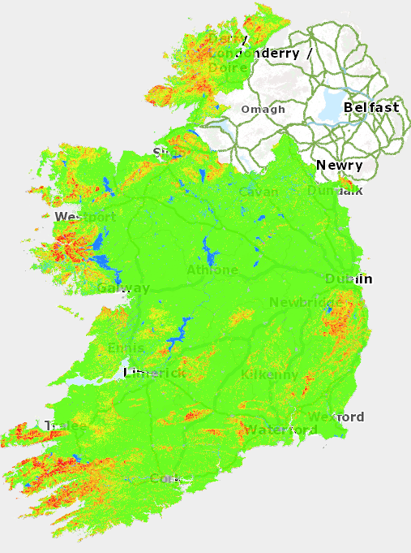

Slide 15
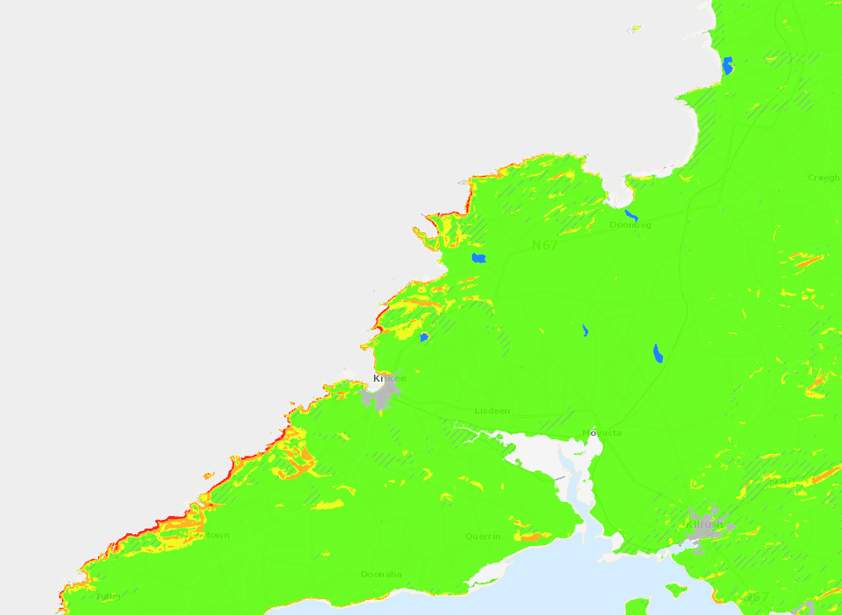
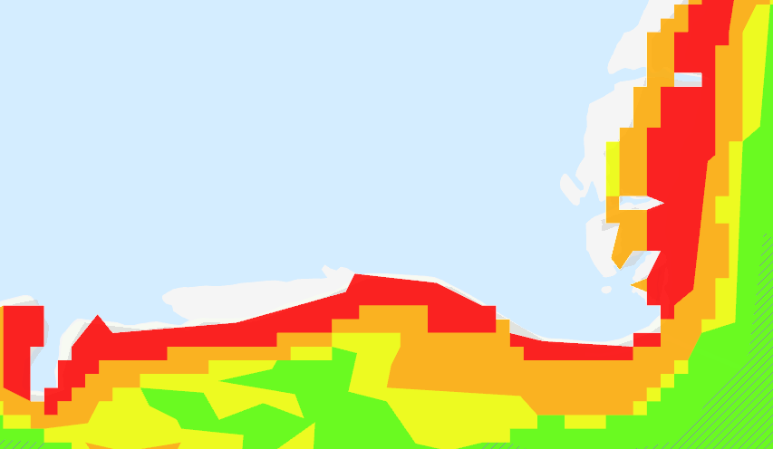

Slide 16
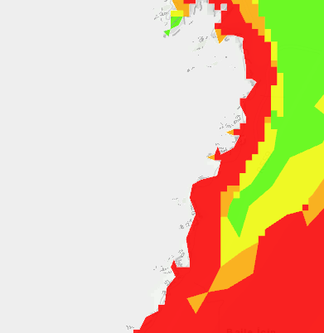

Slide 17
Increase in average in winter precipitation receipts
Increase in winter precipitation intensity and the frequency of intense winter precipitation events (Murphy et al., 2019, Matthews et al., 2016)
Drier summers interrupted by intense rainfall events owing to increased humidity caused by warmer air temperatures (Nolan, 2015, Nolan et al., 2013, Fealy and Sweeney, 2007, Fealy and Sweeney, 2008, McElwain and Sweeney, 2007)
Summer precipitation receipts are predicted to decrease (Fealy et al., 2008)
Overall increase in energy content of wind for winter months (Gallagher et al., 2016)
North Atlantic storm track is expected to respond by strengthening and extending further eastward (Ulbrich et al., 2008).

