Slide 1


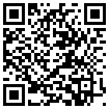

A review of hydrological modeling of pesticides in surface runoff:
current status, progress achieved and desirable improvements.
Centanni M¹., Ricci G.F¹., De Girolamo A.M²., Romano G¹., Gentile F¹.
¹ University of Bari Aldo Moro, Department of Agricultural and Environmental Sciences, Bari, Italy
² National Research Council, Water Research Institute (IRSA-CNR), Bari, Italy
Session HS1.1.2- Role of hydrology in policy, society and interdisciplinary collaborations: across disciplines and beyond scientists
09:20–09:25 | EGU22-8317 Virtual presentation
EGU General Assembly 2022, Vienna, Austria, 23–27 May 2022, EGU22-8317, https://doi.org/10.5194/egusphere-egu22-8317.

Slide 2
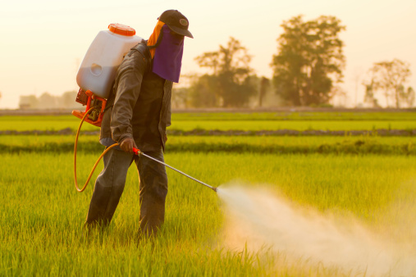
Background
Pesticides are mainly used in agriculture for plant protection.
In last years the use of pesticides has risen a lot also in the urban environment due to parks weeds control, insect regulation and urban agriculture.
Pesticide can contribute in increase the food production with the same cultivated surfaces areas.
The excessive use of pesticides represents a threat for soil, water quality and human health.
EGU General Assembly 2022, Vienna, Austria, 23–27 May 2022, EGU22-8317, https://doi.org/10.5194/egusphere-egu22-8317.

Slide 3
Objectives
Update the review concerning the use and diffusion at global scale of models to simulate pesticides coming from diffuse sources.
Analyzing the spatial and temporal scales of the model implementations.
Investigate possible relationships between compound and model.
EGU General Assembly 2022, Vienna, Austria, 23–27 May 2022, EGU22-8317, https://doi.org/10.5194/egusphere-egu22-8317.

Slide 4
Methods
Identification
Scopus keyword:
pesticides, model, watershed, hydrology, water quality,
diffuse pollutant (596 records)
Deleted before 2013 after 2020 (263 records)
Deleted:
review, book, book chapter, editorial and note (79 records)
Screening
Records Screened (254)
Excluded:
no modeling, groundwater modeling, pesticides only monitored or sampled (227 records)
Eligibility
Records eligible (27)
Records included (27)
Included
Total Records included (33)
Other sources:
snowballing approach (6)
EGU General Assembly 2022, Vienna, Austria, 23–27 May 2022, EGU22-8317, https://doi.org/10.5194/egusphere-egu22-8317.

Slide 5
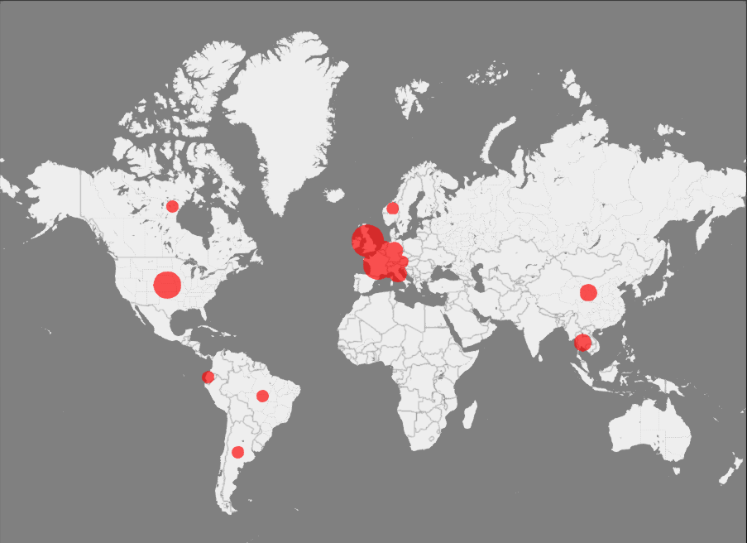
Results
Country | Records
Argentina | 1
Austria | 1
Belgium | 2
Brazil | 1
Canada | 1
China | 2
Ecuador | 1
England | 5
France | 6
Germany | 2
Italy | 1
Liechtestein | 1
Luxembourg | 1
Netherlands | 1
Norway | 1
Swiss | 5
Thailand | 2
United States | 5
Wales | 2
Global distribution of the study areas
7.1%
9.52%
14.28%
69.1%
Europe resulted the continent with the highest incidence of records (69.1%), followed by North America (14.28%), Asia (9.52%) and South America (7.1%).
France (14.28%) resulted the country with the highest number of studies followed by England and Swiss (both 11.9%), Belgium (4.76), Germany (4.76) and Wales (4.76%).
EGU General Assembly 2022, Vienna, Austria, 23–27 May 2022, EGU22-8317, https://doi.org/10.5194/egusphere-egu22-8317.

Slide 6
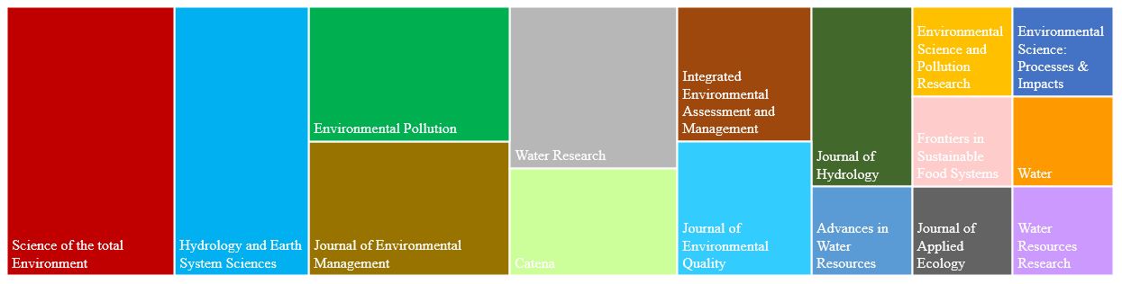
Results
Number of journals: 16
Science of the Total Environment (5 papers)
Hydrology and Earth System Sciences (4 papers)
Environmental Pollution, Water Research and Journal of Environmental Management (3 papers each).
The papers per year over the study period ranged from 2 to 11.

Slide 7
Results
Relationship between geographical area and model
Model
17 different models were implemented to simulate fate and transport of pesticides.
SWAT was the most used at global scale (35.71%).
France was the country with the largest records, followed by England, Switzerland and the USA. In Europe several models have been used, in the US only the SWAT has been used.

Slide 8
Results
The pesticides were grouped in three categories:
herbicides, with a frequency of 76%
insecticides with 14%
fungicides with 10%.
34 different compounds were modeled
Atrazine was the most studied (27.57%), followed by metolachlor (17.14%) and isoproturon, glyphosate, acetoclhor, metaldehyde and chlorpyrifos (8.57%).
14%
10%
76%
N° Record

Slide 9
Results
Relationship between pesticides and models
N° Record
SWAT is the model that simulated the highest number of pesticides, followed by IMPT, MACRO and iWaQa.

Slide 10
Conclusions
Europe resulted the continent with the highest incidence of papers (69.1%), followed by North America (14.28%).
Data availability influenced the global distribution of modeling applications.
SWAT is the most used model to simulate the fate and transport of pesticides in surface runoff.
The most modeled pesticide is atrazine (24.57%), followed by metolachlor (17.14%), isoproturon, glyphosate, acetochlor, metaldehyde and chlorpyrifos (8.57%).
The review confirm that pesticides concentrations are often higher than water quality acceptable limits.
There is no uniformity in terms of result among the papers: concentrations, loads or just the risk classes are reported.
EGU General Assembly 2022, Vienna, Austria, 23–27 May 2022, EGU22-8317, https://doi.org/10.5194/egusphere-egu22-8317.

