Slide 1
Partitioning of green-blue water fluxes around the world: ML model explainability and predictability
Daniel Althoff*, Georgia Destouni

Slide 2

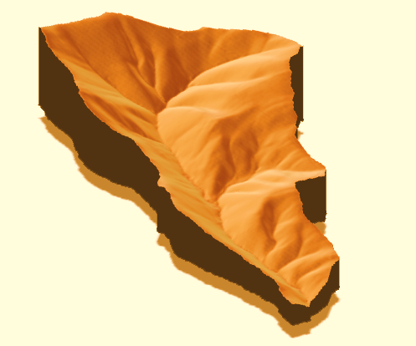
Green-blue water fluxes
Precipitation (P)
Evapotranspiration (ET)
Runoff (R)
Water flux partitioning:
Blue-water flux: R/P
Green-water flux: ET/P

Slide 3
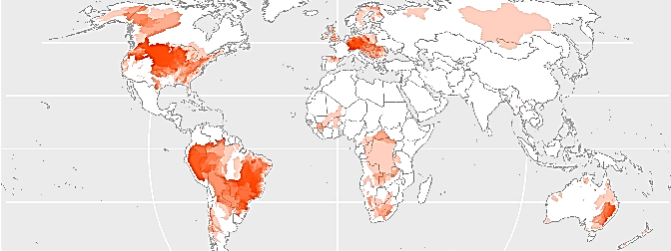
Objectives
Develop global machine learning (ML) model for predicting average water flux partitioning
Explore the model pattern recognition, and predictability capabilities for areas outside its initial domain
Compiled data for 3,614 hydrological catchments:
R, P, temperature, topography, land-use/-cover
For physical relevance check – also independent quantification
of some key hydrological characteristics:
Aridity index (AI), average time it takes for input and output fluxes to equilibrate (T_{eq}), avg. groundwater contribution to avg. runoff (R_{gw0}/R_{avg})
Data

Slide 4
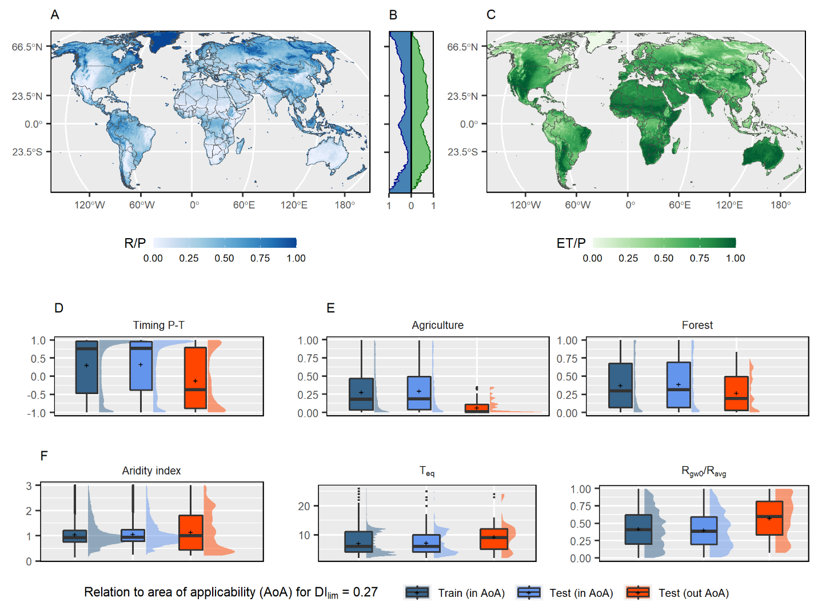
Model applicability
Machine learning model:
Cubist regression¹
Training set: 2,857 catchments
Test set: 757 catchments
Model interpretation:
Shapley values^{2,3}
Model applicability:
Dissimilarity index⁴

Slide 5
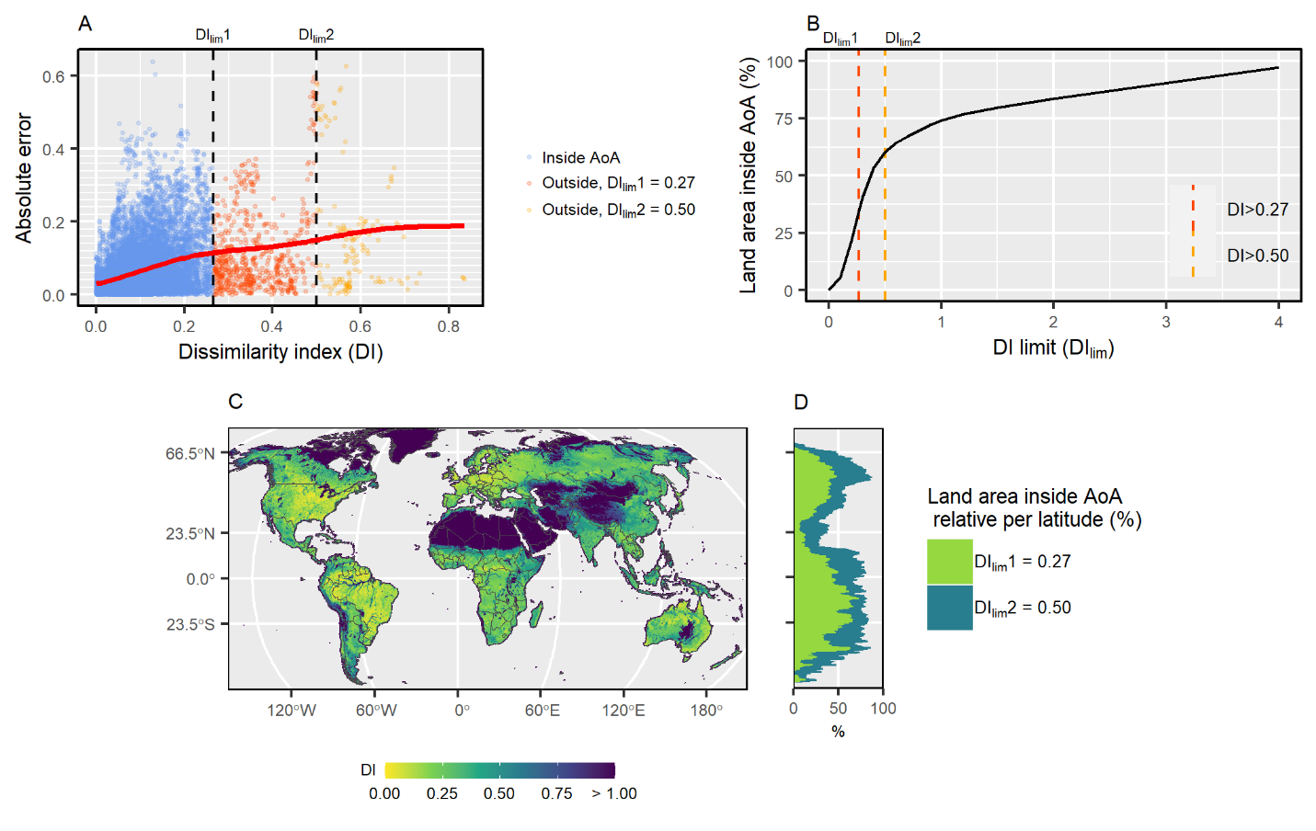
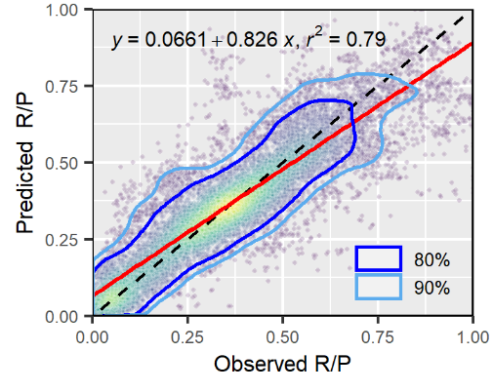
Model applicability
KGE = 0.87

Slide 6
Thank you
Daniel Althoff
daniel.althoff@natgeo.su.se

