Slide 1




Molecular biomarkers in mega old permafrost
Loeka Jongejans, Kai Mangelsdorf, Susanne Liebner, Guido Grosse, Mikhail N. Grigoriev, Alexander N. Fedorov and Jens Strauss
Further collaborators: Cornelia Karger, Thomas Opel, Sebastian Wetterich, Jérémy Courtin, Hanno Meyer, Alexander I. Kizyakov, Andrei G. Shepelev, Igor I. Syromyatnikov

Slide 2
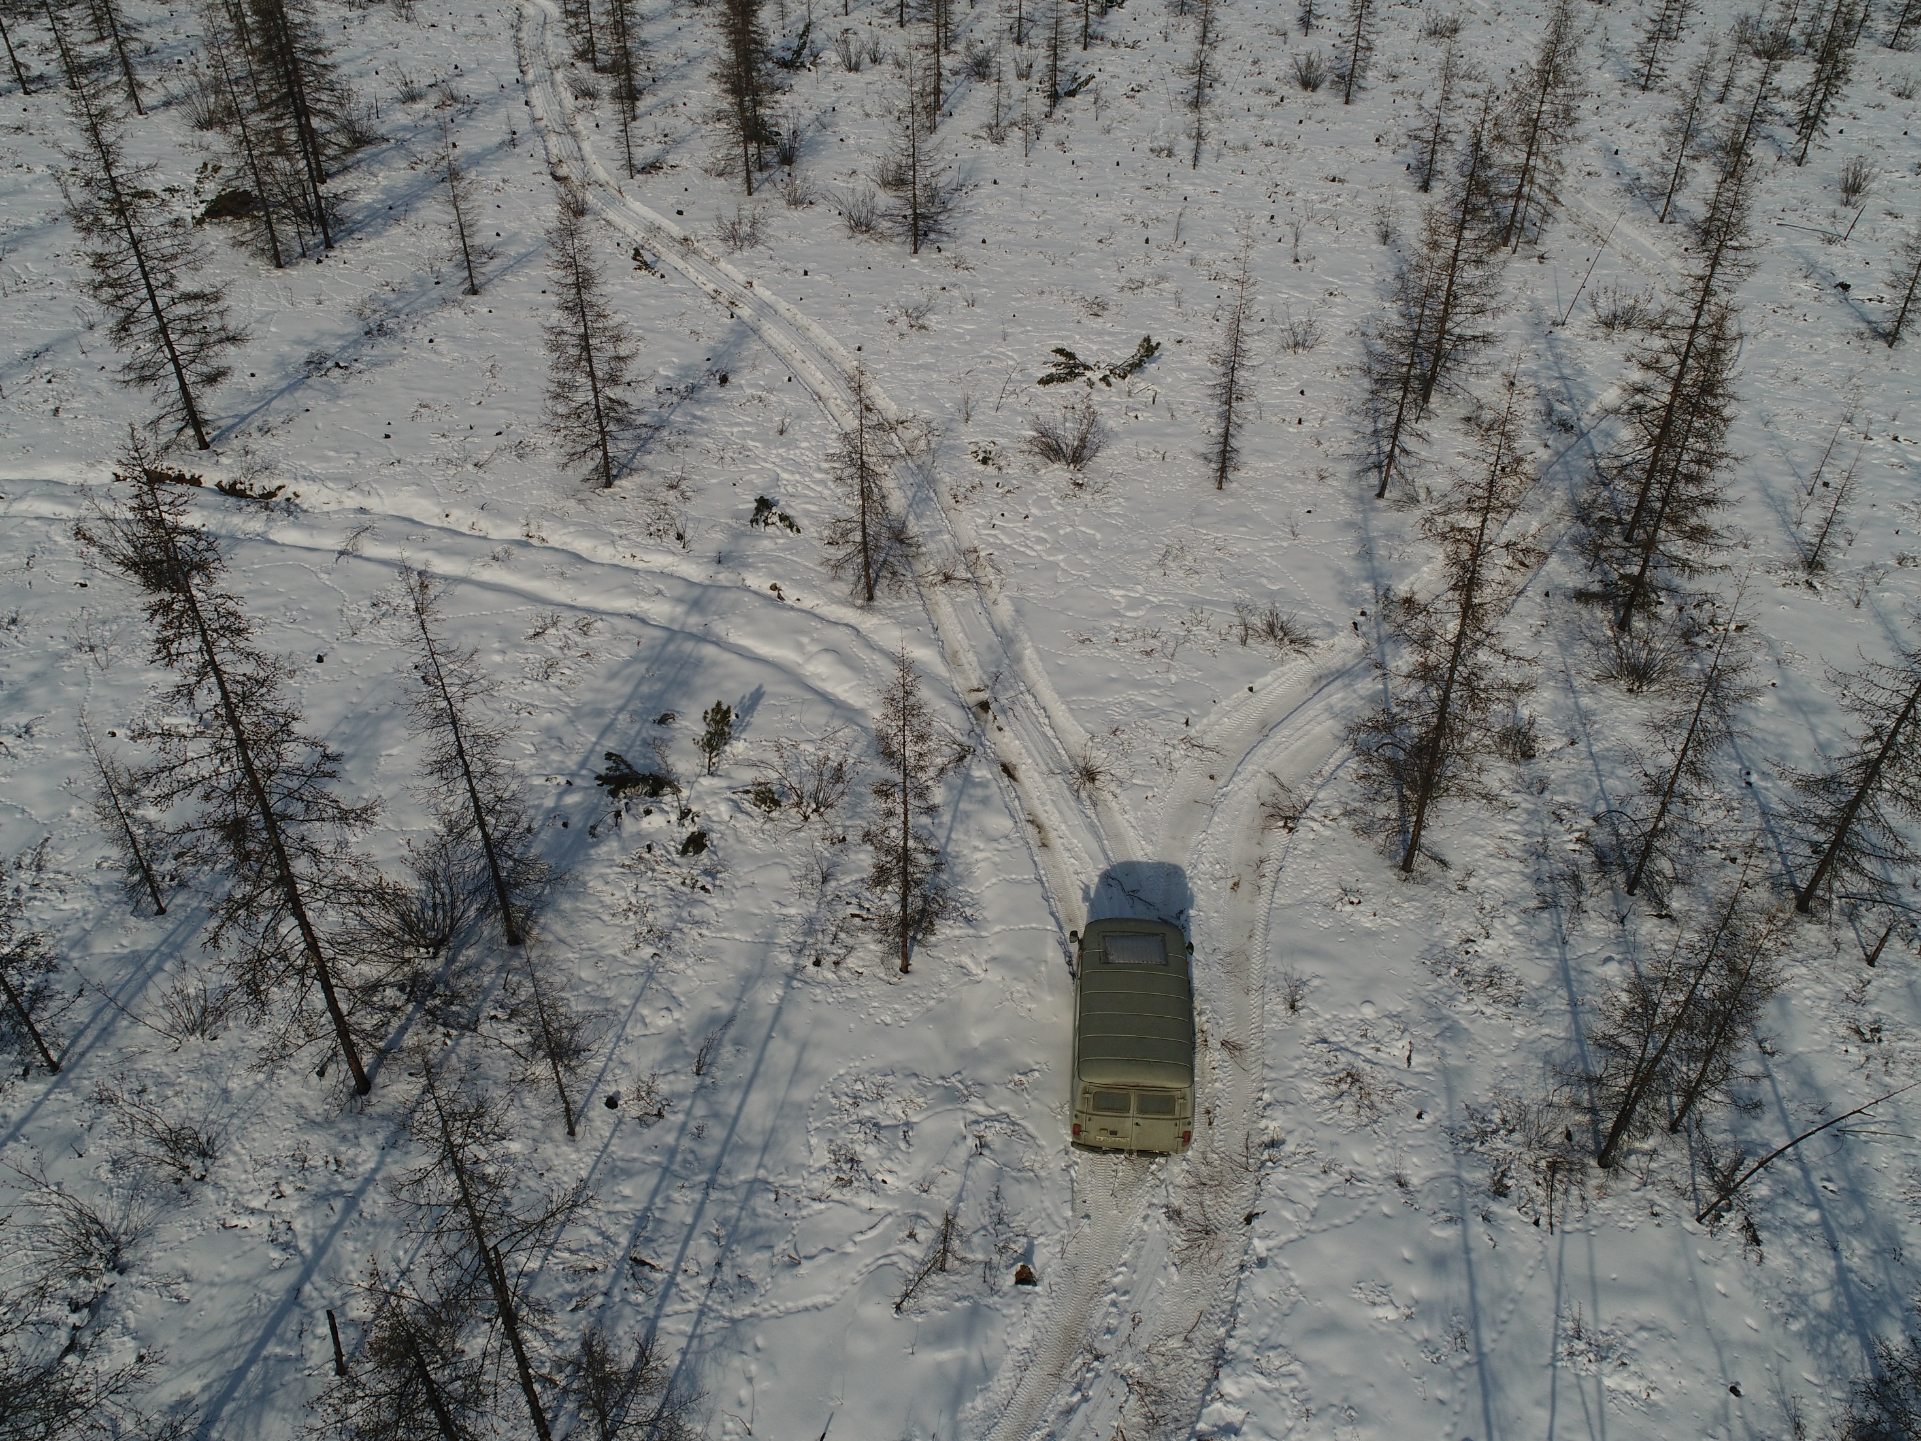
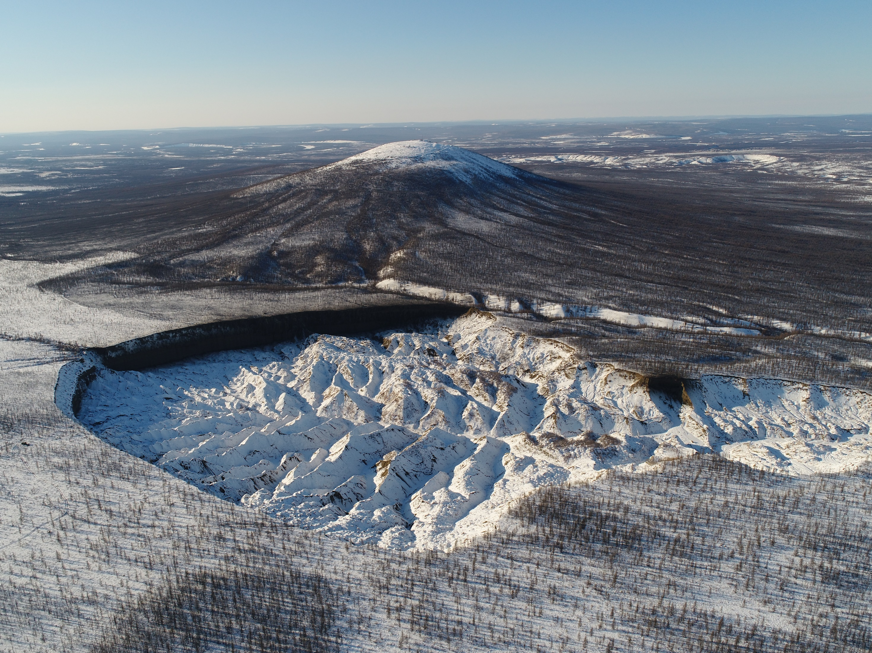
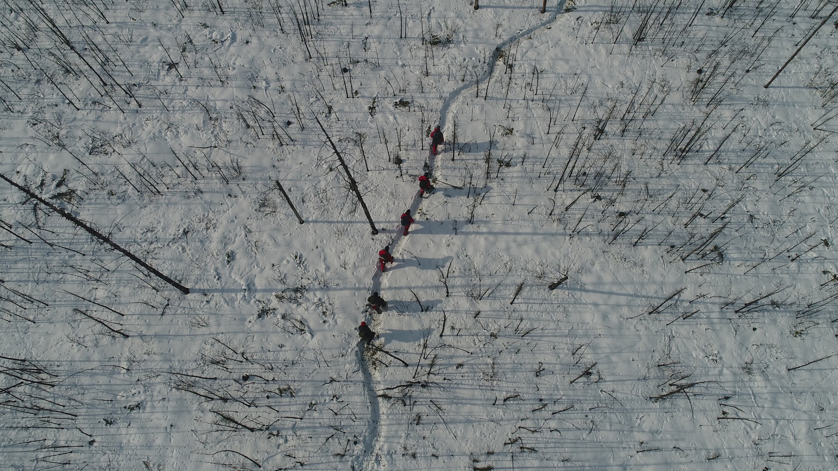
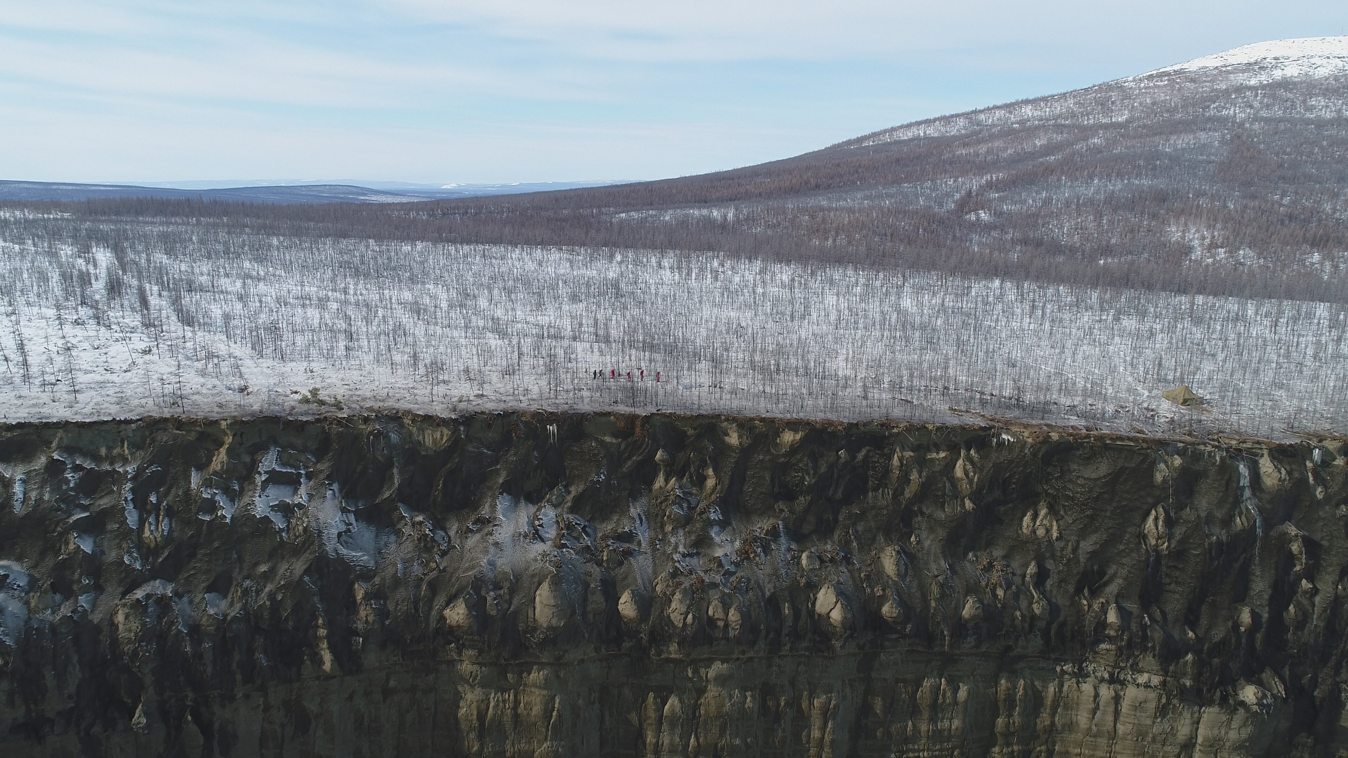
Batagay
© A. Kizyakov
© A. Kizykov

Slide 3
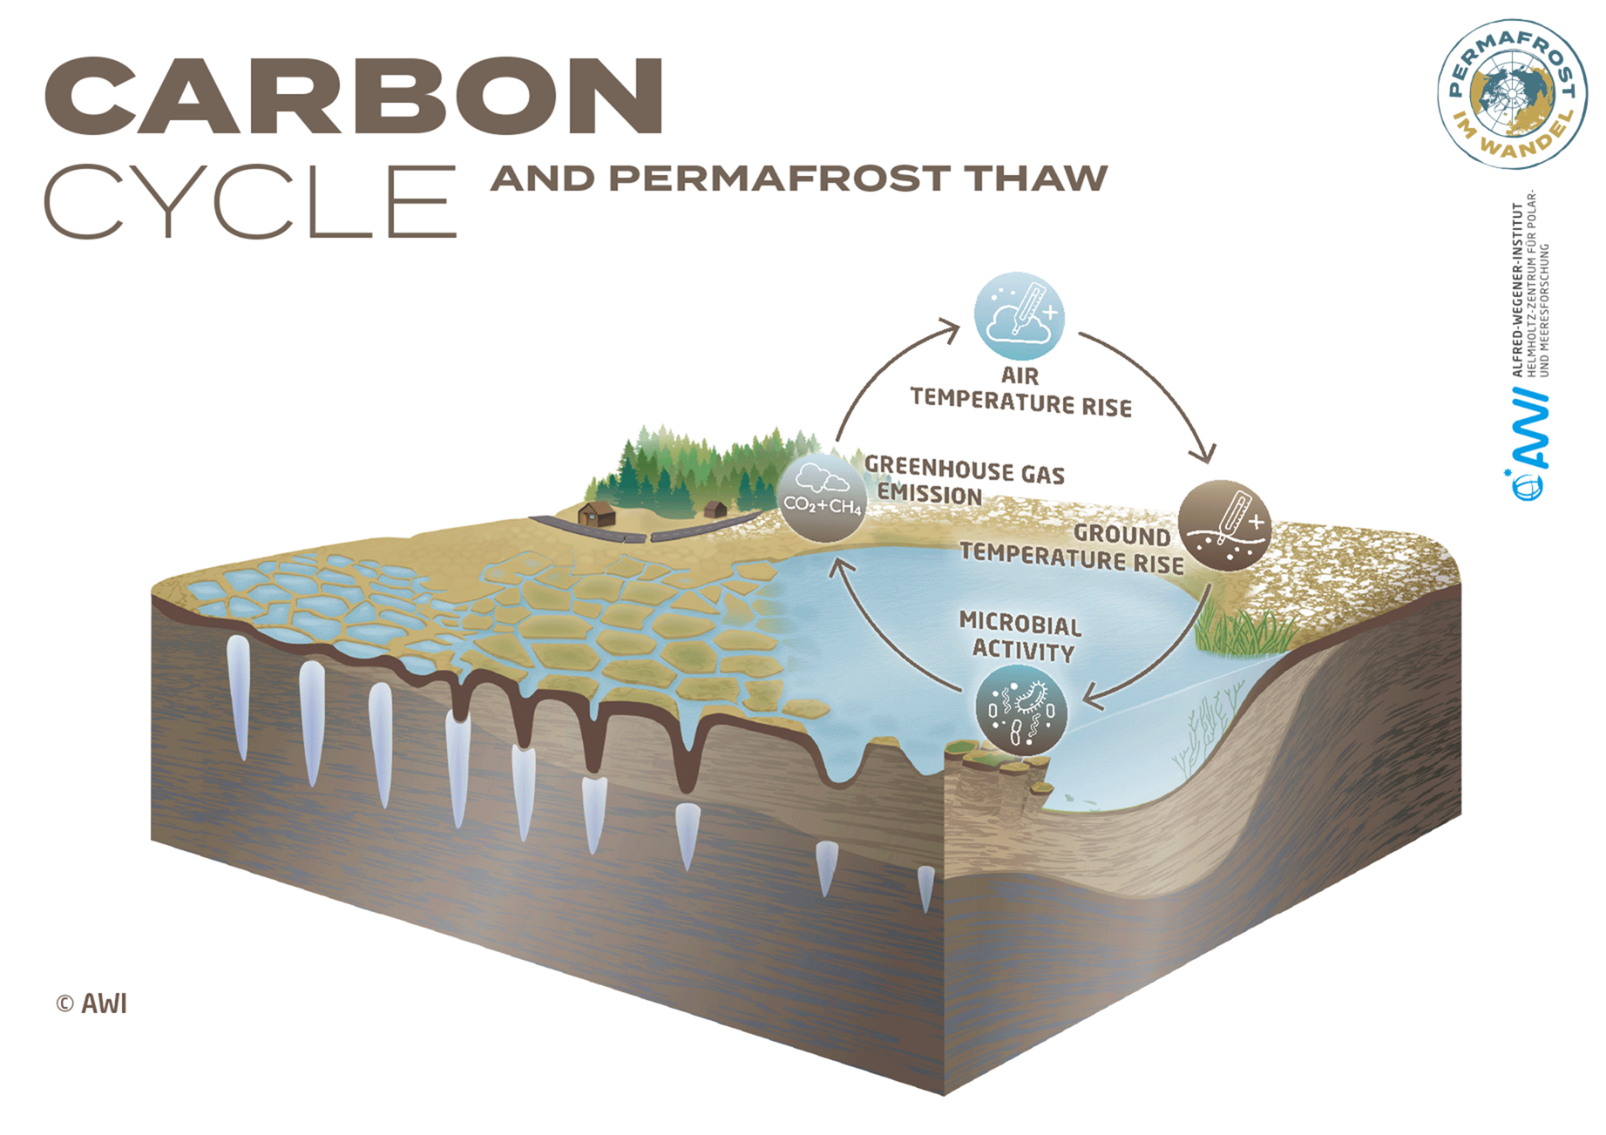
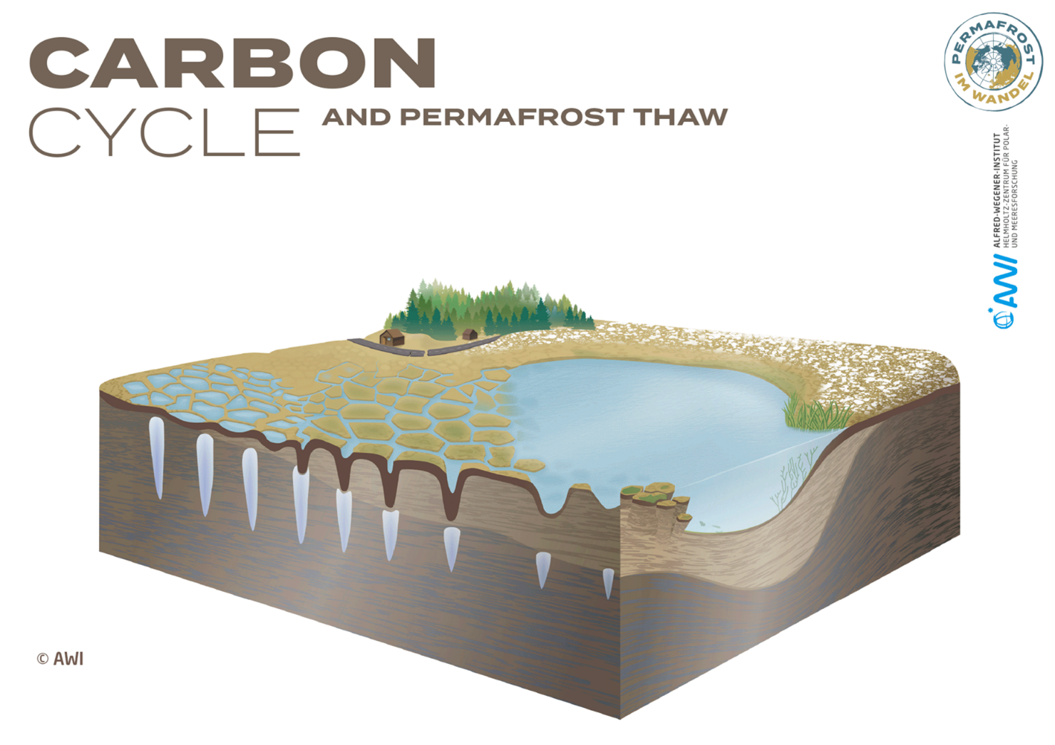
Notes:
Large regions of the Arctic are underlain by permafrost, or perennially frozen ground
In permafrost, large amounts of organic matter (e.g., plant remains) are stored

Slide 4
Aim: to assess the permafrost-locked organic matter quality using biomarker proxies
What are biomarkers?

Slide 5

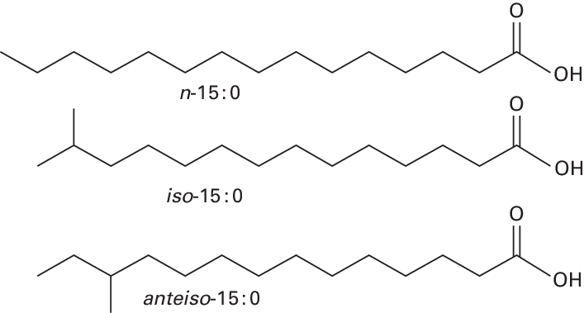
Biomarkers
Molecular fossils from once-living organisms
For example: alkanes and fatty acids
Source and preservation of organic matter

Slide 6
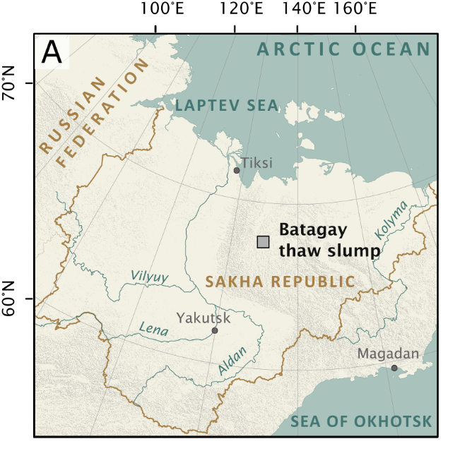
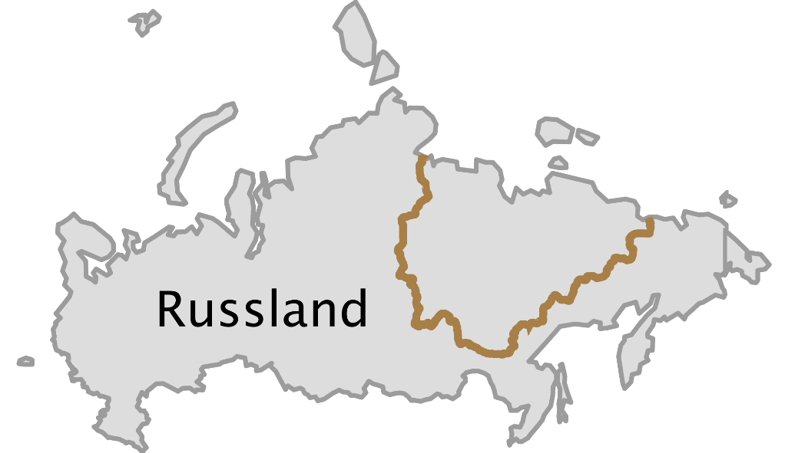
Batagay thaw slump

Slide 7
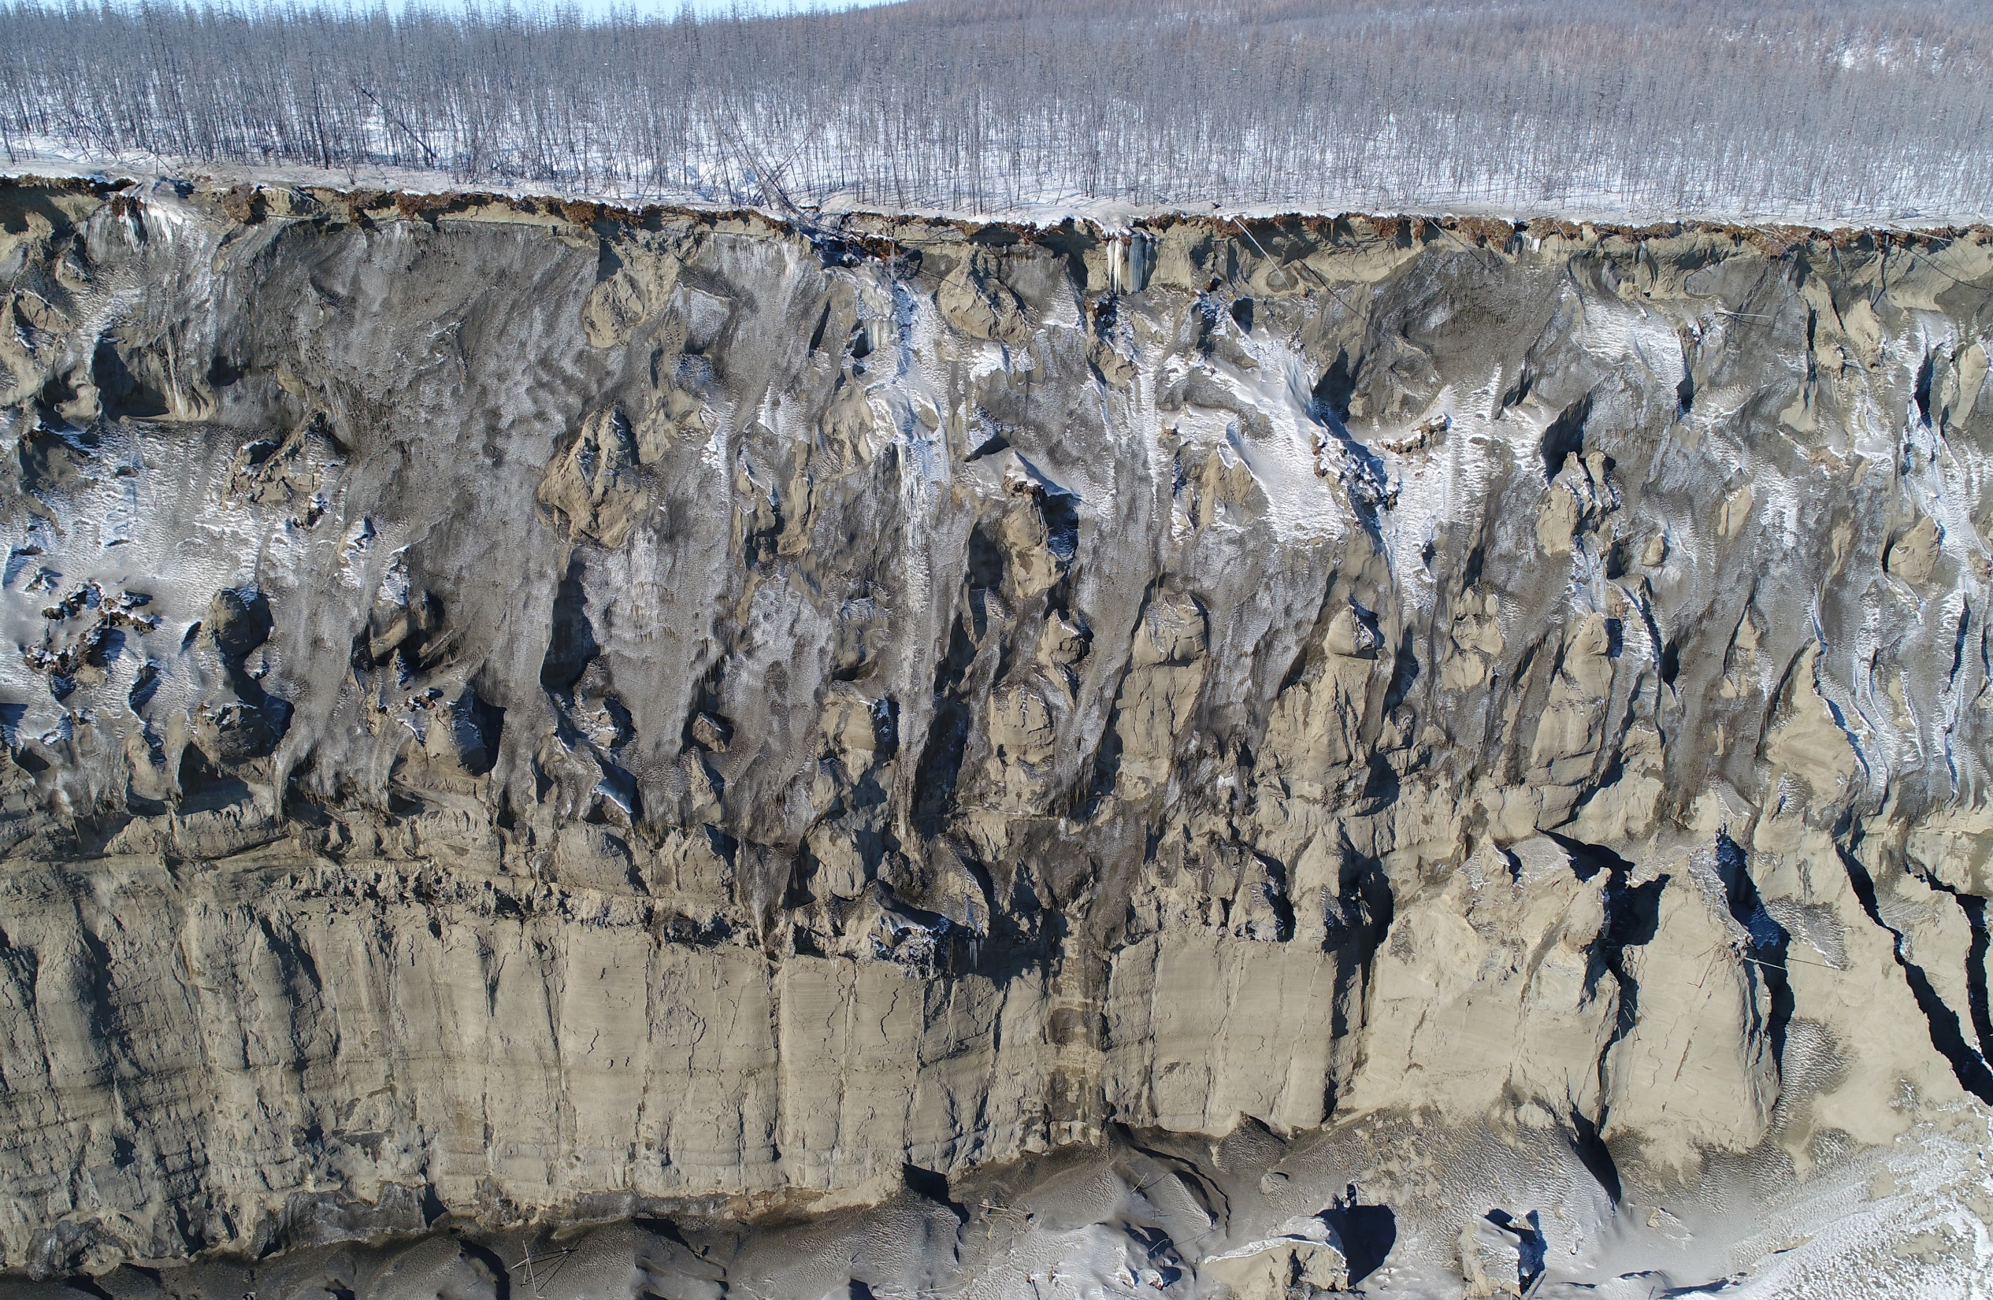
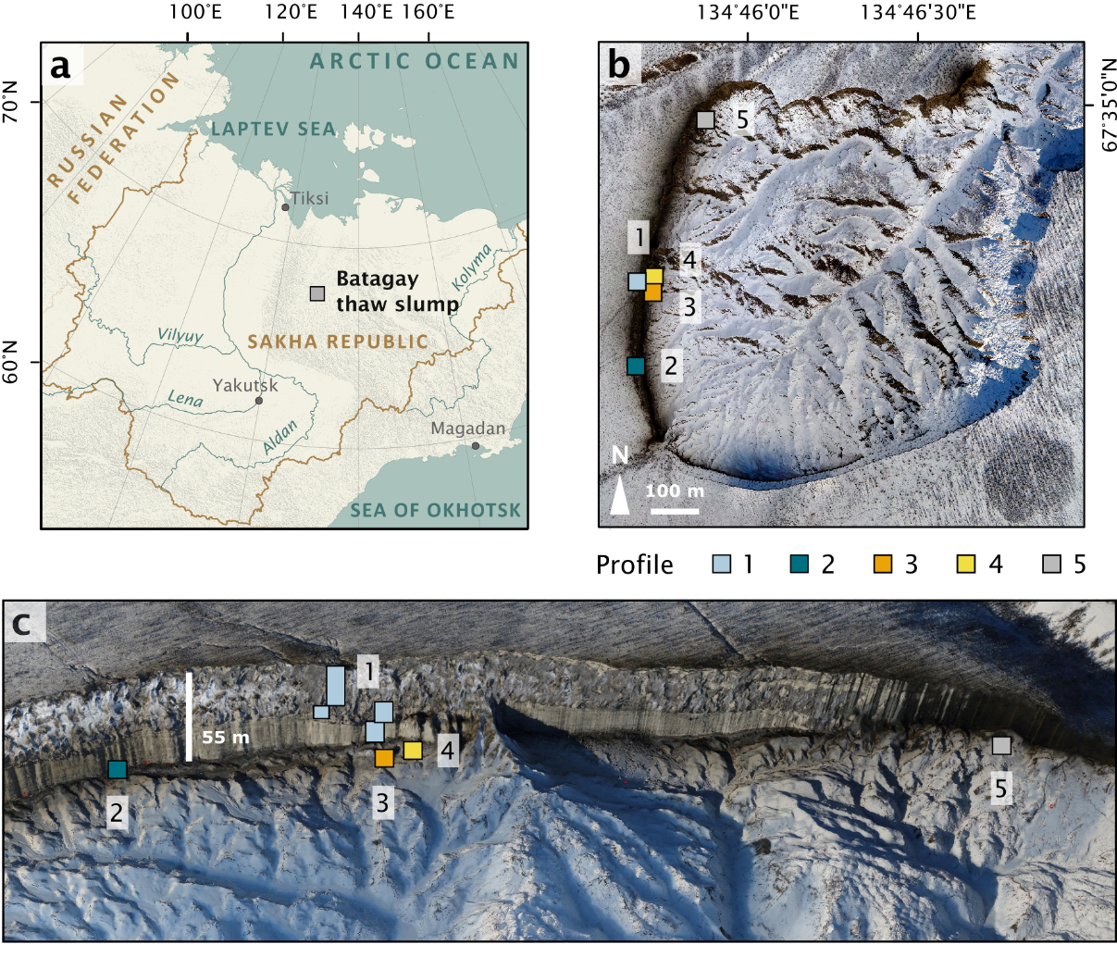
Thaw slump grows rapidly
650,000 years old!
© A. Kizyakov

Slide 8
Main findings
Biomarkers well-preserved in ancient permafrost deposits
Distinct differences for glacial and interglacial periods
Fatty acids: more microbial activity during interglacial
Alkanes: wetter conditions during Holocene Interglacial

Slide 9
Outlook
Study of molecular biomarkers of permafrost regions is valuable for characterization of organic matter
Rapid permafrost thaw processes mobilize ancient organic matter which enhances greenhouse gas emissions from permafrost regions

Slide 10
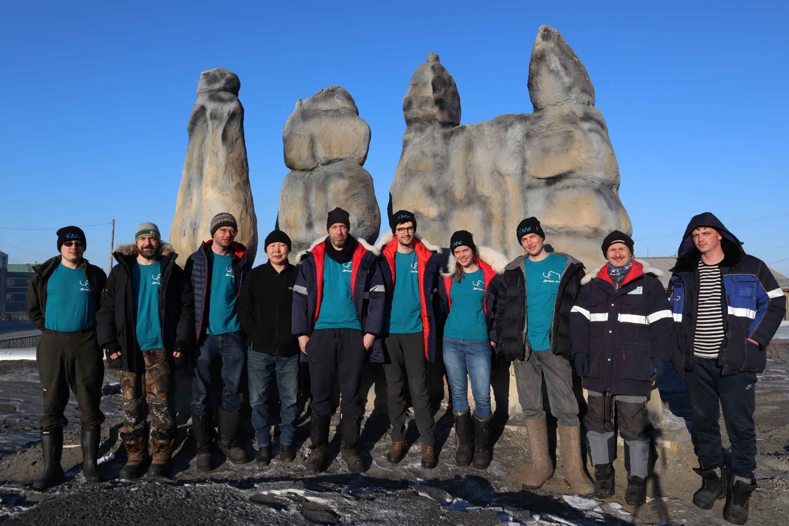

Thank you!
Loeka.Jongejans@awi.de @JongejansLoeka

