Slide 1
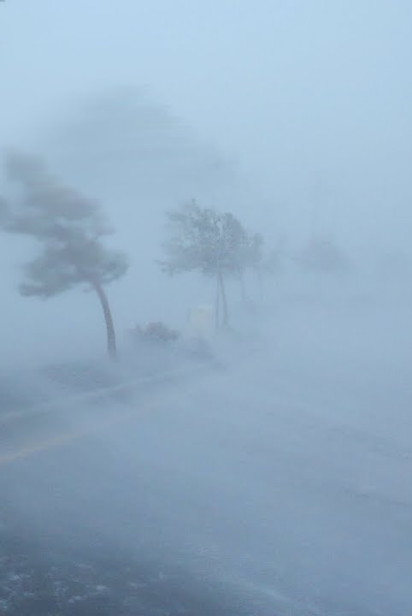




Record breaking stormy seasons and compound precipitation and wind footprints over Europe
Laura E. Owen¹
Jennifer L. Catto¹, Nick J. Dunstone² and David B. Stephenson¹
¹The University of Exeter, ²Met Office

Slide 2
The Problem: small event set
The risk of very rare and unprecedented stormy seasons and their precipitation and wind extremes is largely unknown.
These events hard to look at from the observational record due to the small sample size.
A solution: GloSea5
The Global Seasonal forecast system version 5 (GloSea5) from the UK Met Office is an ‘experimental’ high resolution version of the climate model HadGEM3, with a resolution of 25 km (for details of the model setup see MacLachlan et al. [2015]).
24 times more data than observations
We generate 24 timeseries of 6h total precipitation and 10m wind speed by drawing from each of the ensemble members.
Tracks are made using Kevin Hodges tracking algorithm, TRACK, on 850hPa vorticity
These are compared against the reanalysis dataset ERA5.
All datasets in this study are from the period 1993 to 2016, for the winter season, December to February.

Slide 3
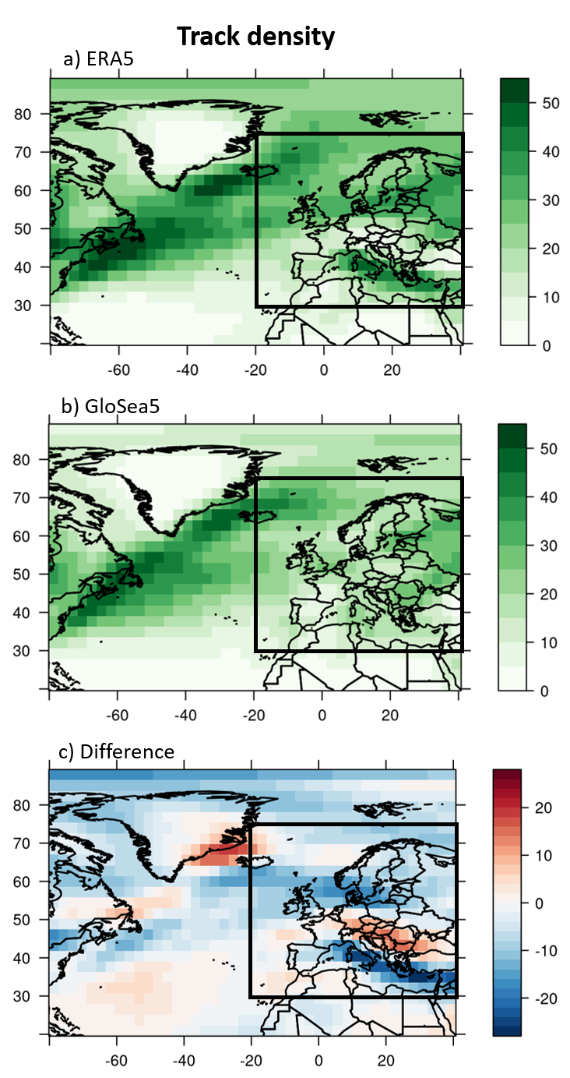
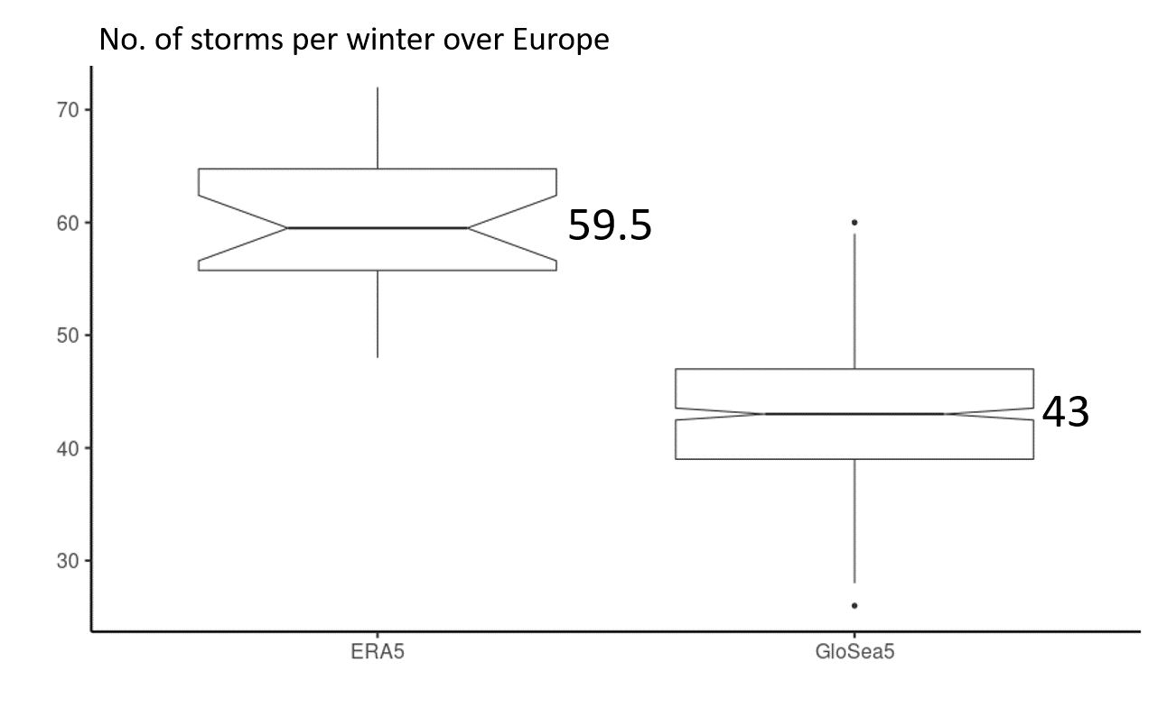
1. How well can GloSea5 represent the frequency and characteristics of storms over Europe?
Despite biases in GloSea5 it is shown to have a reasonable representation of the storm tracks over Europe and the North Atlantic and can simulate the variability in extratropical cyclone frequency well.
However, GloSea5 does underestimate the number of storms over Europe, on average ERA5 has 59.5 storms a season and GloSea5 43.
This underestimation may be due to northward shifts in the North Atlantic and Mediterranean storm tracks

Slide 4
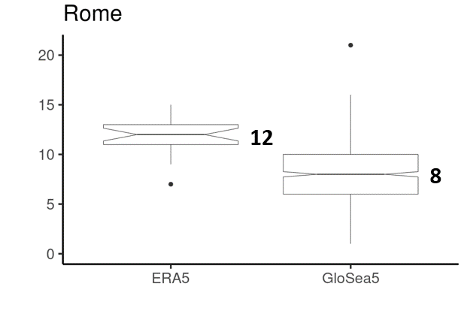
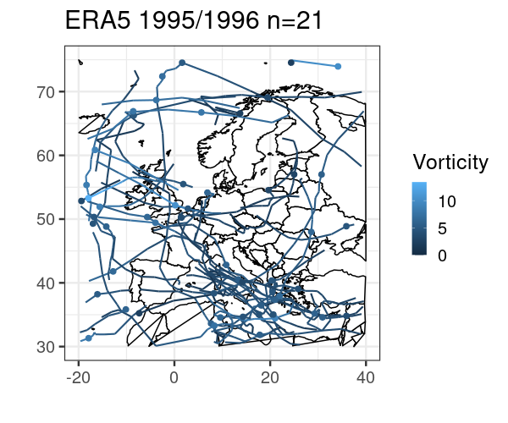
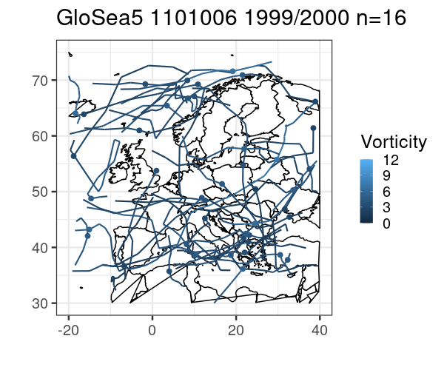
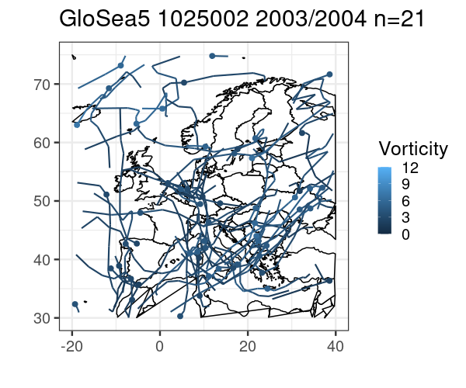
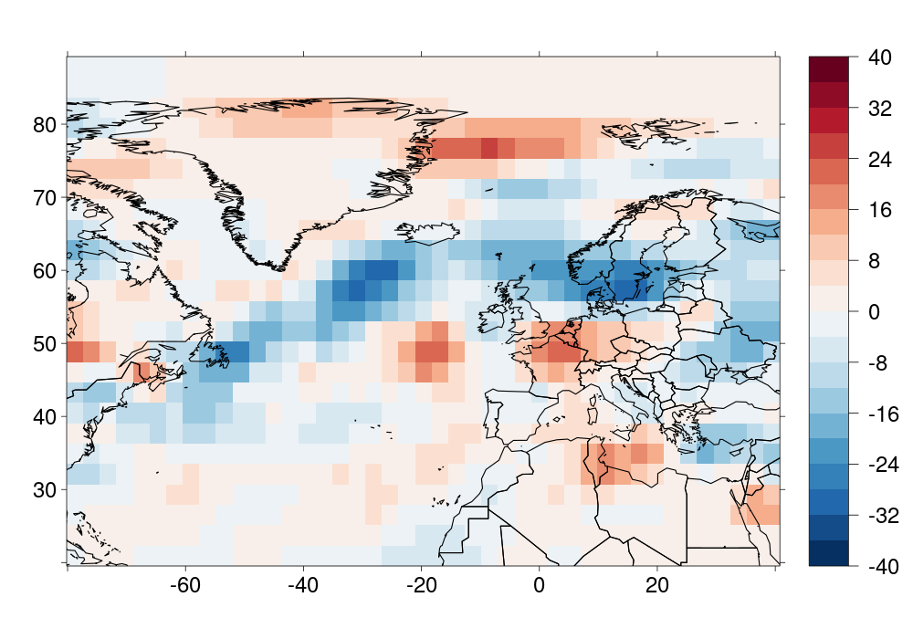
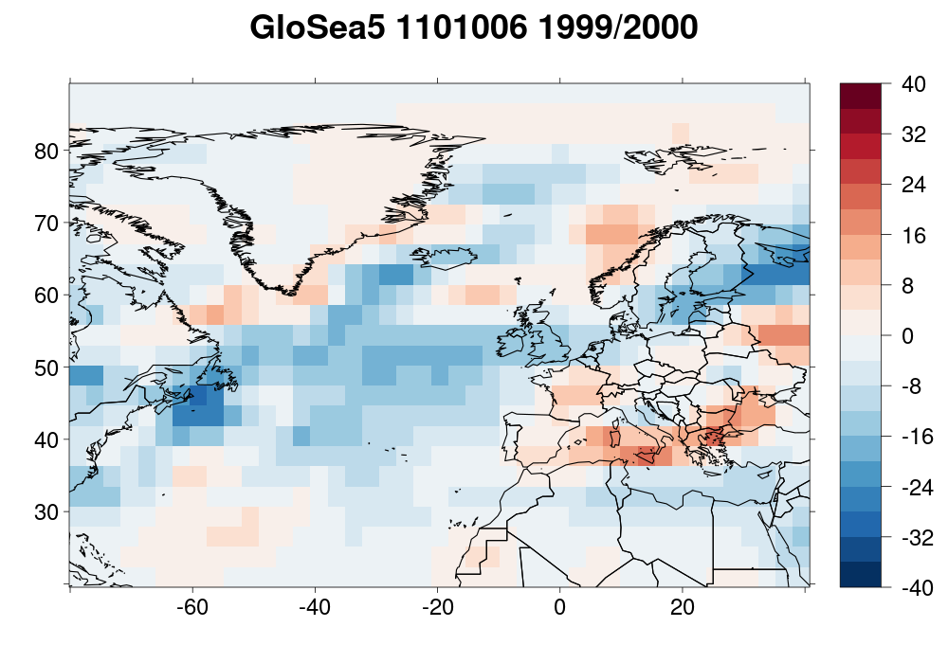
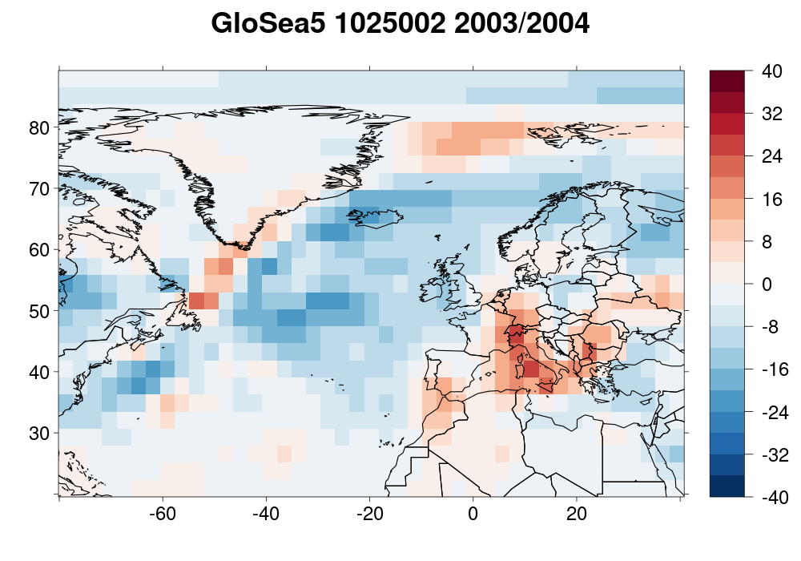
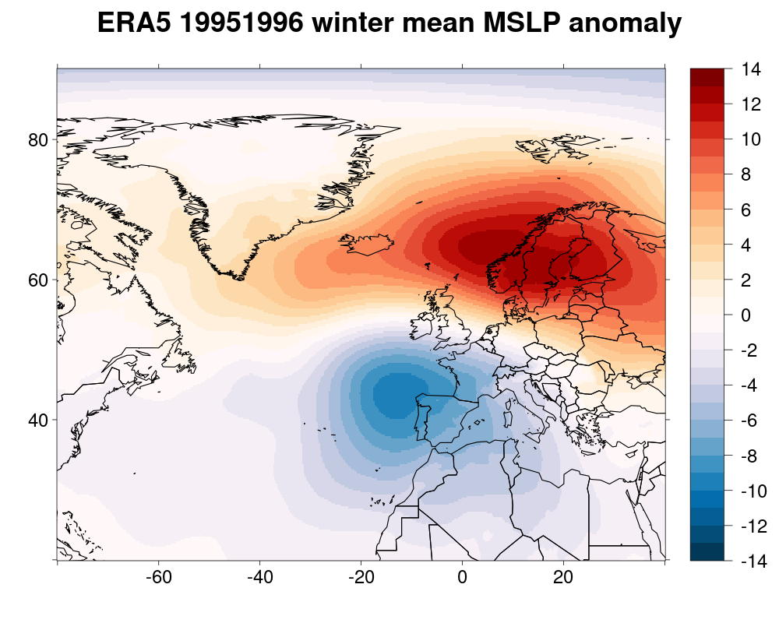
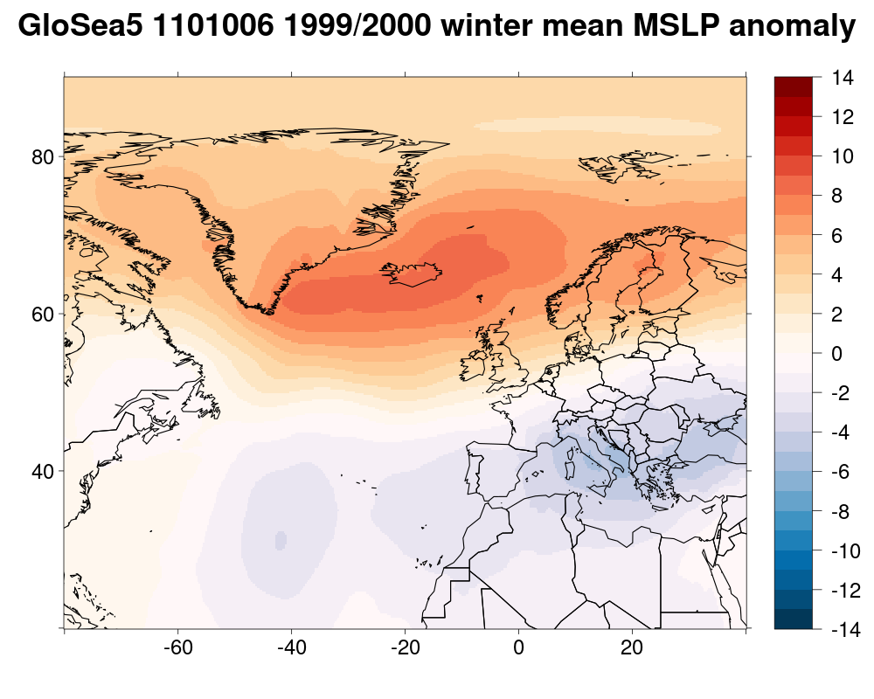
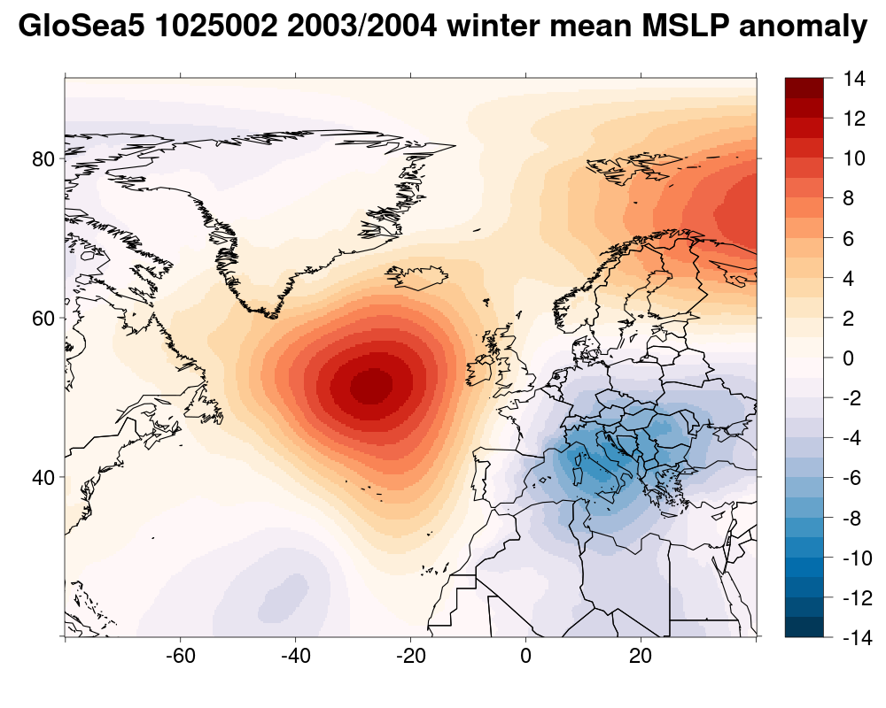
2. Can GloSea5 give us insight into unrealised tracks and large scale dynamics of record breaking stormy seasons?
Tracks, track density and winter mean MSLP anomaly for the stormiest winters over Rome
ERA5 1995/1996 n=15
GloSea5 n=16
GloSea5 n=21
It is possible to have a winter with 1.4 more storms than the historical record.
GloSea5 can produce realistic large scale dynamical patterns.
Some of these large scale patterns are different to historical extreme storm seasons and some look different to anything seen historically.
GloSea5 gives insight into unrealised climatic states for stormy seasons.

Slide 5
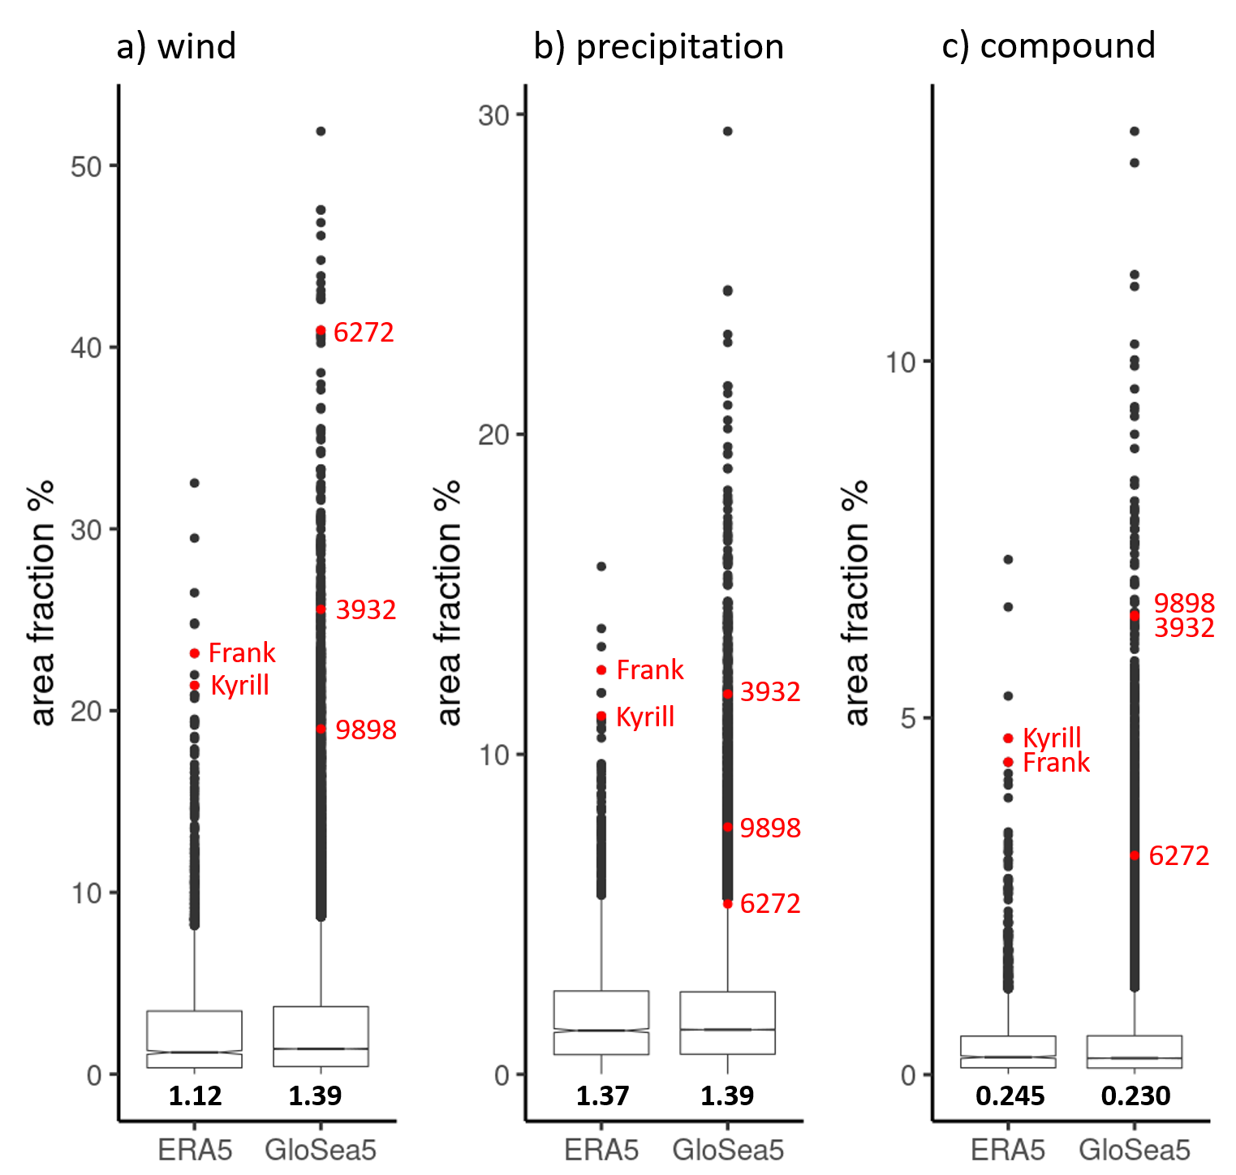
3. What can GloSea5 tell us about the size of record breaking extreme footprint storms?
Fraction area of extremes for storms over Europe
GloSea5 represents the size of extreme wind, precipitation and compound footprints very well.
The median fraction areas of all three extremes are statistically indistinguishable between GloSea5 and ERA5.
It is possible in the current climate to get storms with footprints of extremes almost double the size of that seen historically.
GloSea5 suggests it is possible to get a storm with an extreme footprint 2 to 3 times larger than Kyrill and Frank.

Slide 6
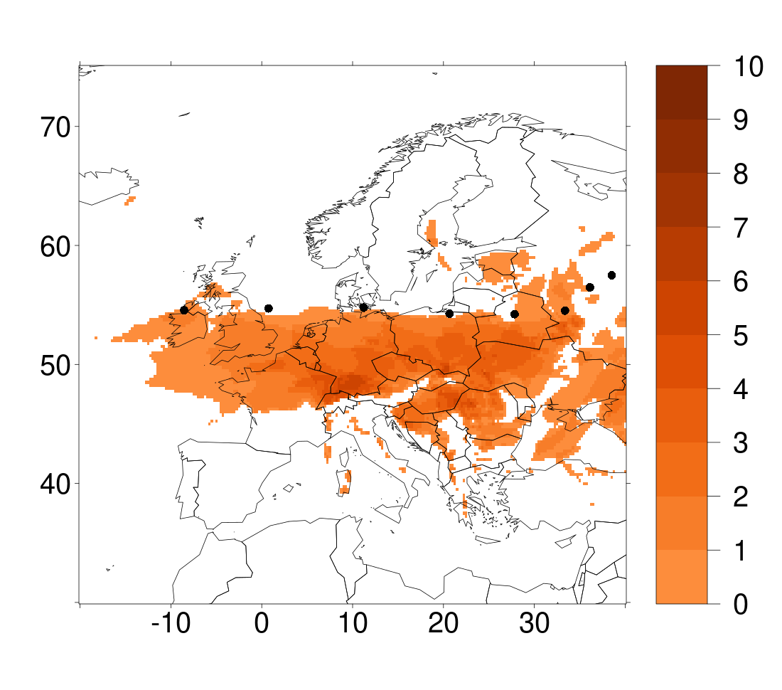
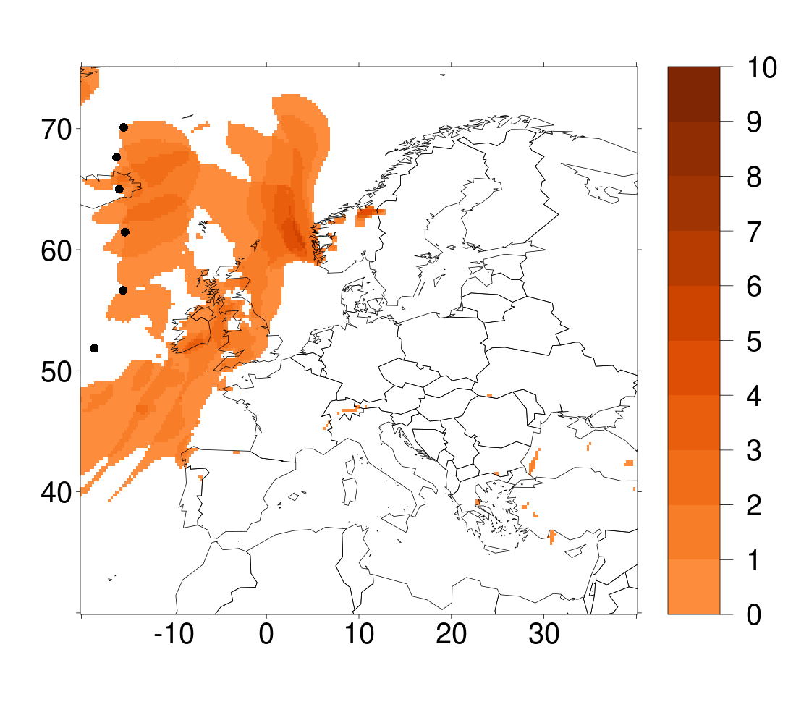
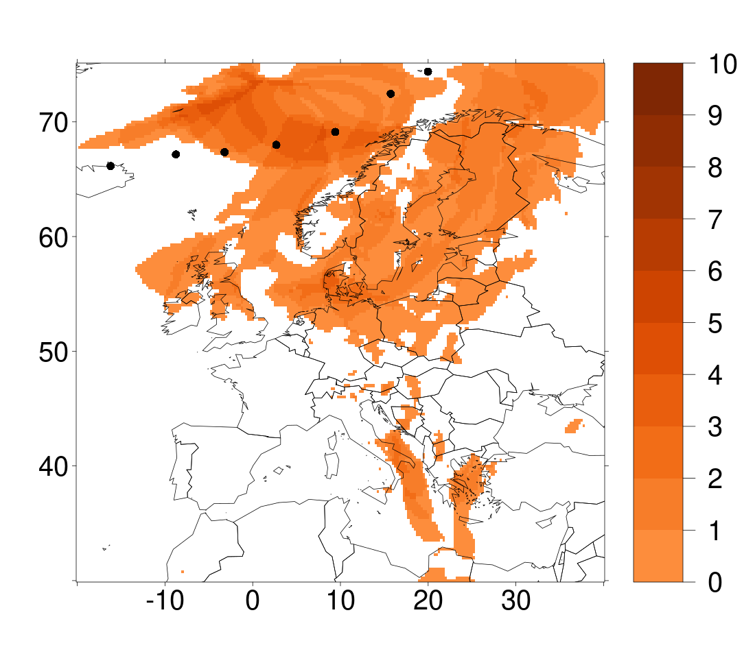
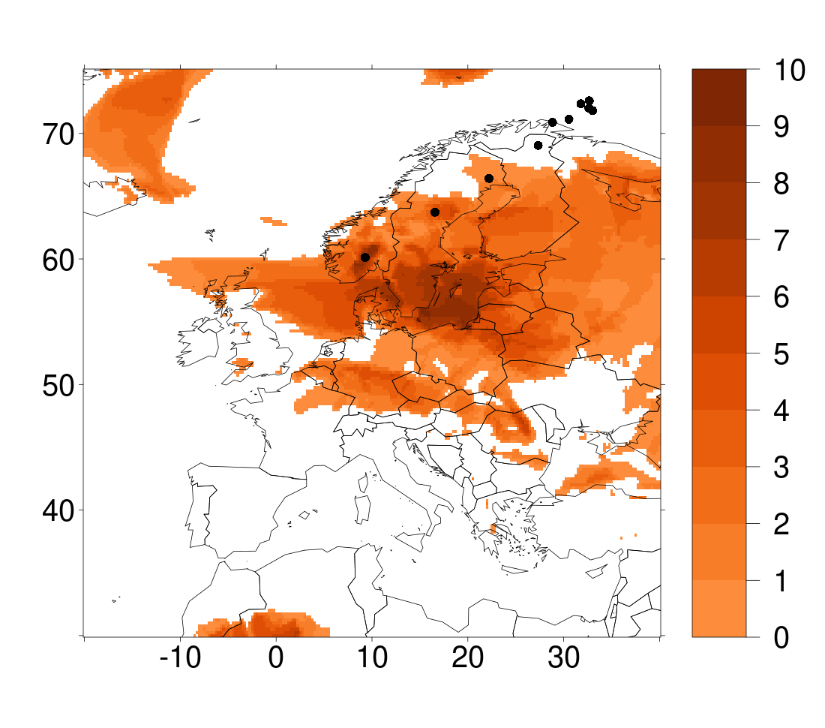
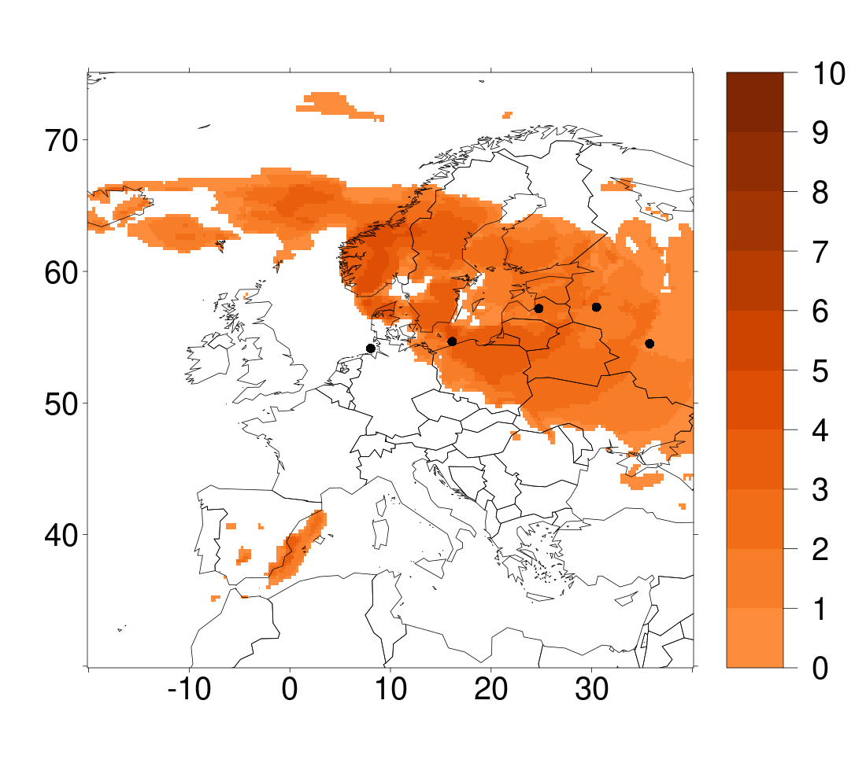
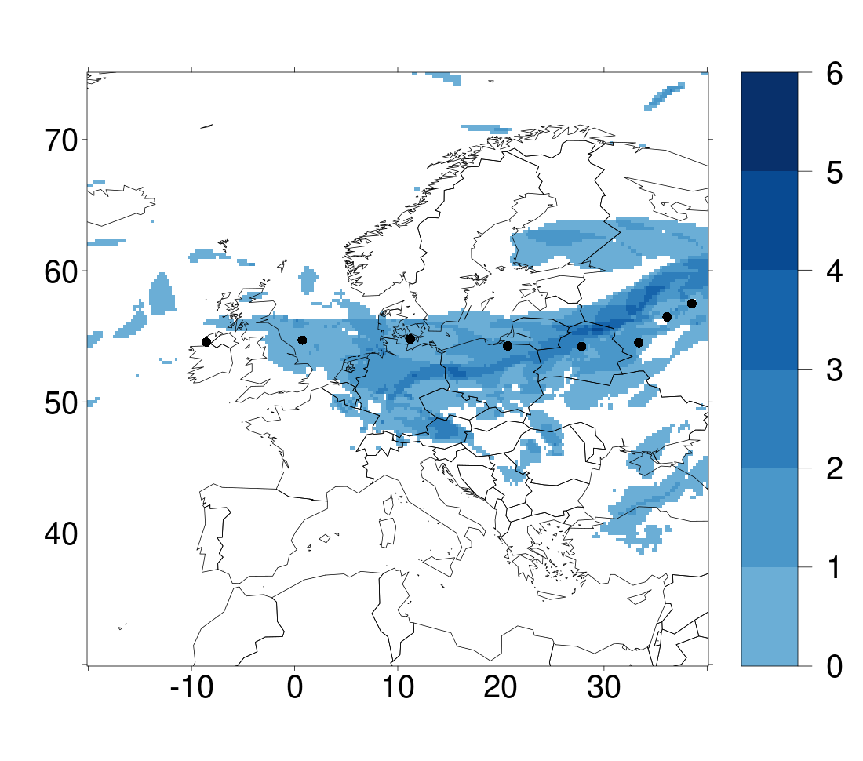
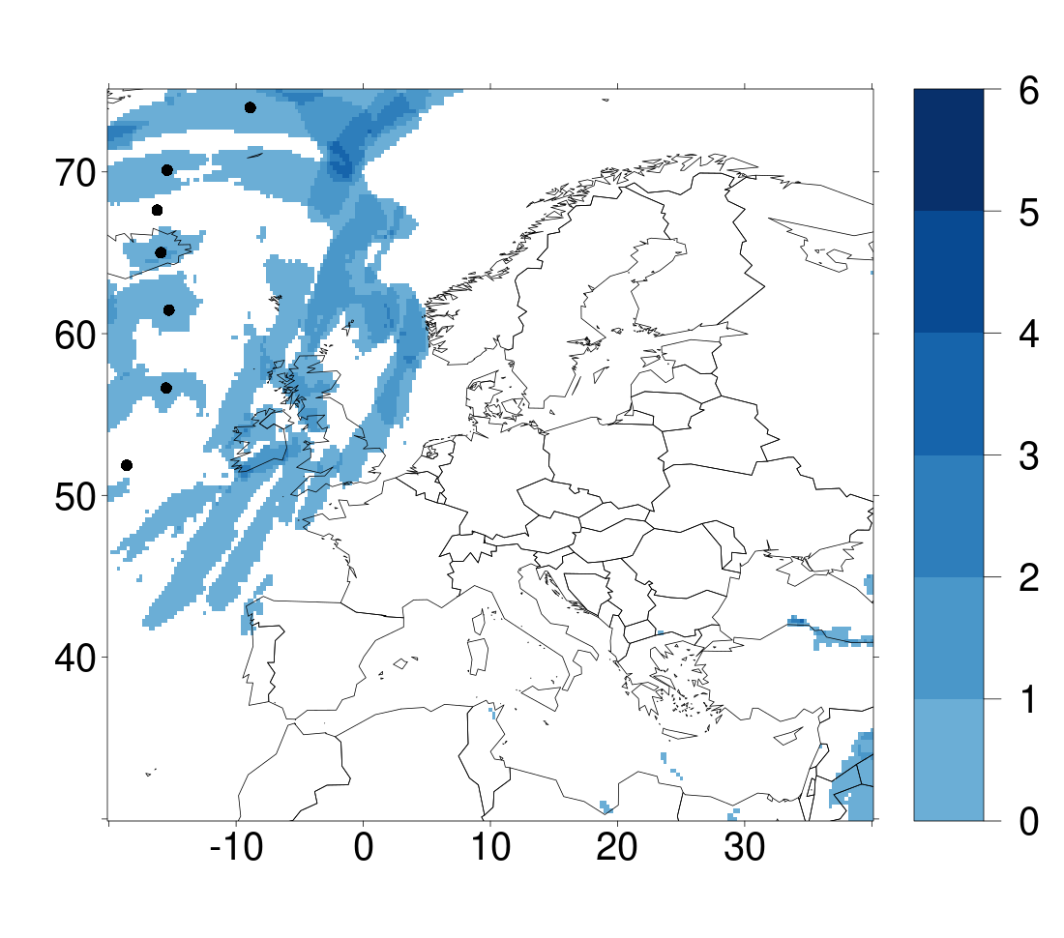
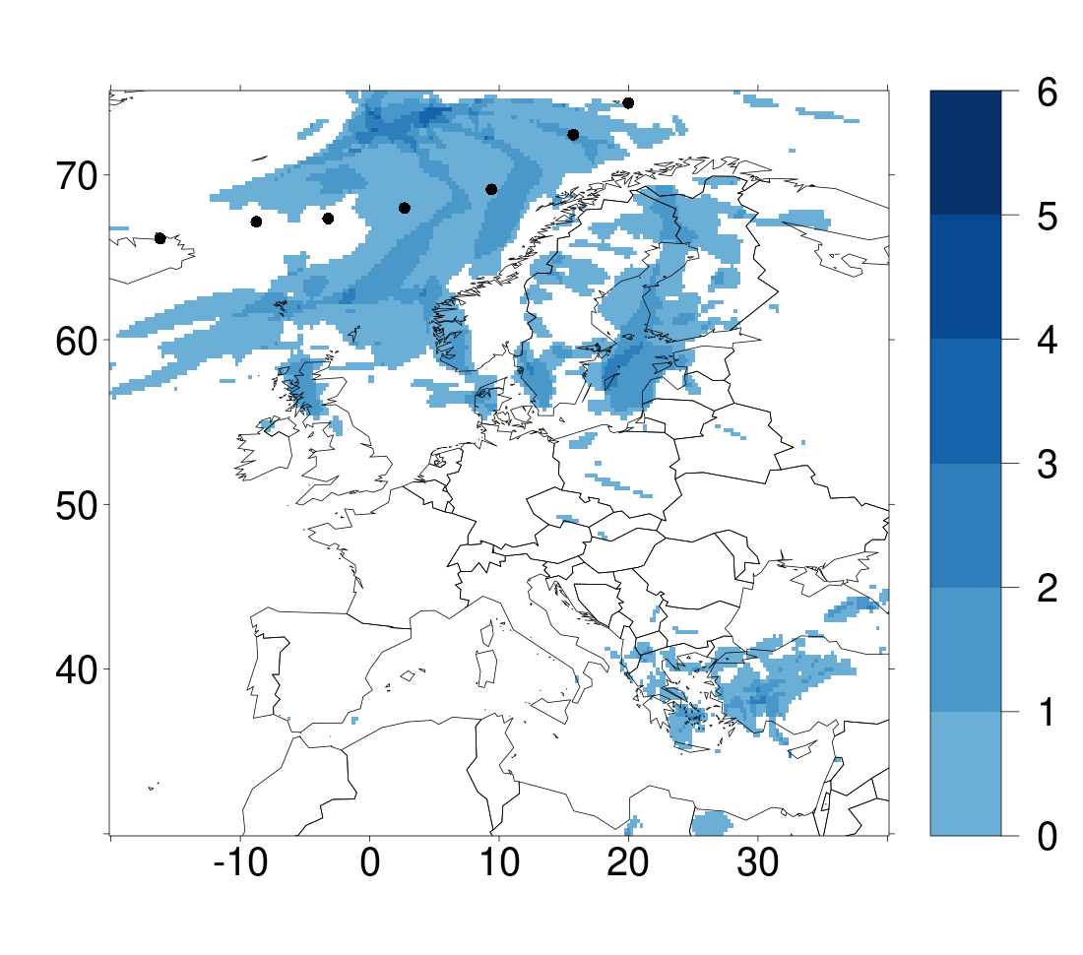
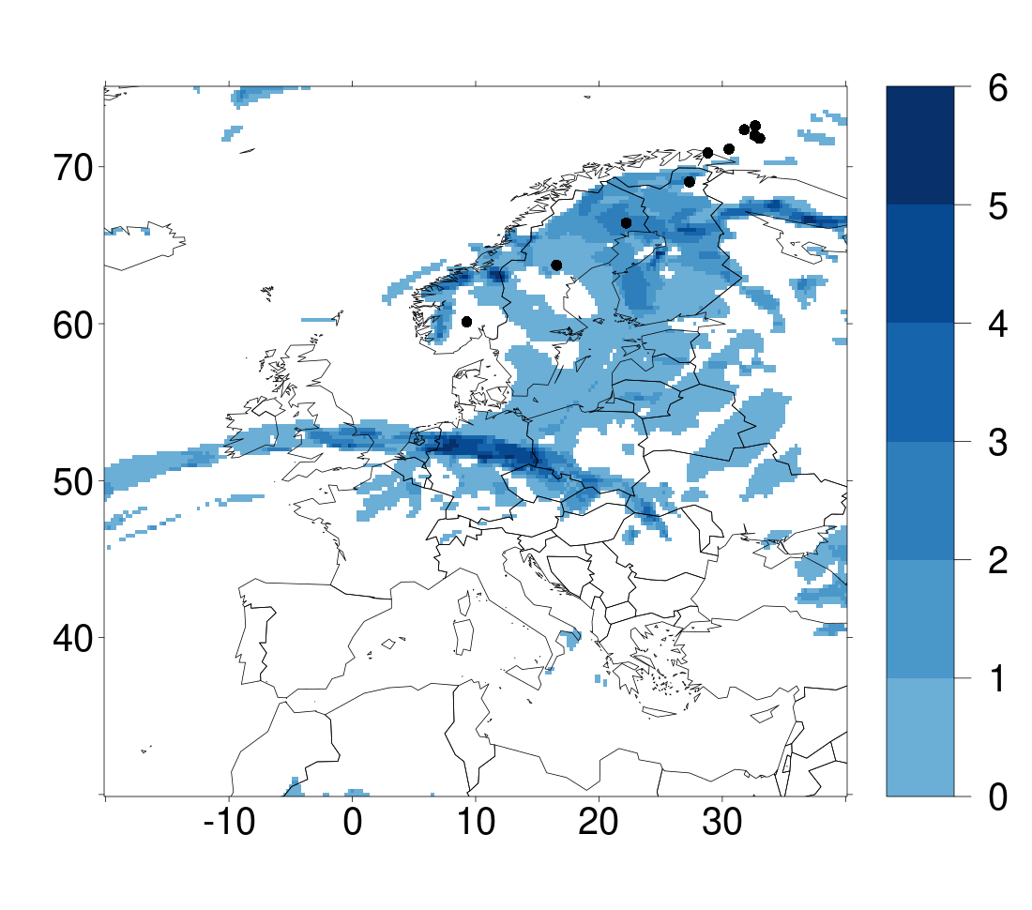
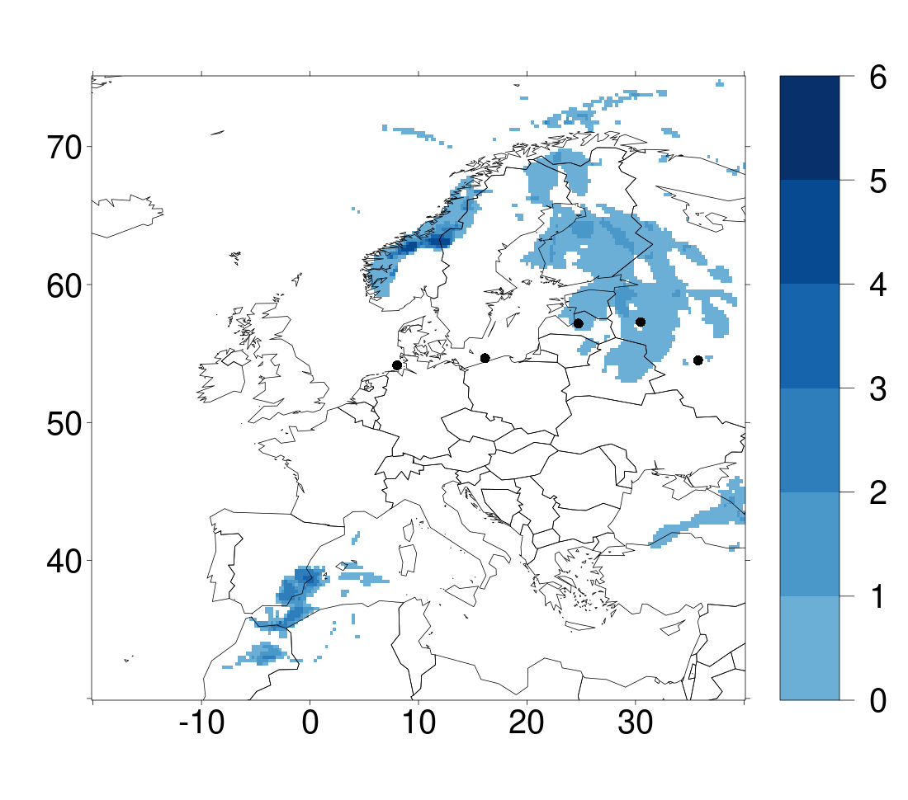
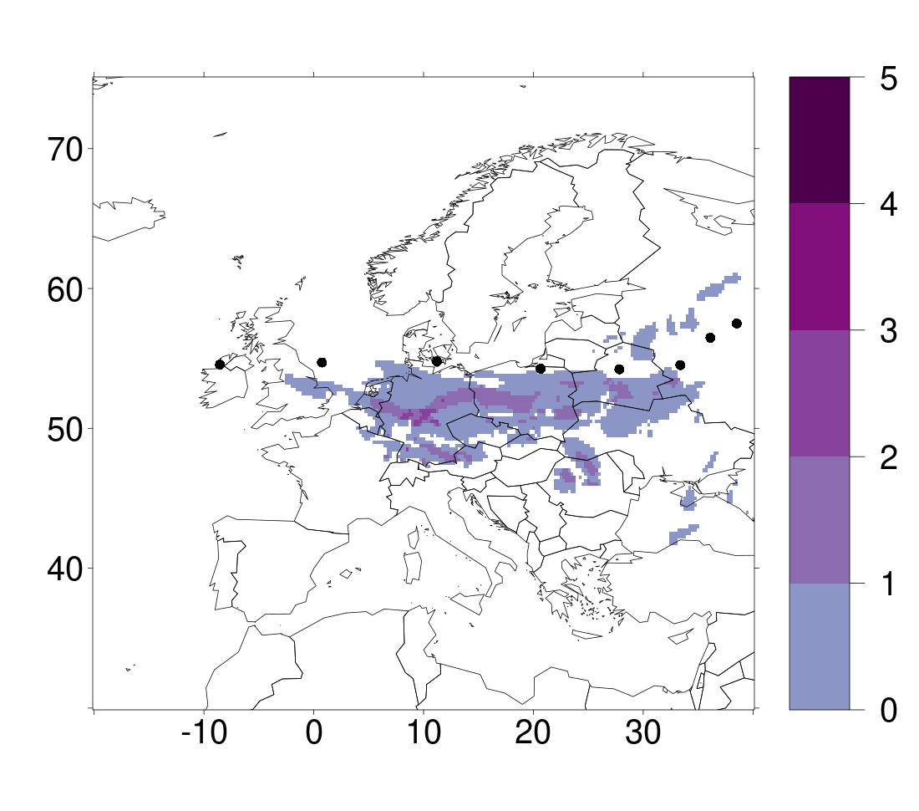
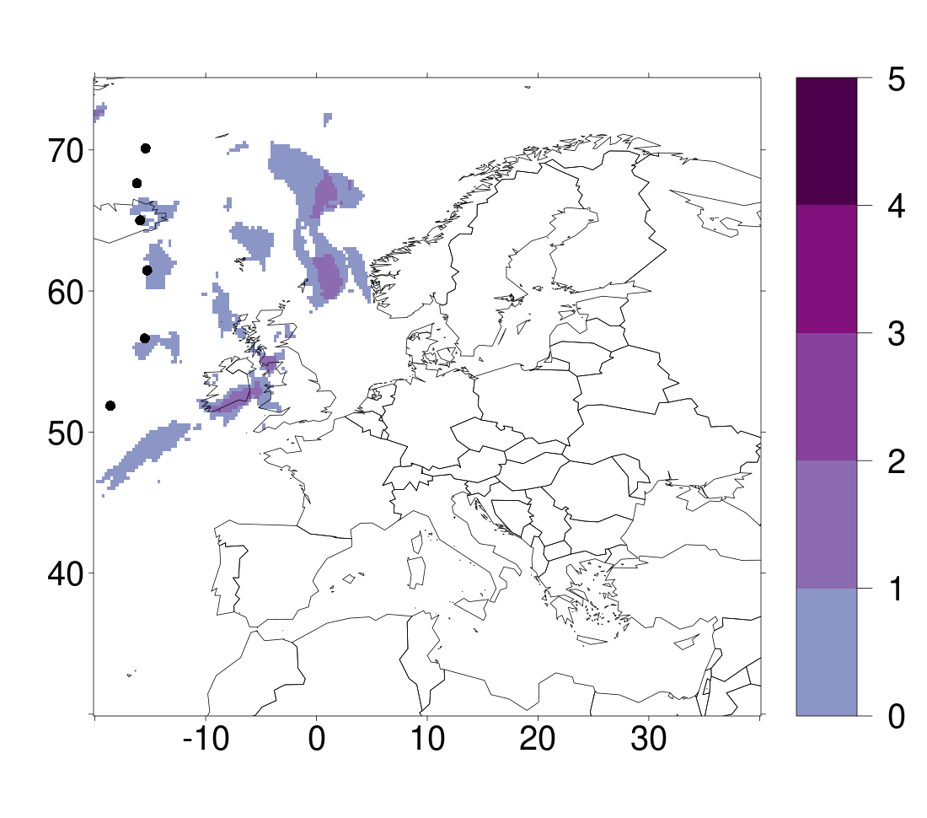
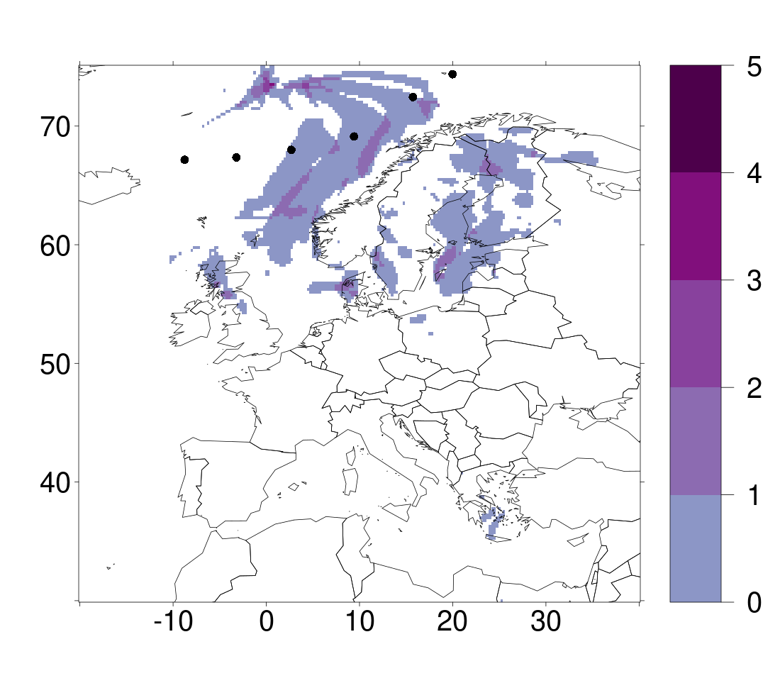
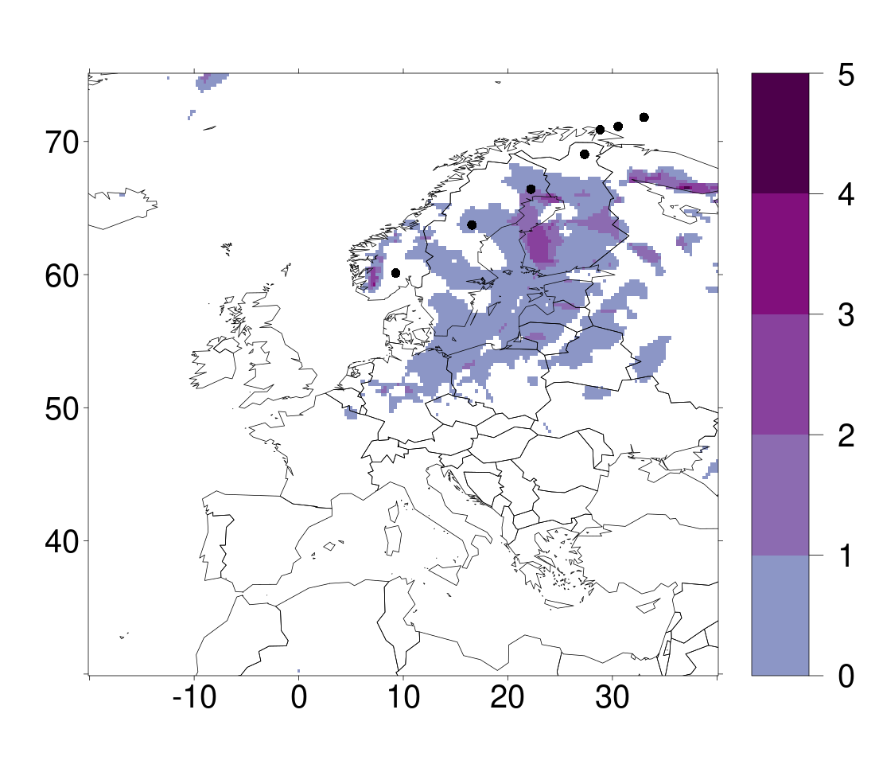
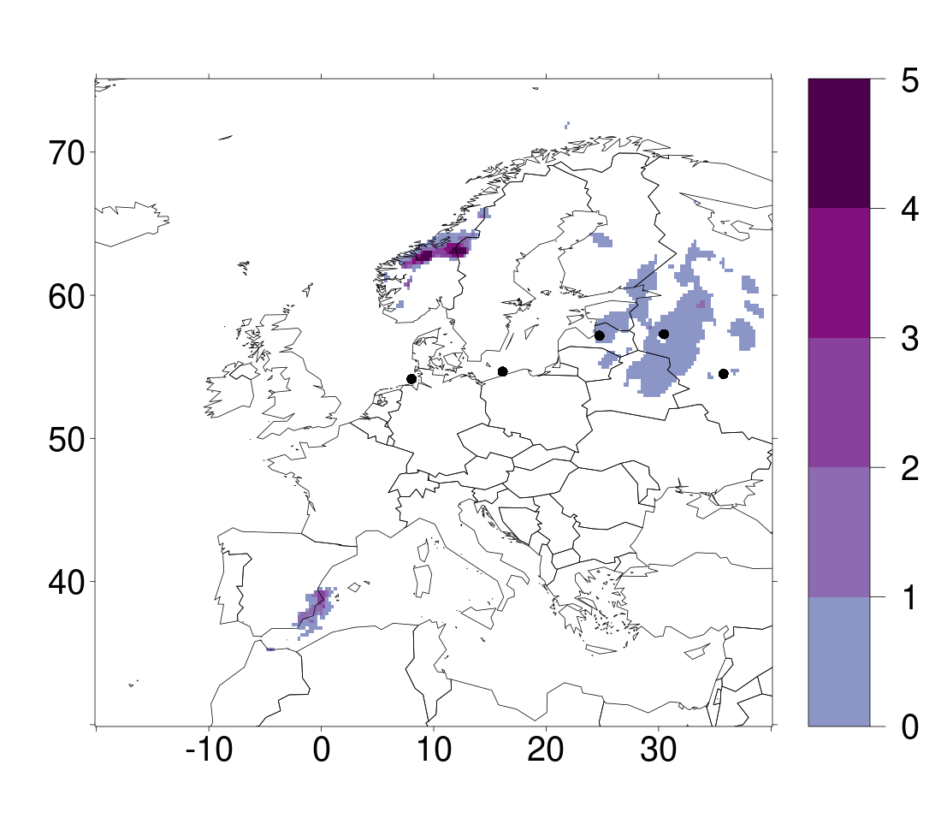
3. What can GloSea5 tell us about the size of record breaking extreme footprint storms?
Footprints of wind (top), precipitation (middle) and compound (bottom) extremes
a) Storm Kyrill
b) Storm Frank
c) GloSea5 3932
d) GloSea5 9898
e) GloSea5 6272
It is possible to get storms with very large footprints of extremes that travel through or very close to Europe.
These storms have the potential to cause significant destruction to a very large area of Europe and surrounding seas.

Slide 7
Thank you! Any questions?
Additionally feel free to contact me at:
lb663@exeter.ac.uk

