Slide 1

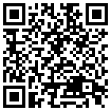

Airbone data strategy in the French National cluster AERIS
Olivier Bex-Chauvet, Sébastien Payan, Damien Boulanger, Asmae Bouhouili, Vianney Retornard, and Cathy Boonne
EGU22-8371 - GI6.2 – EGU 2022, Vienna

Slide 2
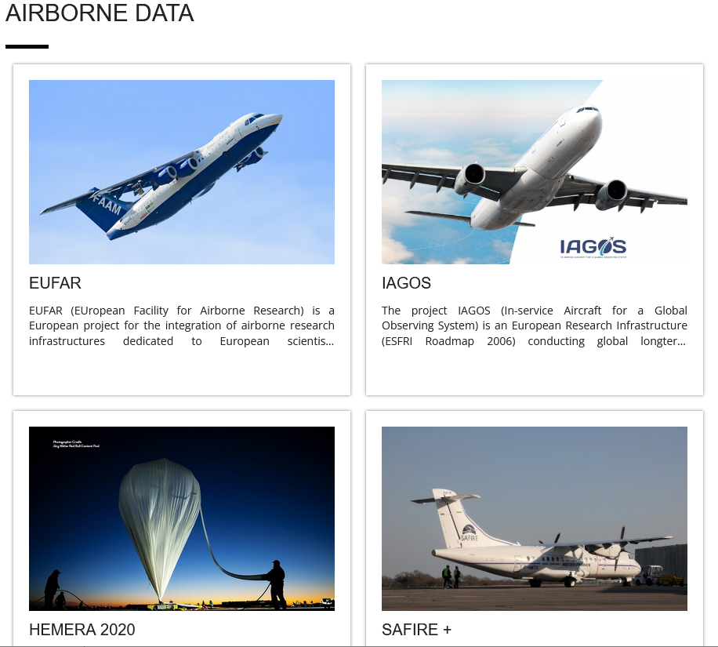
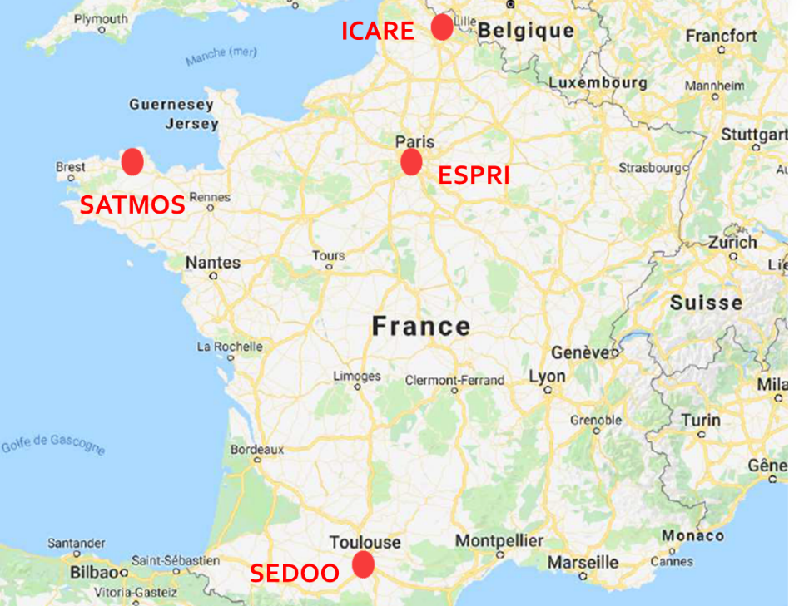

General Context
Objectives
A 20-year heritage
AERIS is the French Data and Services Cluster for Atmosphere
Facilitate, enhance, bring together observation and campaign data produced by the French atmospheric science community :
  Satellite
  In situ
  Aircraft
  Balloon
Deliver enhanced data and products to users
Enable optimal exploitation of observation systems for studies at local, regional, continental and global scales.
Project management
+ than 200 projects (satellite, ground, balloons, planes, campaigns, databases, tools) including many structuring European projects (ACTRIS, HEMERA, Eurochamp)
Of which 82 projects submitted by the way of the AERIS call for projects, 90% concentrated in 3 areas of activity: campaigns, operation of satellites, ACTRIS-FR
https://www.aeris-data.fr/
Notes:
Facilitate and enhance the use of French atmospheric data acquired by satellites, ground-based

Slide 3
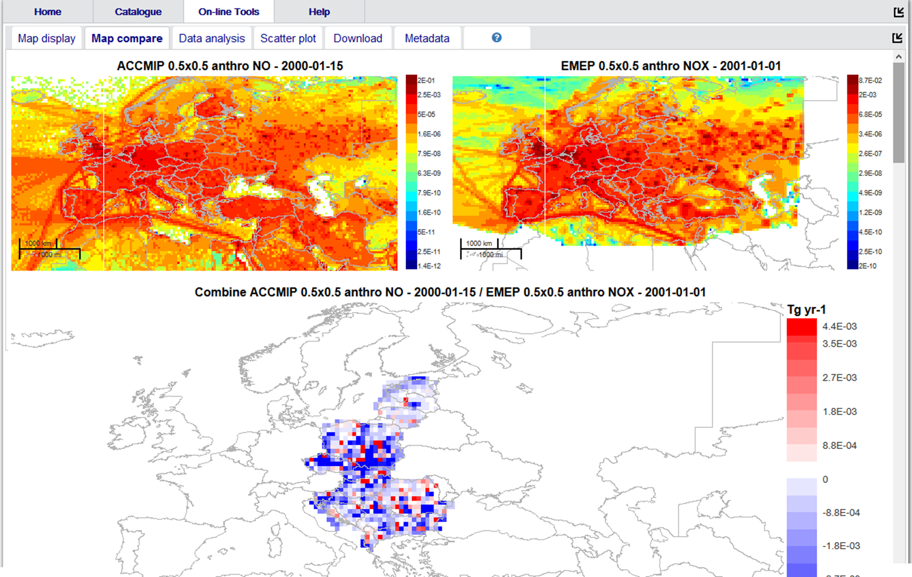
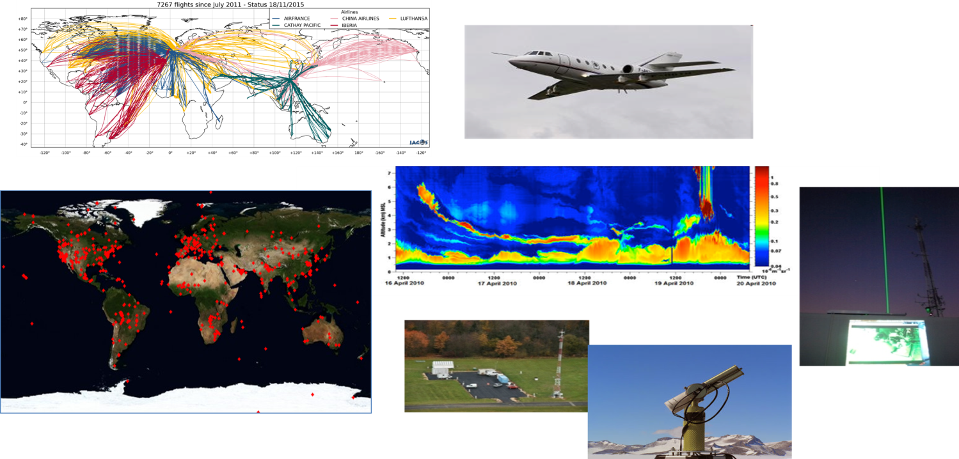
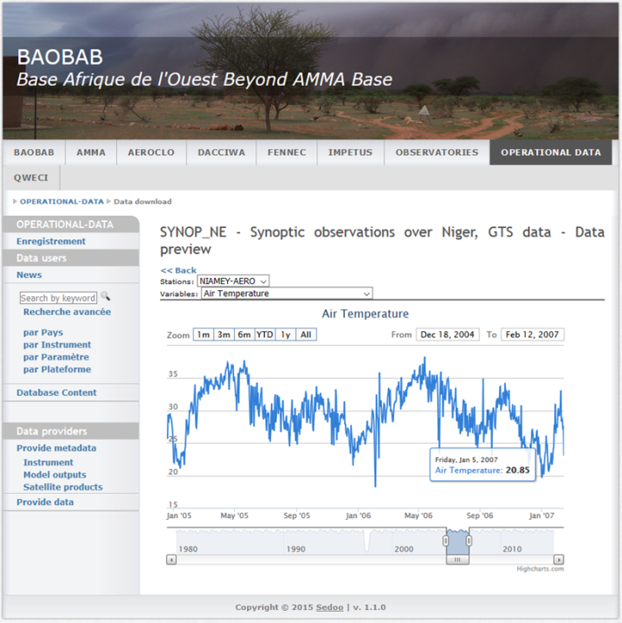
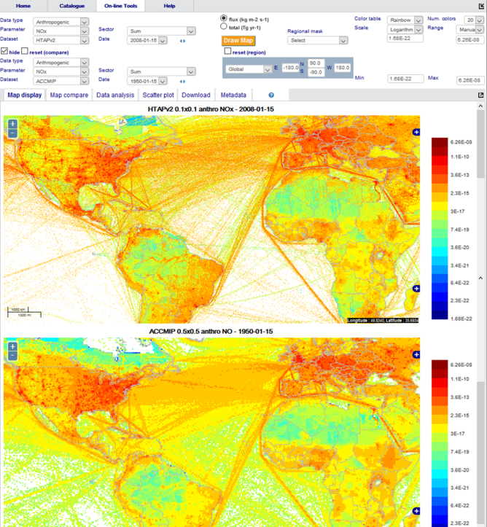
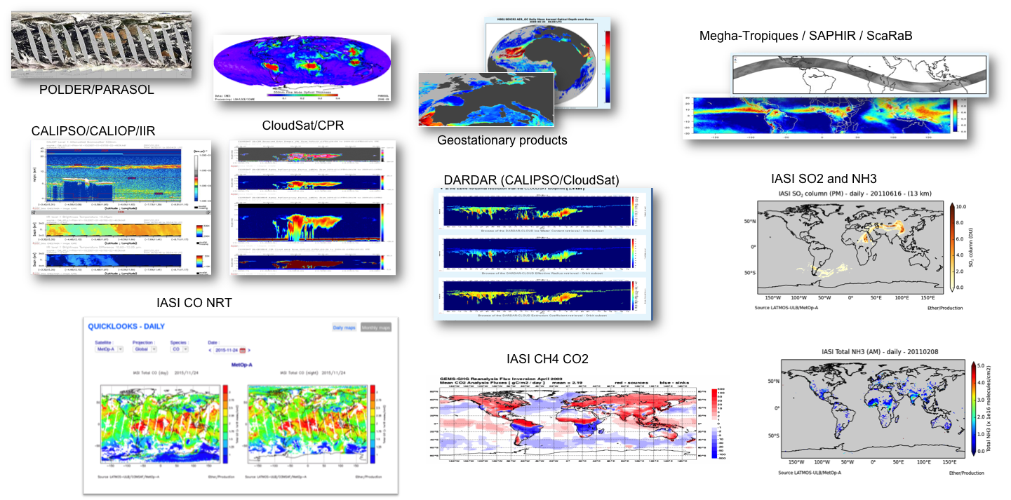
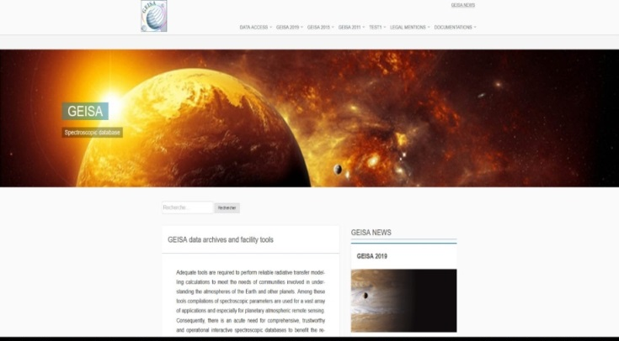
AERIS: integrated data and services centres
Ground and airborne data (planes, balloons)
Tools/Services
Satellite-ground co-location
Visualization
Campaign support
Laboratory / Databases
A single entry for the atmosphere data
ECCAD
IUPAC
GEISA
Satellite data
https://www.aeris-data.fr/

Slide 4
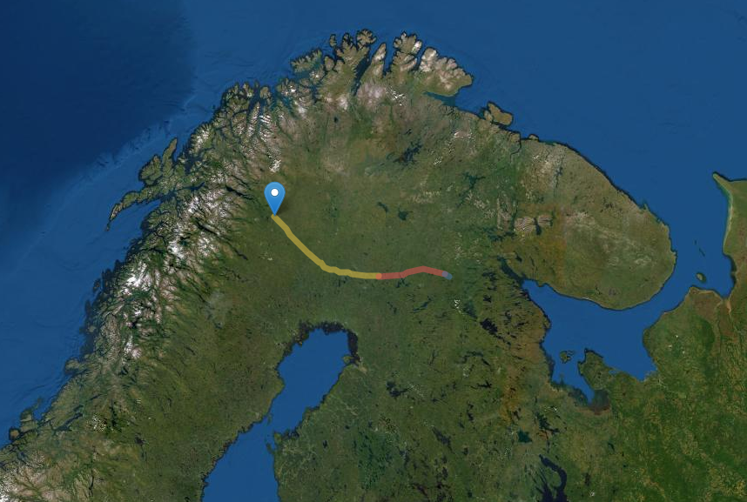

HEMERA
Integrated access to balloon-borne platforms for innovative research and technology
Data from balloon survey campaigns operated by the international science community
The database also includes all French data measured on balloons
Hemera data portal
  Data managed and distributed in a unified fashion (NetCDF)
  Archive balloon survey data
  Environment to accommodate future campaigns
Dedicated tools for visualization of balloons trajectories, profiles, etc.

Slide 5
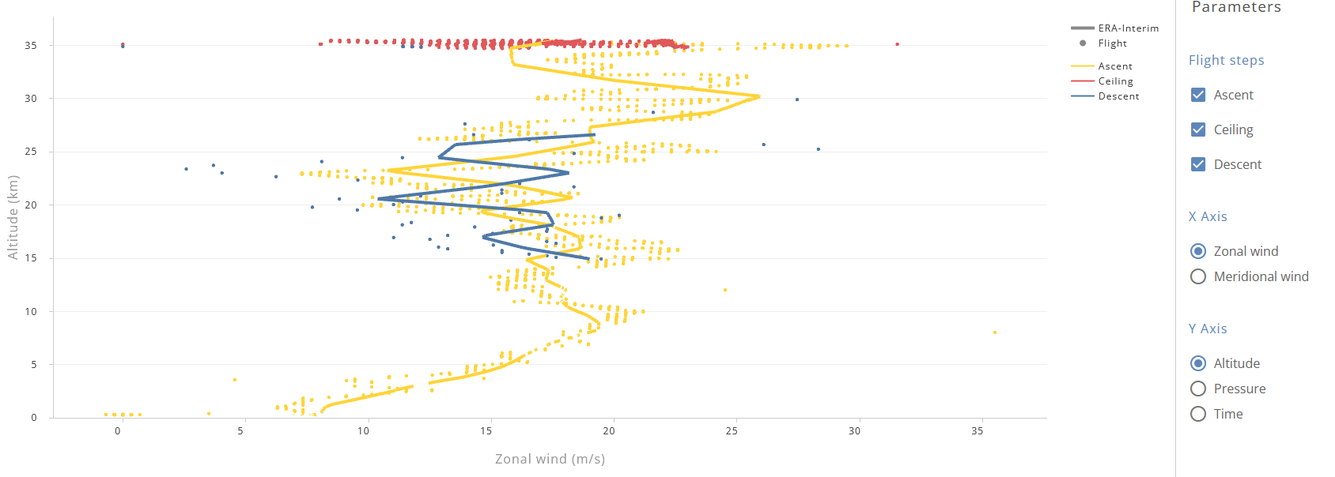
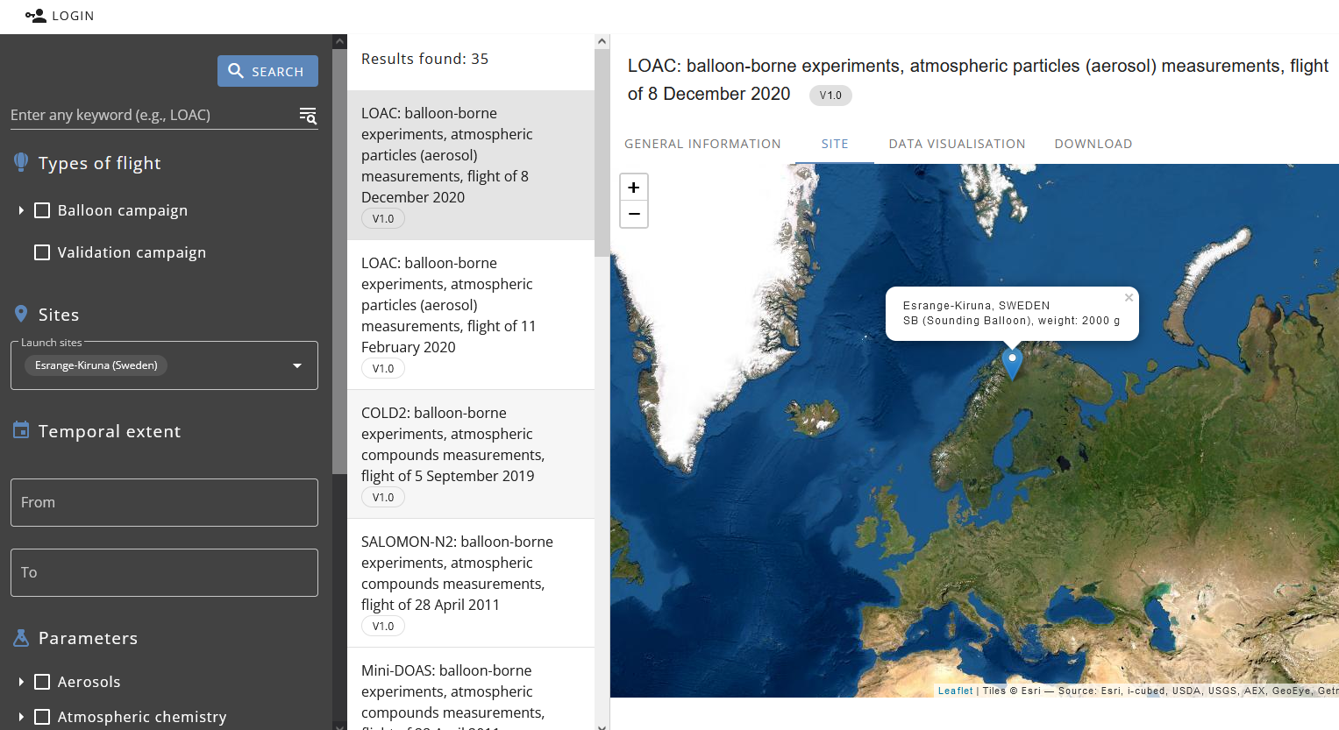
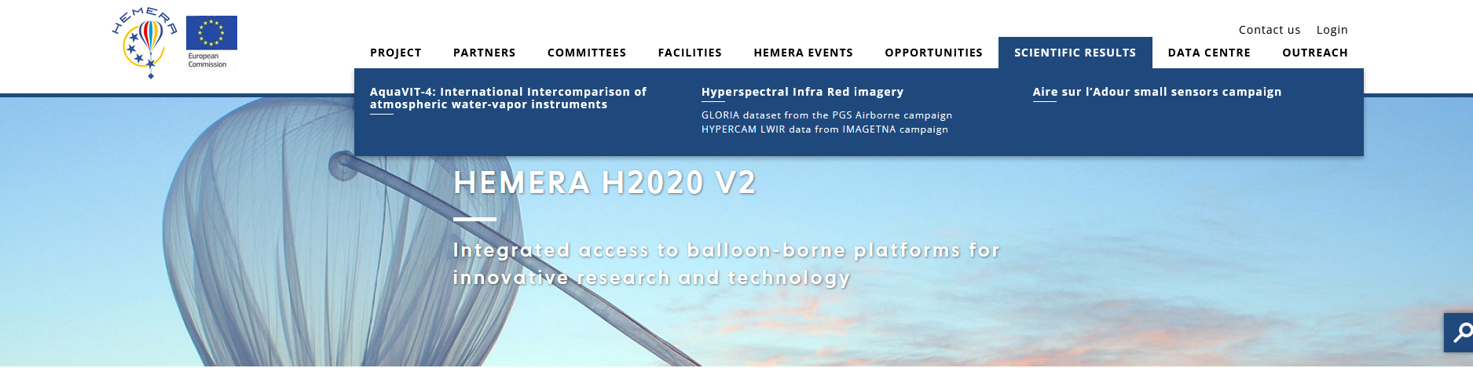
HEMERA – Data Portal
https://data.hemera-h2020.eu

Slide 6

SAFIRE+
Data from airborne scientific survey campaigns flown over nearly 30 years, by French research aircraft today operated by the SAFIRE unit (https://www.safire.fr/en/)
The database includes
  Data from core instruments operated by SAFIRE
  Data from instruments hosted for the campaigns
Work still in progress to collect data from some old campaigns
Data Portal
  Discovery of the datasets : campaigns, instruments, variables, trajectories, etc.
  Tools for the PIs of the campaigns: metadata edition, data upload, etc.
  The data download can be done by campaign, aircraft or flight
  Visualization tools under development (quicklooks, profiles, etc.)
Data catalogue tool also used for EUFAR

Slide 7
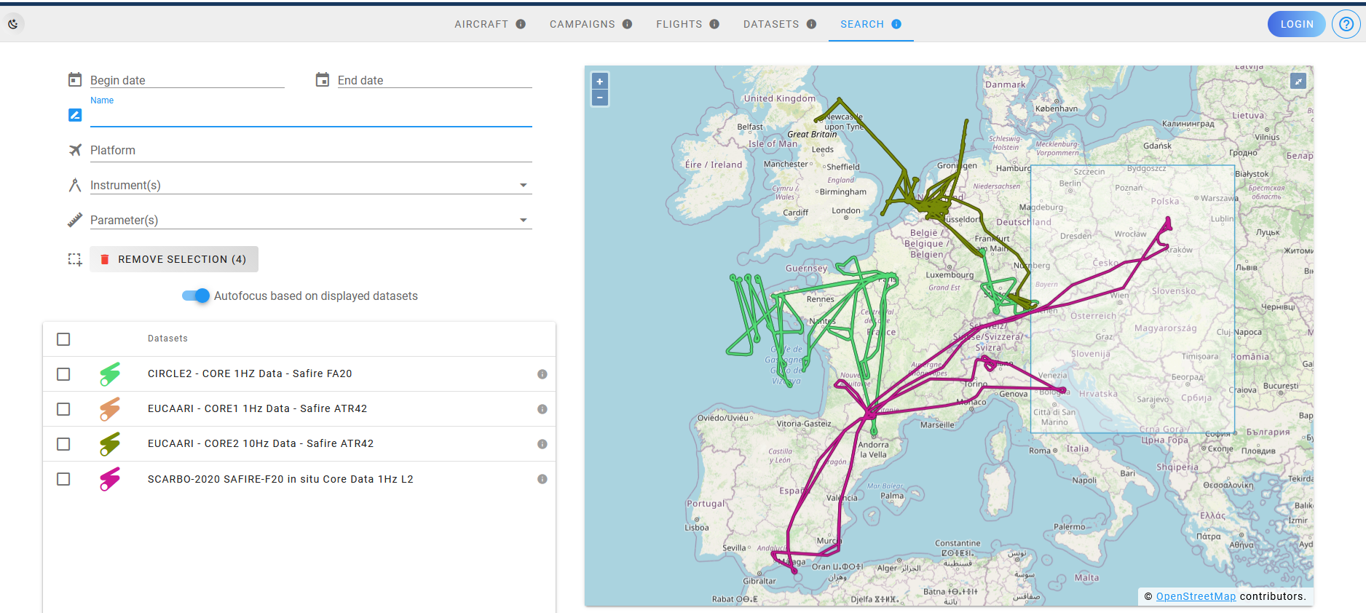
SAFIRE+ - Data Portal
https://safireplus.aeris-data.fr

Slide 8

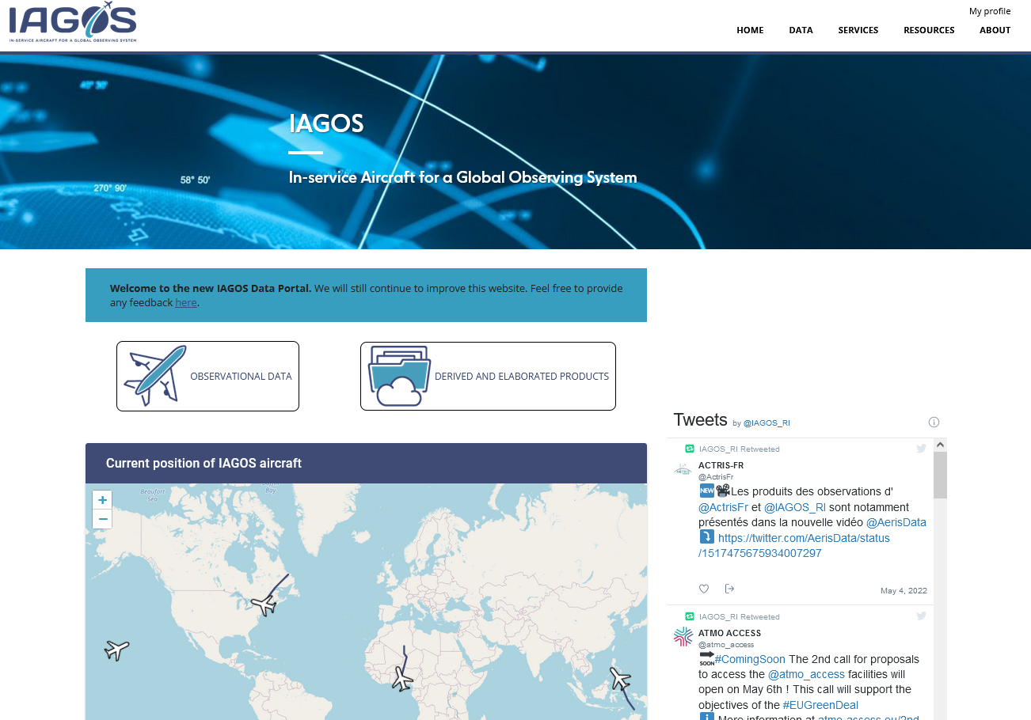
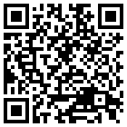
IAGOS
See presentation:
The new IAGOS Data Portal
Damien Boulanger, Asmae Bouhouili, Olivier Bex-Chauvet, Pawel Wolff, Valérie Thouret, and Hannah Clark
EGU22-7775

Slide 9

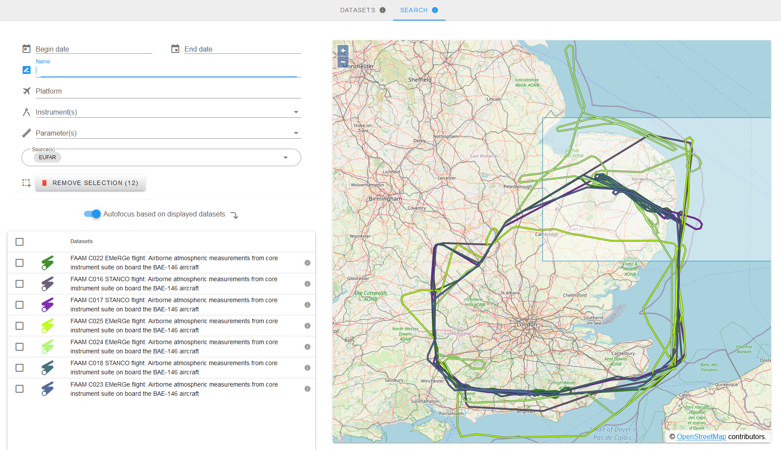
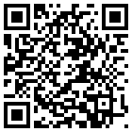
EUFAR
See presentation:
New EUFAR flight finder
Vianney Retornard, Damien Boulanger, Wendy Garland, and Paola Formenti
EGU22-8353

Slide 10
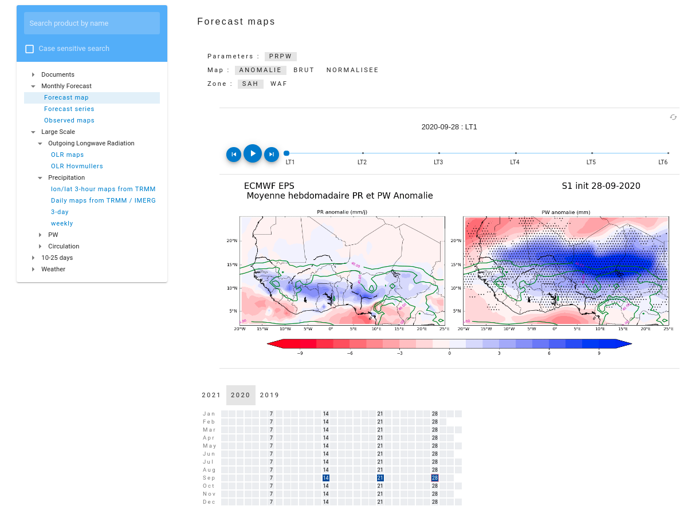
Airborne campaigns
AERIS supports airborne campaigns
Operational websites providing digital tools to facilitate the organization of the campaigns
  Data repository with secure storage and standardized data access (e.g. OPeNDAP)
  Specific products (e.g. forecasts from various data centres like ECWMF, satellite observations, etc.)
  Quicklooks
  Trajectory forecast
  Satellite colocation
Catalogues for discovery and publication of the data acquired during the campaigns

Slide 11
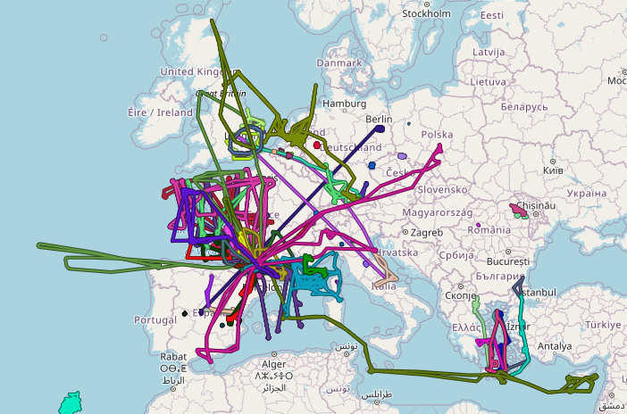
Data management and interoperability
All the data are openly accessible to the scientific community
Application of the FAIR principles with an emphasis on the implementation of interoperability
Cross discovery of all the datasets is implemented or under development on the different data portals with links between AERIS airborne datasets and external ones (e.g. cross discovery of SAFIRE flights on the EUFAR data portal)

Slide 12

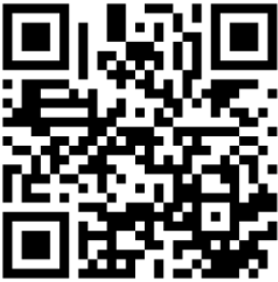
Don’t miss TM AERIS:
A unique data cluster for atmospheric data and services
Tue, 24 May, 19:00–20:00 (CEST) - Room G1
Thank you for your attention

