Slide 1




Mullard Space Science Lab
Evaluating Auroral Forecasts against Satellite Observations
Michaela Mooney^{1,2}
C. Forsyth¹, M. Marsh², M. Sharpe², T. Hughes², S. Bingham², D. Jackson², J. Rae^{1,3}, G. Chisham⁴ and Orbyts Class of 2022⁵
¹ Mullard Space Science Lab, University College London, UK
² Met Office, UK
³ Northumbria University, Newcastle, UK
⁴ British Antarctic Survey (BAS), Cambridge, UK
⁵ St Richard Reynolds Catholic College, Twickenham, UK
_{EGU Conference, 25}^{th} _{May 2022}

Slide 2
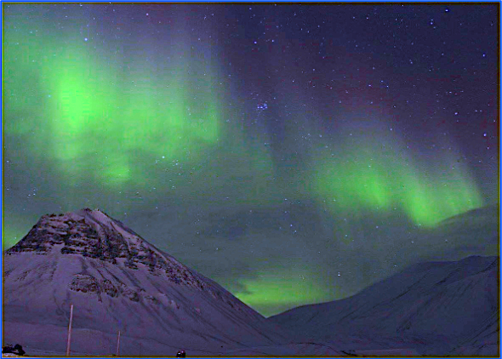
The Societal Impact of the Aurora
The aurora is one of the most visible aspects of space weather and is great for public engagement!
The free electrons and molecules in the upper atmosphere can:
Scatter long-range radio communications,
Backscatter radar signals.
Photo credit: Jennifer O’Kane.
Forecasting the location and probability of aurora is of interest to the aviation and defense sectors as well as the auroral tourism sector.
Credit: Airbus

Slide 3
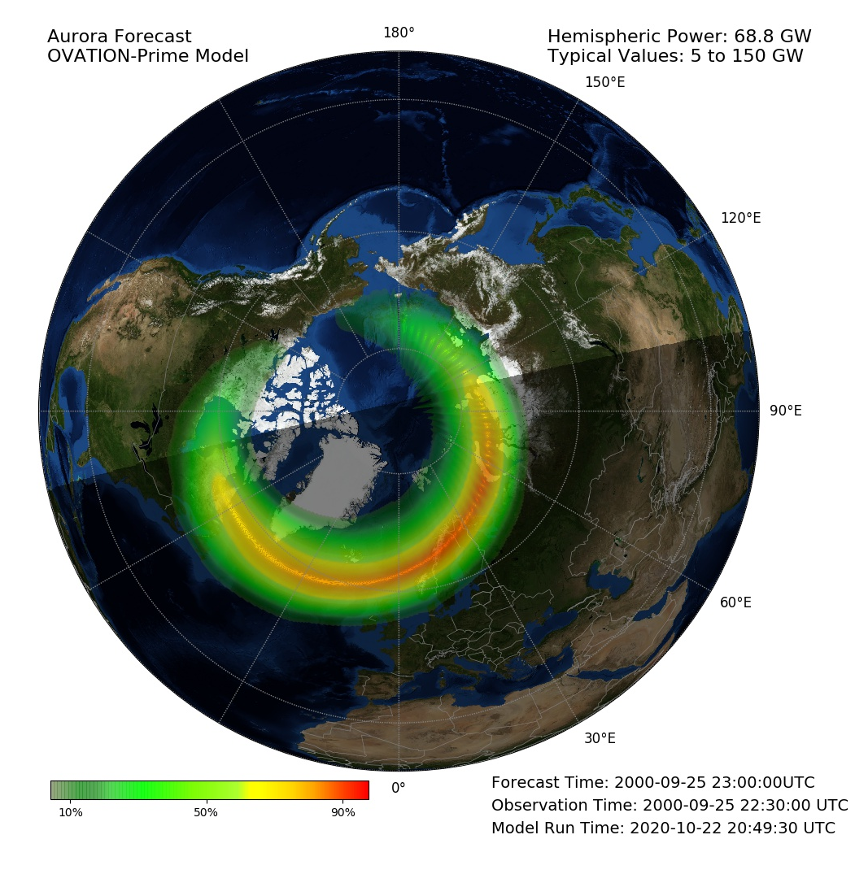
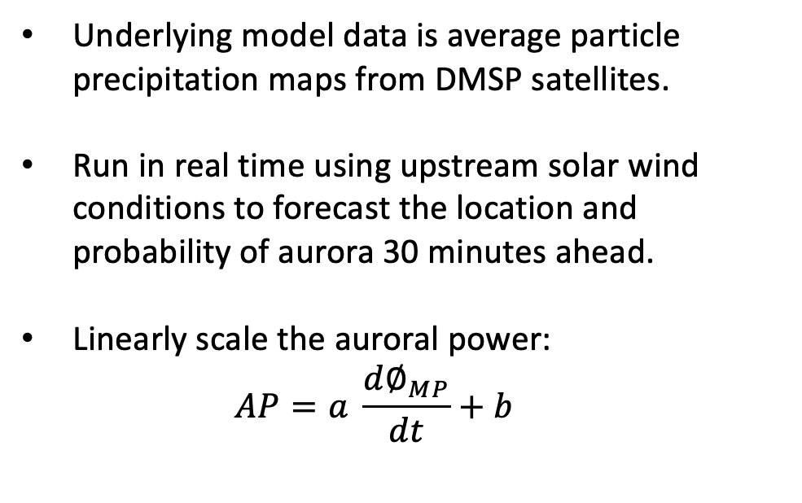
The OVATION-Prime 2013 Auroral Forecast Model
Underlying model data is average particle precipitation maps from DMSP satellites.
Run in real time using upstream solar wind conditions to forecast the location and probability of aurora 30 minutes ahead.
Linearly scale the auroral power:
$$AP=a \frac{d∅_{MP}}{dt}+b$$

Slide 4
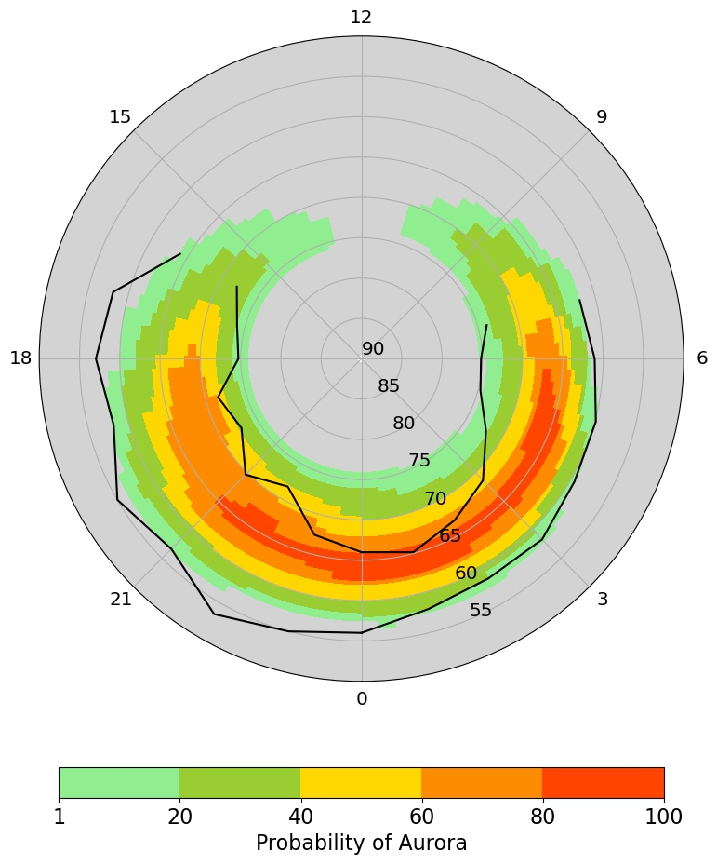

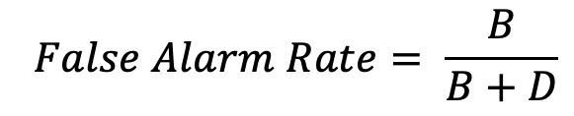
Comparing Auroral Forecasts against Observations
We use auroral boundaries from IMAGE WIC FUV data derived by Longden et al. (2010) and provided by BAS.
In each grid cell, we use truth table analysis to compare whether the aurora was predicted and observed.
 |  | Observations
 |  | Yes | No
Forecasts | Yes | A Hits | B False Alarm
 | No | C Miss | D Correct Negatives
$$Hit Rate= \frac{A}{A+C}$$
$$False Alarm Rate= \frac{B}{B+D}$$
Mooney et al. (2021)

Slide 5
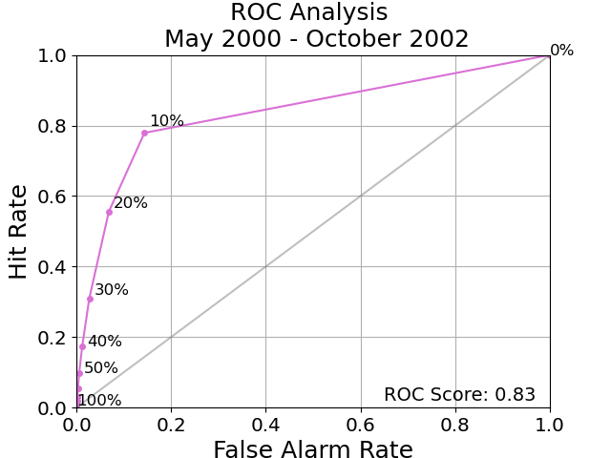

Deterministic Auroral Forecasts
Relative Operating Characteristic (ROC) analysis evaluates how well the model predicts regions of aurora and no aurora.
We plot the hit rate against the false alarm rate for each probability threshold to obtain a ROC curve.
The ROC score is defined by the area under the ROC curve, with a maximum (perfect) score of 1.
Mooney et al. (2021)

Slide 6
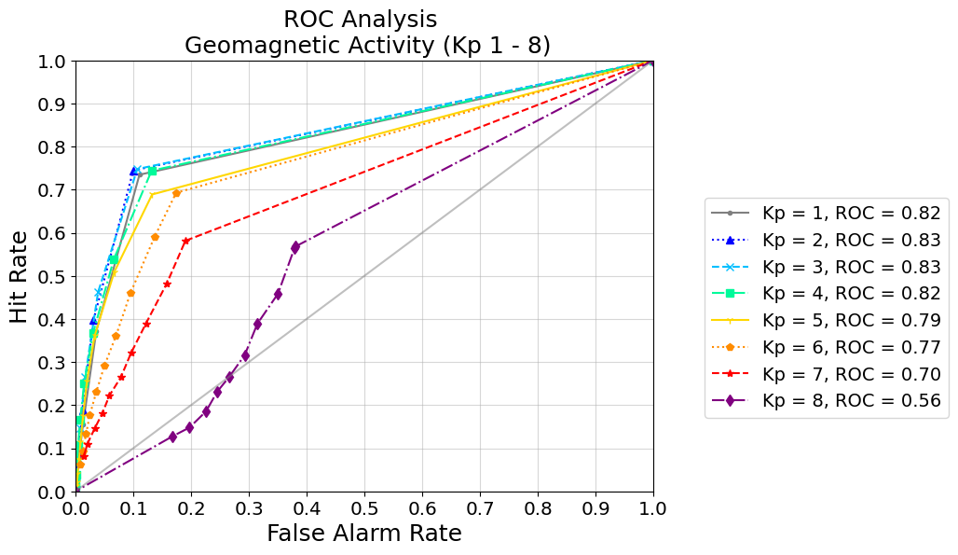
Kp Dependence
Previously, we evaluated the global model performance for different levels of geomagnetic activity (Kp = 1 – 8) in all magnetic latitudes and local time sectors.
Kp = 1 – 4 have similar global ROC scores between 0.82 – 0.83.
The model performance decreased for higher levels of geomagnetic activity, with Kp = 8 having a ROC score of 0.56.
Mooney et al. (2021)

Slide 7
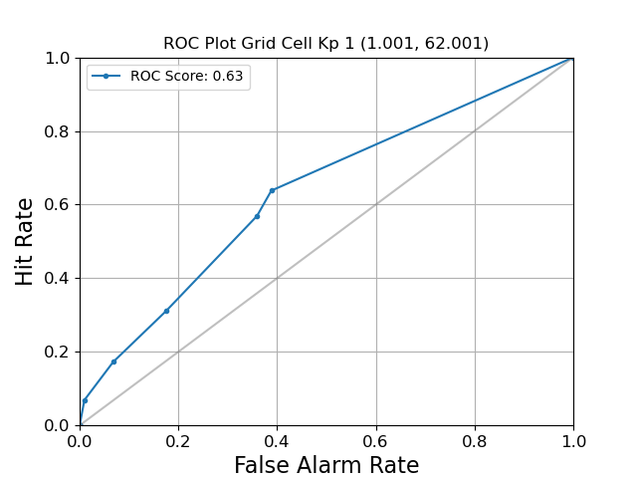
A More Detailed Verification Analysis
In each grid point, we produce a ROC curve and determine the ROC score.
This provides information about the model performance in magnetic latitude and local time.
We repeat this analysis for different levels of geomagnetic activity.

Slide 8
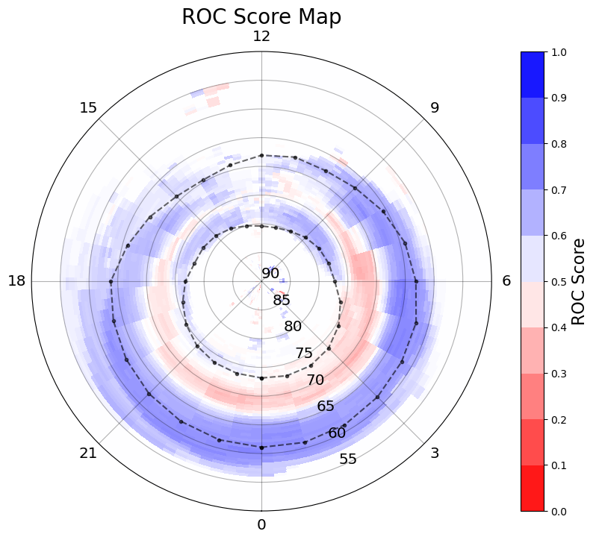
Model Performance in Latitude and Local Time
Blue = high ROC score, good model performance.
Red = low ROC score, poor model performance.
Model performs well at lower latitudes, towards the equatorward auroral boundary.
Model performance is reduced high latitude nightside region, known to be dominated by substorm activity.
Mooney et al. (in prep)

Slide 9
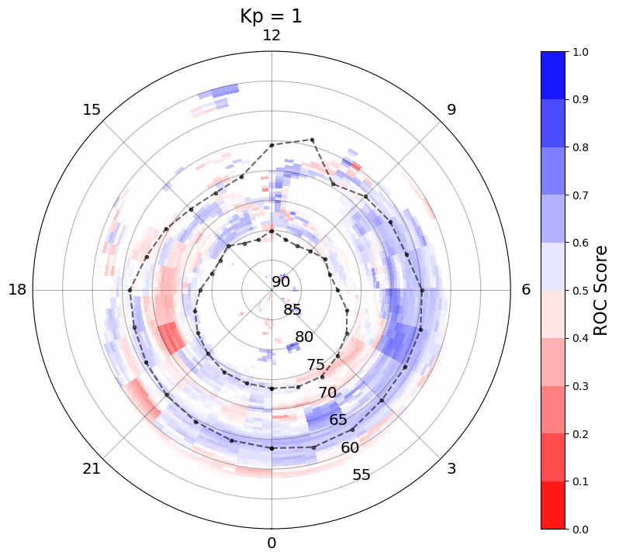
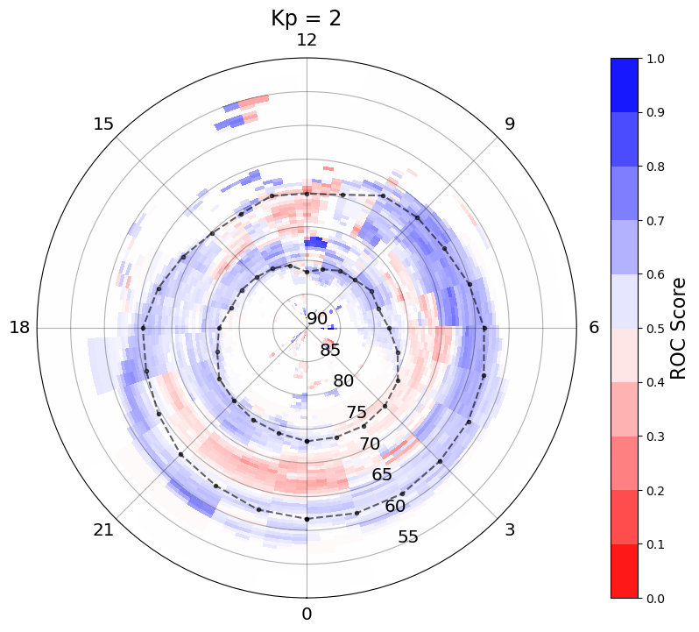
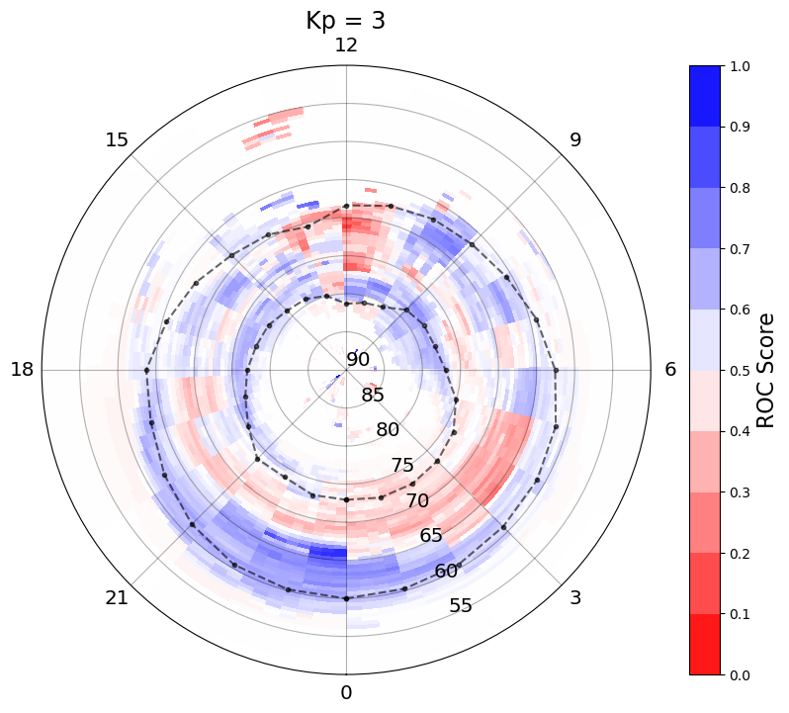
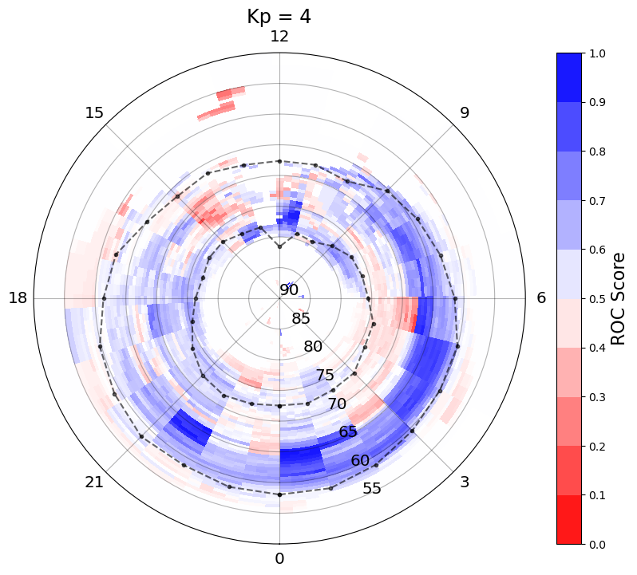

Kp Dependence
Kp 1 – 4
Model performs well at lower latitudes, towards the equatorward boundary.
Model performance is reduced in MLT 11 – 13 and in high latitude nightside region.
Overall, model performance increases with increasing geomagnetic activity, up to Kp = 4.
Mooney et al. (in prep)

Slide 10
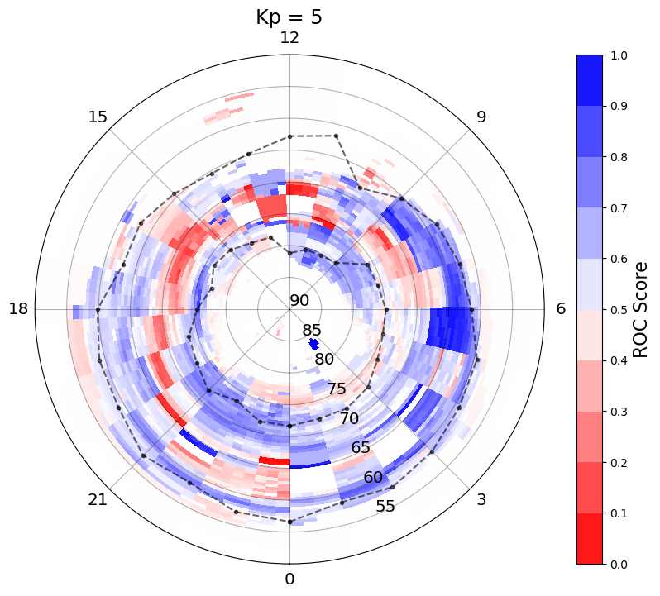
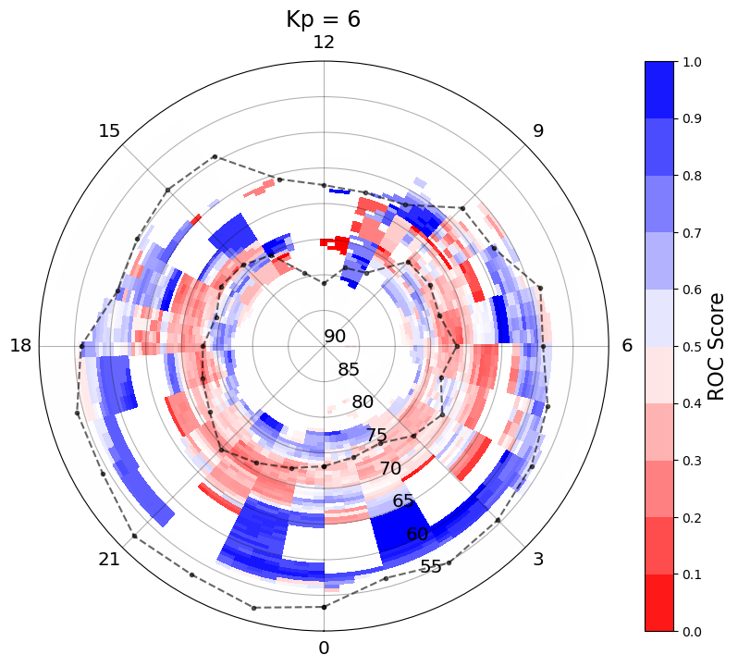
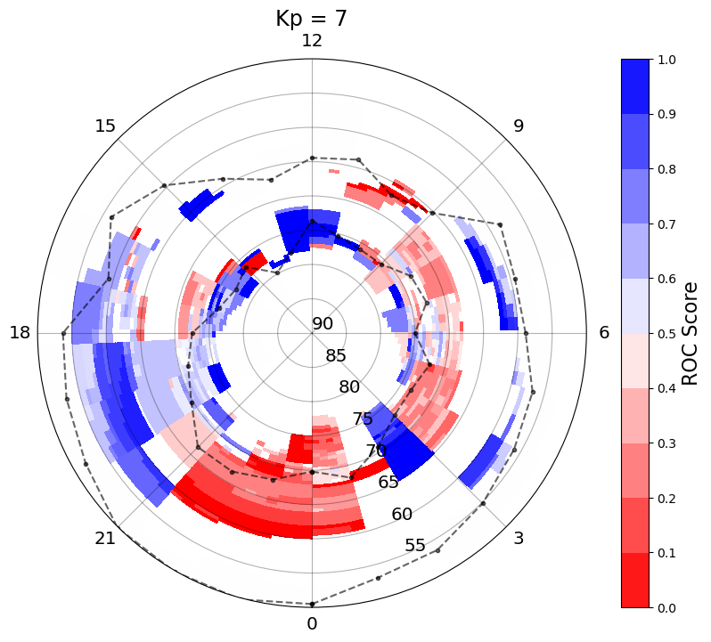
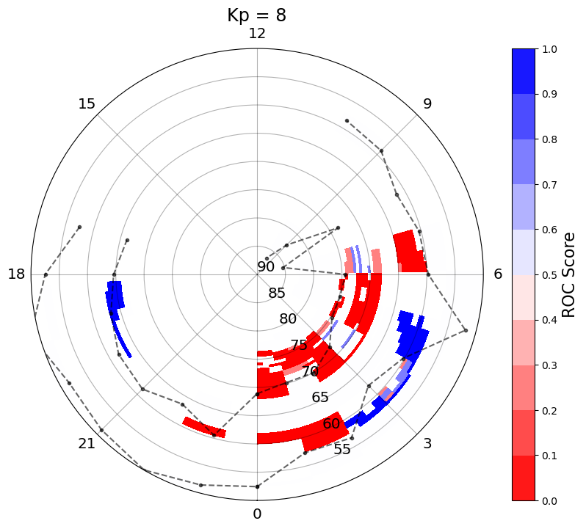
Kp Dependence
Kp = 5 - 6
Regions of high ROC scores agree well with the average observed boundary locations.
Model performance is reduced in the dayside and dusk local time sectors and in the high latitude nightside sectors.
Kp 7 – 8
Too few events to draw any meaningful conclusions!
Mooney et al. (in prep)

Slide 11
Conclusions
Overall, the OVATION-Prime 2013 model predicts the average location of the auroral oval well, particularly for mid levels of geomagnetic activity (Kp = 4 – 5).
Kp levels 1 – 4 had similar global ROC scores of 0.82 – 0.83, however our new analysis shows that the model performance increases with increasing geomagnetic activity up to Kp = 4.
The model predicts the equatorward extent of the auroral oval well, suggesting that the equatorward extent of the auroral is well predicted by only the upstream solar wind conditions.
The model performance is reduced near the poleward auroral boundary which is known to be closely associated with substorm dynamics.
Future generations of auroral forecast models need to include both external and internal drivers.

