Slide 1
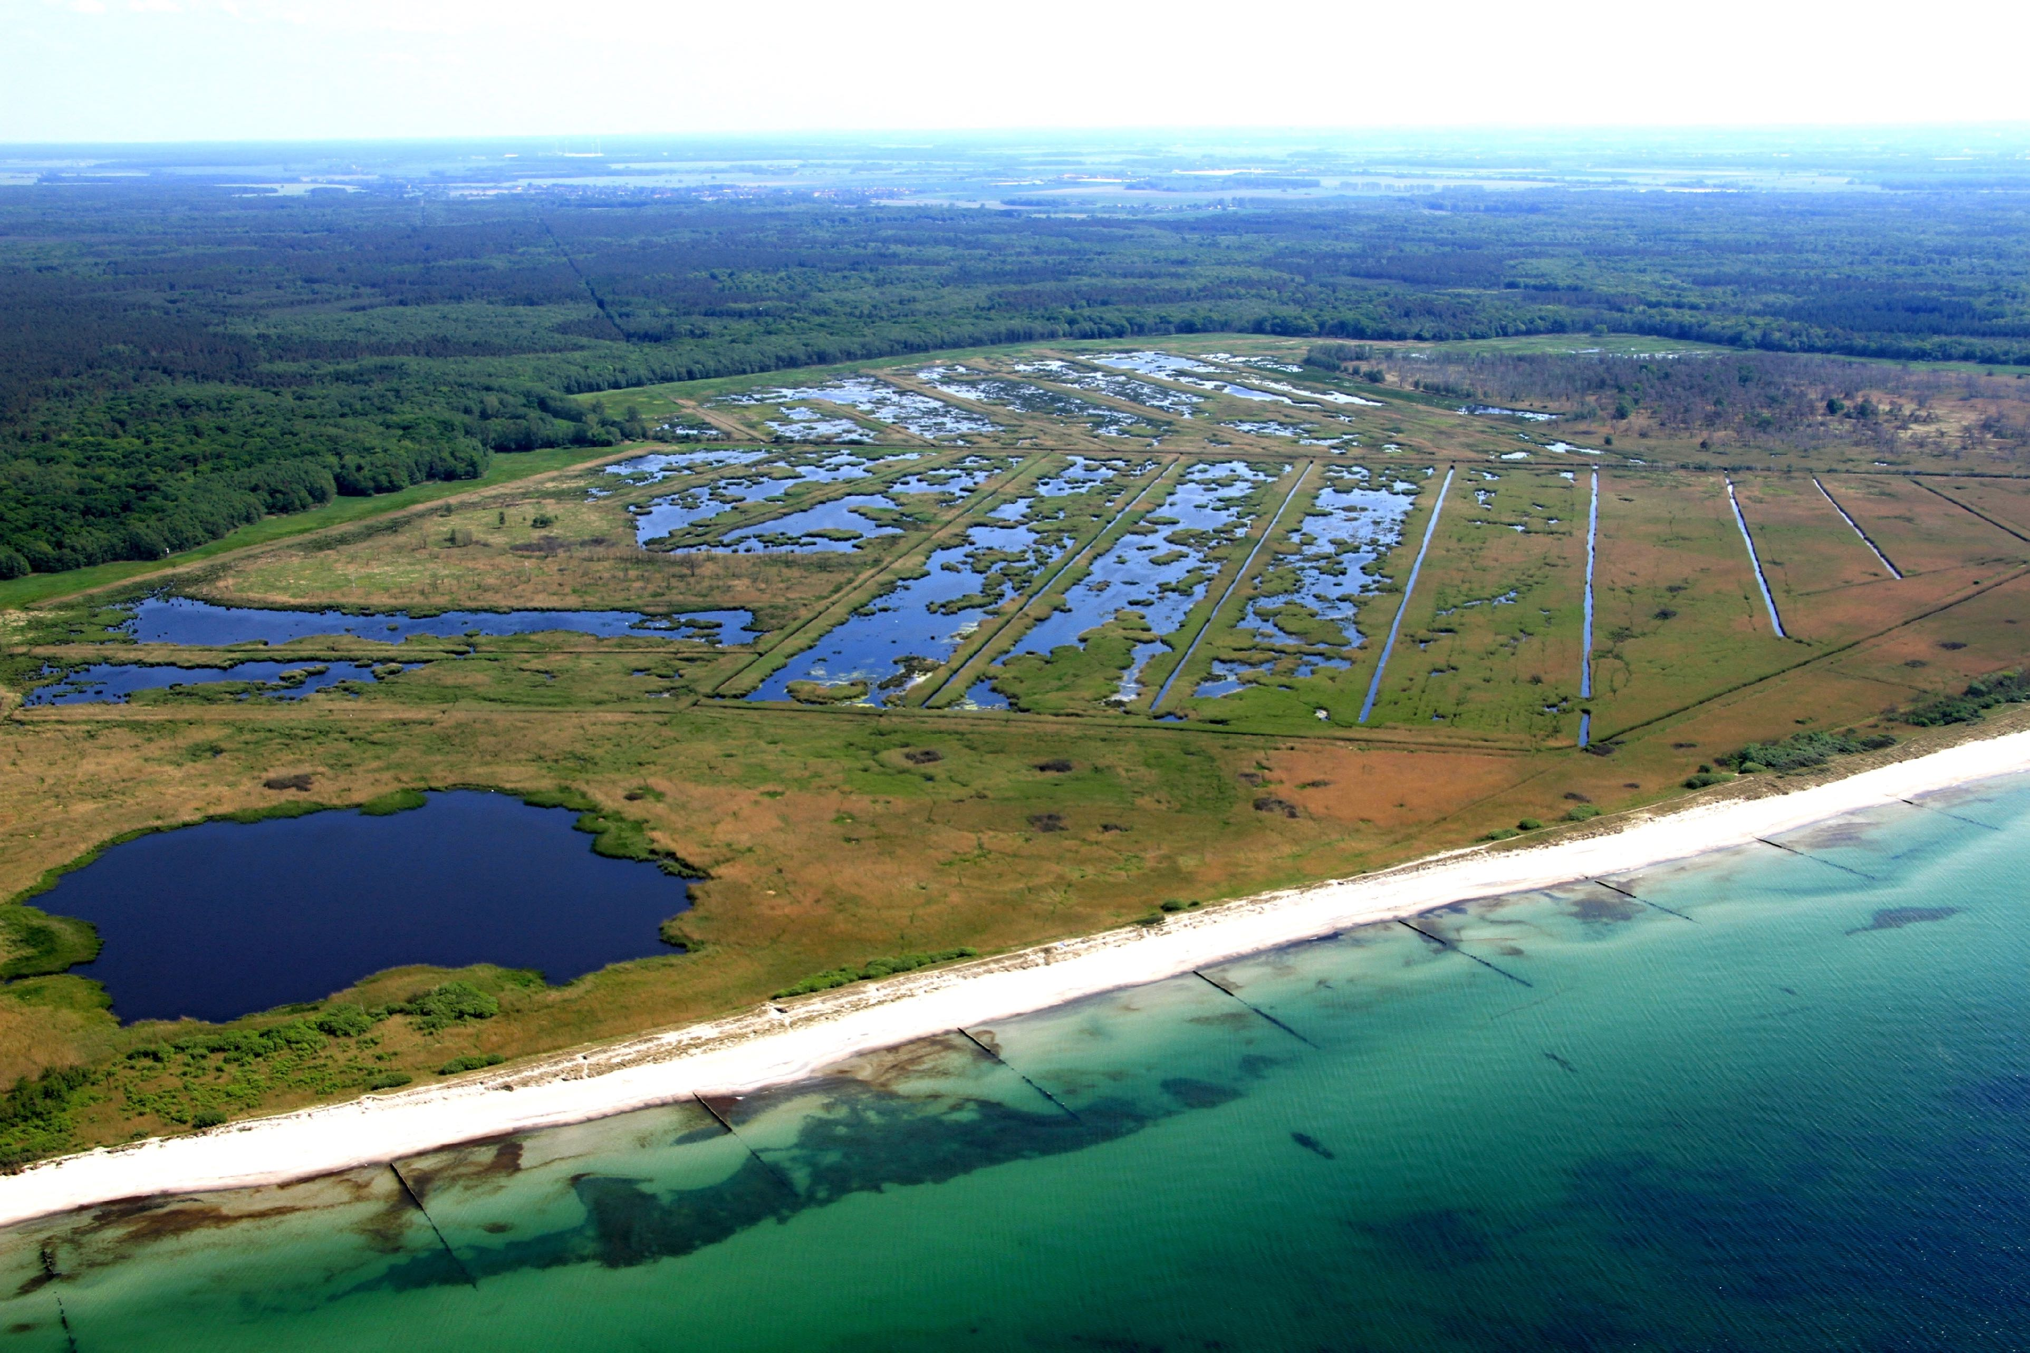
Cordula N. Gutekunst, Susanne Liebner, Anna-K. Jenner,
Klaus-Holger Knorr, Viktoria Unger, Franziska Koebsch, Erwin Don Racasa, Sizhong Yang,
Michael E. Böttcher, Manon Janssen,
Jens Kallmeyer,
Denise Otto,
Iris Schmiedinger, Lucas Winski,
Gerald Jurasinski
Inflow of brackish water and a preceding drought changes methane cycling microbial communities in a freshwater rewetted coastal fen

Slide 2
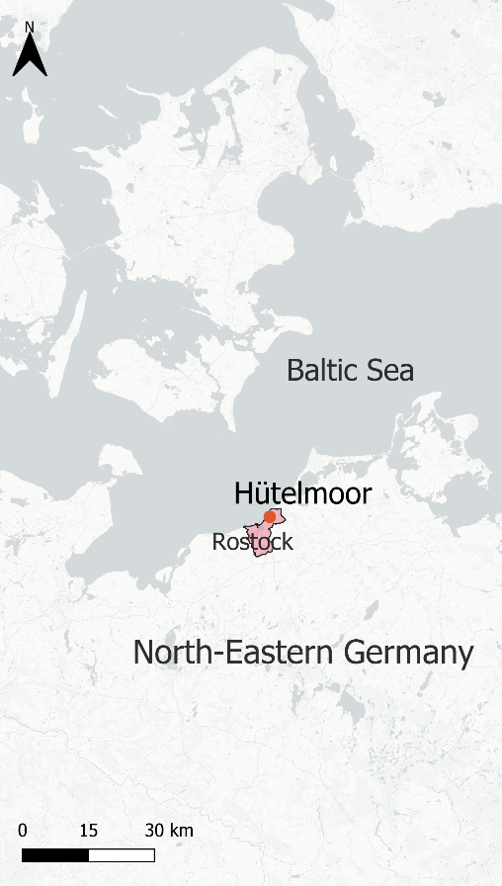
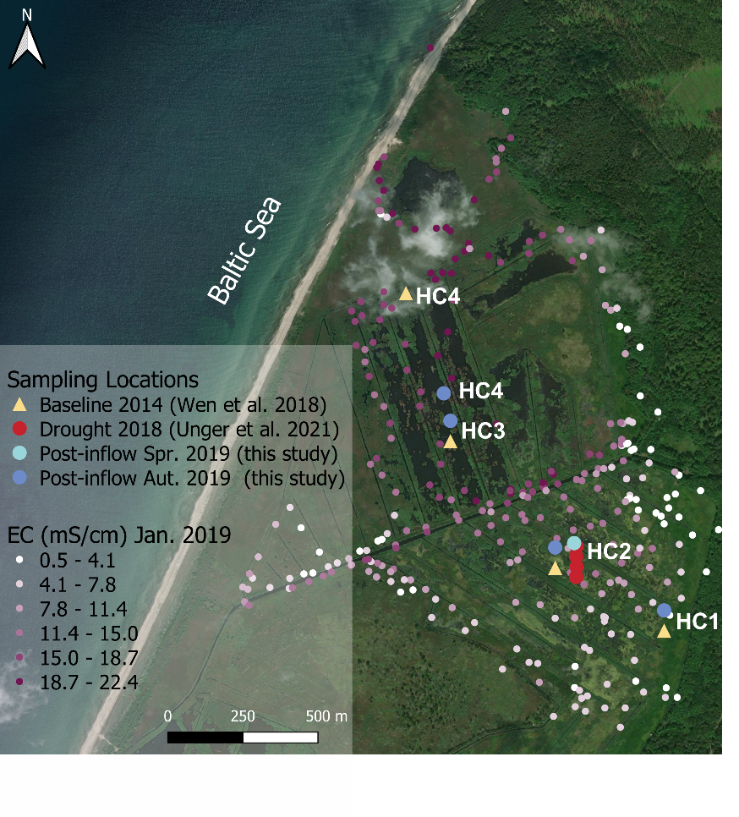
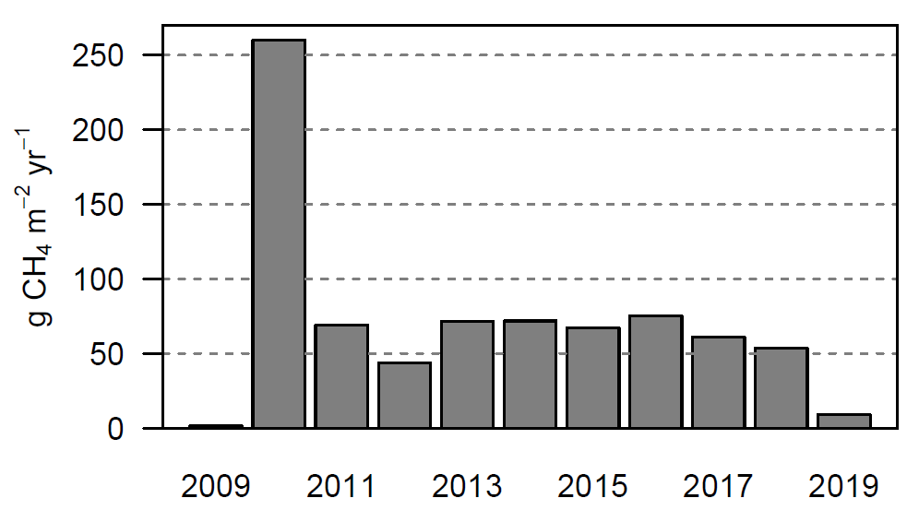
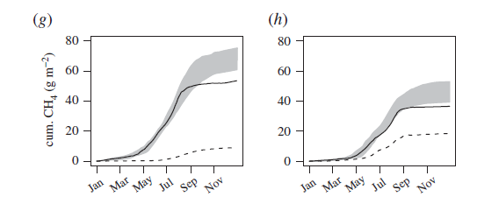

Background
Rewetting with freshwater lead to high CH₄ emissions in study site:
Gutekunst et al. (unpublished)
Koebsch et al. 2020
Koebsch et al. (unpublished)

Slide 3
Background
After a drought in 2018 and the inflow of brackish water in January 2019, CH₄ emissions decreased
→ Did sulfate-containing marine water help to lower CH₄ emissions?
Gutekunst et al. (unpublished)
Koebsch et al. 2020

Slide 4
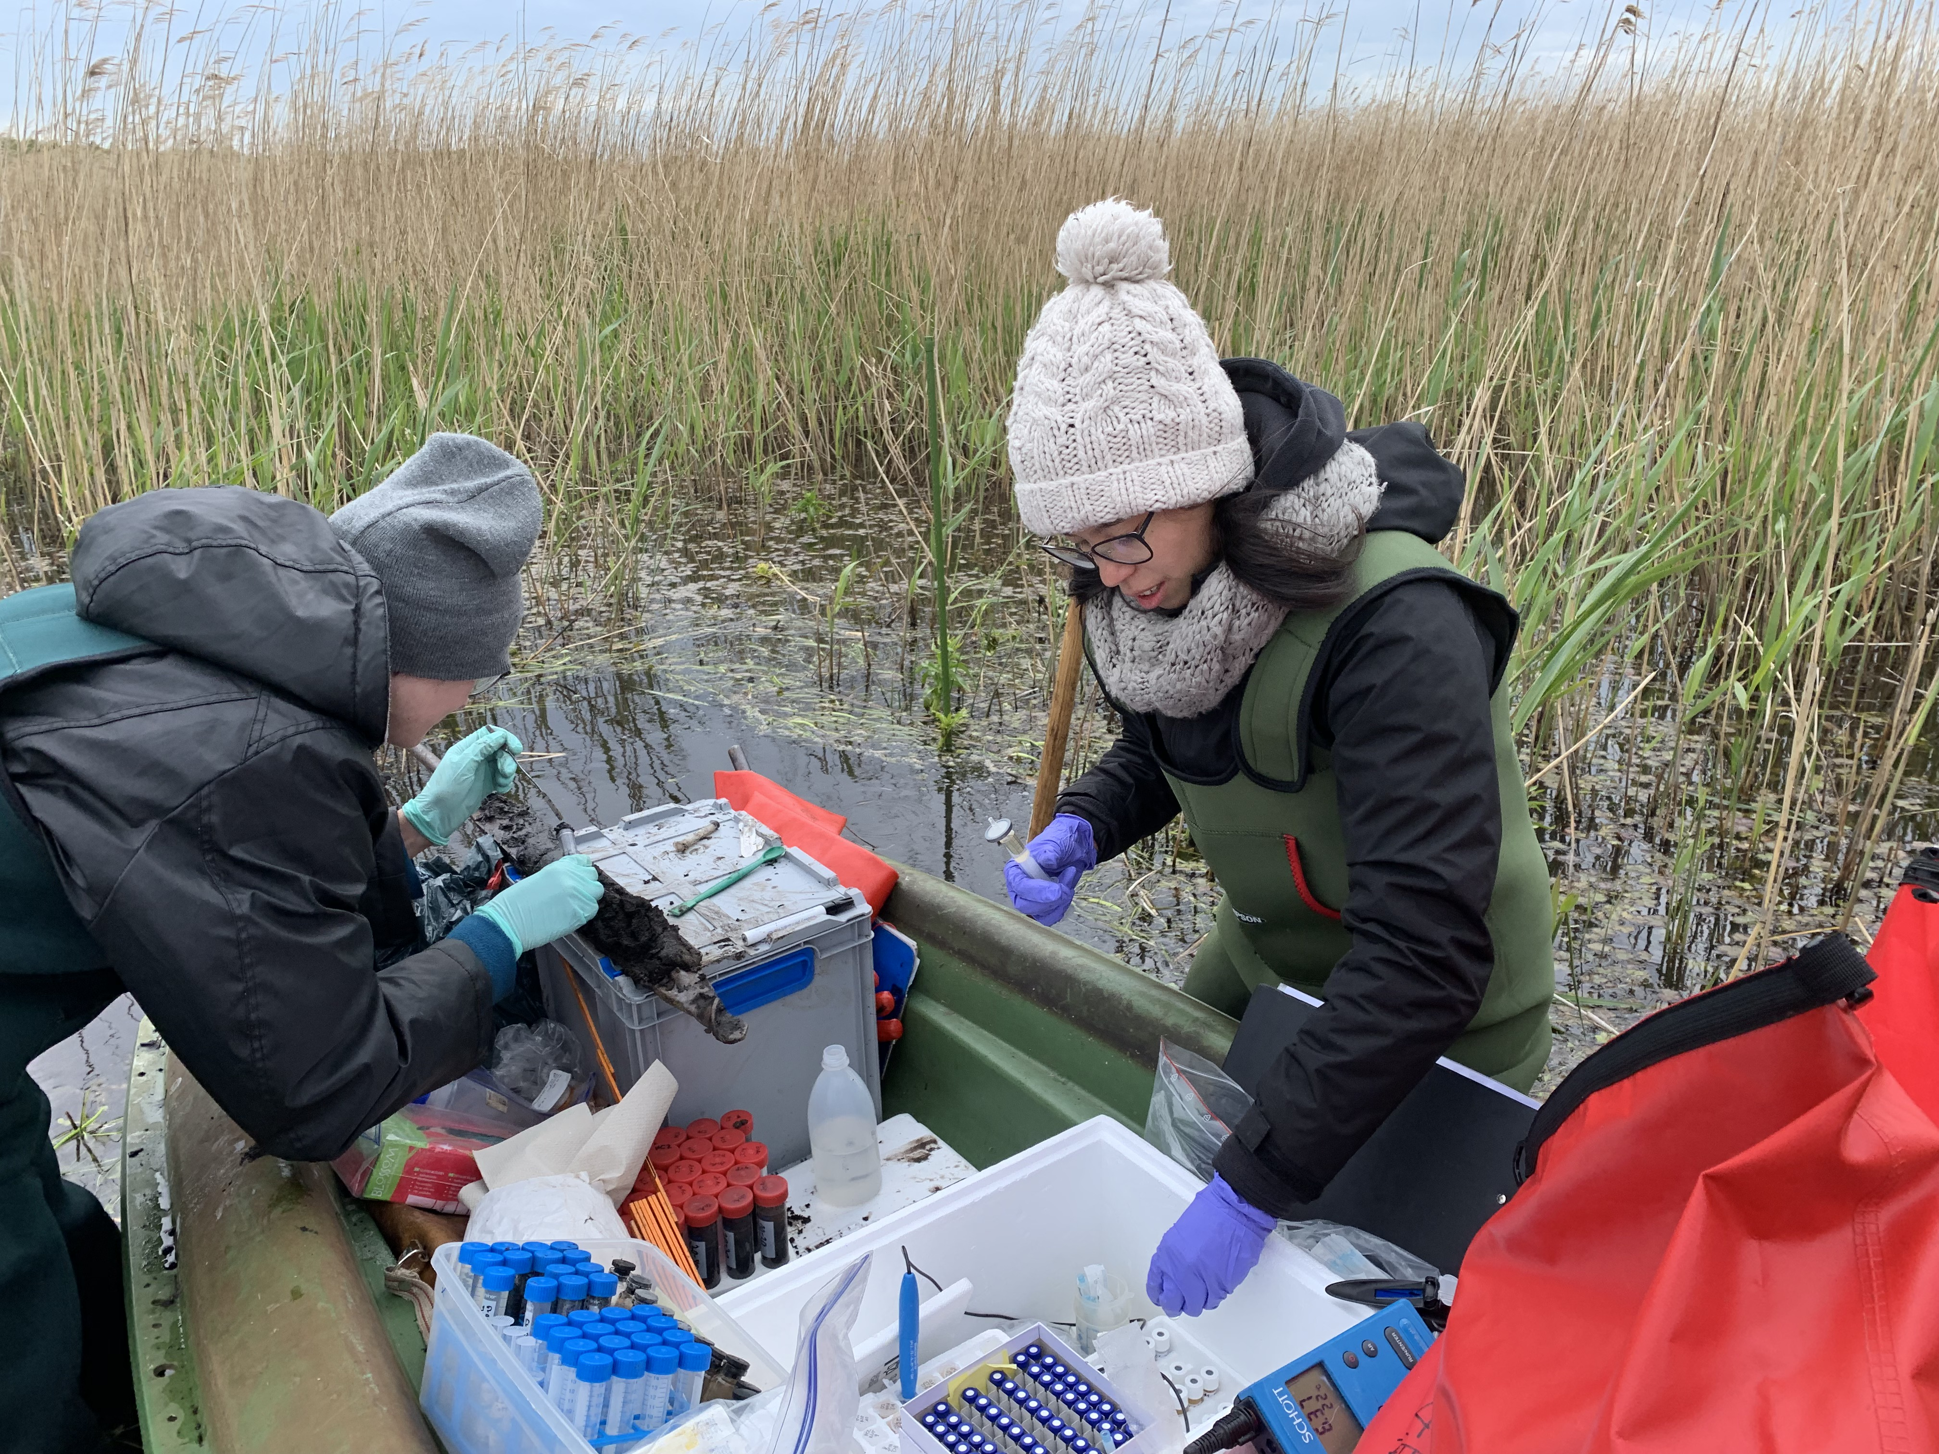
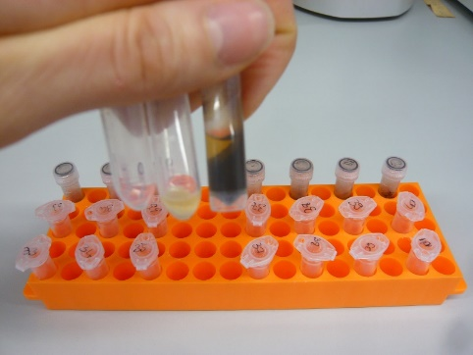
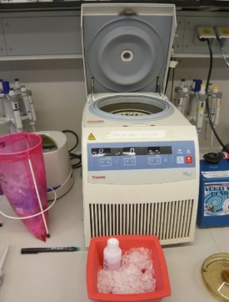
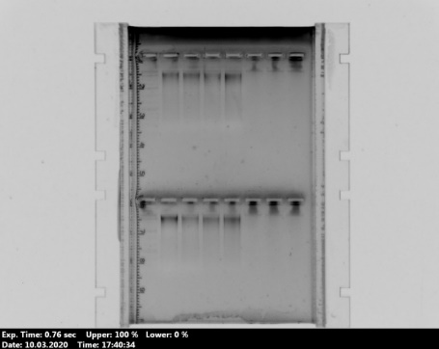
Methods
Pictures by Gerald Jurasinski and Cordula Gutekunst
Soil cores along previous sampled transect during freshwater and drought conditions
Local gas flux measurements using closed-chamber method
Soil plugs for head space GHG concentration and isotopic signature analysis
Ion composition in surface and pore water (ICP)
High-throughput sequencing (16S rRNA) and quantitative polymerase chain reaction (16S rRNA, mcrA,
pmoA, dsrB) of DNA and cDNA

Slide 5
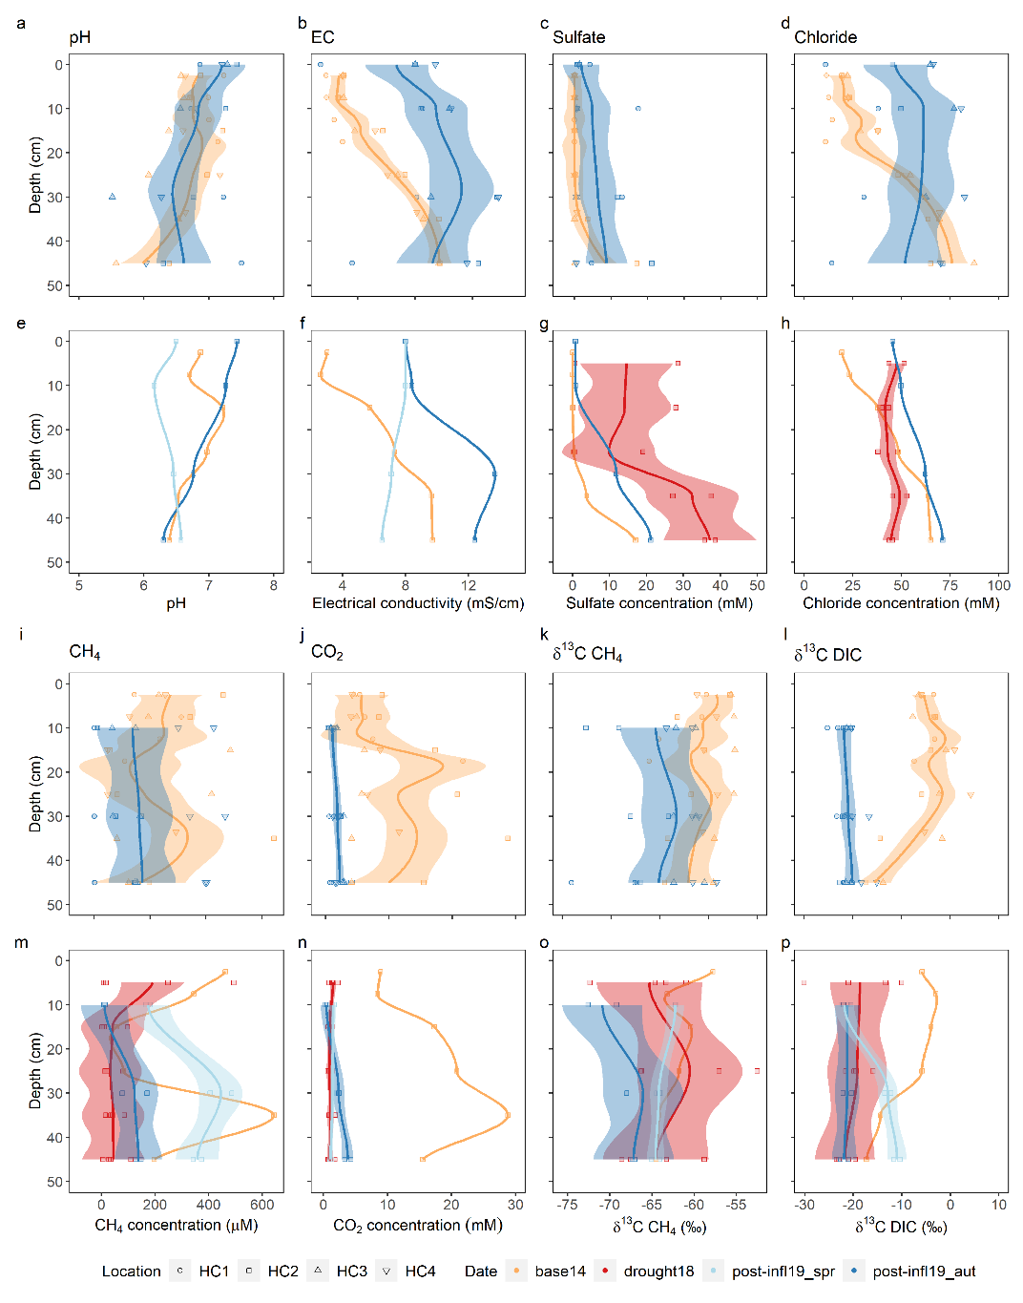
Results
Higher sulfate, chloride and EC after brackish water inflow
Higher CH₄ and CO₂ concentrations, but higher δ¹³C – CH₄ depletion
Gutekunst et al. (unpublished)
Gutekunst et al. (unpublished)

Slide 6
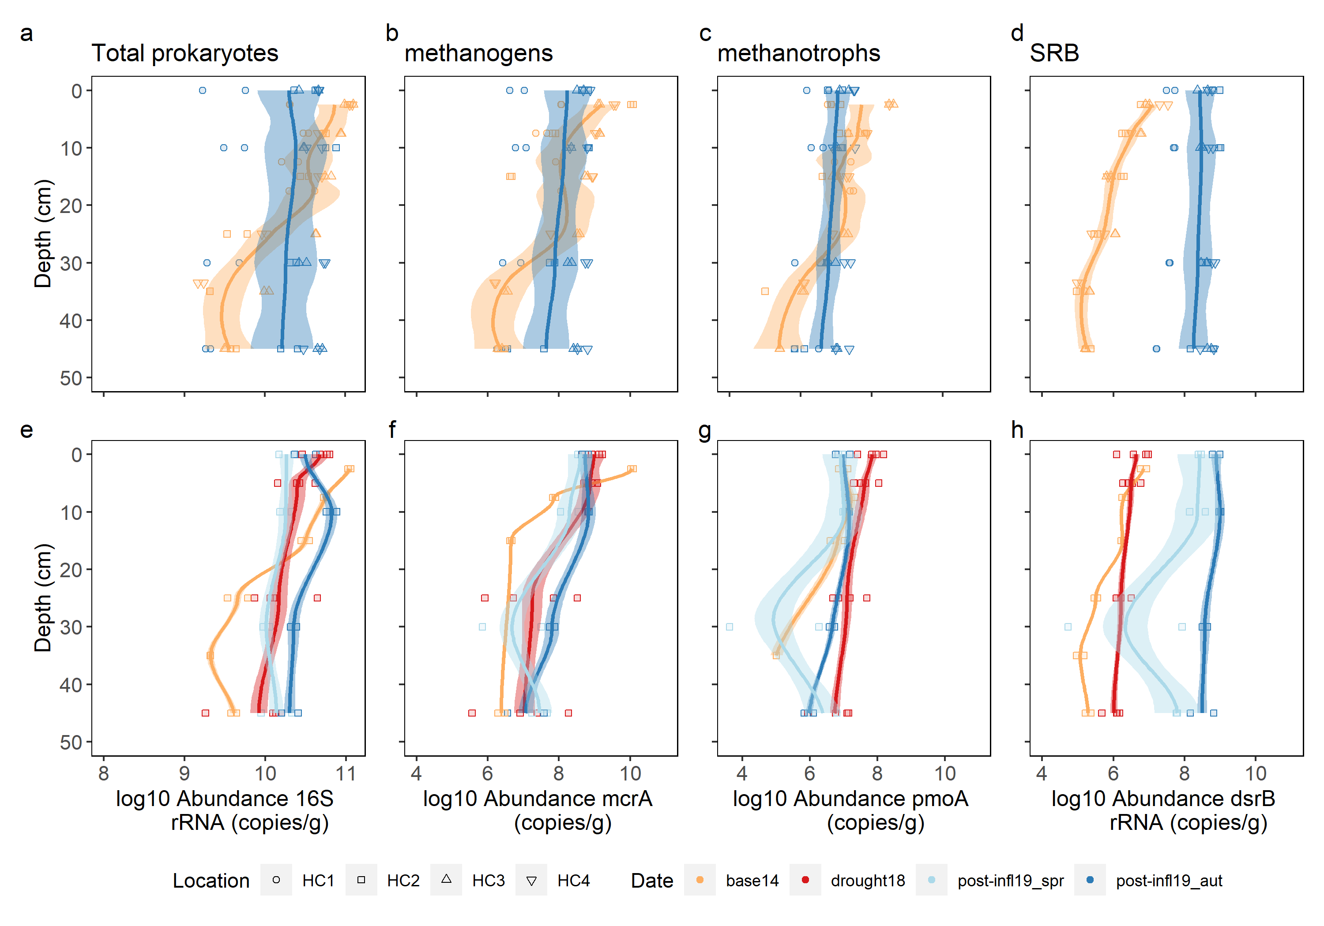
Results
Higher sulfate, chloride and EC after brackish water inflow
Higher CH₄ and CO₂ concentrations, but higher δ¹³C – CH₄ depletion
Methanogens and aerobic methanotrophs changed mostly during drought
Sulfate reducing bacteria increased after brackish water inflow
Gutekunst et al. (unpublished)

Slide 7
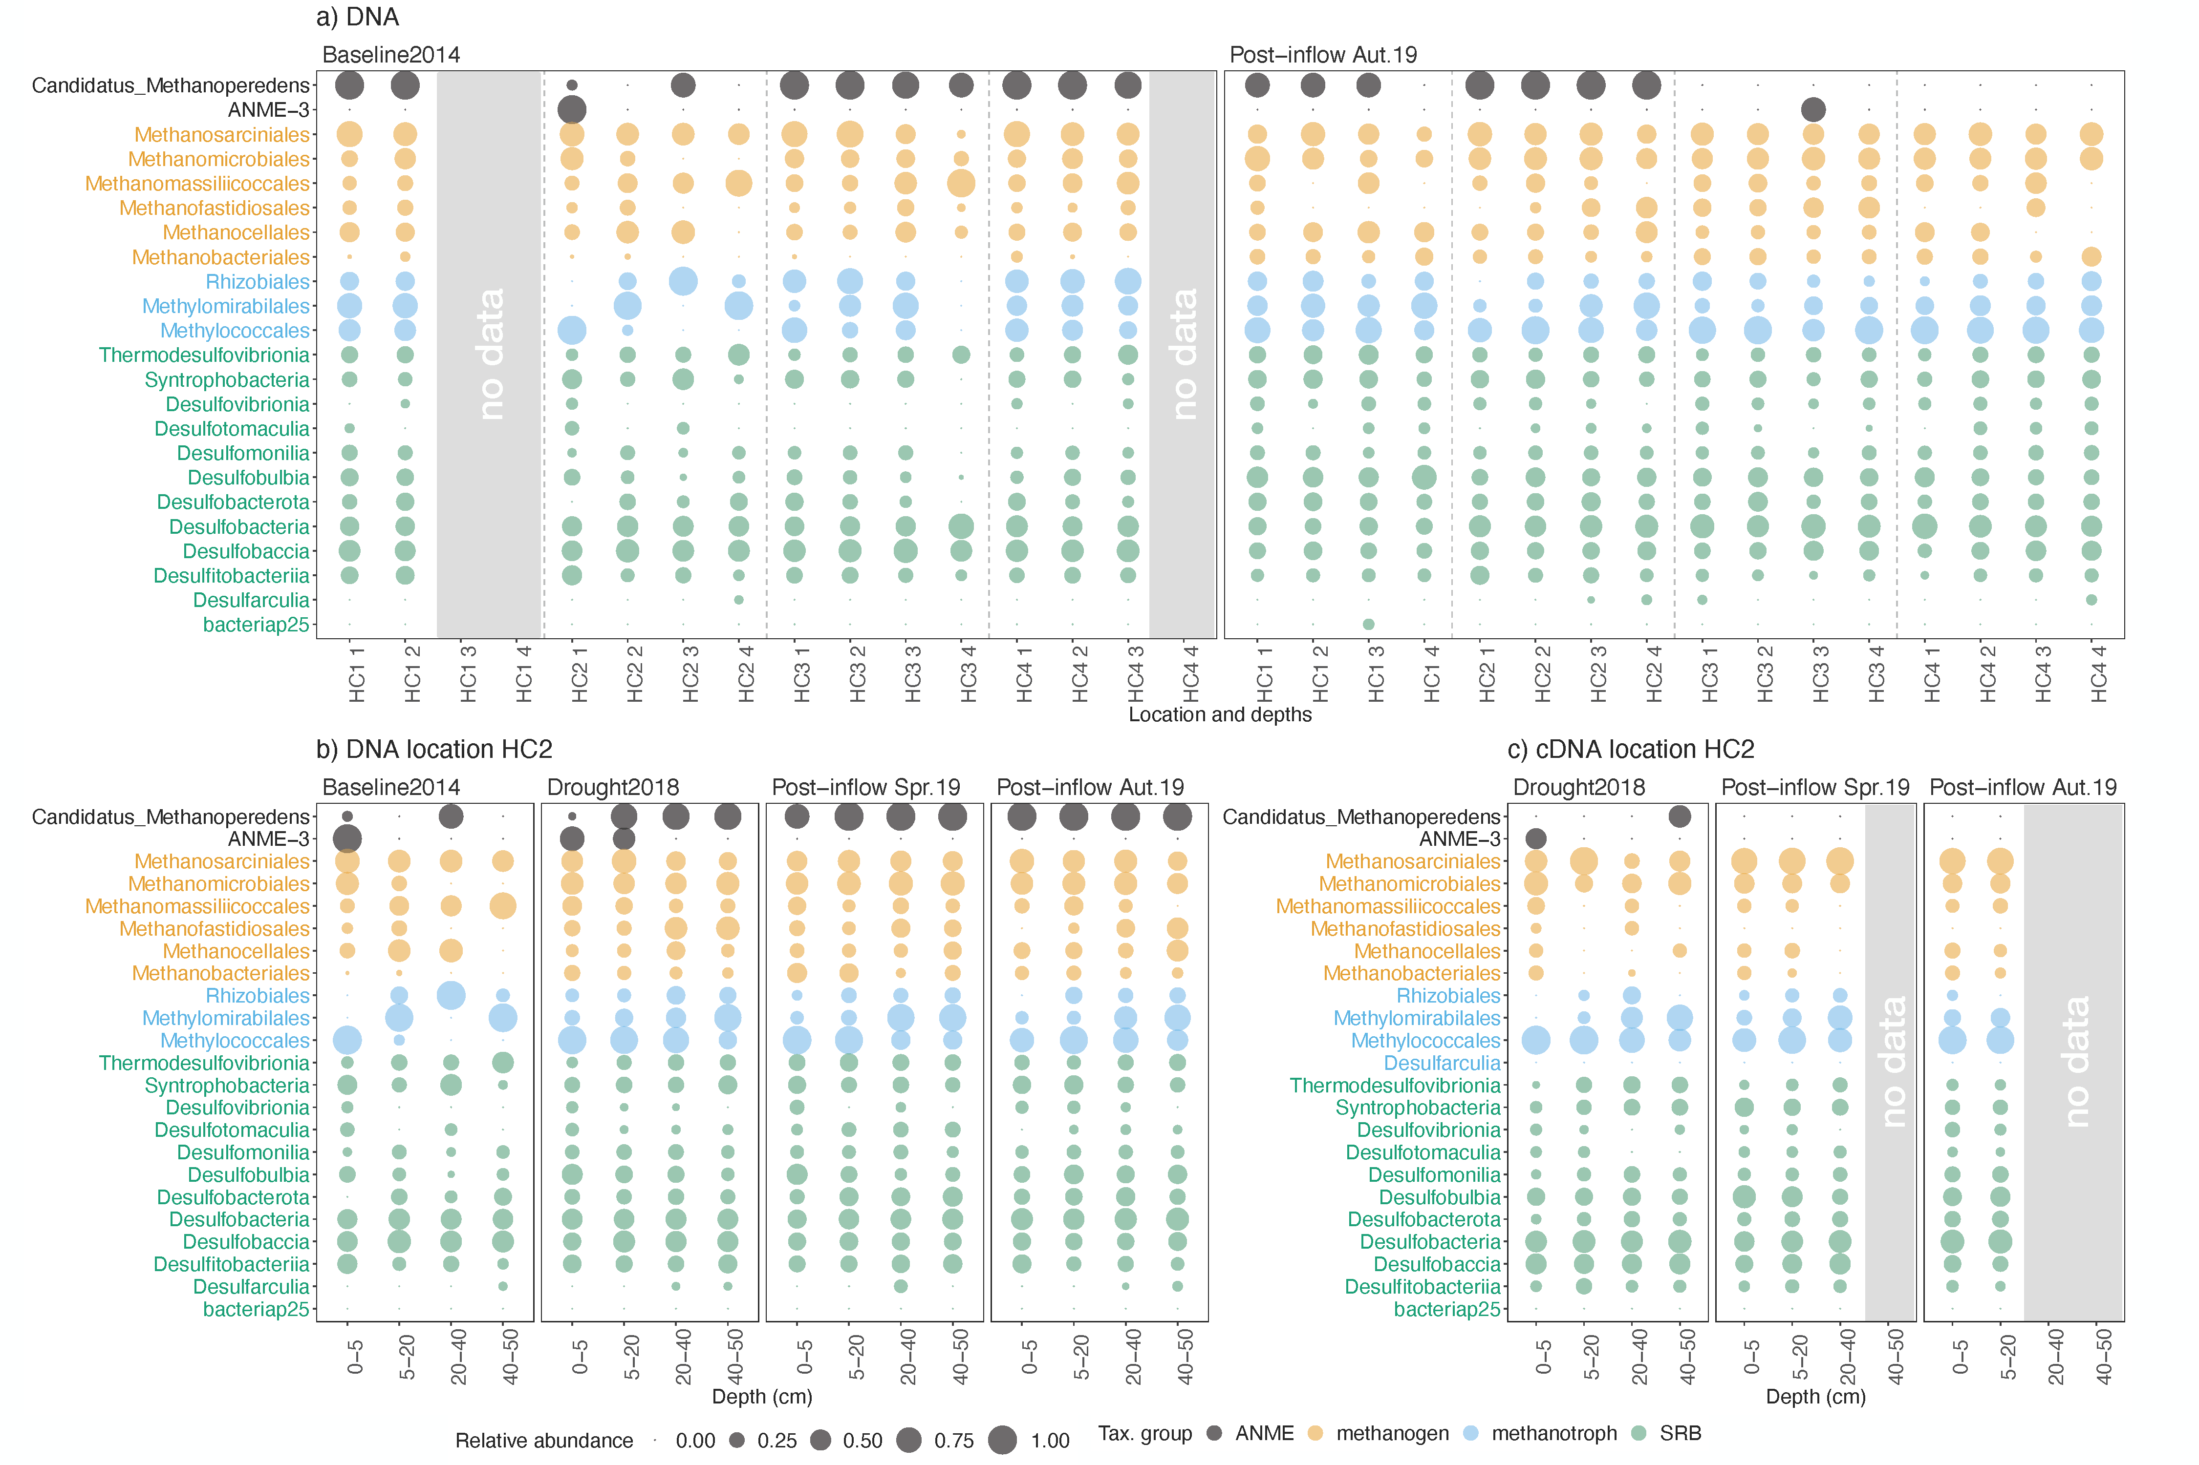
Results – Microbial sequencing
Gutekunst et al. (unpublished)

Slide 8
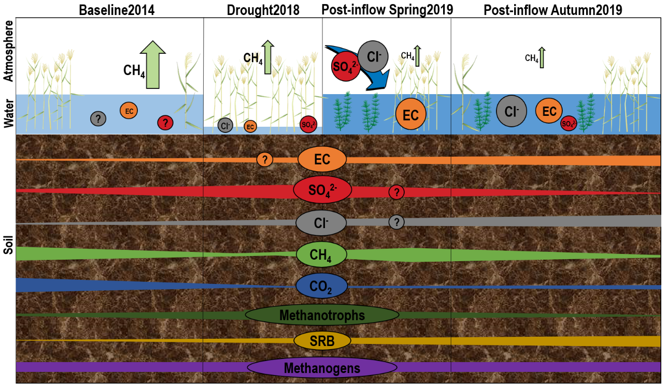
Gutekunst et al. (unpublished)

Slide 9
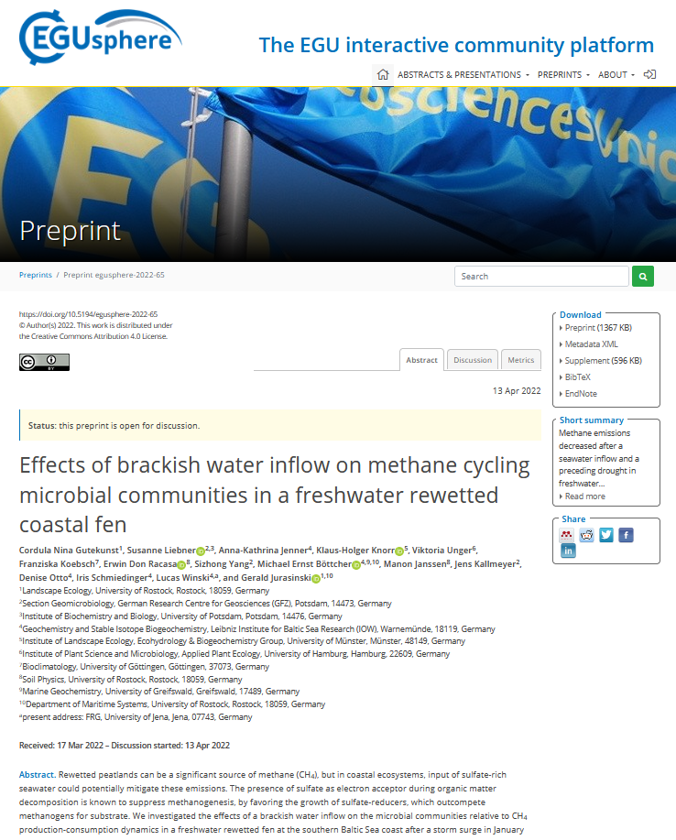
Thank you for your attention!
Check out the manuscript preprint here: https://egusphere.copernicus.org/preprints/2022/egusphere-2022-65/

