Slide 1
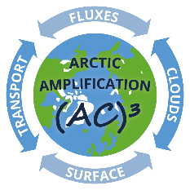


Regional differences in cyclone impacts on Arctic sea ice concentration during winter
Lars Aue¹, Annette Rinke¹
¹ Alfred Wegener Institute, Helmholtz Centre for Polar and Marine Research, Potsdam, Germany
Timo Vihma², Petteri Uotila³
² Finnish Meteorological Institute, Meteorological Research, Helsinki, Finland
³ University of Helsinki, Institute for Atmospheric and Earth System Research, Helsinki, Finland
Mirseid Akperov⁴
⁴ A.M. Obukhov Institute of Atmospheric Physics, RAS, Moscow, Russia
Picture: Alfred-Wegener-Institut/Stefan Hendricks CC-BY 4.0

Slide 2
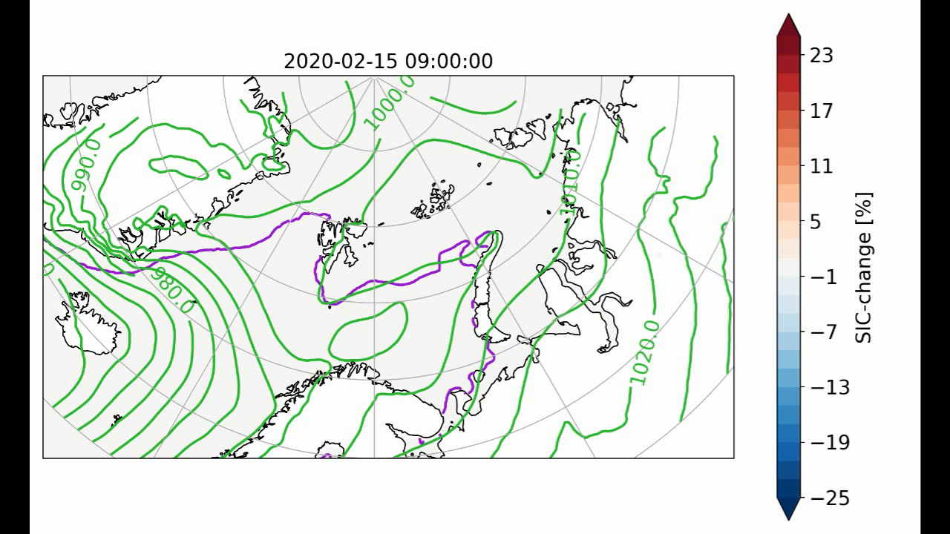
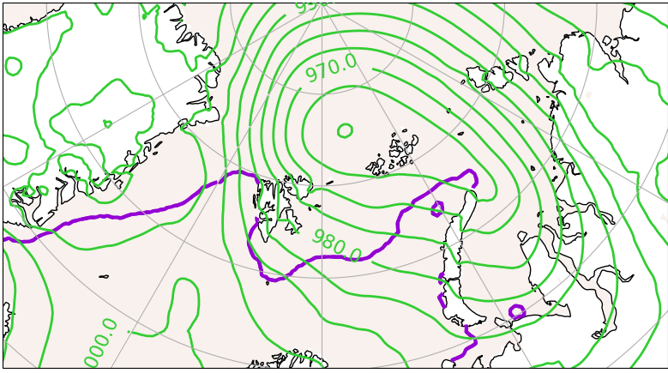
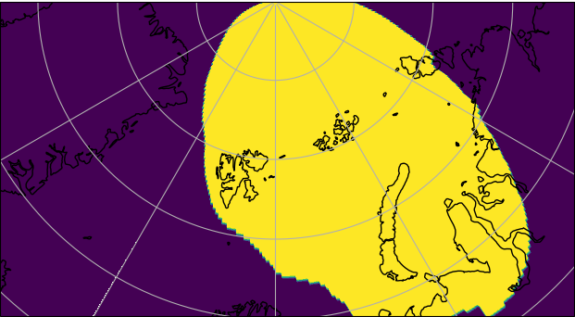
Introduction: Cyclone impacts on SIC
SIC change [%] in Mid-February 2020 during passage of a cyclone
What is the overall impact of cyclones on SIC?
Statistical analysis for winter (December to February) 2000 – 2020.
Based on ERA5 reanalysis and cyclone tracking algorithm (Akperov et al., 2015).
Compare SIC change over a few days for cyclone samples and non-cyclone samples at each gridcell.
Cyclone Tracking: 19.2.2020
SIC and MSLP as daily means (SIC relative to 15.2.20) taken from ERA5.

Slide 3

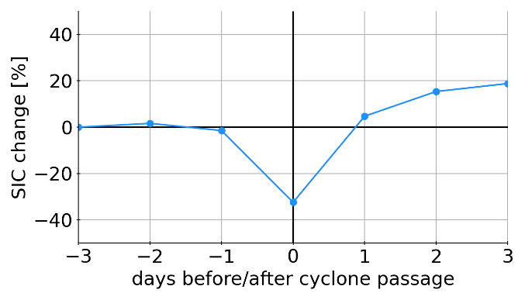
Introduction: Cyclone impacts on SIC
SIC change [%] in Mid-February 2020 during passage of a cyclone
What is the overall impact of cyclones on SIC?
Statistical analysis for winter (December to February) 2000 – 2020.
Based on ERA5 reanalysis and cyclone tracking algorithm (Akperov et al., 2015).
Compare SIC change over a few days for cyclone samples and non-cyclone samples at each gridcell.
SIC change at 47°E, 77°N (15.2.20 – 21.2.20)
SIC and MSLP as daily means (SIC relative to 15.2.20) taken from ERA5.

Slide 4
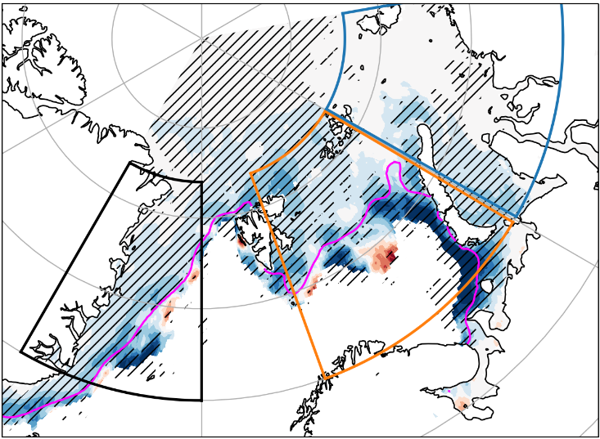
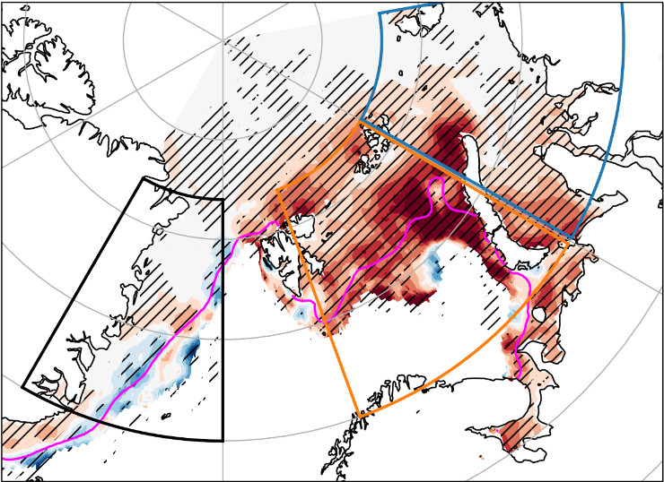
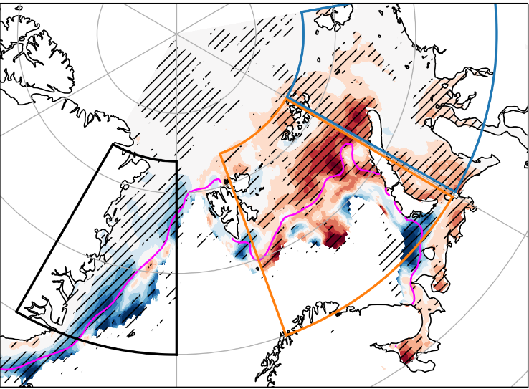
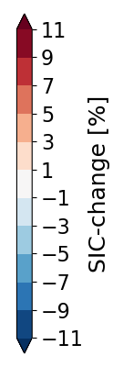
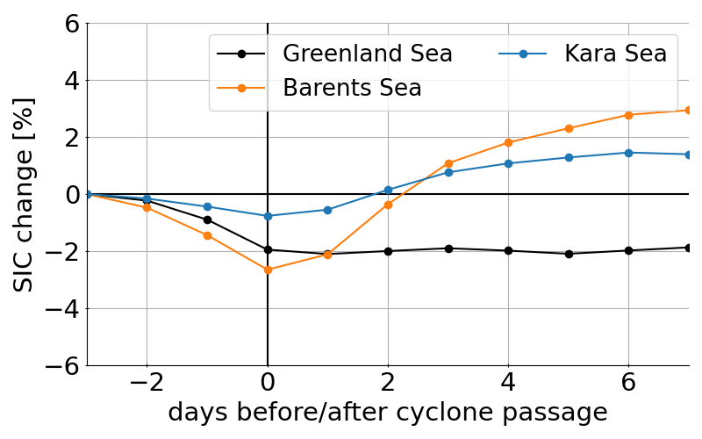
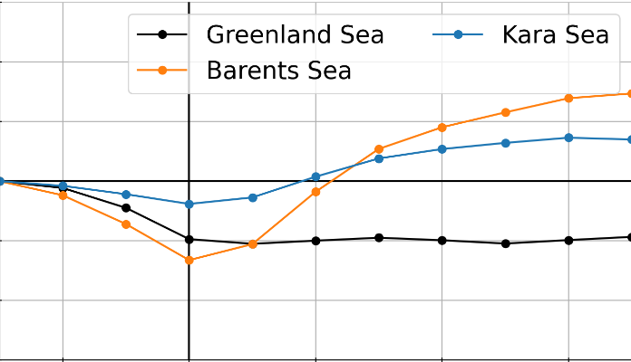
Statistics: Cyclone impacts on SIC
Anomalous SIC change related to cyclones (winter, 2000-2020)
Prior & during cyclone (day -3 to day 0)
After cyclone (day 0 to day 5)
Overall effect (day -3 to day 5)
Summary
Regional difference in cyclone impact on SIC.
Decrease in Greenland Sea.
Increase in Barents Sea.
Further results
Dynamics vs thermodynamics.
Influence of cyclone intensity and sea ice conditions.
„New“ vs „old“ Arctic.

Slide 5
Statistics: Cyclone impacts on SIC
Anomalous SIC change related to cyclones (winter, 2000-2020)
Prior & during cyclone (day -3 to day 0)
After cyclone (day 0 to day 5)
Overall effect (day -3 to day 5)
L
L
L
Summary
Regional difference in cyclone impact on SIC.
Decrease in Greenland Sea.
Increase in Barents Sea.
Further results
Dynamics vs thermodynamics.
Influence of cyclone intensity and sea ice conditions.
„New“ vs „old“ Arctic.

Slide 6
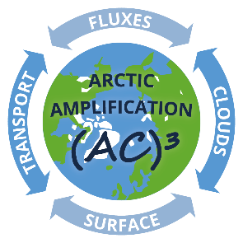

Thank you for your attention!
lars.aue@awi.de
Acknowledgements
This work was supported by the DFG funded Transregio-project TR 172 “Arctic Amplification (AC)3“ and the European Union’s Horizon 2020 research and innovation framework programme funded "PolarRES" project.
References
Akperov, Mirseid & Mokhov, Igor & Rinke, Annette & Dethloff, Klaus & Matthes, Heidrun & Mokhov, I. (2014): Cyclones and their possible changes in the Arctic by the end of the twenty first century from regional climate model simulations, Theoretical and Applied Climatology, 122.

