Slide 1
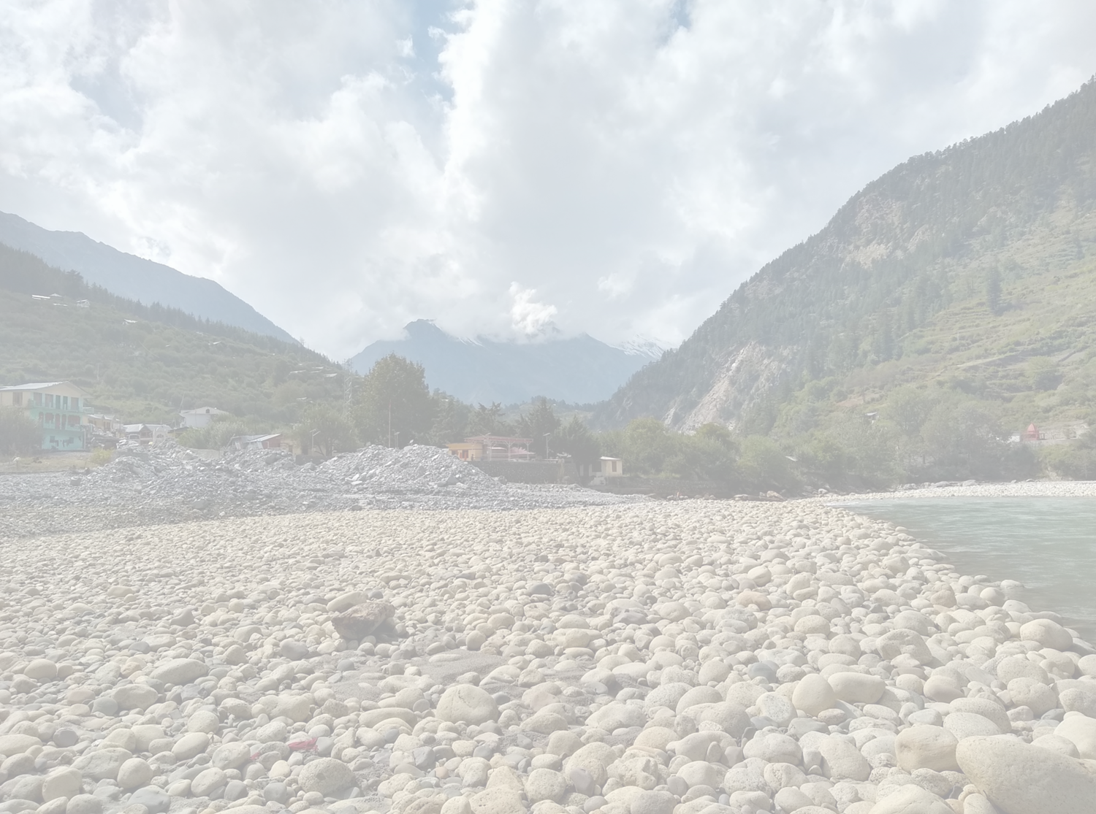

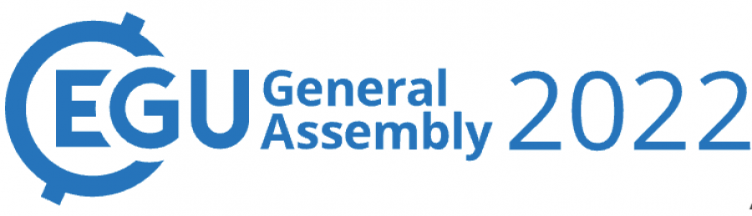

Isotopic and geochemical studies in the Upper Ganga Basin, Uttarakhand, India: Implications on Dissolved Inorganic Carbon Systematics
Nikitasha Chatterjee^{1*}, Sameer K. Tiwari², Anil K. Gupta¹, Kanishak Sharma¹
Presented by:
Nikitasha Chatterjee
Ph.D student
Department of Geology and Geophysics, IIT Kharagpur
*chatterjeenik001@gmail.com

Slide 2

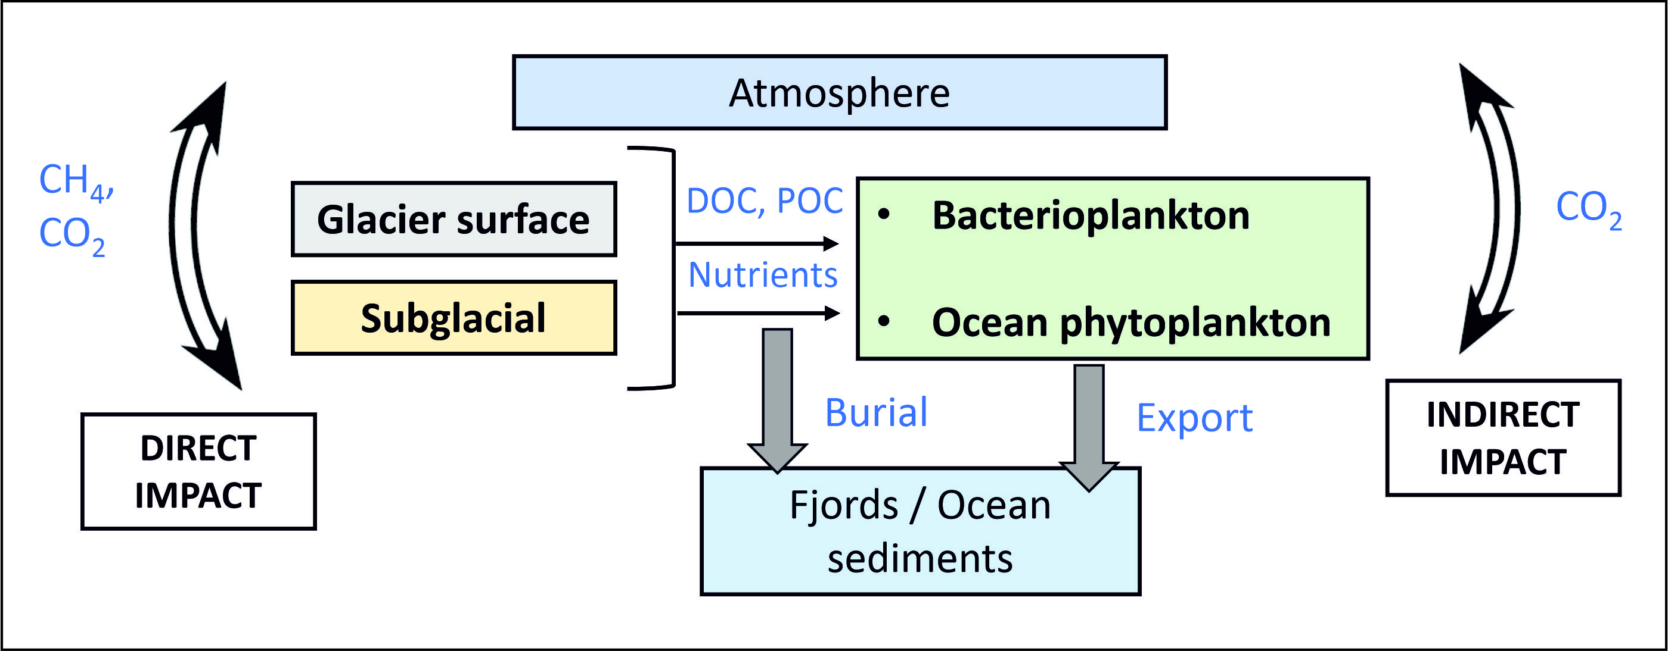
Introduction
In recent years, the release of organic and inorganic carbon from the melting glaciers has been a subject of scientific research (Yde et al., 2011; Wadham et al., 2019).
It can have a vital effect on the riverine carbon cycle and primary productivity.
Carbon cycle has also been linked with weathering of rocks: silicate weathering acting as a source and carbonate weathering acting as a sink of dissolved CO₂ in short period of time (Khadka et al., 2014).
Figure 1. Schematic diagram showing carbon cycle in glacial and subglacial environment (after Yde et al., 2011)

Slide 3

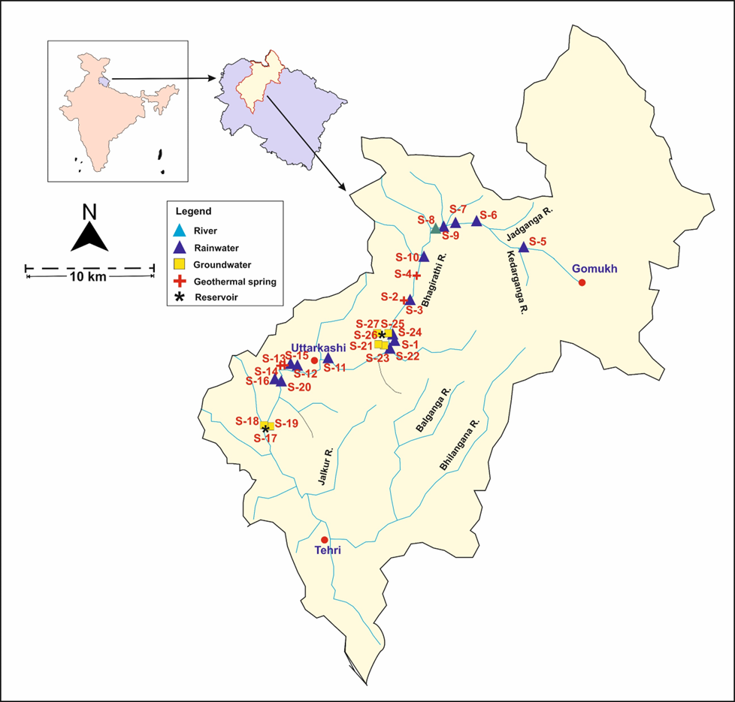
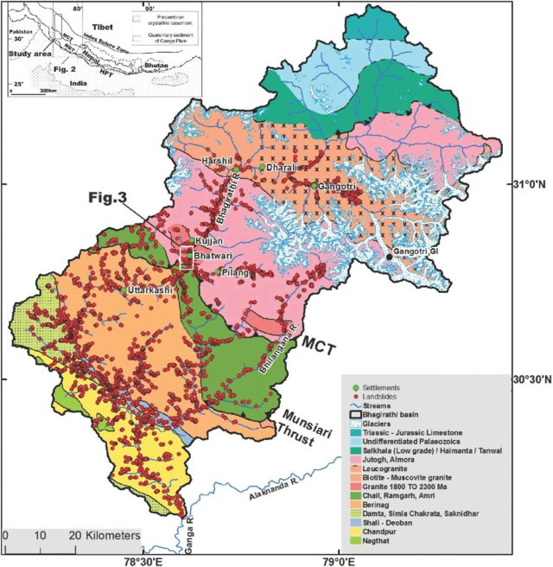
Study Area
Bhagirathi River Basin, Uttarakhand, India
Bhagirathi River is a proglacial melt-stream of Gangotri glacier which is one of the largest Himalayan glaciers.
Figure 1. Map of the study area showing the sampling points
Figure 2. Geological map of Bhagirathi Basin (Yadav et al., 2020)

Slide 4

Aims & Objectives
To study the bedrock weathering pattern of the Bhagirathi Basin.
To understand dissolved organic and inorganic carbon systematics which includes the study of HCO₃⁻ and δ¹³C in the surface water of the basin.
Estimating the partial pressure of dissolved CO₂ (pCO₂) of the Bhagirathi river water.

Slide 5

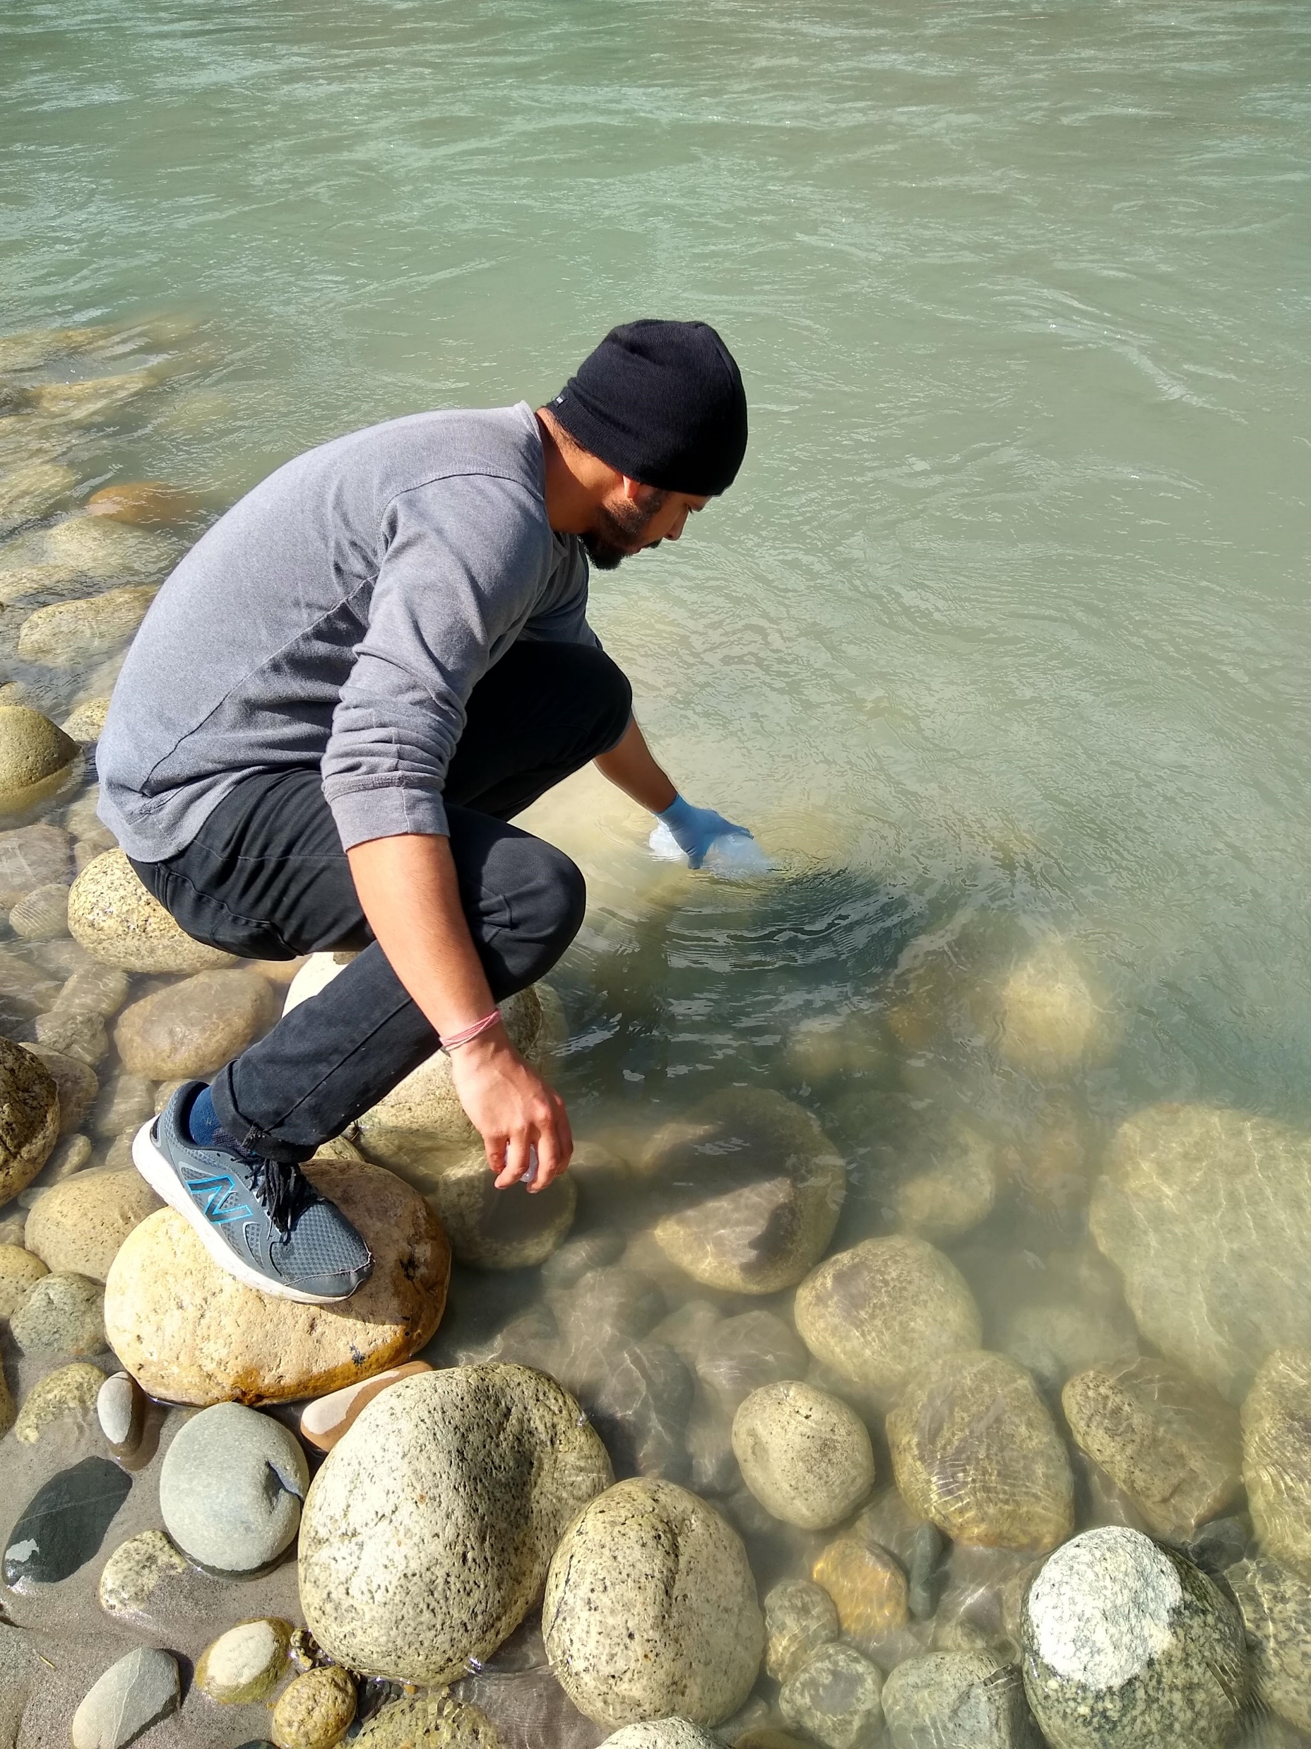
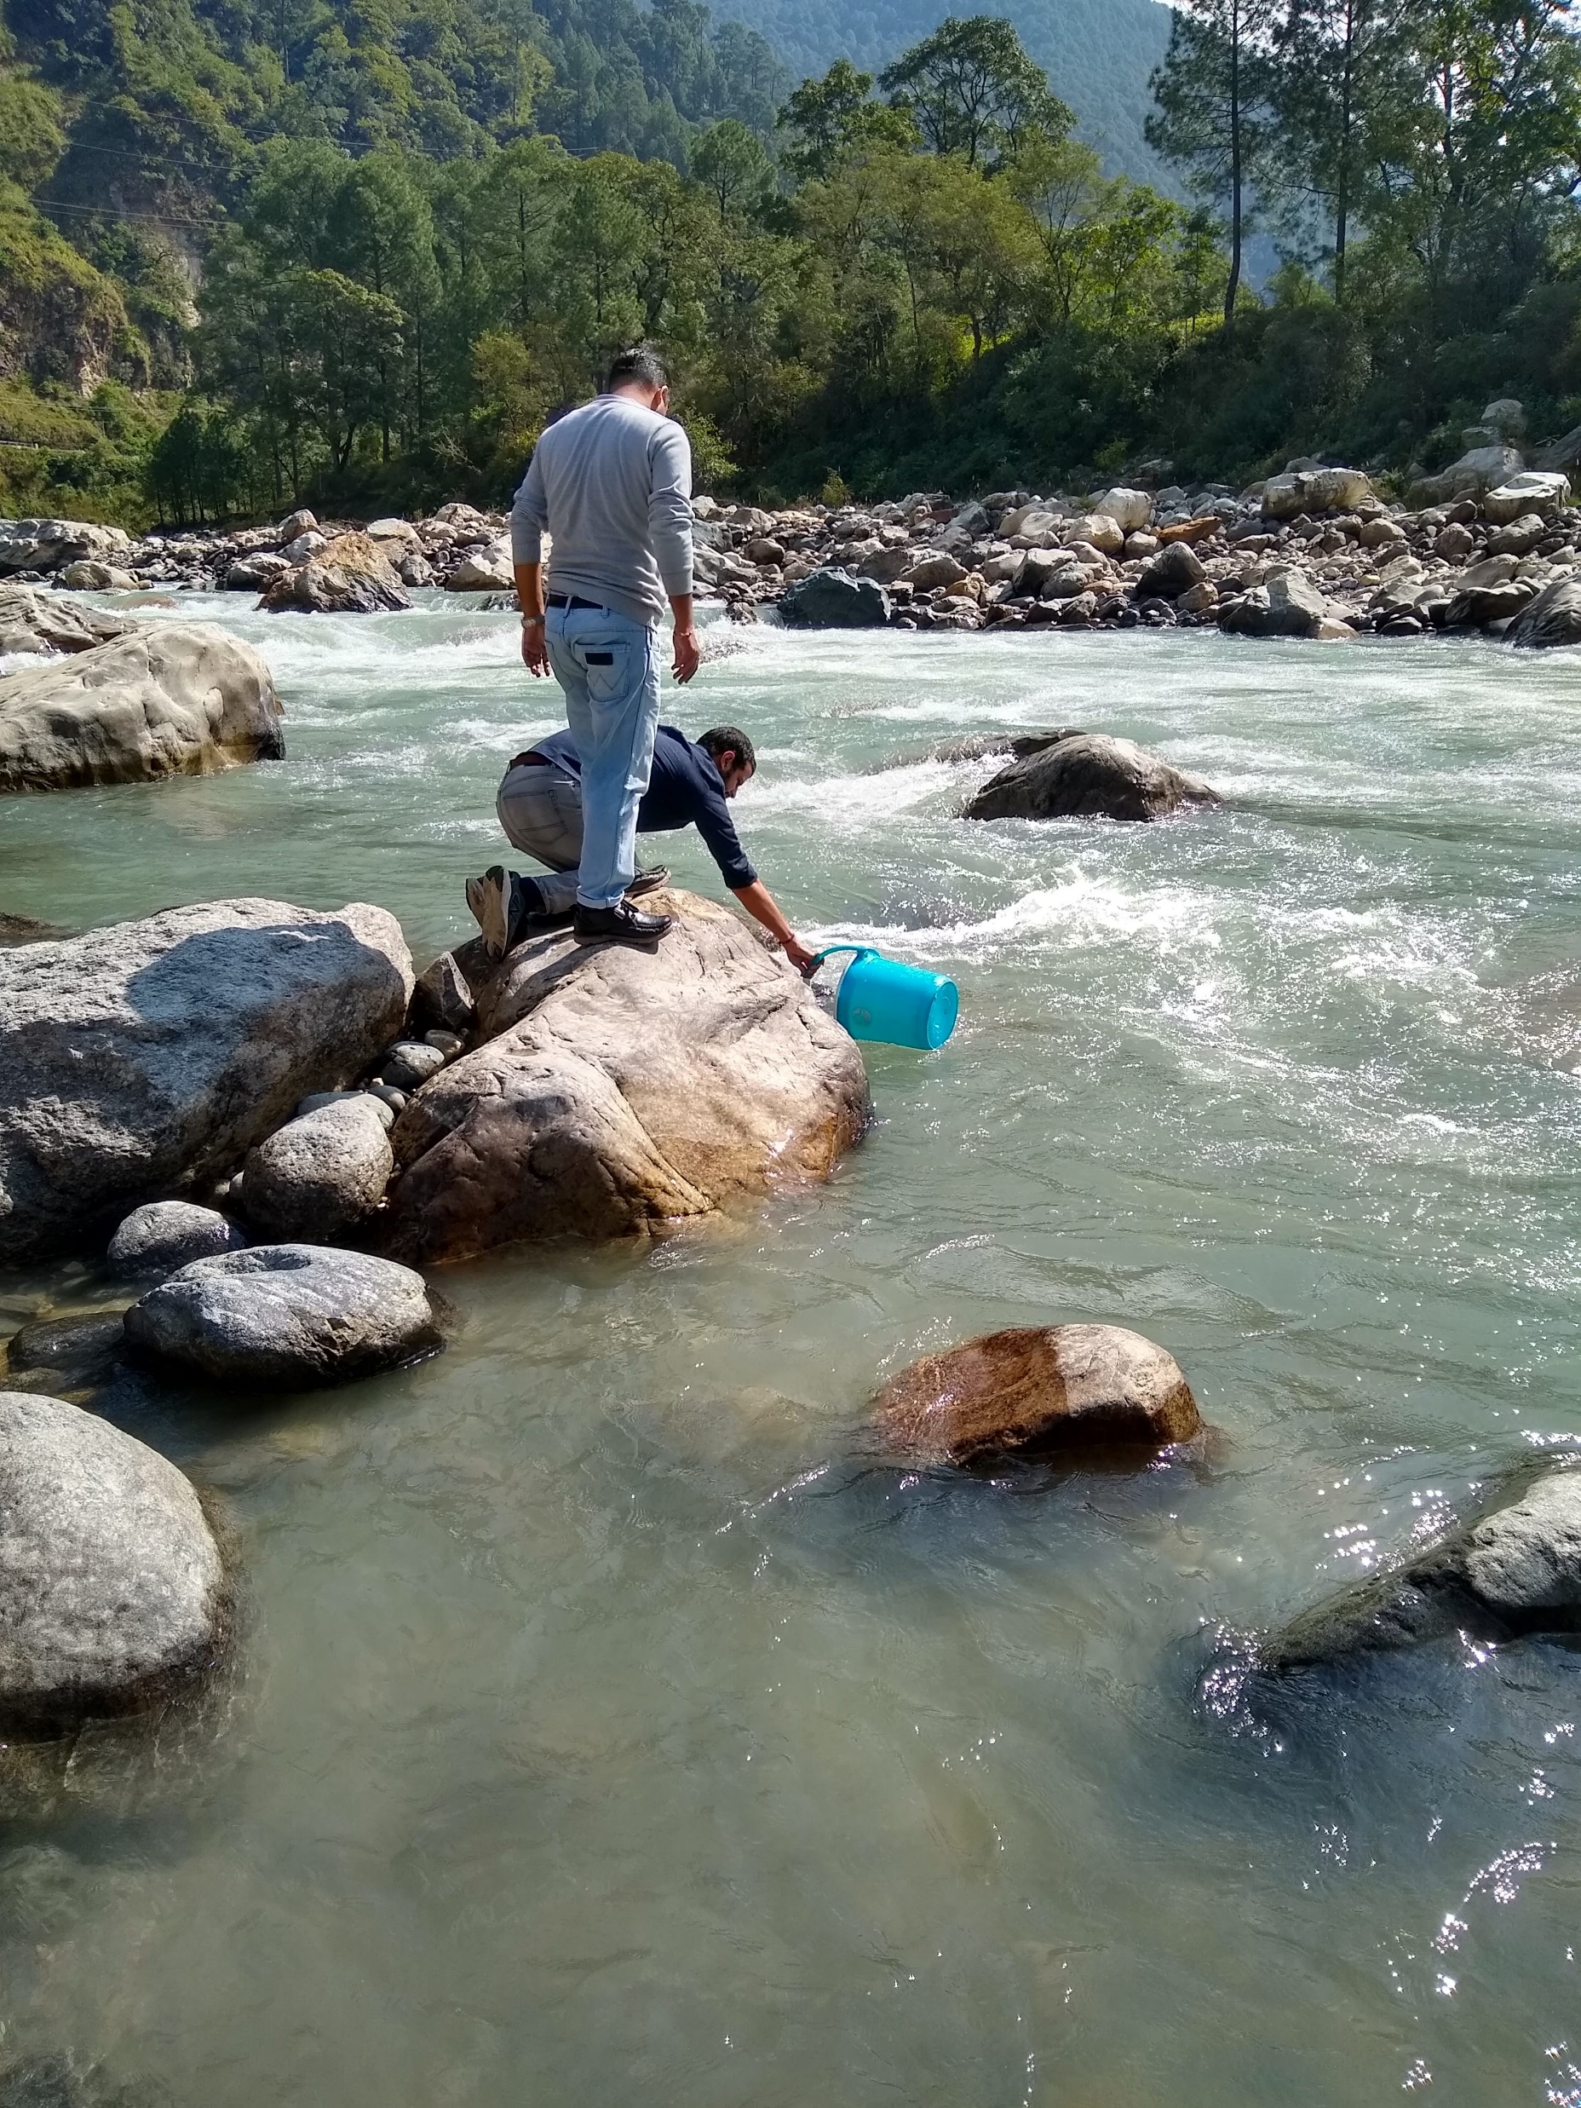
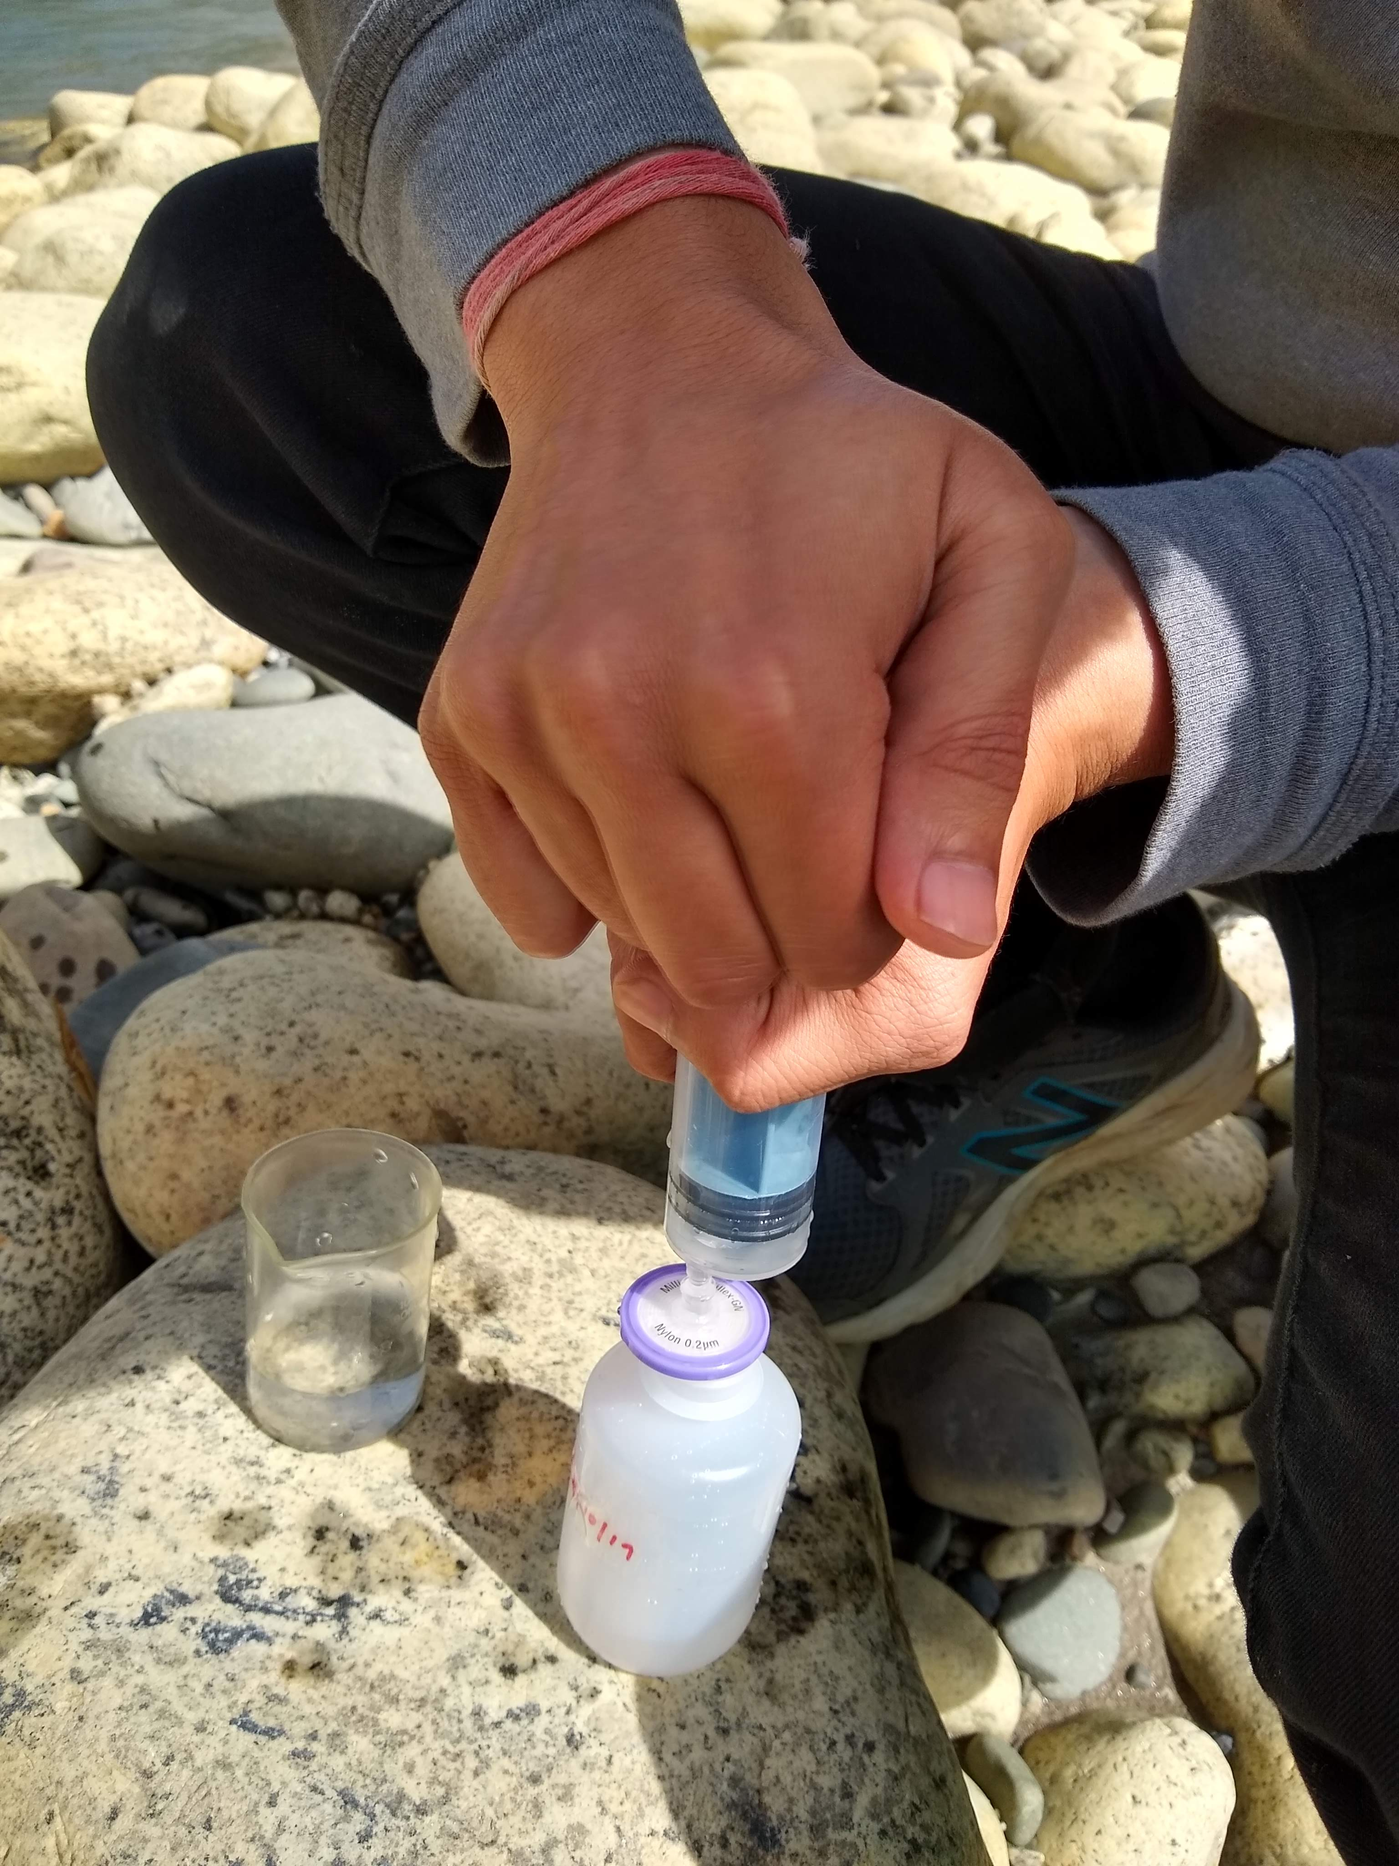

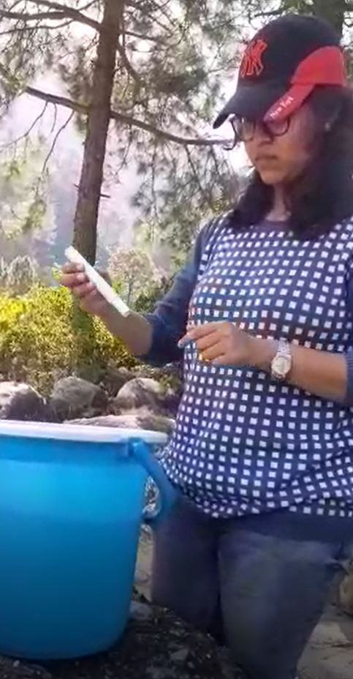
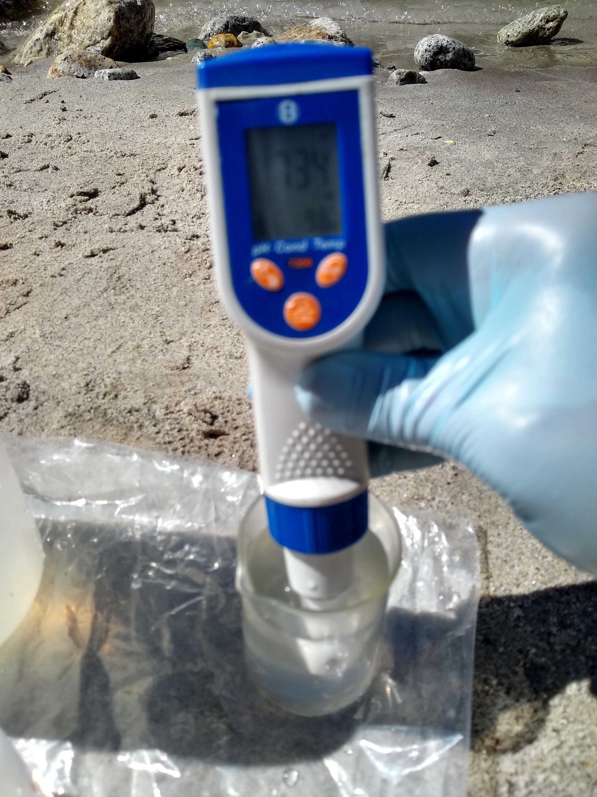
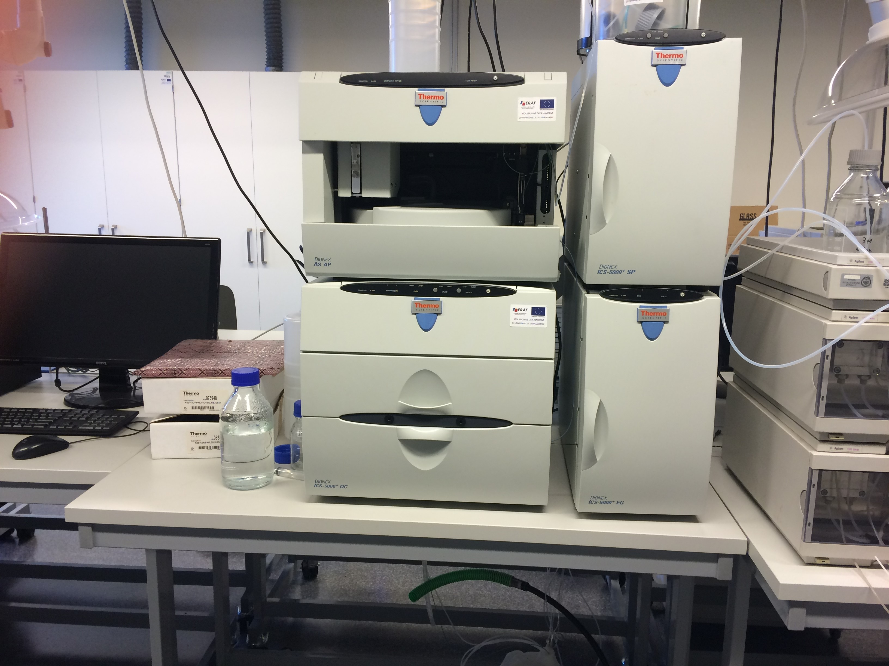
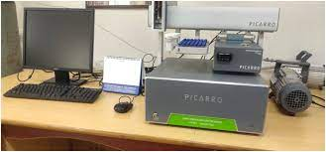
Sampling and methodology
A total of 27 surface water (river, groundwater, geothermal spring and reservoir) were collected during post-monsoon season (October 2019).
FILTRATION
SAMPLING
CHEMICAL ANALYSIS
PHYSICAL PARAMETERS

Slide 6


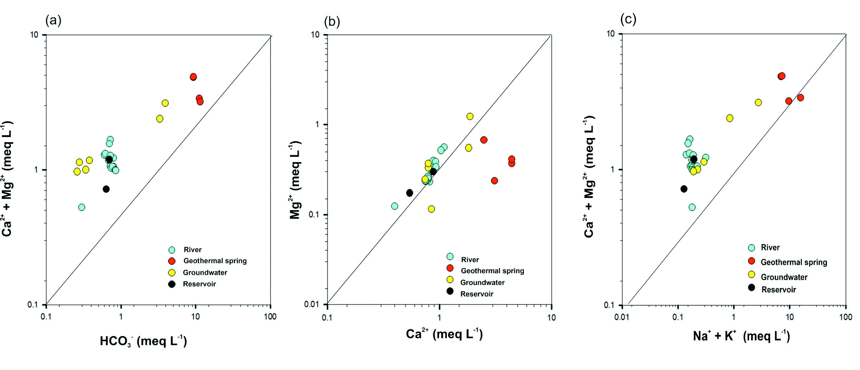
Results and Discussion
Results and Discussion
Figure 3. Ionic plots of the samples: (a) Ca²⁺ + Mg²⁺ vs HCO₃⁻ (b) Mg²⁺ vs Ca²⁺ and (c) Ca²⁺ + Mg²⁺ vs Na⁺ + K⁺
In figure (a) and (b) samples lie close to the 1:1 line, indicating the source of Ca²⁺, Mg²⁺ and HCO₃⁻ ions is same.
In figure (c), the mean value of the ratio Ca²⁺ + Mg²⁺ / Na⁺+ K⁺ is 6.5, which indicates carbonate weathering is dominant in the watershed.

Slide 7

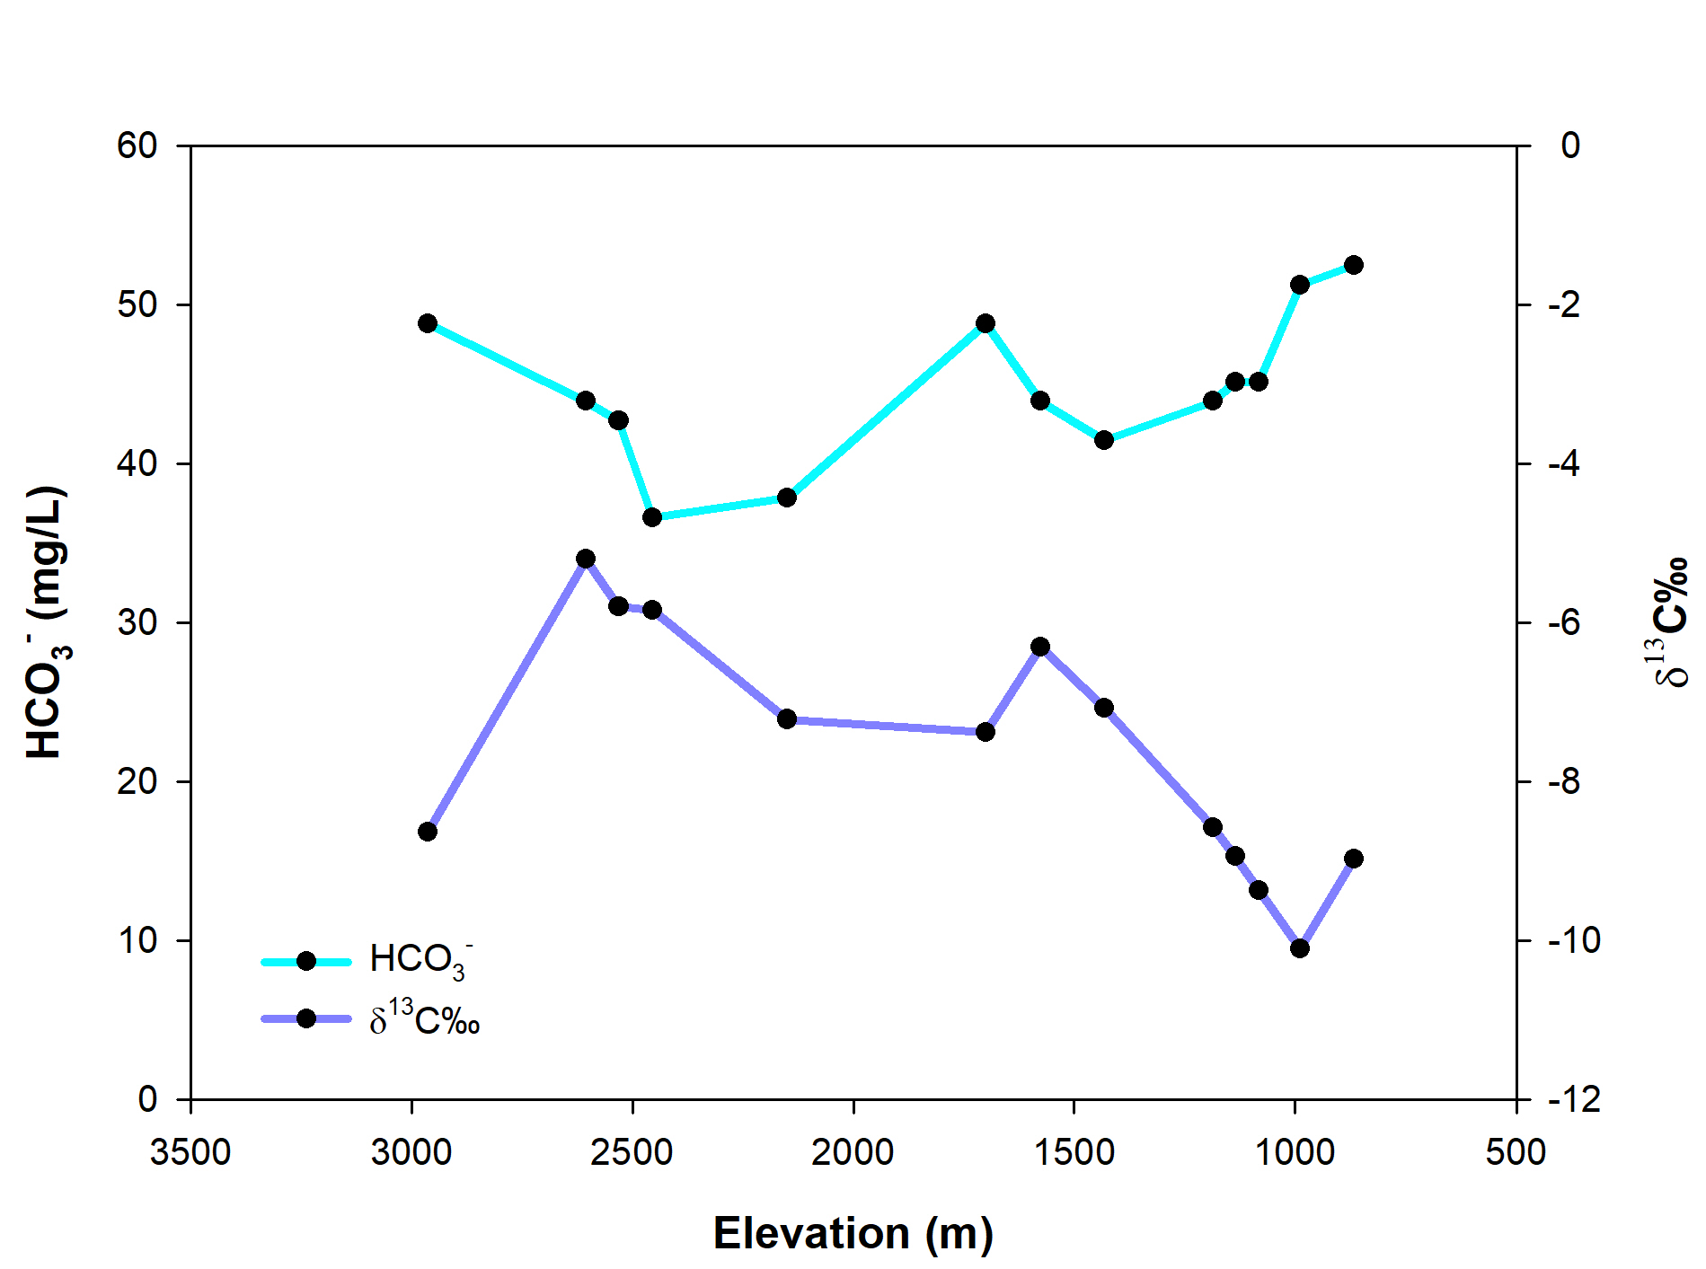
Results and Discussion
Results and Discussion
The DIC (HCO₃⁻ ) in river water can have three sources (Chakrapani and Veizer, 1986):
Dissolution of carbonate minerals
Soil Organic Matter (SOM)
Atmospheric CO₂ in exchange with air-water interface
After applying fractionation equation by Solomon & Mook., 1986, we inferred that the source of DIC for Bhagirathi River varies between two end members: carbonate dissolution in the upstream part and SOM in the downstream part.
Figure 4. Spatial variation of DIC (HCO₃⁻) and δ¹³C‰ in the river with respect to elevation. Elevation scale is shown from high to low for convenience.
The δ¹³C measured for river water samples range from– 10 to -5 ‰.

Slide 8

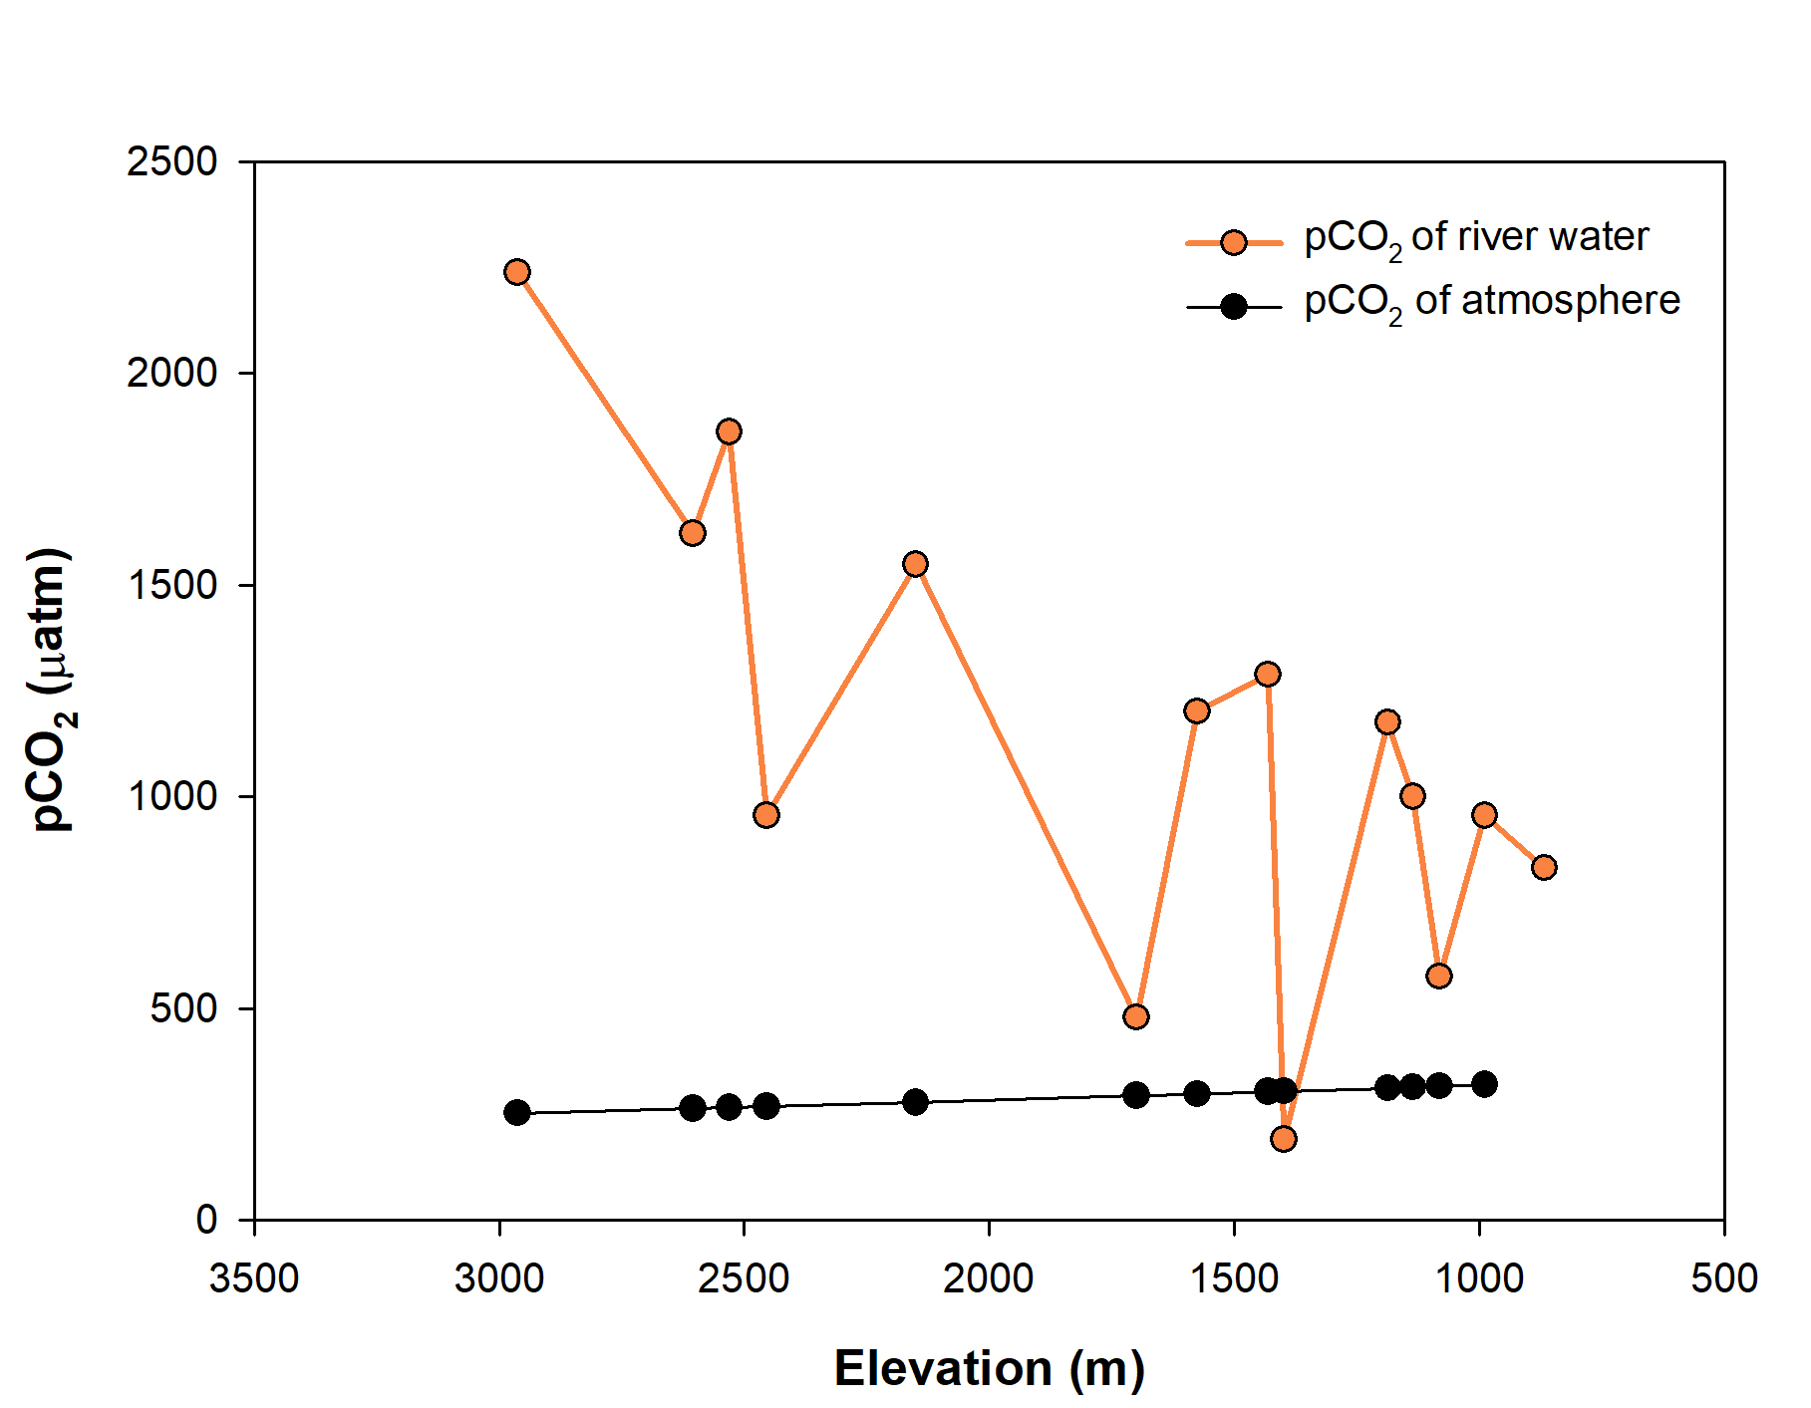
Results and Discussion
pCO₂ of river water is calculated by PHREEQC version 3.7.1.
The mean pCO₂ river is 1137 µatm which is about 3.5 times of pCO₂ atmosphere.
The pCO₂ river values are high in the upstream part where silicate rocks are predominant and low in the downstream part where carbonate rocks become gradually more abundant.
Figure 5. Spatial variation of pCO₂ of river and the atmosphere with respect to elevation.

Slide 9

Conclusions
Our study area is predominated by silicate rocks, though carbonate weathering signatures are observed.
Carbon isotopic studies of Bhagirathi river water reveals that the source of HCO₃⁻ gradually changes from carbonate dissolution to soil organic matter, as we go downstream and vegetation becomes abundant.
pCO₂ studies of river water gives an indication that there may be some degassing phenomenon occurring in the basin, which welcomes further future studies.

Slide 10

Acknowledgements
I am extremely thankful to my supervisor Prof. Anil Kumar Gupta and co-supervisor Dr. Sameer K. Tiwari for their constant academic guidance and logistics support throughout my Ph.D. work. I’m thankful to Department of Geology & Geophysics, IIT Kharagpur for providing me institute fellowship and necessary funds to continue my work. I’m particularly thankful to Wadia Institute of Himalayan Geology for supporting me in the field work and providing facilities for all the geochemical analysis (major ions and isotopes) of the samples. I’m grateful to all the colleagues in my lab for their brotherly guidance.

Slide 11
References
Holmen, K. (1992) The Global Carbon Cycle, in, Butcher, S., Charlson, R., Orians, G., and Wolfe, G., (eds.), Global Biogeochemical Cycles, London, Academic Press, p. 237-262
Hood, E., Battin, T., Fellman, J. (2015) Storage and release of organic carbon from glaciers and ice sheets. Nature Geoscience 8, 91–96.
Khadka, M.B., Martin, J.B., Jin, J. (2014) Transport of dissolved carbon and CO₂ degassing from a river system in a mixed silicate and carbonate catchment. Journal of Hydrology, v. 513, pp. 391 – 402.
Li, S.Y., Lu, X.X., He, M., Zhou, Y., Li, L., Ziegler, A.D. (2011) Daily CO₂ partial pressure and CO₂ outgassing in the upper Yangtze River basin: a case study of Longchuanjiang China. Biogeosciences Discussions, v. 8, pp. 10645–10676.
Liu, Z., Wolfgang, D., Liu, H. (2011) Atmospheric CO₂ sink: Silicate weathering or carbonate weathering? Applied Geochemistry, v. 26, pp. S292 – S294.
Negi, H.S., Thakur, N.K., Ganju, A., Senhmani, (2012) Monitoring of Gangotri glacier using remote sensing and ground observations. Journal of Earth System Science, v. 121, pp. 855 – 866.
Salomons, W., Mook, W.G. (1986) Isotope geochemistry of carbonates in the weathering zone, Handbook of Environmental Isotope Geochemistry. Elsevier editors, pp. 241-269.
Wadham, J.L., Hawkings, J.R., Tarasov, L. (2019) Ice sheets matter for the global carbon cycle. Nature Communications 10, 3567.
Yu, S., Du, W., Sun, P., He, S., Kuo, Y., Yuan, Y., Huang, J. (2014) Study on the hydrochemistry character and carbon sink in the middle and upper reaches of the Xijiang River basin, China. Journal of Environmental Earth Science.

Slide 12

Yde, J.C., Barsena, T.G., Finster, K.W. (2011) Subglacial and Proglacial Ecosystem Responses to Climate Change. In book: Climate Change - Geophysical Foundations and Ecological Effects, Chapter: 23.
THANK YOU

