Slide 1




P-band InSAR for Ground Deformation Surveying: Advantages and Challenges
Yuankun Xu¹, Zhong Lu², Roland Burgmann¹, Scott Hensley³, Eric Fielding³
¹UC Berkeley, Berkeley, CA, USA
²Southern Methodist University, Dallas, TX, USA
³Jet Propulsion Laboratory, Pasadena, CA, USA

Slide 2
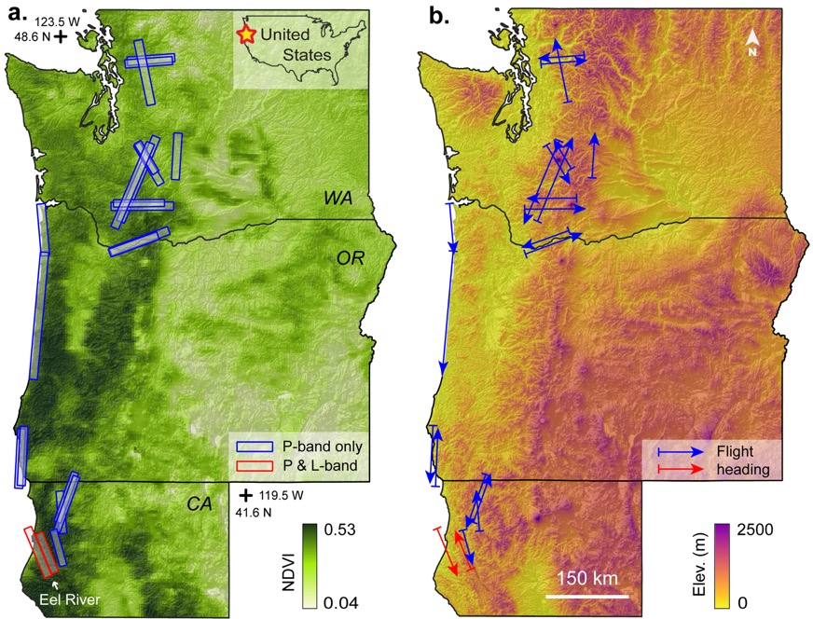
1. Overview of UAVSAR P-band experiment on the US West Coast
Band | P-band | L-band
Side-looking direction | Left | Left
Center wavelength (cm) | 69.72 | 23.84
Slant range resolution (m) | 8.2 | 1.67
Azimuth resolution (m) | 0.6 | 0.6
Multi-looked range spacing (m) | 5.0 | 5.0
Multi-looked azimuth spacing (m) | 7.2 | 7.2
Date of acquisition #1 | 13 Nov 2020 | 27 Oct 2020
Date of acquisition #2 | 05 May 2021 | 13 May 2021
Motivation: P-band InSAR for surveying forested terrains
Flight segments: 20 P-band + 2 P/L-band (Eel River)
Mapped deformation features: 257 active landslides
231 not in the USGS landslide inventory (Jones et al., 2019)
195 not in the 2007-2019 ALOS-1/2 mapping (Xu et al., 2021)

Slide 3
2. P-band vs. L-band: Backscattering amplitude & InSAR coherence
Backscattering (P > L): volume scattering
Coherence (P=0.7 vs. L=0.4): vegetation penetration
P-to-L coherence difference by land cover type: developed space (0.2), forest (0.17), pasture/hay (0.15)

Slide 4
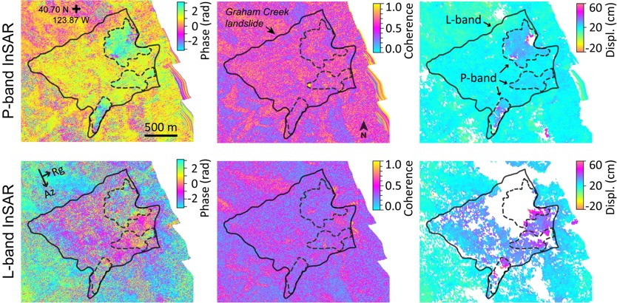
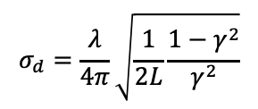
3. P-band vs. L-band: Deformation detection and measurement
$$σ_{d}=\frac{λ}{4π}\sqrt{\frac{1}{2L}\frac{{1−γ}^{2}}{γ^{2}}}$$
InSAR precision:
Higher coherence --> Clearly capturing deformation
Longer wavelength --> Resolving high-gradient deformation
Longer wavelength --> Insensitivity to subtle deformation

Slide 5
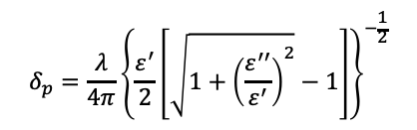
4. P-band: Snow penetration depth
$$δ_{p}=\frac{λ}{4π}{\left\{\frac{ε^{′}}{2}\left[\sqrt{1+{\left(\frac{ε^{′′}}{ε^{′}}\right)}^{2}}−1\right]\right\}}^{−\frac{1}{2}}$$
Radar penetration depth:
Penetration depth depends on wavelength and water content
P-band: Full penetration by 1.5 m (coherence as high as 0.9 )
Coherence decreases with snow depth after 1.5 m
SAR amplitude increase with snow depth (< 2.5 m)

Slide 6
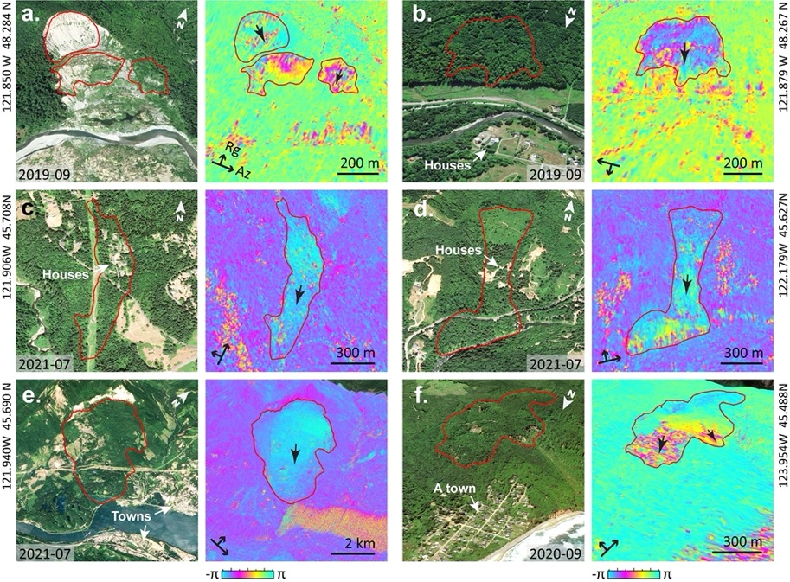
4. Highlight of mapped active landslides by P-band SAR
Advantages of P-band SAR
Long wavelength --> Better coherence for forested area
Variable heading angles --> sensitivity to deformation
High resolution --> capturing small-sized landslides

Slide 7
THANK YOU!

