Slide 1






The effect of relative humidity on eddy covariance latent heat flux measurements and its implication for partitioning into transpiration and evaporation
EGU22-8416
Weijie Zhang^{1,2}, Jacob A. Nelson¹, Mirco Migliavacca³, Rafael Poyatos^{4,5}, Diego G. Miralles², Tarek S. El-Madany¹, Nuno Carvalhais^{1,6}, Markus Reichstein^{1,7}, Martin Jung¹
¹Department of Biogeochemical Integration, Max Planck Institute for Biogeochemistry, Jena, Germany
²Hydro-Climate Extremes Lab (H-CEL), Faculty of Bioscience Engineering, Ghent University, Ghent, Belgium
³European Commission, Joint Research Centre, Ispra (VA), Italy
⁴CREAF, Cerdanyola del Vallès, Spain
⁵Universitat Autònoma de Barcelona, Cerdanyola del Vallès, Spain
⁶Departamento de Ciências e Engenharia do Ambiente (DCEA), Faculdade de Ciências e Tecnologia (FCT),
Universidade Nova de Lisboa, Lisbon, Portugal
⁷Michael-Stifel-Center Jena for Data-Driven and Simulation Science, Jena, Germany
wzhang@bgc-jena.mpg.de

Slide 2
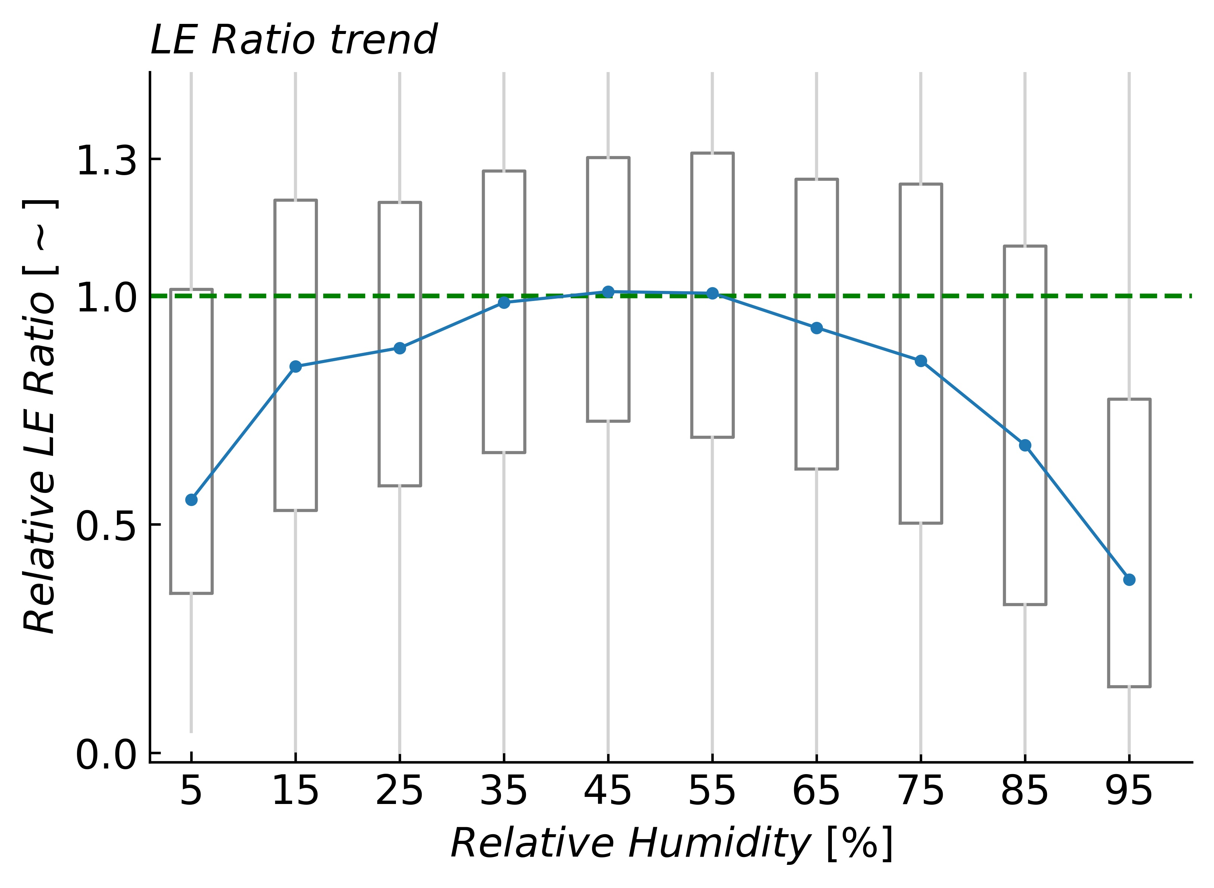


Water fluxes are generally underestimated by eddy covariance systems under high relative humidity conditions. (RH-dependent errors)
41 Closed-Path Sites
@FLUXNET 2015
@Hourly
No RH dependence
$${LER}_{i}=\frac{{LE}_{i}}{{Rn}_{i}−H_{i}−G_{i}}$$
$${Relative LER}_{i}=\frac{{LER}_{i}}{{LER}_{RH∈[50\%,60\%)}}$$
EGU22-8416

Slide 3
Water fluxes are generally underestimated by eddy covariance systems under high relative humidity conditions. (RH-dependent errors)
41 Closed-Path Sites
@FLUXNET 2015
@Hourly
No RH dependence
RH dependence
$${LER}_{i}=\frac{{LE}_{i}}{{Rn}_{i}−H_{i}−G_{i}}$$
$${Relative LER}_{i}=\frac{{LER}_{i}}{{LER}_{RH∈[50\%,60\%)}}$$
LE
underestimation
H underestimation
EGU22-8416

Slide 4
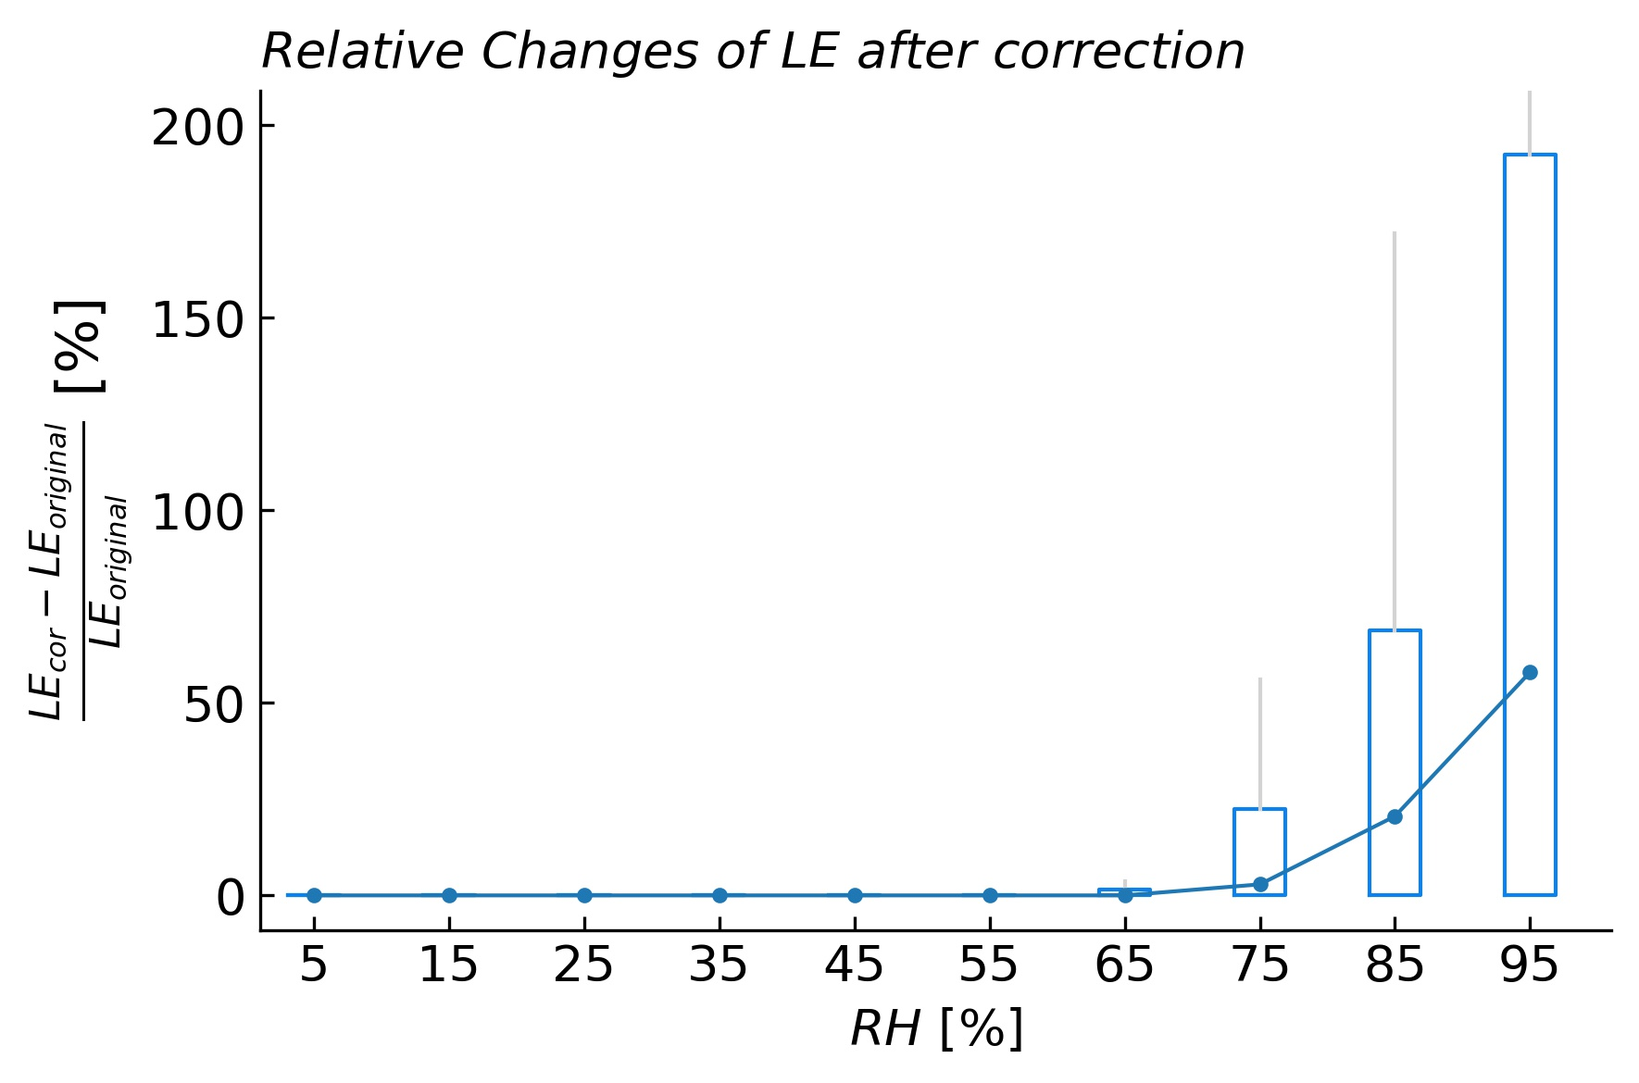
Bowen ratio method does NOT correct for the error (data not shown)
A machine-learning based emperical method to ‘correct’ for the error
@ Hourly
LE is increased by
~58%
at very high RH
EGU22-8416

Slide 5
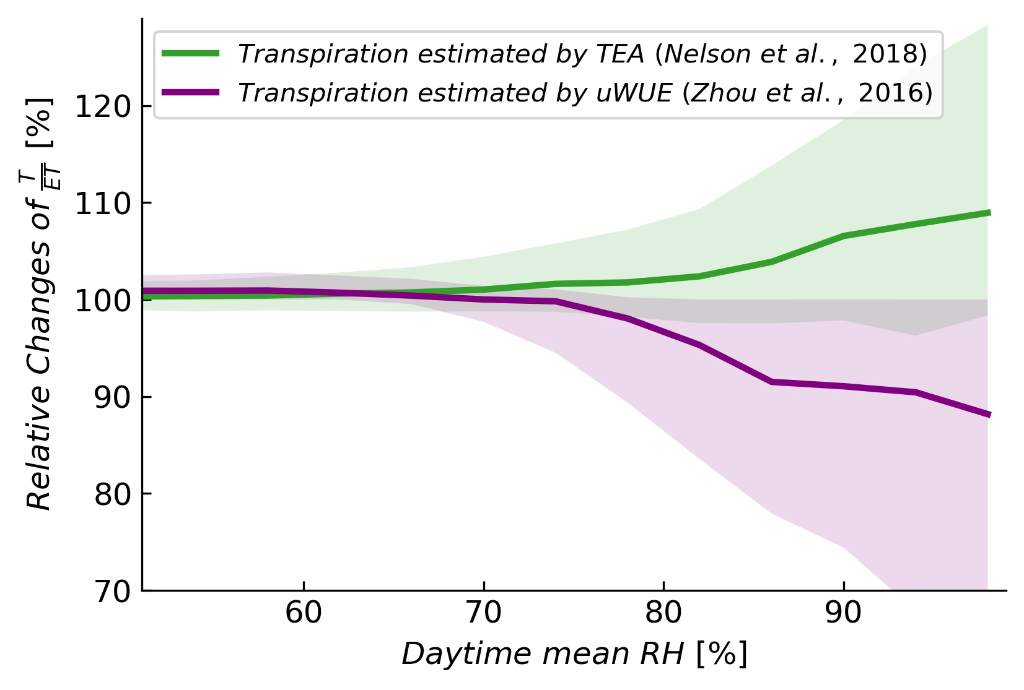
Implication of RH-dependent errors for partitioning ET into transpiration and evaporation.
@ Daily
Increased ET goes to:
TEA: Transpiration
uWUE: Evaporation
EGU22-8416

Slide 6
Summary
The underestimation of hourly LE at high RH (RH > 90%) is pronounced at closed-path sites in the FLUXNET2015 dataset;
Bowen ratio based energy balance closure method likely does NOT correct for these systematic errors (NOT shown in this presentation);
The systematic errors in LE potentially affects T/ET and WUE estimation under high RH (i.e. low VPD) conditions;
Future studies based on energy fluxes should take these effects into consideration because these errors could be also present in future datasets if not correctly addressed with the setup (heating) and processing (spectral corrections).
EGU22-8416

Slide 7




EGU22-8416
THANKS to:
Principal Investigators at the eddy covariance sites
and the FLUXNET comunity:
AmeriFlux
AfriFlux
AsiaFlux
ChinaFlux
ICOS
OzFlux-TERN
......
SAPFLUXNET
Pre-print:
Abstract:
wzhang@bgc-jena.mpg.de

Slide 8
EGU22-8416
THANKS to:
Principal Investigators at the eddy covariance sites
and the FLUXNET comunity:
AmeriFlux
AfriFlux
AsiaFlux
ChinaFlux
ICOS
OzFlux-TERN
......
SAPFLUXNET
Thank You!
Pre-print:
Abstract:
wzhang@bgc-jena.mpg.de

