Slide 1






Effect of warming on β-glucosidase activity and root exudates depends on soil moisture: Combining zymography with glucose imaging and enzyme kinetic
Seyed Sajjad Hosseini^{1,2}, Sayeda Rabia Sultan², Mehdi Rashtbari², Amir Lakzian¹, and Bahar S. Razavi²
¹Department of Soil Science, Faculty of Agriculture, Ferdowsi University of Mashhad, Mashhad, Iran,
²Department of Soil and Plant microbiome, Institute for phytopathology, University of Kiel , Germany
Presenter, Seyed Sajjad Hosseini

Slide 2
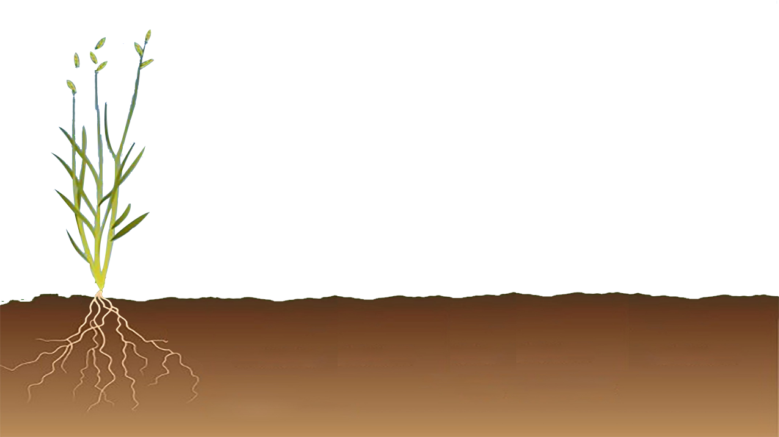

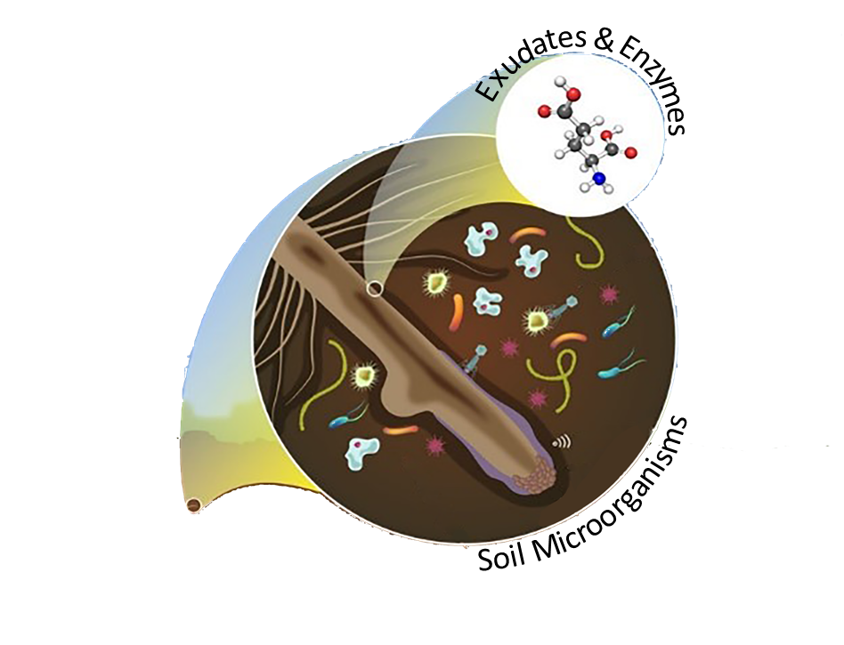
Introduction
Enzyme activity is crucial for the decomposition of soil organic matter (SOM) and nutrient cycling.
β-glucosidase, an enzyme primarily important for carbon cycle, acting in the cleavage of cellobiose into glucose molecules.
Drought & Warming
Warming stimulate root exudation and enzyme activities while drought drop releasing of root exudates and inhibit enzyme activities.
However, how the interaction of warming and drought regulate these processes in the rhizosphere is poorly known.

Slide 3
Objective
To investigate the interaction effects of warming and drought on glucose release from wheat roots, hotspots of β-glucosidase activity, and enzyme kinetic parameters (V_{max} and K_{m})
We grew wheat plants for one month in rhizoboxes under different treatments:
Drought (30% WHC) + 20 ºC
Drought (30% WHC) + 30 ºC
Optimum (70% WHC) + 20 ºC
Optimum (70% WHC) + 30 ºC

Slide 4
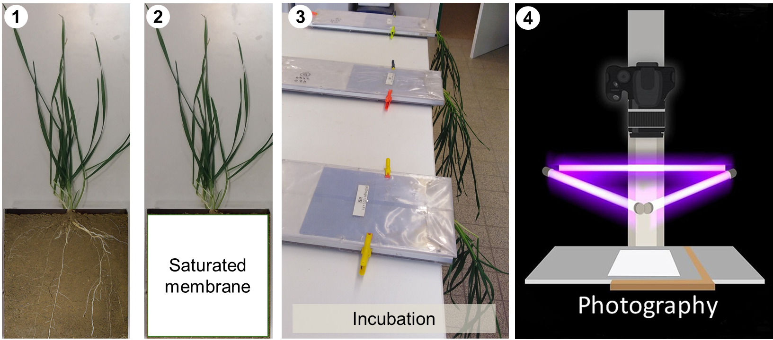
Methods: zymography and glucose imaging (in situ)
Zymography: membrane saturated with 4-MUF- β-D-glucopyranoside and incubated for 2 hours
Glucose imaging: membrane saturated with a reaction mixture (phosphate buffer+ glucose oxidase+ horseradish peroxidase+ Ampliflu red) and incubated for 1 hour

Slide 5
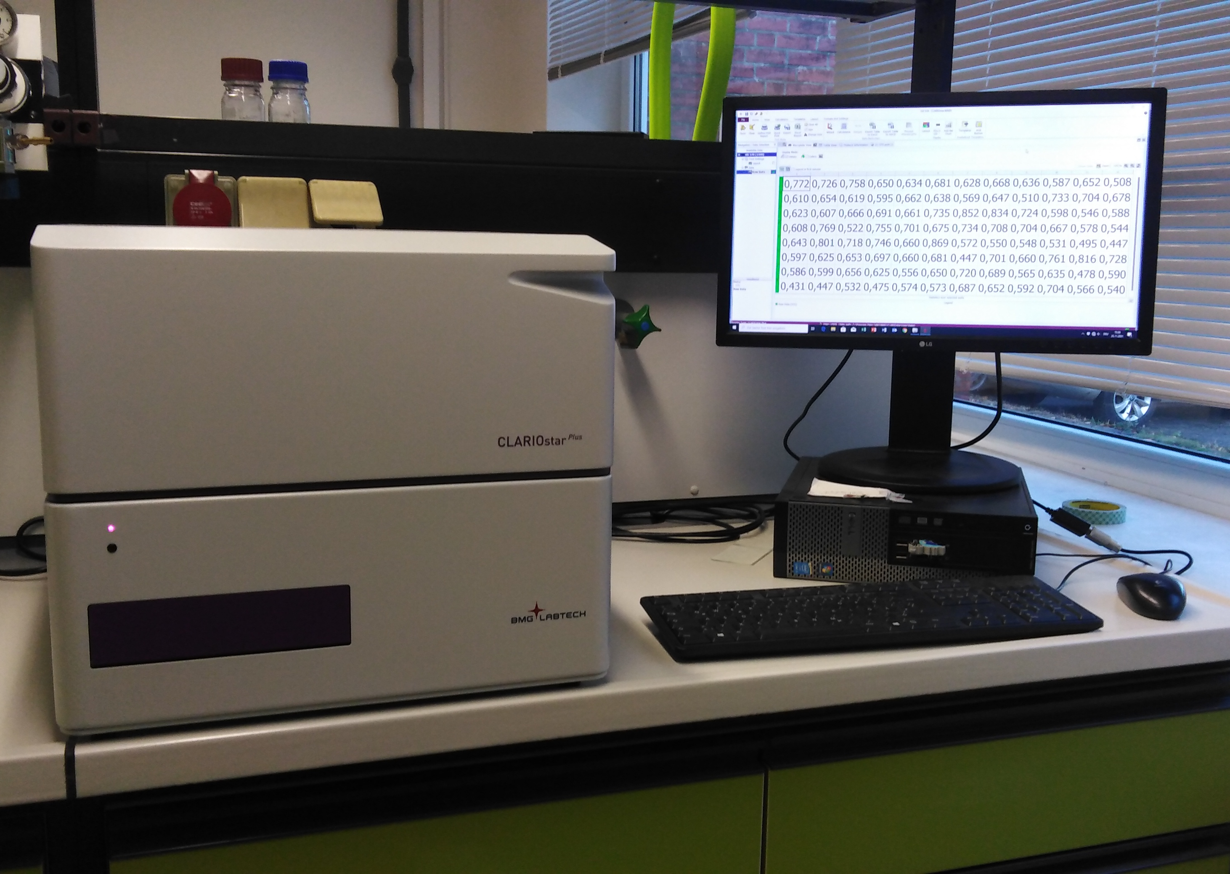
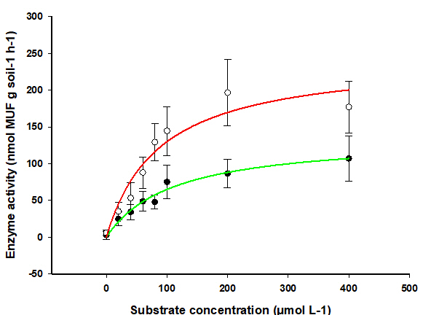
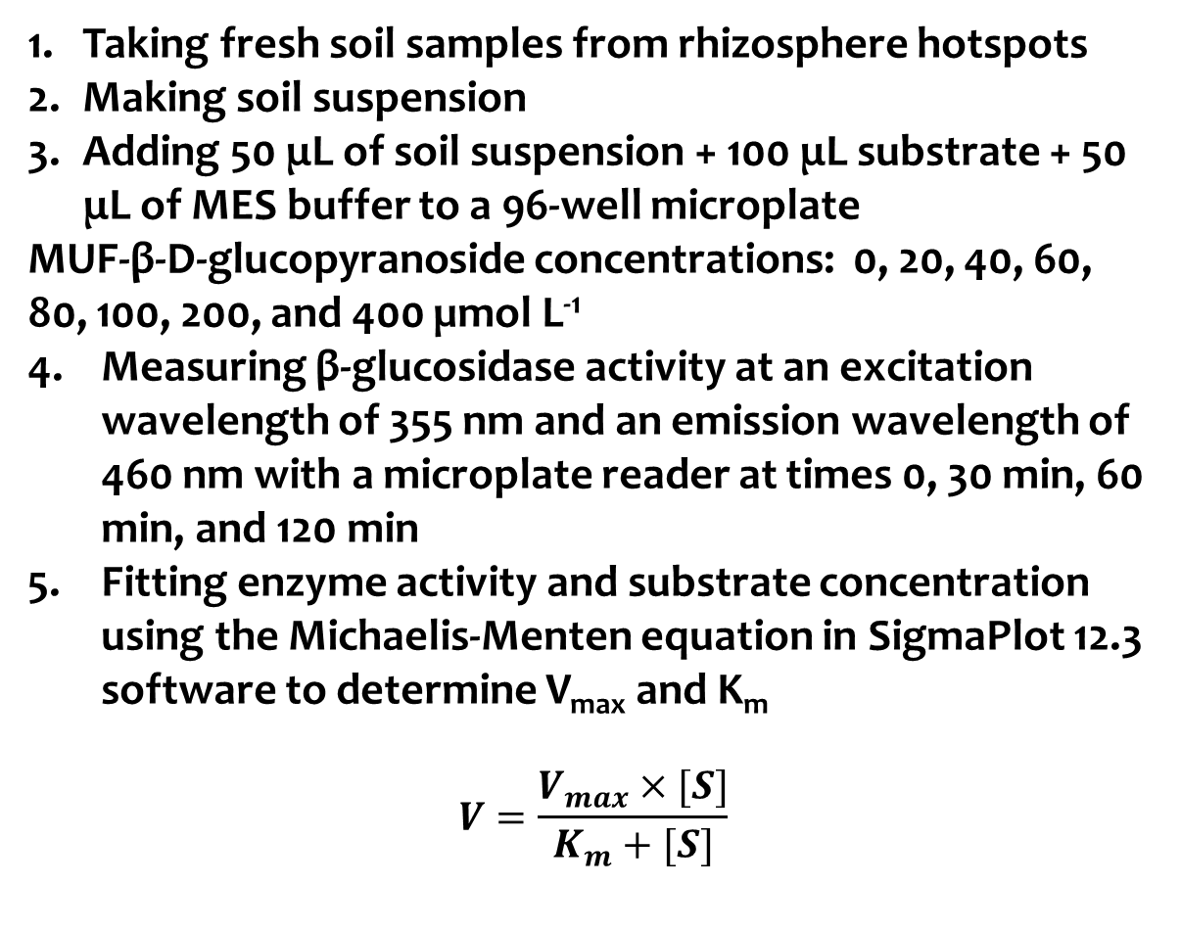
Methods: enzyme kinetic (ex-situ)
Taking fresh soil samples from rhizosphere hotspots
Making soil suspension
Adding 50 μL of soil suspension + 100 μL substrate + 50 μL of MES buffer to a 96-well microplate
MUF-β-D-glucopyranoside concentrations: 0, 20, 40, 60, 80, 100, 200, and 400 µmol L⁻¹
Measuring β-glucosidase activity at an excitation wavelength of 355 nm and an emission wavelength of 460 nm with a microplate reader at times 0, 30 min, 60 min, and 120 min
Fitting enzyme activity and substrate concentration using the Michaelis-Menten equation in SigmaPlot 12.3 software to determine V_{max} and K_{m}
$$V=\frac{V_{max}×[S]}{K_{m}+[S]}$$
CLARIOstar Plus multi-mode microplate reader (BMG LABTECH, Germany)

Slide 6
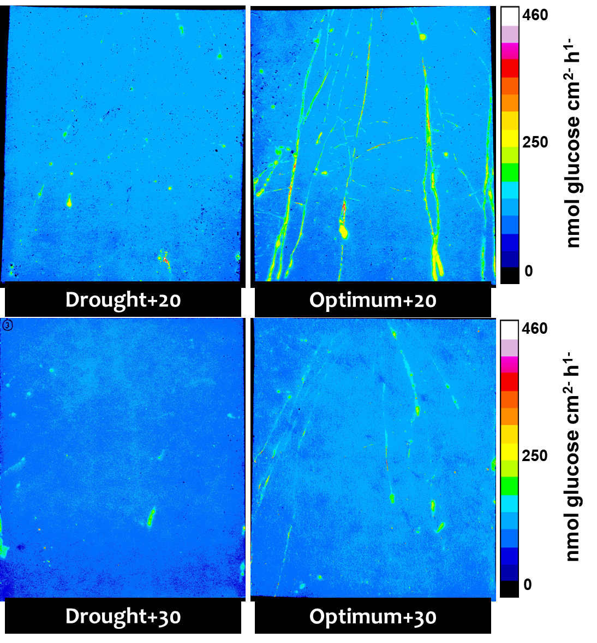
Result: hotspot percentage of glucose release
-57%
Warming decreased hotspot of glucose release in optimum condition while did not change it in drought condition.

Slide 7
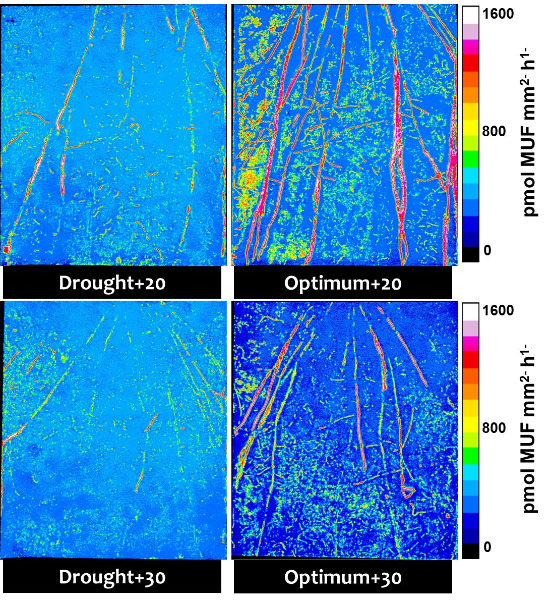
Result: hotspot percentage of β-glucosidase
-28%
Warming decreased hotspot of β-glucosidase in optimum condition while did not change it in drought condition.

Slide 8
Result: V_{max} and K_{m} of β-glucosidase
Warming increased V_{max} of β-glucosidase in optimum condition while decreased it in drought condition.
Warming decreased K_{m} of β-glucosidase in drought conditions while did not change it in optimum condition.

Slide 9
Highlights
Same pattern was observed for hotspots of β-glucosidase and glucose release which confirms low molecular weight organic carbon and enzymes jointly release from wheat roots.
Drought decreased hotspots of β-glucosidase and glucose release in both temperature.
Effects of warming on hotspots of β-glucosidase, glucose release and enzyme kinetic parameters depended on soil moisture condition:
Warming decreased hotspots of β-glucosidase and glucose release in optimum condition while did not change them in drought condition.
Warming in optimum condition (high labile carbon availability) increased enzyme production and did not change the affinity of enzyme for substrates. While warming in drought condition (low labile carbon availability) produced an enzyme pool with high affinity to substrate and decreased enzyme production.

Slide 10
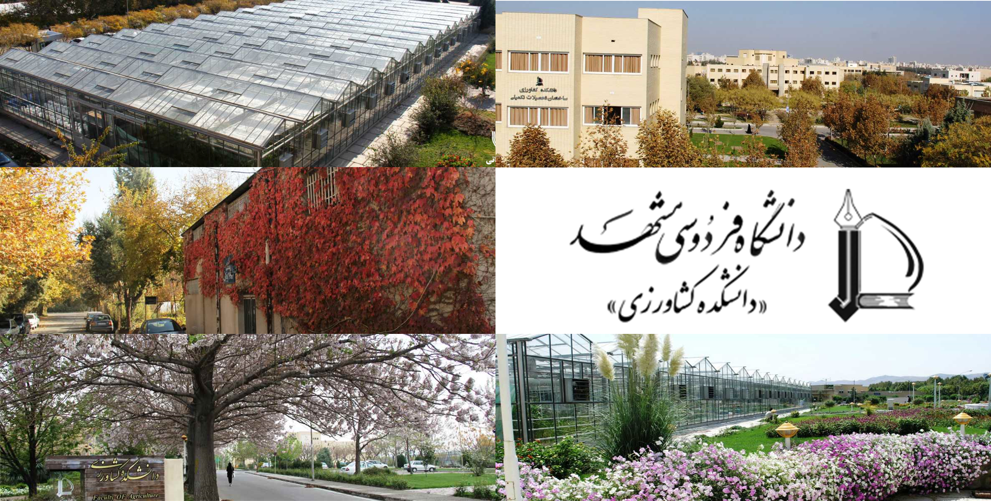
Thanks for your kind attention
Faculuty of Agriculture, Ferdowsi University of Mashhad, Mashhad, Iran

