Slide 1


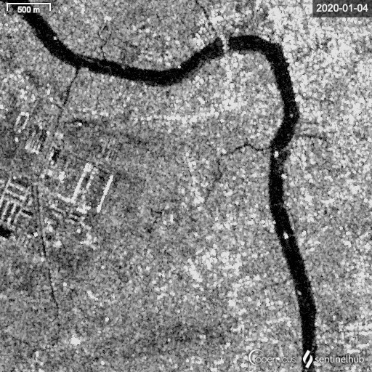
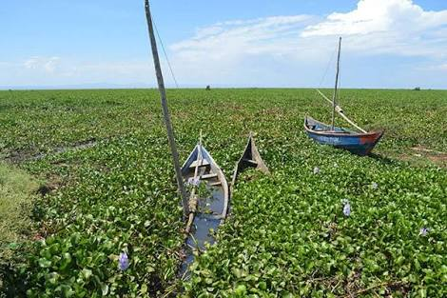



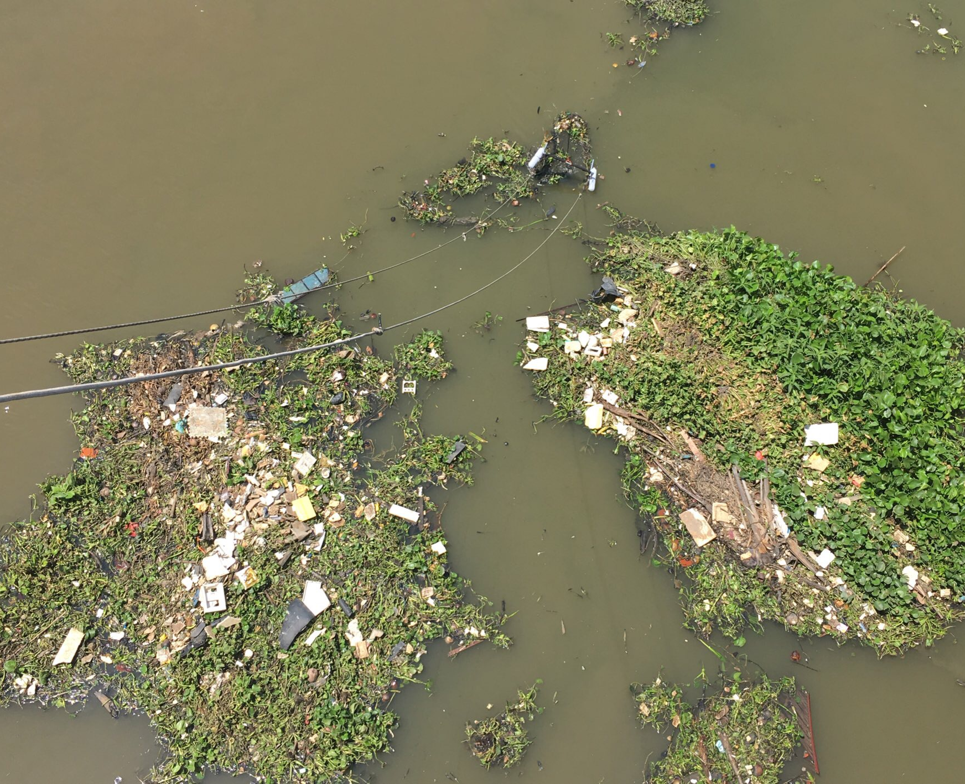
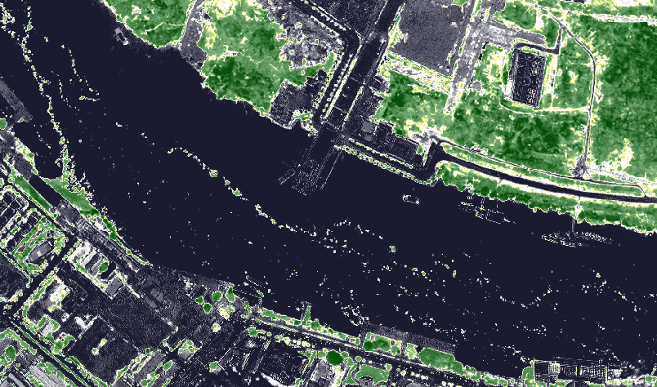
Stuck in vegetation: the role of hyacinths in macroplastic debris accumulation in tropical rivers
Louise Schreyers, Thanh-Khiet Bui, Tim van Emmerik, Lauren Biermann, and Martine van der Ploeg
24 May 2022
Reach out at:
Email: louise.schreyers@wur.nl
Twitter: @LouiseSchreyers

Slide 2


Main take-away messages
1. Water hyacinth accumulate and carry the majority of macroplastic items in the Saigon river, Vietnam
~ 60% of plastic are transported within hyacinths
2. Proof-of-concept to estimate plastic density at river surface by using hyacinth coverage as a proxy
Combining satellite and field-based observations
3. Next steps: spatial and temporal variability in plastic densities
How to account for spatiotemporal variability in plastic densities in hyacinths?

Slide 3
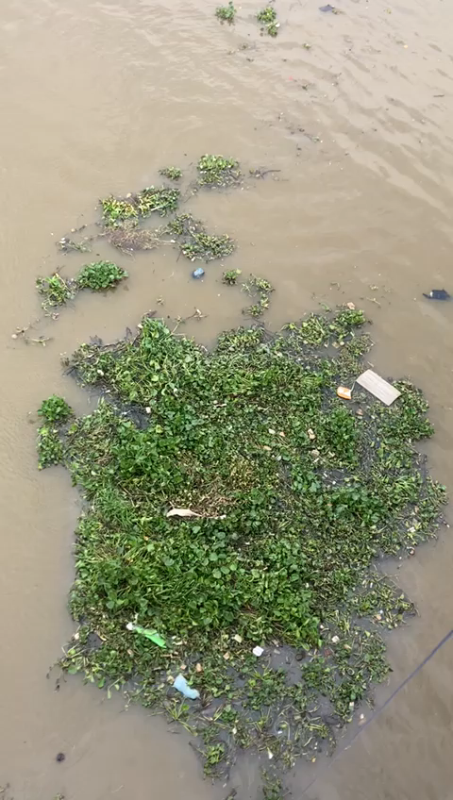
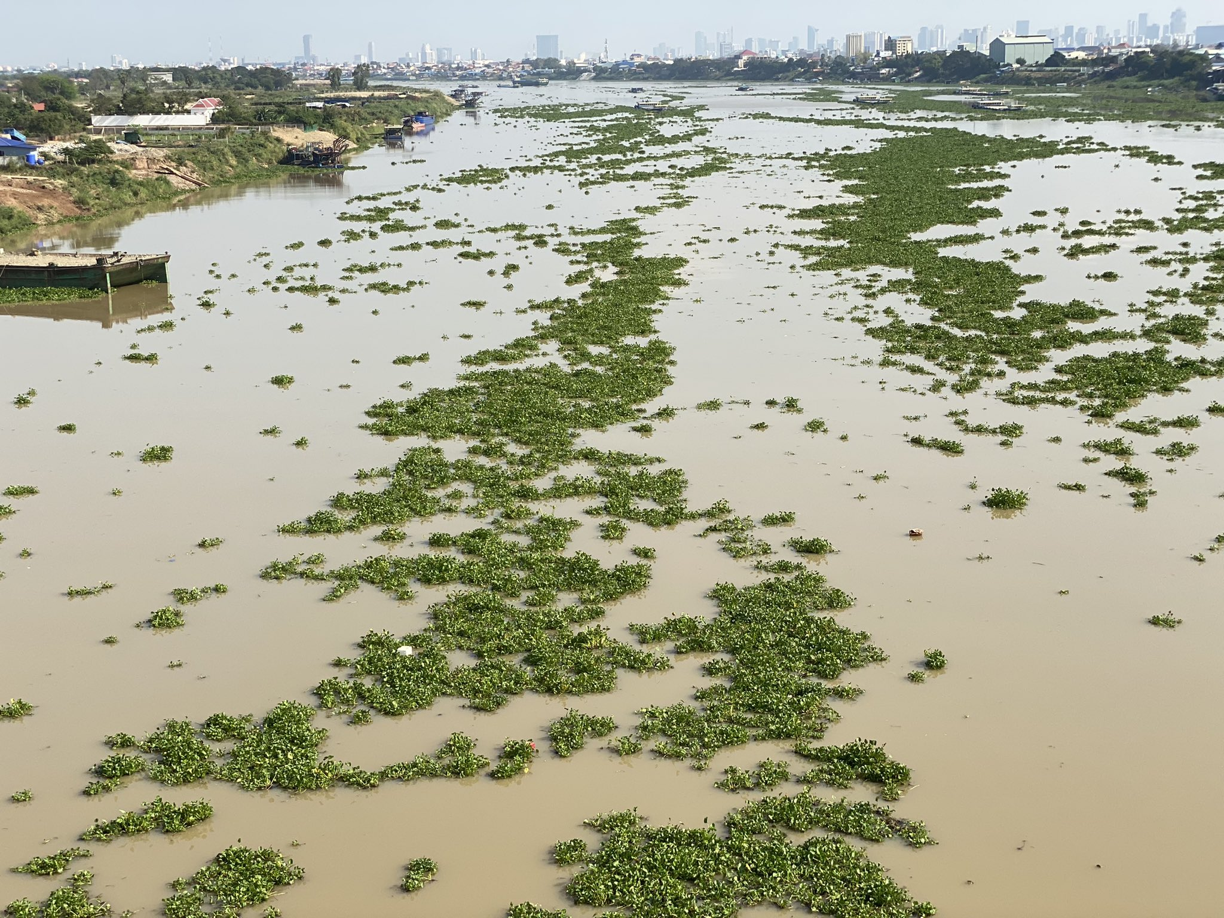
Hyacinths as a proxy for floating macroplastic densities in rivers
Floating patches of water hyacinths cover large portions of the Saigon river and other rivers
Patches accumulate debris including macroplastic items
They drift and move at the water surface: pathway for plastic transport
Their presence is linked to poor water quality levels (eutrophication). They can grow very quickly (double size in a few days)
The link between their coverage in rivers and hydrological cycle is unclear
Hyacinth invasion are common in most tropical freshwater systems

Slide 4
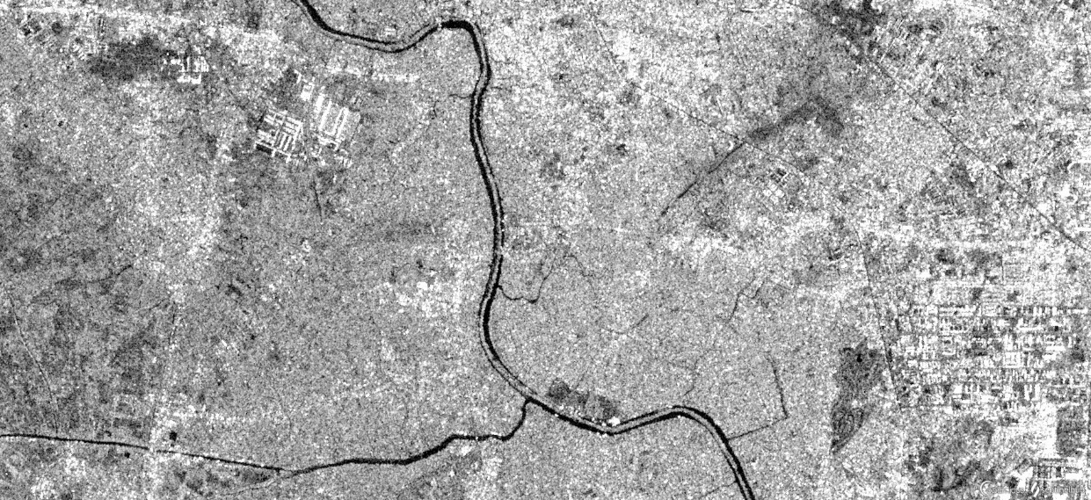
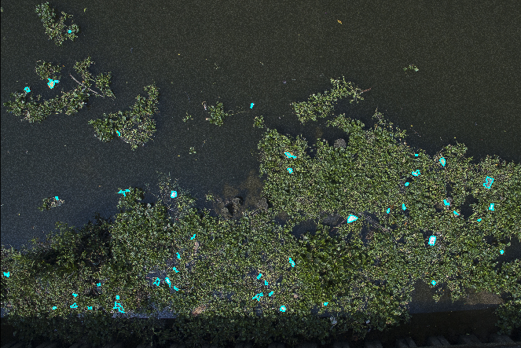

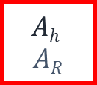
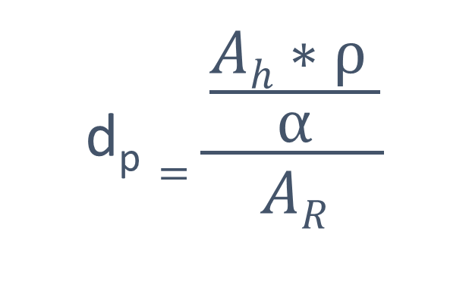
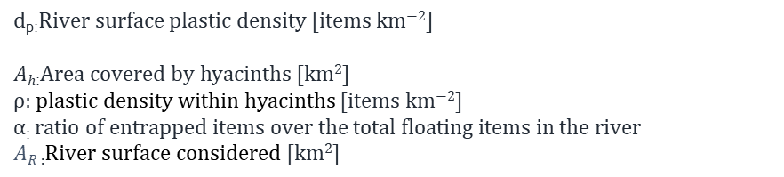
Indirect sensing of floating plastic in rivers
Satellite remote sensing
$$\text{d}\text{p}=\frac{\frac{Ah∗ρ }{α}}{AR}$$
Water hyacinths
$$Ah$$
$$AR$$
$$\text{ρ}$$
$$α$$
$$d\text{p}\text{:}\text{River} \text{surface} \text{plastic} \text{density}\text{ [}\text{items} \text{km}\text{−2}\text{]}$$
$$Ah\text{:}\text{Area} \text{covered} \text{by} \text{hyacinths}\text{ [}\text{km}\text{2}\text{]}$$
ρ: plastic density within hyacinths $\text{[}\text{items} \text{km}\text{−2}\text{]}$
$α\text{: }\text{ratio} \text{of} \text{entrapped} \text{items} \text{over} \text{the}$total floating items in the river
$AR$ $\text{:}\text{R}\text{iver} \text{surface} \text{considered} \text{[}\text{km}\text{2}\text{]}$
UAV imagery and other field-based methods
Combining large-scale detection of hyacinth with field-based estimates of plastic density within hyacinths

Slide 5

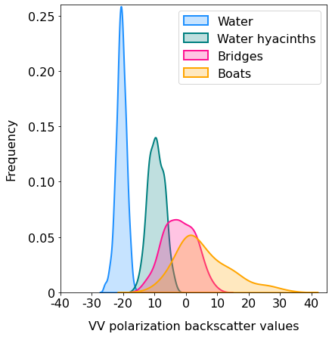
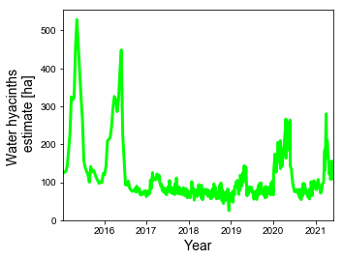


Detection of hyacinth coverage with freely available satellite images
1. Algorithm/mask detection
2. Coverage estimates
$$\text{d}\text{p}=\frac{\frac{Ah∗ρ }{α}}{AR}$$
Use of both Sentinel-1 and 2 satellite missions
Freely accessible images
Combined, high revisit time (approximately 4 days)
Spatial resolution can reach 10 meter
Swath widths of 250-290 km: enable to cover entire river systems
Long-term archives: from 2015 onwards
$$d\text{p}\text{:}\text{River} \text{surface} \text{plastic} \text{density}\text{ [}\text{items} \text{km}\text{−2}\text{]}$$
$$Ah\text{:}\text{Area} \text{covered} \text{by} \text{hyacinths}\text{ [}\text{km}\text{2}\text{]}$$
ρ: plastic density within hyacinths $\text{[}\text{items} \text{km}\text{−2}\text{]}$
$α\text{: }\text{ratio} \text{of} \text{entrapped} \text{items} \text{over} \text{the}$total floating items in the river
$AR$ $\text{:}\text{R}\text{iver} \text{surface} \text{considered} \text{[}\text{km}\text{2}\text{]}$

Slide 6
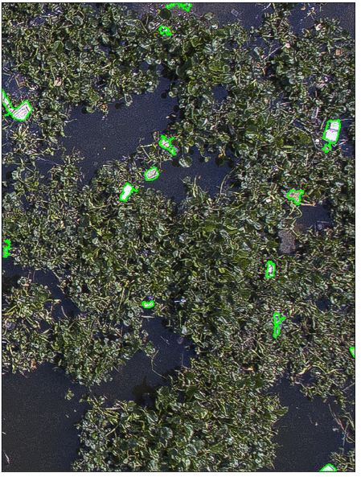

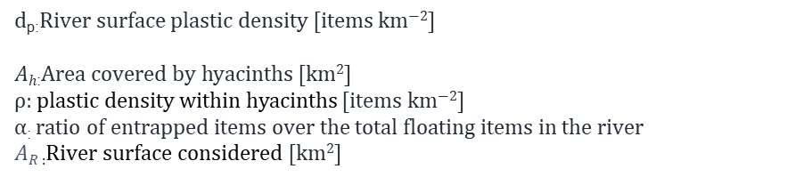
Plastic density estimates using UAV images
Use of UAV images is an effective method to detect floating macroplastic
Use of pixel-based approach with RGB images is easy to implement but difficult to generalize
Works well if most floating macroplastic are of a distinct colour
Challenges: glint (false positives), full automation
Monitoring is time-consuming and only covers a small portion of the river
Object-detection with ML requires large amounts of manually labelled training data
$$d\text{p}\text{:}\text{River} \text{surface} \text{plastic} \text{density}\text{ [}\text{items} \text{km}\text{−2}\text{]}$$
$$Ah\text{:}\text{Area} \text{covered} \text{by} \text{hyacinths}\text{ [}\text{km}\text{2}\text{]}$$
ρ: plastic density within hyacinths $\text{[}\text{items} \text{km}\text{−2}\text{]}$
$α\text{: }\text{ratio} \text{of} \text{entrapped} \text{items} \text{over} \text{the}$total floating items in the river
$AR$ $\text{:}\text{R}\text{iver} \text{surface} \text{considered} \text{[}\text{km}\text{2}\text{]}$
$$\text{d}\text{p}=\frac{\frac{Ah∗ρ }{α}}{AR}$$

Slide 7
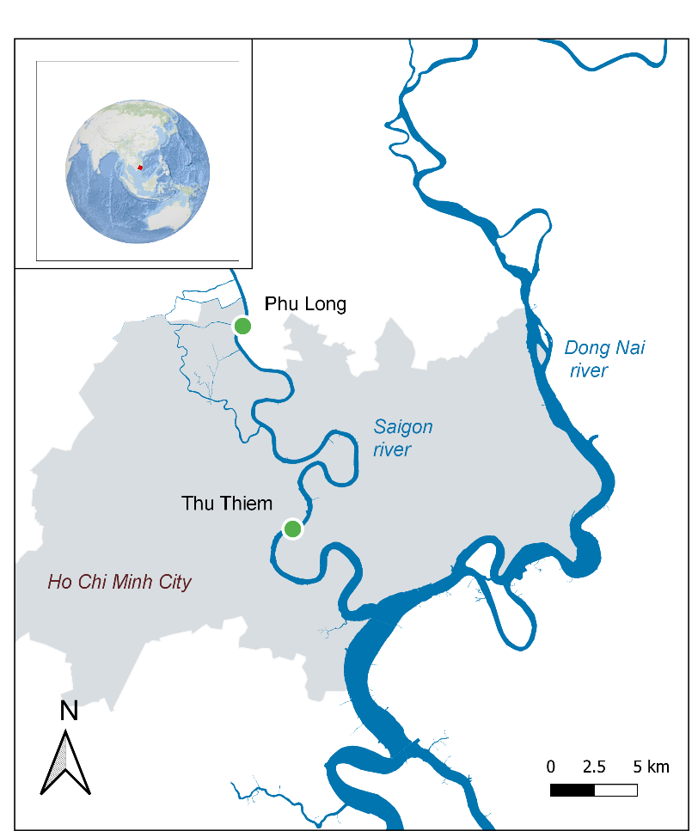
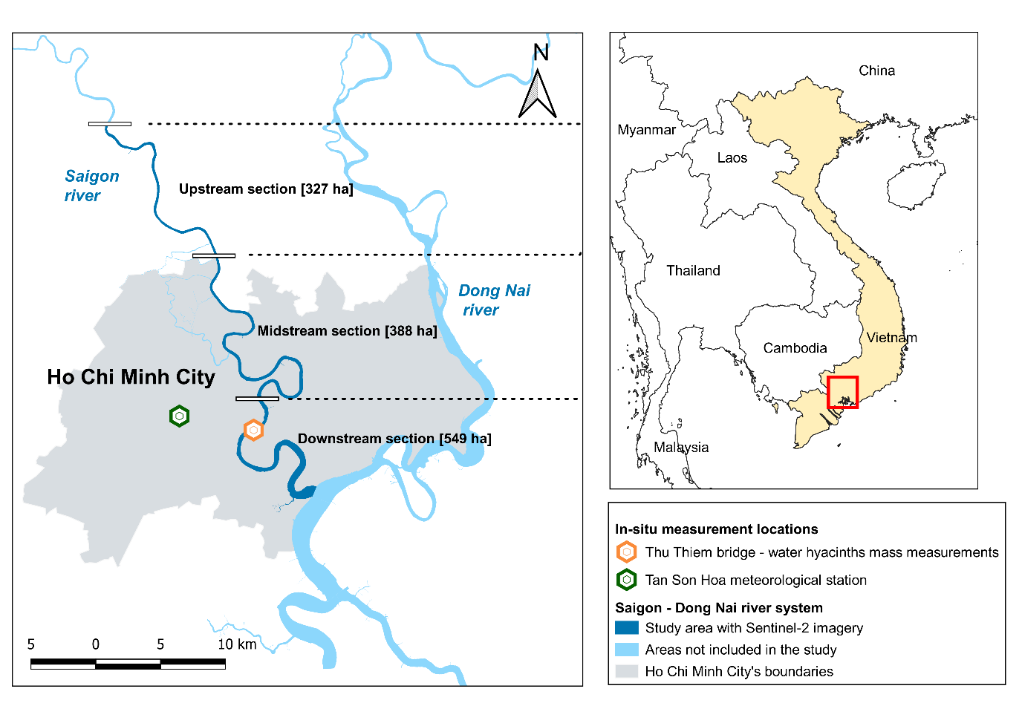




Next steps
Spatial variability in plastic densities within hyacinths (ρ)
ρ_{l1} : 1.9 x 10⁵ $\text{[}\text{items} \text{km}\text{−2}\text{]}$
ρ_{l2 :} 2.1 x 10⁶ $\text{[}\text{items} \text{km}\text{−2}\text{]}$
Temporal variability in in plastic densities within hyacinths (ρ)
l1: upstream site
l2: downstream site
ρ_{min}: 1.1 x 10⁴ $\text{[}\text{items} \text{km}\text{−2}\text{]}$
ρ_{max}: 4.3 x 10⁵ $\text{[}\text{items} \text{km}\text{−2}\text{]}$

Slide 8
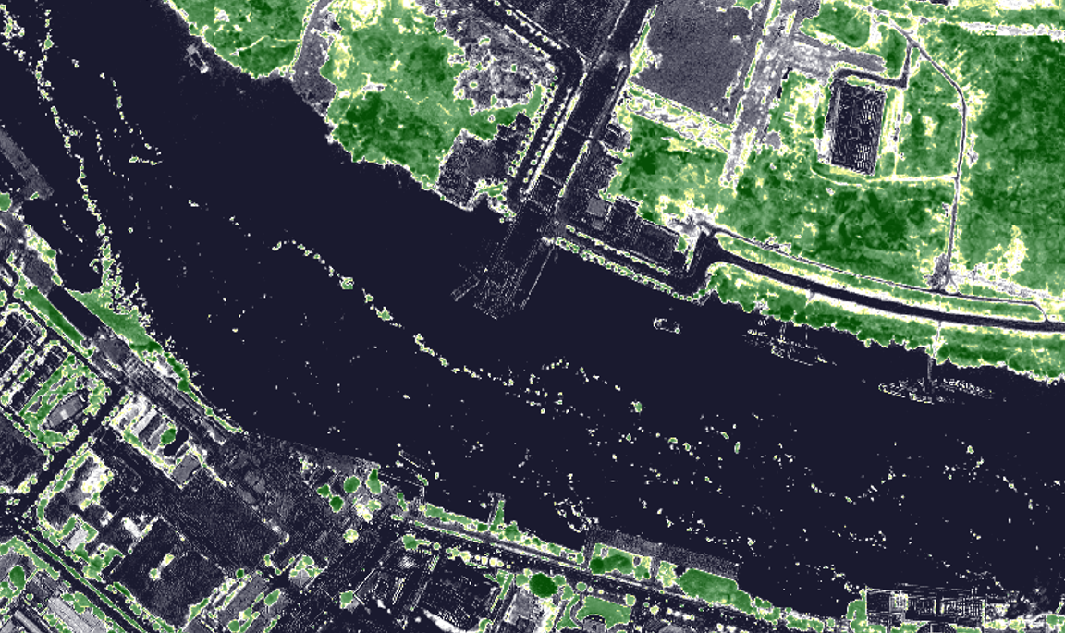
Thank you!
Reach out at:
Email: louise.schreyers@wur.nl
Twitter: @LouiseSchreyers

