Slide 1
Machine learning-derived predictions of river flow across Switzerland
Etienne Fluet-Chouinard¹, Postdoctoral researcher
William Aeberhard², Eniko Szekely², Massimiliano Zappa³, Sonia I. Seneviratne¹, Lukas Gudmundsson¹
¹ ETH Zurich, ² Swiss Data Science Center, ³ Swiss Federal Institute for Forest, Snow and Landscape Research (WSL)

Slide 2
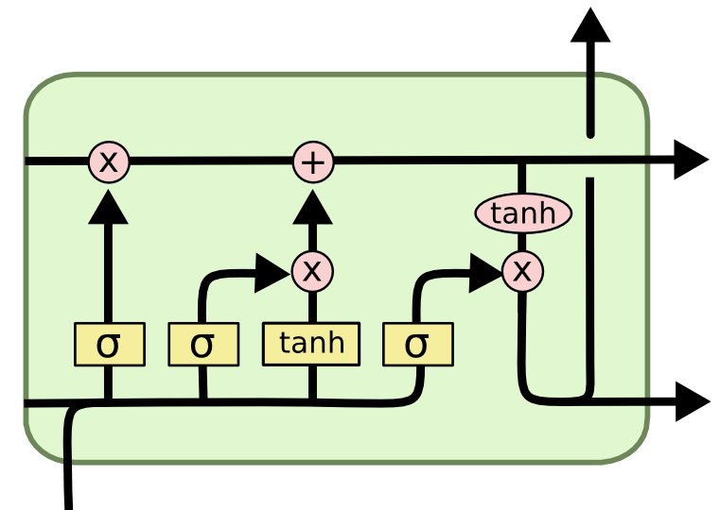
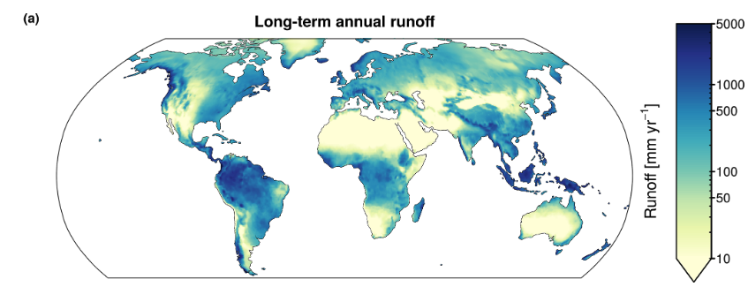
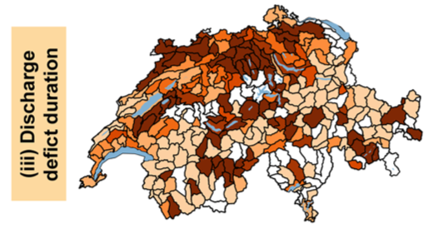
Background
Global data-driven runoff predictions at coarse scales
(G-RUN; Ghiggi et al. 2019)
Growing application of LSTM for rainfall-runoff prediction on CAMELS databases
(e.g. Kratzert et al. 2018)
Management need for drought monitoring & warning across Switzerland
(Brunner et al. 2019)

Slide 3
Objectives:
Develop machine learning model predicting daily runoff (mm/day) trained on ~260 river gauges in Switzerland over 1980-2020
Generalize predictions at new locations in space
  Single model over all gauges, or regional models (ex. glacial vs lowland models)
Compare learning and extrapolation performance of difference model architectures
Benchmark against process-based model of WSL federal agency, particularly for drought monitoring
Notes:
, including graph methods leveraging spatio-temporal information

Slide 4
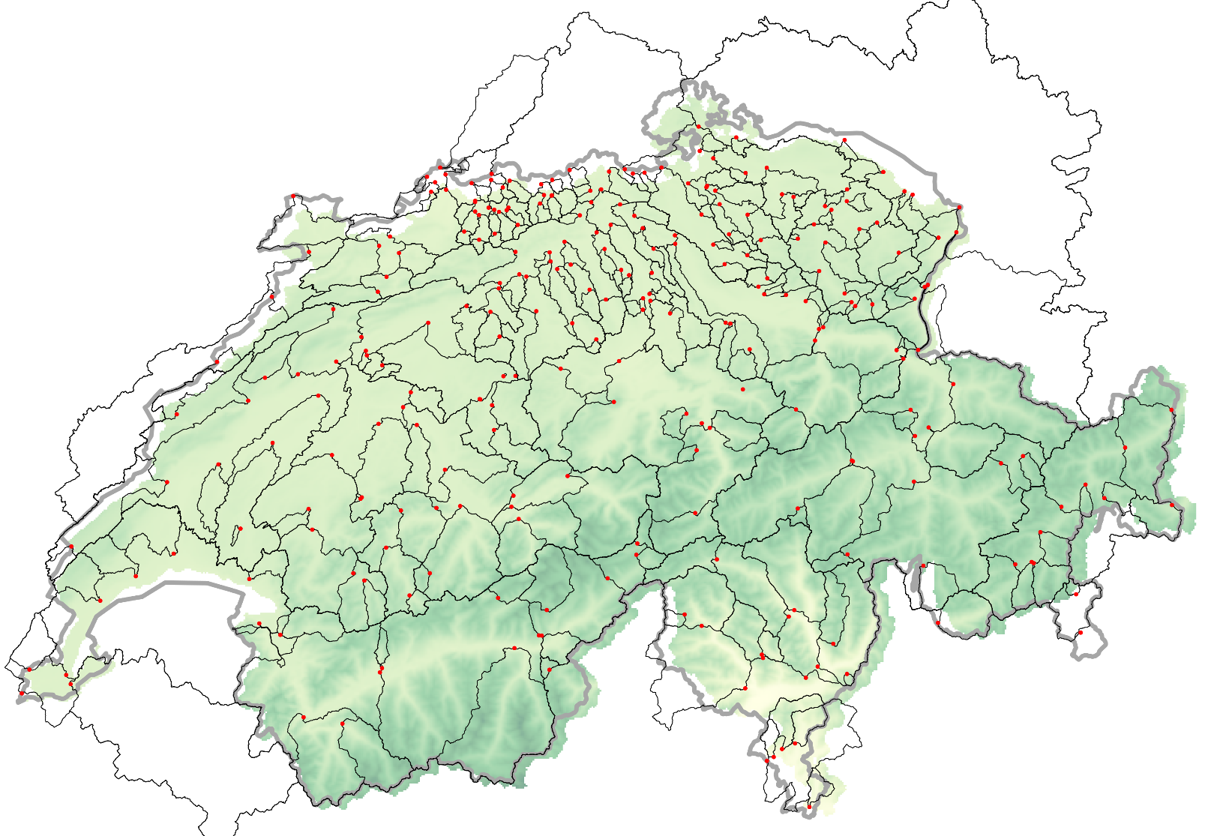
Data
No CAMELS database exists for Switzerland yet! (but soon! see CAMEL-CH EGU22-9859 presentation by Marvin Hoge)
Streamflow gauge database:
262 gauge locations (federal & canton level)
3.5 million daily measurements between 1980-2020
Headwater and large flow-through rivers
Daily predictors:
Precipitation
Min. temperature (°C)
Max. temperature (°C)
Total radiation (W m⁻²)
Sunshine duration
Water pressure (hPa)
Snowpack storage (mm)
Static predictors:
Slope
Soil depth (m)
Soil hydraulic conductivity (m s⁻¹)
Available field capacity (%)
Sorted land use
Lead windows (52 per predictor variables):
Daily average for 30 previous days
Weekly average for 5 to 20 previous weeks
Monthly average for 7 to 12 previous months
Gauge locations and basin outlines

Slide 5
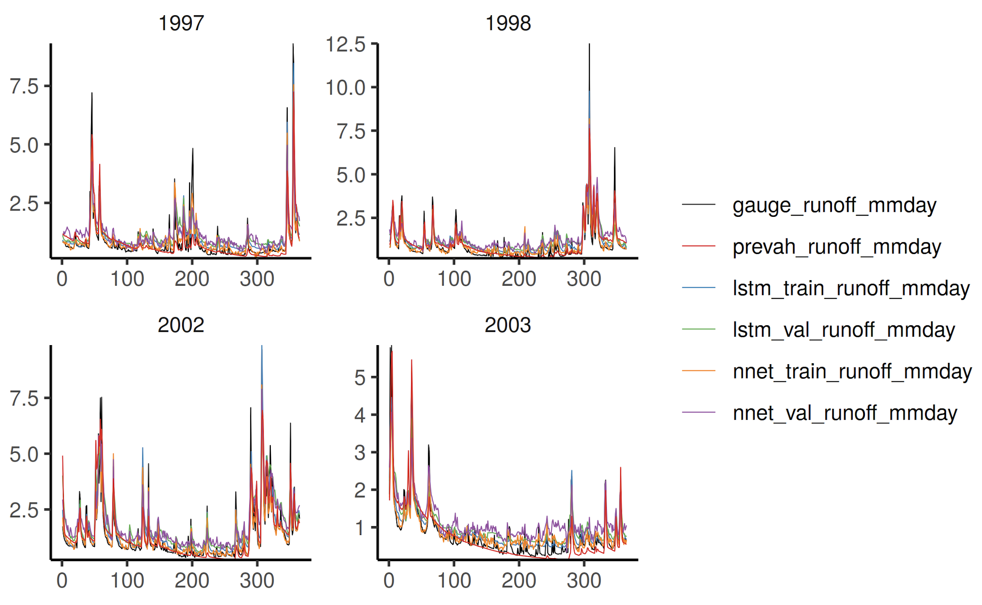
Methods & Experiments
 | Model structure | Split type | Train/val | Hyperparameters
1a | NNet | Time split | Train: < 2000-01-01 Test: > 2000-01-01 | N_{gauge}=30 Units=512 Layers=2 Dropout=0.2 (L2) Epochs=100
1b | LSTM | Time split | Train: < 2000-01-01 Test: > 2000-01-01 | N_{gauge}=30 Units=512 Layers=2 Dropout=0.2 (L2) Epochs=100
2a | NNet | Gauge split | Leave-gauge out (k=5) | N_{gauge}=30 Units=512 Layers=2 Dropout=0.2 (L2) Epochs=100
2b | LSTM | Gauge split | Leave-gauge out (k=5) | N_{gauge}=30 Units=512 Layers=2 Dropout=0.2 (L2) Epochs=100
Notes:
Subset of
Subset of 40 gauge stations
Models:
Neural Net
LSTM
CNN
Graph Conv Network
Trained across all stations (no pretraining)
Gauge cross-validation:
k=10 cross validation
Exclude entire stations

Slide 6
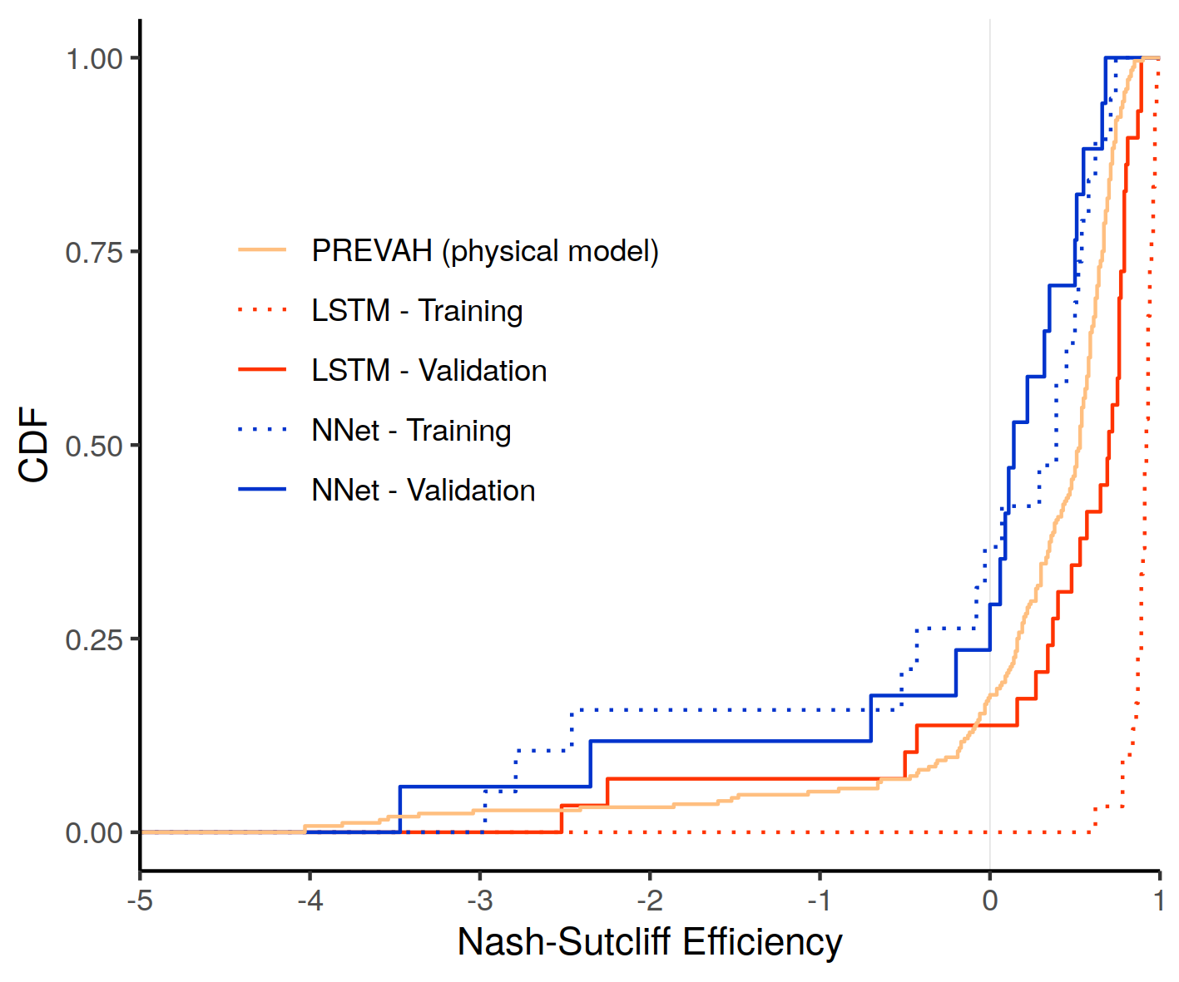
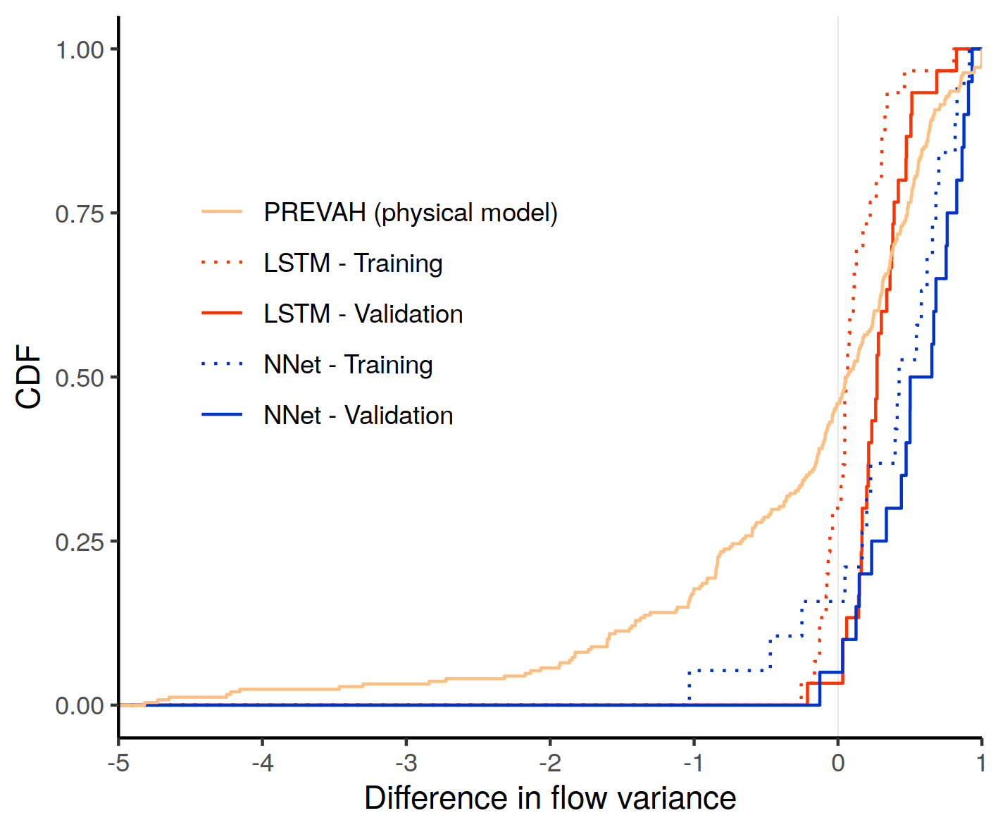
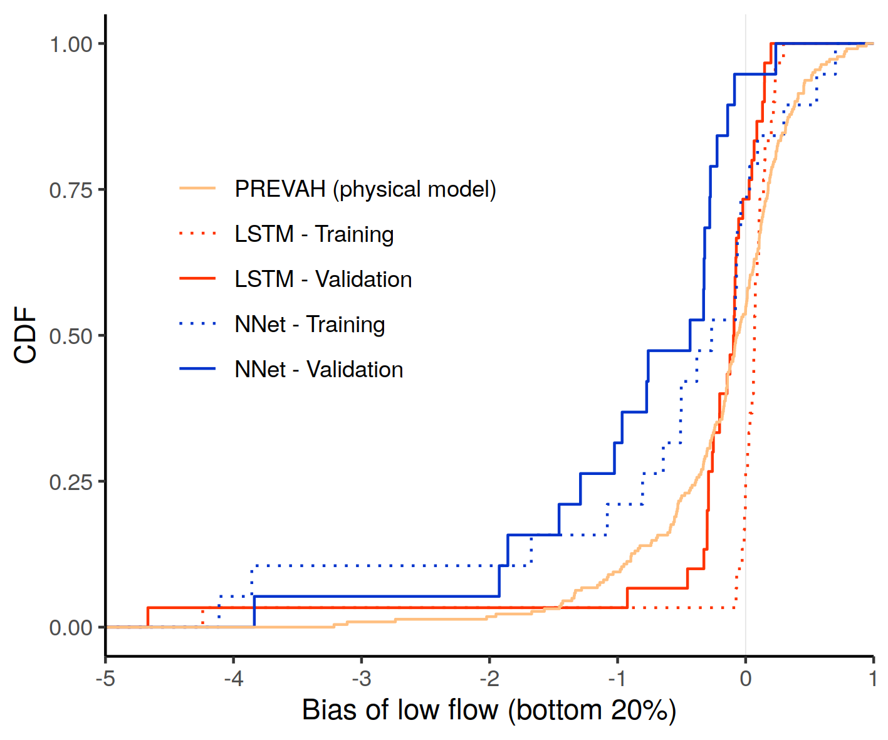
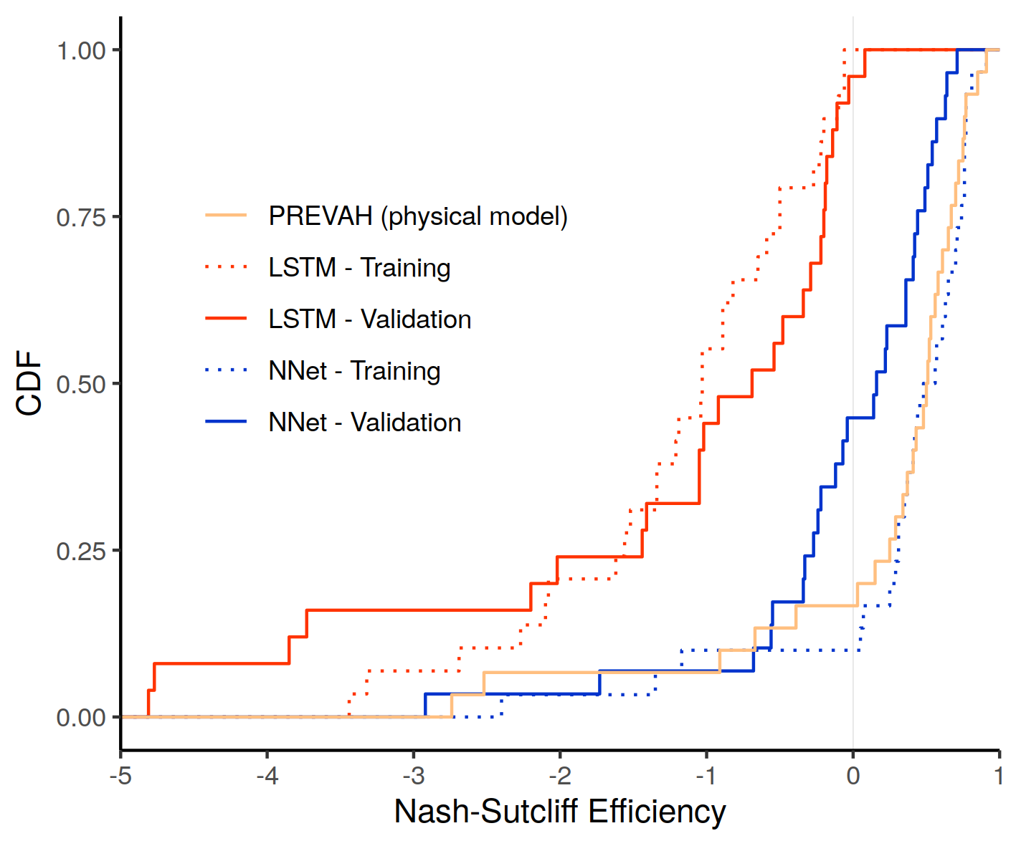
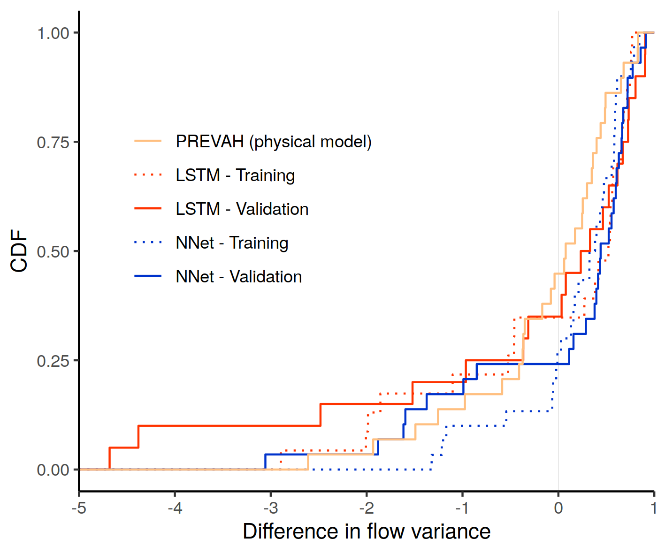
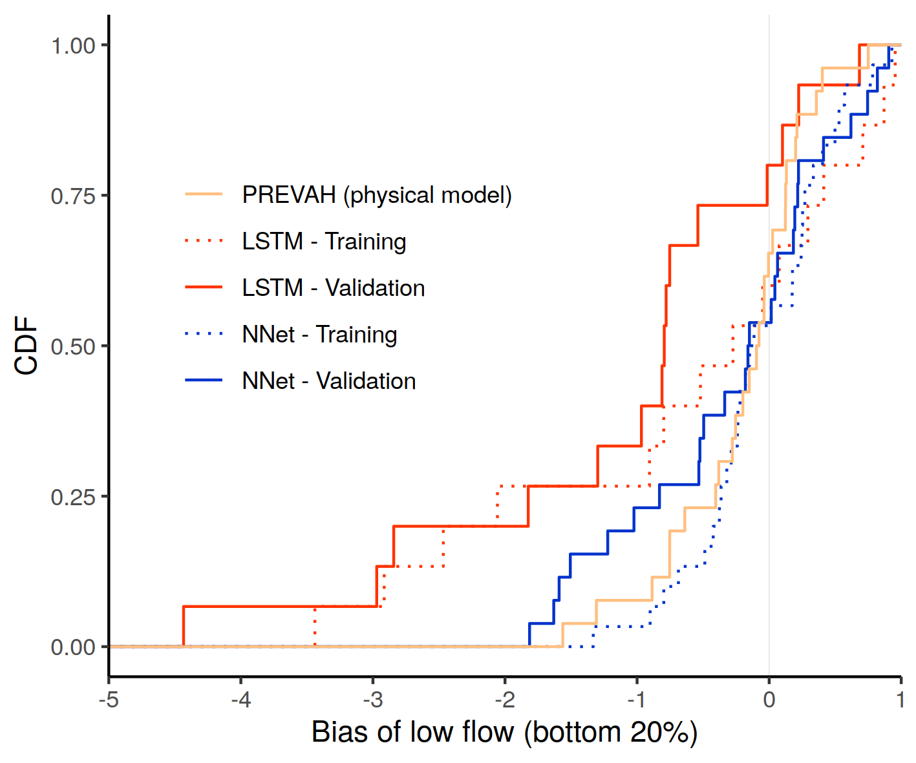
Methods & Experiments (n_{gauges}=30)
Time split
Gauge split

Slide 7
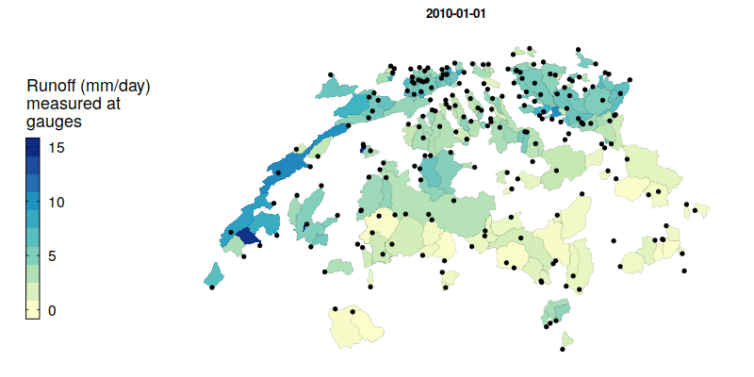
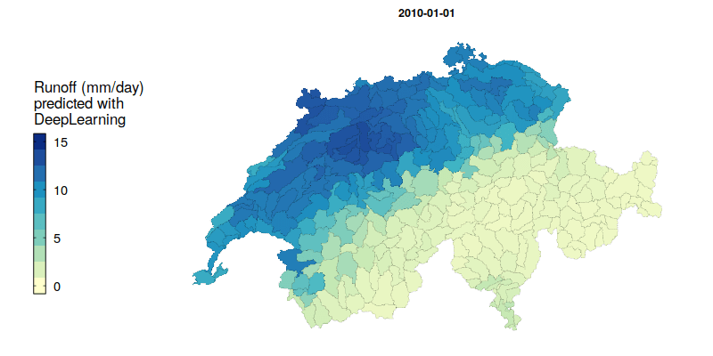
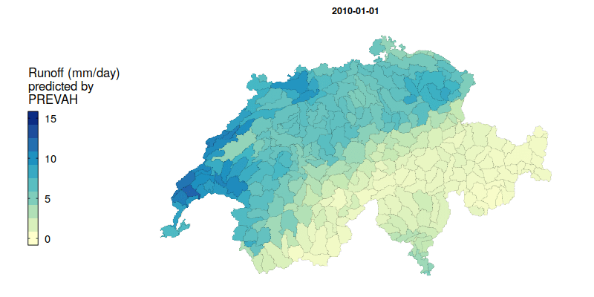
Extrapolation demonstration across 307 management units

Slide 8
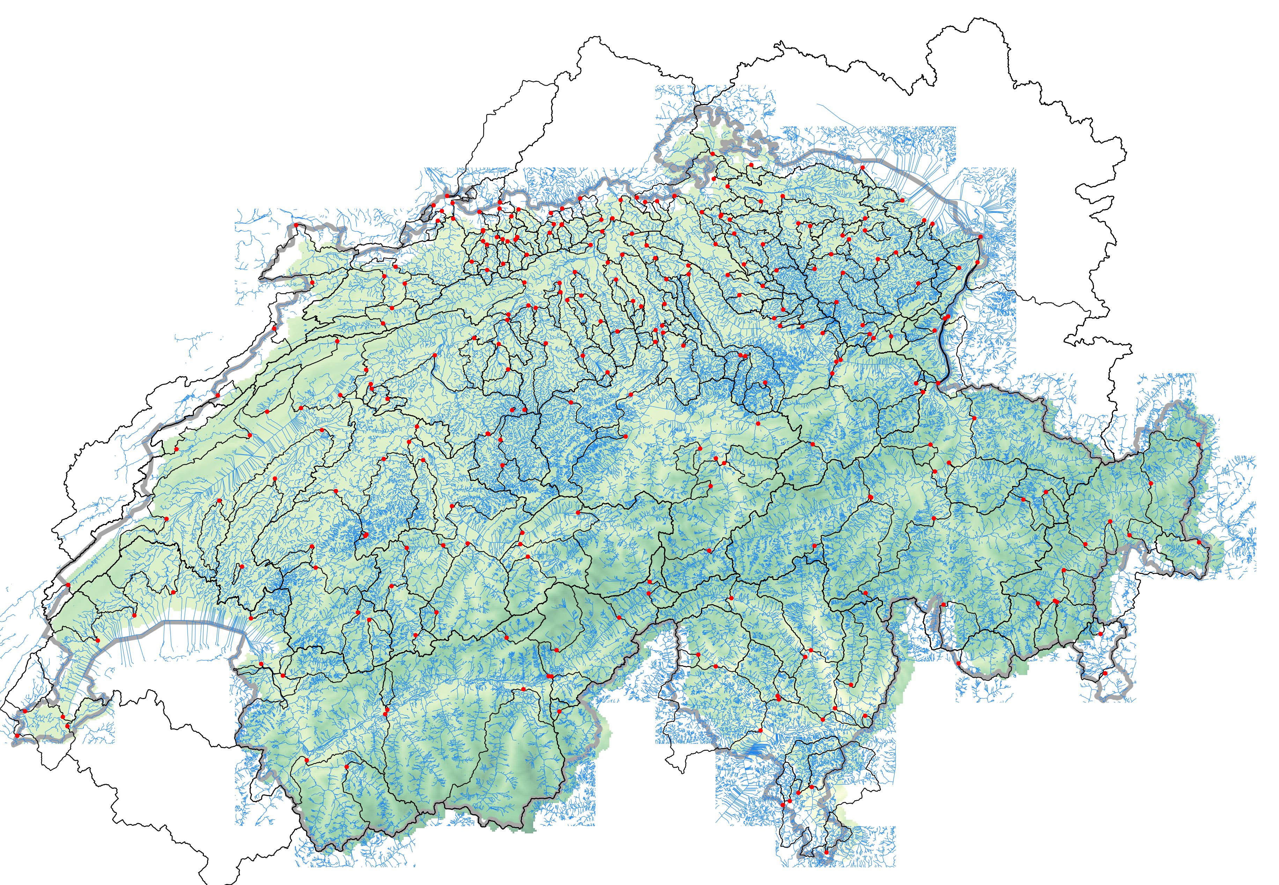
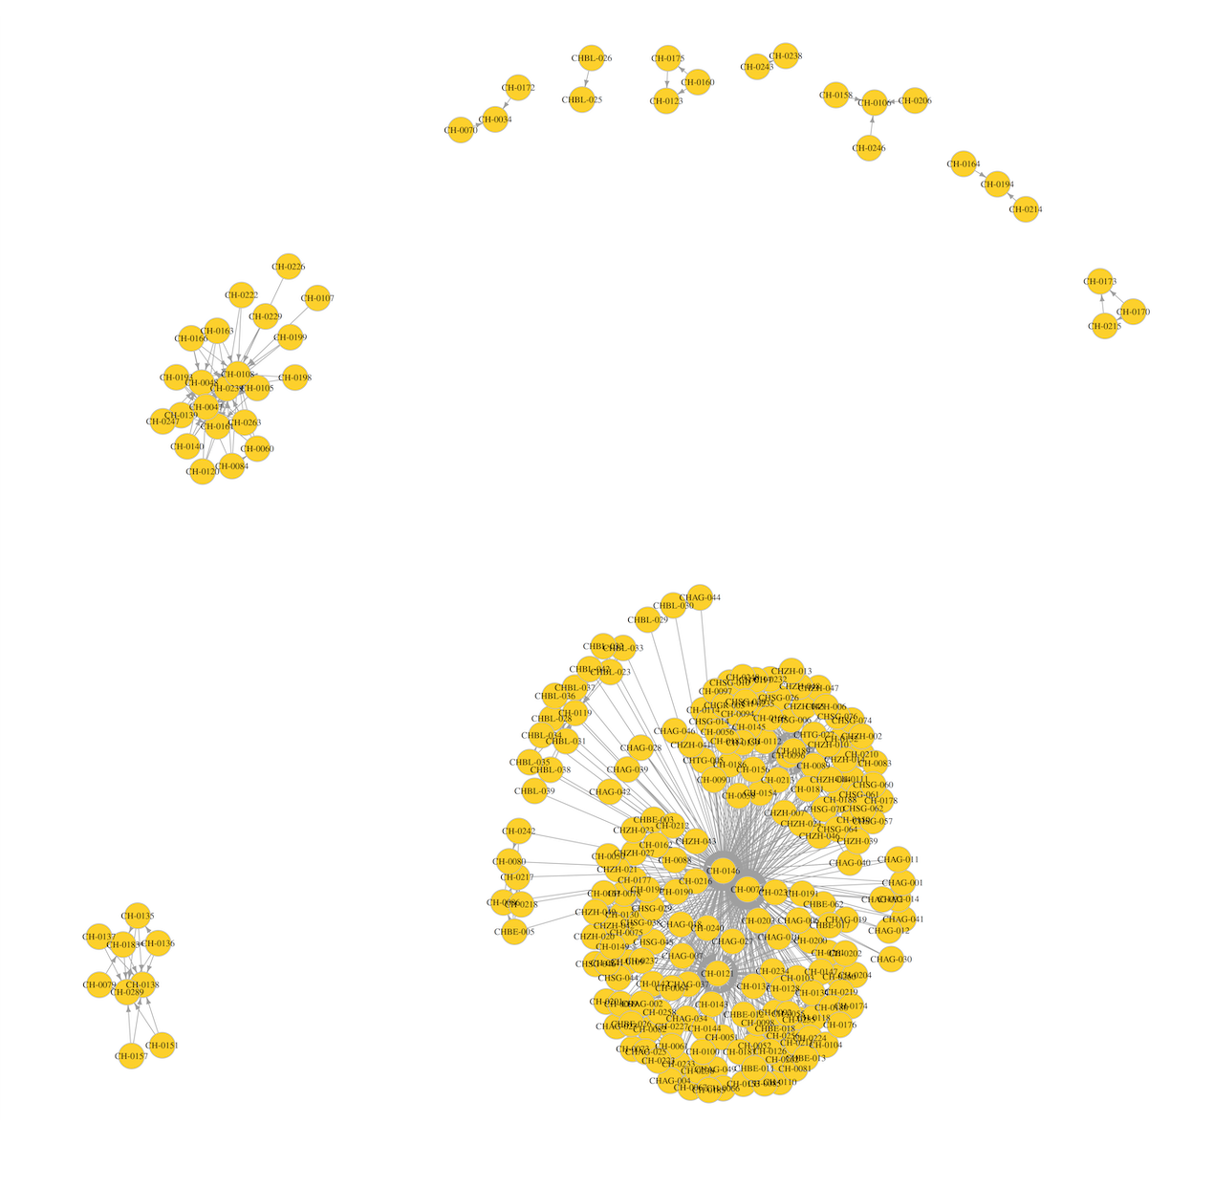
Network topology of gauge network across Switzerland
River network summary:
1043 connections between gauges (includes direct & indirect paths)
81 gauges with at least one upstream gauges
239 unique from_nodes, from 264 starting gauges
Graph-Convolutional-LSTM architecture to predict at new locations:
  2 layers: Convolutional layer, then LSTM layer
  Along river distance as measure of neighborhood
Rhône river
Most downstream gauge:CH-0108
Rhine & Aare rivers
Most downstream gauge: CH-0146
Inn river
Most downstream gauge: CH-0289
Notes:
Lukas: Flow accumulating the information? Make it sparse.
Jia paper only used the closest upstream gauge.
Sequentially predicting catchments, from upstream to downstream.
Weight influence in runoff, except for aggregation where total volume.
Predict runoff on all catchments; then convert to volume and aggregate downstream as weighted sum. (weighted in GCN by area).
239 unique from_nodes, from 264 starting gauges; maybe from clipping? (missing Doubs catchment?)

Slide 9
Conclusions / summary:
The End. Thank you!
First predictions from LSTM achieve comparable performance to process-based model (PREVAH)
Deep learning methods have potential to predict streamflow across larger management units across Switzerland
DL predictions at ungauged basins is challenging, even for LSTM, and may require graph-based approaches

