Slide 1

Detection of extreme events from IASI observations
Adrien Vu Van, Anne Boynard, Pascal Prunet, Dominique Jolivet, Olivier Lezeaux, Patrice Henry, Claude Camy-Peyret, and Cathy Clerbaux

Slide 2

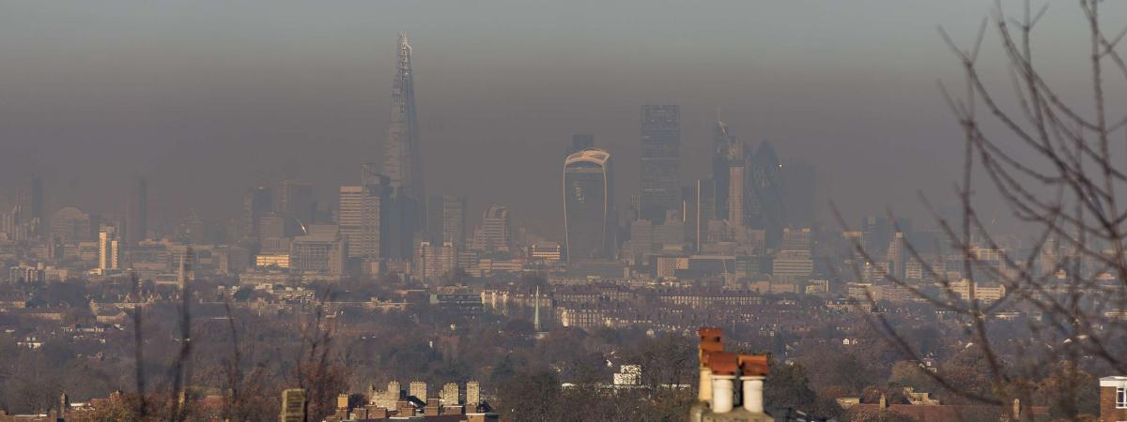
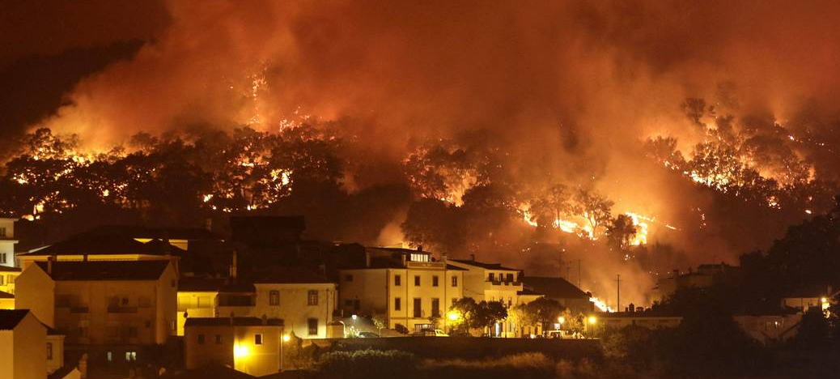
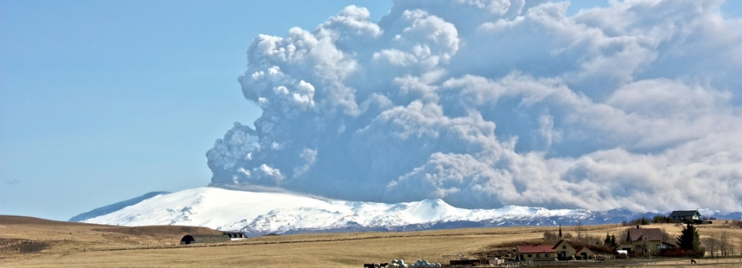
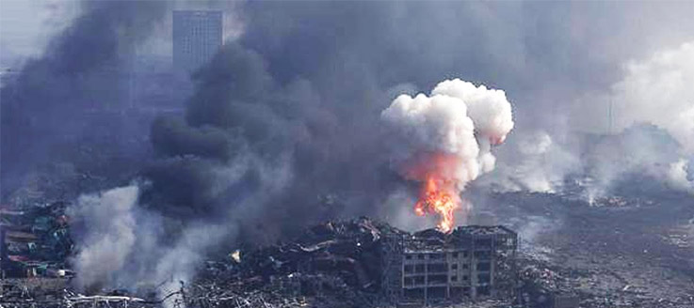
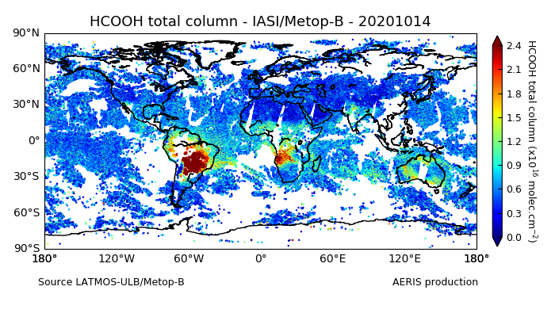
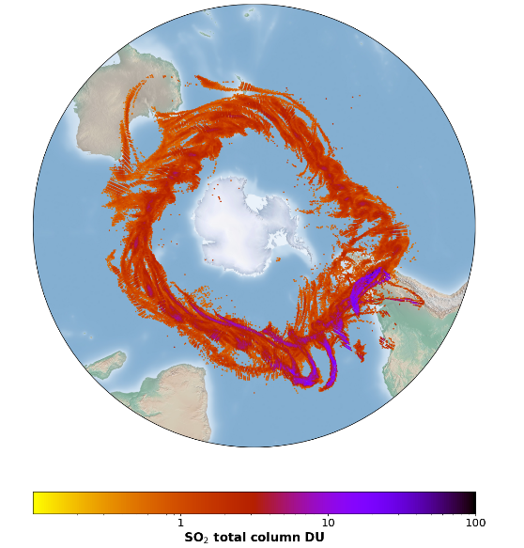
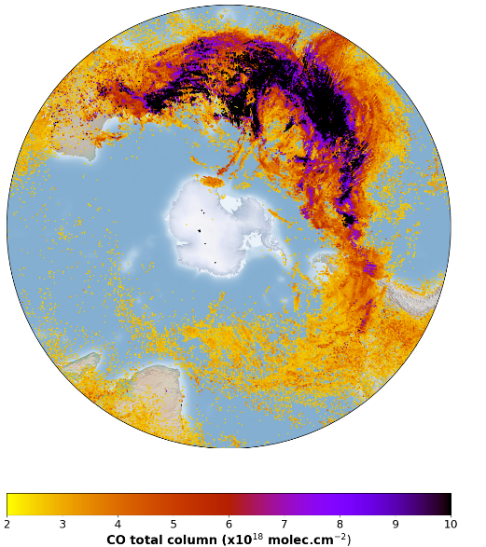
INTRODUCTION
Extreme events become more frequent and intense
IASI retrievals
https://iasi.aeris-data.fr
➔ Early detection and monitoring of atmospheric chemical composition is a major issue
Limitations
Important volume of data (1 day = 1 millions spectra/IASI)
Finding extremes is not trivial
Few species is near real time, difficult to characterize an event
No data in case of cloudy situation
Depend on altitude. Need adjustement for some species (C₂H₄)
3rd to 20th
june 2011
Feux
1st to 19th
january 2020
➔ How to use the IASI data for an efficient detection of extreme events ?
➔ Since 2006 (+15 years) IASI/Metop has detected more than 30 species (C. Clerbaux et al., 2015)
Notes:
-interest for : events…
-There are currently some concentration products available on aeris
-huge volume of data
- How to use…

Slide 3
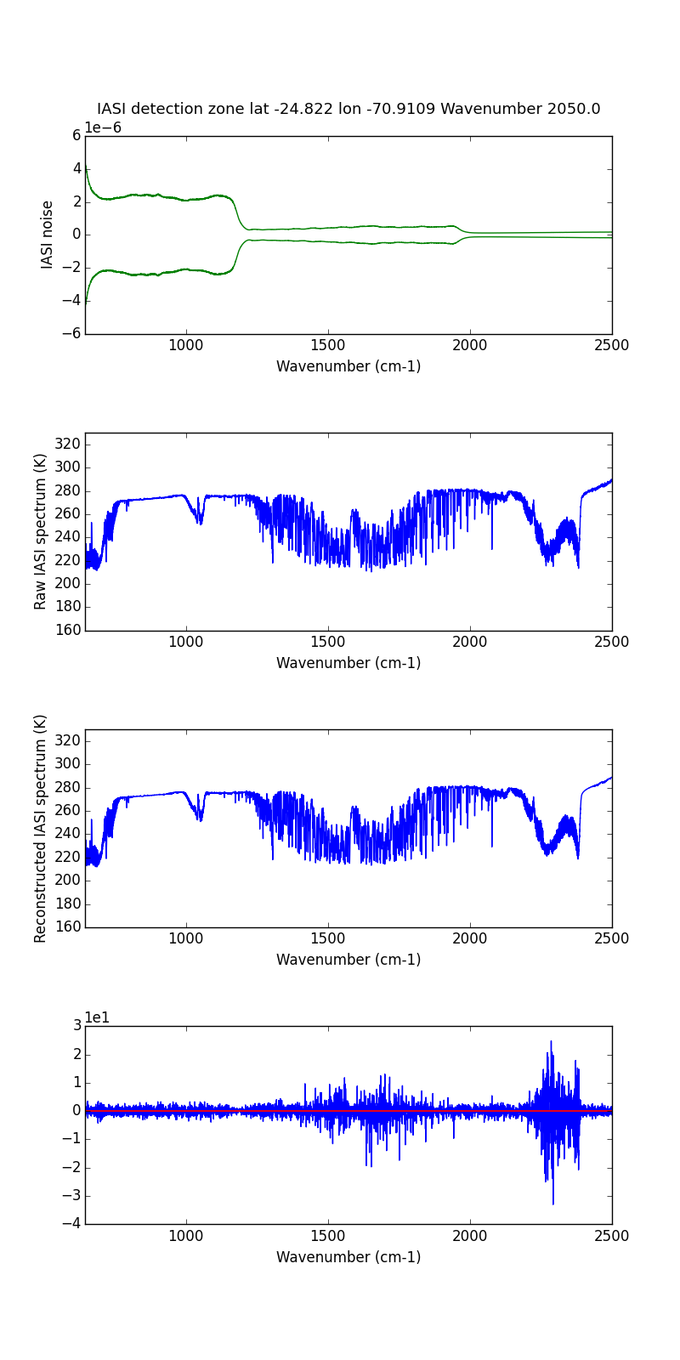
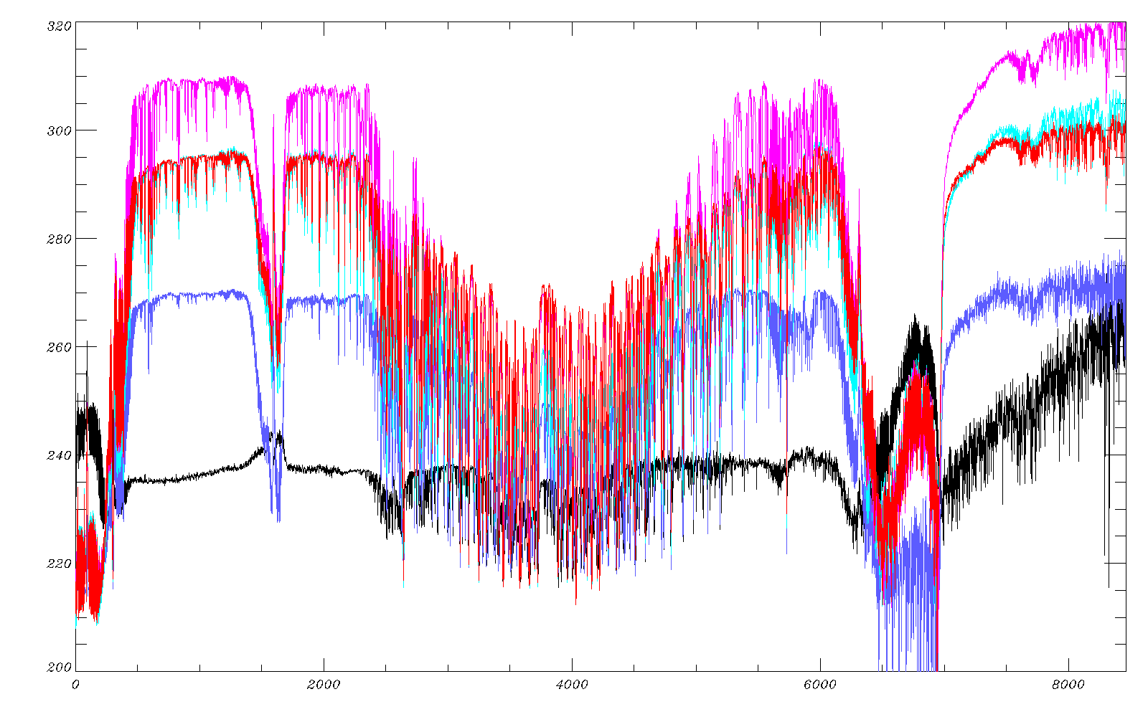
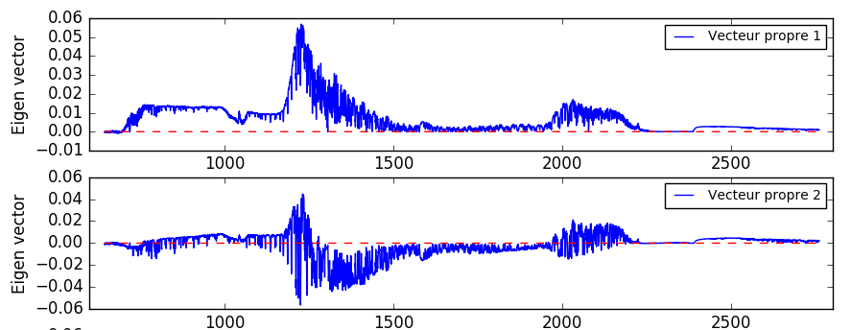
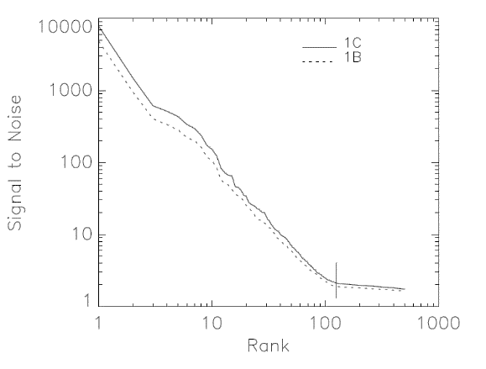
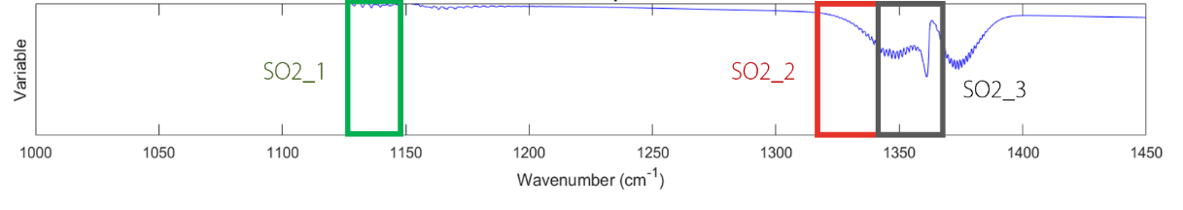
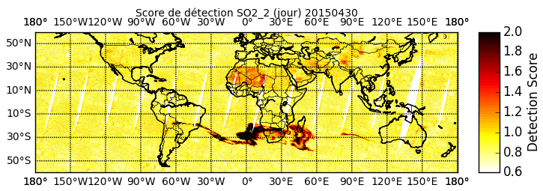
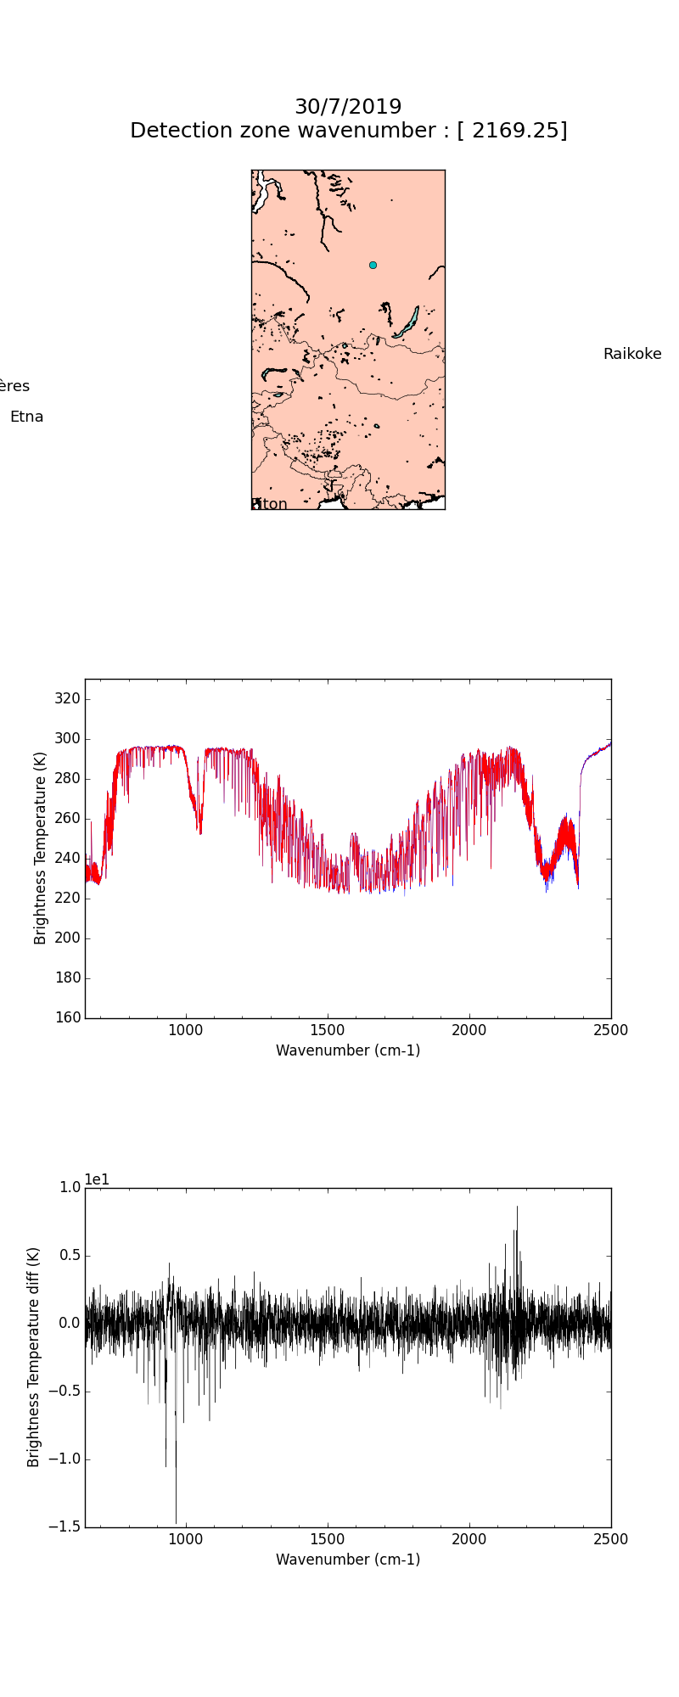
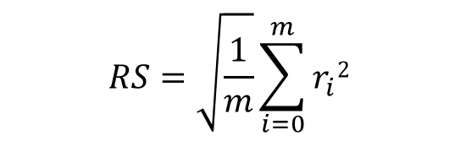
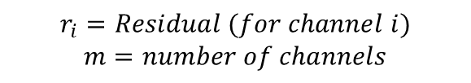

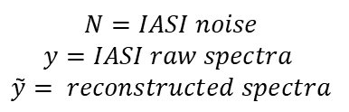
PRINCIPAL COMPONENT ANALYSIS
A statistical method that shown good results for the detection of outliers
Raw spectra
Database 2013 (120 000 spectra)
Eigenvectors base
$$RS=\sqrt{\frac{1}{m}}\sum_{i=0}^{m}{r_{i}2 }$$
Reconstructed spectra
$$r_{i}=Residual (for channel i)$$
$$m=number of channels$$
Indicators
$r=N^{−1}(y−\overset{͂}{y}$)
SPASCIA
$$N=IASI noise$$
$$y=IASI raw spectra$$
$$\overset{͂}{y}= reconstructed spectra$$
Reconstruction score
Residuals
Notes:
- This method is made by firstly create a database with a statistical amount of spectra. It is important to select as many conditions as possible to depict the regular atmospheric variability
- Not going into details : we create a base of eigenvectors with the database and use the first 150 in this method.
- Then we project IASI spectra on these eigenvectors, to calculate reconstructed spectra and by calculated the difference between the raw and the reconstructed spectra we obtain a residu.
- For evaluating the correlation between the two spectra we can calcule a reconstruction score with this equation on specific spectral bands (called indicators) that are supposed to be associated to a specific molecule absorption signature.

Slide 4
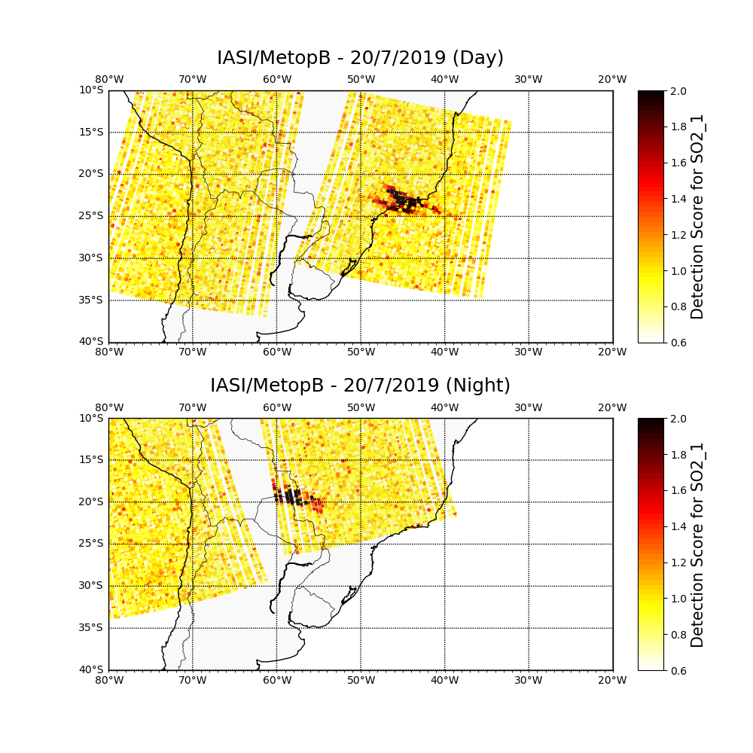
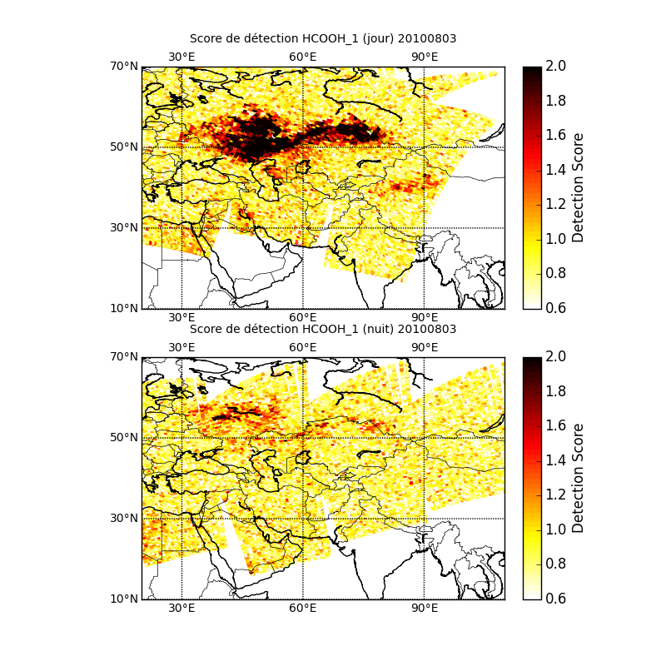
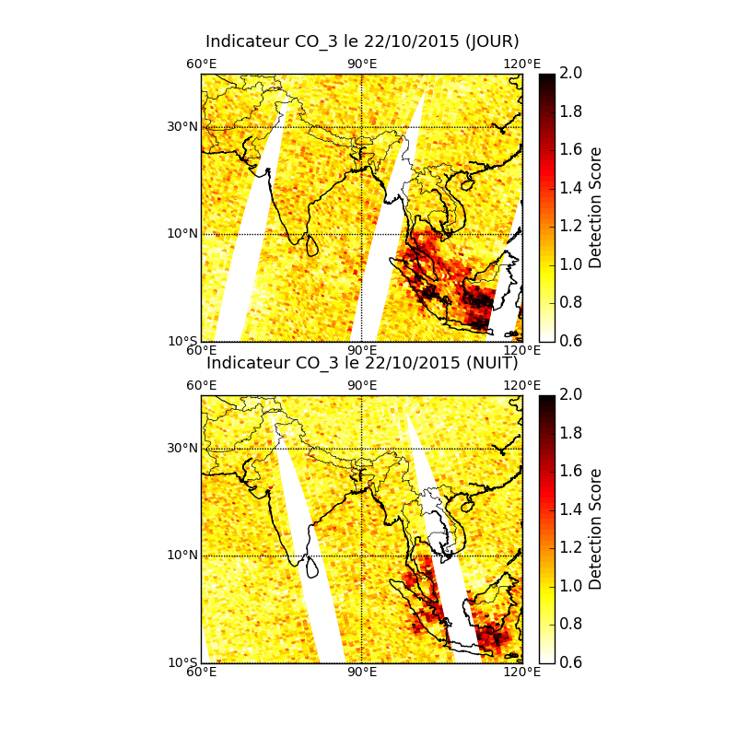
PRINCIPAL COMPONENT ANALYSIS
Limitation of regular approch
Questions
Is it possible to detect new or non retrieved molecules from IASI spectra ?
Can we classify events with combination of molecule detections
➔ More spectroscopic approach instead of an “a priori” indicator method
Volcanism
Fires
Pollution
Limitations
Detection of outliers are possible but indicators are not fine-tuned very sensible to interferences and chemical characterization is not precise.
Spectral indicators are limitated.
Notes:
With the PCA method we can ask two main questions : is it possible to detect unknown species, non retrieved species,
But also, is it possible to classify events with combination of indicators
We observe that anomalies are detected with the regular method but we propose a new approach mostly to avoid interference, false detection or false characterization of an event that why we have created the PCA extrema method base on the granule.

Slide 5
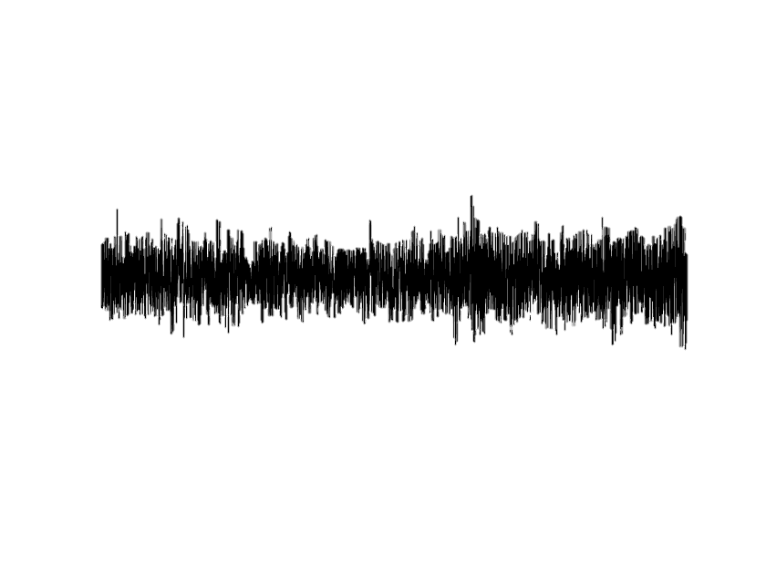
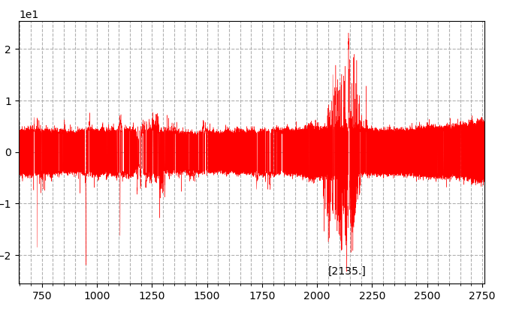
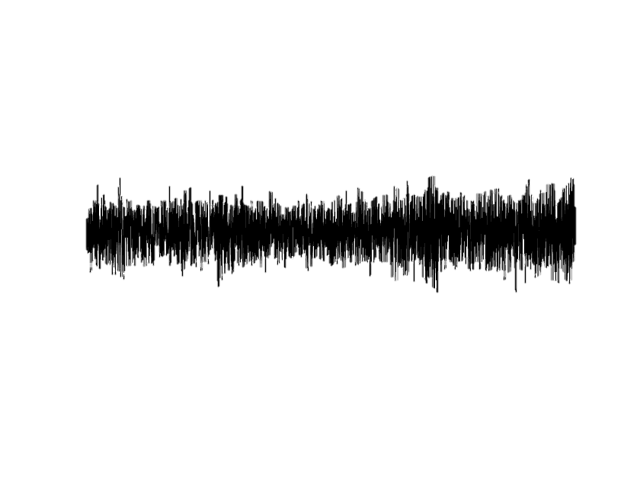
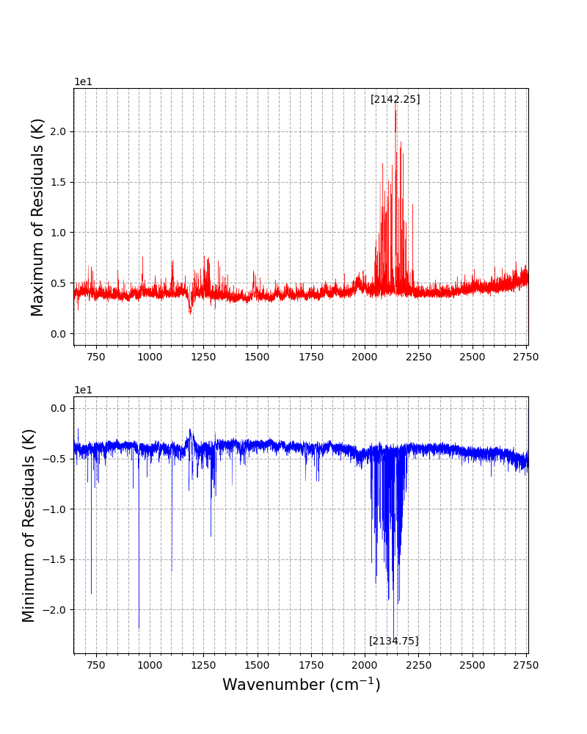
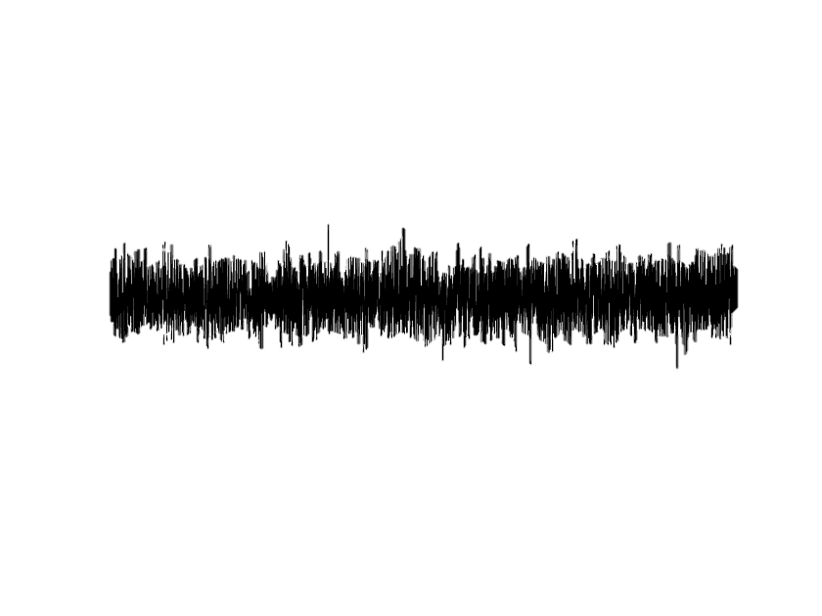
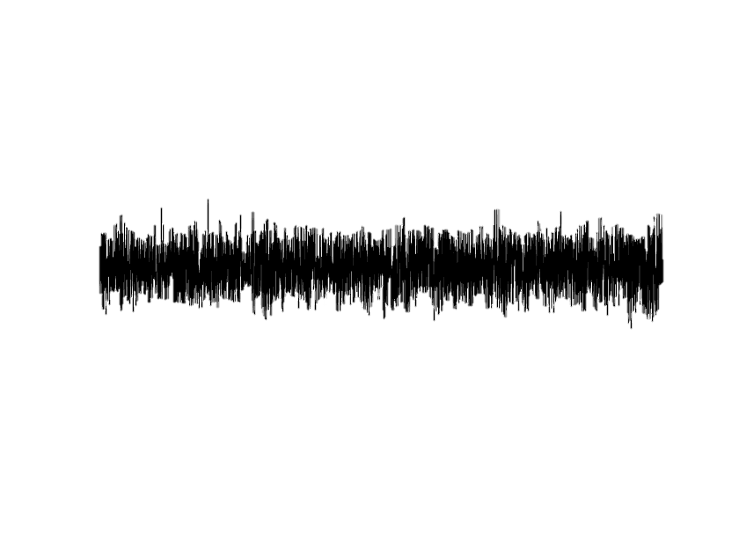
PRINCIPAL COMPONENT ANALYSIS
Ubinas – Volcanisme intense
A new approach to exploit residual maxima in near real time
➔ Study extrema for all spectral channels (645 cm-1 – 2760 cm-1) in residuals
BASE ON IASI GRANULE
Among the spectra for each IASI channel we select extrema to create extrema_residual
Pseudo-spectrum :
Extrema_Residual
Residuals | 1 | 2 | 3 | … | 8461
1
2
3
4
N
MAX MIN
…
…
Notes:
Beaucoup potentiels outliers

Slide 6
PRINCIPAL COMPONENT ANALYSIS
A new approach to exploit residual maxima in near real time
We observe peaks with high variability (outliers) and assuming the database is well constructed :
High intensity peaks shows weak absorbers in the atmosphere (a priori) (also depending on interferences, spectral domain and absorption bands)
Lower intensity peaks (low variability) can also give information in some domains with high interferences with water for example
BASE ON IASI GRANULE
Among the spectra for each IASI channel we select extrema to create extrema_residual
Pseudo-spectrum :
Extrema_Residual
Residuals | 1 | 2 | 3 | … | 8461
1
2
3
4
N
MAX MIN
…
…
Notes:
Separation studies for positive and negative extrema

Slide 7
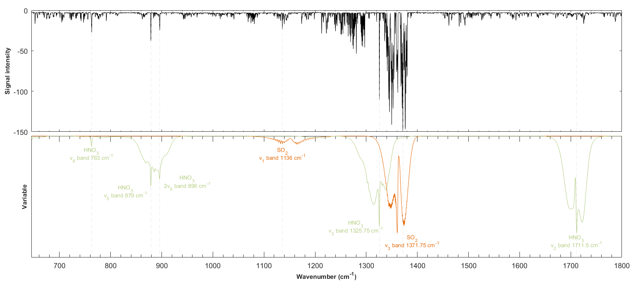
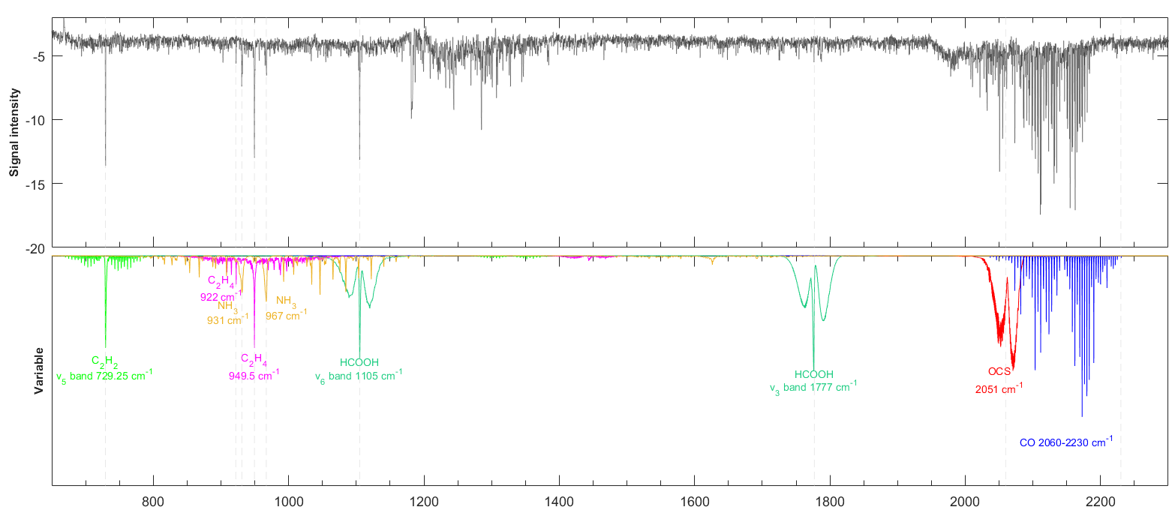
RESULTS
Results
We observe peaks with high intensity signal in one example of GMI captured above an event of :
Volcanism (Ubinas 2019)
HNO₃ and SO₂ reliable detections
Fires (Australia 2020)
C₂H₂, C₂H₄, HCOOH, NH₃ reliable detections.
HCN, C₄H₄O and CH₃OH in other granules.
The behaviour of the spectral domain between 2000 and 2200 cm⁻¹ is not well understood.
Notes:
Je vous presente 3 exemples de resultats

Slide 8
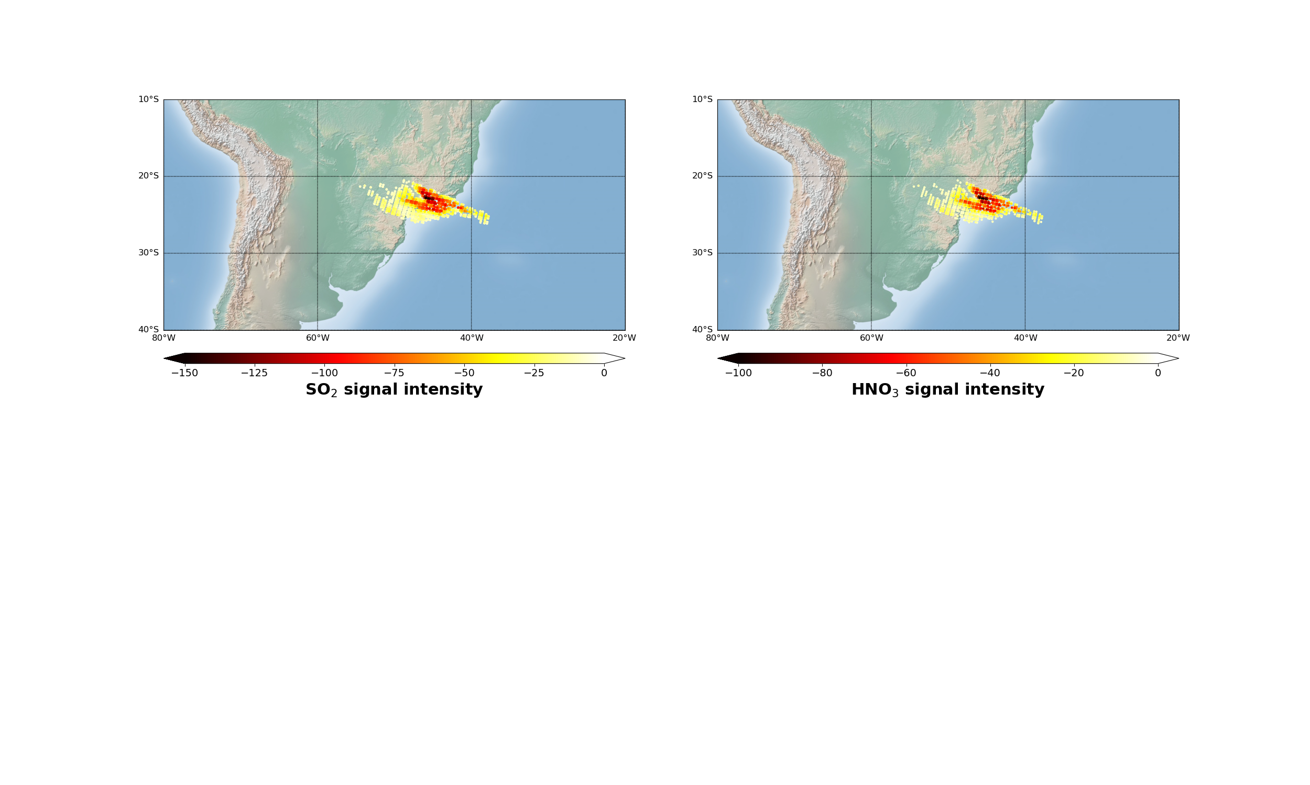
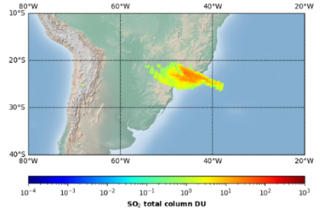
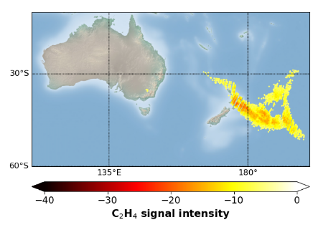
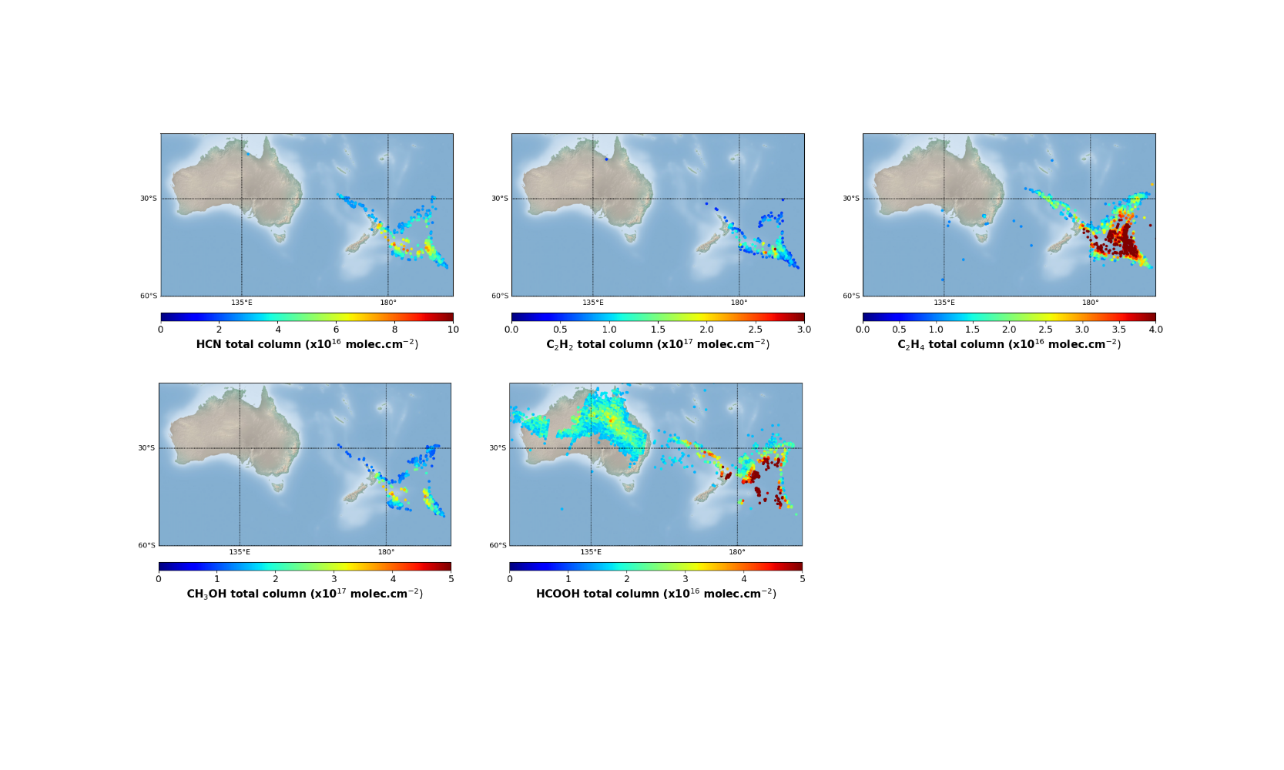
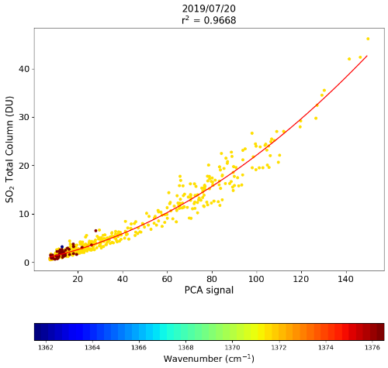
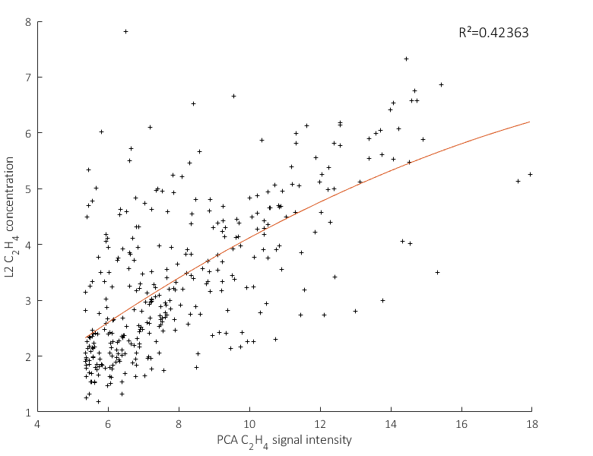
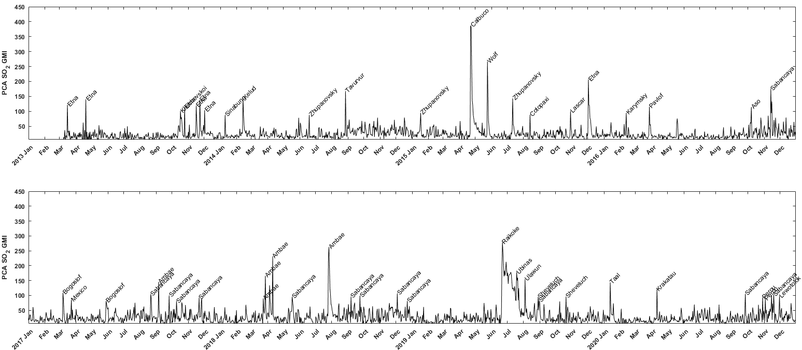
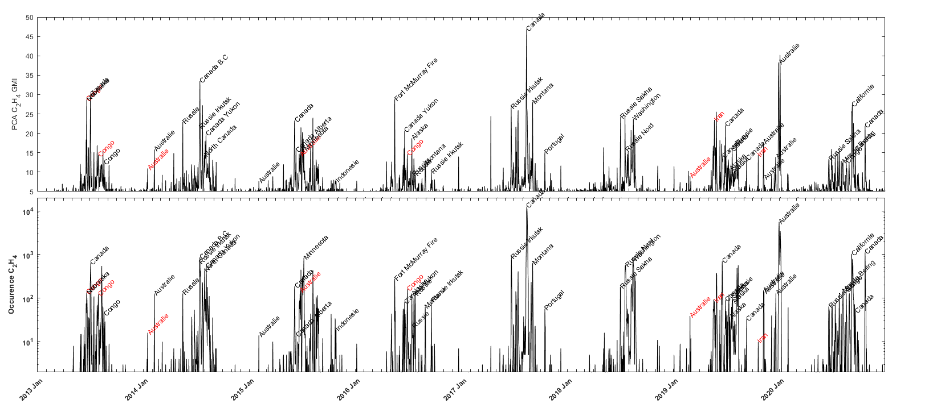
RESULTS
Spatial distribution
Volcanism (Ubinas 2019)
Fires (Australia 2020)
Excellent correlation between SO₂ PCA signal and IASI L2 SO₂ total column.
Medium correlation between C₂H₄ PCA signal and IASI L2 C₂H₄ total column.
Archives
2013 - 2020

Slide 9
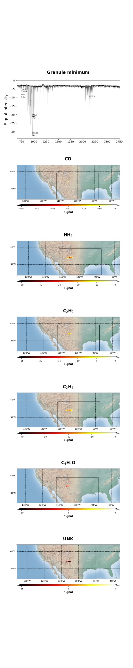
CONCLUSION
Automatic Near Real Time Detection (last week)
PCA method is able to detect outliers
PCA GMI is able to fine characterize events in terms of species (indicators), intensity (signal) and size (occurrence)
Correlation exist between PCA intensity products and L2 data
Archives shows seasonality of fires
The method allows near real time use

Slide 10
THANK YOU FOR YOUR ATTENTION

Slide 11
PRINCIPAL COMPONENT ANALYSIS
Ubinas – Volcanisme intense
Fine indicators
➔ Creation of fine tuned indicators
Computed spectral range (cm⁻¹) | Width (cm⁻¹) | Infrared absorption peaks | Molecule | References
711.500 - 713.500 | 2.000 | 712 cm⁻¹ (HCN bande ν₂ branche R) | HCN | [Lahuis F. et al., 2000]
729.250 - 730.000 | 0.750 | 729.25 cm⁻¹ (C₂H₂ Q-branch ν₅) | C₂H₂ | [Vinatier S., 2007]
744.250 – 744.750 | 0.500 | 744 cm⁻¹ (C₄H₄O ν₁₃ band) | C₄H₄O | [Pankoke B. et al., 1993]
763.000 - 763.750 | 0.750 | 763 cm⁻¹ (Q-branch ν₈ HNO₃) | HNO₃ | [Rothman L.S. et al., 2009]
790.250 – 790.750 | 0.500 | 790 cm-1 (HONO Q-branch mode trans-ν₄) | HONO | [Barney W.S. et al., 2000]
821.750 – 822.250 | 0.500 | 822 cm⁻¹ (C₂H₆ Q branch ν₇) | C₂H₆ | [Vinatier S., 2007]
853.500 - 854.250 | 0.750 | 854 cm⁻¹ (NH₃ Q branch) | NH₃ | HITRAN
867.750 - 868.750 | 1.000 | 868 cm⁻¹ (NH₃ Q branch) | NH₃ | HITRAN
878.500 - 880.000 | 1.500 | 879 cm⁻¹ (HNO₃ Q-branch ν₅) | HNO₃ | [Teggi S., 1999]
887.250 - 888.250 | 1.000 | 888 cm⁻¹ (NH₃ Q-branch) | NH₃ | HITRAN
891.750 - 892.250 | 0.500 | 892 cm⁻¹ (NH₃ Q-branch) | NH₃ | HITRAN
895.500 - 896.750 | 1.250 | 896 cm⁻¹ (HN0₃ 2ν₉ band Q-branch) | HNO₃ | [Teggi S., 1999]
908.000 - 909.000 | 1.000 | 908.3 cm⁻¹ (NH₃ Q branch) | NH₃ | HITRAN
931.750 - 933.750 | 2.000 | 930 cm⁻¹ (transition NH₃ Q-branch) | NH₃ | HITRAN
949.000 - 950.500 | 1.500 | 949 cm⁻¹ (C₂H₄ ν₇ band Q-branch) | C₂H₄ | [Vinatier S., 2007]
966.000 - 968.000 | 2.000 | 967 cm⁻¹ (transition NH₃ Q-branch) | NH₃ | HITRAN
991.750 - 993.500 | 1.750 | 992.8 cm⁻¹ (NH₃ Q-branch) | NH₃ | HITRAN
1007.750 - 1008.250 | 0.500 | 1008 cm⁻¹ (NH₃ Q-branch) | NH₃ | HITRAN
1033.000 - 1033.750 | 0.750 | 1033.5 cm⁻¹ (Q-branch CH₃OH) | CH₃OH | [Razavi A., 2011]
1034.000 - 1034.250 | 0.250 | 1034 cm⁻¹ (NH₃ Q-branch) | NH₃ | HITRAN
1046.250 - 1047.250 | 1.000 | 1047 cm⁻¹ (NH₃ Q-branch) | NH₃ | HITRAN
1065.750 - 1066.250 | 0.500 | 1066 cm⁻¹ (NH₃ Q-branch) | NH₃ | HITRAN
1075.750 - 1076.250 | 0.500 | 1076 cm⁻¹ (NH₃ Q-branch) | NH₃ | HITRAN
1084.500 - 1085.750 | 1.250 | 1085 cm⁻¹ (NH₃ Q-branch) | NH₃ | HITRAN
1103.000 - 1104.250 | 1.250 | 1104 cm⁻¹ (NH₃ Q-branch) | NH₃ | HITRAN
1104.500 - 1105.750 | 1.250 | 1105 cm⁻¹ (ν₆ band Q-branch) | HCOOH | [Rinsland, C.P. et al., 2004]
1183.500 - 1184.750 | 1.250 | 1184 cm⁻¹ (ν₈ band Q-branch) | CH₃COOH | [De Longueville H. et al, 2021]
1121.500 - 1122.750 | 1.250 | 1122 cm⁻¹ (NH₃ Q-branch) | NH₃ | HITRAN
1325.750 - 1326.250 | 0.500 | 1326 cm⁻¹ (ν₃ HNO₃) | HNO₃ | [Perrin A. et al., 2012]
1344.500 - 1346.500 | 1.000 | 1345 cm⁻¹ (SO₂ ν₃ band) | SO₂ | HITRAN
1370.500 - 1372.000 | 1.500 | 1371 cm⁻¹ (SO₂ ν₃ band) | SO₂ | HITRAN
1375.750 - 1377.000 | 1.250 | 1376 cm⁻¹ (SO₂ ν₃ band) | SO₂ | HITRAN
1710.750 - 1711.500 | 0.750 | 1711 cm⁻¹ (Q-branch HNO₃) | HNO₃ | [Rothman L.S. et al., 2009]
1776.750 - 1777.250 | 0.500 | 1777 cm⁻¹ ( HCOOH ν₃ band) | HCOOH | [Perrin A. et al., 2009]
2032.500 - 2087.000 | 54.500 | 2062cm⁻¹ (center of OCS strong ν₃ band) | OCS
2111.000 – 2112.250 | 1.250 | 2111.50 cm⁻¹ (P-branch CO) | CO | [Hadji-Lazaro J., 1999]
2123.000 – 2124.250 | 1.250 | 2123,75 cm⁻¹ (P-branch CO) | CO | [Hadji-Lazaro J., 1999]
2130.000 – 2132.250 | 2.250 | 2131.75 cm⁻¹ (P-branch CO) | CO | [Hadji-Lazaro J., 1999]
2157.750 – 2158.725 | 1.000 | 2158.00 cm⁻¹ (R-branch CO) | CO | [Hadji-Lazaro J., 1999]
2164.750 – 2166.000 | 1.250 | 2165.75 cm⁻¹ (R-branch CO) | CO | [Hadji-Lazaro J., 1999]
Notes:
Beaucoup potentiels outliers

